Slide 1
Sales Performance Analysis A Comparative study of Primary & Secondary dataset Analysis Period: January 2015 – December 2018
MISSION X
Compiled by 25FT – G2 :
Bushra Khan
Perpetual Rodrigues
Mosiana Atiola
Notes:
Good morning. Today, we present Mission X – a comparative sales performance analysis of our Primary and Secondary business units from 2015 to 2018. We are Group 2, composed of Bushra, Perpetual, and Mosiana. Thank you for your time.

Slide 2
CONTENTS
Executive Summary
Introduction & Objectives
Data Source
Methodology
Dashboard Overview
Primary Sales Performance
Secondary Sales Performance
Product Performance Analysis
Regional Performance Analysis
Time Intelligence Analysis
90-Day Forecast Analysis
Conclusions
Recommendations
Notes:
We'll begin with the executive summary, then explain our methodology and objectives. Next, we'll walk through the key performance insights across sales, products, regions, and time. Finally, we'll present our forecast and strategic recommendations

Slide 3
EXECUTIVE SUMMARY
This report compares sales performance using two independent datasets (Primary & Secondary) from 2015-2018 to guide strategic decision-making.
Key Insights :
Primary Dataset shows a smaller, declining operation with $1.9m in sales (a 1.09% decrease). It is highly concentrated in the UK (92.9%) and peaks seasonally in July.
Secondary Dataset is the growth engine, with $14m in sales – over 7 times larger than Primary. It is globally diversified, with strong sales in the US, China & UK and peaks in December.
The core insight is a major scale disparity. Secondary operates at a much larger volume and is growing, while Primary is smaller and declining.
Recommendations:
Follow a two-part strategy.
Stabilize the Primary business by optimizing its seasonal European focus to reverse its decline.
Accelerate the Secondary business by scaling its successful electronics and global model, targeting 15% growth in 2019.
Notes:
Our analysis reveals a clear disparity in performance. The Primary business, with $1.9 million in sales, is declining slightly and is heavily concentrated in the UK with seasonal peaks. In contrast, the Secondary business is our growth driver, with $14 million in sales—over seven times larger—and is globally diversified.We recommend a dual strategy: stabilize Primary and accelerate Secondary growth.

Slide 4
INTRODUCTION & OBJECTIVES
Project Background:
Mission X is a sales performance analysis comparing two independent business units over the same period (2015-2018) to identify improvement opportunities.
Analytical Objectives:
Compare performance across Primary & Secondary datasets
Identify root causes of Primary’s decline vs. Secondary’s growth in sales
Forecast 90-day performance using historical trends
Provide strategic recommendations
Scope & Limitations:
Time period: 2015-2018
Data – Complete transactional records for both datasets
Limitations – independent datasets
Notes:
Mission X was designed to compare two distinct business units over the same four-year period. Our objectives were to identify performance gaps, diagnose the causes of Primary’s decline versus Secondary’s growth, provide a 90-day forecast, and deliver actionable strategic guidance.

Slide 5
DATA SOURCE
Dataset | Primary | Secondary
Source | Mission X | E-commerce
Period | 2015-2018 | 2015-2018
Sales | $1.9m | $14m
Products | Christmas items | Electronics
Markets | Europe-focused | Global

Slide 6
METHODOLOGY
Processing:
Each dataset cleaned independently
Analysis:
Side-by-side comparative evaluation
Validation:
Cross-dataset trend confirmation
Visualization:
Parallel Power BI dashboards
Insights:
Comparative without data blending
Tools:
Power BI
DAX measures
Custom dashboards
Time series forecasting
Notes:
We used complete transactional records for both units, cleaned and analyzed independently. Using Power BI and time-series forecasting, we developed parallel dashboards to compare performance without blending data, ensuring a clear and unbiased view.

Slide 7
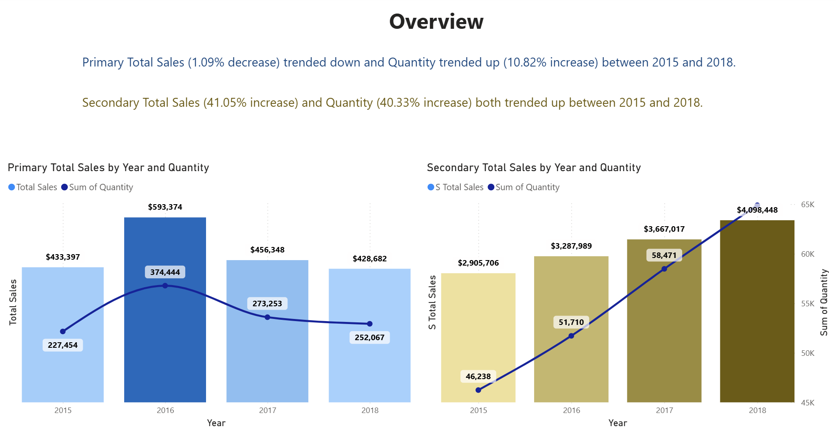
DASHBOARD OVERVIEW
Mission X Dashboard Navigation
Overview (Comparative Summary)
Primary Sales Performance
Secondary Sales Performance
Product Performance Analysis
Regional Performance Analysis
Time Intelligence (YTD Analysis)
90-Day Forecast
Dashboard Design:
Consistent layout – parallel structure for easy comparison
Color coding – Blue theme for Primary, Yellow for Secondary
Geographic Mapping – Regional performance
Time Intelligence – Year-over-year comparisons
Forecast Visualization – 90-day predictive modelling
Notes:
Our dashboard is built for clarity and comparison, with a consistent layout, color-coded themes—blue for Primary, yellow for Secondary—and dedicated views for sales, products, regions, time trends, and forecasts.

Slide 8
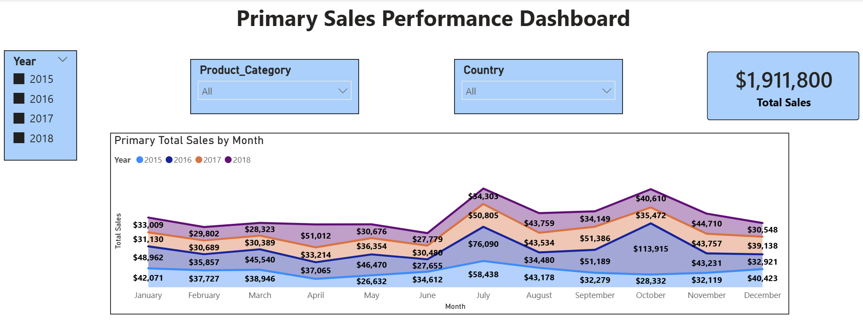
PRIMARY SALES PERFORMANCE
Sales Performance
Total Sales: $1,911,800 (YTD basis)
Annual Trend: 1.09% decrease
Key Insights
Seasonal Peaks: July & October show strongest performance
Annual Low: June consistently underperforms
Christmas items dominate Primary sales, creating seasonal dependency
Performance Optimization Opportunities
Address June decline – investigate causes of annual low performance
Leverage July & October peaks – replicate success factors
Diversify product mix – reduce dependency on Christmas items
Notes:
Primary sales totaled $1.9 million but show a 1.09% annual decline. Key challenges include heavy reliance on Christmas and other gift items and a consistent low in June. To improve, we recommend diversifying the product mix and leveraging peak months like July and October.

Slide 9
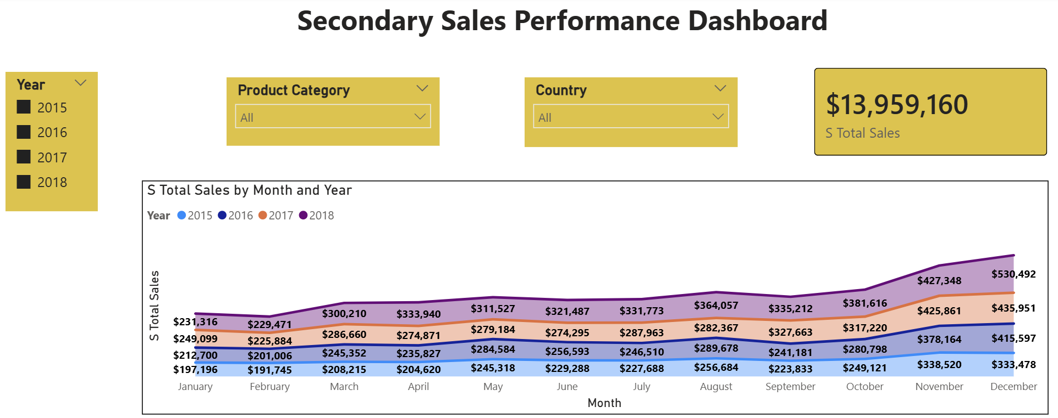
SECONDARY SALES PERFORMANCE
Sales Performance
Total Sales: $13,959,160 (YTD basis)
Growth: +$1,192,742 increase (2015-2018 comparison)
Key Insights
Consistent growth: monthly progression throughout the year
December dominance: 12.29% of annual sales in single month
Electronics Focus: Bluetooth speakers, 4K cables, smartphone cases
Global reach: Larger customer base with year-round demand
Success Factors
Product diversification across electronics
Global market access
Lower seasonal dependency
Scalable electronics-focused model
Notes:
Secondary sales reached $14 million over these years, with strong growth driven by electronics such as Bluetooth speakers and smartphone cases. This unit benefits from consistent monthly demand, global reach, and a scalable model.

Slide 10
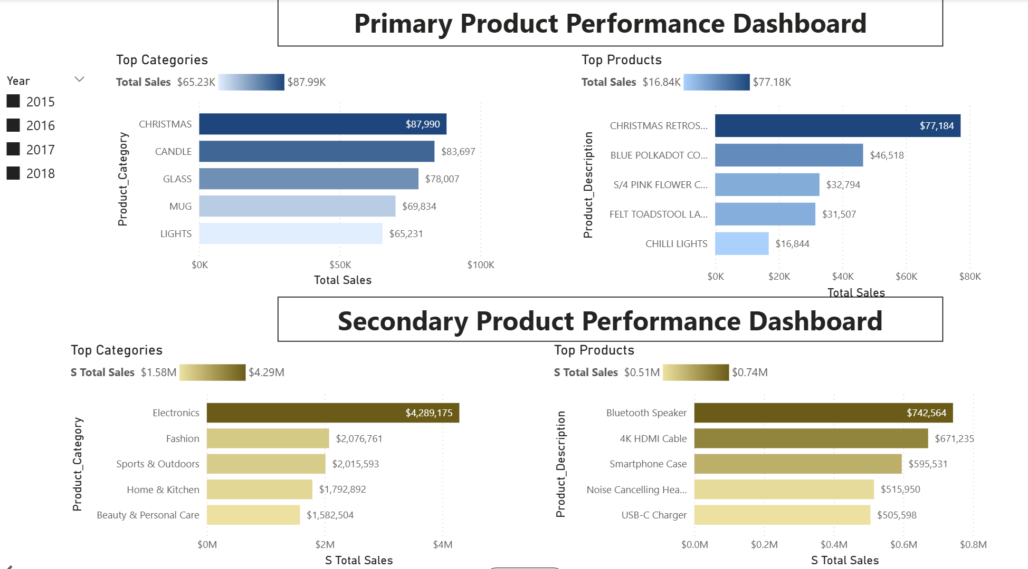
PRODUCT PERFORMANCE ANALYSIS
Primary Product Strategy Analysis
Focus: Christmas category (Candles & Glassware)
Issue: Highly seasonal
Challenge: Limited portfolio
Secondary Product Strategy Analysis
Focus: Electronics, led by the Bluetooth Speaker
Strength: Year-round, consistent demand with a diversified portfolio
Opportunity: Aligns with market trends
Recommendation
Primary Expansion: Add non-seasonal products to decrease dependency
Portfolio Optimization: Balance seasonal and year-round products
Notes:
Primary’s product strategy is seasonal and narrow, focused on Christmas and other gifting categories. Secondary’s portfolio is diversified and aligned with year-round market demand. We recommend Primary expand into non-seasonal products to balance its offerings.

Slide 11
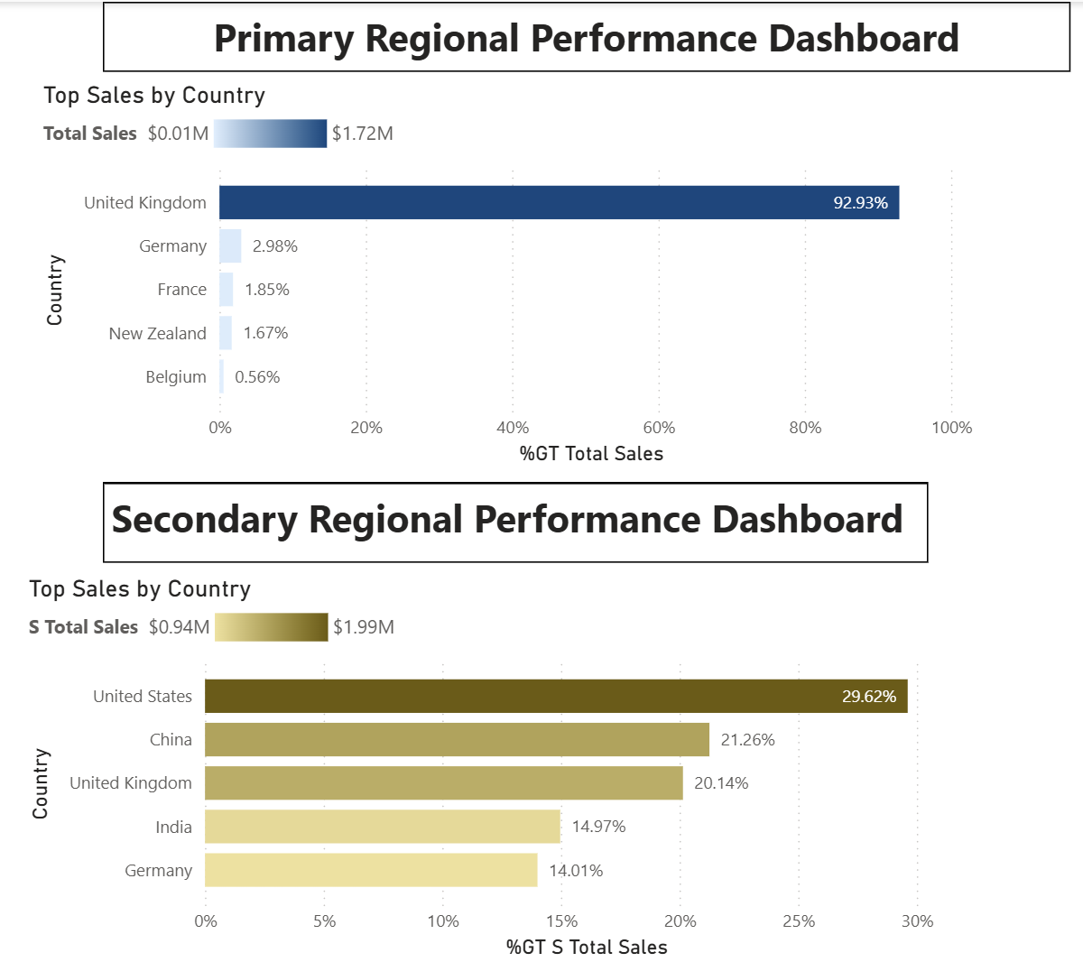
REGIONAL PERFORMANCE ANALYSIS
Primary Dataset Regional Performance
Primary market – UK 92.93% centered in Europe with the UK as the main hub
Secondary Dataset Regional Performance
Secondary market – USA 29.62% dominant market with global presence mainly in US & China
Recommendations:
Strengthen the primary market by expanding further in Europe (UK, Germany, France)
Grow the secondary market by building on its strong US base to increase global reach
Cross-learn: Apply the secondary market’s global approach to the primary and use the primary’s European expertise to support secondary growth in Europe.
Notes:
Primary is heavily UK-focused, while Secondary operates globally with strong sales in the US and China. We recommend Primary expand further in Europe and that Secondary leverage its US base to enhance global reach. Cross-learning between units can strengthen both.

Slide 12
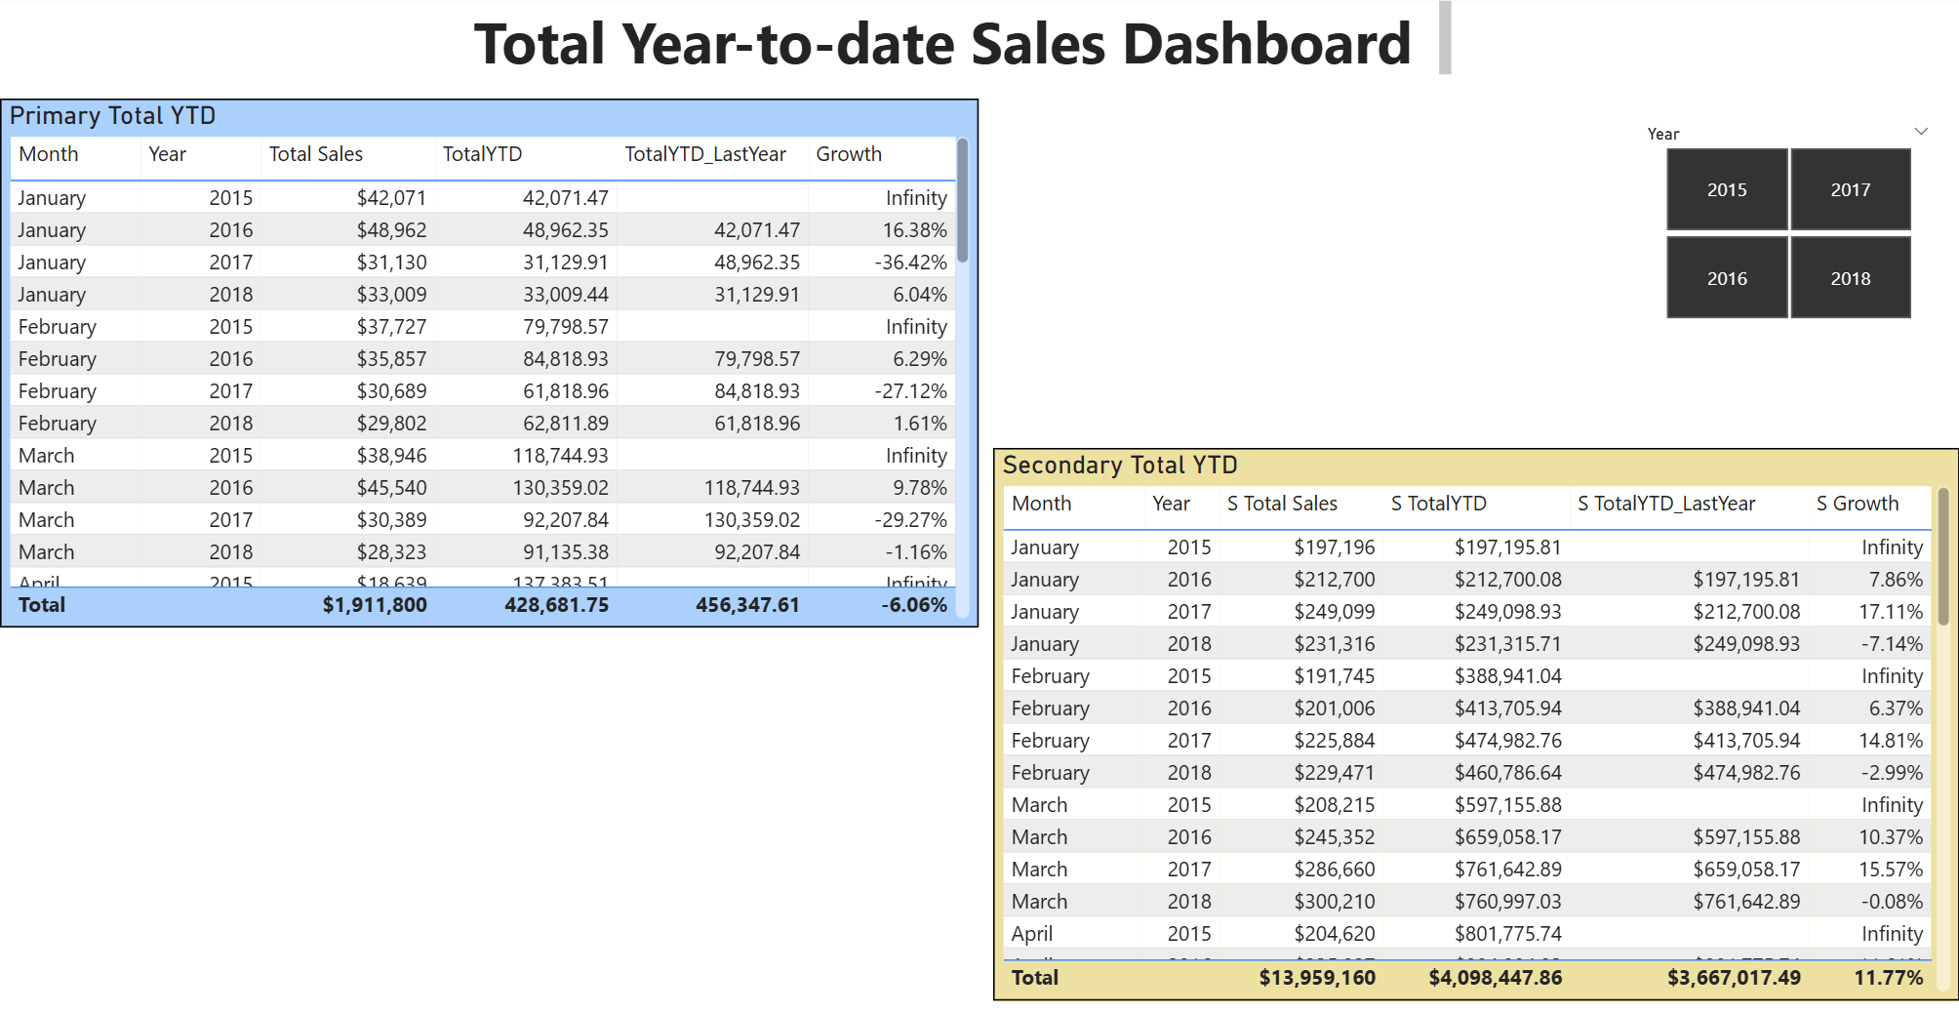
TIME INTELLIGENCE ANALYSIS
Year-to-Date Performance Analysis as at Dec 2018
Primary Dataset YTD Performance
Total YTD Sales : $428,682
Comparative Performance: decrease 6.06% vs. previous year
Secondary Dataset YTD Performance
Total YTD Sales : $4,098,448
Comparative Performance: increase 11.77% vs. previous year
Notes:
As of December 2018, Primary’s year-to-date sales declined by 6.06%, while Secondary’s grew by 11.77%. This widening gap highlights the urgency for strategic intervention in Primary

Slide 13
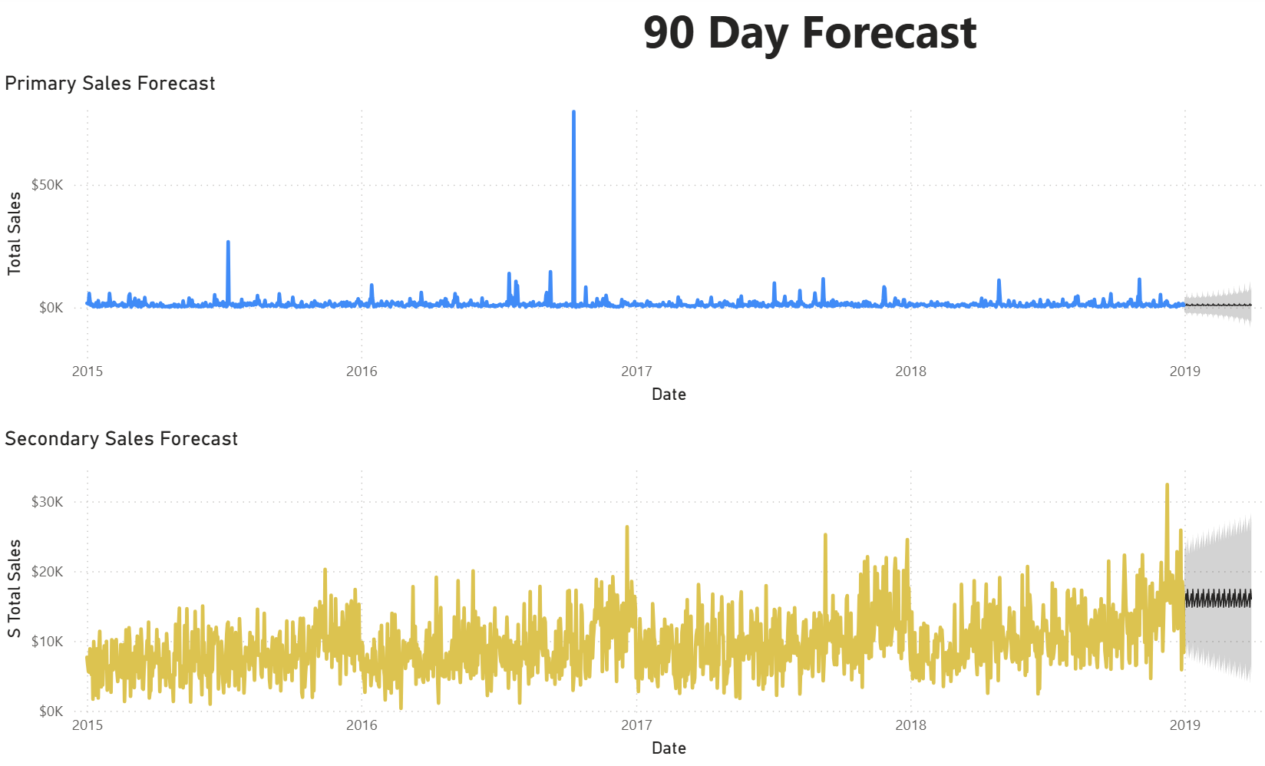
90 DAY FORECAST ANALYSIS
Predictive Performance Analysis as at Dec 2018
Primary Sales Forecast
Current Trend: Declining (-1.09% annual, -6.06% YTD)
Outlook: Without intervention, the decline will likely continue
90-day projection: upper +$8.3k, lower -$6.3k
Risk: High – immediate changes needed to reverse trend
Secondary Sales Forecast
Current Trend: Growing (+$1.19m, +11.77% YTD)
Outlook: Growth expected to continue with strong market demand
90-day projection: upper +$27k, lower +$5k
Confidence: High – scalable model supports predictable growth
Summary: Primary requires urgent turnaround; Secondary is poised for continued, scalable growth.
Notes:
Looking ahead, Primary’s decline is expected to continue without action, while Secondary is projected to maintain strong growth. This underscores the need for immediate stabilization of Primary and continued investment in Secondary’s scalable model.

Slide 14
CONCLUSION
Performance Assessment Summary as at Dec 2018
Primary Dataset:
Declined 1.09% (-6.06% YTD), due to seasonal dependency on Christmas products and a narrow European focus.
Secondary Dataset:
Grew +$1.19m (11.77% YTD), driven by a diversified electronics portfolio and global market reach.
Key Insight
Secondary operates at 7.3x the scale of Primary, with fundamentally different growth patterns and seasonality.
Strategic Imperative
Primary requires immediate turnaround through product and geographic diversification
Secondary should accelerate its proven growth model into new markets
Cross-learning between the two units can drive integrated improvement.
Notes:
In summary, Primary is declining due to seasonal and geographic limitations, while Secondary is thriving through diversification and global expansion. The strategic imperative is clear: Primary requires immediate turnaround, and Secondary should accelerate growth.

Slide 15
RECOMMENDATION
Primary Recommendations
Immediate Actions – Primary Turnaround Initiative
Product Diversification
Secondary Recommendations
Expand Electronics Lines
Leverage December peak
Reduce Christmas dependency from 80% to 60% with new year lines
June Performance Fix : Address annual low point in June with targeted promotions
Market Expansion : Increase India market share from 15% to 18% via local campaigns
Add 2-3 new tech products quarterly
Extend holiday success to other months
Scale Predictable Growth
Maintain 11.77%+ YTD growth with quarterly reviews
Notes:
We propose a two-part strategy:
Stabilize Primary by diversifying products and expanding carefully in Europe.
Accelerate Secondary by scaling its electronics model and targeting 15% growth in 2019.
We also recommend structured cross-learning between teams to transfer best practices. Thank you.

