Slide 1
Static Analysis of Heap-Manipulating Programs using Separation Logic
Author
Tomáš Brablec
Supervisor
Ing. Tomáš Dacík
Advisor
prof. Ing. Tomáš Vojnar, Ph.D.

Slide 2
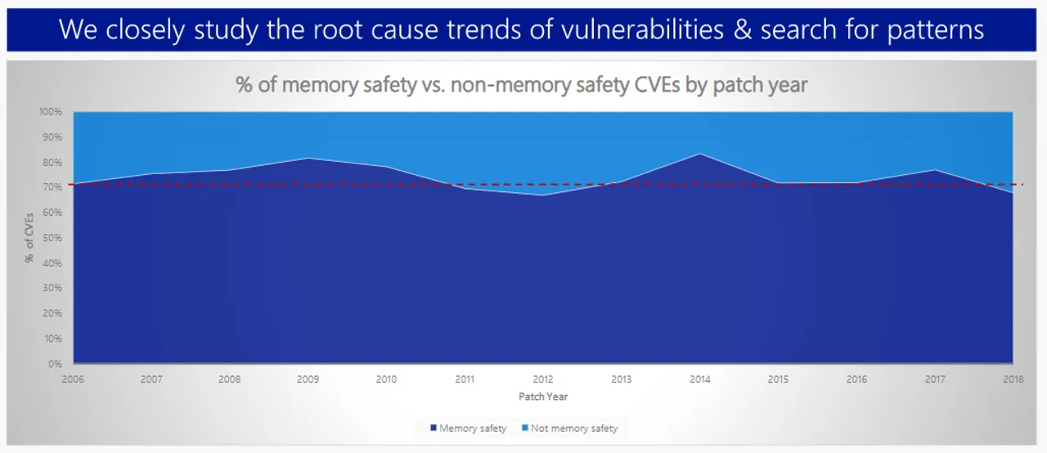
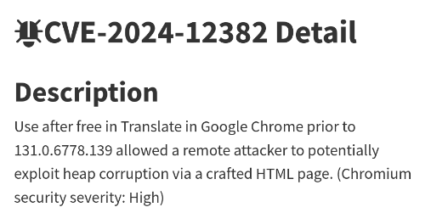
Motivation
Manual memory management creates a whole class of bugs
Use-after-free, double-free, memory leaks, …
Memory safety errors are a common source of security vulnerabilities
Linked lists are a common data structure in low level software
Example of a recent memory safety bug
Microsoft: Around 70% of CVEs are memory related

Slide 3


Verification Tool
This work introduces the KTSN verification tool
Goals: verification of memory safety and bug detection
Focused on programs with variants of linked lists
Abstract memory states are encoded in separation logic (SL)
Compared to existing approaches, a dedicated solver Astral
is used for checking SL formulae:
  Better modularity
  Higher precision than syntactic comparison
Implemented in the Frama-C framework using dataflow analysis
Astral

Slide 4
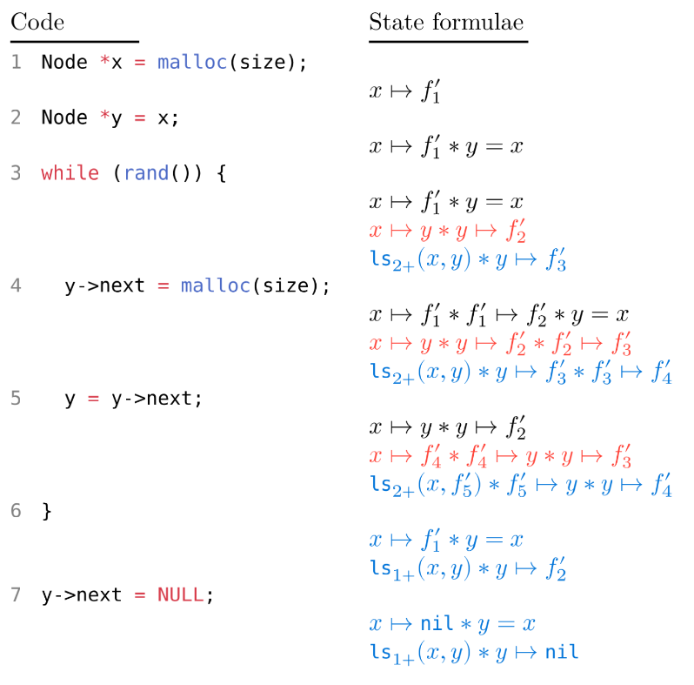
Implementation
Analyzed program’s AST is preprocessed into simple instructions
These instructions are interpreted as changes to the SL formulae
Invariants for loops are found using abstraction and checking entailments of formulae using the solver
Analyses of function calls are cached using function summaries
simplified analysis progress

Slide 5
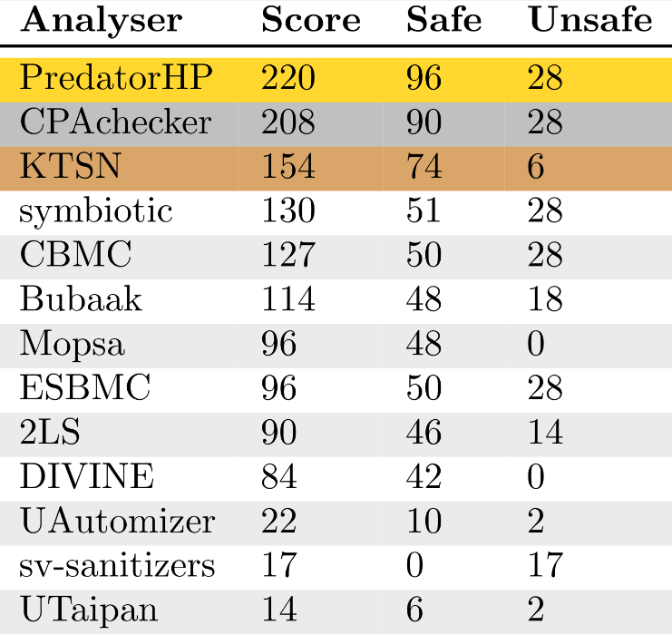
Results
Tested on crafted programs:
  Verification of programs with singly/doubly linked lists and nested lists
  Can find use-after-free and double-free bugs,
null-pointer dereferences, and memory leaks
Tested on SV-COMP benchmarks, surpasses
all but two other tools on linked lists
Outperforms the EVA analyzer from Frama-C
on most benchmarks in this category
Presented the results at Excel@FIT
Comparison with SV-COMP'25 participants

Slide 6
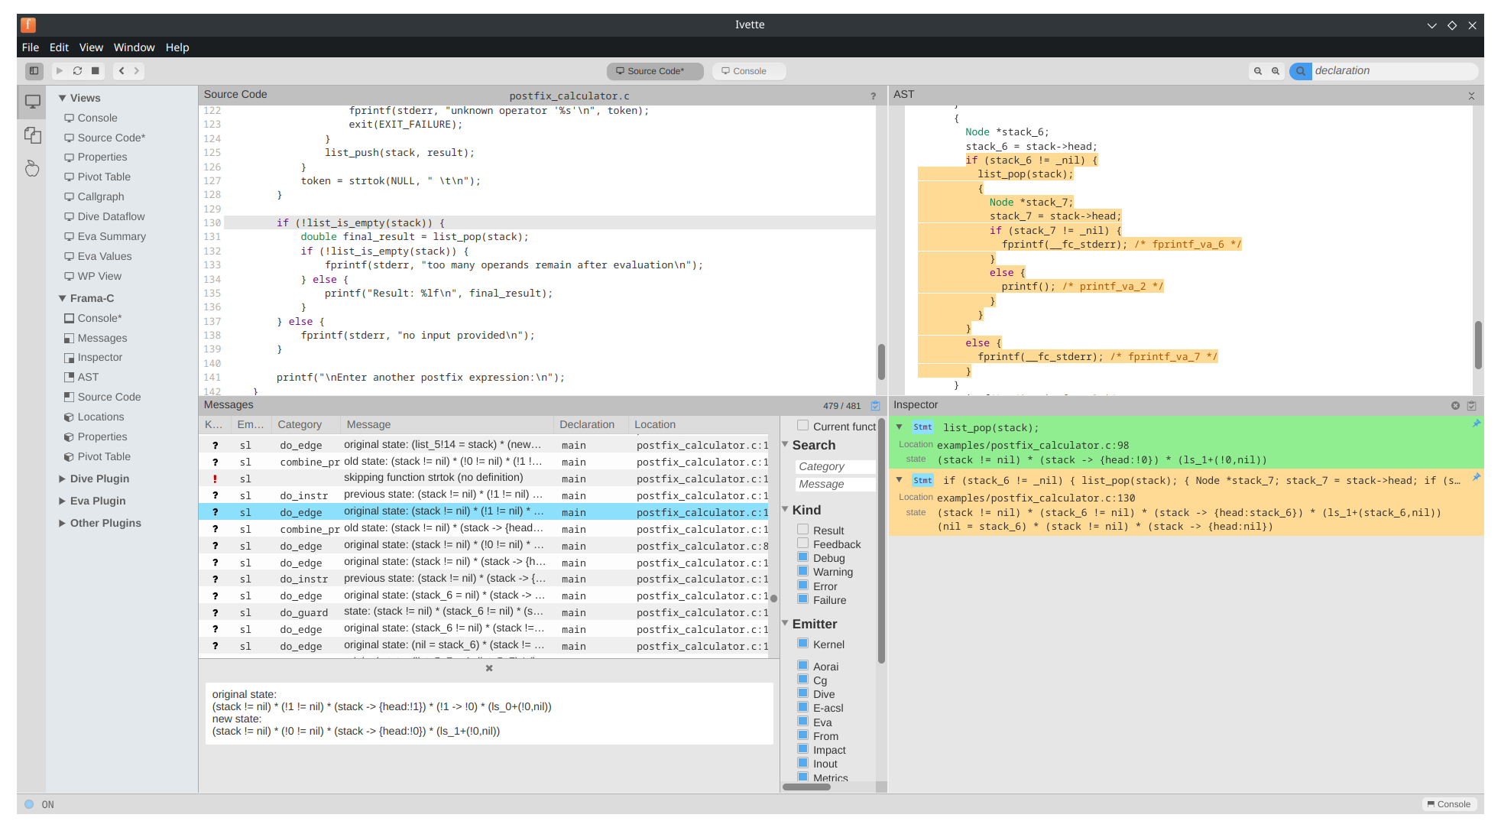
Results in Ivette (Frama-C GUI)

Slide 7
Conclusion
Implemented a static analyzer able to verify the memory safety of programs working with linked lists
The method outperforms most other analyzers in this category, while being more flexible
Future work
Compete with other analyzers in SV-COMP 2026
Extend the analysis to other types of lists
Integrate our method into the EVA analyzer to improve its analysis of programs with linked lists

Slide 8
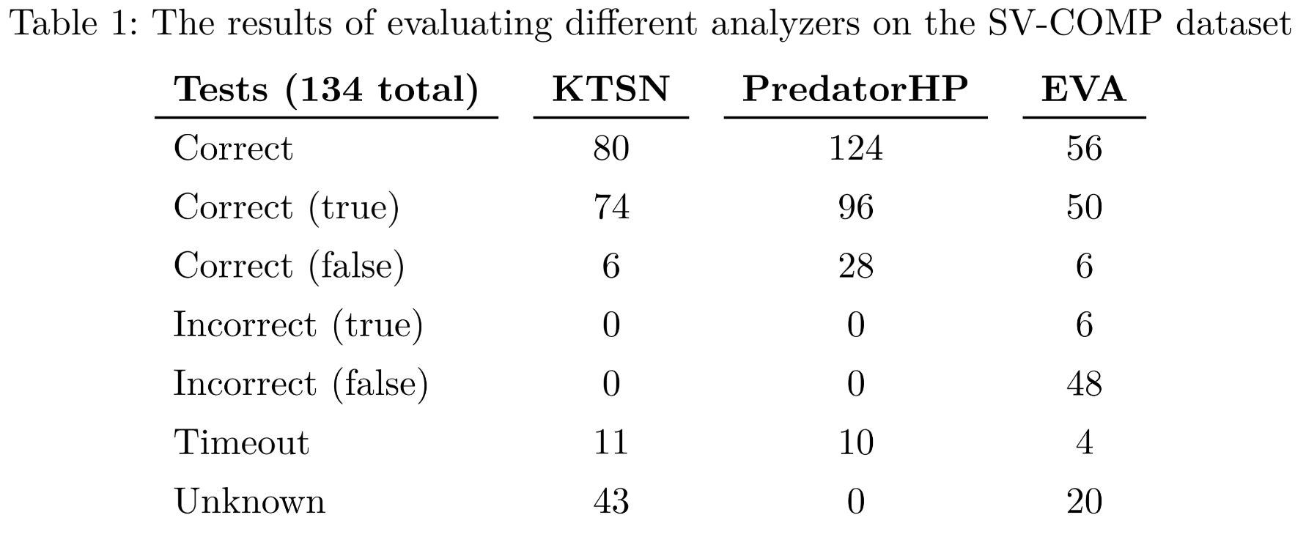
Interpretation of Results
“Co znamenají řádky "Correct (true)", "Correct (false)", "Incorrect (true)" a "Incorrect (false)" v tabulce 1?”
Correct (true) - Analyzer correctly verified 74 programs
Correct (false) - Analyzer correctly identified 6 programs with a bug
Incorrect (true) - Analyzer did not report any false positives
Incorrect (false) - Analyzer did not report any false negatives

Slide 9
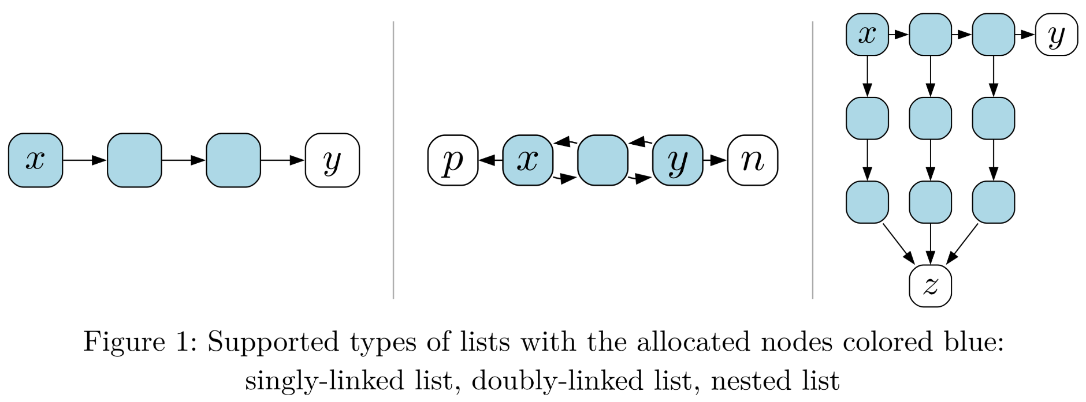
Supported list types

Slide 10
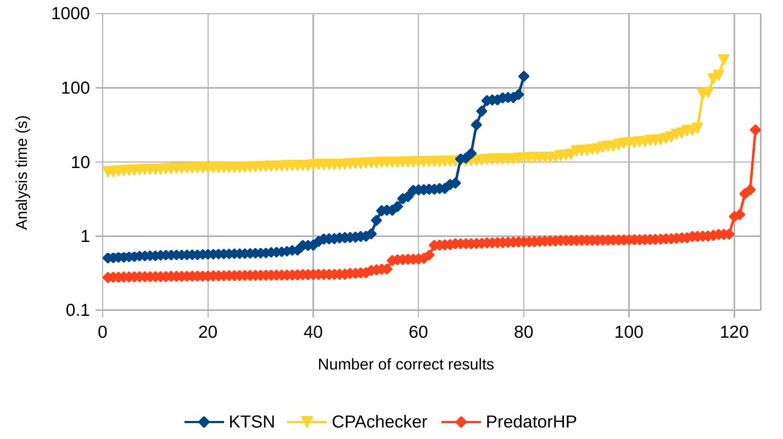
Comparison of analysis times

Slide 11
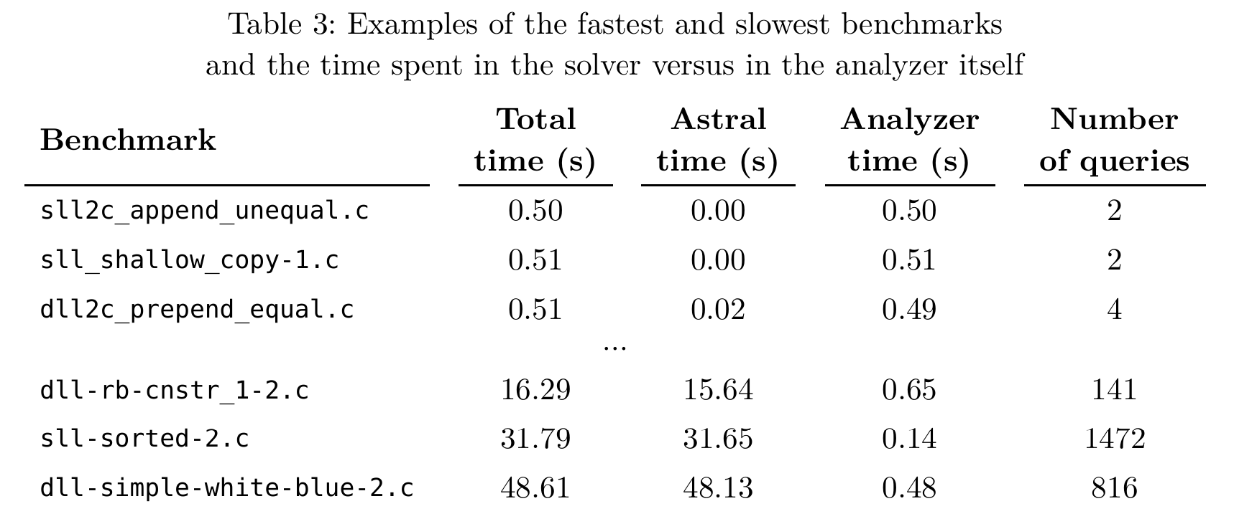
Time spent in KTSN and Astral

