Slide 1
Shape Analysis Using Separation Logic
Author
Tomáš Brablec
Supervisors
Tomáš Dacík, Tomáš Vojnar

Slide 2
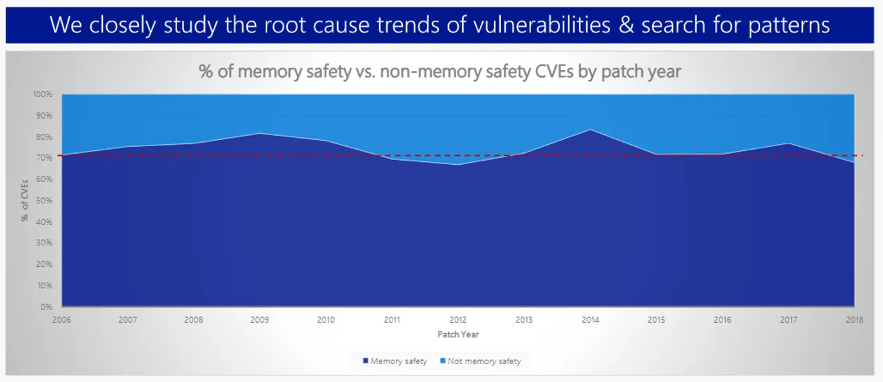
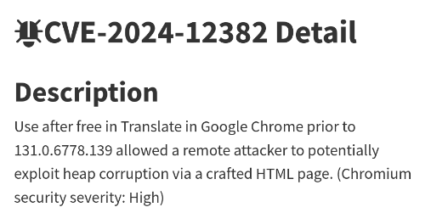
Motivation
Manual memory management creates a whole class of bugs
use-after-free, double-free, memory leaks, …
Memory errors are a common source of security vulnerabilities
Linked lists are a common data structure in low level software
Example of a recent memory safety bug
Microsoft: Around 70% of CVEs are memory related

Slide 3


Verification Tool
The goal is to create a tool for verification of programs
Abstract program states are encoded in separation logic
Solver (Astral) used to check satisfiability
By checking satisfiability, the tool proves properties of the program
The secondary goal is to test Astral itself in real-world use-cases
Astral

Slide 4
Current State
Implementation mostly finished (AST preprocessing, abstraction, simplification of formulas, function summaries, GUI output, …)
Testing and optimization is in progress
Benchmarking on public datasets of programs (SV-COMP) remains to be done
Analysis is implemented for most common types of lists (singly/doubly linked lists, nested lists)

Slide 5
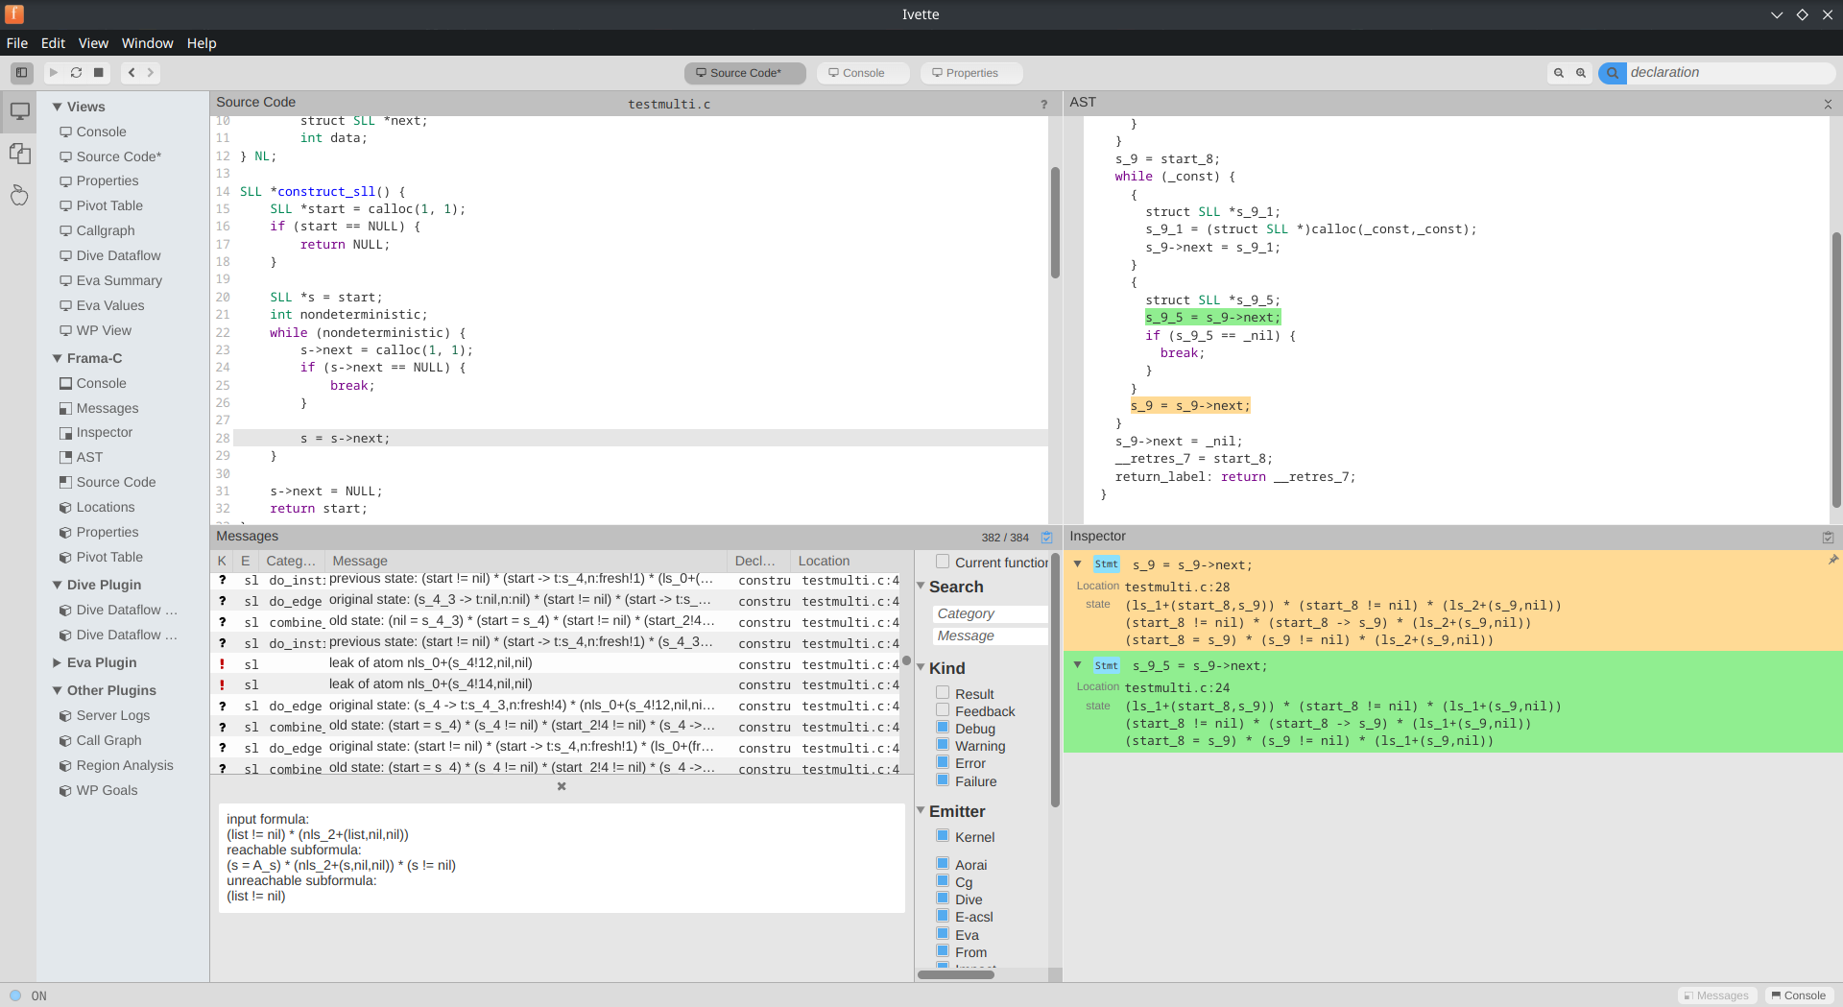
Results in Ivette (Frama-C GUI)

Slide 6
Conclusion
Implemented a verification tool able to analyze programs working with linked lists
Discovered several bugs in Astral leading to incorrect results during debugging
Possible extensions
Analysis of other types of lists
Under-approximating analysis mode (useful for finding bugs)

