Slide 1
Shape Analysis Using Separation Logic
Author
Tomáš Brablec
Supervisors
Tomáš Dacík, Tomáš Vojnar

Slide 2
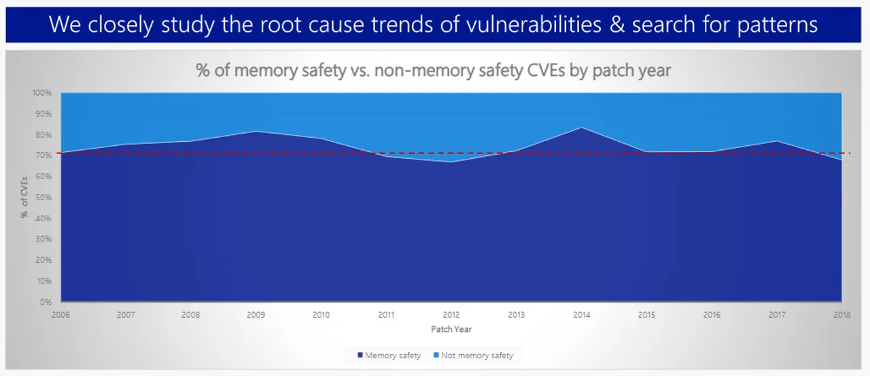
Motivation
Manual memory management creates a whole class of bugs
Memory errors are a common source of security vulnerabilities
Dynamic analysis does not prove correctness
There is space for static analysis and possibly formal verification
Microsoft: Around 70% of CVEs are memory related

Slide 3
Introduction
The goal is to develop a prototype of a static shape analyser
Use separation logic to represent program states
Focus on programs that work with linked lists
Utilize the Frama-C framework to simplify implementation
Use the Astral solver to efficiently work with separation logic

Slide 4
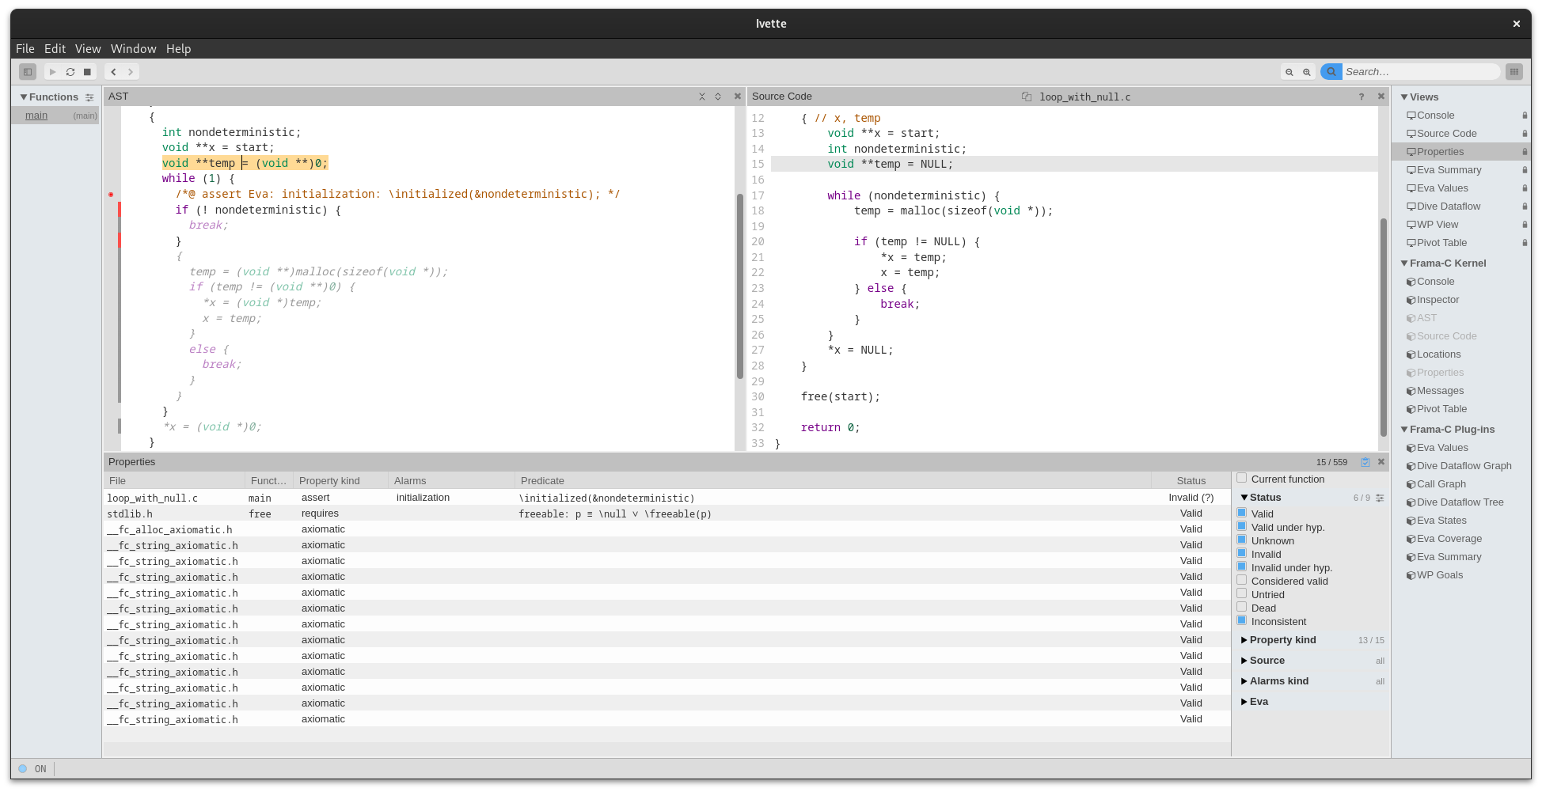

Frama-C
Modular framework for analysis of C code
The program is represented in the C Intermediate Language (CIL)
CIL is based on a modified AST with extra information
a GUI frontend called Ivette is under development

Slide 5
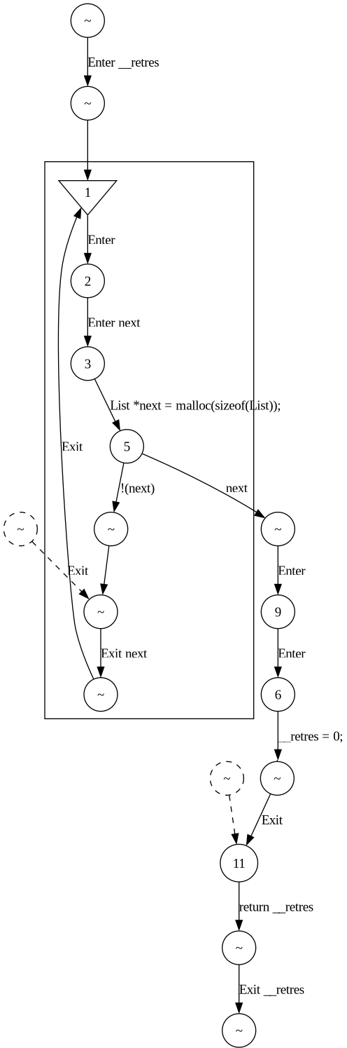
Dataflow Analysis
Runs on the Control Flow Graph (CFG) of the input code
Each node of the CFG is assigned an analysis state
States of all nodes are updated until a fixpoint is found for all of them
The plugin defines a transfer function that computes new states for nodes based on the states of predecessor nodes
Updates are propagated along the edges of the CFG
example of a CFG

Slide 6

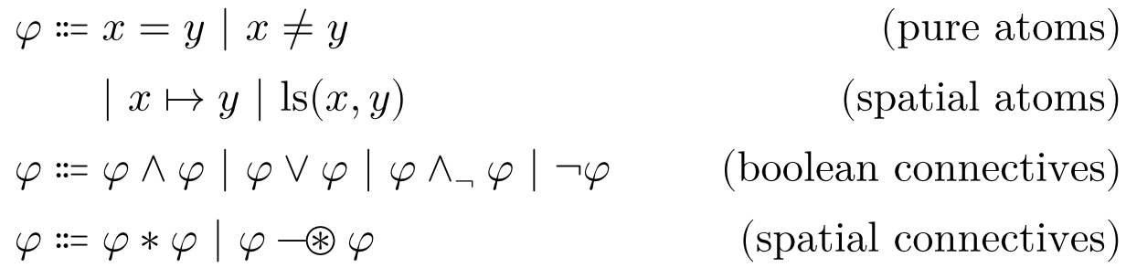
Separation Logic
Developed to solve the problem of globality in analyses
SL formulae describe the state of the heap
Enables abstraction over linked lists of arbitrary length
Dedicated solver for SL – Astral
Astral
syntax of SL formulae

Slide 7
Shape Analysis
Derives the shapes of data structures on the heap
Previous work defines abstraction rules for a minimal language
My objectives:
  adapt this method to work on a subset of C
  use Astral for solving SL formulae
The use of Astral provides greater flexibility than the original method

Slide 8
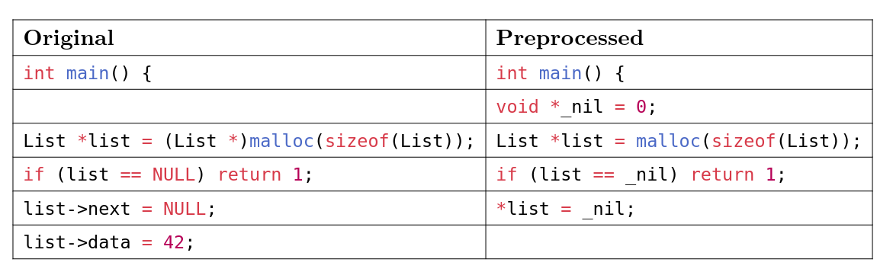
Implementation
Currently limited to programs without function calls
Preprocessing is done on the AST to simplify statements
Constants are removed, field accesses are converted to dereferences
During the analysis, the formulae are simplified between statements
Results are reported using Ivette
preprocessing example

Slide 9
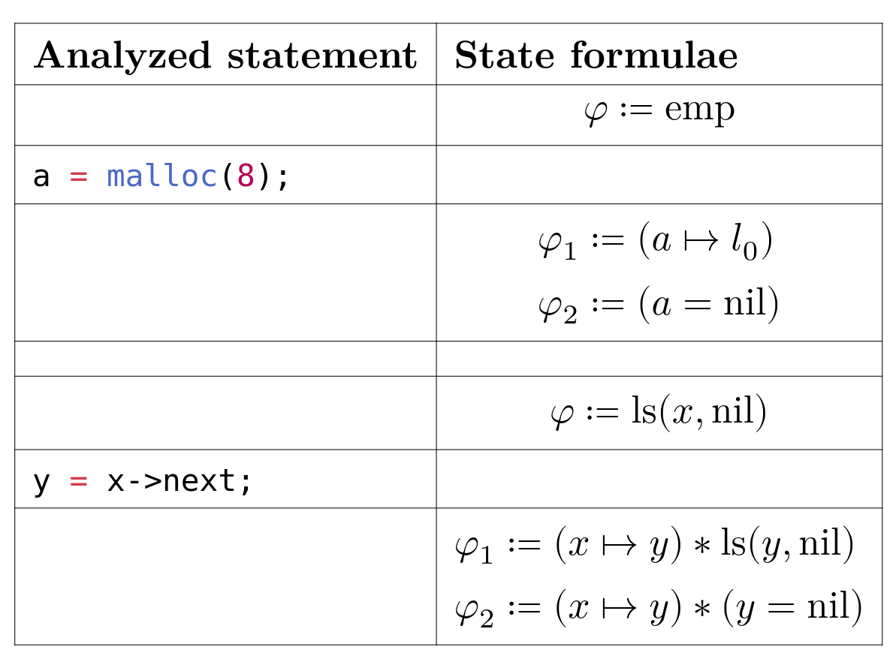
Implementation
The visit of every relevant statement modifies the state formulae
malloc splits the state into the cases of successful and failed allocation
Dereference of a list node splits the state according to the length of the list

Slide 10
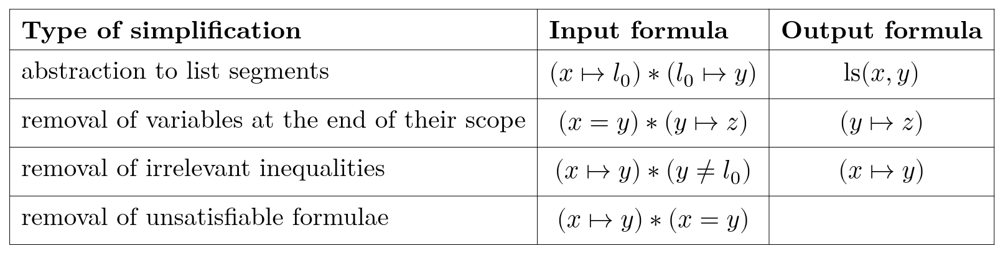
Abstraction and simplification
The abstraction ensures that the analysis will terminate
Between statements, the formulae are also simplified and deduplicated
This is done to speed up the analysis
examples of simplifications

Slide 11
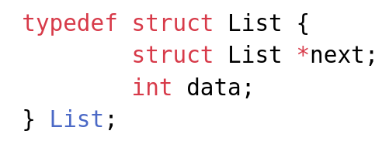
Example of analysis results
The analyzed code constructs a linked list, traverses all nodes, and then deallocates it
The following program works with a singly linked list

Slide 12
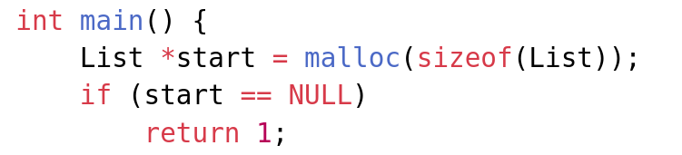
Example of analysis results
The program starts by allocating the first node
At this point, the state is represented by a formula

Slide 13
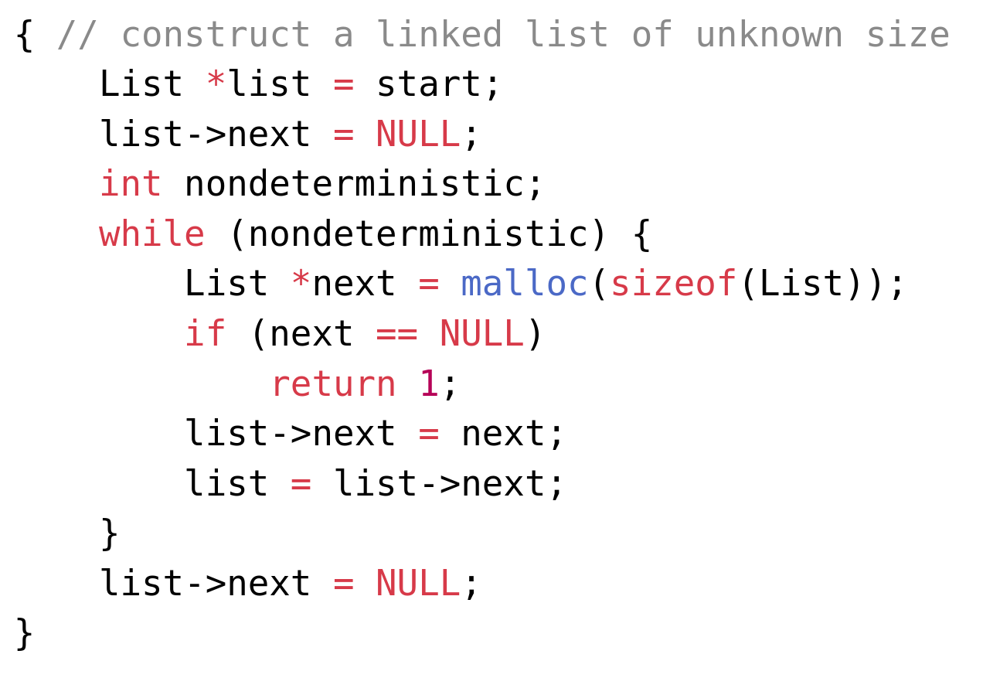
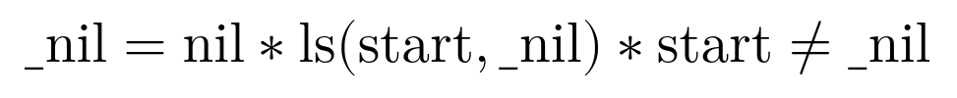
Example of analysis results
Then the whole list is allocated, up to a nondeterministic length
After this, the state is

Slide 14
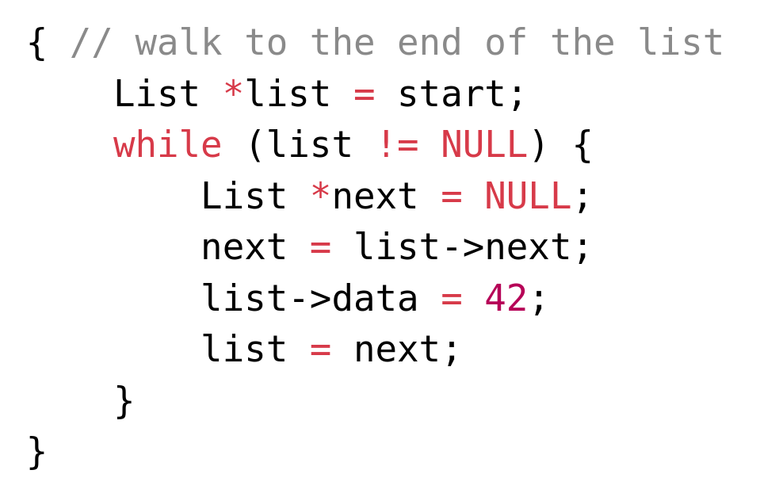
Example of analysis results
After traversing the list, the state stays the same since the shape of the data structure did not change

Slide 15
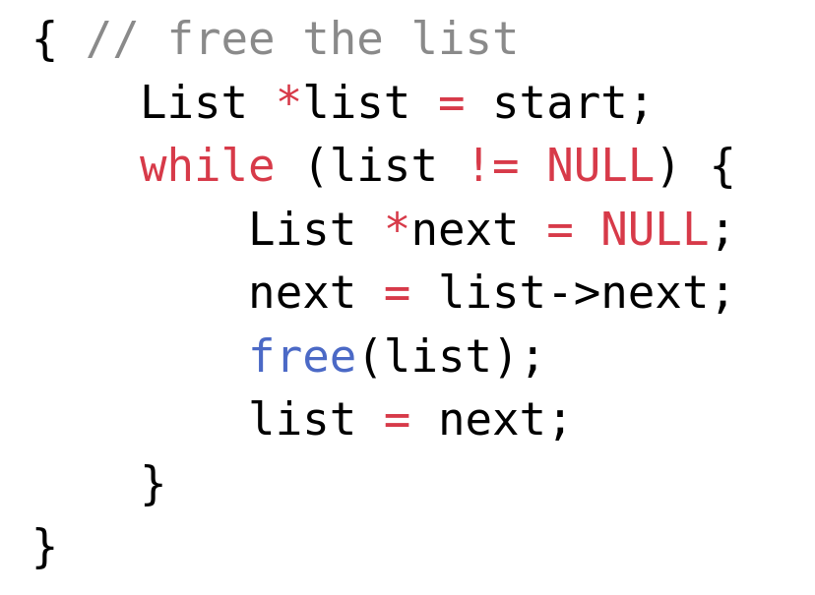
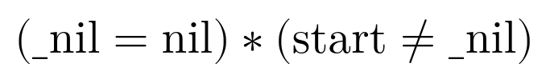
Example of analysis results
At last, all nodes are deallocated
The state is changed to reflect that

Slide 16
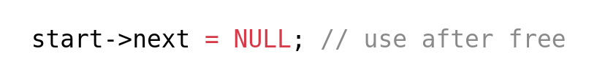
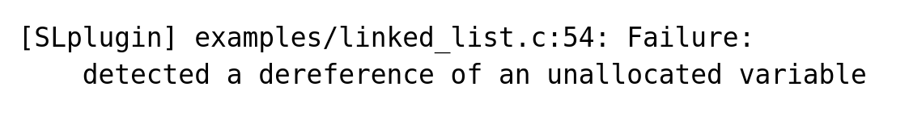
Error detection
The analysis is not only able to detect the shape of data in a correct program, it can also detect memory errors
If we try to access the list after deallocation, the bug is detected
After adding this line below the deallocation, an error is raised

Slide 17
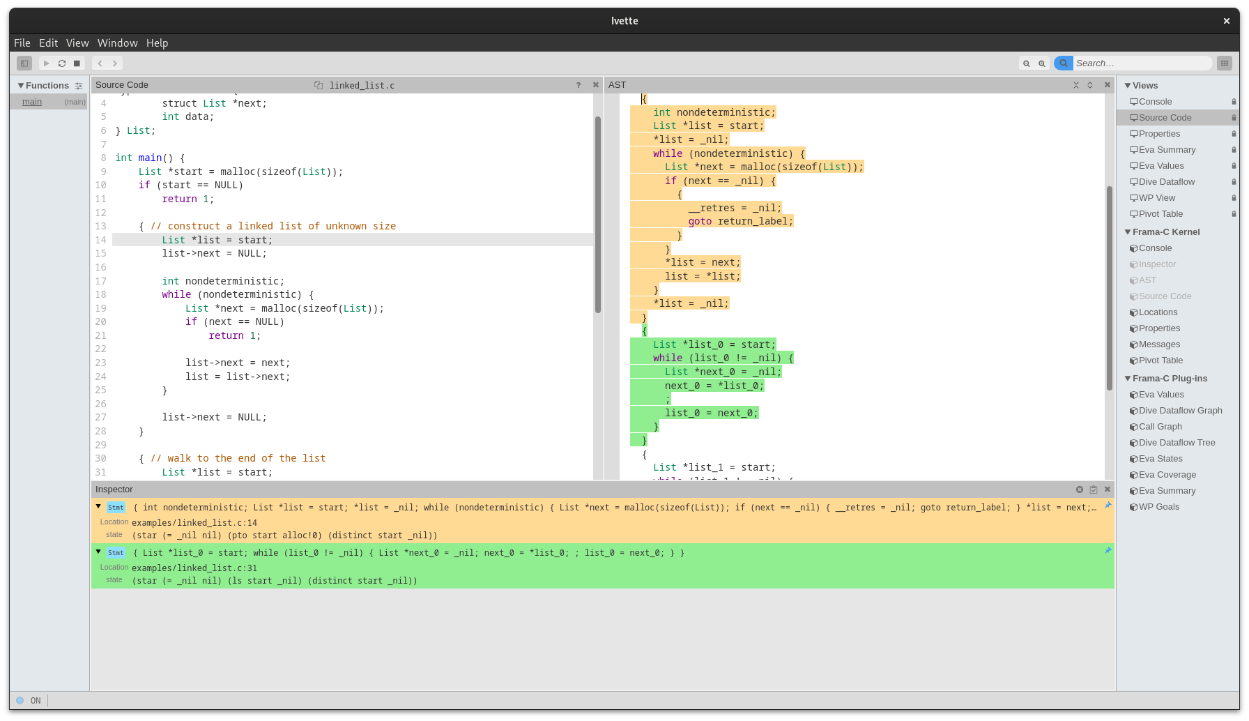
Results in Ivette
These results can be viewed using the Ivette GUI extension

Slide 18
Future work
Support the analysis of function calls, possibly with caching of results
Preprocess complex statements to enable the analysis of more programs
Support global and static variables
Most importantly, extend the analysis to more complex data structures
(doubly linked lists, nested lists)
Benchmark the analysis and compare it to other solutions

Slide 19
Summary
Studied topics: Frama-C framework, dataflow analysis, separation logic, Astral solver, shape analysis
Implemented a prototype of shape analysis using separation logic, able to analyze simple programs that work with linked lists

