Slide 1
Shape Analysis Using Separation Logic
Author
Tomáš Brablec
Supervisors
Tomáš Vojnar, Tomáš Dacík

Slide 2
Introduction
The goal is to develop a prototype of shape analysis
Find bugs in code that handles dynamic memory allocation
Develop as a plugin for the Frama-C framework
Using separation logic to describe program’s memory at each point

Slide 3

Frama-C
Modular framework for analysis of C code
Developed in the OCaml programming language
C code represented as C Intermediate Language (CIL)
CIL is based on a modified AST with extra information
Analyses are developed using a plugin system

Slide 4
Dataflow analysis
Runs on the Control Flow Graph (CFG) of the input code
Each node of the CFG is assigned a state
States of all nodes are updated until a fixpoint is found for all of them
User defines a transfer function that computes new states for nodes based on the states of predecessor nodes
Updates are propagated along the edges of the CFG

Slide 5

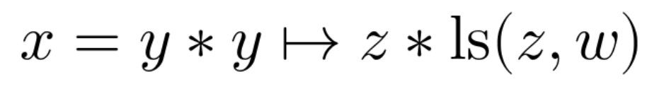
Separation logic
Attempts to solve the problem of globality in analyses
An SL formula describes the state of the program’s memory in an abstract way
Points-to atoms, list segments, equalities
Separating conjunction
Dedicated solver for SL – Astral
Symbolic heap is the fragment of SL used for this analysis
Astral

Slide 6
Shape analysis
Derives the shapes of data structures in the heap
List segments can abstract linked lists of arbitrary length
Previous work defines shape analysis using SL for a minimal language, without the use of a dedicated solver
My task is to adapt their method to work on (a subset of) C, and to use Astral for solving SL formulae
by using a dedicated solver for SL, we can always extend the analysis further (predicates for doubly linked lists, nested lists, even non-pointer data)

Slide 7
Implementation
Currently limited to programs without loops, function calls, and complex assignments
A list of symbolic heaps as the state for each node
The implementation consists of the following:
  Transfer function
  Join operation
  Filtering states for branches of if statement
  Filtering out unsatisfiable formulae, and simplification

Slide 8
Transfer function
Generates new data for a statement based on the previous statement’s data
Only variable initializations, assignments, and dereferences are analyzed
Non-pointer variables are ignored
Initializations by a call to malloc split state formula to two, representing a successful and failed allocation
Assignments are done by substitution of variable’s name in the formula

Slide 9
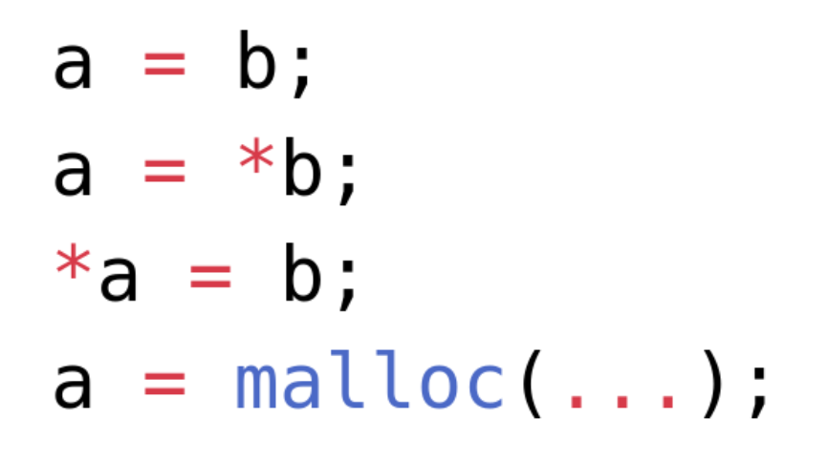
Transfer function (cont.)
An assignment with a dereference on the right-hand side – the target is found by the transitive closure of equality for the left-hand side variable
An assignment with a dereference of the left-hand side – similar to the above
These basic operations will be enough to analyze more complex assignments composed from them
statements, for which the analysis is implemented

Slide 10
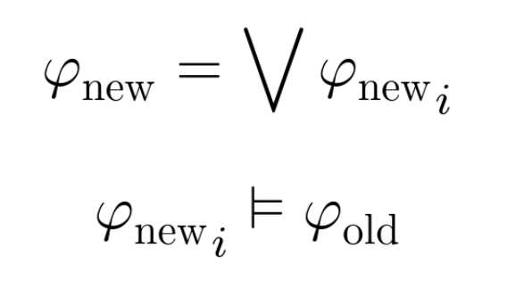
Join operation
When a new state is computed for a node, this function joins it together with the old stored state, and stores the result
Iterates through all formulae of the new state, and checks its entailment to the whole old state
Only formulae that do not satisfy the entailment are added
Otherwise, we would be adding redundant information

Slide 11
Conditionals
Generating two states for the branches of an if statement based on the condition
Only equalities and inequalities of two variables are analyzed, other conditions are treated as nondeterministic
Only formulae that are satisfiable with the given condition added to them are sent to the respective branch

Slide 12
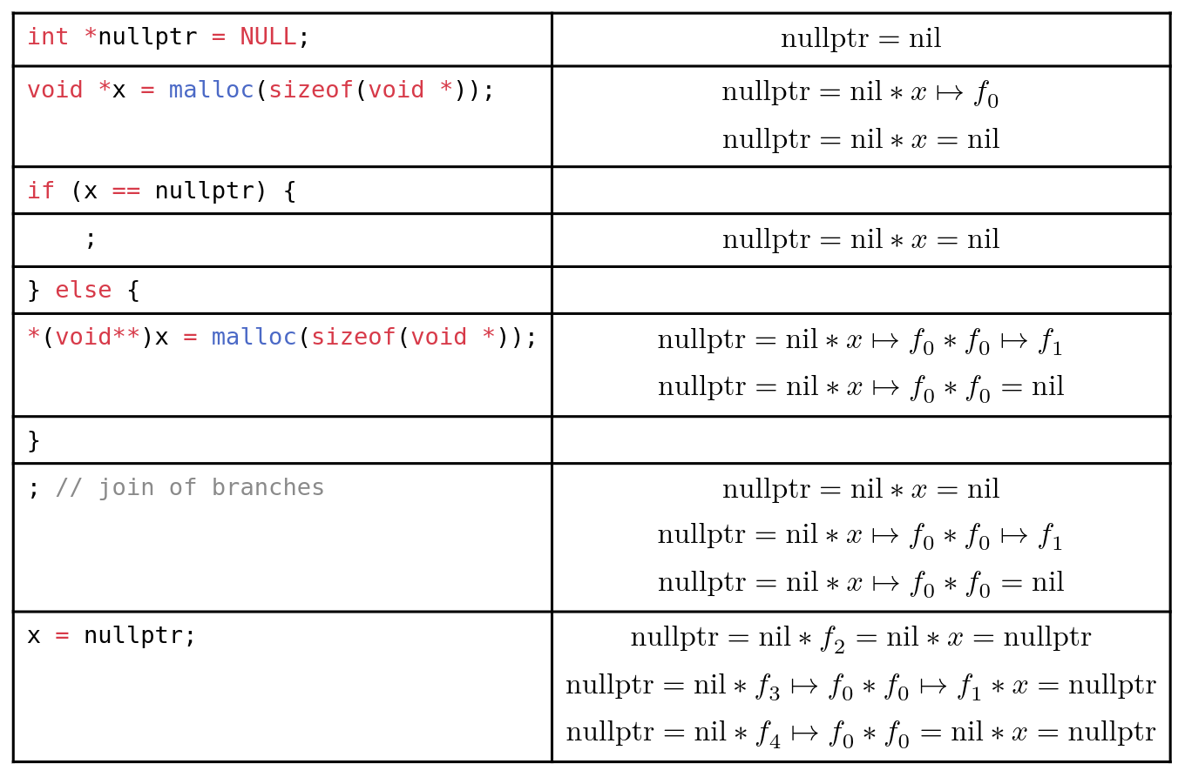
Example of analysis results

Slide 13
Future work
Abstraction to list segments (needed for termination of loops)
Analysis across function calls
Preprocessing passes over CIL to simplify code
Pull variable declarations to the top scope of each function
Split more complex assignments into a series of simpler ones
Find structs that represent linked lists, and rewrite struct member accesses to simple dereferences
Inline functions to avoid analyzing function calls

Slide 14
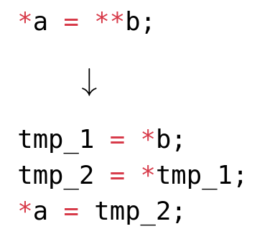
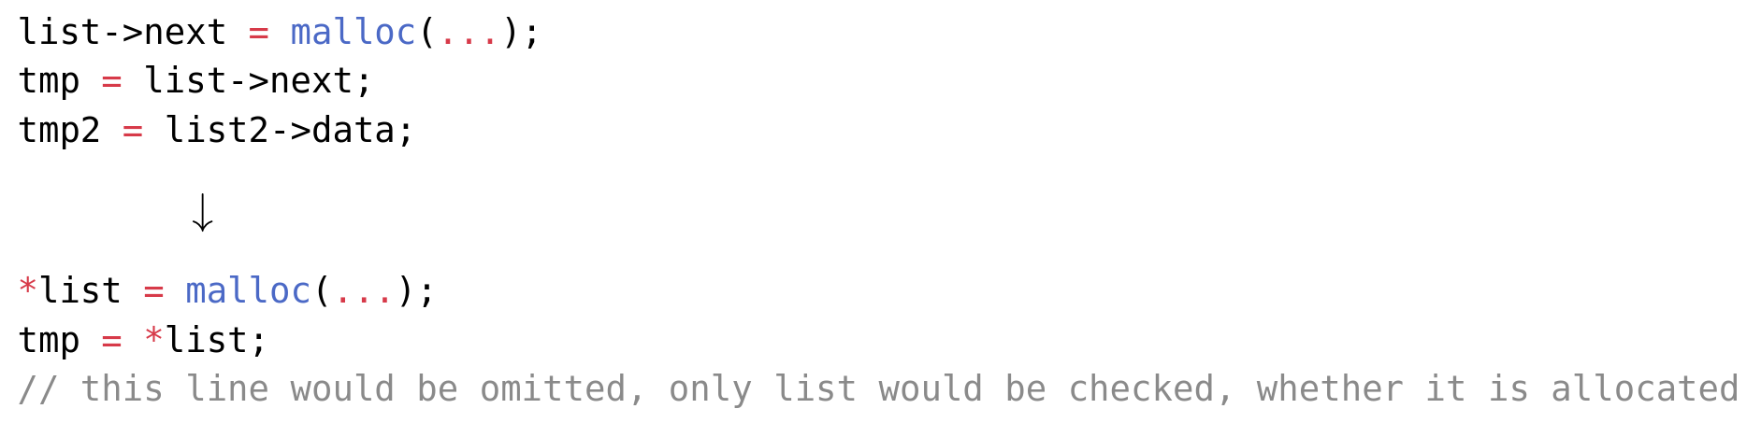
Examples of preprocessing

Slide 15
Summary
Studied topics: Frama-C framework, dataflow analysis, separation logic, Astral solver, shape analysis
Implemented a first prototype of shape analysis using separation logic, in the form of a Frama-C plugin

