Slide 1
DEEP QUATERNION NEURAL NETWORK FOR 3D SOUND SOURCE LOCALIZATION AND DETECTION
Quaternion Domain
Conclusion
Network Structure
Introduction
Dataset & Metrics
Experimentation & Results
Project of Neural Network Course
Sveva Pepe, Marco Pennese & Claudia Medaglia

Slide 2
The sound event localization and detection (SELD) task includes recognizing a known set of sound event classes (such as ‘dog bark’, ‘bird call’, and ‘human speech’) in the acoustic scene, detecting their individual onset and offset times, and further localizing them in space when active.
Experimentation & Results
Quaternion Domain
Conclusion
Network Structure
Introduction
Dataset & Metrics
Deep Quaternion Convolutional Recurrent Neural Network are used to solve this problem.

Slide 3
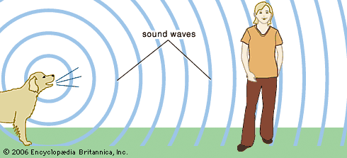
When we are in an anechoic chamber or in open space, we can estimate the DoA in a closed form as the opposite direction of the active intensity vector.
So, why do we need a Neural Network?
Experimentation & Results
Quaternion Domain
Conclusion
Network Structure
Introduction
Dataset & Metrics

Slide 4
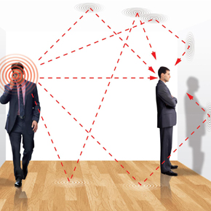
In practice the estimates obtained across all time frequency bins are inconsistent in reverberant environments.
In order to deal with noise and reverberation, we propose a
neural network based method using appropriate input features.
Experimentation & Results
Quaternion Domain
Conclusion
Network Structure
Introduction
Dataset & Metrics

Slide 5
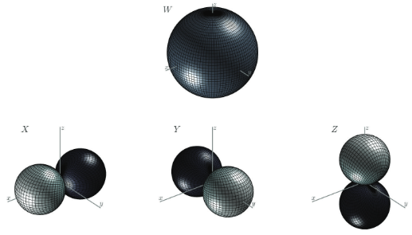
3D audio files are sampled using the Ambisonics technique, where sampling is based on the decomposition of sound in a linear combination of orthogonal bases of spherical harmonics. First-order Ambisonics (FOA) was considered, which is composed of 4 microphone capsules.
Pressure microphone:
omnidirectional microphone with a unitary gain for all directions and corresponds
to the spherical harmonic function of order 0.
It is denoted with W.
Conclusion
Introduction
Network Structure
Dataset & Metrics
Quaternion Domain
Experimentation & Results
Gradient of pressure (acoustic velocity):
three microphones are orthogonal figure-of-eight microphones and correspond to the spherical harmonic functions of order 1. They are denoted with X,Y,Z.

Slide 6

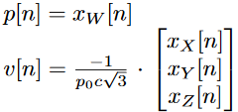
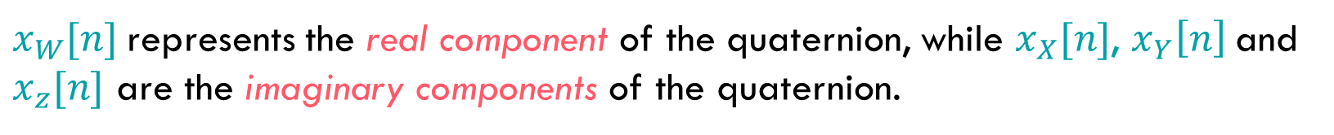
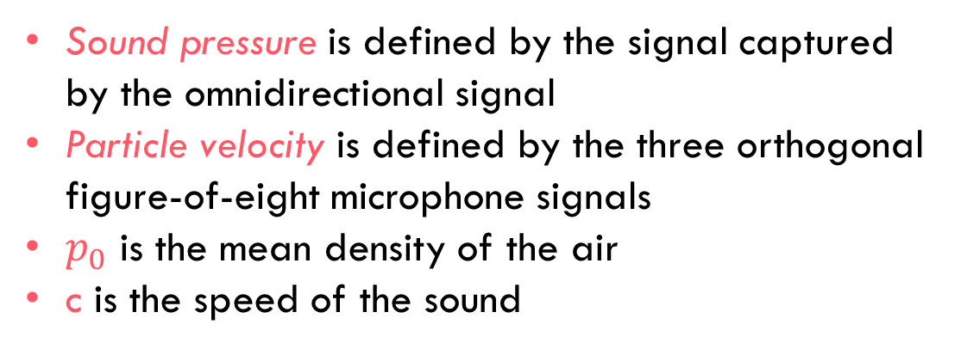
Single quaternion-valued ambisonics signal
$x_{W}[n]$represents the real component of the quaternion, while $x_{X}[n]$, $x_{Y}\left[n\right]$and $x_{z}[n]$ are the imaginary components of the quaternion.
Sound Field (Acoustic Intensity)
Average of the sound pressure, p[n],
and the particle velocity, v[n], over time
Conclusion
Introduction
Network Structure
Dataset & Metrics
Quaternion Domain
Experimentation & Results
In Ambisonics Format
Sound pressure is defined by the signal captured by the omnidirectional signal
Particle velocity is defined by the three orthogonal figure-of-eight microphone signals
$p_{0}$ is the mean density of the air
c is the speed of the sound

Slide 7


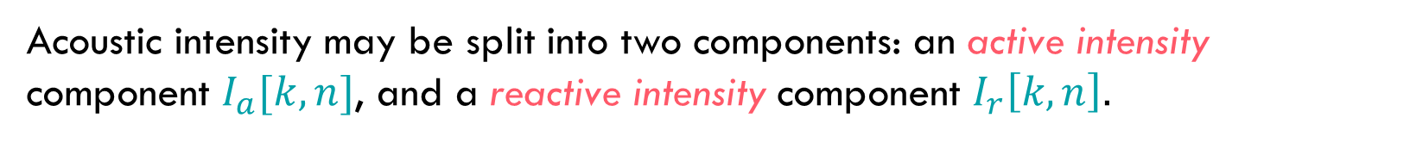
Acoustic intensity may be split into two components: an active intensity component $I_{a}[k, n]$, and a reactive intensity component $I_{r}\left[k, n\right].$
time average of the acoustic intensity
transport of sound energy and
whose mean value is non-zero
Conclusion
Introduction
Network Structure
Dataset & Metrics
Quaternion Domain
Experimentation & Results
imaginary counterpart of the active intensity
dissipative local energy transport and whose mean value is zero
Active intensity refers directly to DOA, while reactive intensity indicates whether a given frequency-time bin is dominated by sound directed by a single source.

Slide 8
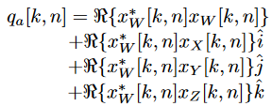
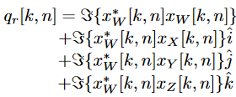



Three components for each intensity vector and another more channel related to the magnitude of the omnidirectional microphone signal in order to improve the performances of the localization task.
Conclusion
Introduction
Network Structure
Dataset & Metrics
Quaternion Domain
Experimentation & Results
normalize quaternion using potential energy density related to the sound pressure $(ε_{P})$ and kinetic energy density related to the particle velocity $(ε_{K})$ .
$$ε_{T}=ε_{P}+ε_{K}$$

Slide 9
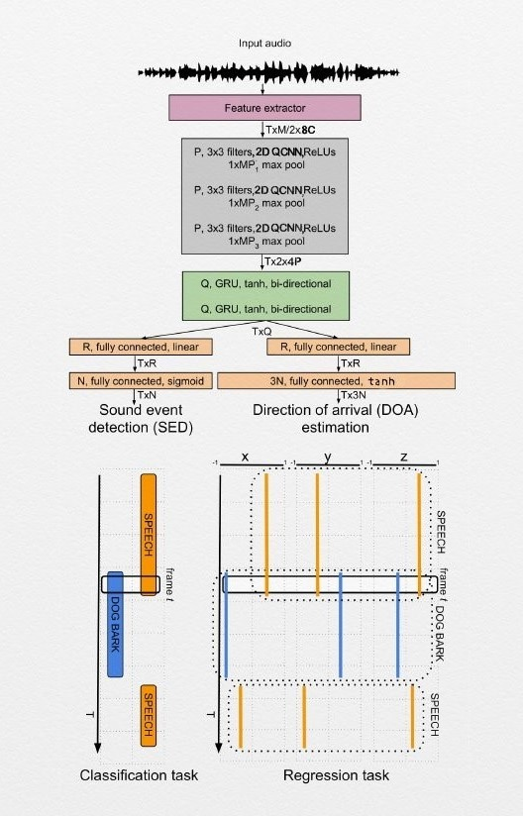
Quaternion Convolutional Recurrent Neural Network
Three convolutional layers based on quaternions (QCNN)
Two recurrent layers (QRNN)
Two parallel outputs: both are composed of two fully-connected layers, which obviously differ in their activation functions and size that receive input from previous layers.
Conclusion
Introduction
Network Structure
Quaternion Domain
Dataset & Metrics
Experimentation & Results

Slide 10
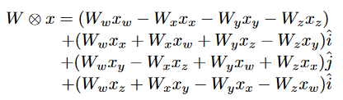
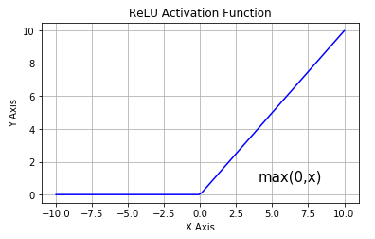
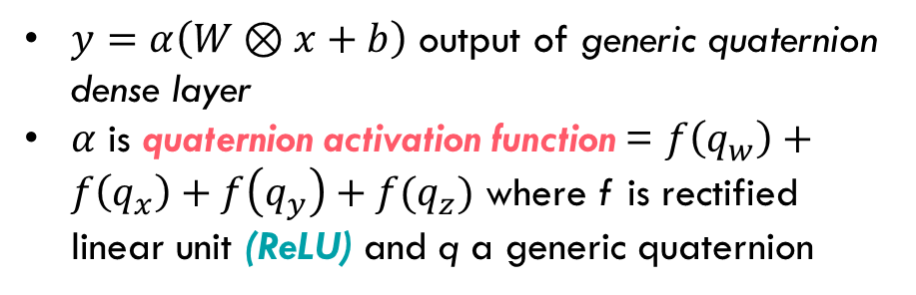
Convolutional stage
Quaternion Convolutional Layer
Detector stage
Pooling stage
Convolutional stage: Hamilton’s product
x is the vector of the quaternions taken as input
W a generic quaternion filter matrix
HP allows quaternion neural networks to capture internal latent relations within the features of a quaternion.
Conclusion
Introduction
Network Structure
Quaternion Domain
Dataset & Metrics
Experimentation & Results
Detector stage: choice of activation function
$y=α\left(W⊗x+b\right)$ output of generic quaternion dense layer
$α$ is quaternion activation function = $f\left(q_{w}\right)+f\left(q_{x}\right)+f\left(q_{y}\right)+{f(q}_{z})$ where f is rectified linear unit (ReLU) and q a generic quaternion

Slide 11
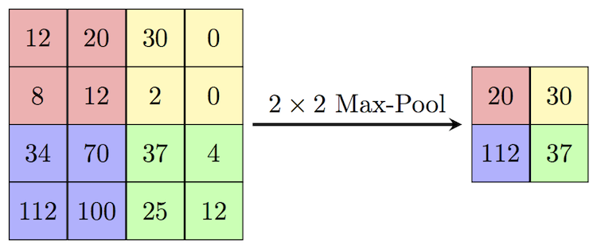
Pooling stage: decrease the computational power required to process the data through dimensionality reduction.
Max-Pooling is done by applying a max filter to non-overlapping subregions of the initial representation.
feedback loop
Q nodes of quaternion gated recurrent units (QGRU)
Activation function: hyperbolic tangent (tanh)
Conclusion
Introduction
Network Structure
Quaternion Domain
Dataset & Metrics
Experimentation & Results
Quaternion Recurrent Layer
SED as multi-class multilabel classification (linear + sigmoid activation function)
Fully-connected Layers
DOA as multi-output regression
(linear + tanh activation function)

Slide 12

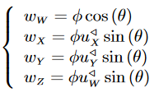
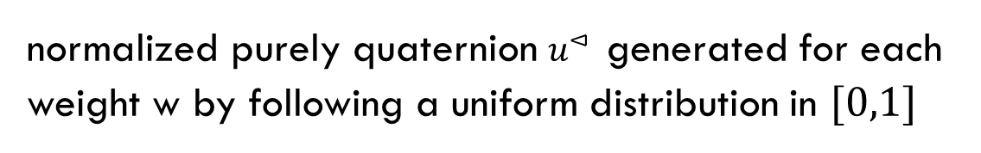

Weight Initialization
normalized purely quaternion $u^{⊲}$ generated for each
weight w by following a uniform distribution in $[0,1]$
Quaternion-value components of w
Conclusion
Introduction
Network Structure
Quaternion Domain
Dataset & Metrics
Experimentation & Results
$θ$ randomly generated in the range $[−π,π]$
$φ$ is a randomly generated variable related to the variance of the quaternion weight
variance of the quaternion weight: $var (W) = 4σ^{2}$, where $σ$ is the standard deviation

Slide 13
TAU Spatial Sound Events 2019 - Ambisonic
Stationary point sources from multiple sound classes each associated with a temporal onset and offset time, and DOA coordinate represented using azimuth and elevation angle.
Development set: 400, one-minute long recordings sampled at 48000 Hz, divided into four cross-validation splits of 100 recordings each.
Evaluation set: 100, one-minute long recordings.
Introduction
Conclusion
Quaternion Domain
Network Structure
Dataset & Metrics
Experimentation & Results
Difference between each of the development dataset splits and evaluation dataset is the isolated sound event examples employed.
Eleven sound event classes: knock, drawer, clearthroat, phone, keysDrop, speech, keyboard, pageturn, cough, doorslam and laughter
250 audio files, randomly divided into five splits in a way that in each split there is an equal number of examples for each class: we used the first four for training the network, while the remaining one is used for testing (20%).

Slide 14
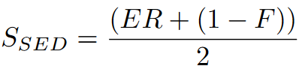



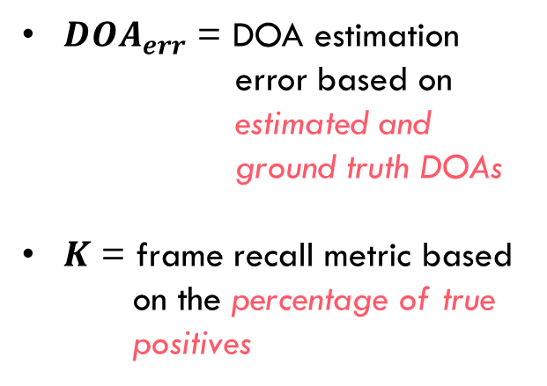
SELD task can use individual SED and localization (DOA) metrics.
$ER$ = error rate based on the total number of active
sound event classes in the ground truth
$F$ = F-score based on the number
of true and false positives
${DOA}_{err}$ = DOA estimation error based on estimated and ground truth DOAs
$K$ = frame recall metric based
on the percentage of true
positives
Conclusion
Introduction
Conclusion
Quaternion Domain
Network Structure
Network Structure
Dataset & Metrics
Experimentation & Results

Slide 15
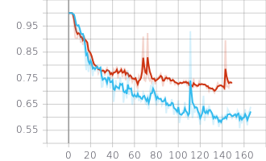
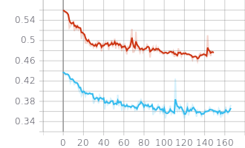
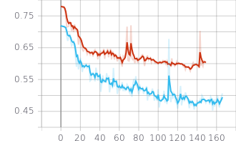
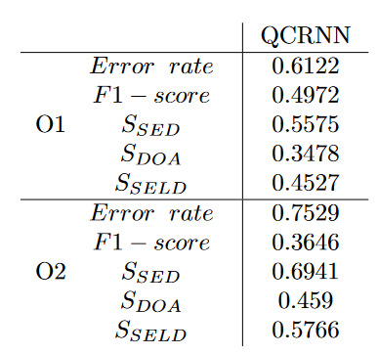



Quaternion Convolutional Neural Network with 32 filters
$$S_{SED}$$
$$S_{DOA}$$
$$S_{SELD}$$
Introduction
Conclusion
Quaternion Domain
Network Structure
Dataset & Metrics
The red line refers to the 32 filter network trained on the samples with 2 overlaps (ov2), while the light blue line refers to the same network trained on samples with a single sound overlap (ov1).
Network performs better with samples with a single overlap than that with two overlaps.
Experimentation & Results

Slide 16
Modifying the parameters and evaluating the results using a different network, and the models have been trained over 150 epochs.
First Experiment
Change number of filters: 32 and 16;
Analyzing the results on both the datasets (with one overlap (ov1) and two overlaps (ov2));
Sequence length of T = 512 frames, window length M = 512, batch size of 10, Q = 128 nodes for the recurrent networks and R = 32 nodes for the fully connected layers.
Introduction
Conclusion
Quaternion Domain
Network Structure
Dataset & Metrics
Experimentation & Results
Second Experiment
Compare the proposed quaternion CRNN with the traditional approach: SELDnet architecture based on traditional convolutional layer
Default parameters : T = 128, M = 2048, C = 4, P = 64, MP1 = MP2 = 8, MP3 = 4, Q = R = 128, N = 11
used the winning configuration of our first experiment (P = 32 filters), in order to have about same number of parameter of the proposed quaternion network and of the SELDnet, in this way the results are comparable.

Slide 17
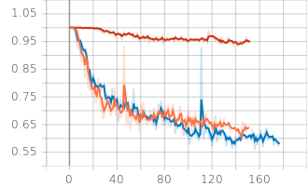
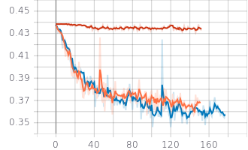
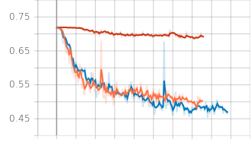



Experiments carried out: QCRNN 16, QCRNN 32 and CRNN
$S_{SED}$ on ov1
$S_{DOA}$ on ov1
Introduction
Conclusion
Quaternion Domain
Network Structure
Dataset & Metrics
Experimentation & Results
$S_{SELD}$ on ov1
orange: QCRNN net with 16 filters in the quaternion convolutional layers;
blue: QCRNN net with 32 filters in the quaternion convolutional layers;
red: Traditional Seld-net CRNN approach with default parameters;

Slide 18
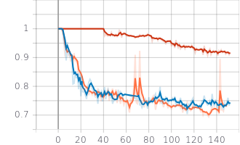
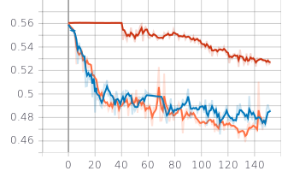
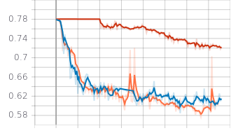
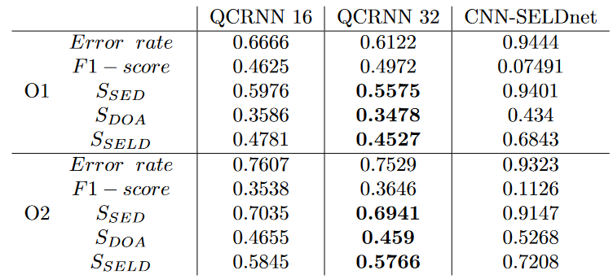



$S_{SED}$ on ov2
$S_{DOA}$ on ov2
$S_{SELD}$ on ov2
orange: QCRNN net with 32 filters in the quaternion convolutional layers;
blue: QCRNN net with 16 filters in the quaternion convolutional layers;
red: Traditional Seld-net CRNN approach with default parameters;
Introduction
Conclusion
Quaternion Domain
Network Structure
Dataset & Metrics
Experimentation & Results
The best results on the
TAU Dataset in terms of the SED score, DOA score and SELD score considering several experiments.

Slide 19
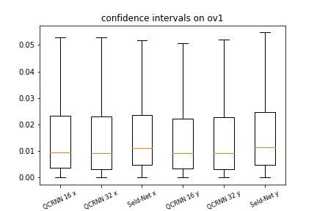
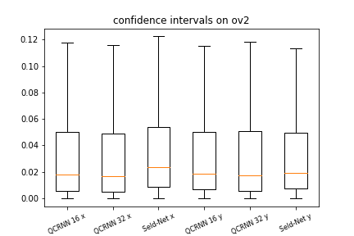
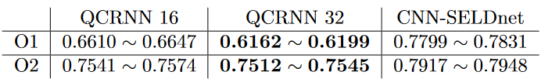
Confidence intervals for the prediction on the localization of the sound source (x and y coordinates) for each network tested on the different overlap.
Introduction
Conclusion
Quaternion Domain
Network Structure
Dataset & Metrics
Experimentation & Results
Confidence intervals computed on regression task
Confidence intervals computed on classification task
The confidence intervals of the classification error rate computed with 95% of confidence.
The best results of our experiments are reached with the QCRNN Net with 32 filters.

Slide 20
We analyzed the different results considering the sounds with one or two overlaps, fixing the filters first at 32 and then at 16.
The models trained on the dataset with two overlaps performs worse than the models trained on the dataset with only one overlap.
The network with P = 32 filters in the QCNN layers performs slightly better than the model with only 16 filters.
Compare the results obtained with a SELDnet architecture based on normal convolutional layer.
Results have proved that the use of quaternion-valued acoustic intensity vector as input features leads to an improvement of 3D SELD performance in challenging environments compared to the traditional approach.
Introduction
Conclusion
Quaternion Domain
Network Structure
Dataset & Metrics
Experimentation & Results

Slide 21
THE END
Introduction
Conclusion
Quaternion Domain
Network Structure
Dataset & Metrics
Experimentation & Results

