Slide 1
Session Types and Cake
Wen Kokke, J. Garrett Morris, and Philip Wadler
University of Edinburgh
Notes:
I’m gonna talk about session types and cake – or, session types for sharing finite resources – like cake – with a bunch of people.
What I’ll describe in this talk is a simple and elegant trick for adding finite non-determinism to classical processes.

Slide 2
First, a story.
Notes:
But first, a story.

Slide 3
This is Ami.
They love cake.
This is Boé.
She loves cake too.
Notes:
These are the two characters in our story.
Ami and Boé.
They both love cake, and they’re on holiday in the US at the moment.
They’ve decided – independently – to indulge in something that really only feels appropriate if you do it in the US.
Order cake online, and have it delivered to your door.

Slide 4
This is a store.
It sells cake.
There is only one cake left.
Notes:
This is a store.
It’s called “24”, because that’s what the twitter emoji for stores happens to say.
It’s cool like that.
There’s one unfortunate thing about this store.
It has only one cake left.

Slide 5
Ami and Boé have to race.
That’s ok. The store doesn’t mind.
Notes:
That’s means Ami and Boé have to race.
For the store, that’s ok.
It doesn’t mind.
It just wants to sell its one cake.
It doesn’t mind dishing out an extra serving of disappointment.

Slide 6
So… Races are good sometimes!
Notes:
If we were to write out a program modeling this interaction...
It would be racy.
That’s okay.
Sometimes races are good.

Slide 7
And deadlocks are bad.
I’m sure we all know.
Notes:
Usually, I’d have an extra bit of a story, where Ami gets the cake…
They decide to sell the cake on to Boé, ‘cuz they like profits more than cake.
But since it’s a back-alley cake resale, neither party is trusting.
Ami demands to get the money first.
Boé demands to get the cake first.
Anyway, the point is, they’re stuck…
And it’s a deadlock…
And deadlocks are bad…
But I’m sure you all know.

Slide 8
This is Classical Processes.
Notes:
Okay.
So I talked about modeling that example as a program.
The language I like to use to model concurrent interactions is called “Classical Processes” by Wadler
You can see it here, but…

Slide 9
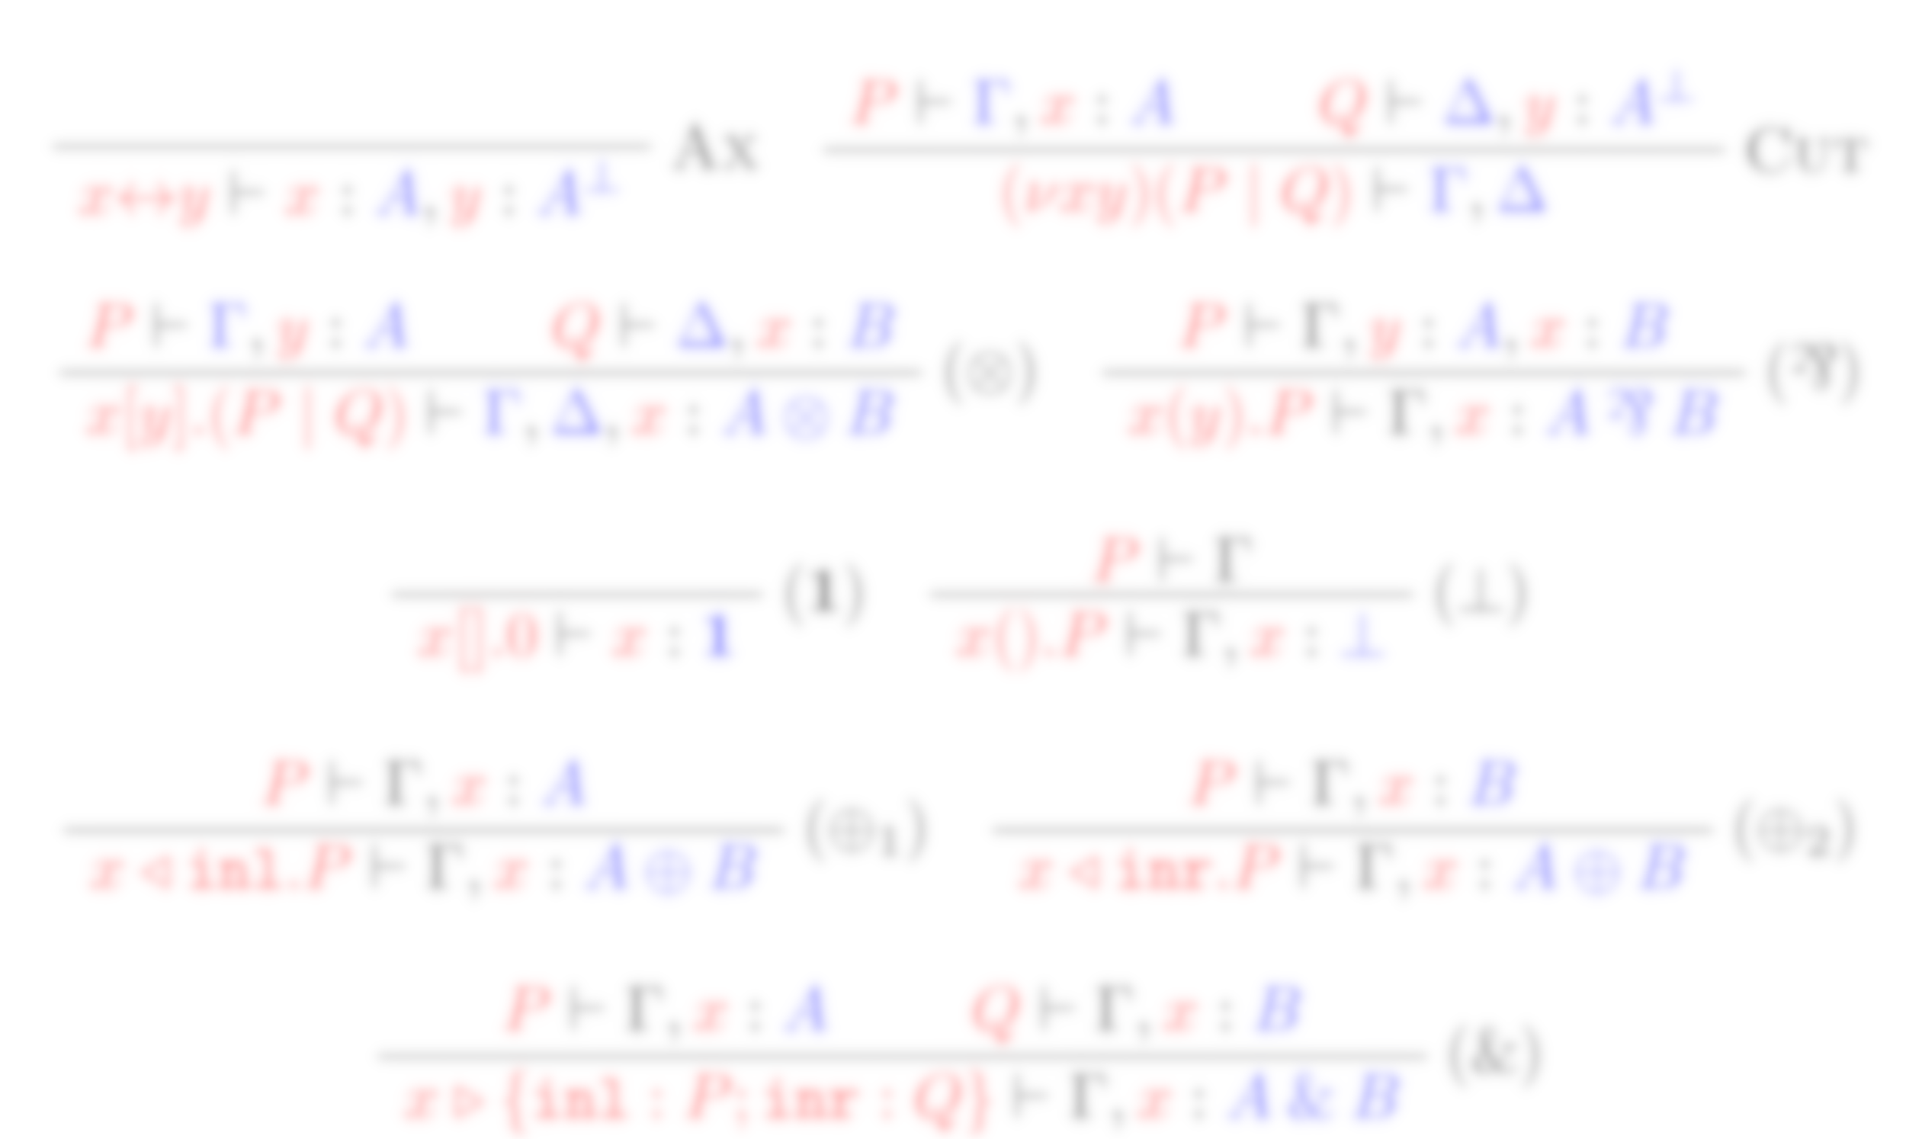
This is Classical Processes.
It’s basically classical linear logic,
typing a process calculus.
Notes:
It’s basically just linear logic, where we’ve invented some process terms to go with each rule…
Because of that, it has some very strong properties.
It has progress and preservation, is free from live- and deadlocks, and is terminating…
Plus, it’s been extended with various constructs, so we know it’s a versatile basis.

Slide 10
This is CP’s syntax.
We can make new channels and split.
We can send a message and split.
We can receive a message.
Notes:
But you don’t really need to know about the typing rules of CP.
All you need to know to follow this talk is this syntax.
We can create a new channel with two endpoints, x and y, which are available in P and Q, respectively.
We can send messages using square brackets, and receive them using round brackets.
In both cases, the name in brackets is fresh.
Hence, we have internal sends only.
If we send a message, P takes care of the message, Q takes care of the rest of the session.
Note that, if we create a new channel, or send a message, we have to split immediately afterwards.
This is going to be a problem.

Slide 11
Oh no! Something’s wrong.
Notes:
However, this has a syntax has a few problems.
See what we’d really like to write is something like this.
Two clients, Ami and Boé, communicating over a shared channel with a server.
But somewhere in that term there’s a pool of clients, composed in parallel.
And if you recall from our syntax, we don’t have parallel composition.
It’s only allowed (and forced) directly after channel creation or sending.

Slide 12
Oh no! Something’s wrong.
pool of clients
Notes:
However, this has a syntax has a few problems.
See what we’d really like to write is something like this.
Two clients, Ami and Boé, communicating over a shared channel with a server.
But somewhere in that term there’s a pool of clients, composed in parallel.
And if you recall from our syntax, we don’t have parallel composition.
It’s only allowed (and forced) directly after channel creation or sending.

Slide 13
No parallel composition?!
Notes:
These are the rules for channel creation and sending in CP.
They’re both binary rules, and both embed a parallel composition.
What we’d like to do is to extract this parallel composition.

Slide 14
Just doing it is dangerous!
Notes:
However, doing this decomposition naively is dangerous.
There’s a reason these rules are stuck together in CP.
If you unstuck them, bad things happen.
You’ll get multicut – i.e. any number of processes can communicate on a channel – which isn’t generally what you want in session-typed systems.
And you’ll get deadlocks.

Slide 15
Remember what’s in parallel!
Notes:
Instead, there’s a small trick.
You have to remember which channels are in parallel to which other channels.
So we’re gonna use hyperenvironments, which remember which channels are in parallel to which other channels by putting them in different environments, separated by a vertical bar.
Obvious conflict with BCNF syntax is obvious.
So when you compose, you remember that the channels from the LHS aren’t connected to the channels from the RHS.
And then when you cut – since you’re connecting the sets of channels – you merge these environments.

Slide 16
This is Hypersequent CP.
Notes:
Okay.
So I talked about modeling that example as a program.
The language I like to use to model concurrent interactions is called “Classical Processes” by Wadler
You can see it here, but…

Slide 17
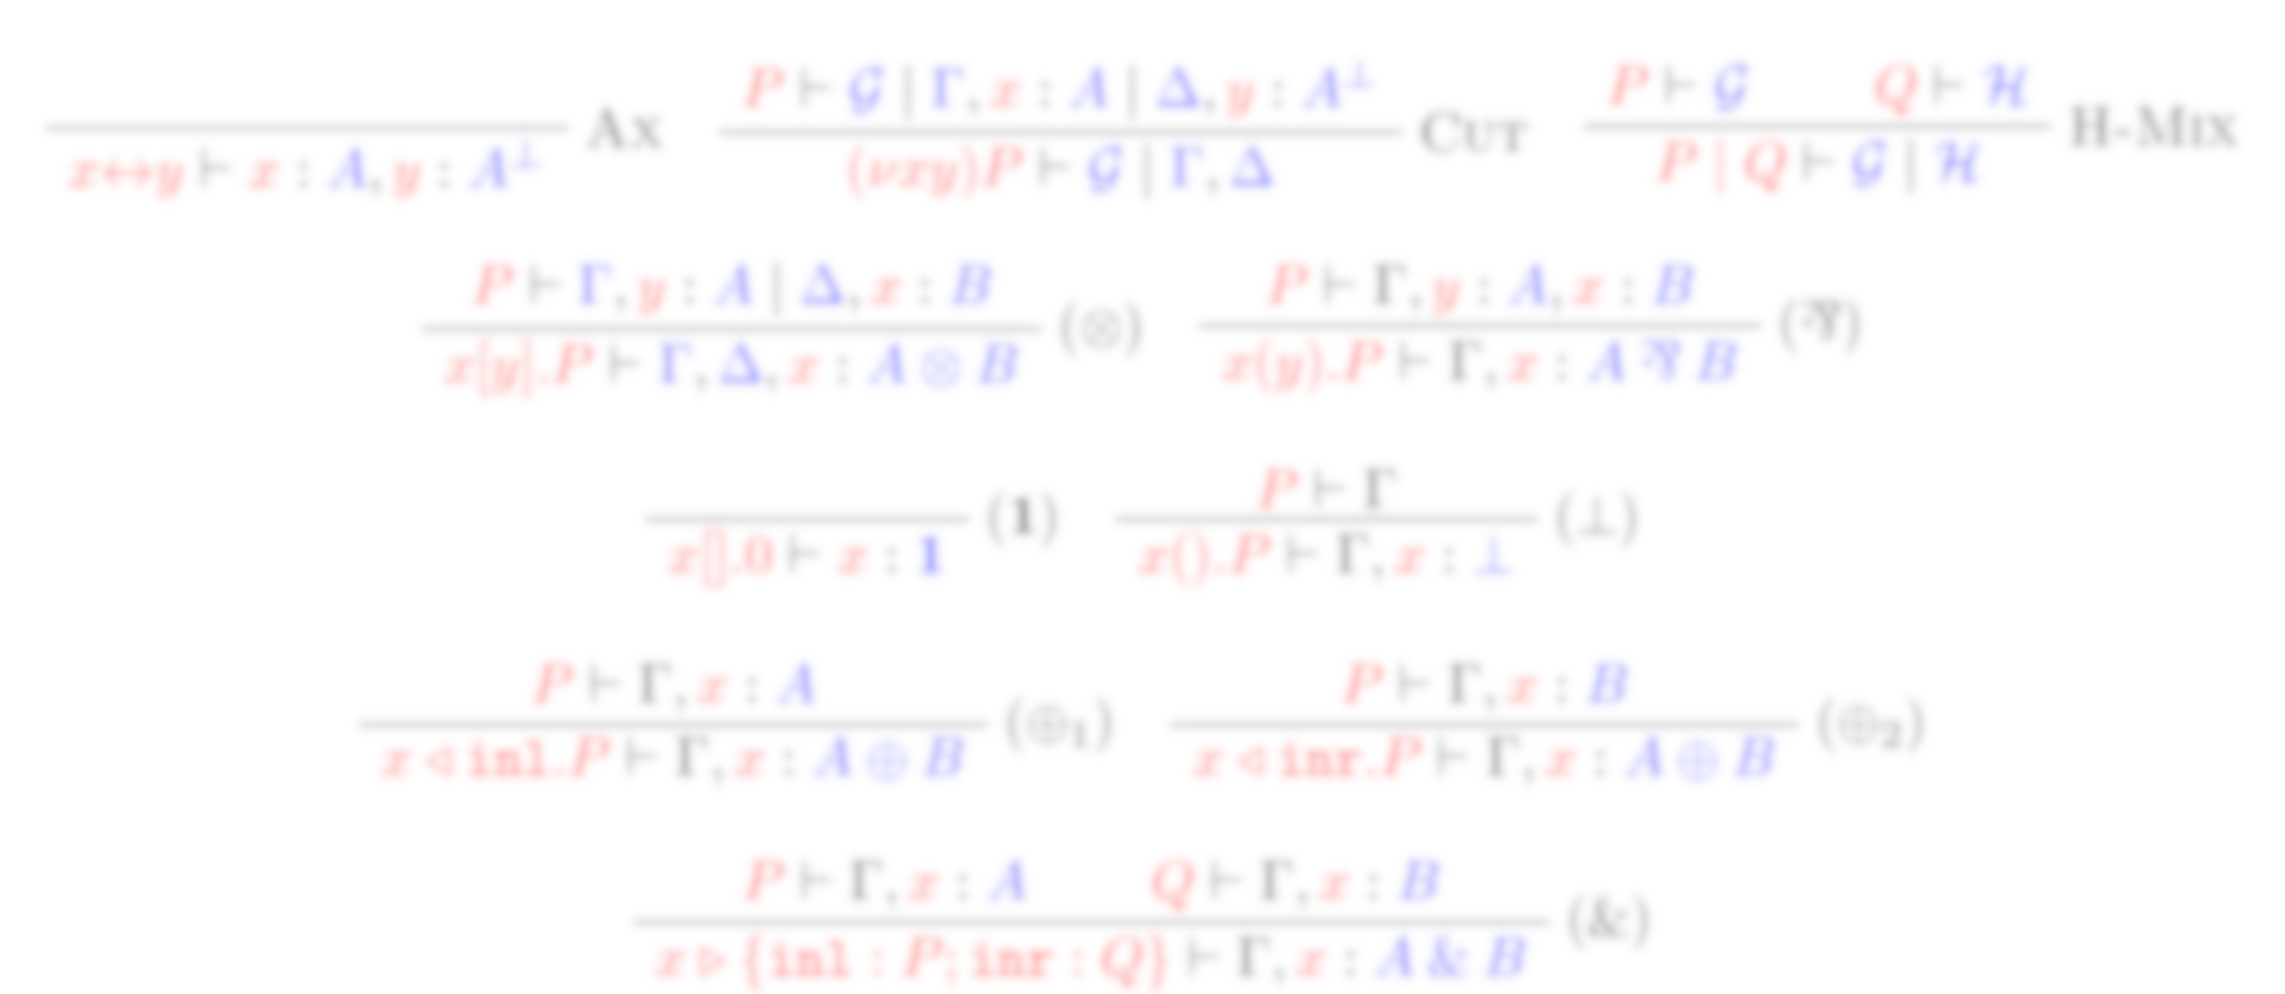
This is Hypersequent CP.
It’s still basically classical linear logic,
typing a process calculus.
Except now it has parallel composition.
Notes:
Okay.
So I talked about modeling that example as a program.
The language I like to use to model concurrent interactions is called “Classical Processes” by Wadler
You can see it here, but…

Slide 18
This is HCP’s syntax.
We can make new channels.
We can split.
We can send message y over channel x.
We can receive message y over channel x.
Notes:
So this is the final syntax we’ll end up with.
This is the context in which we make our contribution.

Slide 19
Ami and Boé have to race.
That’s ok. The store doesn’t mind.
Notes:
That’s means Ami and Boé have to race.
For the store, that’s ok.
It doesn’t mind.
It just wants to sell its one cake.
It doesn’t mind dishing out an extra serving of disappointment.

Slide 20
This is what we’ve added.
Notes:
We’ve got a construct for saying “this interaction is a client interaction of type A” and a constructor for saying “this interaction is a server interaction of type A”
Both constructs will create a channel of type !/? A with a ONE.
Note that we’re marking sending/receiving on shared channels with a star, to set them apart from normal send/receive.
We can group together a bunch of interactions, either client or server.
The crucial difference is in HOW.
The server contraction on the right is normal contraction.
Both interactions live in the same environment, so they can depend on one another, be interleaved, etc.
This is contraction the way you’d have it for the standard ? exponential.
The client contraction on the left is different.
It demands that the two (bunches of) client interactions live in different environments!
Hence, they must be in parallel.
This rule forces a parallel composition.
Using these rules, we can type our example.

Slide 21
This is our example race.
( : Could be cake, could be disappointing.)
Notes:
This is a typing derivation for our example.
We’re using the little gift box to mean “this could either be a cake, or it could be empty”
We could use a sum type here, but then the whole derivation would be much bigger, and we’d have to talk about those…
So just pretend “cake” and “no cake” are of the same type.
Note that we have two separate client processes on the left, which are mixed together and then contracted.
On the right we have a single server, taking care of both interactions.
If we run this process, there is a natural non-deterministic choice.

Slide 22
This is our example race.
( : Could be cake, could be disappointing.)

Slide 23
Ami gets the cake.
( : Could be cake, could be disappointing.)

Slide 24
Ami gets the cake.
( : Could be cake, could be disappointing.)

Slide 25
Boé gets the cake.
( : Could be cake, could be disappointing.)

Slide 26
And so we had races, but no deadlocks.

Slide 27
What’s not yet right?
No recursion 😔
No infinite interactions 😩
But:
Conflation confers concurrency.
Notes:
Okay, so what’s missing?
Recursion.
That’s a big one.
At the moment our system does not support recursion.
Now, we can probably add some primitives for recursion, but we know, for a fact, that the recursion based on the work by Lindley and Morris doesn’t work out of the box, which is rather unsatisfactory.
However, from the work by Atkey, Lindley, and Morris, we know that conflating two duals generally gives you more expressivity.
And conflating these duals gives you a construct known as “access points”.
Which is expressive enough to give you non-determinism (obviously) and recursion (woo!) and deadlocks.
We’re not talking about that construct here, because we’re not interested in deadlocking calculi.
So our hope is that we can use some other mechanism in the future to constrain this calculus, and give you a nice, well-behaved version of this calculus which supports recursion.

Slide 28
What is ‘conflation’?
Makes two duals isomorphic
Conflation of !/? confers:
No lock freedom 😩
No termination 😔
Concurrent shared state 🙂
Recursion 😄

Slide 29
Other mechanisms?
Non-deterministic local choice
Equally expressive, not equal
Translate from O(1), to O(n!)

Slide 30
Other mechanisms?
Manifest Sharing:
Recursion 🙂
No deadlock freedom 😔
Cannot interleave requests 😩

Slide 31
Non-deterministic HCP:
Simple extension of HCP
Finite non-determinism
Deadlock free
Thanks!

