Slide 1
Software architectures and development
Course: 2371137+E371137 (PIS, DIS)
CTU, FS, U12110
Martin Vitoušek

Slide 2
Architectures
Monolithic architecture
Service-Oriented Architecture
Microservices architecture
Serverless architecture
Event-Driven Architecture
and many more

Slide 3
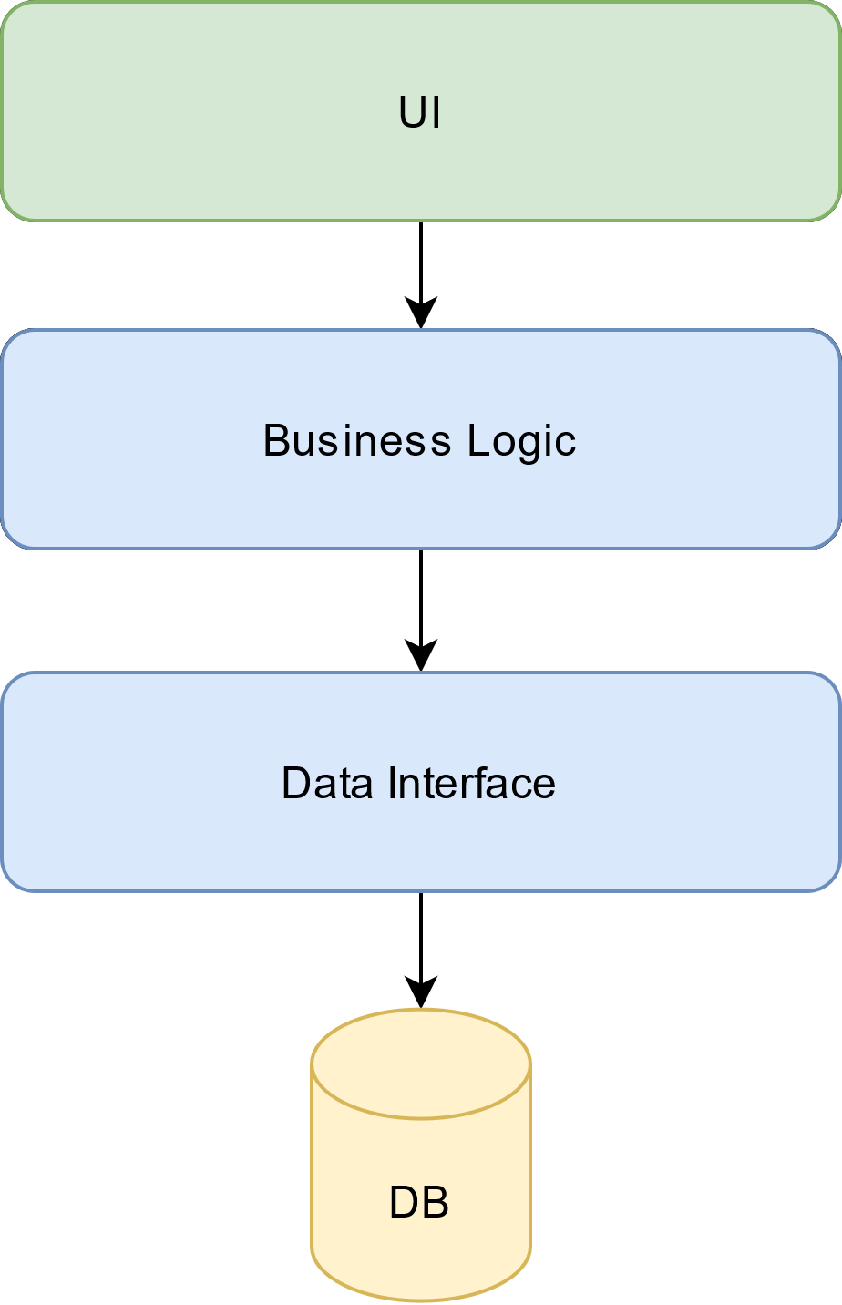
Monolithic architecture
Pros:
Easier to develop initially
Suitable for small projects
Cons:
Scaling challenges
Complex maintenance and updates
Limited flexibility
Early stages of:
Facebook, Netflix
Amazon, Twitter …

Slide 4
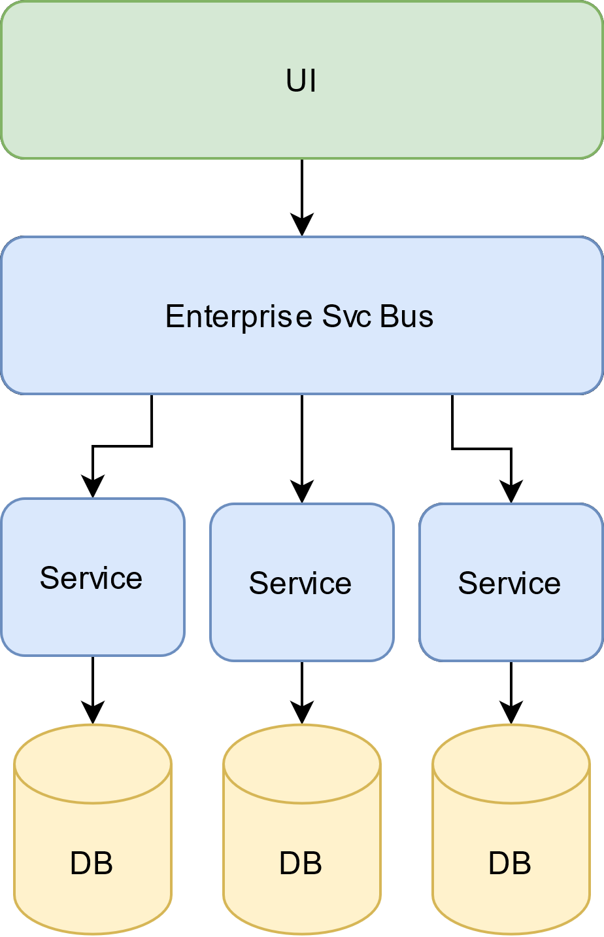
Service-Oriented Architecture
Pros:
Better scalability
Reusable services
Easier maintenance and updates
Cons:
Complexity in managing services
Potential communication overhead
IBM, Walmart, Bank of America

Slide 5
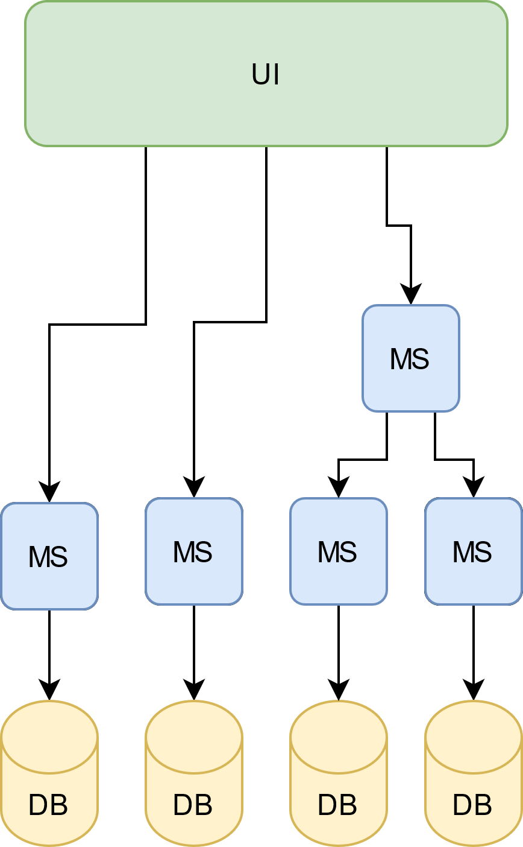
Microservices architecture
Pros:
Exceptional scalability and flexibility
Independent development and deployment
Adaptable to changing requirements
Cons:
Complexity in managing a large number of services
Potential overhead in inter-service communication
Uber, Spotify, Airbnb, Nike

Slide 6
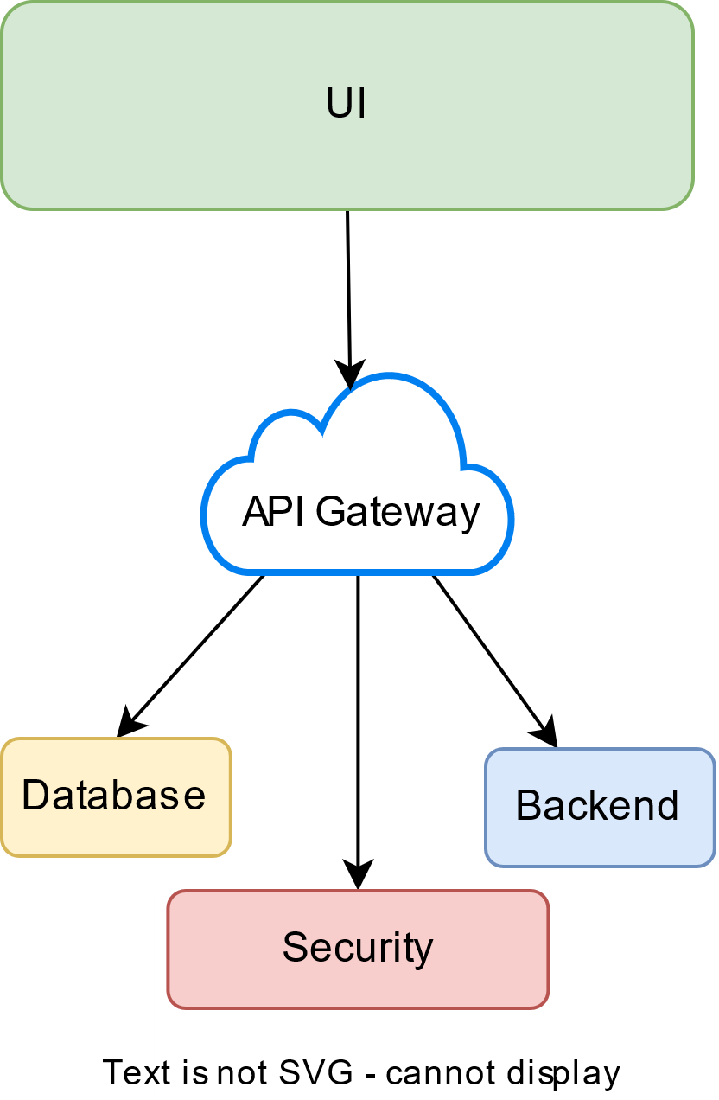
Serverless architecture
Pros
Scalability with Automatic Scaling
Cost Savings and Faster Time to Market
Cons
Vendor Lock-in
Cold Start Latency
Monitoring and Debugging Complexity
Netflix, CocaCola, Nordstorm

Slide 7
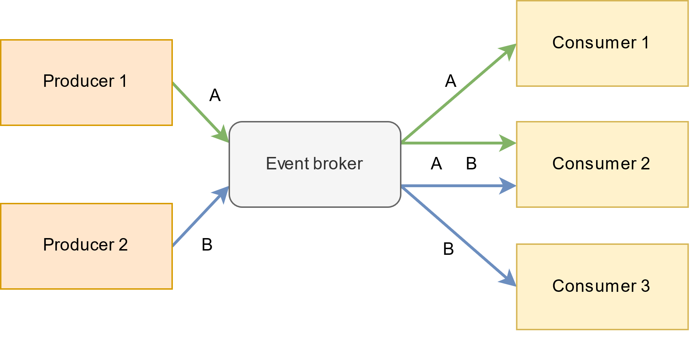
Event-Driven Architecture
Pros
Flexibility, Agility, Scalability
Fault Tolerance
Real-time Processing
Cons
Complexity, Debugging and Monitoring
Event Ordering and Consistency
LinkedIn, Netflix, Uber, Twitter

Slide 8
Criteria
Scalability: Horizontal vs. Vertical scaling.
Availability: Redundancy, fault tolerance, and high availability.
Performance: Load balancing, caching, and optimization techniques.
Security: Authentication, authorization, encryption, and compliance.
Cost effectivness: …

Slide 9
Virtualization and containerization
Virtualization
… creates virtual machines, each with complete OS and a set of virtualized HW, such as CPU, memory, storage, and network interfaces
Conteinerization
… encapsulates apps with dependencies into lightweight, portable containers that share the host OS kernel

Slide 10
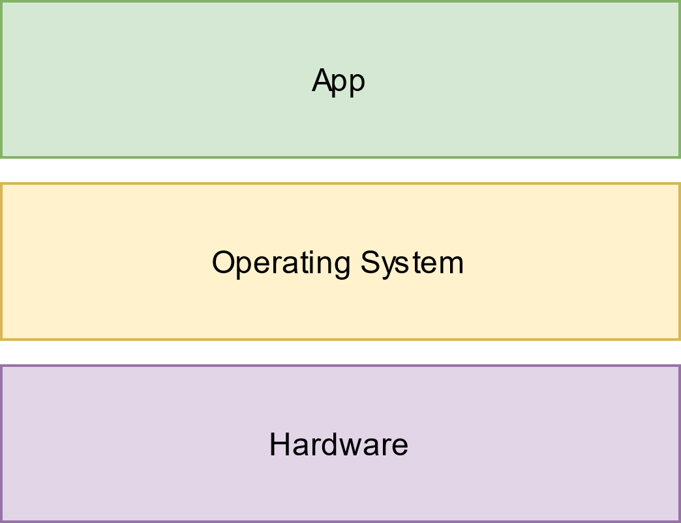
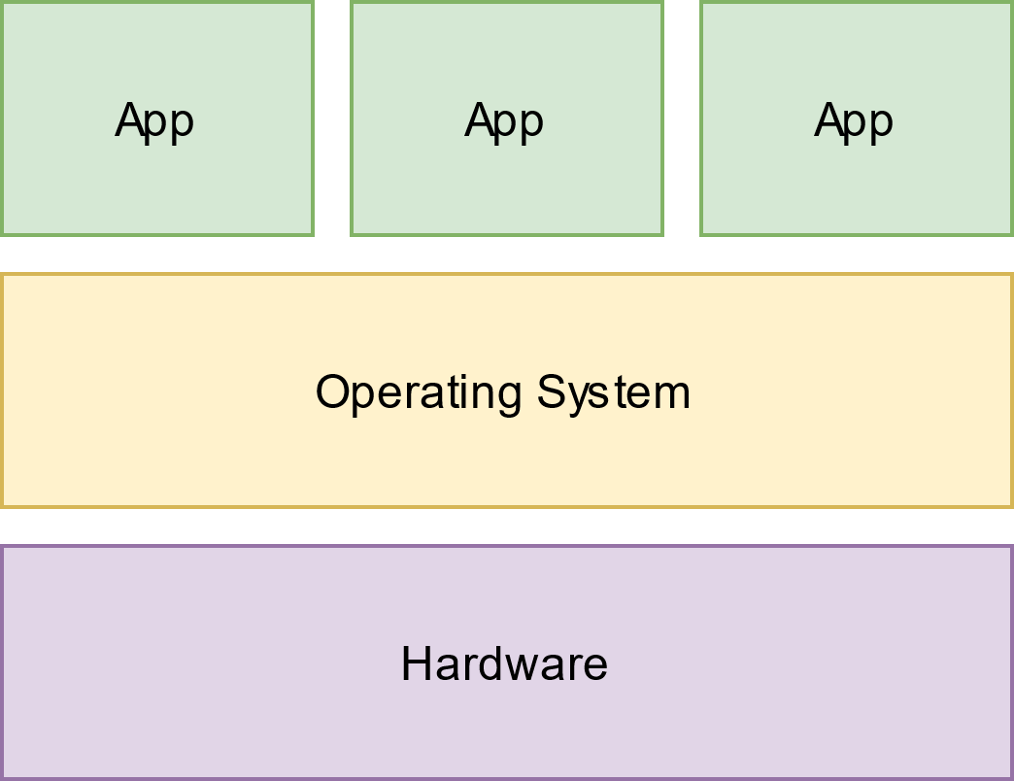
From one app to more apps

Slide 11
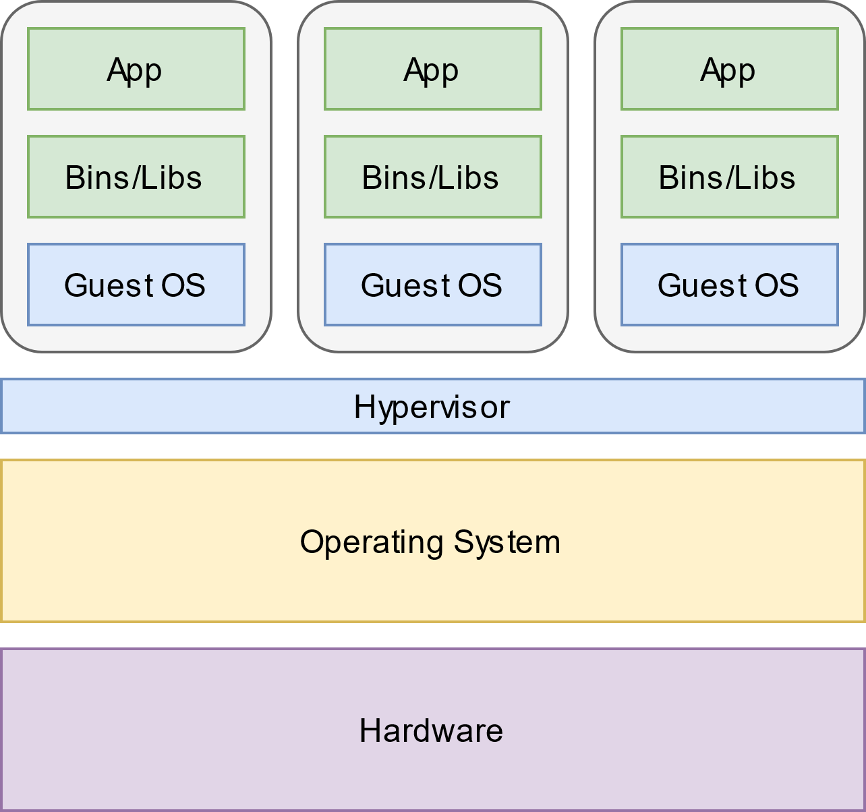
Virtualization

Slide 12
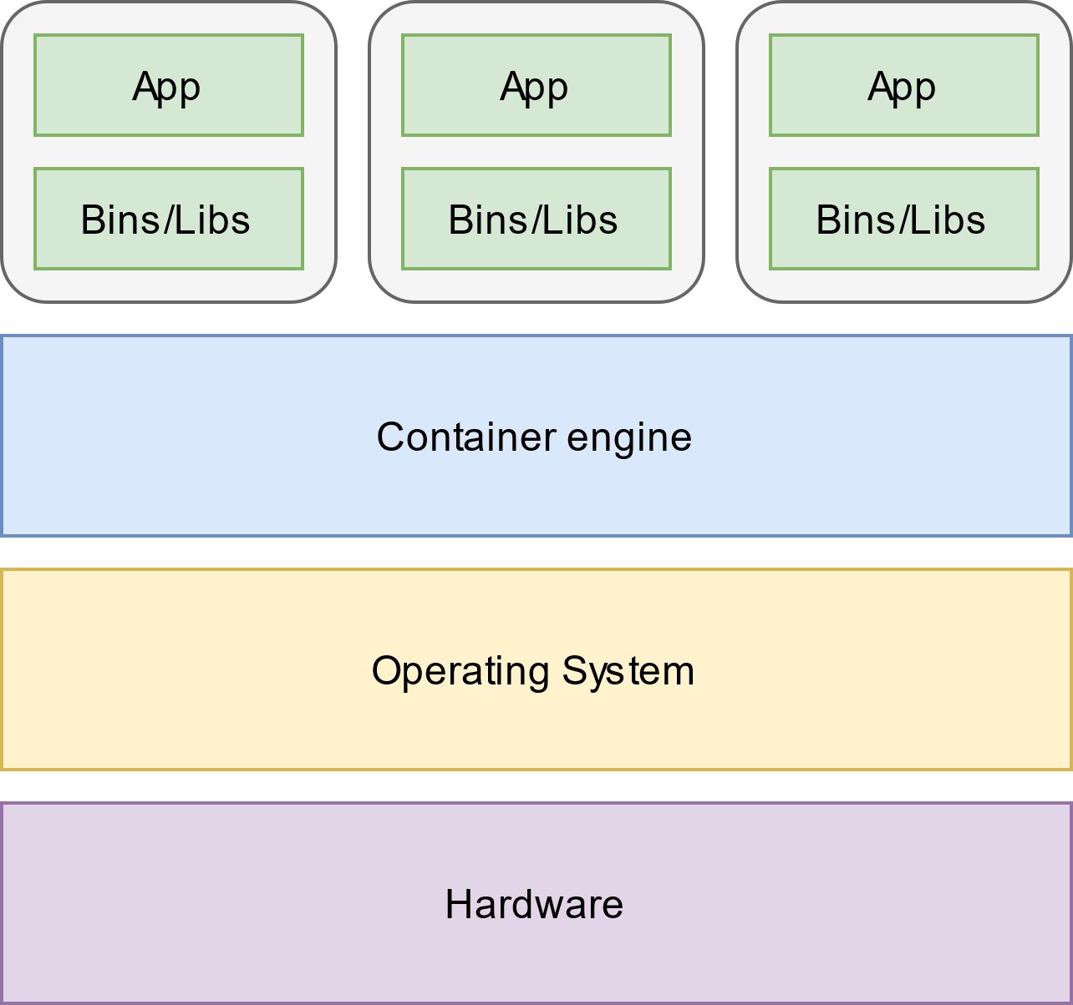
Containerization

Slide 13
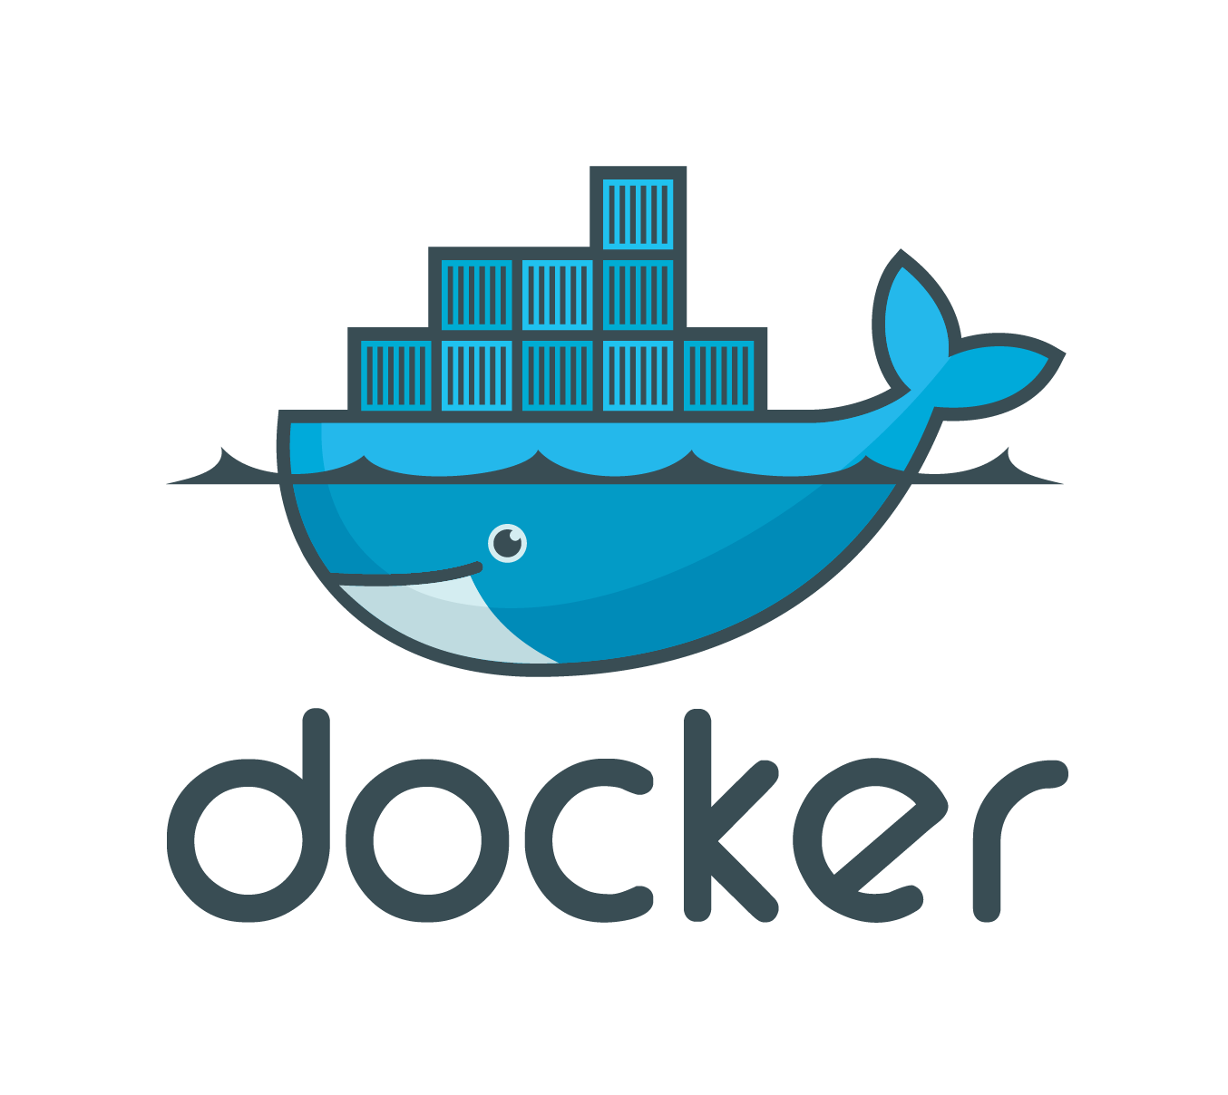
Docker
… a platform designed to help developers build, share, and run container applications
Containerization
Isolation
Efficiency
Portability

Slide 14
Integration and Delivery
Deployment
DevOps
Continuous Integration and Continuous Delivery
Infrastructure as a Code
GitOps
Kubernetes

Slide 15
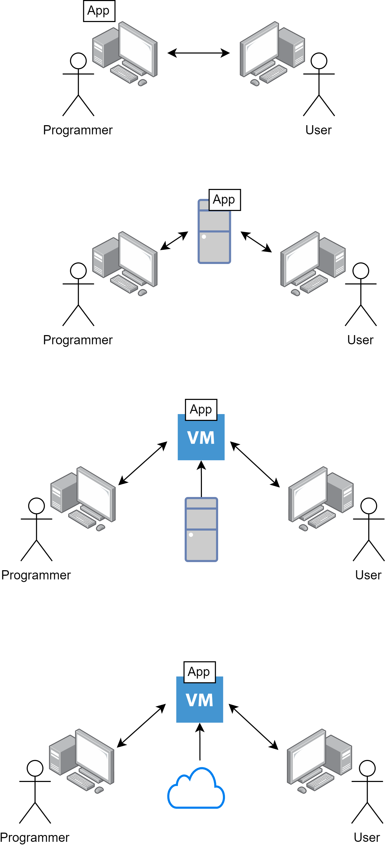
Deployment
Local
Remote
Virtual (local or remote)
Cloud

Slide 16
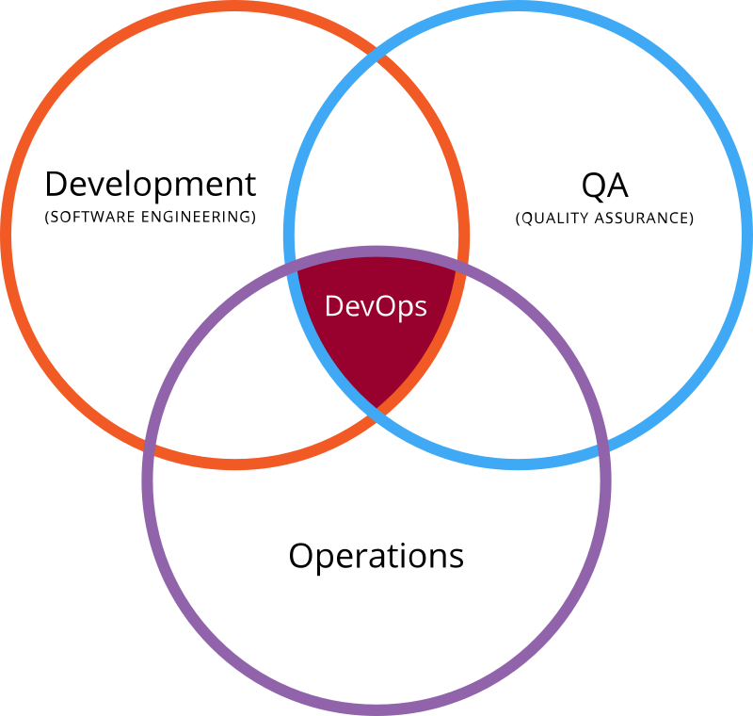
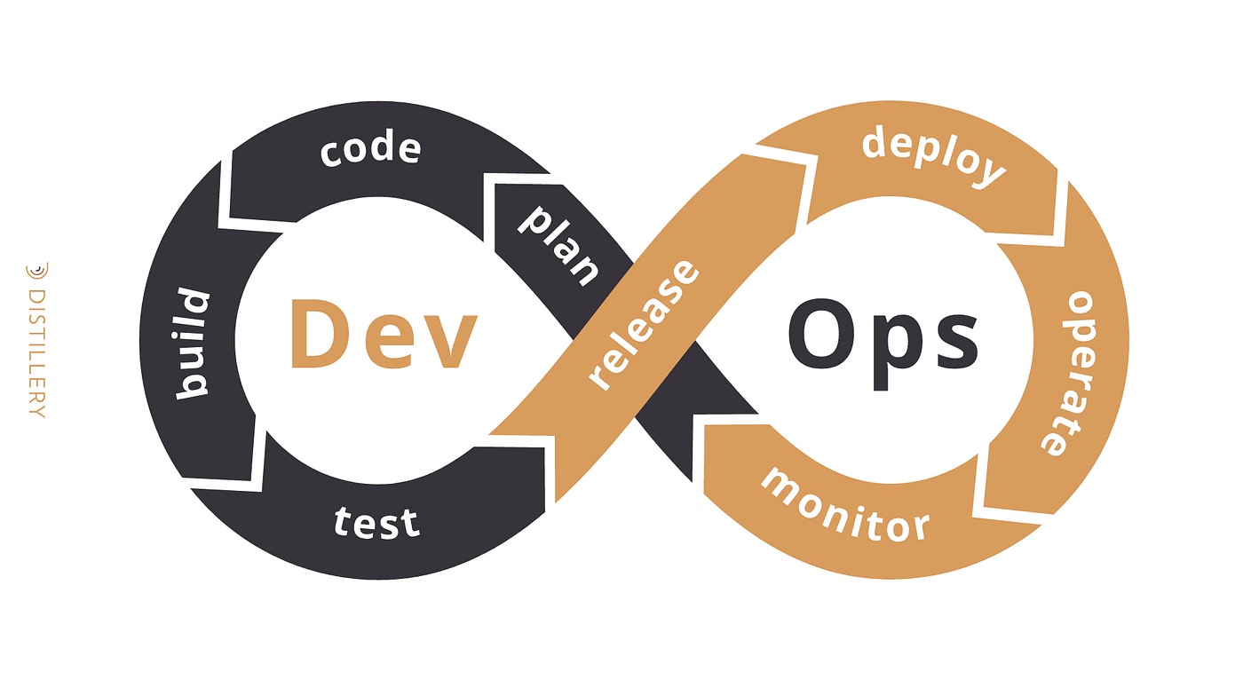
DevOps
Culture
Automation
Feedback Loop
Infrastructure as Code (IaC)
Continuous Integration and Continuous Deployment (CI/CD)

Slide 17
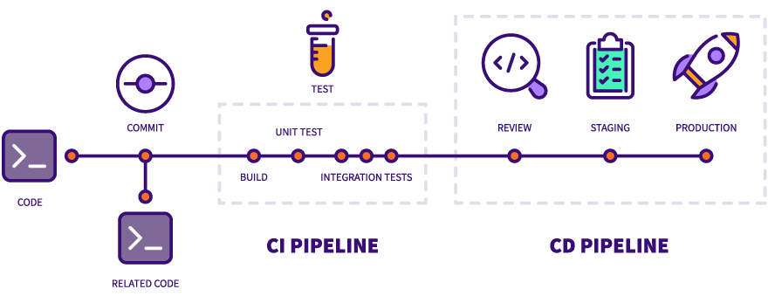
Continuous Integration and Continuous Delivery (CI/CD)

Slide 18
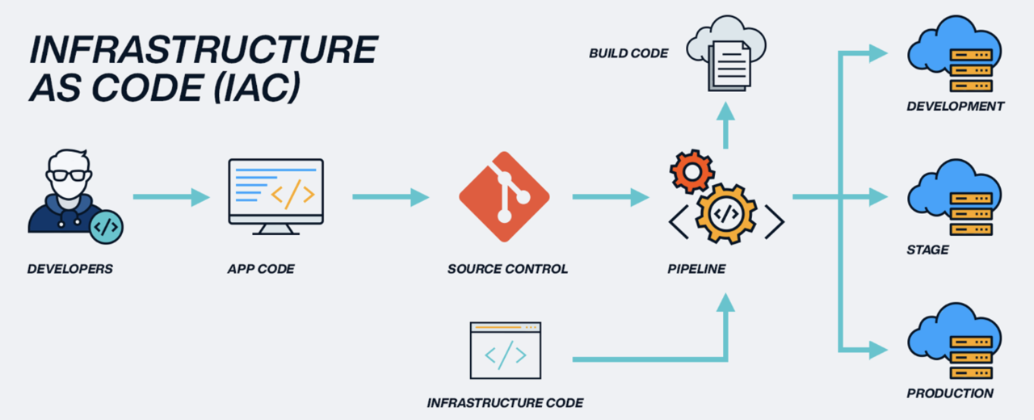
Infrastructure as a code

Slide 19
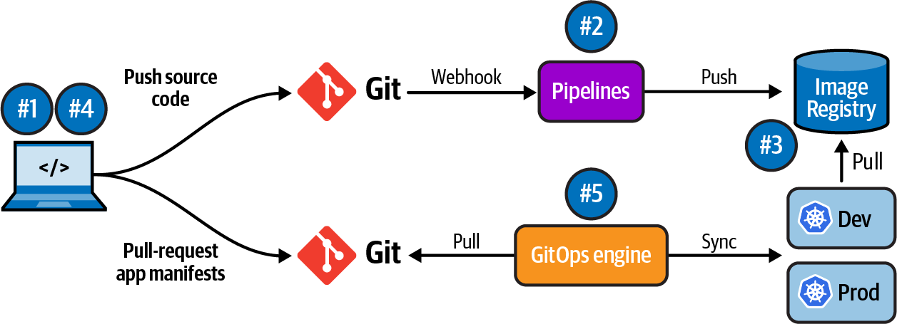
GitOps

Slide 20
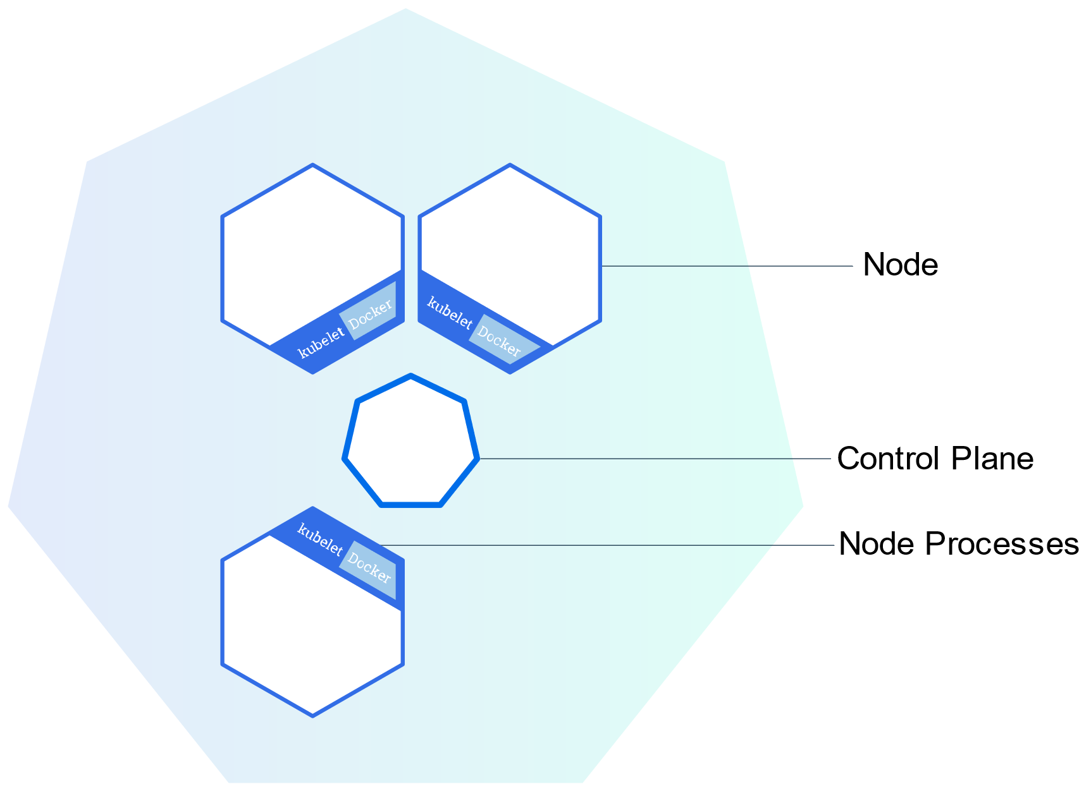
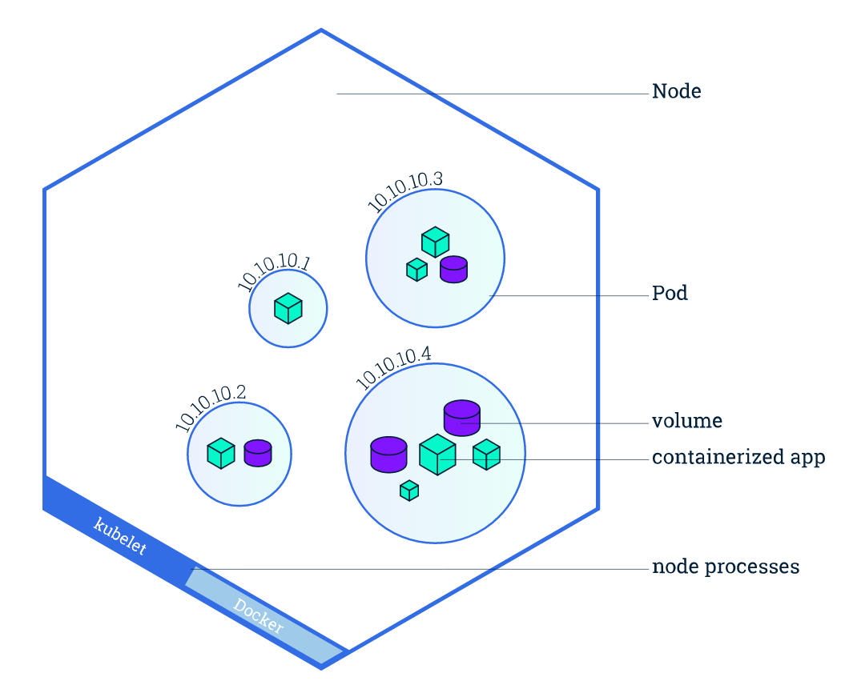
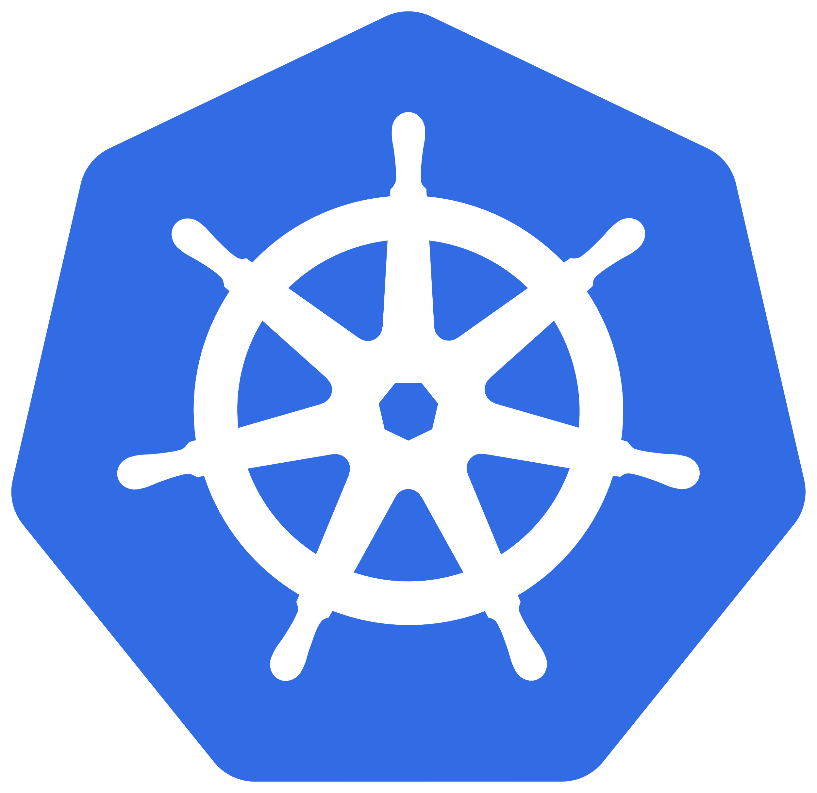
Kubernetes
… a system for automating deployment, scaling, and management of containerized applications
Container Orchestration
Scaling and Load Balancing
Self-Healing
Declarative Configuration

