Slide 1


Lottery Scheduling Implementation for FreeRTOS
Armenante Pietro - 329425
Coduri Christian - 333235
Lombardi Giovanni - 329015
Serafini Luca - 329442
Academic Year 2023/24

Slide 2






Configuration and Installation
Chocolatey
Eclipse
MinGW
FreeRTOS
QEMU
GCC Toolchain

Slide 3
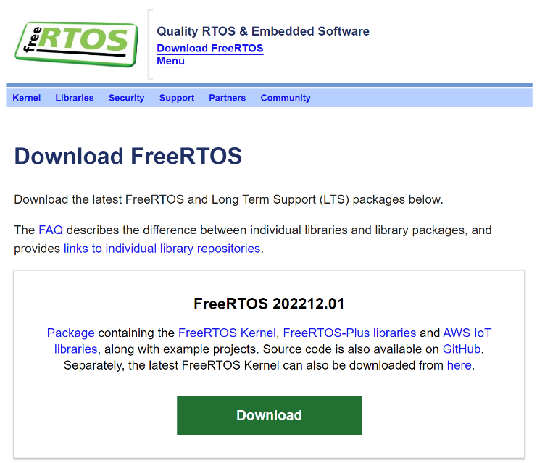
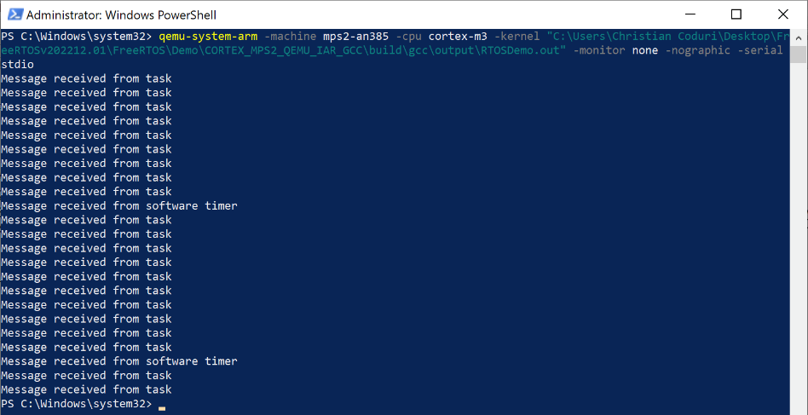
How to build a Demo
The essential steps
Install an Eclipse distribution
Install the GCC Toolchain
QEMU download
Install FreeRTOS
Install Chocolatey
Download and install Make
Eclipse – Import the Demo
Eclipse – PATH Update
Install MinGW
Project > Build All
Run QEMU using the command:
qemu-system-arm -machine mps2-an385 -cpu cortex-m3 -kernel "C:\Users\Christian Coduri\Desktop\FreeRTOSv202212.01\FreeRTOS\Demo\CORTEX_MPS2_QEMU_IAR_GCC\build\gcc\output\RTOSDemo.out" -monitor none -nographic -serial stdio

Slide 4
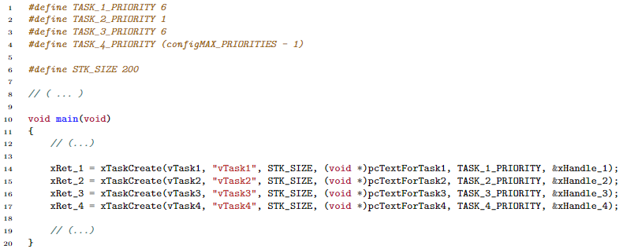
A practical example
Four task functions are defined in the code: vTask1, vTask2, vTask3, and vTask4. Each task function is responsible for printing a specific message to the console.
Then, the tasks are created in the main function using xTaskCreate. Each task is assigned a priority level and a stack size to manage resources efficiently.

Slide 5
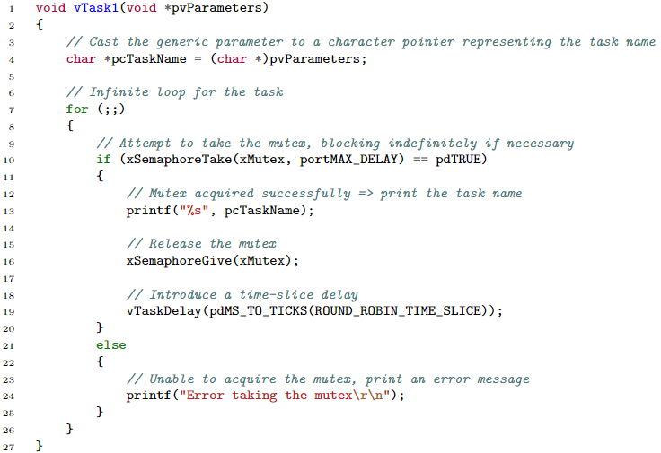
A practical example
A mutex is created using FreeRTOS Semaphore API …
… ensuring mutual exclusion while accessing the UART peripheral from multiple tasks.

Slide 6
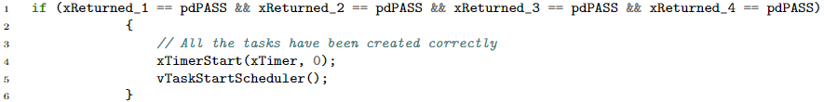
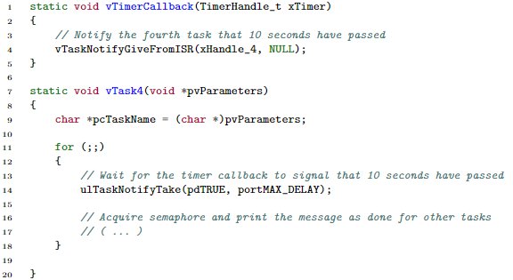

A practical example
Then, a Timer has been created:
As the tasks have been created, the timer starts counting and the scheduler starts working.
A timer callback function, vTimerCallback, is defined to notify Task 4 when a certain time interval elapses and it can proceed executing its code.

Slide 7
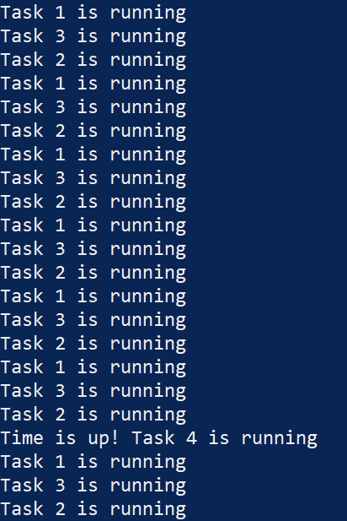
A practical example
The main function initializes the UART peripheral, creates tasks, and starts the FreeRTOS scheduler. Once the scheduler starts, tasks execute concurrently, printing their respective messages to the console. Task 4 waits for the timer callback to occur before executing.

Slide 8
Lottery Scheduling Algorithm
A lottery scheduler is a probabilistic scheduling algorithm structured around the following principles:
Ticket Allocation
Random Ticket Selection
Winner Determination
Execution
Repeat
CPU time is proportional to the number of tickets given to each tasks. Giving each process at least one lottery ticket guarantees that it has a non-zero probability of being selected at each scheduling operation. For this reason, the lottery ticket scheduler provides a fair method for allocating CPU time among processes, mitigating the risk of starvation.

Slide 9
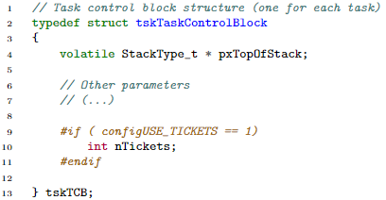
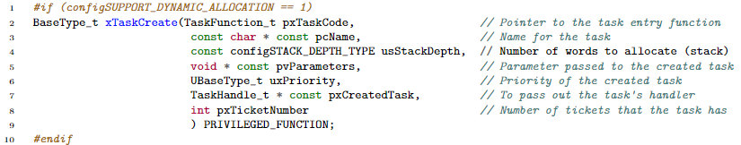
1. Ticket Allocation
In the file FreeRTOSConfig.h a constant named configUSE_TICKETS has been defined.
The Task Control Block (TCB) structure has been revised to include the effective number of tickets assigned to each task.
In the task.h file, the prototype of the function xTaskCreate has been modified to allow specifying the number of tickets directly when creating a new task.

Slide 10
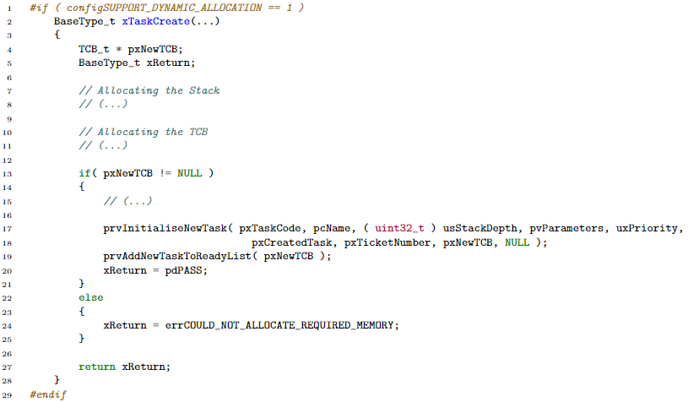
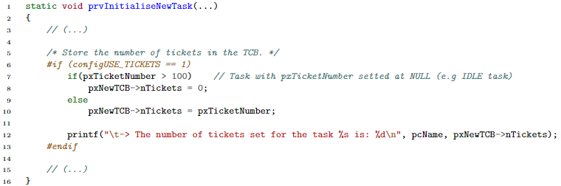
1. Ticket Allocation
The function definition is located in the file task.c and has been modified by adding a new parameter passed to the prvInitialiseNewTask function.
The prvInitialiseNewTask function has been updated to store also the number of ticket with all the necessary information into the already allocated TCB remaining unaltered its functionalities.
Thanks to this process, the function to create task dynamically can be called in the following way:

Slide 11
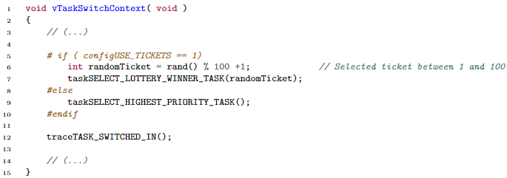
2. Random Ticket Selection
In the file task.c there is a function called vTaskSwitchContext, which is responsible for switching from one task to another when a context switch is required. This function achieves its functionalities by calling other two functions: taskSELECT_HIGHEST_PRIORITY_TASK() and traceTASK_SWITCHED_IN().
The same modification has been applied to the vTaskStartScheduler function, which is invoked by the main to start the scheduler and choose the initial task to run. The only difference between the code added in this two functions is that in the vTaskStartScheduler there is a call to srand(), which initializes the seed for all subsequent calls to rand().

Slide 12
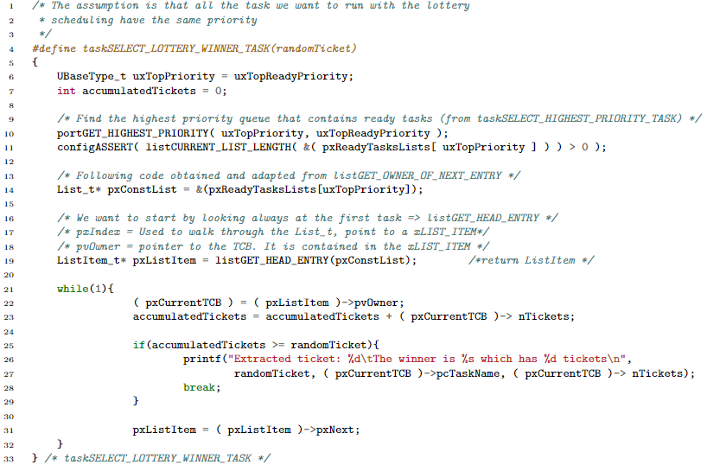
3. Winner Determination
Finally, the function responsible for determining the winner in the lottery scheduling is defined as a macro named taskSELECT_LOTTERY_WINNER_TASK. This function takes the previously extracted randomTicket as input and use it to determine the winning process.

Slide 13
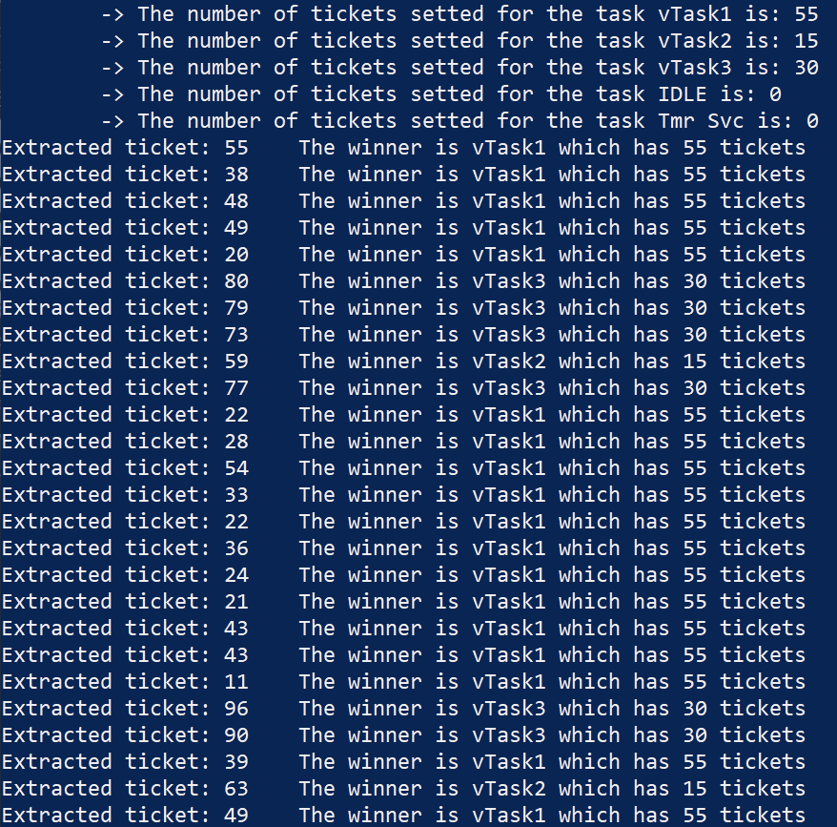
4. Execution
As a result, for each extracted ticket, it is shown how a winner task is selected.

Slide 14
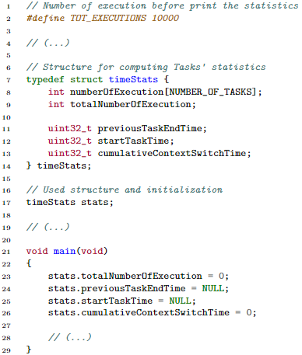
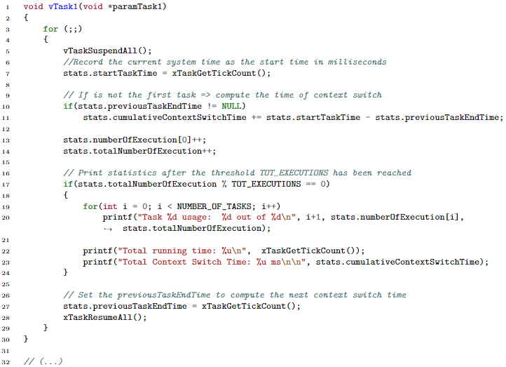
Evaluation
The evaluation has been conducted by means of tasks distribution and context switch timing spent.

Slide 15
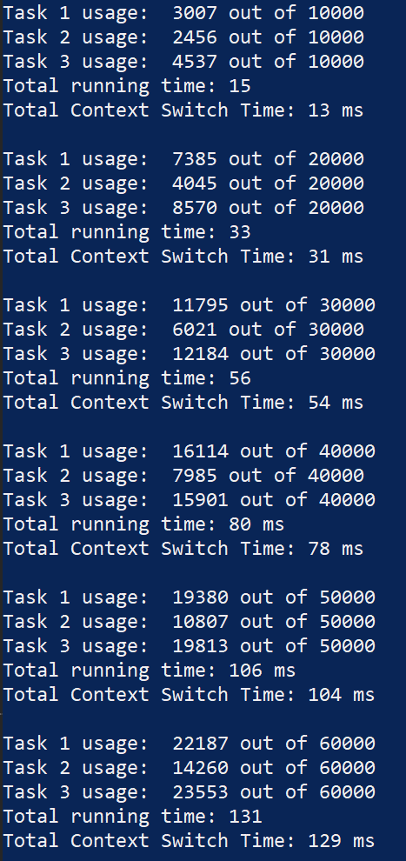
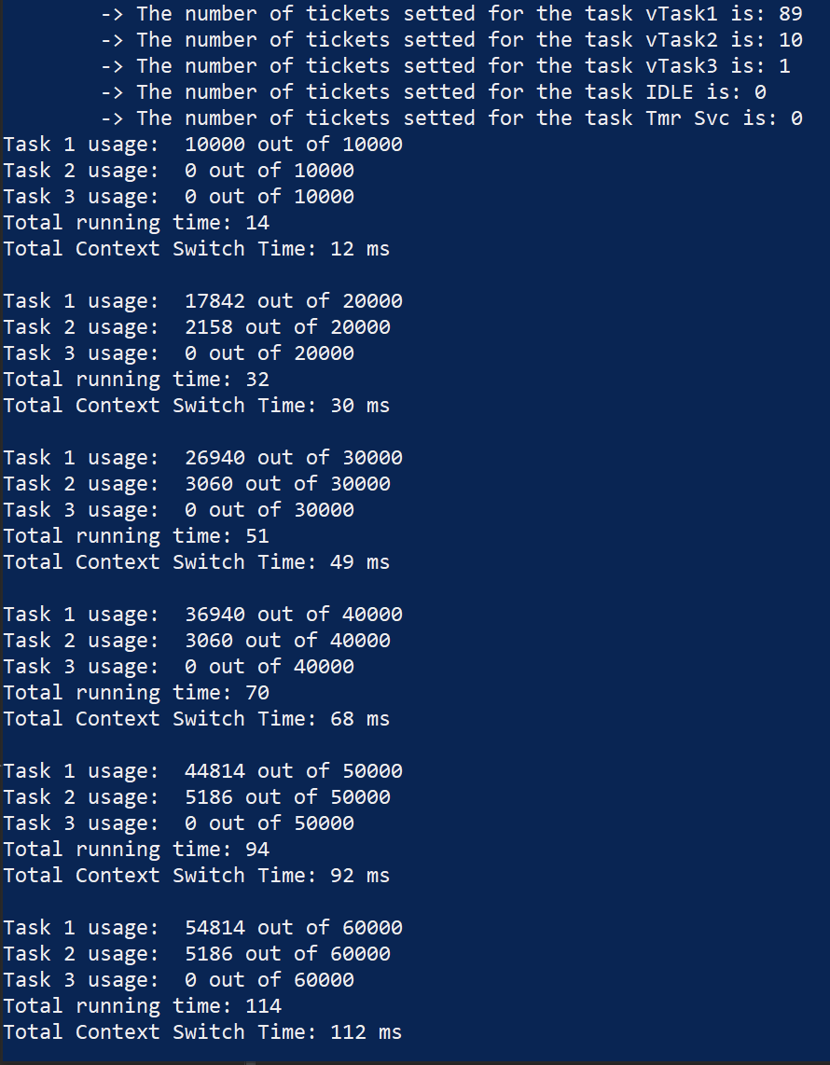
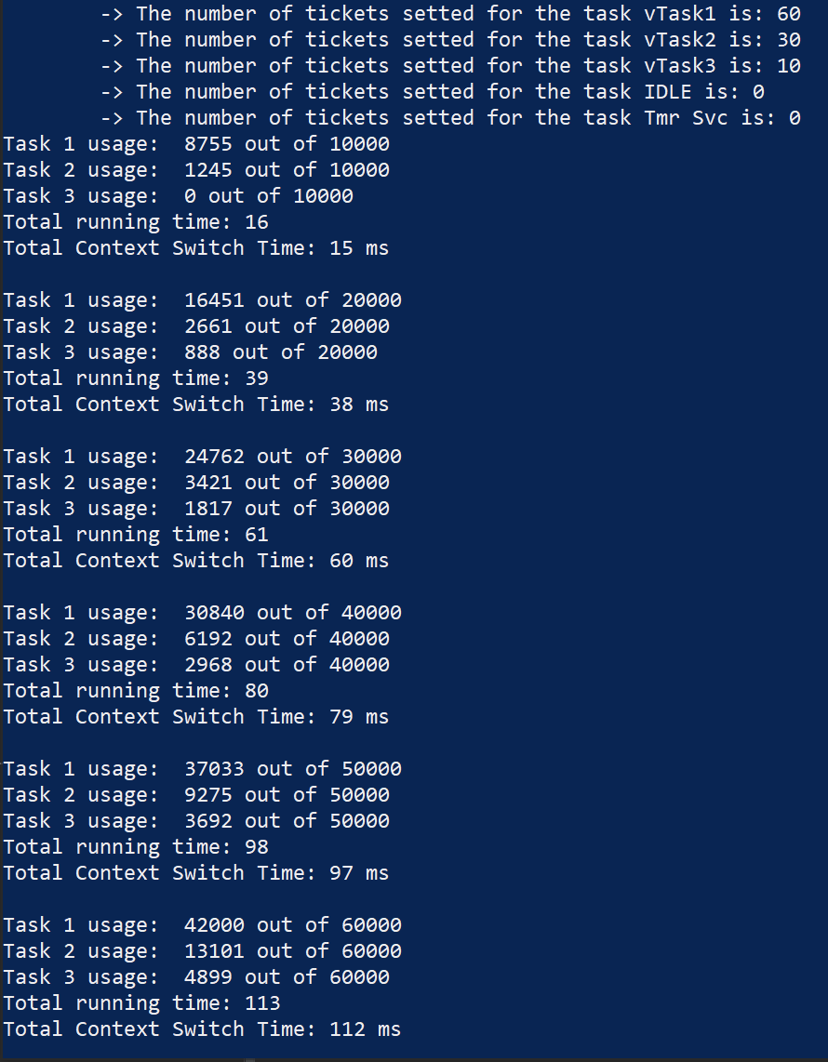
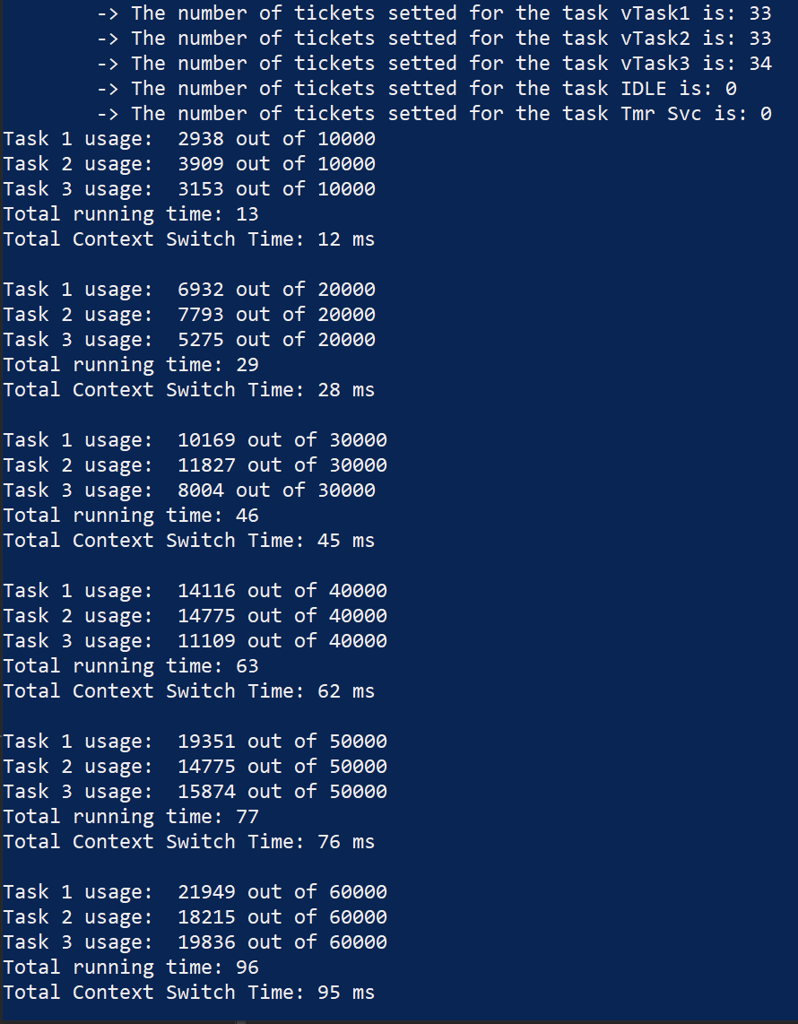
Evaluation
Round Robin aims to allocate CPU utilization equally among all involved tasks, theoretically achieving a percentage of 33 for each task.
Given that in this implementation the total number of tickets is 100, the ticket scheduler achieves a distribution that respects the number of tickets assigned to each task.

Slide 16
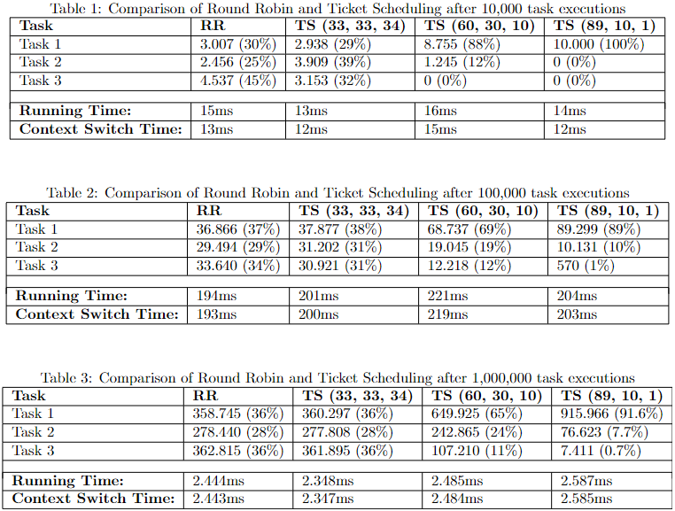
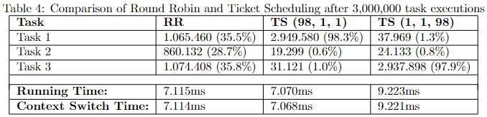
Evaluation
Task order influences Context Switch Time
Comparison between Round Robin and Ticket Scheduling

