Slide 1
USTB
Quick update

Slide 2
Unit Testing
Server
Central
Repository
and SCM
Redmine
GIT
GIT bare
dev_wiki
Developer
#1
Developer
#2
Developer
#3
GIT
GIT
GIT
User
Documentation

Slide 3
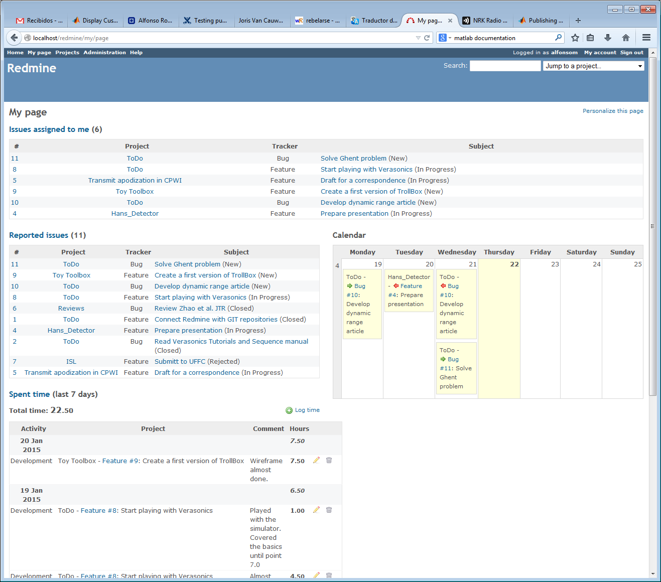
Redmine

Slide 4
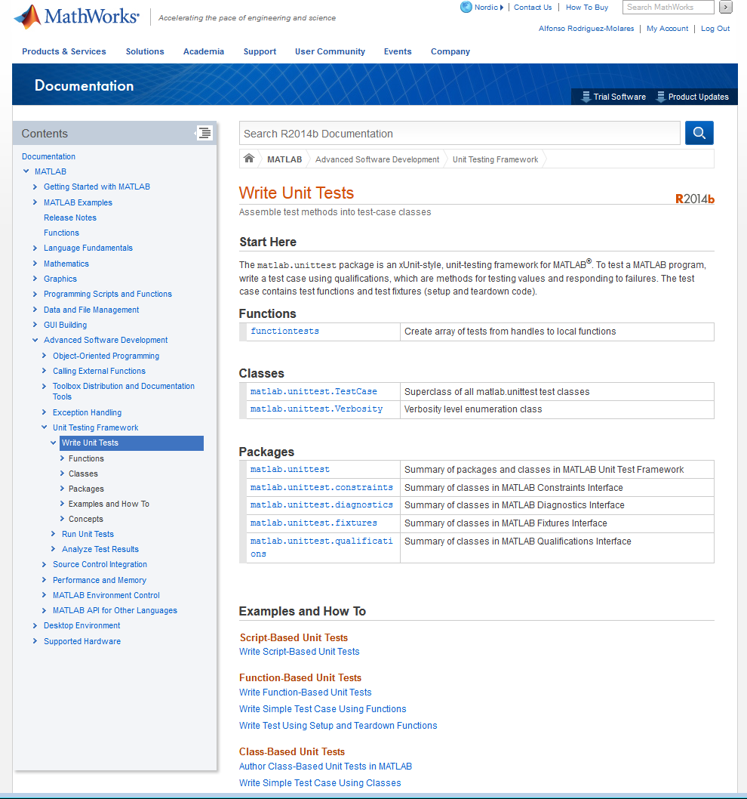
Unit testing framework
Batch
1.- git fetch
2.- open matlab
3.- run unit_tests
4.- save results in WD
5.- git commit
6.- git push
7.- if(error) alarm
8.- close matlab
Validity
Performance

Slide 5
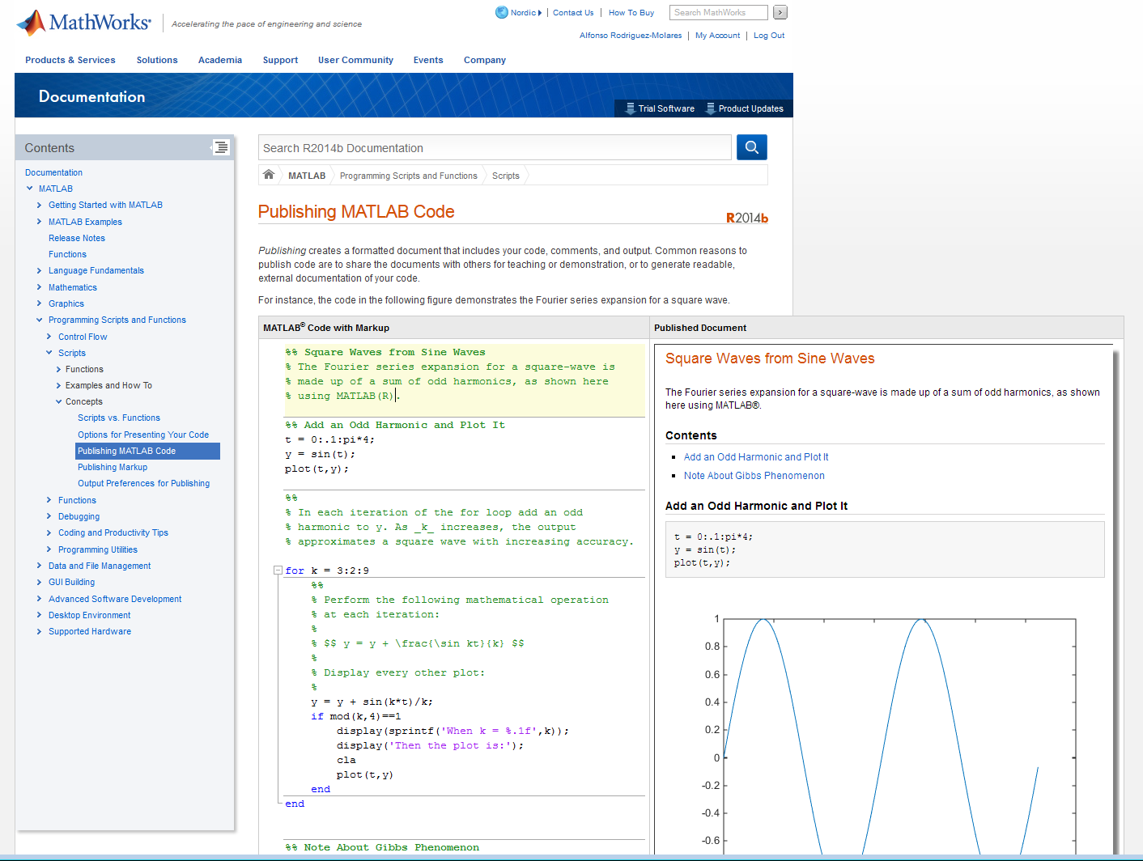
Documentation

Slide 6
Documentation
https://www.ntnu.no/wiki/pages/viewpage.action?pageId=78977565

Slide 7
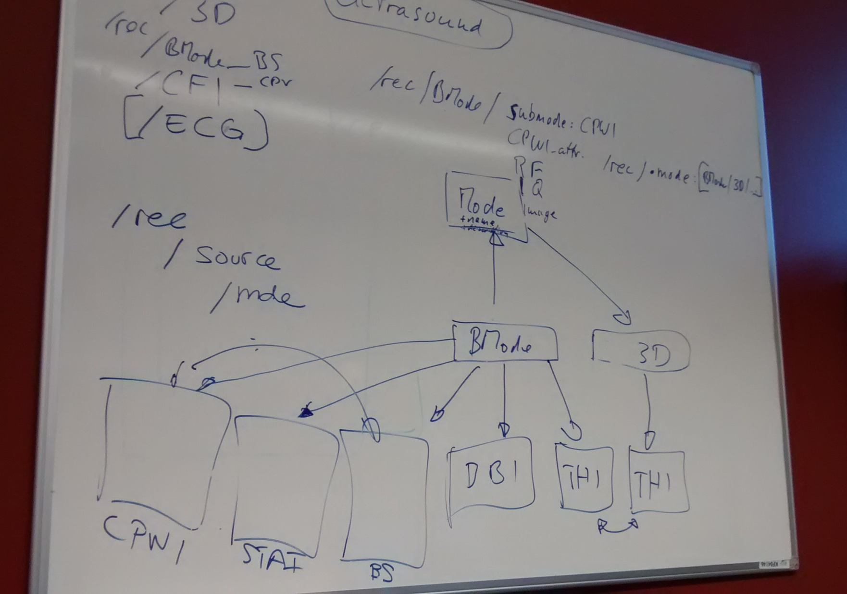
Ultrasound File Format (UFF)

Slide 8
The Big Picture
Verasonics
USTB
WRAPPER
USTB
UFF

Slide 9
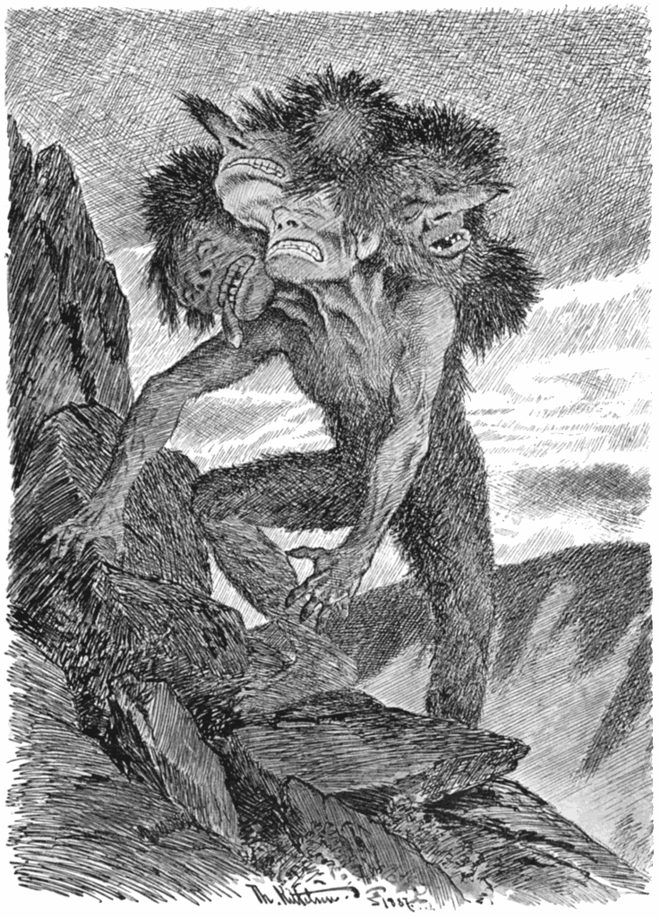
Multiheaded-Troll
Four implementations
Matlab simple
Matlab optimised
Mex
Mex GPU

