Slide 1

InsightFlow: Predictive Analytics and Modeling
A comprehensive machine learning project focused on heart disease prediction using advanced analytics and modeling techniques. This presentation walks through the complete data science workflow from data preparation to model evaluation and selection.

Slide 2

Project Overview and Setup
Core Objectives
Dataset Source
Load and prepare the heart disease dataset
The analysis uses an anonymized heart disease dataset containing patient medical data and diagnostic outcomes. The dataset is publicly available from the zero-to-mastery-ml GitHub repository and includes 303 patient records with 14 features.
Build predictive machine learning models
Train models and generate predictions
Evaluate model performance comprehensively
Technical Environment
The project utilizes Python's essential data science libraries including pandas for data manipulation, numpy for numerical operations, matplotlib and seaborn for visualization. A random seed of 1234 ensures reproducibility across all experiments.

Slide 3

Dataset Exploration and Initial Analysis
Dataset Dimensions
Target Distribution
303 rows × 14 columns
165 positive cases
Complete dataset with no missing values, ensuring data quality and reliability for modeling
138 negative cases
Relatively balanced classes with 54.5% positive and 45.5% negative cases
Data Quality
Zero missing values
All features have appropriate data types with no null values requiring imputation
Initial examination revealed a clean dataset with proper data types across all features. The age range spans from 29 to 77 years with a mean of 54.4 years. Key physiological measurements include resting blood pressure (trestbps) averaging 131.6 mm Hg and maximum heart rate (thalach) averaging 149.6 bpm.

Slide 4
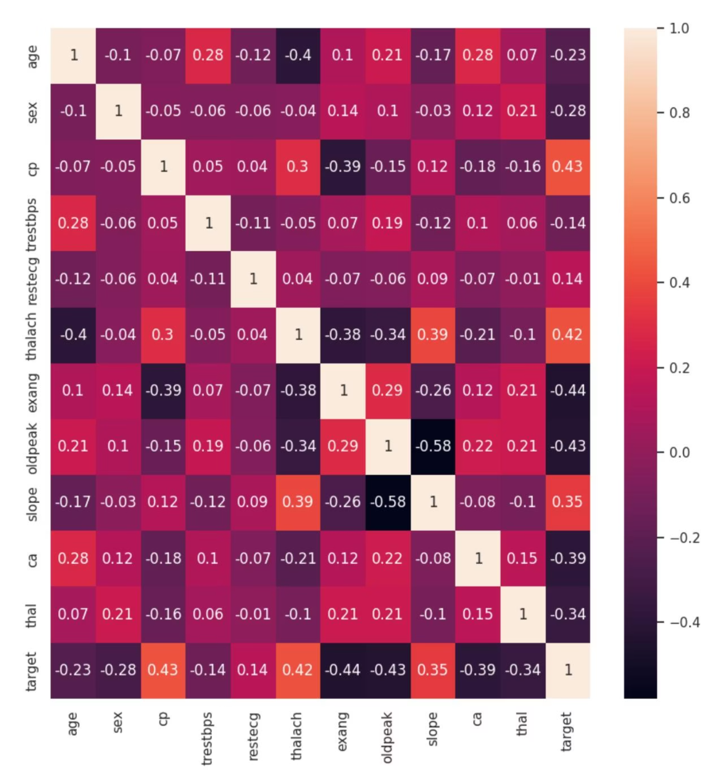
Correlation Analysis and Feature Selection
Top Correlating Features
cp (chest pain): 0.434 correlation
thalach (max heart rate): 0.422
slope: 0.346
exang (exercise angina): -0.437
oldpeak: -0.431
ca (vessels): -0.392
Features Removed
Based on correlation analysis, fbs (fasting blood sugar) and chol (cholesterol) were eliminated due to low correlation with the target variable (-0.028 and -0.085 respectively).
Correlation heatmap showing relationships between features and target variable

Slide 5
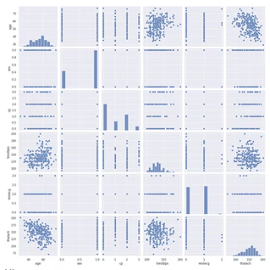
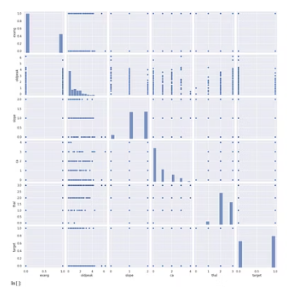
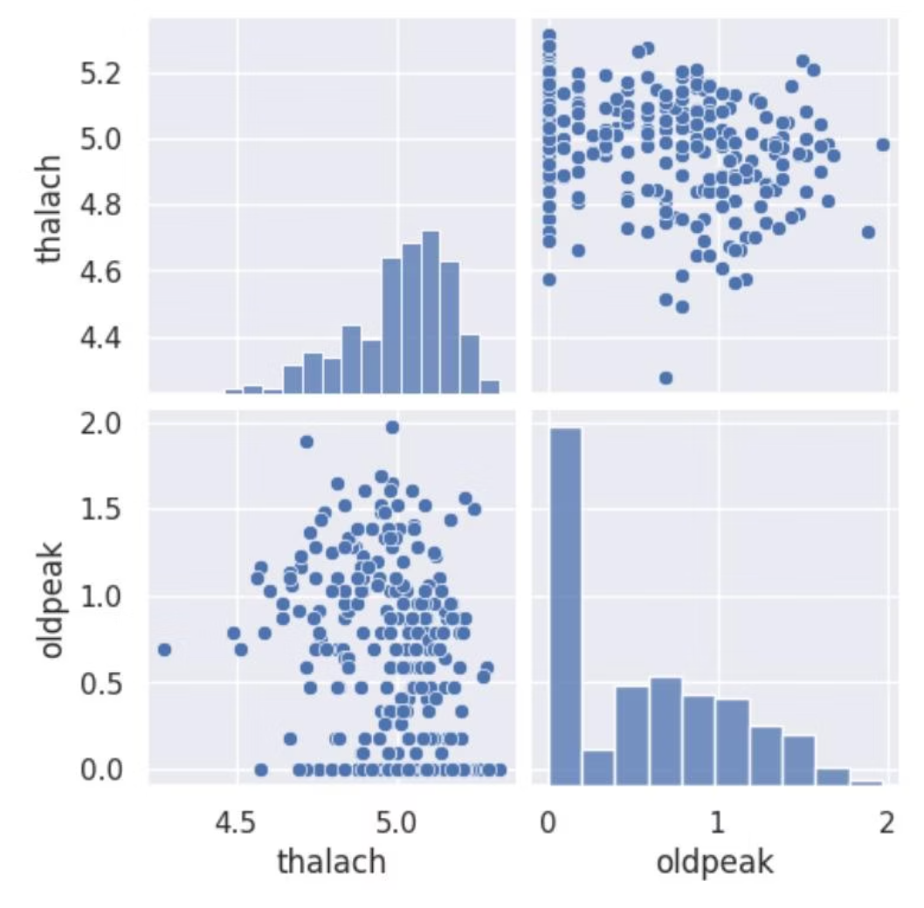
Visual Data Exploration
Comprehensive pairplot analysis revealed important patterns and relationships within the dataset. The visualizations were split into two groups to maintain clarity and readability.
Data Transformation
Post-Transformation Results
Logarithmic transformation was applied to columns 5 (thalach) and 7 (oldpeak) to normalize their distributions and improve model performance. This transformation helps handle skewed data and reduces the impact of outliers.
After applying log transformation, the distributions became more normalized, making them more suitable for machine learning algorithms that assume normally distributed features.

Slide 6
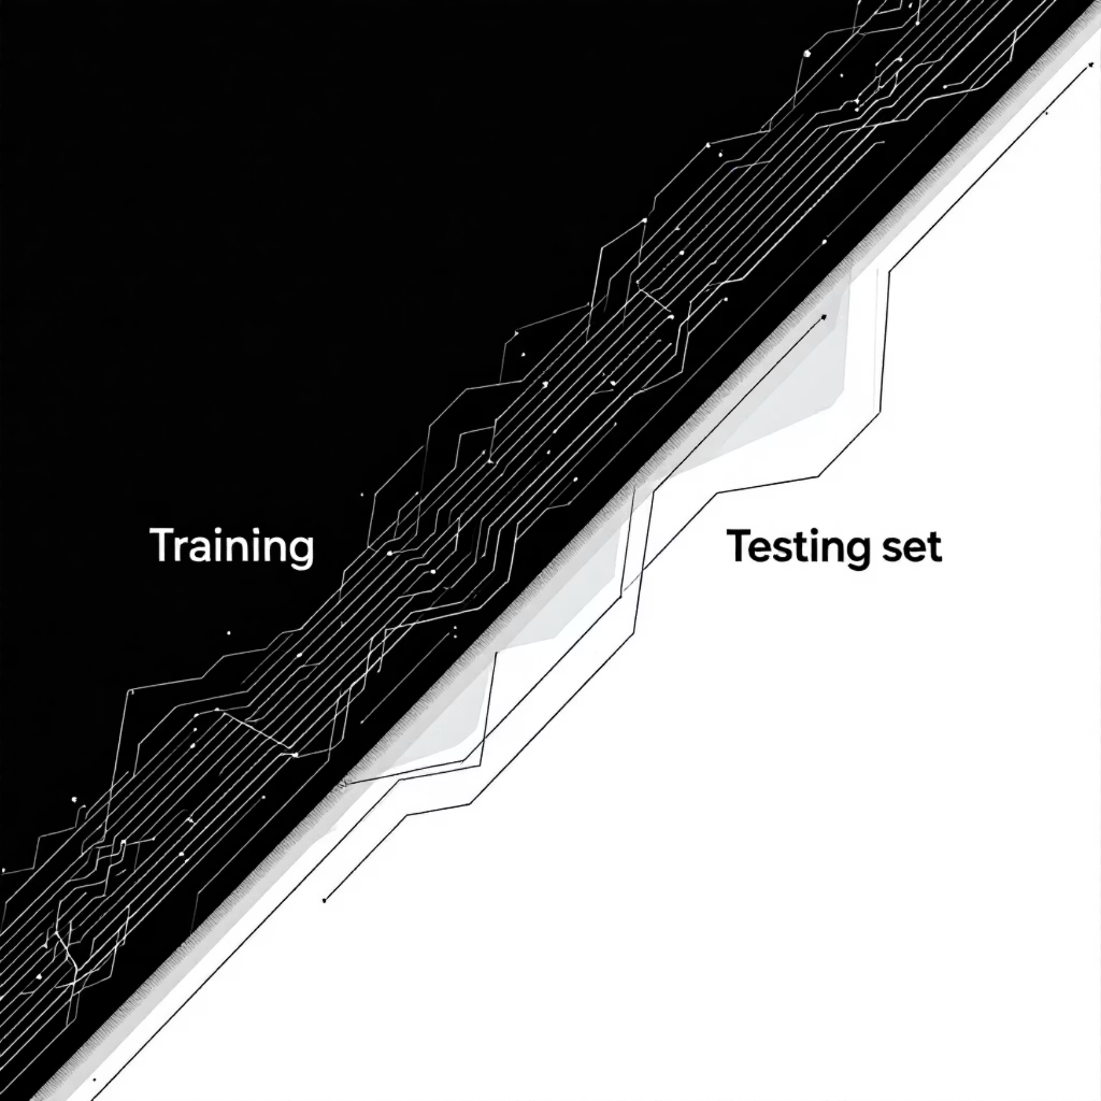
Model Preparation and Training Split
01
02
03
Feature-Target Separation
Train-Test Split
Feature Scaling
Independent variables (X) were separated from the target variable (y) to prepare for supervised learning. The target column indicates presence or absence of heart disease.
Dataset divided into 70% training (212 samples) and 30% testing (91 samples) using stratified sampling with random_state=1234 for reproducibility.
StandardScaler applied to normalize features, ensuring all variables contribute equally to model training. This is crucial for distance-based algorithms and improves convergence.
Final Dataset Dimensions
Training features: (212, 11)
Testing features: (91, 11)
Training target: (212,)
Testing target: (91,)

Slide 7
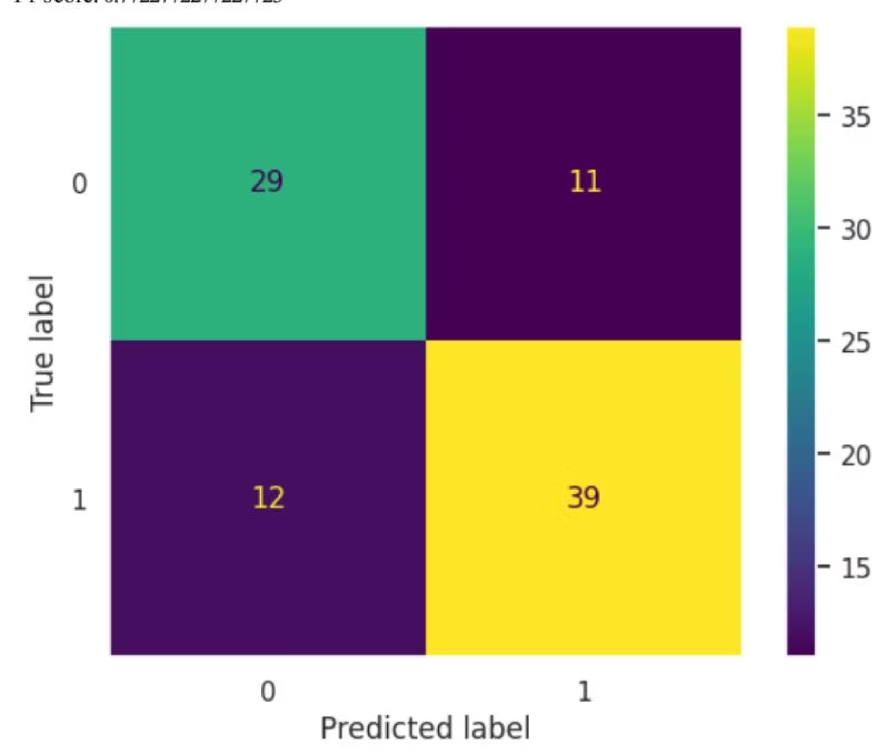
Logistic Regression: Initial Results
Model Performance Metrics
75%
78%
Accuracy
Precision (Class 1)
Overall correct classification rate
When predicting disease, correct 78% of the time
76%
0.77
Recall (Class 1)
F1-Score
Identifies 76% of actual disease cases
Good balance between precision and recall
Baseline Comparison
Dummy classifier (most frequent strategy) achieved only 56% accuracy, confirming our logistic regression model provides substantial predictive value over random guessing.
Confusion matrix showing 29 true negatives, 11 false positives, 12 false negatives, and 39 true positives

Slide 8



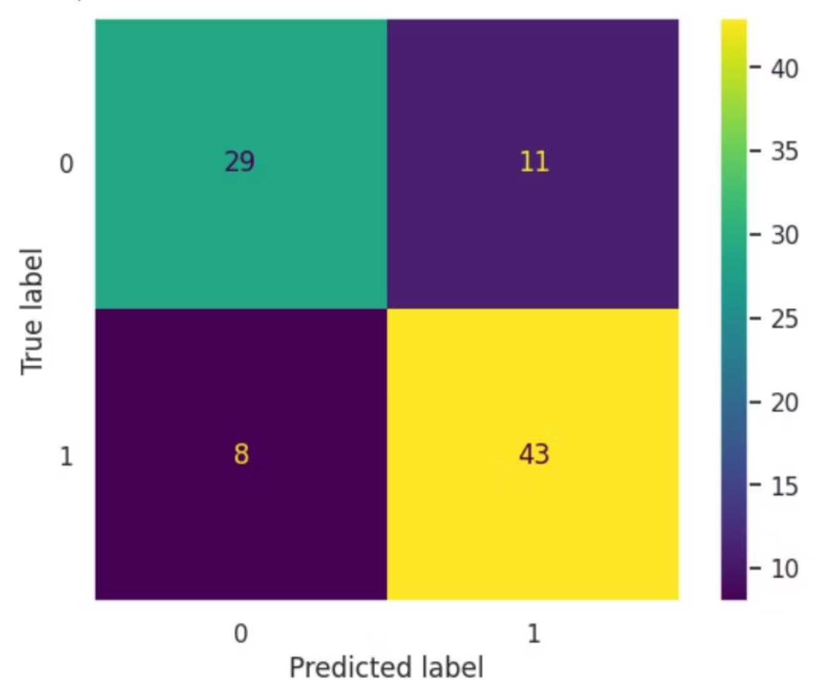
Hyperparameter Tuning and Optimization
Grid Search
Best Parameter
Improved Results
Tested C values: [0.001, 0.01, 0.1, 1, 10, 100] using 5-fold cross-validation
C = 0.1 identified as optimal regularization strength
Accuracy increased from 75% to 79% - a 4.5% improvement
Optimized Performance
Accuracy: 79.1%
Precision (Class 0): 78%
Precision (Class 1): 80%
Recall (Class 0): 72%
Recall (Class 1): 84%
F1-Score (Class 1): 0.82
Cross-Validation Score
Mean Accuracy: 84.5% ± 4.8%
The low standard deviation indicates stable, consistent performance across different data splits with minimal overfitting.
Improved confusion matrix after hyperparameter tuning

Slide 9
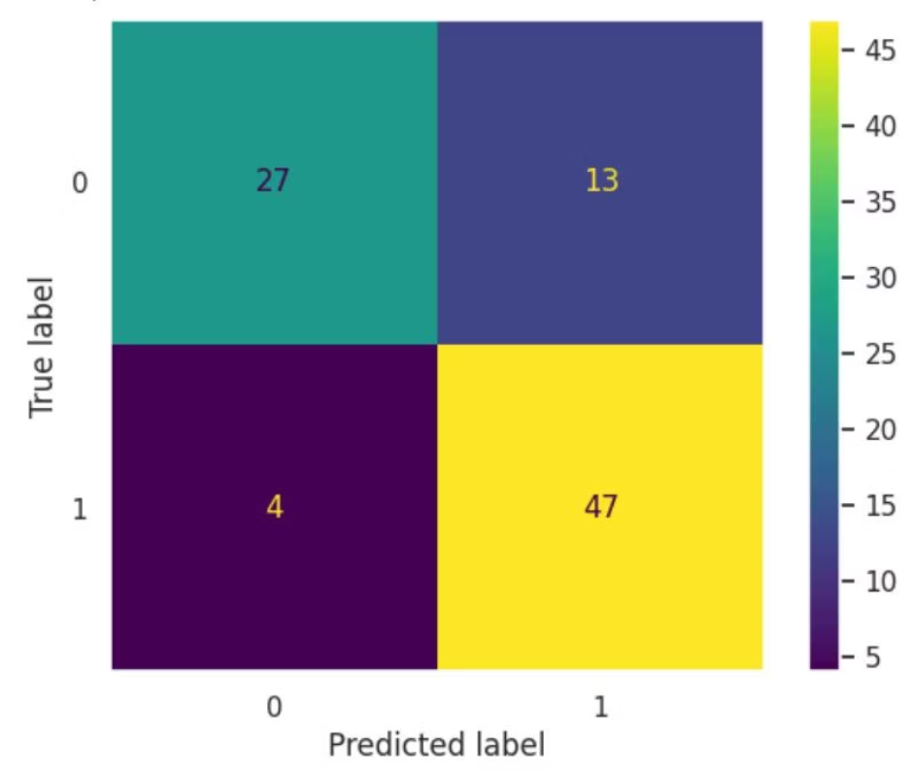
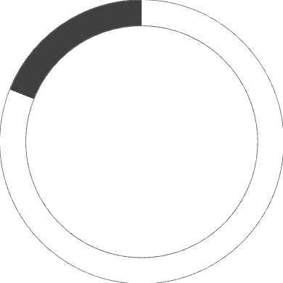
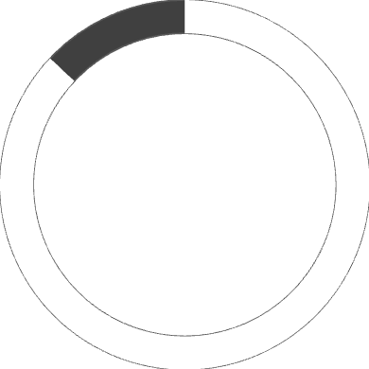
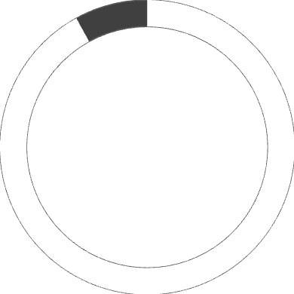
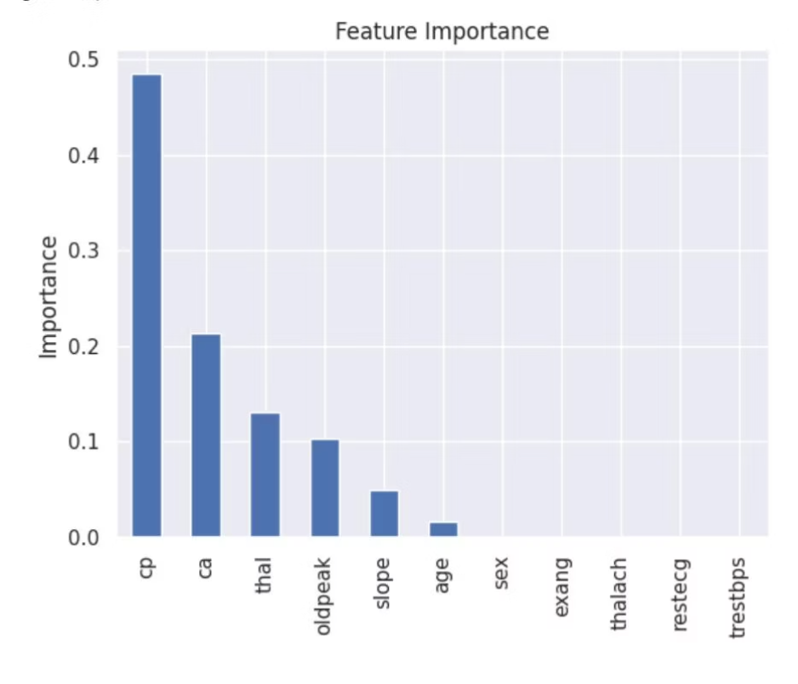
Decision Tree Model: Superior Performance
The decision tree classifier was trained as an alternative approach, with hyperparameter tuning revealing max_depth=3 as optimal.
Decision Tree Metrics
81%
Accuracy
87%
Decision tree confusion matrix showing strong performance
Precision (Class 0)
92%
Recall (Class 1)
Cross-Validation: 83.0% ± 4.9%
Slightly less accurate than logistic regression in cross-validation but demonstrates excellent recall for disease detection.
Feature Importance Analysis
Top Contributing Features:
cp (chest pain): 48.5% importance
ca (vessels): 21.4% importance
thal: 13.1% importance
oldpeak: 10.4% importance
slope: 5.0% importance
Chest pain type emerges as the dominant predictor, contributing nearly half of the model's decision-making power.

Slide 10


Final Model Selection and Clinical Considerations
False Negative Risk
False Positive Risk
Model misses a positive patient, declaring them "healthy" when actually ill. Consequence: Patient doesn't receive timely care or treatment, potentially leading to serious health complications or death.
Model overdiagnoses, declaring patient "ill" when actually healthy. Consequence: Patient experiences anxiety, undergoes unnecessary tests or treatments, but is not in direct danger.
Recommended Model: Logistic Regression
In medical diagnostics, minimizing false negatives is paramount. While the decision tree showed slightly higher test accuracy (81% vs 79%), the logistic regression model demonstrates:
Superior cross-validation performance: 84.5% vs 83.0%
Better generalization: Lower risk of overfitting
Clinical safety: Fewer missed disease cases
Interpretability: Clear feature coefficients for medical review
The 4.5% accuracy improvement through hyperparameter tuning demonstrates the critical importance of model optimization in achieving reliable predictions.
Key Insight: In healthcare applications, maximizing recall (sensitivity) takes precedence over overall accuracy. It's better to err on the side of caution, ensuring sick patients receive necessary care even if it means some false alarms.

