Slide 1
url:https://junglecafegalway.com/

Slide 2


Slide 3
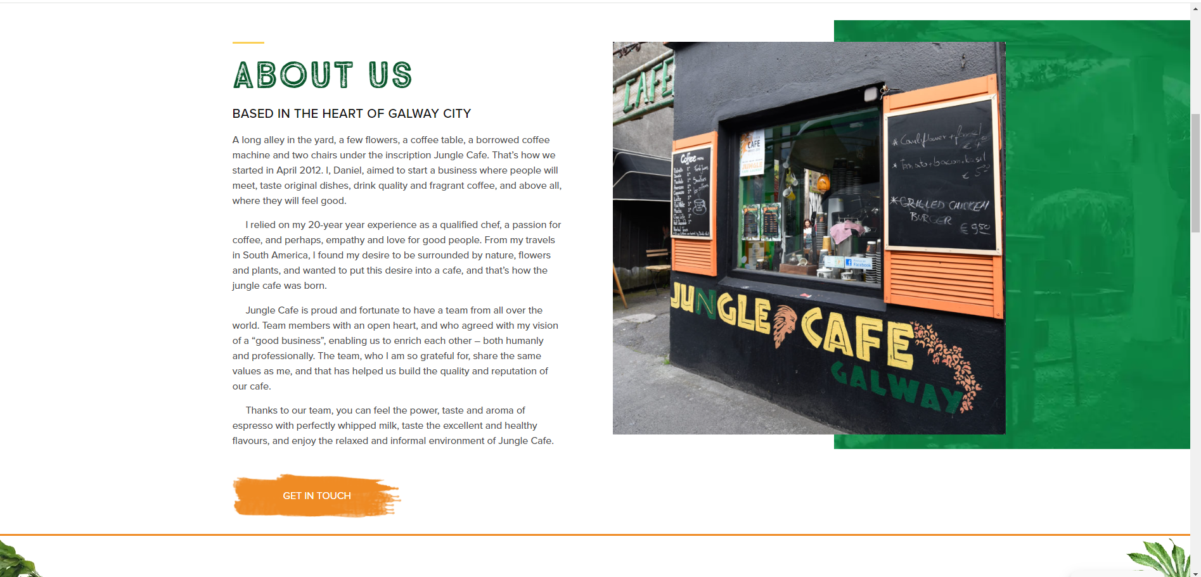

Slide 4


