Slide 1
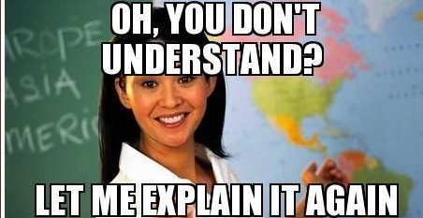
Appendix – Odds N Ends

Slide 2
Miscellaneous – Optical Character Recognition
A_OCR_w_tesseract.R
OCR – Optical Character Recognition
Identify letters in pictures.

Slide 3
Reading in other file formats
So far we have read in CSV (comma separated values) files.
Often you will be asked to use other data sources.
.txt (plain text)
.doc & .docx (Microsoft Word)
.xls & .xlsx (Microsoft Excel
R can even interpret PDF, image and other less popular files (ie SPSS).

Slide 4
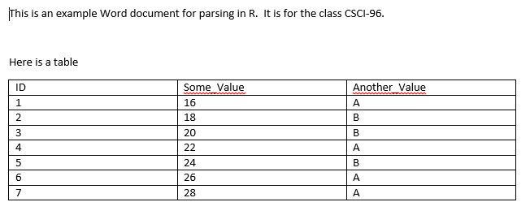
Let’s Practice
B_readDOCX.R
Get tables
Get simple text
Extracting Text
Parse the Table

Slide 5
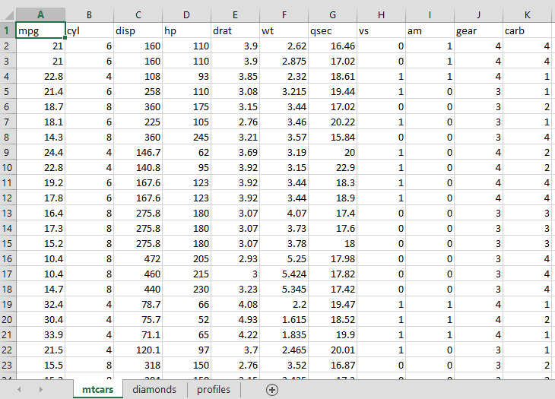
Let’s Practice
C_read_xlsx.R
List all worksheets
Read in individual sheets
Get the table data
Identify all Worksheets

Slide 6
PDFs
D_readPDFs.R
Formatting is really tough. May require a lot of string manipulation

Slide 7
TXT Files
E_readTXT.R
Reads line by line, table formatting can be hard without strsplit

