Slide 1

Interop Workshop
6-7 February 2024 - Barcelona

Slide 2

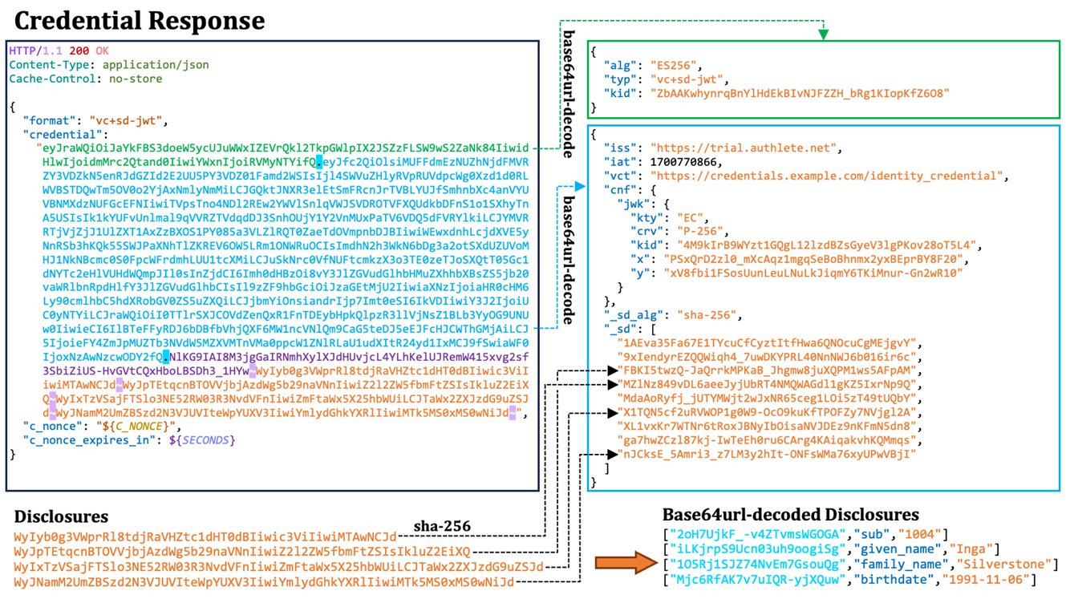
Today’s Topics
Trust Infrastructure with OpenID Federation 1.0
Accreditation and Trust Establishment process. Technical components: Entity Configuration and Subordinate Statement, Trust Marks, Metadata Policies, Wallet Attestation (WTE).
Data Model
SD JWT VC with OpenID Identity Assurance Profile.
Revocation
OAuth Status Attestation, an OCSP Stapling like approach, link.
Notes:
Dear all, good afternoon. Once again, I miss your company as I am forced to participate remotely.
For this, I thank the colleagues from IPZS and FBK who are with you and who will expand on what I consider a lukewarm introduction to what you will be able to share together in Barcelona. As the Italian delegation today, we bring 3 topics: trust infrastructure based on OpenID Federation, PID data model, and credential revocation. This latter was efficiently done this morning, so we can go further with other actionable stuffs pertaining the revocation field, like Erik said: next action, map feature and properties on use cases.
PLAN for this presentation
Federation:
Clarify the terminology in particular accreditation and trust evaluation
Show how accreditation works with the detail of the EC and trust mark
PID Issuance phase: show step by step which are the trust checks needed
Presentation phase: show step by step which are the trust checks needed
Requirements: show the list and the mapping on how with satisfy them
2. Identity Assurance
3. Status attestation
https://unsplash.com/it/foto/due-persone-che-si-stringono-la-mano-n95VMLxqM2I

Slide 3

Trust Model and Trust Infrastructure
From Challenges to Solutions Using OpenID Federation 1.0
Notes:
Today I’ll start with basic elements like Trust establishment between the entities, with the intention of better explaining the parts about the policy language, the trust marks, and the role of the accreditation bodies.

Slide 4
Establishing the Trust with the VCI
{ "typ":"vc+sd-jwt", "alg":"RS512", "kid":"dB67gL7ck3TFiIAf7N6", "trust_chain" : [ "NEhRdERpYnlHY3M5WldWTWZ2aUhm ...", "eyJhbGciOiJSUzI1NiIsImtpZCI6 ...", "IkJYdmZybG5oQU11SFIwN2FqVW1B ..." ] }
LET’S START FROM THE END (THE QUESTION)
Requirements in the Trust Infrastructure:
Trusted Third Party trusted over all the other entity (TA/CA …)
Accreditation Bodies (same as the previous or its intermediate)
Way to obtain list (or list of list -> decentralized) of Issuers
Way to establish the Trust in realtime (no pre-obtained …)
Requirements in the Credential (or any other signed artifact):
Unique Identifier of the Issuer (uid)
Confidentiality on the transport (TLS)
Attestation signed by a Trusted Third Party (compliance+keys)
Signatures using attested keys (proof that we’re talking with … )
Attestation that the credential is not revoked (then neither its issuer)
This approach is identical for all the leaves of the tree, such as credential issuers, relying parties, wallet providers ...
{ "_sd": ["7WG4nT6K26_R3975zcwnVwg"], "iss": "https://issuer.example.org", "exp": 1883000000, "sub": "NzbLsXh8uDCcd7noWXFZAf", "jti": "urn:uuid:6c5c0a49-b58", "status": {"status_attestation": …}, "vct": "PersonalIdentificationData", "verified_claims": { "verification": { "_sd": ["gd8gRxKT1hg8pt"], "trust_framework": "eidas", "assurance_level": "high" }, "claims": { "_sd": [ … ]}}, "_sd_alg": "sha-256", "cnf": {"jwk": { …}} }
Notes:
First of all I love to answer at the concrete question our chair put in the agenda: How to establish the trust with an OpenID Credential Issuer?
Here an example of a decoded digital credential, provided in sd-jwt vc format on the right, and a list of general requirements to get the things work.
Let’s start from the requirements.
The Entity, where the trust must be evaluated with, uses a unique identifier (UID), we use the HTTPs URL, ensuring precise identification within the network. Confidentiality during data transport, if any interaction is required with the credential issuer, is guaranteed through TLS.
A trusted third party provides attestation, which includes trustworthy cryptographic keys used for verifying signatures, Signatures created using these attested keys serve as proof of identity of the issuer, confirming that communications are with the intended entity. And also verifiable proof of compliances, ensuring that it is compliant to the trust framework, then authorized to do what it claim to do. This establishes a secure, trustworthy environment for digital interactions, leveraging both encryption and trusted attestations to maintain integrity and confidentiality, also verifiable over time.
In the left top we have the decoded JWT header, in the bottom left the JWT payload. In Italy we use both mdoc cbor and sd-jwt but we’re trying to do as much as possible with SD-JWT, leaving mdoc cbor just for MDL.
Today we’ll talk about how to implement compliance checks using Federation, using Trust Marks and metadata policy, where they are used, in which cases they are suggested and the benefits they brings.

Slide 5
Terminology
Trust Model, principles and guidelines defining how trust is established, maintained, and validated within the digital identity Wallet ecosystem.
Infrastructure of Trust, underlying physical and digital systems, protocols, and technologies that enable and support the establishment and management of trust among entities, according to the Trust Model.
Trust Framework, normative text including policies, “administrative” and accreditation protocols, and technologies designed to manage the trust infrastructure and the trust relationships.
  Policy Classes, rules, behaviors, and procedures for managing and enforcing compliances.
Trust Evaluation, verification and assessment about trustworthiness of entities, credentials and data exchanged.
Trust Establishment, verification of the adherence to agreed-upon standards and protocols between entities.
Notes:
Don’t worry, I don't want to bore you with long explanations. As for the terminology, I have found some inconsistencies regarding the use of the terms trust model, trust infrastructure, and trust framework during the expert group, In particular, it seems that there is still confusion about some peculiarities that distinguish these entities.
In summary, the trust model provides the theoretical foundation, the trust infrastructure is the practical implementation of that model, and the trust framework encompasses the governance, the administrative and technical operations and policies details, that guide the interaction of all the entities involved in the system. In particular, today I’ll try to speech some more about policies within a concrete trust infrastructure.

Slide 6
Principles and General Properties of the Trust Model
Delegation: Technical ability/feature to delegate authority or responsibilities to other entities, allowing for a distributed trust mechanism.
Transitive Trust: Trust established indirectly through a chain of trusted relationships, enabling entities to trust each other based on common authorities and trusted intermediaries.
Scalability: Designed to efficiently manage an increasing number of entities or interactions without a significant increase in trust management complexity.
Interoperability: Supports seamless interaction and trust establishment between diverse systems and entities within the federation.
Flexibility: Adaptable to various operational and organizational needs, allowing entities to define and adjust their trust relationships and policies.
Autonomy: While part of a federated ecosystem, each entity retains control over its own definitions and configurations.
Security: Incorporates mechanisms to ensure the integrity, confidentiality, and authenticity of the trust relationships and interactions within the federation.
Privacy: Designed to respect and protect the privacy of the entities and individuals involved, minimal disclosure is part of this.
Notes:
In this slide, I list a series of properties that in Italy we have found indispensable for the construction of an infrastructure that scales, and I say that scales I mean not only technically but also administratively across different domains and according to criteria for the division of responsibilities and mechanisms of delegation. However, today I only want to talk to you about the transitive property of trust, that allow us to bring in the system the delegation mechanisms.

Slide 7

SUMMARY OF THE TRUST MODEL “MUST HAVES”
REQUIREMENTS SATISFIED
Are they who they say they are? (ENTITY IDENTIFIERS)
Are they compliant with the security and privacy requirements required by the ecosystem (e.g., EUDI Wallet)? (COMPLIANCE)
Superiors sign statements about Subordinates in Trust Chain (KEY HIERARCHY)
Authorization to carry out intended actions (POLICIES)
  in both online & offline interactions (ENCAPSULATED TRUST)
  and verifiable in the future using retained historical keys (NON-REPUDIATION)
Use with any AuthN/AuthZ technology (PROTOCOL AGNOSTIC)
Photo by freepik
Notes:
Starting from the fundamental requirements, this slide attempts to encapsulate the key steps we undertake in our implementations when certifying trust, the trust mechanisms needs to:
- identify the subject under evaluation to ensure it is uniquely distinguishable, since we're reminiscent of the Greek myth where Ulysses blinds Polyphemus and claims his name is 'No One'.
- assess the subject's compliance, typically by consulting a trusted third party who certifies this compliance.
- acquire the subject's cryptographic keys, attested by a trusted third party, to ensure we are interacting with the correct entity.
- obtain and implement policies relevant to the subject or the category it belongs to, preventing any unauthorized or undesirable actions.
- secure a method to validate, in the future, any outputs from the subject, even when its keys have expired and are no longer usable. This ensures that no entity within our ecosystem can repudiate what they have requested, obtained, or declared about themselves or others.
Importantly, we need to apply these steps universally, without exception, ensuring our requirements are met in both online and offline scenarios.

Slide 8
THE TOPOLOGIES OF TRUST INFRASTRUCTURES
Flat vs. Decentralized and Hierarchical
AS
Trust Anchor X
Trust Anchor Y
INT A
INT B
INT C
INT D
RS / VCI
RP
TRUST LISTS
Wallet Provider
Wallet Provider
Issuer
Issuer
WALLET PROVIDER
other LEAF NODES
Verifier
RP
Photo by freepik
Notes:
This slide presents two models. On the left, we see a typical star architecture, which is typically centralized. In this model, all information related to all entities, public keys, applicable rules, and interoperability metadata are stored in a single repository.
This model simplifies our world but places a significant administrative burden on the central node. From a technical perspective, this centralization introduces a single point of failure. If this node fails, the entire system is affected. Therefore, this node needs to be replicated to have resilience against a technical failure and ensure its constant availability.
However, in the real world, there are factors beyond technical failures that could lead to the failure of this node, such as administrative or governance issues, privacy risks if interaction traces between participants are accessible from a single node, and economic failure in terms of process sustainability and node maintenance. This means that even if the trusted list in the center of the star is scaled and distributed, it still represent a single entity.
In contrast, the model on the right presents a distributed topology across different nodes. Each node performs specific functions according to a delegation model and with limited powers. Each node also refers to different contexts, granting local administrative autonomy and technical and process governance.
It is precisely this model that I was looking for when I decided to implement OpenID Federation, and it is precisely the solution that I believe is right for us, respecting the autonomy that our community guarantees to its members, in the full respect of the common rules and consolidated protocols.

Slide 9
TRANSITIVE TRUST
How to go from Marco to Bob?
Alice (Trust Anchor)
TRUST ANCHOR
Bob (Intermediate)
ACCREDITATION BODIES
Marco (RP)
Arianna (VCI)
LEAF NODES: RP, OP, RS, AS, VCI, …
Bob and Marco are Subordinate of Alice
Arianna is Descendant of Alice and Subordinate of Bob
Problems to solve:
How to link entities that don’t have any direct link?
How to establish if Marco and Arianna comply with the same rules?
How to ensure that Marco and Bob apply Alice's rules?
Notes:
In this slide we see a representation of an hierarchy that use the Trust Anchor as root element, and below it, the configuration of leaves and intermediates. The key question is how these leaves can establish the trust each other. I think that’s important introduce here a fundamental property of the Trust Model we want and that I found in OpenID Federation.
Transitive trust is a property where trust between two entities can be extended to a third entity. Here's a simple example: if Alice trusts Marco and Bob, and Bob trusts Arianna, then Marco and Arianna can trust each other.
This enables the formation of trust relationships across a network without the need for every pair of entities to have a direct trust relationship. In the context of OpenID Federation, Marco and Bob are direct subordinates of Alice due to their direct link, while Arianna is a subordinate to Bob and a descendant of Alice.
However, it's important to note that transitive trust can also introduce risks. If one entity in the chain is compromised, it can potentially affect the trust relationships throughout the chain. Therefore, careful management and periodical verification of trust relationships are crucial in systems that use transitive trust, that’s why in OpenID Federation a short-lived cryptographic Trust Chain is used where the single compromission of an entity ends with the invalidation of the entire chain.

Slide 10
THE PATH TO THE TRUST
Trust Resolution and Trust Chain building
REQUIREMENTS
1. All the Trust Anchors URLs/public keys must be taken from the Trusted Lists.
2. The Trust Anchors public keys published on their own MUST match the ones obtained from the Trusted Lists -> double check (don’t rely entirely on TLS!)
Trusted List
3. Get information/keys about the Intermediate from the TA + policies
Trust Anchor X
Trust Anchor Y
2. Get information from the Leaf’s Superior (Intermediate)
What the Intermediate says about the Leaf
The Leaf’s key to verify the Leaf’s information + policies
What the Intermediate says about itself.
INT
NAB XY.B
NAB Y.A
NAB Y.B
1. Get information from the Leaf
What the Leaf says about itself.
Wallet Provider
Wallet Provider
Issuer
Issuer
OUTPUT
1. Trust Chain
2. Final metadata according to the processed policies
3. Verified Trust Marks
Wallet Instance
Wallet Attestation issued by a Trusted Party.
It attests the reliability and the security of the Wallet.
RP
Notes:
In this slide, I represent the OpenID Federation trust chain in green, while the trusted list is outside of the trust chain and represents the repository where the public keys of the trust anchor are published.
In green, we have the federation trust chain, INT means Intermediate and actually is an Accreditation Body that has registered a Leaf, that in this example is a Wallet Provider.
Outside the trust chain, we have the wallet attestation, where the wallet provider that issued it is attestable through federation trust chain, while the user's personal device is attested through the responsibility of the wallet provider.
The trust chain is composed by a sequence of signed objects linked each other, which we will analyze today. These carry metadata and policies to ensure both the interoperability and compliance of the participants. Today, we will see how policies are applied in a coercive manner and to do so efficiently, economically, but above all transparently, in Italy to the metadata we reserve a particular function. Indeed, the result of the trust chain and the policies collected in it is called final metadata.

Slide 11
OpenID Federation Functional Features
Flexibility
Support for protocol-specific metadata, policies, Trust Marks, and ecosystem roles. Tailored configurations meet specific needs, enhancing adaptability in diverse environments.
Multiple federations. Entities can participate in multiple federations with different Trust Anchors.
Multiple roles: Can a Trust Anchor in one Federation be an intermediate in another? With OpenID Federation YES.
Transparency, online access to all Trust relationships:
Federation API makes Trust relationships transparent and consultable online by providing a standardized way to share and access trust information, enabling real-time navigation of the federation
Dynamic Relationships among Entities
Adding entities to and removing entities from organizations and federations is a local operation
Only requires superior to issue an updated Subordinate Statement about entity (or to stop issuing it)
Short entity statement timeouts can enable timely addition, revocation, and metadata updates
Constraints ensure compliance with policies
Can prevent malicious parties and misconfigurations from performing actions they’re ineligible for
Offline Usage enabled through cached trust chains
trust_chain JWS header parameter can occur within requests, responses, attestations, and digital credentials
Notes:
Therefore, so far, I have tried to do my best to describe to you at a high level how OpenID Federation can enrich our ecosystem.
I am aware that OpenID Federation, alone, is able to satisfy all our requirements but at the same time I see greater value in a harmonization plan that can give mine to us.
At the end of this presentation, I hope to have shared with you what I have to increase the awareness of our working group in relation to the potential of openid federation and why we decided to use it in Italy.
Basically, when we started implementing our wallet solution in Italy, we did not have a tool comparable to openid federation to build a complex infrastructure such as the one we are working on within the expert group.
That's why we have felt the requirement to use OpenID Federation, for all the requirements and the implementation strategy I shown you.
What we know is that OpenID Federation has all the necessary blocks to satisfy the requirements that may emerge in the future, while in this presentation I wanted to talk to you about federation as a sort of framework for building a transparent and flexible trust infrastructure.
Think of Italy, for example, which may configure two Trust Anchors within itself, one of these in ebsi. the Italian CABs could be registered on both the trust anchors, the ebsi and the federation one, using the same federation API. In the discovery phase, even if the non-EBSI trust anchor was not available, the one on EBSI would continue to work.
I see great potential in EBSI, limiting its use in the role of trust anchor, so that its storage remains streamlined and does not centralize all kinds of information for multiple purposes and roles within the ecosystem.

Slide 12
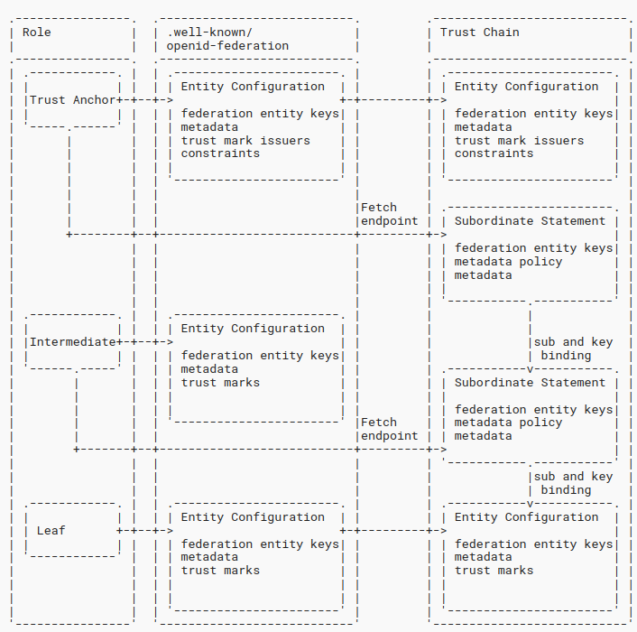
THE PATH TO THE TRUST
Discovery and Trust Chain Building
Notes:
This representation is extracted from the official specifications of OpenID Federation, where the discovery procedure and the composition of the trust chain are described.
Starting from the bottom, from the leaf, the Entity Configuration is collected, thus knowing its superior authority and reaching it to obtain the superior’s entity configuration. In this way, the fetch endpoint is known, and from this, the subordinate statement is obtained, which provides policies and public keys to verify and align what the leaf has said about itself. The chain continue unless the Trust Anchor is found.
I want to give you some details on this, let’s keep in mind that a trust chain can be built of statically evaluated with the sole Trust Anchor public key, then a Trust Chain can be collected or statically provided by an entity and in relation to itself.
The chained approach makes the everything contained within the chain is protected, using cryptographic and claim bindings.

Slide 13
OpenID Federation Entity Configuration
{ "alg": "ES256", "kid": "xQxDJyRB1Z5aL3r3WUc4BForq5yzHHEU9xx-Dl4_IKE", "typ": "entity-statement+jwt" } . { "sub": "https://rp.example.it", "iss": "https://rp.example.it", "iat": 1516239022, "exp": 1516298022, "jwks": { "keys": [{ ... "kid": "xQxDJyRB1Z5aL3r3WUc4BForq5yzHHEU9xx-Dl4_IKE"}] }, "metadata": { "openid_relying_party": { "redirect_uris": [ "https://rp.example.it/callback" ], "logo_uri": "https://rp.example.it/images/32x32.png", "client_registration_types": ["automatic"], "jwks": { … }, ... }, "trust_marks": [ { "id": "https://federation.example.com/rp/under-age", "trust_mark": "eyJraWQiOiJm..." } ], "authority_hints": [ "https://intermediate.example.it" ], ... }
What the Leaf says about itself;
it is exposed at the .well-known/openid-federation endpoint;
It is a self-signed JWT containing the Entity’s:
public keys (Federation Keys and Protocol Specific Keys)
Protocol specific metadata, for each supported role/protocol
authority_hints signalling the entity IDs of Superior Entities that can issue a Subordinate Statement
trust_marks that are statements of compliances to particular profiles or requirements
Notes:
The first element of a trust chain is called the entity configuration and contains what an entity says about itself, it is a self-issued and self-signed declaration.
This freedom to autonomously declare any information allows all entities to use a single entity configuration for different federations or contexts. The Entity Configuration is signed with keys contained in the top-level jwks attribute, whose purpose is exclusively to carry out cryptographic operations for trust evaluations. Each key specific to a protocol is published within the specific metadata, ensuring that different keys are used for different purposes.
An entity configuration can contain various metadata, each of a different type, allowing a single entity to perform multiple roles. Consider an EAA Provider that is simultaneously an OAuth authorization server, a verifiable credential issuer, and a relying party.
Finally, two more pieces of information: authority_hints is a list of superior authorities from which it is possible to obtain an attestation to evaluate the validity of this entity configuration. The other piece of information is a trust mark.

Slide 14
OpenID Federation Trust Marks
{ "alg": "ES256", "kid": "xQxDJyRB1Z5aL3r3WUc4BForq5yzHHEU9xx-Dl4_IKE", "typ": "entity-statement+jwt" } . { "sub": "https://rp.example.it", "iss": "https://rp.example.it", "iat": 1516239022, "exp": 1516298022, "jwks": { "keys": [{ ... "kid": "xQxDJyRB1Z5aL3r3WUc4BForq5yzHHEU9xx-Dl4_IKE"}] }, "metadata": { "openid_relying_party": { "redirect_uris": [ "https://rp.example.it/callback" ], "logo_uri": "https://rp.example.it/images/32x32.png", "client_registration_types": ["automatic"], ... }, "trust_marks": [ { "id": "https://federation.example.com/rp/under-age", "trust_mark": "eyJraWQiOiJm..." } ], "authority_hints": [ "https://intermediate.example.it" ], ... }
As a result of the Registration Process each entities (Leafs, Intermediates and Trust Anchors) expose:
/.well-known/openid-federation:
gives the Entity Configuration
a self-signed JWT that contains:
the Entity's public key
metadata of the Entity
trust_marks that are statements of conformance to a profile or set of requirements
{ "alg": "ES256", "kid": "FifYx03bnosD8m6gYQIfNHNP9cM_Sam9Tc5nLloIIrc", "typ": "trust-mark+jwt" } . { "id": "https://federation.example.com/rp/under-age", "iss": "https://intermediate.example.it", "sub": "https://rp.example.it", "iat": 1579621160, "organization_name": "RP & Co.", "policy_uri": "https://rp.example.it/privacy_policy", "tos_uri": "https://rp.example.it/info_policy" }
Notes:
Let’ open a quick parentheses with the Trust Marks. In few words a Trust Mark is issued by a trusted authority.
An entity in a federation should publish its trust marks in its entity configuration to prove its compliance with certain standards, policies, or regulations.
In this approach is crucial the role of the accreditation bodies in issuing trust marks, setting standards, and conducting audits.
The Trust Marks have a lifetime, they expires, can be reissued and can be revoked as well.
The authorities that can issues recognizable trust marks within a federation are published by the trust anchor of the federation, an entity cannot issue a trust marks if not allowed by the trust anchor and the underlying trust framework that defines the trust mark types.

Slide 15
Recap: OpenID Federation Trust Marks
What’s it? In few words: a Verifiable Attestation.
What’s intend for? It attests compliances of an Entity with specific profiles/rules.
For example, Trust Mark are suitable for attesting:
conformance to a national public service profiles;
conformance to the rules for data management of particular protected users (disabled, underaged …);
stipulation of an out-of-band agreement between two organization's Entities;
conformance to a security profile;
…

Slide 16
OpenID Subordinate Statement
{ "alg": "ES256", "kid": "FifYx03bnosD8m6gYQIfNHNP9cM_Sam9Tc5nLloIIrc", "typ": "entity-statement+jwt" } . { "iss": "https://intermediate.example.it", "sub": "https://rp.example.it", "iat": 1516239022, "exp": 1516298022, "jwks": { "keys": [{ ... "kid": kxQxDJyRB1Z5aL3r3WUc4BForq5yzHHEU9xx-Dl4_IKE" }] } "source_endpoint": “https://intermediate.example.it/ftch", "metadata": { "federation_entity": {"organization_name":"FED"}, … }, "metadata_policy": { "openid_relying_party": { "id_token_signed_response_alg": { "one_of": [ "ES256", "ES384" ] } } } }
As a result of the Registration Process, the Accreditation Body (Trust Anchors and Intermediates) issues a Subordinate Statements though the fetch Entity Statement endpoint.
It is a JWT containing the Subordinate’s:
public key
and optionally, also:
metadata of the Entity (overloaded arbitrary)
metadata_policy (applied dynamically)
metadata vs metadata_policy
metadata applies only to direct Subordinates
metadata_policy to the entire chain (Subordinate + Descendants)
Notes:
The subordinate statement specifies what a Trust Anchor (TA) or an accreditation body knows and attests about its subordinate. This must contain at least the federation public keys with which to validate the subordinate's entity configuration.
Additionally, it can publish parts of metadata to override those published by the subordinate and also metadata_policy to do the same to both subordinates and descendants and in a more dynamic way, operating atomic changes on pre-existing information.

Slide 17


REQUIREMENT FOR AUTOMATED POLICIES
What If… Someone Cheats?
Do we agree that Policies are not “informative only” ?
Policy application MUST be enforced in a coercive manner.
Therefore, How? OpenID Federation has a Policy Language.
https://identitadigitale.gov.it/
Notes:
We can establish compliance by verifying that a subject claims to be compliant, we can also have a trusted third party confirming this through cryptographic mechanisms. However, what happens if the subject, only at the time of the accreditation, is compliant and the time after anymore, due to a misconfiguration or just because it is dishonest and cheats?
That’s why establishing policies is something, while create mechanisms to enforce their technical application is something different, more advanced and anyway required.
Today, we’ll see how OpenID Federation defines a policy language to dynamically change the entities metadata enforcing their compliance to the shared rules.
The OpenID Federation policy language is applied to the entities metadata and changes the entity configuration, for each specific protocol, according to the federation regulations.
For instance, we managed to disable a vulnerable signature algorithm within the federation without the need to send thousands of emails. This was accomplished by simply publishing a metadata policy and ensuring it was applied within a specified timeframe, this eliminates any administrative cost.
Another important aspect is that the Federation Trust Chains expire and must the renewed, enabling periodical checks.

Slide 18

WE ESTABLISH THE TRUST WITH SIMPLE RULES
Equation for a Relationship
PROOF of IDENTITY
+
PROOF of COMPLIANCE to requirements
=
TRUST
Periodically renewed,
like human relationships!
https://identitadigitale.gov.it/
Picture by best5.it
Notes:
When I think about the term trust relationship the human behaviour comes to my mind,
that’s why I want to show you this slide that me and Mike have presented during the European Identity and Cloud conference in 2023.
In our human relationships we use to assess trust in another subject, confirming that the subject is indeed who it claim to be. However, this alone is not sufficient because identification doesn't automatically establish trust.
Therefore, We need to determine whether the subject has the ability to perform a task or comply with a requirement that holds value for us.
For instance: we build trust with colleagues in the workplace based on our past successes in specific tasks. Similarly, we trust a technology after using it for a period of time and experiencing positive results.

Slide 19
A SIMPLE LANGUAGE USING JSON
Policy Language Operators
default: sets a default value for a metadata parameter if none is provided by the subordinate entity.
essential: it means that entities within the federation must provide this piece of metadata.
value: specifies a fixed value for a metadata parameter that must be used by all descendants entities.
subset_of: sets the value provided by the subordinate entity as a subset of the value specified in the policy.
superset_of: sets the value provided by the subordinate entity as a superset of the value specified in the policy.
one_of: Specifies that the value provided by the subordinate entity must be one of the values listed in the policy.
add: adds the value provided by the subordinate entity.
https://identitadigitale.gov.it/
Notes:
In OpenID Federation 1.0, metadata policy operators are used to define how metadata related to an entity can be modified in a coercitive way. These operators also specify how to handle conflicts or discrepancies between metadata values. The metadata policy language uses the operators we see in the slide.

Slide 20
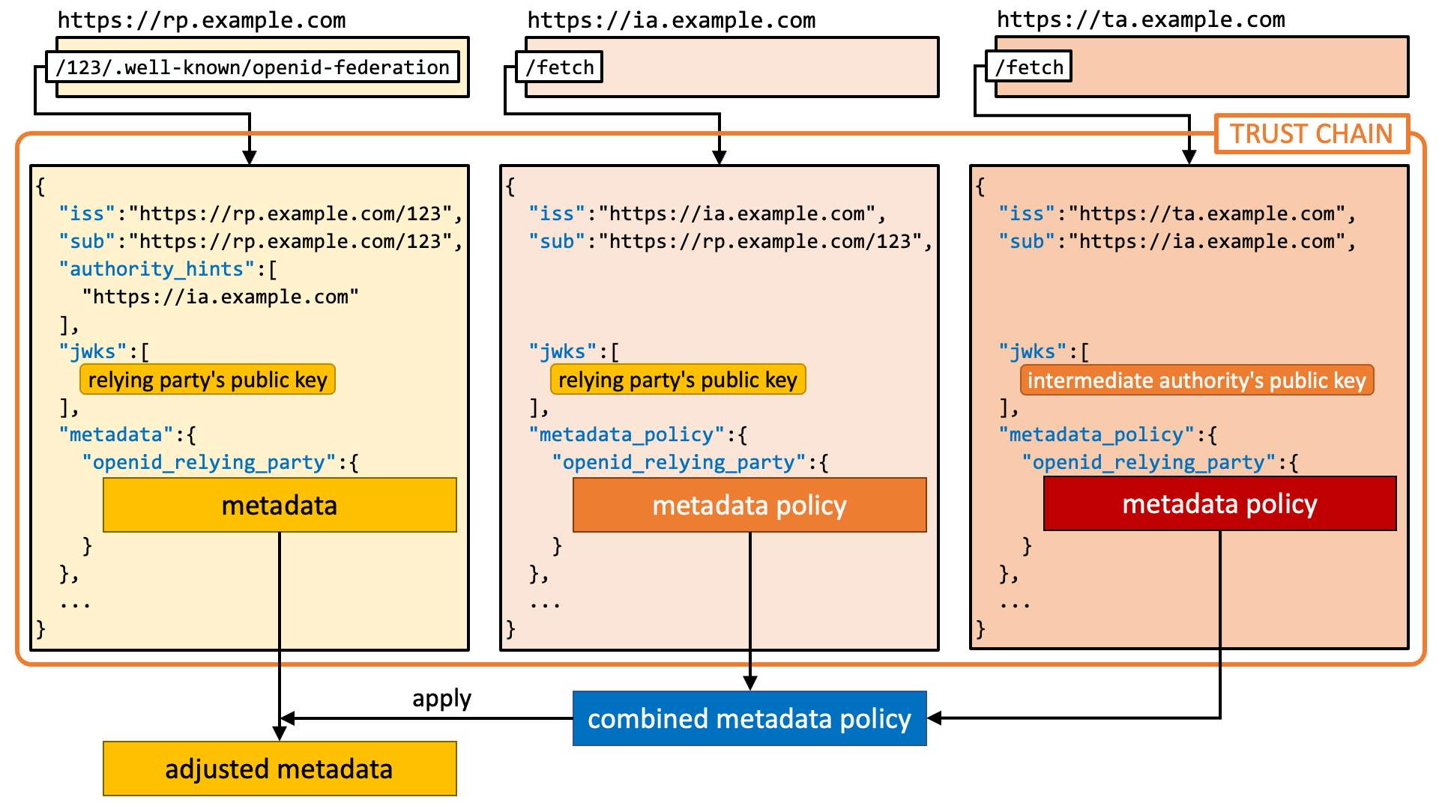
FINAL METADATA PROCESSING - POLICIES INCLUDED
{ ... "metadata_policy": { "openid_relying_party": { "id_token_signed_response_alg": { "one_of": [ "ES256", "ES384" ], "default": "ES256", } } }
{ ... "metadata": { "openid_relying_party": { "contacts": [ "rp_admins@entitya.example.com" ], "response_types": [ "code" ], ... } }
{ ... "metadata_policy": { "openid_relying_party": { "contacts": { "add": "helpdesk@example.com" } } } }
"metadata": { "openid_relying_party": { "contacts": [ "rp_admins@entitya.example.com", "helpdesk@example.com" ], "response_types": [ "code" ], "id_token_signed_response_alg": "ES256", ... }
Credits: Authlete (source)
Notes:
In this slide, a flow for composing a trust chain and the subsequent processing of policies to obtain the final metadata is represented.

Slide 21

PROBLEM -> REQUIREMENT -> SOLUTION -> IMPLEMENTATION
Ecosystem Potential Issues
The compromised/malicious RP requests User personal information through social engineering. Fake promises, fake prizes, phishing...
The bogus Issuer issues Credentials for which it is not authorized to issue
An RP would not know which Credential Issuer is eligible for issuing determined Credentials
An RP would obtain data from under-age Users without grants for that
A fake Accreditation Body would carry out onboarding systems and inspections without any authorization
The coffee machine that requires personal data … Do we have enough?
Notes:
During the previous episodes, we amused ourselves in front of this slide. Today, I will use the problems described here to exemplify their respective solutions according to the typical approach of OpenID Federation.

Slide 22
Policy by examples - the Malicious RP
Problem: A malicious or compromised Relying Party (RP) illicitly requests personal User information via social engineering tactics, which it is unauthorized to request.
Solution 1: The data requested by the RP must be attested by an Accreditation Body and verified by the Wallet Instance. These MUST be defined within the RP's metadata. A Metadata Policy is defined to force this (essential + value).
Solution 2: Metadata element overload using metadata.wallet_relying_party.presentation_definition.
{ ... "metadata_policy": { "wallet_relying_party": { "presentation_definition": { "essential": true, "value": { … } } } }
{ ... "metadata": { "wallet_relying_party": { "presentation_definition": {...} } }

Slide 23
Policy by examples - the bogus Credential Issuer
Problem:
The bogus Issuer issues Credentials for which it is not authorized to issue.
An RP would not know which Credential Issuer is eligible for issuing determined Credentials.
Solution: … The same mechanisms described for the RP, metadata overload or metadata policy on the Credential Issuer metadata.
{ ... "metadata_policy": { "openid_credential_issuer": { "credentials_supported.PersonIdentificationData.format": { "nested": true, "essential": true, "one_of": { "mso_mdoc", "vc+sd-jwt" } } }
{ ... "metadata": { "openid_credential_issuer": { "credentials_supported": {...} } }

Slide 24
Policy by examples - RP Handling Data of Underage Users
Problem: An RP would obtain data from under-age Users without grants for that
Solution: The Trust Framework must define a Trust Mark for this specific scope. The Trust Mark is included in the RP's Entity Conf as evidence of the permissions to manage data of underage users.
{ "alg": "ES256", "kid": "FifYx03bnosD8m6gYQIfNHNP9cM_Sam9Tc5nLloIIrc", "typ": "trust-mark+jwt" } . { "id": "https://federation.example.com/rp/under-age", "iss": "https://intermediate.example.it", "sub": "https://rp.example.it", "iat": 1579621160, "organization_name": "RP & Co.", "policy_uri": "https://rp.example.it/privacy_policy", "tos_uri": "https://rp.example.it/info_policy" }
The Trust Mark:
is issued by a Trust Mark Issuer
accredited by the Trust Anchor
can be verified against revocations, in real-time
Notes:
In this example, we use a trust mark because there are some administrative characteristics of entities that are not addressed by specific exchange protocols, such as authorizations or compliance to handle certain highly specialized data, as in this example.

Slide 25
Policy by examples - Fake Accreditation Body
Problem: An unauthorized fake Accreditation Body conducts onboarding and inspections.
Solution: The Trust Framework must define a Trust Mark for this specific scope.
The Trust Mark is included in the Intermediate Entity Configuration.
Notes:
Anche in questo caso l’uso di un Trust Mark è una soluzione ideale.

Slide 26
Preliminary Registration with an Accreditation Body is always Required
All the Entities MUST be registered with an Accreditation Body.
It must identify the Entity and verify that it satisfies all the technical, administrative, legal and domain-specific requirements.
If the process succeeds:
  it issues Subordinate Statements related to the Entity, when requested (public endpoint);
  it may issue a Trust Mark that proves the compliance of an Entity with known rules and requirements defined within the Trust Model.
Notes:
Given that we have said there are authorities that publish subordinate statements for their direct subordinates and authorities, entirely transversal to the trust chain, that publish and revoke trust marks, we naturally arrive at the requirement of the importance of the role of accreditation bodies, which have the burden of evaluating the compliance of the entities they register and attesting to it in a verifiable manner.

Slide 27
Policy Language vs. Trust Marks
Both related to a specific Entity.
Policy Language is dynamically applied to Metadata and other static json artifacts: actually, on protocol specific metadata.
  It can be defined by TA and Intermediates any time, eg: disable a vulnerable algorithm doesn’t require any update of the trust framework or the sending of thousands of emails.
Trust Marks statically issued with predefined lifetime
  Can be revoked (Trust Mark Status endpoint)
  Needs to be defined within a Trust Framework, each of them with specific purpose and meaning.

Slide 28

And now … Let’s Speak Easy
With mDoc CBOR and X.509 PKI

Slide 29
OpenID Federation Trust chain in the Mobile Security Object
The Mobile Security Object of the Mobile Driving License in CBOR Format (mDoc CBOR) is a COSE Document as defined in the CBOR Object Signing and Encryption (COSE) [RFC9053].
draft-demarco-cose-header-federation-trust-chain defines how to use a Federation Trust Chain in the MSO in a similar way it actually uses an X.509 Certificate Chain.
January updates: John Bradley (Yubico) joined as co-author of the draft.

Slide 30
X.509 with OpenID Federation
We can use OpenID Federation to establish the Trust for the issuance of one or more X.509 Certificates to a specific Entity that has requested these using draft-demarco-acme-openid-federation
With this mechanisms we can provide X.509 Certificates to mDoc CBOR Verifiers and any other Entity that requires X.509 Certificates, in particular with legacy Entities.
It makes transparent which certificates was issued to which entity using the federation api. We would not rely only on DNS+TLS for trust evaluation for the issuance of X.509 certificates. It helps automation and reduces costs for large deployments/ecosystems.
Notes:
We can use OpenID Federation to establish trust and compliance of an entity for the issuance of an X.509 certificate. By using federation and ACME, we can bring a model and significant automation to reduce the costs of certificate provisioning.
Moreover, once a certificate is issued through ACME + Federation, the issuing authority would publish this within the Subordinate Entity statement, offering a completely transparent track of the issued certificates within the federation. Using Federation Trust Chain we then are not dependant anymore to CRL list and OCSP, if we want to get rid of them, nothing prevents us to continue working with these, we don’t have any conflict with federation. Anyway, enabling forward-thinking approaches would allow us to have a progressive approach to abandon X.509 in the future, if required, not required for today.
As soon as possible, I will resume working on this draft to officially present it at the IETF with the help of Stefan Santesson, who is one of the co-authors of the X.509 PKI (RFC5280).

Slide 31
We DID it :-) (at least we thought about this)
Backlog:
https://github.com/oauth-wg/oauth-sd-jwt-vc/issues/41
https://bitbucket.org/openid/connect/issues/1467/did-resolver-method-for-oidc-federation
did:openid:example.it:oidc:rp[#$kid-value]
this URN is translated to https://example.it/oidc/rp/.well-known/openid-federation and requires a Federation Entity Discovery to build a valid Trust Chain. This doesn't preclude any other OpenID Connect trust resolution method in the present or in the future, giving to the trust resolver the freedom to decide which openid standard to use for the resolution of the keys. Kid value is optional depending to the scope of the did identifier, if related to a subject or to a key.
did:openid-trustchain:BASE64({"kid": 1, "trust_chain": [ ... ]})
this URN is translated to a static OpenID Connect Federation Trust Chain, that gives a snapshot of the federation configuration and of the trust relationships between the subject and the Trust Anchor, its metadatas, the metadata policies, trust mark... Everything about the Trust Model, without any federation entity discovery process. The revocation check can be done as well, with a trust chain fast renewal (using the source_endpoint of each subordinate statement)

Slide 32

Thank You
What about using EBSI for implementing the European Trust Anchor … ?
Notes:
Alen, Jose, and all of you are aware of my proposal to enable the federation API in EBSI, something I have officially presented during a workshop with the expert group,
We all are aware that EBSI is a platform while federation is a specification.
I believe that having a Trust Anchor in Europe, with, in addition to what EBSI already offers, an OpenID Federation API, is the stop application we should create.
I used to say that the best infrastructure of trust is yet to come and we’re the people for do this.
Thank you for you attention

Slide 33
Decentralized and Hierarchical
OpenID Federation Roles
Registration Authority
Trust Anchor Entities
Trust Anchor A
Trust Anchor B
Trust Anchor C
Listed in the Trusted List. They Issues signed statements and X.509 Certificates (CAs).
Intermediates Entities
Intermediate A
Intermediate B
Provisioning of the accreditation system. Surveillance of their registered Entities.
Leaf Entities
Entity A
Entity B
Entity C
E.g., RPs, OPs in OIDC
Trust Evaluator/Target Entity
Entity B is a Subordinate Entity of Intermediate B, i.e. direct descendant of Intermediate B
Intermediate B is a Superior Entity of Entity B

Slide 34
Federation Endpoints
./well-known/openid-federation endpoint (for all Entities): provides the Entity Configuration.
Accreditation Bodies (Trust Anchors and Intermediates) must expose:
Fetch endpoint (only Trust Anchors and Intermediates): provides the Entity Statement related to Subordinate Entities.
Subordinate listing endpoint: returns the list of the subordinate Entities.
Accreditation Bodies (Trust Anchors and Intermediates) optionally expose:
Trust Mark status endpoint: allows an Entity to test if a Trust Mark is still active or not.
Historical Federation Entity Keys endpoint: provides the list of keys previously used by the Federation Entity to provide non-repudiation of statements signed by it after key rotation.
Resolve Entity Statement endpoint: used to provide validated metadata and Trust Marks for an Entity.
Trust Marked Entities Listing endpoint: is exposed by Trust Mark issuers and lists all the Entities for which Trust Marks have been issued and are still valid.
The Trust Mark endpoint: is protected endpoint exposed by Trust Mark issuers to provide the Trust Marks to their owners.

Slide 35
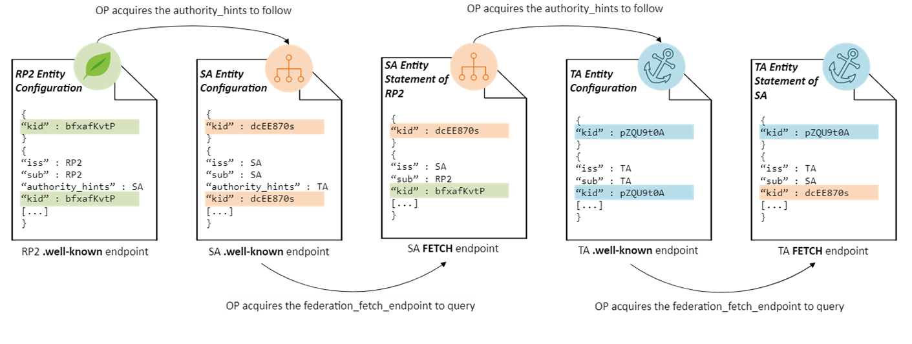
OID Federation: Trust Establishment
In OID Federation, this is done through the Trust Chain Resolution, which consists of the following subphases:
Entity Statements fetching
Trust Chain validation
Cryptographically verifiable concatenation of Entity Statements that represents a chain starting at a leaf Entity and ending in a Trust Anchor, verifiable using one of the Trust Anchor public keys

Slide 36
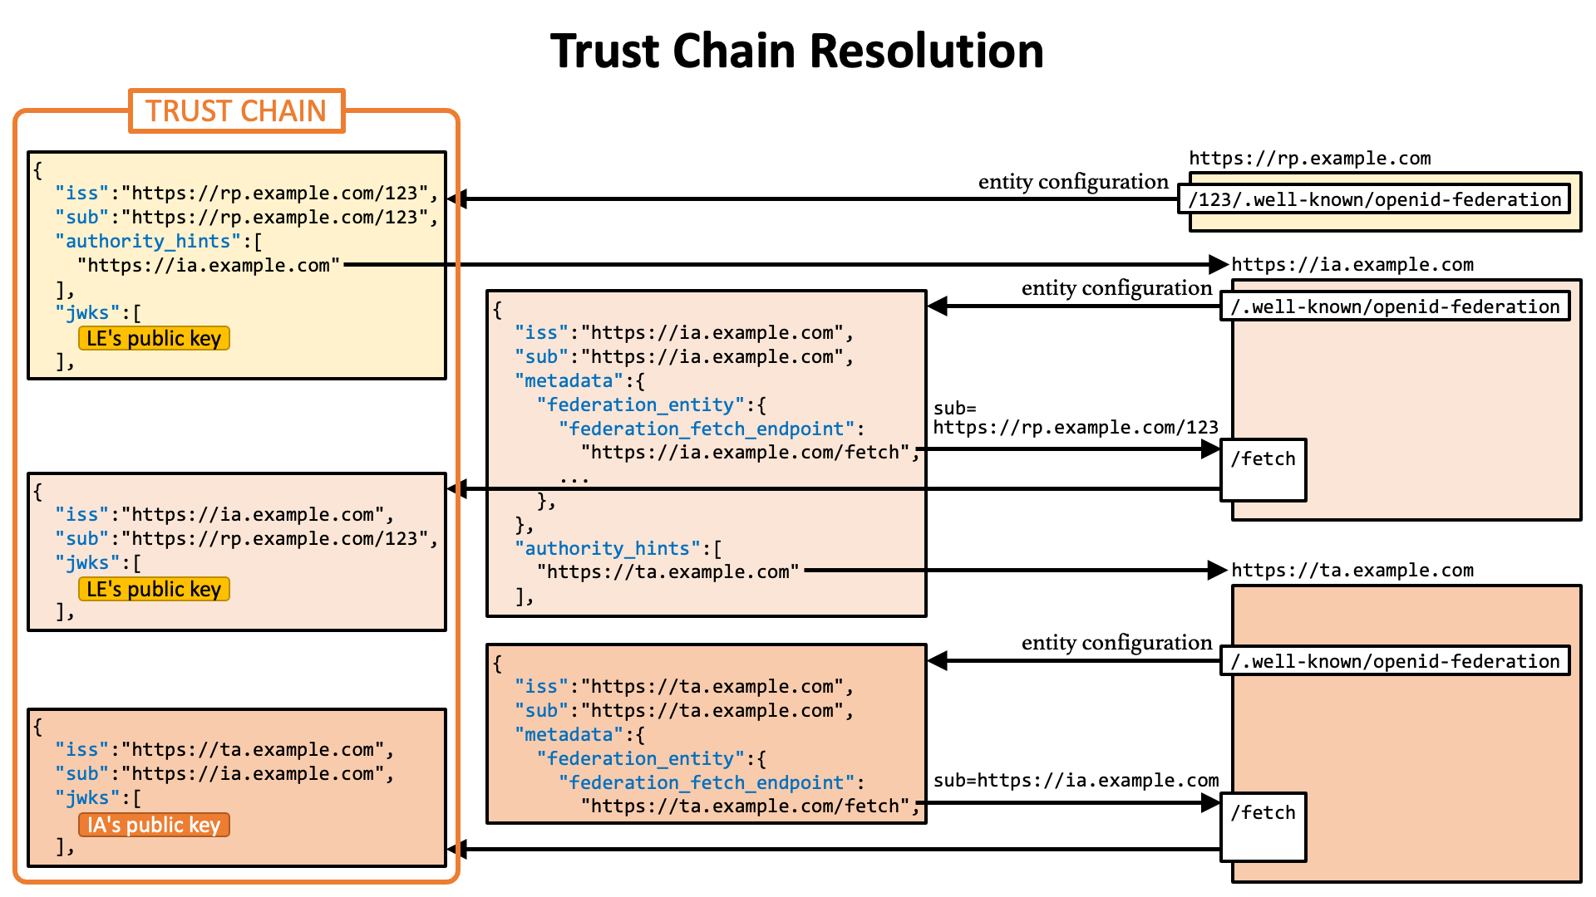
OID Federation: Trust Chain Resolution
Credits: Authlete (source)

Slide 37
Metadata Resolution process
Credits: Authlete (source)

Slide 38
OID Federation: Applying Metadata Policies
Metadata Resolution process: process followed by a Trust Evaluator Entity to derive the final metadata of a Target Entity. It requires a run of the Trust Establishment process as the metadata and their policies are contained within the Entity Configurations and Statements fetched during the establishment process.
A Registration Authority may enforce administrative and technical information (e.g. cryptographic algorithms, claims requested by an RP or provided by an OP, etc.)
Metadata policy may be applied only to a direct subordinate Entity or to the entire chain depending on the use cases.

Slide 39
SUMMARY
Trust Establishment + Metadata Resolution
ASSUMPTION: all Entities performed the Registration process
3. Get information/keys about the Intermediate from the TA + policies
Trust Anchor X
Trust Anchor Y
2. Get information from the Leaf’s Superior (Intermediate)
What the Intermediate says about the Leaf
The Leaf’s key to verify the Leaf’s information + policies
What the Intermediate says about itself.
Int. A
Int. XY.B
Int. Y.A
Int. Y.B
1. Get information from the Leaf
What the Leaf says about itself.
Entity A
Entity D
Entity B
Entity C
OUTPUT
1. Trust Chain
2. Final metadata according to the processed policies
3. Verified Trust Marks

Slide 40
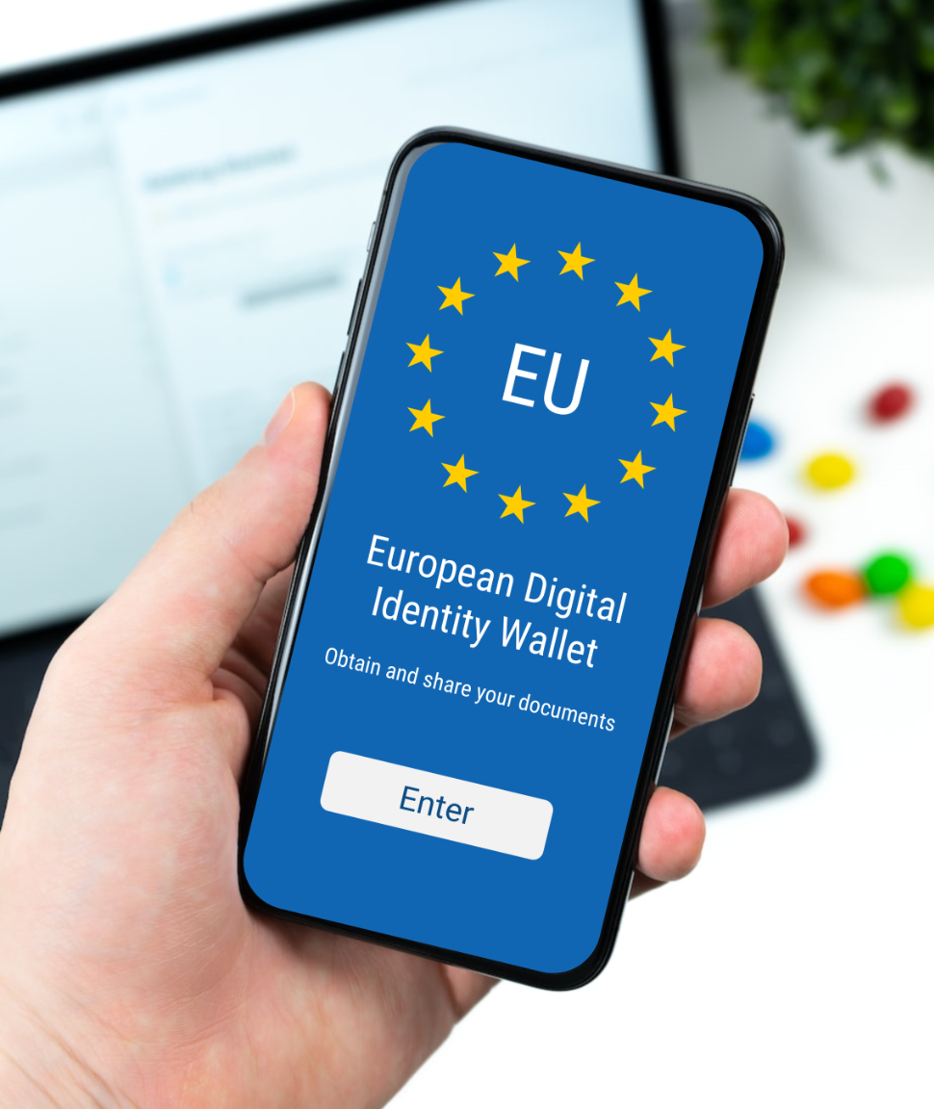
Using OpenID Federation in the Wallet Ecosystem

Slide 41
Wallet Ecosystem
REQUIREMENTS
1. All the Trust Anchors URLs/public keys must be taken from the Trusted Lists.
2. The Trust Anchors public keys published on their own MUST match the ones obtained from the Trusted Lists -> double check (don’t rely entirely on TLS!)
OpenID Federation Roles
EU Trusted List
Trust Anchor Entities
Trust Anchor MS
Trust Anchor IT
Trust Anchor MS
Listed in the Trusted List. They Issues signed statements and X.509 Certificates (CAs).
Intermediates Entities
CABs/NABs
Intermediates
CABs/NABs
Intermediates
CABs/NABs
Intermediates
Provisioning of the accreditation system. Surveillance of their registered Entities.
Leaf Entities
Relying Parties
Wallet Providers
Issuers
PID/(Q)EAA Providers, RPs, Wallet Providers, QTSPs, (Q)EAA Schema Providers, etc.
Presents Credentials
Issues Credentials
Reliability and security of the mobile apps are attested by Verifiable Attestations provided by Wallet Providers and Relying Parties
Verifier Apps
Wallet Instances
Not an Organization. It doesn’t require federative registration.

Slide 42
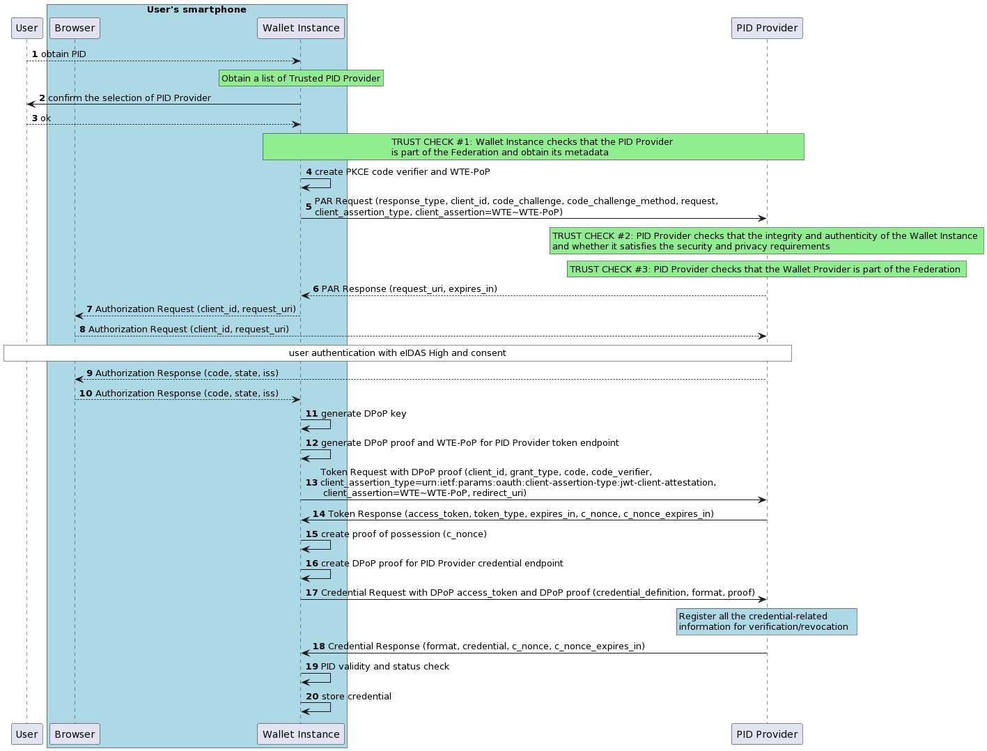
Issuance Phase
Notes:
https://www.plantuml.com/plantuml/png/bLJTRzis47_dNt587hO0CePjRm9QD1zUOxJO3DT1NWe8Z7IsRv58ZHzMiuVzxJkIjaevJT020IAJTp_-FevyPvqqpdUjaDvfvRi7D4Bql4OrzL8vEBkpQCv0Ml12FEWlQU4d2xRZgdwd5Px1-KVQxjnLwt7QUsNqCBRBwTwzR5jqi51CGTKOQmQ1gW4-HPoGM2vkO6dqdfe36d65XzdiBGmbw0SdIG4N2M6KTWXwZmO6O6ABzxVhzwlv_4_nLwgIq99re3UmDjuwR2073mGYX133xAqleTPgGwO3jqEms6BjI2lkddO9prG2aySfWu8c5DQhkqzhkBwTNt-0yrzBEF40wXtMZvRFaYuUc9y1WYomAP5wsFm3ULL6Eb8rHnF8MUZGoKOwcOk1O1Mm7eFICVA7wpbhQn2O9sq8JGIvNyzdIxqyr1FNBozNiC9_FB9dFnkqlLOMA_VKOm5rIwXSHKqHeQfw5_IeBPx-hfZHJdEPIKW5V5Q7PcajcY0YmyoNtp2b_mwqBY0tznLhVokdrftwIihXrf1xYgAbvpNbgEQ5excdoOXGEEnOHZZPWMNZBTjc3uDH-n6kDxINzLFKIWOxXhOmHl6T2dv_LS78Rzn_UJQo8H2KRimOQqgJSqsnL2oY0FpICsrRaRhWbY6sU5d29Tka3VsROCUPo8OWWxaGNiPE-k56CR6ey71-VxjOpuMtQBvcbS06SZl0nStb9xZb9oZwNmTDoZtNpOnEo6GMX84jWDDs_8-i7GKCFzAKNRGjgX01mWrFBZpYqujxlT5wary_s6WpZT_fHrJ0YdfDB2sxdslU6KrDVcIWkSbR8vKxtZBT72_fyVw_U2VVUADAGhSfUS9aPqiTGYXJxMoidONQyk_1pOuxpZ6bQ5dnMRrwiSC4D6ImFeu09QUIlDnnMTTeRHNzA98jaMG-jYoiKbhLE7vKsKm_VmkJLVpNQsiPdScnSQapba_hCt-V1yKbJPXFsOvfPM5TVzrzdbWkBKp3DCUnisfmGugYhU7yJheYLLrywssv-dWt5olSadMyAjisl0yPpPd1baKr84WbD0QEkj9Wf8lsYy6zJf-GloXZJhcoCQm3k-oqxuuccBgNBJN7LpLCahVf7SpghDCcboFUCJdVjVy3

Slide 43
Issuance Phase
E.g., using the Entity listing endpoint exposed by the MS Trust Anchor

Slide 44
Issuance Phase
The Wallet Instance MUST check whether the Issuer is part of federation, and then it derives its metadata from the Trust Chain by applying the policies (enabling/disabling the credential allowed for the issuance)
The Issuance flow starts with the User who selects in the Wallet Instance the attestation to be issued and the corresponding Issuer from a list of alternatives. Given the Issuer Entity Identifier, the Wallet Instance performs the Trust Establishment process + Metadata Resolution process.
[Wallet Instance = Trust Evaluator, PID Provider = Target Entity]
E.g., using the Entity listing endpoint exposed by the MS Trust Anchor

Slide 45
Issuance Phase
The Wallet Instance MUST check whether the Issuer is part of federation, and then it derives its metadata from the Trust Chain by applying the policies (enabling/disabling the credential allowed for the issuance)
The Issuance flow starts with the User who selects in the Wallet Instance the attestation to be issued and the corresponding Issuer from a list of alternatives. Given the Issuer Entity Identifier, the Wallet Instance performs the Trust Establishment process + Metadata Resolution process.
[Wallet Instance = Trust Evaluator, PID Provider = Target Entity]
E.g., using the Entity listing endpoint exposed by the MS Trust Anchor
The Issuer MUST check the integrity and authenticity of the Wallet Instance and whether it satisfies the security and privacy requirements for the attestation storage before issuing the required credentials
The Issuer checks the WTE. It ensures that:
the Wallet Instance maintains a level of integrity that is capable of preventing any manipulation or forgery attempts by unauthorized third parties.
pass conformity checks from the Wallet Provider that assures that the security and trust objectives are fulfilled.

Slide 46
Issuance Phase
The Wallet Instance MUST check whether the Issuer is part of federation, and then it derives its metadata from the Trust Chain by applying the policies (enabling/disabling the credential allowed for the issuance)
The Issuance flow starts with the User who selects in the Wallet Instance the attestation to be issued and the corresponding Issuer from a list of alternatives. Given the Issuer Entity Identifier, the Wallet Instance performs the Trust Establishment process + Metadata Resolution process.
[Wallet Instance = Trust Evaluator, PID Provider = Target Entity]
E.g., using the Entity listing endpoint exposed by the MS Trust Anchor
The Issuer MUST check the integrity and authenticity of the Wallet Instance and whether it satisfies the security and privacy requirements for the attestation storage before issuing the required credentials
The Issuer checks the WTE. It ensures that:
the Wallet Instance maintains a level of integrity that is capable of preventing any manipulation or forgery attempts by unauthorized third parties.
pass conformity checks from the Wallet Provider that assures that the security and trust objectives are fulfilled.
The Issuer MUST check that the Wallet Provider is part of the federation
There are two alternatives:
Dynamic: as part of the Issuance flow, the Wallet Instance performs a PAR Request containing the Wallet Trust Evidence (WTE) issued by the Wallet Provider. From the iss claim of the WTE the Issuer extracts the Wallet Provider Entity Identifier and checks if it is part of federation performing the Trust Establishment process.
[PID Provider = Trust Evaluator, Wallet Provider = Target Entity]
Static: the Issuer verifies the Trust Chain in the header of WTE.

Slide 47
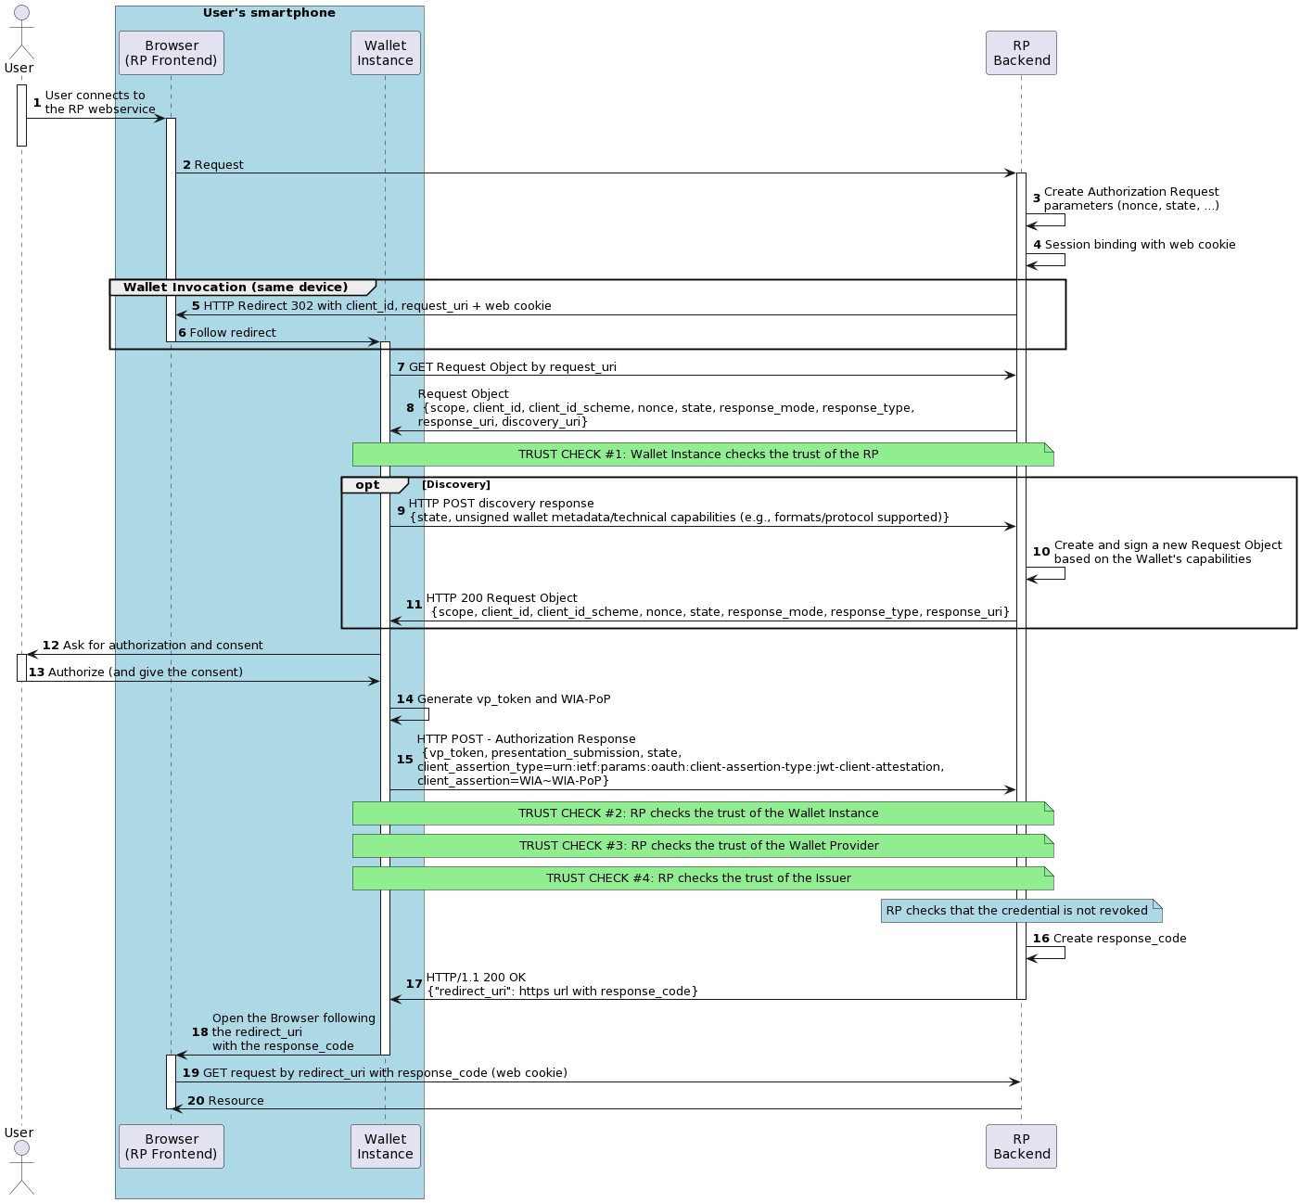
Presentation Phase
The Wallet Instance MUST check whether the RP is part of federation
There are 2 alternatives:
  Dynamic:
    OpenID4VP: from the client_id claim of the Request Object the Wallet Instance extracts the RP Entity Identifier and checks if it is part of federation performing the Trust Establishment process + Metadata Resolution process.
    [Wallet Instance = Trust Evaluator, RP = Target Entity]
    ISO 18013-5: based on x.509 certificates in combination with the OpenID Federation
  Static: it checks the Trust Chain from the header of the Request Object and then does a fast renewal of this for checking the revocation.
and has the authorization to ask for a certain credential.
Given the Trust Chain, the Wallet Instance applies the policy and checks the RP’s Trust Marks if any (example a Trust Mark that allows the handling of data related to under.age user).
Requirement: presentation_definition must be included in the RP’s metadata.
Notes:
https://www.plantuml.com/plantuml/png/lLLBZzis4BxpLmoSWstKzZxIau04sTtciKY1DHm7kHWmA6fiSIsHAZcIkbriVtj9qPOb6oswbvmaKJFVDzzm7XyiSKDbdh6XHIeBnalIginZD8mDkI1jB6iUa0AtCFXkqGnOhFyChqCBDdS8HQeL3W3U_2wtATrc9RB27KiX2wu8gatZV6jqxPnMQhIOmoUZ5Q5AniwjPrmtjZzubY6jrBro8Ig10-PimH7tWUF6U35VgLikTivam1YmOOxMyYrQz-6YbnKdX9IbC7tlOed0Xmv2AuM2B926bQ8KmKLLO-p-LLBWqTEvi0GxEApQJDzNSGGB_AD4I_s_HxVOMSQUqzlU6VI7DoMbsiY_E4cj3W2EtwdYEH8Q2oEbdU09EE7a7hFPRDp1-UQaUTTOgaIgBTIIKX-sqwDt4XdR6bqM4F87zwhI8d2Dh2E01Bqu3-Wak5HyMIxdBen46XG4Ro-l0w3892fQosG29iIuBes4NxfCrSR7L4VmIMUPhi4459-ERkhQzzfV8MDrK08HVFwuR3Fm43_w0EAdBjzUTWtHgTrAmRCLki19DzJsTMr5YhdxsK-bGLjePN6TwwJxIKyUQANQ0ySzWKGwXWhDa_zyOKnfGl07K4-yW53iMuEe8bWkldzRmjsNZtTVuSrLTCn_A5zmyOYT1LzcP4fBe3Umhpd6T47msu7jcA1mEVC71zp6qWRjmdtUoogLbLk52TI1D4VY2IT-GIXI9GNFGF22npAJ9D7226VRsGGsskISx4LXD6cXCx1bKMX3c8nVseA3jdAvIi3p00U5zVc5nDnY0berieByeUqJ7-ypIBk-lFmP5zkzrfTE4QOGmOtT-KG0x_MbrogyYoBM7I0X-BQ94KRUSYihzAeFBkEJSL7l--GpAZJ-h2hMf7SOU7xStqpdUWw7U-zU-_HiNhIN3yy7b0aK1ZrlOxEsPPpBPaQqwLcfVGAvjMWQAv-PTwLHaKJQHCtqiP7sMOY2xRIrdNhRwB6cwU4F4Th0DZc7VkS4_RqNzQgkkOvSD_nhevmqr2jmt_uVtBdHbKpGm2k0V_rFu7jhopvU2nPd9KRGS-OKAiXWWeeapq1QSAvWi7ANdB3pNNAiQw4JR2Pw7OhducfsrJJNmrS_9WQ7oUmRO111IbHOA4qMPdqFveKbsDjWTTWJ3mM6pjulSTWqGzzleB0yknpko2Dx-pvw5xnctIrnNAf-AuGT4DP15_SyNXWTDzAOjMjjWLQNHfmGdcZhxwaFg98op_u1
Remark: In case of Verifier mobile apps, these should obtain a verifier attestations (or X.509 Certificate):
Using Federation: Attestation issue in the form of a Trust Mark

Slide 48
Presentation Phase
The RP checks the integrity and authenticity of the Wallet Instance
It checks that the Wallet Instance has not been tampered with and is a genuine, trusted application, the RP checks the WTE.
Remark: The presence of a valid attestation (e.g., a PID) is not sufficient, as a compromise of the Wallet Instance/Solution can occur after the issuance phase. Thus, even if the Issuer performed the WTE checks, the same security guarantees cannot hold.
Notes:
Remark: In case of Verifier mobile apps, these should obtain a verifier attestations (or X.509 Certificate):
Using Federation: Attestation issue in the form of a Trust Mark

Slide 49
Presentation Phase
The RP checks the integrity and authenticity of the Wallet Instance
It checks that the Wallet Instance has not been tampered with and is a genuine, trusted application, the RP checks the WTE.
Remark: The presence of a valid attestation (e.g., a PID) is not sufficient, as a compromise of the Wallet Instance/Solution can occur after the issuance phase. Thus, even if the Issuer performed the WTE checks, the same security guarantees cannot hold.
The RP MUST check whether the Wallet Provider that manages the Wallet Instance is part of federation
There are 2 alternatives:
  Dynamic [RECOMMENDED]: from the iss claim of the WTE the RP extracts the Wallet Provider Entity Identifier and checks if it is part of federation performing a run of the Trust Establishment process + Metadata Resolution process. [RP=Trust Evaluator, WP=Target Entity]
  Static: it checks the Trust Chain from the header of the WTE.
Notes:
Remark: In case of Verifier mobile apps, these should obtain a verifier attestations (or X.509 Certificate):
Using Federation: Attestation issue in the form of a Trust Mark

Slide 50
Presentation Phase
The RP checks the integrity and authenticity of the Wallet Instance
It checks that the Wallet Instance has not been tampered with and is a genuine, trusted application, the RP checks the WTE.
Remark: The presence of a valid attestation (e.g., a PID) is not sufficient, as a compromise of the Wallet Instance/Solution can occur after the issuance phase. Thus, even if the Issuer performed the WTE checks, the same security guarantees cannot hold.
The RP MUST check whether the Wallet Provider that manages the Wallet Instance is part of federation
There are 2 alternatives:
  Dynamic [RECOMMENDED]: from the iss claim of the WTE the RP extracts the Wallet Provider Entity Identifier and checks if it is part of federation performing a run of the Trust Establishment process + Metadata Resolution process. [RP=Trust Evaluator, WP=Target Entity]
  Static: it checks the Trust Chain from the header of the WTE.
The RP MUST check whether the Issuer of the obtained attestation is part of federation
There are 2 alternatives:
  Dynamic [RECOMMENDED]: from the presented attestation the RP extracts the Issuer Entity Identifier and checks if it is part of federation performing a run of the Trust Establishment process + Metadata Resolution process. [RP=Trust Evaluator, Issuer=Target Entity]
  Static: it checks the Trust Chain from the header of the presented attestation
Notes:
Remark: In case of Verifier mobile apps, these should obtain a verifier attestations (or X.509 Certificate):
Using Federation: Attestation issue in the form of a Trust Mark

Slide 51
Presentation Phase
The RP checks the integrity and authenticity of the Wallet Instance
It checks that the Wallet Instance has not been tampered with and is a genuine, trusted application, the RP checks the WTE.
Remark: The presence of a valid attestation (e.g., a PID) is not sufficient, as a compromise of the Wallet Instance/Solution can occur after the issuance phase. Thus, even if the Issuer performed the WTE checks, the same security guarantees cannot hold.
The RP MUST check whether the Wallet Provider that manages the Wallet Instance is part of federation
There are 2 alternatives:
  Dynamic [RECOMMENDED]: from the iss claim of the WTE the RP extracts the Wallet Provider Entity Identifier and checks if it is part of federation performing a run of the Trust Establishment process + Metadata Resolution process. [RP=Trust Evaluator, WP=Target Entity]
  Static: it checks the Trust Chain from the header of the WTE.
The RP MUST check whether the Issuer of the obtained attestation is part of federation
There are 2 alternatives:
  Dynamic [RECOMMENDED]: from the presented attestation the RP extracts the Issuer Entity Identifier and checks if it is part of federation performing a run of the Trust Establishment process + Metadata Resolution process. [RP=Trust Evaluator, Issuer=Target Entity]
  Static: it checks the Trust Chain from the header of the presented attestation
Remark: the Static checks are needed for offline flows (no connectivity of both the Wallet and the RP)
Notes:
Remark: In case of Verifier mobile apps, these should obtain a verifier attestations (or X.509 Certificate):
Using Federation: Attestation issue in the form of a Trust Mark

Slide 52
How to handle concrete scenarios with Federation
Q: Can an Issuer provide Credentials for which it is not authorized to issue? Can an RP request credentials for which it is not authorized? For example, let's suppose a doctor issuing an e-prescription to a User's Wallet. We want that only pharmacies or hospitals are able to request such a Credentials.
A: The Registration Authority may enforce a subset of Credential types in the final Metadata of the RP or Issuer
Q: An RP may provide services within different federated ecosystems (nested federation). Must it expose different configurations for each ecosystem? For example, a Diploma Issuer in the EUDIW ecosystem may belong to different federated sub-systems (eduGAIN, REFEDS, etc.)
A: An RP may expose the same Entity Configuration. Each Registration Authority may have different Metadata Policy and an Entity communicating with that RP is able to perform the Metadata Resolution obtaining the final Metadata according to the specific rules. Moreover an RP belonging to different federated sub-ecosystems is always recognizable through Trust Marks. They are also useful to enable interoperability between multiple Trust Anchors.

Slide 53
How to handle concrete scenarios with Federation
Q: An RP is authorized by national law to provide services for underage persons, to handle with health or payment data.
Q: A Wallet Provider is authorized to provide a Wallet Solution only for Digital Identity Credentials and not for payments or signature for some security or legal reasons. How can a RP or an Issuer be aware of this?
A: A national Supervisory Body or CAB may be registered in the EUDI Wallet Ecosystems as Trust Marks Issuers. They may provide a RP with a Trust Mark attesting that it is authorized to provide special services or handle with sensitive user’s data. Or they may provide a Trust Mark to the Wallet Provider enabling its Wallet Solution to provide (or not) payment or signature services

Slide 54
Data Model: SD JWT VC with OpenID Identity Assurance Profile
{
"iss": "https://issuer.example.org",
"sub": "NzbLsXh8uDCcd7noWXFZAfHkxZsRGC9Xs",
"jti": "urn:uuid:6c5c0a49-b589-431d-bae7-219122a9ec2c",
"iat": 1683000000,
"exp": 1883000000,
"status": "https://pidprovider.example.org/status",
"vct": "PidIdentificationData",
"verified_claims": {
"verification": {
"trust_framework": "eidas",
"assurance_level": "high",
"evidence": [
{
"type": "electronic_record",
"record": {
"type": "https://eudi.wallet.cie.gov.it",
"source": {
"organization_name": "Ministero dell'Interno",
"organization_id": "urn:eudi:it:organization_id:m_it",
"country_code": "IT"
}
}
}
]
},
"claims": {
"unique_id": "xxxxxxxx-xxxx-xxxx-xxxx-xxxxxxxxxxxx",
"given_name": "Mario",
"family_name": "Rossi",
…
}
}
}
In Italy, we defined a SD-JWT VC data model based on OpenID Identity Assurance Profile [OIDC.IDA].
Provide evidence of the trust framework and the identity proofing procedures underlying the issuance.
The Holder or a Relying Party can rely on this information for their purposes.
Transparency, especially in cases where the authentic source is not acting as a Credential Issuer
However, this breaks the interoperability with the SD-JWT VC Data Model as defined here, as we have the User claims nested in the verified_claims field. (Issue)

Slide 55
Data Model: SD JWT VC with OpenID Identity Assurance Profile
Proposed solution:
Duplicate the User claims at root level according to SD-JWT VC Data Model
Add verified_claims as an array of JSON Objects at the same level of the User claims
This proposal has the following benefits:
The Verifier supporting the IDA profile is able to obtain the evidence of ONE OR MORE Authentic Sources which the User attributes are taken from.
In the case where the Verifier doesn’t support OpenID Identity Assurance Profile, it obtains the User claims. The verifications field would be then ignored.
Further discussions are needed.
{
"iss": "https://issuer.example.org",
"sub": "NzbLsXh8uDCcd7noWXFZAfHkxZsRGC9Xs",
"jti": "urn:uuid:6c5c0a49-b589-431d-bae7-219122a9ec2c",
"iat": 1683000000,
"exp": 1883000000,
"status": "https://pidprovider.example.org/status",
"vct": "PidIdentificationData",
"unique_id": "xxxxxxxx-xxxx-xxxx-xxxx-xxxxxxxxxxxx",
"given_name": "Mario",
"family_name": "Rossi",
"email": "verified@email.example.org",
"verified_claims": [
{
"verification": { ... },
"claims": {
"unique_id": "xxxxxxxx-xxxx-xxxx-xxxx-xxxxxxxxxxxx",
"given_name": "Mario",
"family_name": "Rossi",
…
}
},
{
"verification": { ... },
"claims": {
"email": "verified@email.example.org",
…
}
}
]
}

Slide 56
Revocation - Status Attestation
Use Case Scenario:
A Verifier needs to check the status of a given Credential only during the presentation flow.
A Verifier is not allowed to check the status of a Credential over time (after it was presented by the Holder), due to some privacy constraints.
No internet connection is available during the presentation phase (however, we assume that the Wallet Instance had an internet connection within the last 24h).
The idea:
The Credential Issuer provides the Wallet Instance with a Status Attestation, which is bound to a Digital Credential. This allows the Wallet Instance to present it, along with the Digital Credential itself, to a Verifier as proof of the Digital Credential's non-revocation status.
Notes:
Thank you, Paul. As you know, in Italy, we have supported status lists from the beginning, and we think it's an optimal way to manage revocations;
I also find the work you have done on storage optimization and the general efficiency of the approach exciting to say the least and beyond any doubt, you know that I couldn't have done anything better or similar.
However, we have asked to include an additional approach to enrich the solution you proposed, which we have outlined in a draft. Before moving on to technical solutions, I want to put on the table the issues related to how privacy is protected when we approach the revocations.
In Italy, we are pleased to address the issues raised by the privacy authority, such as the risk that an RP, once it has obtained a credential, can check its status over time and beyond the purposes of the user's authentication. The example I like to give is monitoring how long Paul remains employed at BSI by checking the status of his affiliation credential.
For this reason, we have designed an OCSP stapling-like mechanism, enabling revocation checks also in offline flows, where the verifier is not connected to the internet.
The draft we have created in Italy started from the approach defined in the status list. I consider it as a sort of extension of it, using the same status schema.
I agree that in some use cases, the status list is the way to go, while in other cases, the status attestation is more appropriate. So, I agree that we could define which use cases and kinds of interactions require one or the other, or could enable both.

Slide 57
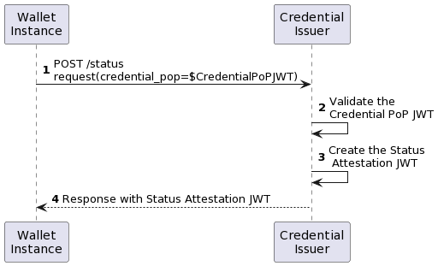
Revocation - Status Attestation Request
{
"alg": "ES256",
"typ": "status-attestation-request+jwt",
"kid": $WIA-CNF-JWKID
}
.
{
"iss": "0b434530-e151-4c40-98b7-74c75a5ef760",
"aud": "https://issuer.example.org/status",
"iat": 1698744039,
"exp": 1698834139,
"jti": "6f204f7e-e453-4dfd-814e-9d155319408c",
"credential_format": "vc+sd-jwt",
"credential_pop": $ …
}
Notes:
Just like the Wallet Attestation, or WTE, is obtained during the execution of the Wallet Instance where necessary, the status attestations are also taken from the wallet instance, without requiring the presentation of the credential but only proving its possession.
This means that we’re working to prevent the credential being provided to the issuer, since accessing to the secure storage would require an additional user authentication according to a loa high.

Slide 58
Revocation - Status Attestation JWT
{
"alg": "ES256",
"typ": "status-attestation+jwt",
"kid": $ISSUER-JWKID
}
.
{
"iss": "https://issuer.example.org",
"iat": 1504699136,
"exp": 1504700136,
"credential_hash": $CREDENTIAL-HASH,
"credential_hash_alg": "sha-256",
"cnf": {
"jwk": {...}
}
}
The cnf.jwk value MUST match with the one provided within the related Credential.
Notes:
The status attestation doesn’t require to be stored in a secure storage and doesn’t contain any information about the user, the subject of the attestation is a credential, not the wallet nor the user. Then this attestation is a sub-artifact related to a digital credential or another attestation.
This specs was born after the IETF in prague, some colleagues asked me to make a step forward with this proposal, at the current stage we have aboard another co-author that will bring this specs for discussion in the next IETF WG in brisbane.

