Slide 1
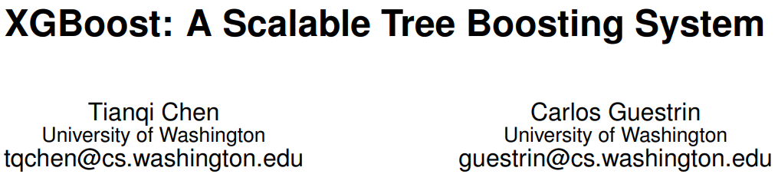
KDD '16: Proceedings of the 22nd ACM SIGKDD International Conference on Knowledge Discovery and Data Mining,
August 2016
Presenting: Peppi-Lotta Saari
Notes:
Paper was written by the person who created the xgboost. It a paper that present and agues for all the optimization that are done and talks about lessons learnt when building XGBoostlessons we learnt when building XGBoost
‹#›

Slide 2
What is xgboost?
“xgboost is short for eXtreme Gradient Boosting package. It is an efficient and scalable implementation of gradient boosting framework by (Friedman, 2001) (Friedman et al., 2000). The package includes efficient linear model solver and tree learning algorithm. It supports various objective functions, including regression, classification and ranking. The package is made to be extendible, so that users are also allowed to define their own objectives easily.”
Chen, Tianqi, et al. "Xgboost: extreme gradient boosting." R package version 0.4-2 1.4 (2015): 1-4.
‹#›
Notes:
This refered paper is also by the creator of xgboost and has examples on how to use the baggage. This paper had a better summary of what xgboost is
‹#›

Slide 3
AGENDA
Why xgboost?
Weighted quantile sketch
How trees are made
Supported features
Handling sparse data
System optimisation
Want to learn more?
Discussion points
2

Slide 4
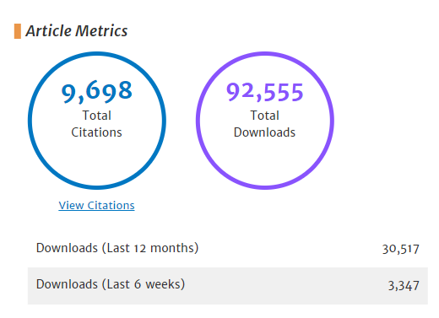
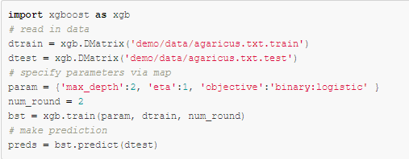
Why xgboost?
Extremely popular
Used in winning solutions
Easy implementation and open source
Kaggle 2015:
17/29 solution used xgboost
KDDCup 2015:
every top 10 winning team used xgboost
store sales prediction; high energy physics event classification; web text classification; customer behavior prediction; motion detection; ad click through rate prediction; malware classification; product categorization; hazard risk prediction; massive online course dropout rate prediction
Training
https://xgboost.ai/about
SCALABILITY!
3
Notes:
Paper is still popular after eight years from it release.
Popular even before the release of the paper.
In Kaggle 8 used solely xgboost and rest used it in ensable with neural nets
I have listed some of the problems where xgboos was used.
Easy implementation. Max_depth of the tree, learning rate and objective. Then just one line of code.
Scalability is the most important reason for it success and I will spend the rest of the time going more into detail about the optimization done.
Often times data can be so big that it canot be stored in one computers main memory and accessing this data can make methods slow. A lot of the optimization presented in this paper deal with this.
‹#›

Slide 5
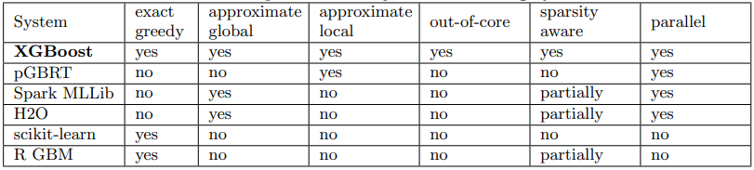
Supported features
EXACT GREEDY
APPROXIMATE GLOBAL
APPROXIMATE LOCAL
Algorithm that enumerates over all the possible splits on all the features
Proposes all the candidate splits during the initial phase of tree construction
Makes new proposals after every split.
More steps but more accurate
These use the weighted quantile sketch
‹#›
Notes:
Basic exact greedy is used for data that can be stored in one computer main memory.
Approximate algorithms both global and local approximate quantiles. These quantiles tell us what threshols the trees nodes should be. These approximate algorithm use weighte quantile sketch.
As you can see no other System implement or support all these optimization as the xgboost. I will be telling more about what weighted quantile sketch, out of core, sparsity aware and rarallel are in the next slides
‹#›

Slide 6
Weighted quantile sketch
QUANTILE SKETCH
WEIGHTED
Data is so large it can not fit in one computers memory, so it is split between multiple computer.
Sketch algorithm can make an approximate histogram from all the data.
From this histogram we get approximate quantiles.
Weight of an observation comes from hessian AKA second derivative of the Loss function.
This is done to enable merging and pruning.
12
Notes:
Instead of having eaqual amount of samples in each quantile we have equal sum of wheights within a quantile.
The authors introduced a novel distributed weighted quantile sketch algorithm that can handle weighted data with a provable theoretical guarantee. This paper didn’t have the proofs for this.
‹#›

Slide 7
​
How trees are made
: regularization term
: output of a leaf
minimize
Prevents over-fitting
Prevents over-fitting
4
Notes:
Terms that prevent over-fitting are not in the ‘normal’ gradient boost algorithm
‹#›

Slide 8
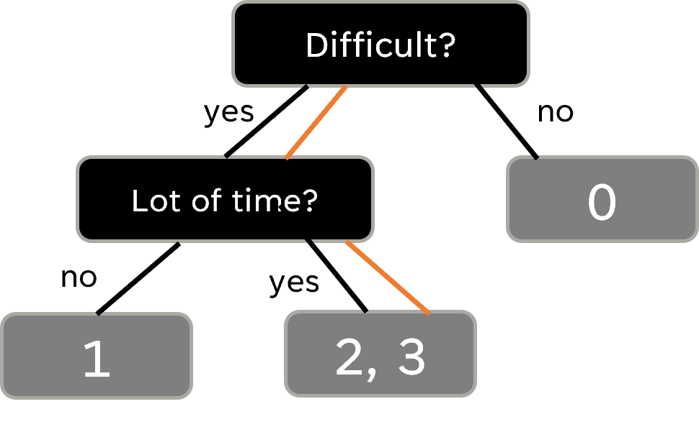
Handling sparse data
Student | Chose too difficult of a subject | Spent way too much time on it | Pass/Fail
0 | no | no | Fail
1 | yes | no | Fail
2 | ? | yes | Pass
3 | yes | yes | Pass
Default paths are generated automatically based on gain.
‹#›
Notes:
In many real-world problems, it is quite common for the input x to be sparse.
There are multiple possible causes for sparsity:
presence of missing values in the data;
2) frequent zero entries in the statistics; and,
3) artifacts of feature engineering such as one-hot encoding.
Gain -> test data on right and left side and see on which side the gain is better and choose that as default direction
To the best of the authors knowledge, most existing tree learning algorithms are either only optimized for dense data, or need specific procedures to handle limited cases such as categorical encoding
‹#›

Slide 9
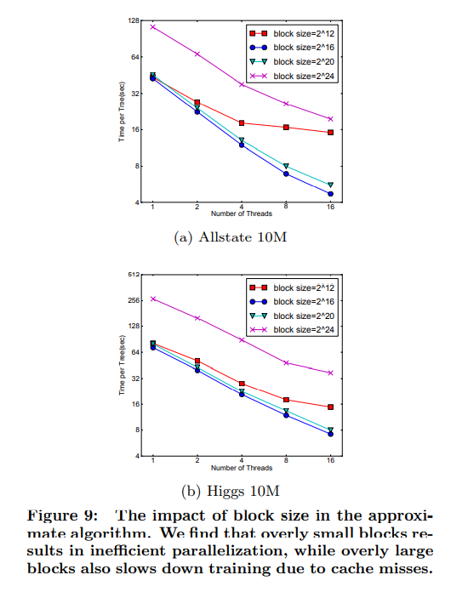
System optimisation
Out-of-core computation
Parallel and distributed computation
Data can divided into blocks and be stored in multiple machines or
disks.
Data is divided into blocks and sorted parallel to each other and then merged.
Cache-aware Access
Blocks for Out-of-core Computation
Block Compression: compress by columns, and decompres on the fly
Block Sharding: shard the data onto multiple disks in an alternative manner
CPU cache gradient and hessian
Greedy exact algorithm uses these for spilt finding.
Twice as fast as a ‘naive’ algorithm with big datasets
samples per block
‹#›
Notes:
In order to reduce the cost of sorting. Data is divided into blocks
A cache-aware algorithm is designed to minimize the movement of memory pages in and out of the processor's on-chip memory cache.
The idea is to avoid what's called "cache misses," which cause the processor to stall
A cache-aware algorithm is explicitly coded to take advantage of the processor's cache behavior
Block: compression The block is compressed by columns, and decompressed on the fly by an independent thread when loading into main memory. This helps to trade some of the computation in decompression with the disk reading cost. Deading a disk takes a lot of time.
A pre-fetcher thread is assigned to each disk and fetches the data into an in-memory buffer. The training thread then alternatively reads the data from each buffer
2 to the power of 16 was derived by testing.
‹#›

Slide 10
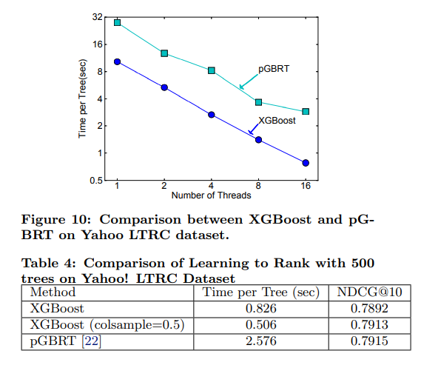
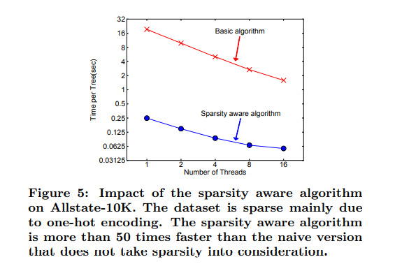
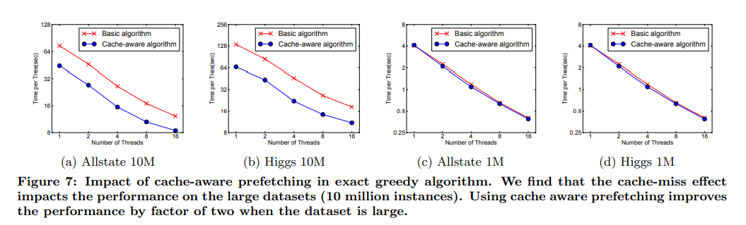
Summary
‹#›

Slide 11
Want to learn more?
https://xgboost.ai/about
These are not scientific recourses but are helpful for understanding
https://www.youtube.com/watch?v=OtD8wVaFm6E
https://medium.com/hypatai/what-makes-xgboost-fast-and-powerful-dc315313ee23
https://climbtheladder.com/xgboost-interview-questions/
‹#›
Notes:
‹#›

Slide 12
Discussion points
What could be the disadvantages of this method?
Do you get any benefit if you use this system for small data?
What are the advantages of using xgboost over other gradient boosting methods?
‹#›
Notes:
‹#›

