Slide 1
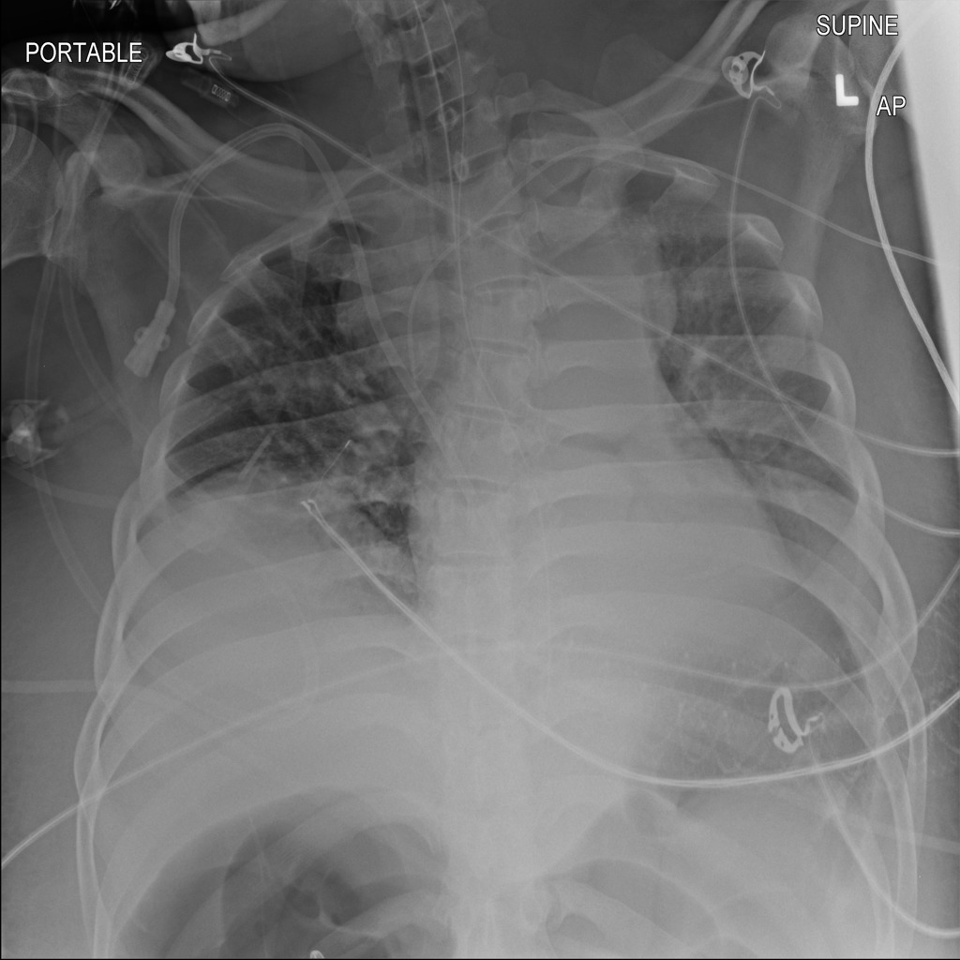
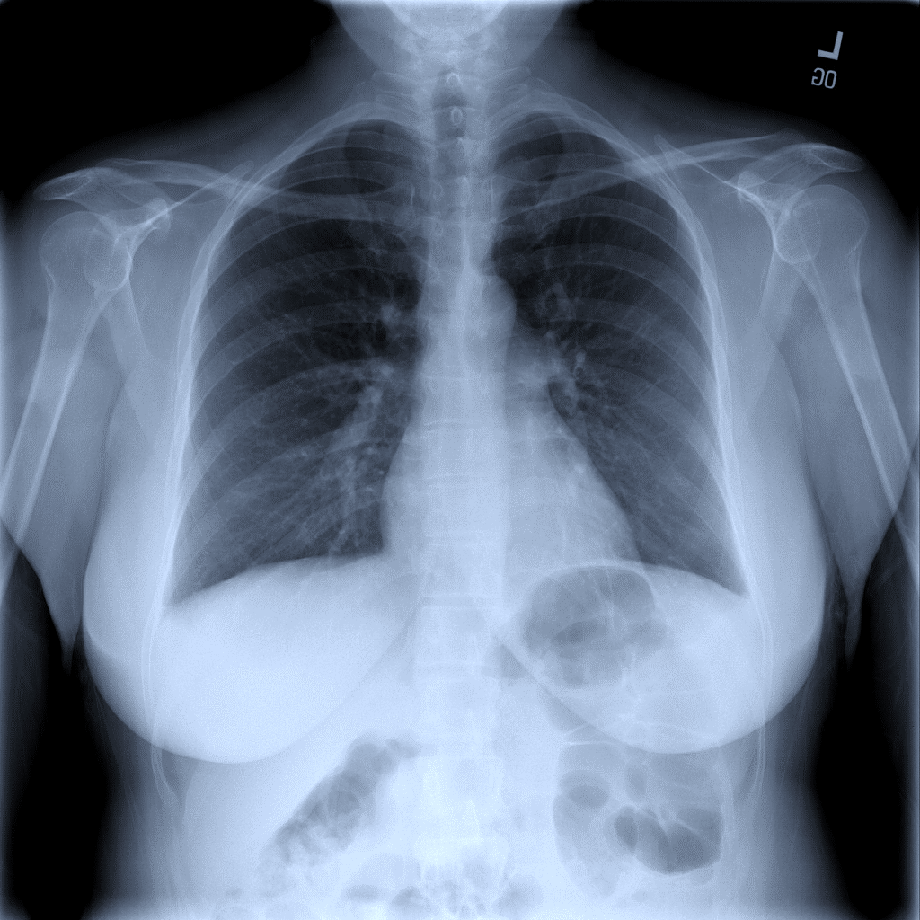
Screening X-ray Images for COVID-19 Infections
Lorenzo Loconte – Giuseppe Colavito – Università degli Studi di Bari Aldo Moro

Slide 2
Task
Goal : understand if a patient has a COVID-19 infection
Data : X-ray image of the chest
Task : binary classification task with an unbalanced dataset

Slide 3
Dataset
 | Train Set | Test Set
Positive | 2,158 (14%) | 200 (50%)
Negative | 13,793 (86%) | 200 (50%)
Total | 15,951 | 400
The COVIDx CXR-2 dataset

Slide 4
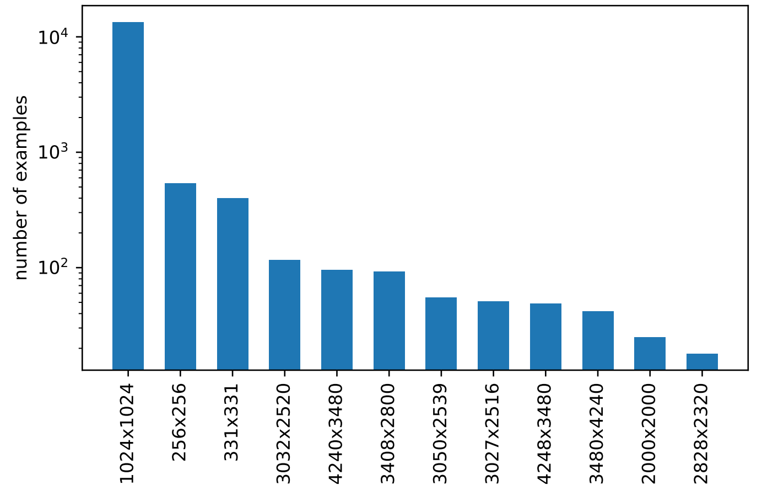
Dataset
The dataset is not uniform in terms of size of the images.
All the images are resized to 224x224

Slide 5
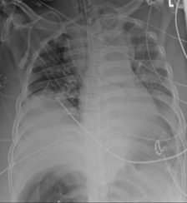
Preprocessing
Before training, the images are preprocessed.
Since some images contain writings on the upper part, the images are cropped (8% of the top-part)

Slide 6
Preprocessing
We are interested only on the chest, so we center crop the image to remove useless parts

Slide 7
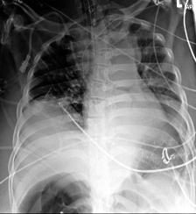
Preprocessing
We investigated the use of histogram-equalization to enhance the quality of the images

Slide 8
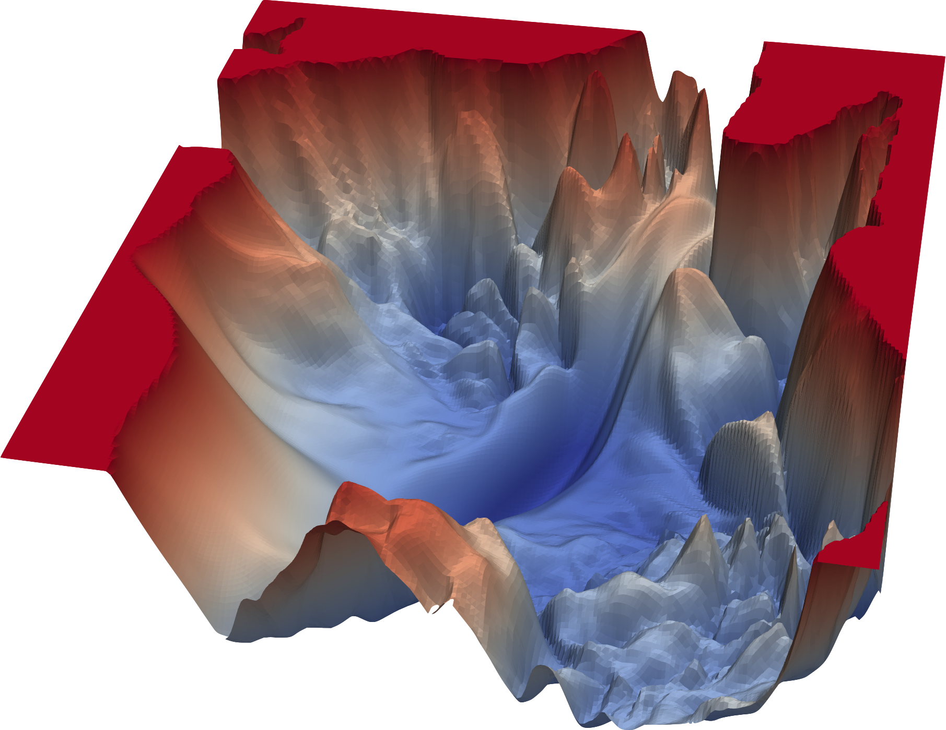
Neural Networks
AlexNet
VGG16
ResNet50
DenseNet121
InceptionV3

Slide 9
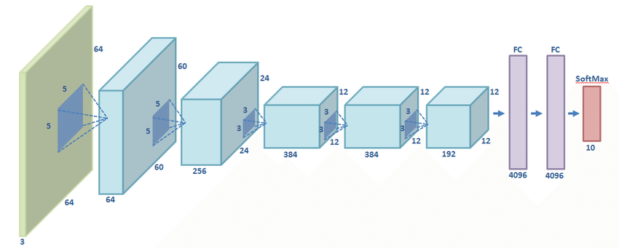
Neural Networks
AlexNet:
convolutional neural network (CNN)
no skip connections
ReLU activation functions
dropout

Slide 10
Neural Networks
VGG:
convolutional neural network (CNN)
stacks of 3x3 and 1x1 convolutions
ReLU activation functions

Slide 11
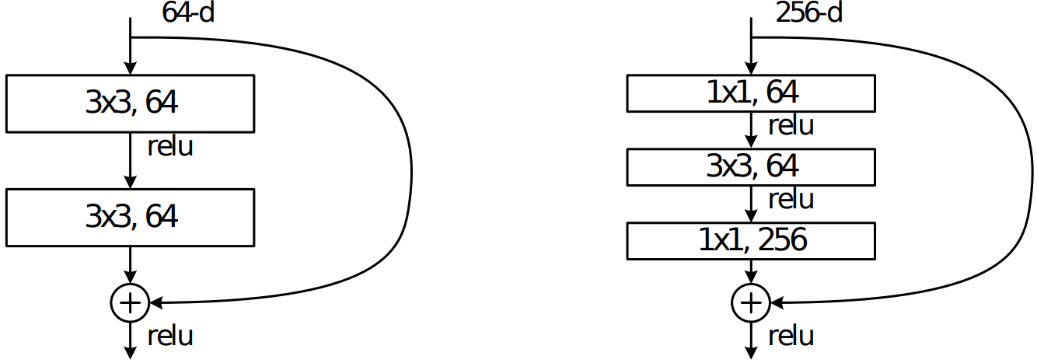
Neural Networks
ResNet:
convolutional neural network (CNN)
skip-connections
residual convolutional blocks (basic/bottleneck)
improves convergence rate → higher learning rate
batch normalization
Basic block
Bottleneck block

Slide 12
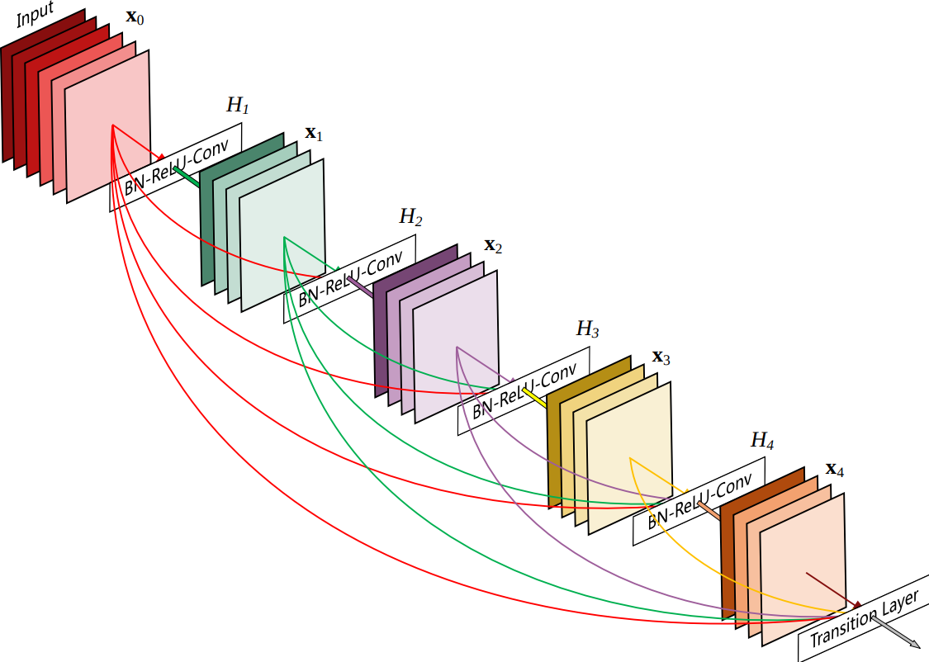
Neural Networks
DenseNet:
convolutional neural network (CNN)
direct connections to all subsequent layers (dense block)
transition layers (convolution and pooling)
ReLU activation functions
batch normalization

Slide 13
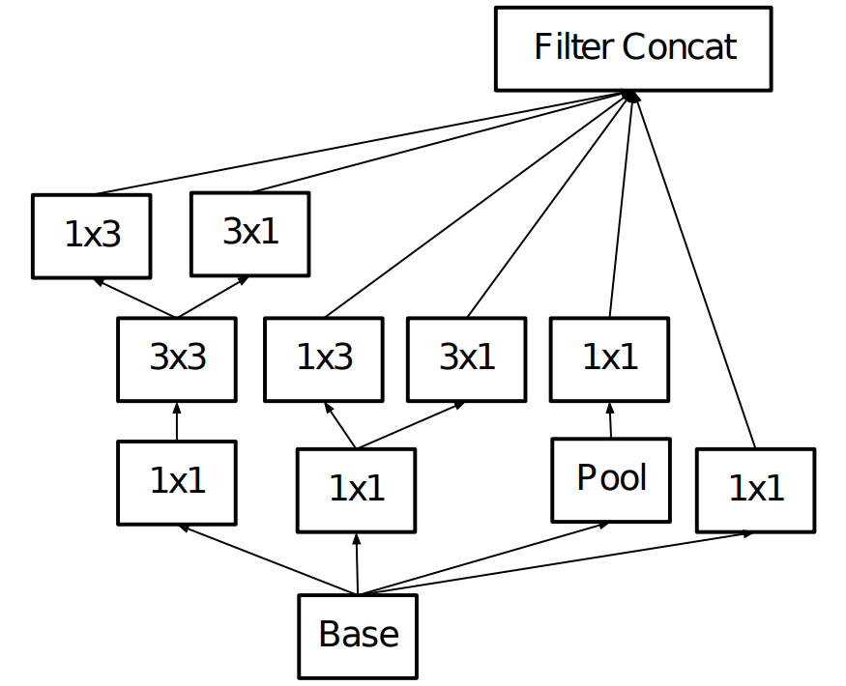
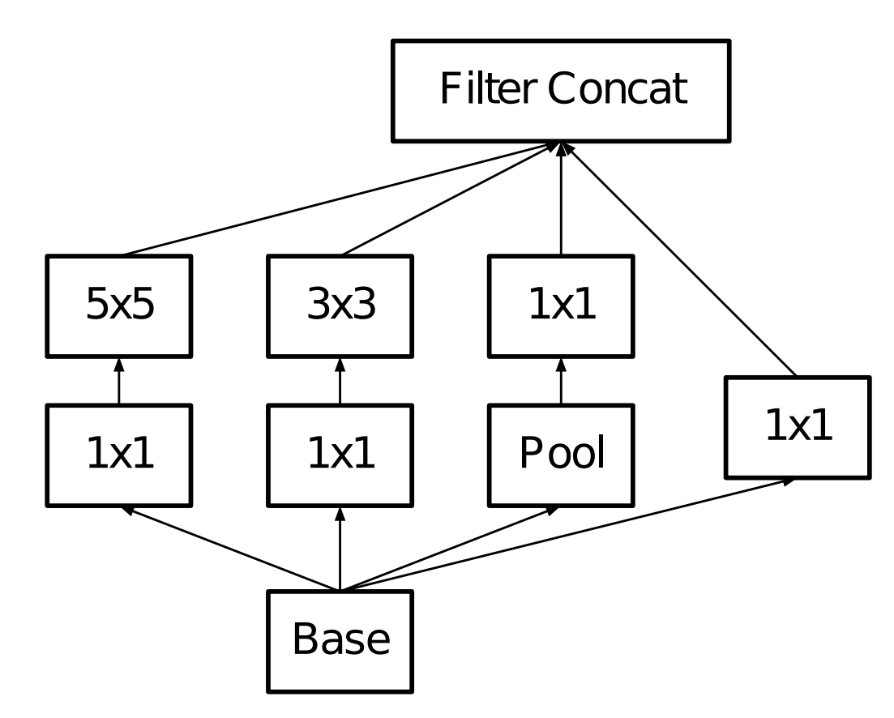
Neural Networks
InceptionV3:
convolutional neural network (CNN)
inception modules (parallel convolutions)
auxiliary classifiers
factorized convolutions
ReLU activation functions
batch normalization
InceptionV3 block
InceptionV1 block

Slide 14
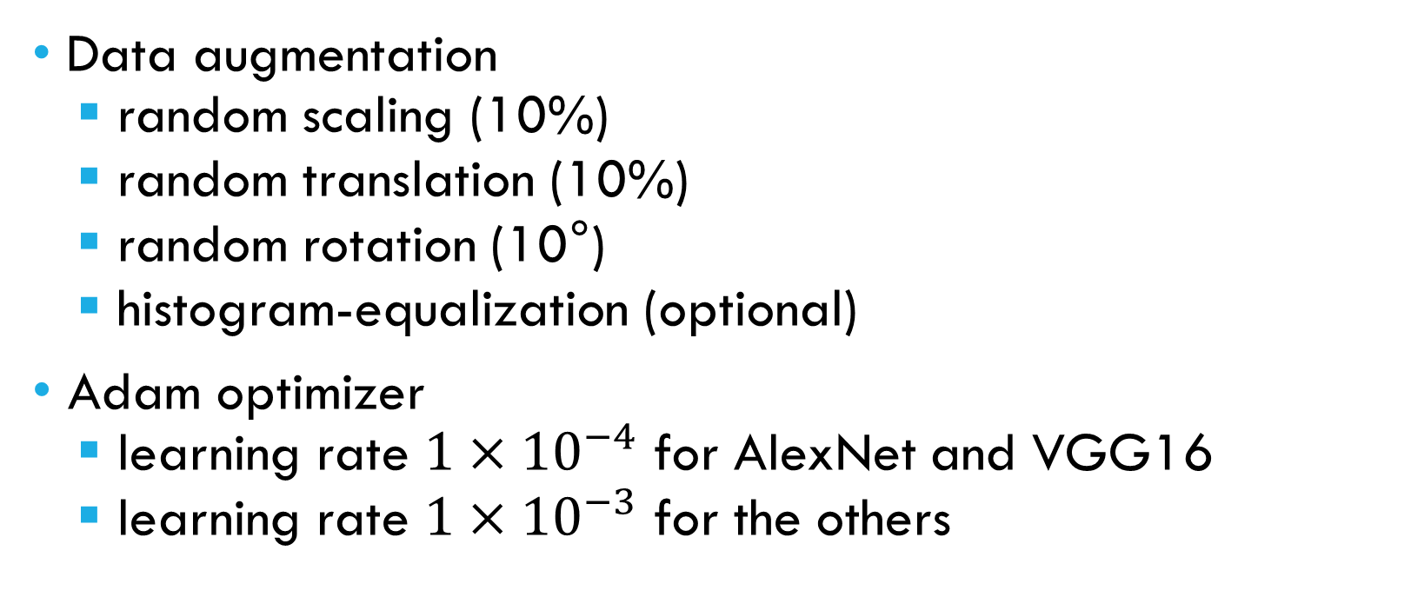
Methodology
Data augmentation
random scaling (10%)
random translation (10%)
random rotation (10°)
histogram-equalization (optional)
Adam optimizer
learning rate ${1×10}^{−4}$ for AlexNet and VGG16
learning rate ${1×10}^{−3}$ for the others

Slide 15
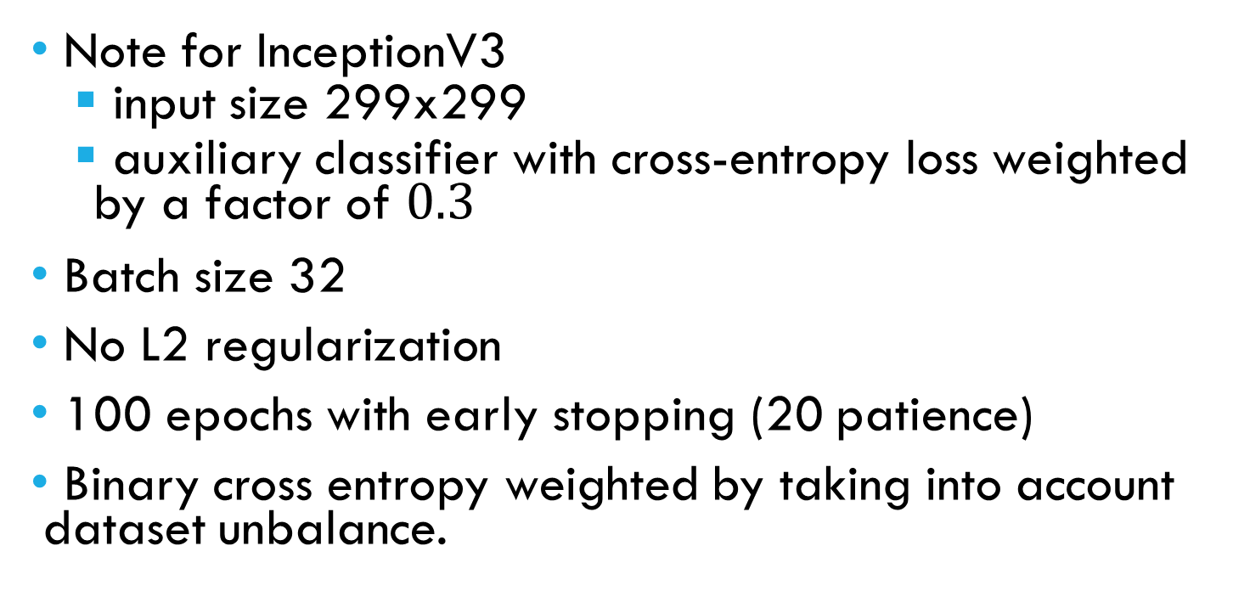
Methodology
Note for InceptionV3
input size 299x299
auxiliary classifier with cross-entropy loss weighted by a factor of $0.3$
Batch size 32
No L2 regularization
100 epochs with early stopping (20 patience)
Binary cross entropy weighted by taking into account dataset unbalance.

Slide 16


Tools and Hardware
Python 3.9
PyTorch library
GoogleColab
Nvidia GTX-1660
Intel 4460 quad-core 3.4 GHz

Slide 17
Evaluation
With Histogram Equalization
Without Histogram Equalization
Architecture | Precision | Recall | F1 | Precision | Recall | F1
AlexNet | 0.918 | 0.905 | 0.904 | 0.932 | 0.923 | 0.922
VGG16 | 0.890 | 0.863 | 0.860 | 0.876 | 0.835 | 0.830
ResNet50 | 0.953 | 0.952 | 0.952 | 0.949 | 0.945 | 0.945
DenseNet121 | 0.955 | 0.955 | 0.955 | 0.919 | 0.905 | 0.904
InceptionV3 | 0.933 | 0.925 | 0.925 | 0.975 | 0.975 | 0.975
Metrics are macro averaged over the two classes

Slide 18
Evaluation
Architecture | # params (M) | CPU Time (ms) | GPU Time (ms)
AlexNet | 57.0 | 21.5 | 2.6
VGG16 | 134.3 | 171.0 | 12.7
ResNet50 | 23.5 | 95.1 | 11.0
DenseNet121 | 7.0 | 84.1 | 21.5
InceptionV3 | 21.8 | 116.4 | 18.3
Number of parameters and inference time for each model

Slide 19
EVALUATION
Architecture | Input size | Precision | Recall | Accuracy
ResNet50 | 224 x 224 | 0.941 | 0.965 | 0.952
DenseNet121 | 224 x 224 | 0.955 | 0.955 | 0.955
InceptionV3 | 299 x 299 | 0.975 | 0.975 | 0.975
COVID-Net CXR-2 | 480 x 480 | 0.970 | 0.955 | 0.963
Comparison with state of the art

Slide 20
Future work
Explore more sophisticated preprocessing algorithm to further enhance images
Explainability and predictions visualization

Slide 21
References
[1] E. Sogancioglu, E. C ̧ alli, B. Ginneken, K. G. V. Leeuwen, and K. Mur-phy, “Deep learning for chest x-ray analysis: A survey,”ArXiv, vol.abs/2103.08700, 2021.
[2] J. P. Cohen, L. Dao, P. Morrison, K. Roth, Y. Bengio, B. Shen,A. Abbasi, M. Hoshmand-Kochi, M. Ghassemi, H. Li, and T. Q. Duong,“Predicting covid-19 pneumonia severity on chest x-ray with deeplearning,” 2020.
[3] M. Li, N. Arun, M. Gidwani, K. Chang, F. Deng, B. Little, D. Mendoza,M. Lang, O. Vtc Lee, A. O’Shea, A. Parakh, P. Singh, and J. Kalpathy-Cramer, “Automated assessment and tracking of covid-19 pulmonarydisease severity on chest radiographs using convolutional siamese neuralnetworks,”Radiology: Artificial Intelligence, vol. 2, p. e200079, 072020.
[4] K. He, X. Zhang, S. Ren, and J. Sun, “Deep residual learning for imagerecognition,”2016 IEEE Conference on Computer Vision and PatternRecognition (CVPR), pp. 770–778, 2016.
[5] G. Huang, Z. Liu, L. Van Der Maaten, and K. Q. Weinberger, “Denselyconnected convolutional networks,” in2017 IEEE Conference on Com-puter Vision and Pattern Recognition (CVPR), 2017, pp. 2261–2269.
[6] C. Szegedy, V. Vanhoucke, S. Ioffe, J. Shlens, and Z. Wojna, “Rethinkingthe inception architecture for computer vision,”2016 IEEE Conferenceon Computer Vision and Pattern Recognition (CVPR), pp. 2818–2826,2016.
[7] K. Simonyan and A. Zisserman, “Very deep convolutional networks forlarge-scale image recognition,”CoRR, vol. abs/1409.1556, 2015.
[8] A. Krizhevsky, I. Sutskever, and G. Hinton, “Imagenet classification withdeep convolutional neural networks,”Neural Information ProcessingSystems, vol. 25, 01 2012.
[9] I. Sirazitdinov, M. Kholiavchenko, R. Kuleev, and B. Ibragimov, “Dataaugmentation for chest pathologies classification,”2019 IEEE 16thInternational Symposium on Biomedical Imaging (ISBI 2019), pp. 1216–1219, 2019.
[10] M. S. Vidya, V. Manikanda Krishnan, G. Anirudh, K. Srinivasa Rao, andJ. Vijayananda, “Local and global transformations to improve learningof medical images applied to chest radiographs ,” inMedical Imaging2019: Image Processing, E. D. Angelini and B. A. Landman, Eds., vol.10949, International Society for Optics and Photonics. SPIE, 2019, pp.813 – 821.
[11] O. Gozes and H. Greenspan, “Deep feature learning from a hospital-scale chest x-ray dataset with application to TB detection on asmall-scale dataset,” in41st Annual International Conference of theIEEE Engineering in Medicine and Biology Society, EMBC 2019,Berlin, Germany, July 23-27, 2019.IEEE, 2019, pp. 4076–4079.[Online]. Available: https://doi.org/10.1109/EMBC.2019.8856729
[12] I. M. Baltruschat, H. Nickisch, M. Grass, T. Knopp, and A. Saalbach,“Comparison of deep learning approaches for multi-label chest x-rayclassification,”Scientific Reports, vol. 9, 2019.
[13] H. Liu, L. Wang, Y. Nan, F. Jin, Q. Wang, and J. Pu,“Sdfn: Segmentation-based deep fusion network for thoracic diseaseclassification in chest x-ray images,”Computerized Medical Imagingand Graphics, vol. 75, p. 66–73, Jul 2019. [Online]. Available:http://dx.doi.org/10.1016/j.compmedimag.2019.05.005
[14] M. Pavlova, N. Terhljan, A. G. Chung, A. Zhao, S. Surana,H. Aboutalebi, H. Gunraj, A. Sabri, A. Alaref, and A. Wong, “Covid-net cxr-2: An enhanced deep convolutional neural network design fordetection of covid-19 cases from chest x-ray images,” 2021.
[15] M. Raghu, C. Zhang, J. M. Kleinberg, and S. Bengio, “Transfusion:Understanding transfer learning with applications to medical imaging,”CoRR, vol. abs/1902.07208, 2019. [Online]. Available: http://arxiv.org/abs/1902.07208
[16] S. Ioffe and C. Szegedy, “Batch normalization: Accelerating deepnetwork training by reducing internal covariate shift,” inProceedingsof the 32nd International Conference on Machine Learning, ser.Proceedings of Machine Learning Research, F. Bach and D. Blei, Eds.,vol. 37. Lille, France: PMLR, 07–09 Jul 2015, pp. 448–456. [Online].Available: http://proceedings.mlr.press/v37/ioffe15.html
[17] C. Szegedy, W. Liu, Y. Jia, P. Sermanet, S. E. Reed, D. Anguelov,D. Erhan, V. Vanhoucke, and A. Rabinovich, “Going deeper withconvolutions,”CoRR, vol. abs/1409.4842, 2014. [Online]. Available:http://arxiv.org/abs/1409.4842
[18] L. Perez and J. Wang, “The effectiveness of data augmentation in imageclassification using deep learning,”ArXiv, vol. abs/1712.04621, 2017.
[19] D. Kingma and J. Ba, “Adam: A method for stochastic optimization,”International Conference on Learning Representations, 12 2014.

Slide 22
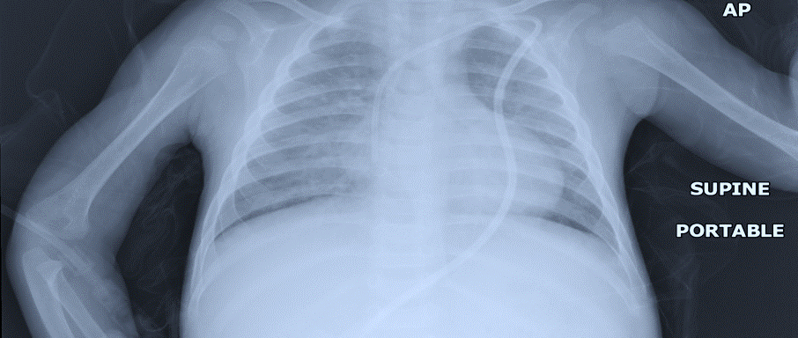
GRAZIE PER L’ATTENZIONE

