Slide 1
Bayesian Inference and Causal Machine Learning Assignment on Experimental Studies
Giuseppe Salerno

Slide 2
2. Dataset exploration
Pre-treatment variable only have been considered. “Income” variable is not in “Table 1 JOBSII data: Pre-treatment variables” so it will not be reported here.
Pre-treatment variable | Treatment group | mean | median | std | Range (max-min) | Pre-treatment variable | Treatment group | mean | median | std | Range (max-min)
Sex | All | 0.58 |  |  |  | educ | All | 13.36 | 13.00 | 2.02 | 9.00
 | Control | 0.62 |  |  |  |  | Control | 13.28 | 13.00 | 2.00 | 9.00
 | Treated | 0.55 |  |  |  |  | Treated | 13.40 | 13.00 | 2.03 | 9.00
Age | All | 36.52 | 35.34 | 9.76 | 51.72 | EconHard | All | 3.62 | 3.67 | 0.85 | 3.67
 | Control | 36.28 | 34.36 | 9.90 | 51.72 |  | Control | 3.47 | 3.33 | 0.92 | 3.67
 | Treated | 36.65 | 35.79 | 9.70 | 43.95 |  | Treated | 3.70 | 3.67 | 0.80 | 3.67
Race | All | 0.18 |  |  |  | Assertive | All | 3.05 | 3.00 | 0.91 | 4.00
 | Control | 0.13 |  |  |  |  | Control | 3.01 | 3.00 | 0.88 | 4.00
 | Treated | 0.20 |  |  |  |  | Treated | 3.06 | 3.00 | 0.93 | 4.00
nonmarried | All | 0.60 |  |  |  | Motivation | All | 5.33 | 5.50 | 0.81 | 3.00
 | Control | 0.57 |  |  |  |  | Control | 5.32 | 5.50 | 0.81 | 3.00
 | Treated | 0.62 |  |  |  |  | Treated | 5.33 | 5.50 | 0.81 | 3.00
All the pre-treatment variables have the same distribution in terms of mean, median, standard deviation and range (except for range in age among treated that is lower).
This is expected because the “completely randomized experiment” is an assignment mechanism that implicitly guarantees

Slide 3
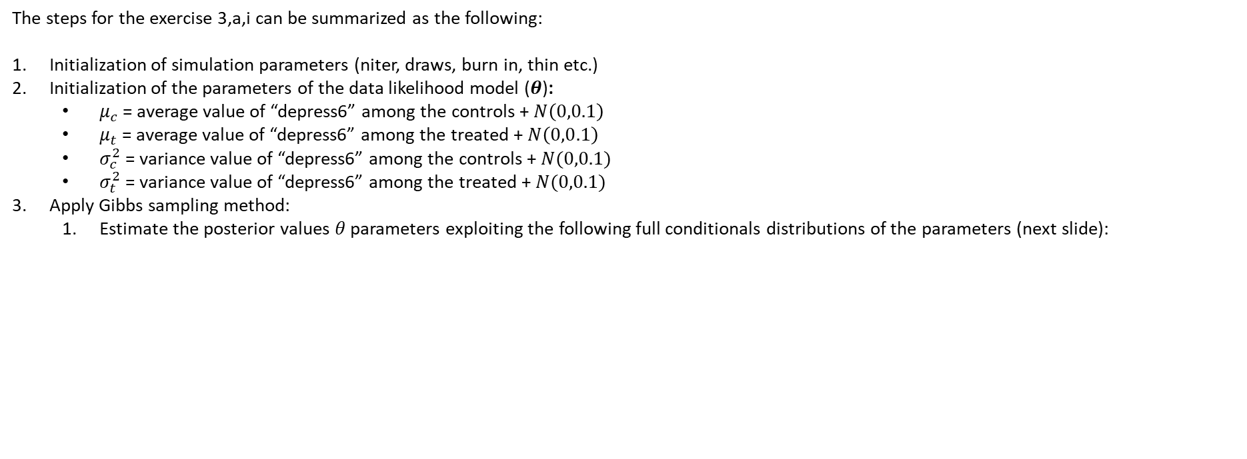
3-a-i. Bayesian Model
The steps for the exercise 3,a,i can be summarized as the following:
Initialization of simulation parameters (niter, draws, burn in, thin etc.)
Initialization of the parameters of the data likelihood model ($θ$):
$μ_{c}$ = average value of “depress6” among the controls + $N\left(0,0.1\right)$
$μ_{t}$ = average value of “depress6” among the treated + $N\left(0,0.1\right)$
$σ_{c}^{2}$ = variance value of “depress6” among the controls + $N(0,0.1)$
$σ_{t}^{2}$ = variance value of “depress6” among the treated + $N(0,0.1)$
Apply Gibbs sampling method:
Estimate the posterior values $θ$ parameters exploiting the following full conditionals distributions of the parameters (next slide):

Slide 4

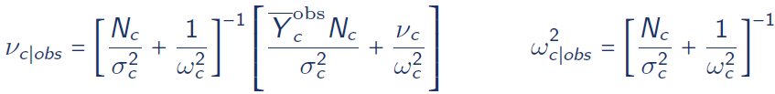

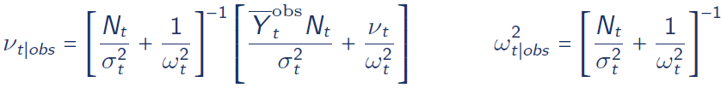

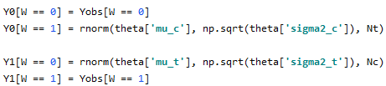

3-a-i. Bayesian Model
Full conditional initialization
The steps for the exercise 3,a,i can be summarized as the following:
Apply Gibbs sampling method:
the posterior values $θ=(μ_{c},μ_{t},σ_{c},σ_{t})$ parameters exploiting the following full conditionals distributions of the parameters:
Impute the missing values with current value of $θ$ (Y is normal distributed with $θ$ parameters):

Slide 5
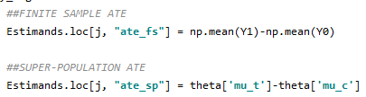
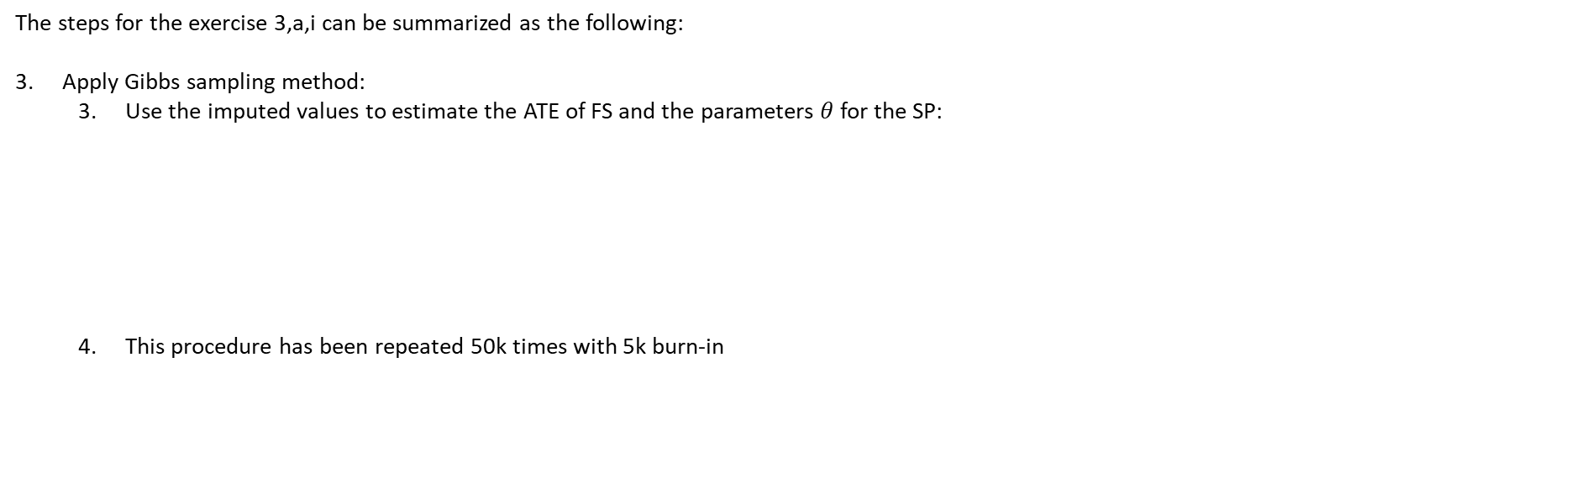
3-a-i. Bayesian Model
The steps for the exercise 3,a,i can be summarized as the following:
Apply Gibbs sampling method:
Use the imputed values to estimate the ATE of FS and the parameters $θ$ for the SP:
This procedure has been repeated 50k times with 5k burn-in

Slide 6
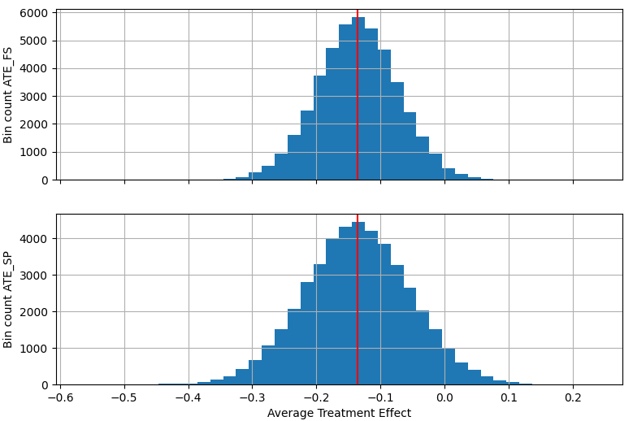
3-a-i. Bayesian Model
metrics | ATE_FS | ATE_SP
count | 45000 | 45000
mean | -0.13558 | -0.13580
std | 0.06230 | 0.08248
2.50% | -0.25803 | -0.29805
50% | -0.13572 | -0.13602
97.50% | -0.01336 | 0.02647
The ATE for both Finite Sample (FS) and Super Population (SP) demonstrates that the treatment has a positive effect on the depression level; in fact, it decreased of around 0.13 with 2.5% and 97.5% still negative (actually for ATE_SP the 97.5 percentile is positive but with a very low value).
To evaluate if a decrease of 0.13 is an high value or not, it is necessary to analyse the depression level; to have a rough idea it is possible to inspect some descriptive statistics.
Pre-treatment variable | Treatment group | mean | median | std | Range (max-min)
depress6 | All | 2.056 | 1.909 | 0.758 | 3.727
 | Control | 2.148 | 2.000 | 0.787 | 3.727
 | Treated | 2.012 | 1.818 | 0.741 | 3.364

Slide 7
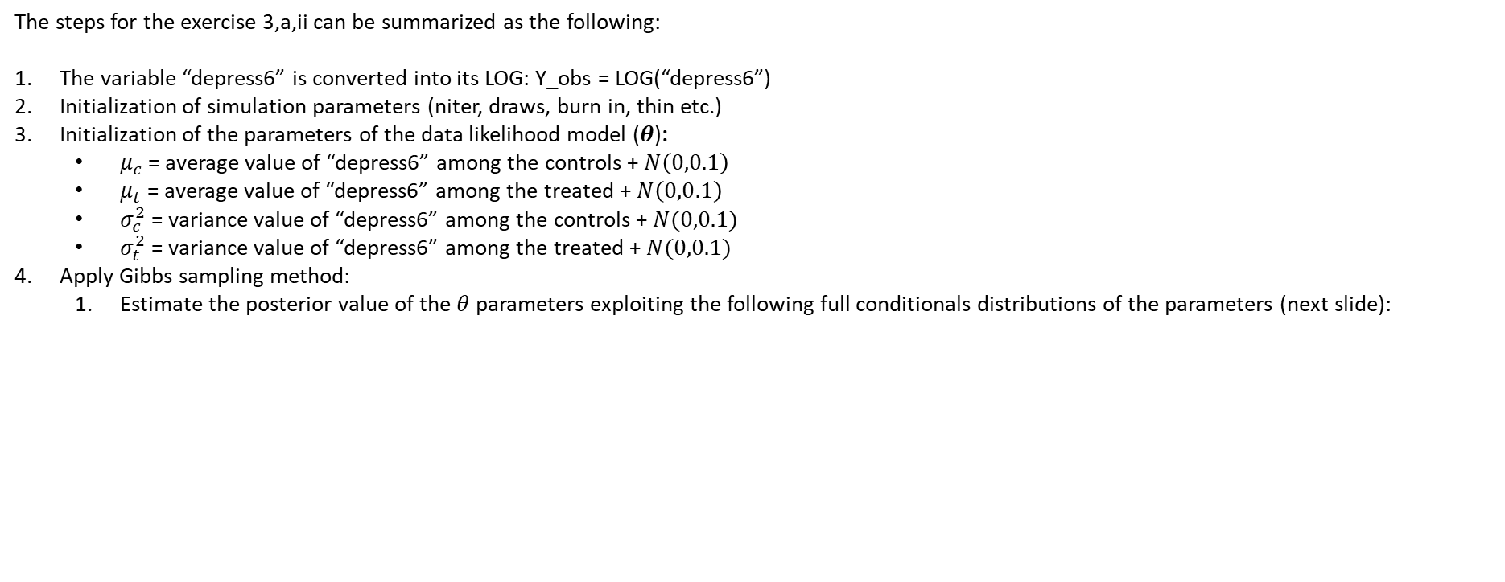
3-a-ii. Bayesian Model
The steps for the exercise 3,a,ii can be summarized as the following:
The variable “depress6” is converted into its LOG: Y_obs = LOG(“depress6”)
Initialization of simulation parameters (niter, draws, burn in, thin etc.)
Initialization of the parameters of the data likelihood model ($θ$):
$μ_{c}$ = average value of “depress6” among the controls + $N\left(0,0.1\right)$
$μ_{t}$ = average value of “depress6” among the treated + $N\left(0,0.1\right)$
$σ_{c}^{2}$ = variance value of “depress6” among the controls + $N(0,0.1)$
$σ_{t}^{2}$ = variance value of “depress6” among the treated + $N(0,0.1)$
Apply Gibbs sampling method:
Estimate the posterior value of the $θ$ parameters exploiting the following full conditionals distributions of the parameters (next slide):

Slide 8

3-a-ii. Bayesian Model
Full conditional initialization
The steps for the exercise 3,a,ii can be summarized as the following:
Apply Gibbs sampling method:
Estimate the posterior value of the $θ=(μ_{c},μ_{t},σ_{c},σ_{t})$ parameters exploiting the following full conditionals distributions of the parameters:
Impute the missing values with current value of $θ:$

Slide 9
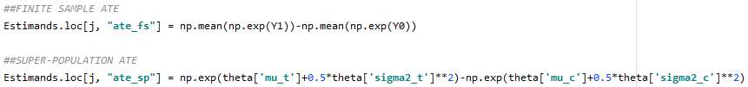
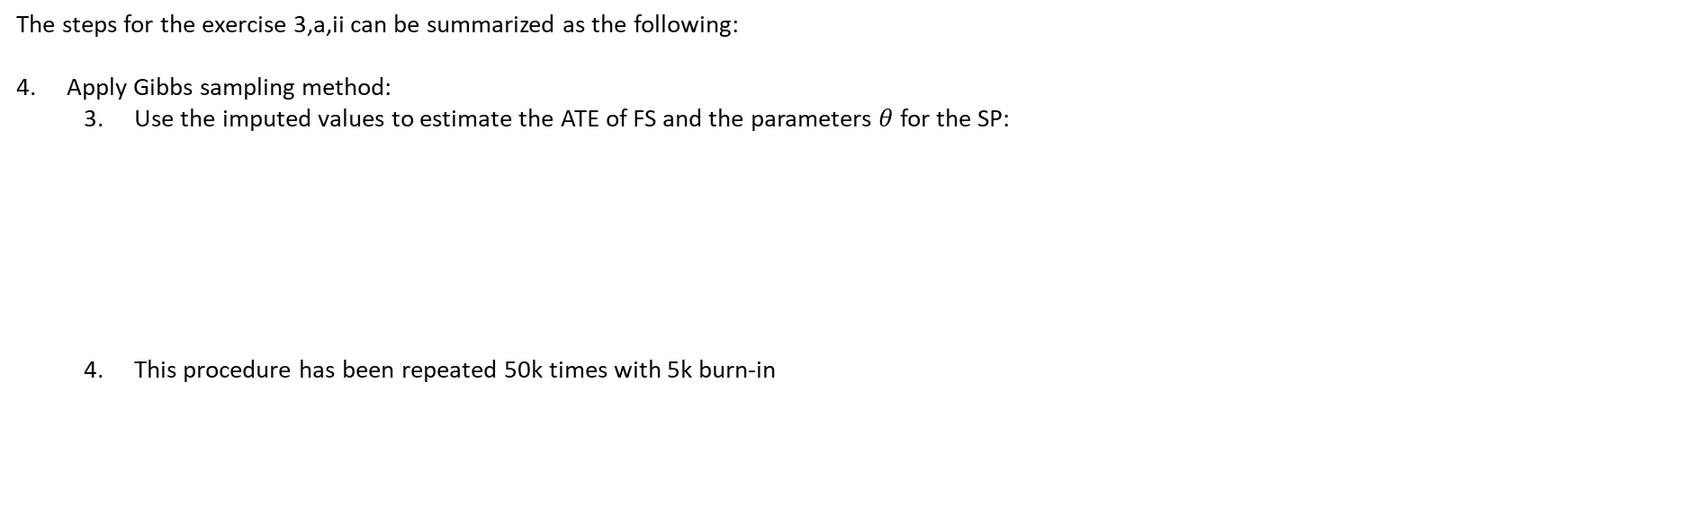
3-a-ii. Bayesian Model
The steps for the exercise 3,a,ii can be summarized as the following:
Apply Gibbs sampling method:
Use the imputed values to estimate the ATE of FS and the parameters $θ$ for the SP:
This procedure has been repeated 50k times with 5k burn-in

Slide 10

3-a-ii. Bayesian Model
metrics | ATE_FS | ATE_SP
count | 45000 | 45000
mean | -0.13602 | -0.13216
std | 0.06164 | 0.07517
2.50% | -0.26209 | -0.28128
50% | -0.13491 | -0.13200
97.50% | -0.01918 | 0.01418
To run this Bayesian model two modification of the previous code where made:
Outcome variable y = LOG(depress6)
Modification of the ATE calculation
ATE_FS = mean(EXP(Y1))- mean(EXP(Y0))
ATE_SP = EXP(mu.t+0.5*sigma2.t^2) -EXP(mu.c+0.5*sigma2.c^2)
The distributions of the previous slide and the one reported here are almost equal.
Is this expected?
Pre-treatment variable | Treatment group | mean | median | std | Range (max-min)
depress6 | All | 2.056 | 1.909 | 0.758 | 3.727
 | Control | 2.148 | 2.000 | 0.787 | 3.727
 | Treated | 2.012 | 1.818 | 0.741 | 3.364

Slide 11



3-b. Bayesian Model
The steps for the exercise 3,b can be summarized as the following:
Initialize the probability of the two Bernoulli distributions (data likelihood) with the ratio of the number of employed units (“employ6”==1) among treated units and with the ratio of the number of non-employed units (“employ6”==0) among control units.
Calculate the parameters of the posterior distributions (Beta) of the parameters $θ$ (the probability of the two Bernoulli distributions $bern\left(π_{c}\right), bern\left(π_{t}\right)$:
The following procedure has been repeated 50k times (next slide):
Prior (uniform) initialization

Slide 12
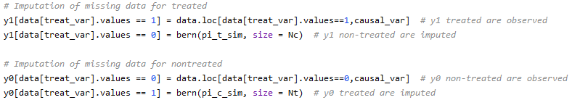


3-b. Bayesian Model
The steps for the exercise 3,b can be summarized as the following:
The following procedure has been repeated 50k times (next slide):
Sample from posterior distribution to retrieve new values for $π_{t}$ and $π_{c}$:
Impute the missing values with current value of $θ:$
Estimate the ATE for Finite Sample and Super Population:

Slide 13
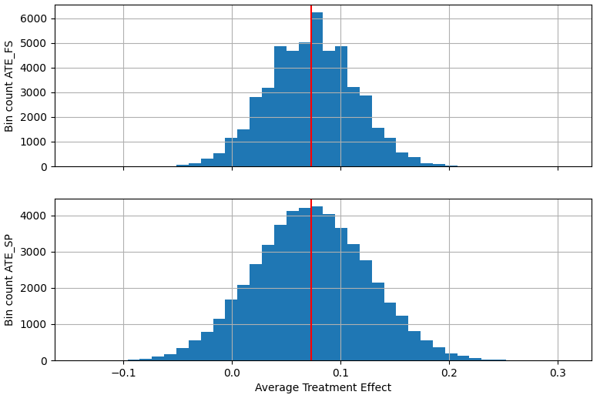
3-b. Bayesian Model
metrics | ATE_FS | ATE_SP
count | 50000 | 50000
mean | 0.07331 | 0.07317
std | 0.03931 | 0.05214
2.50% | -0.00251 | -0.02881
50% | 0.07286 | 0.07293
97.50% | 0.15075 | 0.17616
The average treatment effect for both the FS and the SP is around ~7%. This means that the treatment increases the probability of being employed after 6 months from the treatment of ~7%.
For ATE_SP the 2.5 percentile is “quite negative” and “quite high” (2.88%).
To evaluate if an increase of 7% is an high value or not, it is necessary to analyse the re-employment level; to have a rough idea it is possible to inspect some descriptive statistics.
Pre-treatment variable | Treatment group | mean
employ6 | All | 0.60
 | Control | 0.55
 | Treated | 0.63

Slide 14
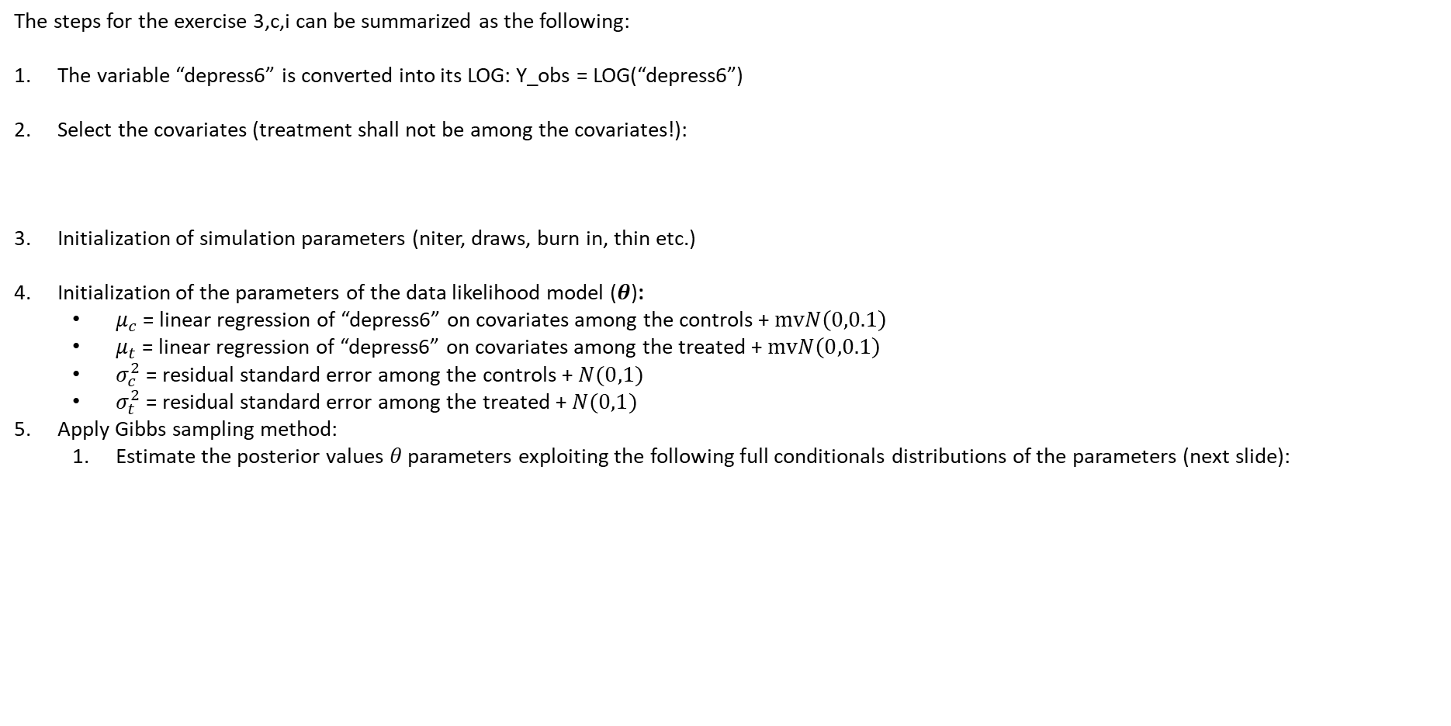
3-c-i. Bayesian Model
The steps for the exercise 3,c,i can be summarized as the following:
The variable “depress6” is converted into its LOG: Y_obs = LOG(“depress6”)
Select the covariates (treatment shall not be among the covariates!):
Initialization of simulation parameters (niter, draws, burn in, thin etc.)
Initialization of the parameters of the data likelihood model ($θ$):
$μ_{c}$ = linear regression of “depress6” on covariates among the controls + $mvN\left(0,0.1\right)$
$μ_{t}$ = linear regression of “depress6” on covariates among the treated + $mvN\left(0,0.1\right)$
$σ_{c}^{2}$ = residual standard error among the controls + $N(0,1)$
$σ_{t}^{2}$ = residual standard error among the treated + $N(0,1)$
Apply Gibbs sampling method:
Estimate the posterior values $θ$ parameters exploiting the following full conditionals distributions of the parameters (next slide):

Slide 15
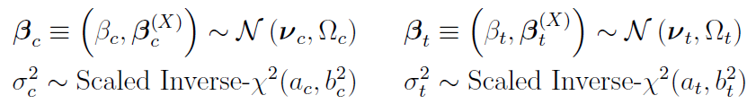
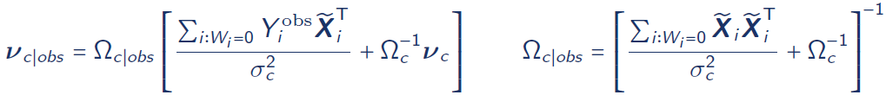
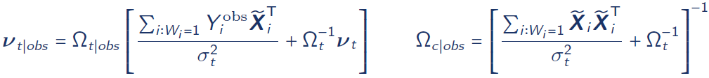


3-c-i. Bayesian Model
Full conditional initialization
The steps for the exercise 3,a,i can be summarized as the following:
Apply Gibbs sampling method:
the posterior values $θ=(μ_{c},μ_{t},σ_{c},σ_{t})$ parameters exploiting the following full conditionals distributions of the parameters:
Impute the missing values with current value of $θ$ (Y is normal distributed with $θ$ parameters):

Slide 16

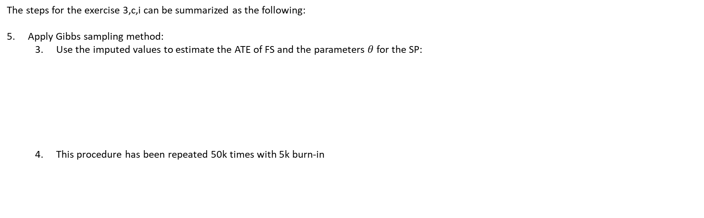
3-c-i. Bayesian Model
The steps for the exercise 3,c,i can be summarized as the following:
Apply Gibbs sampling method:
Use the imputed values to estimate the ATE of FS and the parameters $θ$ for the SP:
This procedure has been repeated 50k times with 5k burn-in

Slide 17
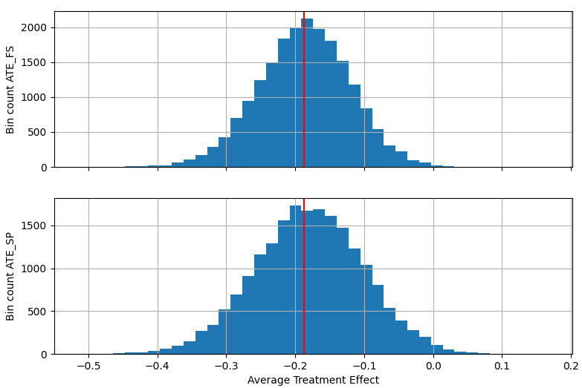
3-a-ii. Bayesian Model
metrics | ATE_FS | ATE_SP
count | 45000 | 45000
mean | -0.18718 | -0.18010
std | 0.06618 | 0.07869
2.50% | -0.32140 | -0.33708
50% | -0.18554 | -0.17953
97.50% | -0.06114 | -0.02704
The ATE for both Finite Sample (FS) and Super Population (SP) demonstrates that the treatment has a positive effect on the depression level; in fact, it decreased of around 0.18 with 2.5% and 97.5% still negative.
It is interesting to note how the introduction of the covariates increased the positive effect of the treatment; this means that, considering the covariates and not only an average effect on all units, the effect of the treatment is even better.
Pre-treatment variable | Treatment group | mean | median | std | Range (max-min)
depress6 | All | 2.056 | 1.909 | 0.758 | 3.727
 | Control | 2.148 | 2.000 | 0.787 | 3.727
 | Treated | 2.012 | 1.818 | 0.741 | 3.364

