Slide 1
Northern Spain Dairy Farms Analysis
Giuseppe Salerno

Slide 2
Agenda
In this presentation the following sections will be presented:
Introduction This section contains a brief description of the dataset and the research question to be answered
Analysis The dataset will be analysed with different methodologies; the selection of each methodology will be justified
Conclusion In this section it will presented a comparison and a discussion between the results obtained in the previous step

Slide 3
Introduction
The dataset contains milk production data from 1993 to 1998 of 247 dairy farms in the norther Spain (247*6 years= 1482 records).
Dependent Variables
Independent Variables
 | MILK | COWS | LAND | LABOR | FEED
 | Liters per year | Number of milking cows | Acres | Number of man-equivalent units | Total amount of feedstuffs fed to the dairy cows per year (kg)
mean | 131107 | 22.12 | 12.99 | 1.67 | 57941
std | 92584 | 11.27 | 6.17 | 0.55 | 47981
min | 14410 | 4.50 | 2.00 | 1.00 | 3924
25% | 68469 | 14.13 | 8.50 | 1.00 | 25589
50% | 110236 | 20.00 | 12.00 | 2.00 | 46029
75% | 163262 | 27.00 | 16.00 | 2.00 | 73297
max | 727281 | 82.30 | 45.10 | 4.00 | 376732
NOTE: I expected the number of cows to be an integer number but in this case it is a real number; I did not find any information about this “peculiarity” online. I will use the data as it is, without considering this issue.

Slide 4
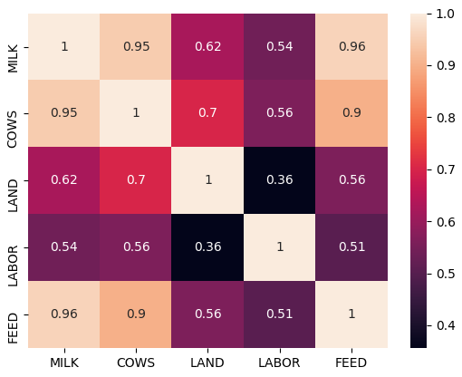
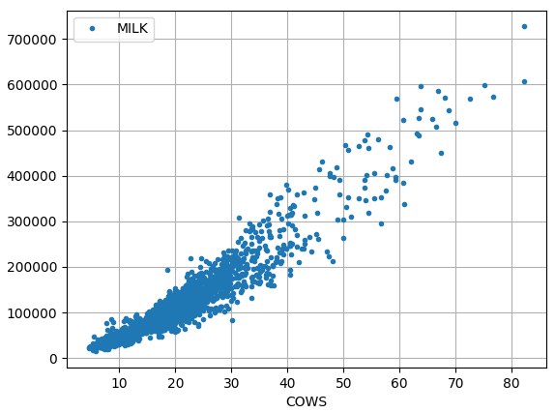
Introduction
As the intuition suggests, all the regressors are positively correlated with the dependent variable.
NOTE: there is a strong multicollinearity between FEED and COWS so FEED won’t be used.

Slide 5
Research Question and Assumptions
The goal of this project is to determine the effect of COWS, LAND and LABOUR on the amount of MILK produced by the farms. The model that will be selected should be able to estimate what an increase of one of the independent variable will be reflected on the dependent variable.
Assumptions:
Linearity in the parameters; the effect of independent variables is linear (additive) on the dependent variable
Conditional homoskedasticity; variance of error term is not correlated with the regressors
Assumptions for Fixed Effect (FE) and Random Effects (RE) models:
FE and RE models are used to control for unobserved time-invariant heterogeneity (something within the FARMS may impact or bias the regressors or outcome variable); they are going to be tested and compared with Hausman test. There is no evidence to assume that there is no correlation between the unobserved variable and the dependent and independent variables. For this reason Fixed Effect seems to be a more correct model to use.
Possible unobserved time-invariant variables: farmer age, cows age, cows race, land topography etc.

Slide 6
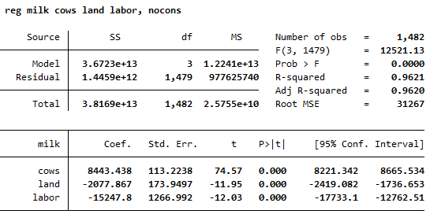
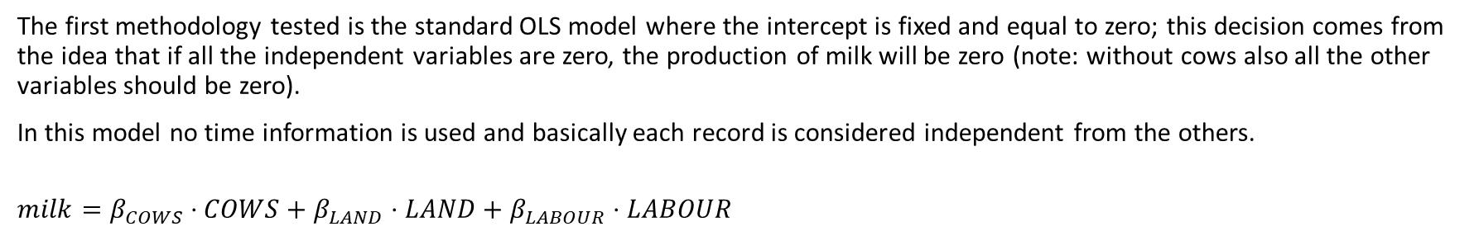
Analysis - OLS
The first methodology tested is the standard OLS model where the intercept is fixed and equal to zero; this decision comes from the idea that if all the independent variables are zero, the production of milk will be zero (note: without cows also all the other variables should be zero).
In this model no time information is used and basically each record is considered independent from the others.
$$milk=β_{COWS}⋅COWS+β_{LAND}⋅LAND+β_{LABOUR}⋅LABOUR$$
These two coefficients are negative, meaning that an increase in labour or in land will decrease the milk production, and this is very counter intuitive.
What if we account for differences in years between farms? Let’s see next methodology.

Slide 7
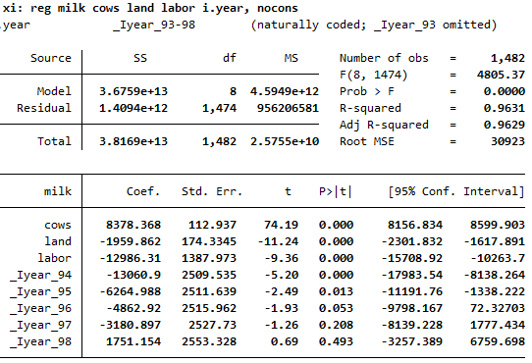
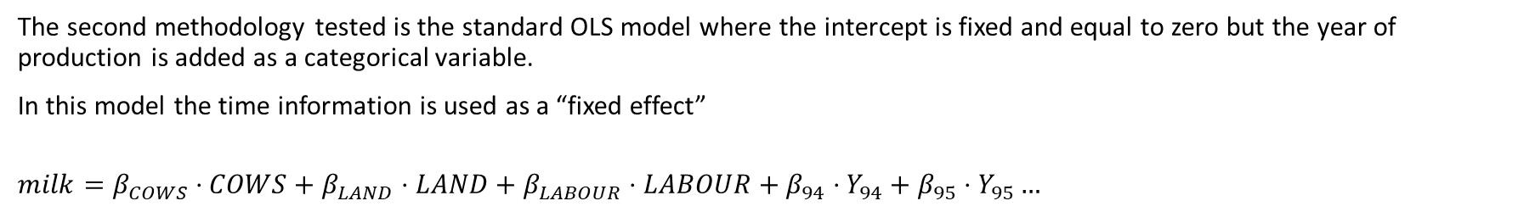
Analysis – OLS + time fixed effect
The second methodology tested is the standard OLS model where the intercept is fixed and equal to zero but the year of production is added as a categorical variable.
In this model the time information is used as a “fixed effect”
$$milk=β_{COWS}⋅COWS+β_{LAND}⋅LAND+β_{LABOUR}⋅LABOUR+β_{94}⋅Y_{94}+β_{95}⋅Y_{95}…$$
The coefficient on the land is still negative and it is still counter intuitive.
Is there any unobserved time-invariant variable that is biasing this model? Let’s see next methodology.

Slide 8
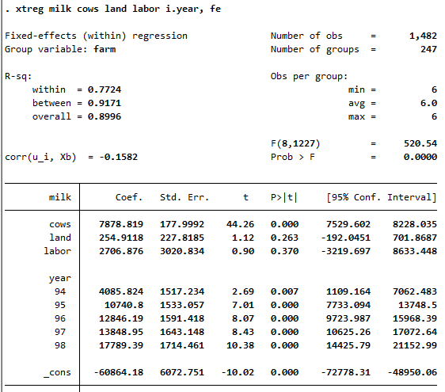
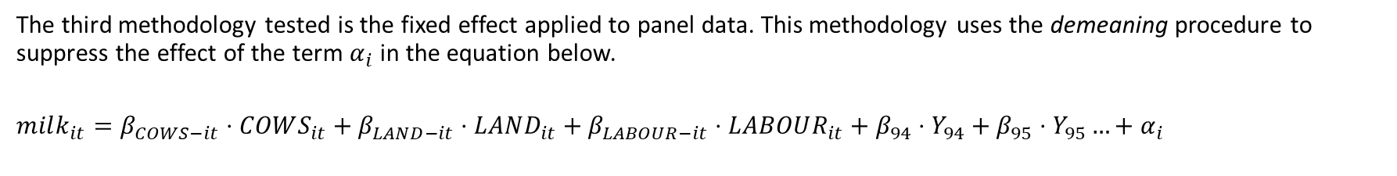
Analysis – Fixed Effects
The third methodology tested is the fixed effect applied to panel data. This methodology uses the demeaning procedure to suppress the effect of the term $α_{i}$ in the equation below.
$$milk_{it}=β_{COWS−it}⋅COWS_{it}+β_{LAND−it}⋅LAND_{it}+β_{LABOUR−it}⋅LABOUR_{it}+β_{94}⋅Y_{94}+β_{95}⋅Y_{95}…+α_{i}$$
The coefficients now are all positives BUT both coefficients for land and labour become statistically not-significant anymore, meaning that there is not sufficient evidence to say that are different from zero.
What can be the problem? Hypothesis:
The model is too simple? Try adding interaction terms.
The data is not reflecting the reality. There is no way to perform this test.
LABOR variable assumes only 12 different values; is it strange?

Slide 9
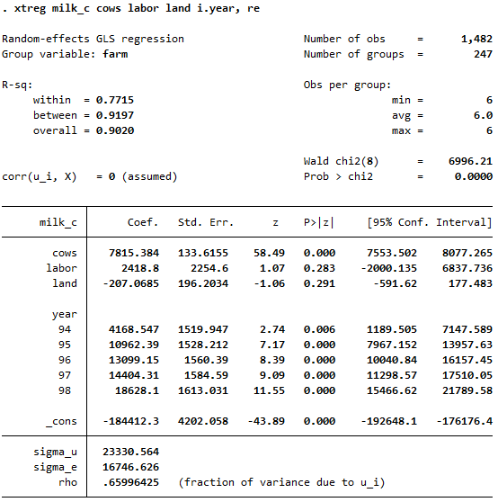
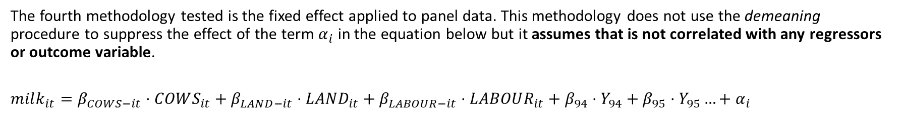
Analysis – Fixed Effects
The fourth methodology tested is the fixed effect applied to panel data. This methodology does not use the demeaning procedure to suppress the effect of the term $α_{i}$ in the equation below but it assumes that is not correlated with any regressors or outcome variable.
$$milk_{it}=β_{COWS−it}⋅COWS_{it}+β_{LAND−it}⋅LAND_{it}+β_{LABOUR−it}⋅LABOUR_{it}+β_{94}⋅Y_{94}+β_{95}⋅Y_{95}…+α_{i}$$
Here we encounter the same problem of the Fixed Effect model: the labour and land are not statistically significant which is also counter intuitive.

Slide 10
Conclusions
None of the model seems suitable for understanding the real structure behind the data; in fact, all the models show some counter intuitive characteristic which is very difficult to justify.
There is the possibility that the data is not collected correctly or there is some transformation of the data that I did not understand. No detailed study about the data has been found on the internet (it is actually one of the reason for the selection of the dataset).

Slide 11
END!

