Slide 1
Northern Spain Dairy Farms Analysis
Giuseppe Salerno

Slide 2
Agenda
In this presentation the following sections will be presented:
Introduction This section contains a brief description of the dataset and the research question to be answered
Analysis The dataset will be analysed with different methodologies; the selection of each methodology will be justified
Conclusion In this section it will presented a comparison and a discussion between the results obtained in the previous step

Slide 3
Introduction
The dataset contains milk production data from 1993 to 1998 of 247 dairy farms in the norther Spain (247*6 years= 1482 records).
Dependent Variables
Independent Variables
 | MILK | COWS | LAND | LABOR | FEED
 | Liters per year | Number of milking cows | Acres | Number of man-equivalent units | Total amount of feedstuffs fed to the dairy cows per year (kg)
mean | 131107 | 22.12 | 12.99 | 1.67 | 57941
std | 92584 | 11.27 | 6.17 | 0.55 | 47981
min | 14410 | 4.50 | 2.00 | 1.00 | 3924
25% | 68469 | 14.13 | 8.50 | 1.00 | 25589
50% | 110236 | 20.00 | 12.00 | 2.00 | 46029
75% | 163262 | 27.00 | 16.00 | 2.00 | 73297
max | 727281 | 82.30 | 45.10 | 4.00 | 376732
NOTE: I expected the number of cows to be an integer number but in this case it is a real number; I did not find any information about this “peculiarity” online. I will use the data as it is, without considering this issue.

Slide 4
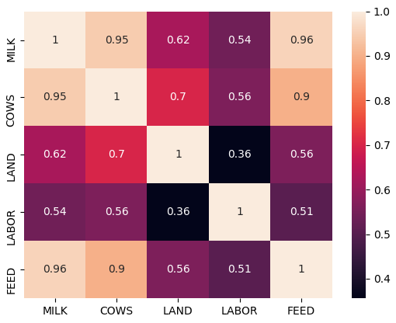
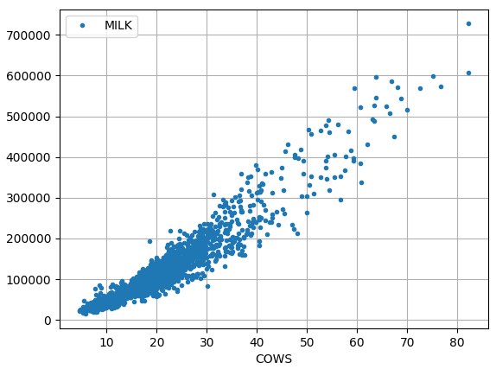
Introduction
As the intuition suggests, all the regressors are positively correlated with the dependent variable.
NOTE: there is a strong multicollinearity between FEED and COWS so FEED won’t be used in this presentation.

Slide 5
Research Question and Assumptions
The goal of this project is to determine the effect of COWS, LAND and LABOUR on the amount of MILK produced by the farms. The model that will be selected should be able to estimate how an increase of one of the independent variable will be reflected on the dependent variable.
Assumptions:
Linearity in the parameters; the effect of independent variables is linear (additive) on the dependent variable
Conditional homoskedasticity; variance of error term is not correlated with the regressors
Assumptions for Fixed Effect (FE) and Random Effects (RE) models:
FE and RE models are used to control for unobserved time-invariant heterogeneity (something within the FARMS may impact or bias the regressors or outcome variable). There is no evidence to assume that there is no correlation between the unobserved variable and the dependent and independent variables. For this reason Fixed Effect seems to be a more correct model to use.
Possible unobserved time-invariant variables: farmer age, cows age, cows race, land topography etc.

Slide 6
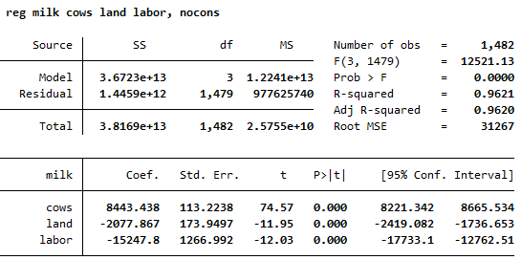
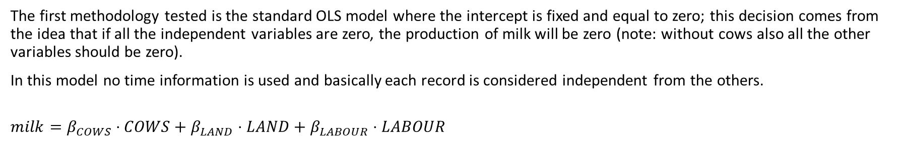
Analysis - OLS
The first methodology tested is the standard OLS model where the intercept is fixed and equal to zero; this decision comes from the idea that if all the independent variables are zero, the production of milk will be zero (note: without cows also all the other variables should be zero).
In this model no time information is used and basically each record is considered independent from the others.
$$milk=β_{COWS}⋅COWS+β_{LAND}⋅LAND+β_{LABOUR}⋅LABOUR$$
These two coefficients are negative, meaning that an increase in labour or in land will decrease the milk production, and this is very counter intuitive.
What if we account for differences in years between farms? Let’s see next methodology.

Slide 7
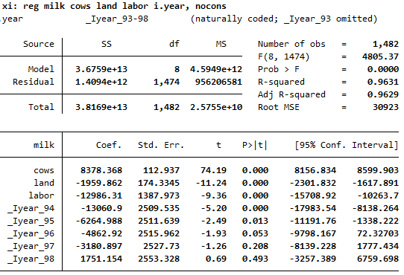
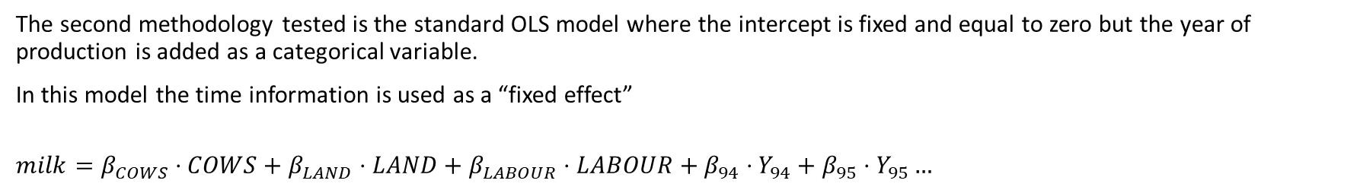
Analysis – OLS + time fixed effect
The second methodology tested is the standard OLS model where the intercept is fixed and equal to zero but the year of production is added as a categorical variable.
In this model the time information is used as a “fixed effect”
$$milk=β_{COWS}⋅COWS+β_{LAND}⋅LAND+β_{LABOUR}⋅LABOUR+β_{94}⋅Y_{94}+β_{95}⋅Y_{95}…$$
The coefficient on the land is still negative and it is still counter intuitive.
Is there any unobserved time-invariant variable that is biasing this model? Let’s see next methodology.

Slide 8
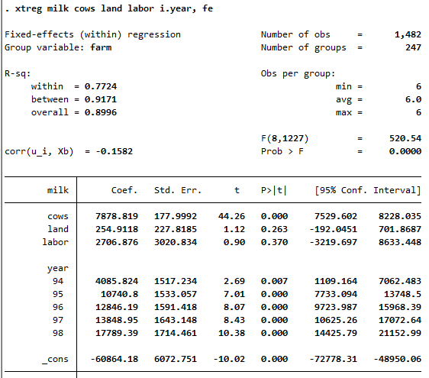
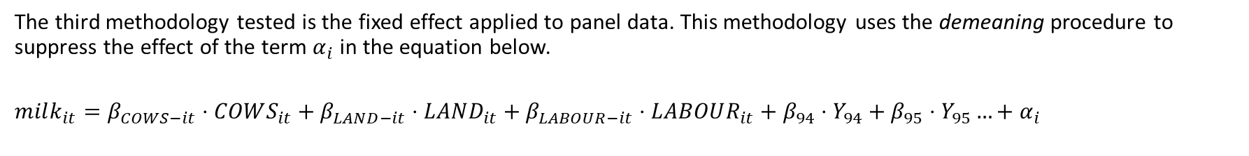
Analysis – Fixed Effects
The third methodology tested is the fixed effect applied to panel data. This methodology uses the demeaning procedure to suppress the effect of the term $α_{i}$ in the equation below.
$$milk_{it}=β_{COWS−it}⋅COWS_{it}+β_{LAND−it}⋅LAND_{it}+β_{LABOUR−it}⋅LABOUR_{it}+β_{94}⋅Y_{94}+β_{95}⋅Y_{95}…+α_{i}$$
The coefficients now are all positives BUT both coefficients for LAND and LABOR become statistically not-significant anymore, meaning that there is not sufficient evidence to demonstrate that are different from zero.
What can be the problem? Hypothesis:
The model is too simple? Try specifying a different model for the data (next analysis).
LABOR and LAND are time invariant? Both LABOR and LAND variable do not change a lot in the dataset; maybe the demeaning procedure can reduce the variables “close-to-zero” and this causes the issue. See next slide.
The data is not reflecting the reality and maybe there is some issue in data acquisition.

Slide 9
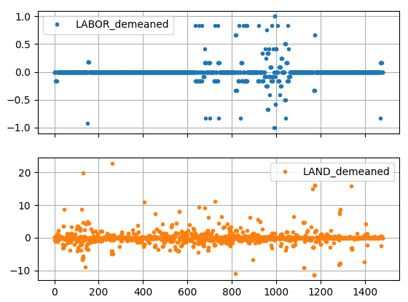
Analysis – Fixed Effects
Here below there are two figures showing the demeaned LABOR and LAND demeaned variables.
The variation of LABOR variable from the mean (grouped by FARM) is very close to zero in the entire dataset
This can be the cause for the coefficient of LABOR in the Fixed Effect model to be not statistically significant.
LAND is less affected by this issue but still there are some farms (55 out of 247) with time-invariant LAND.

Slide 10
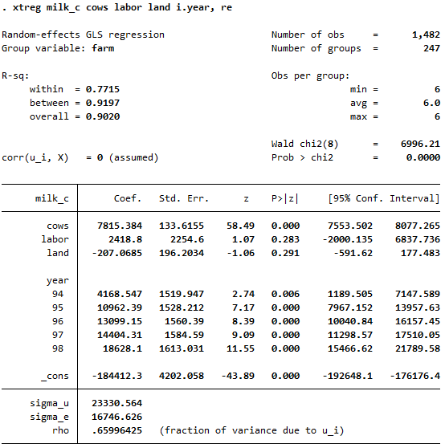
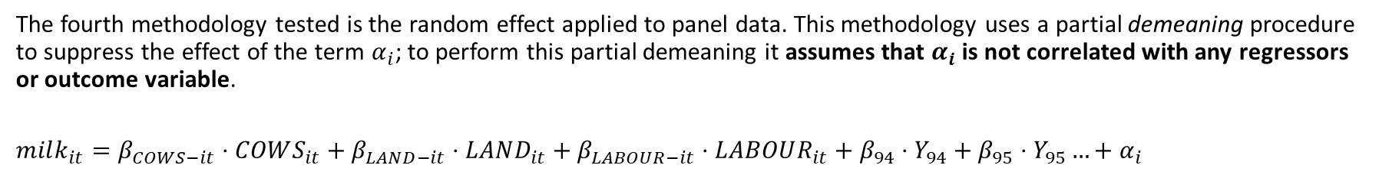
Analysis – Random Effects
The fourth methodology tested is the random effect applied to panel data. This methodology uses a partial demeaning procedure to suppress the effect of the term $α_{i}$; to perform this partial demeaning it assumes that $α_{i}$ is not correlated with any regressors or outcome variable.
$$milk_{it}=β_{COWS−it}⋅COWS_{it}+β_{LAND−it}⋅LAND_{it}+β_{LABOUR−it}⋅LABOUR_{it}+β_{94}⋅Y_{94}+β_{95}⋅Y_{95}…+α_{i}$$
Here we encounter the same problem of the Fixed Effect model: the LABOR and LAND are not statistically significant which is also counter intuitive.

Slide 11
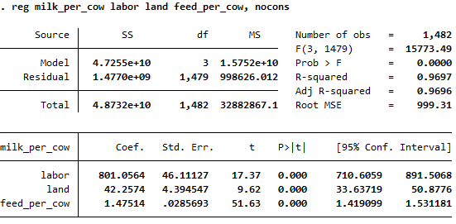
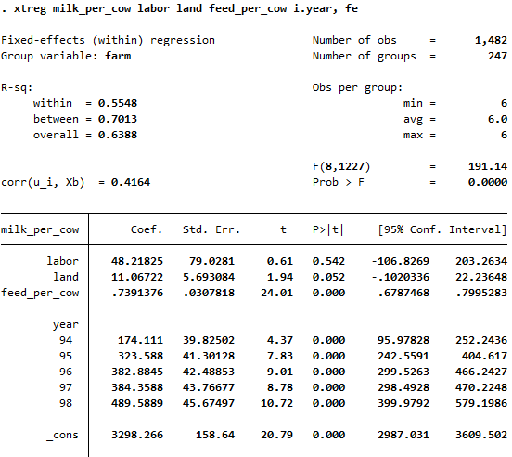
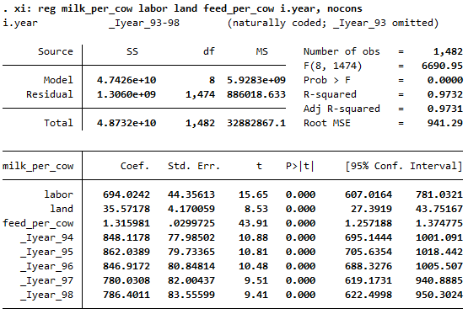
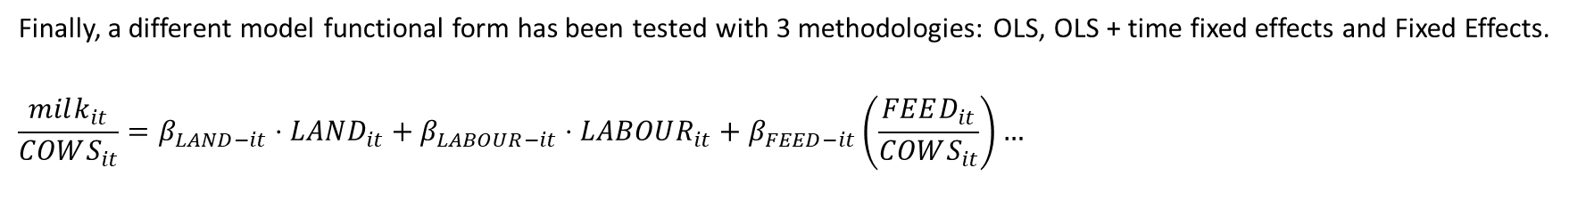
Analysis – Different model specification
Finally, a different model functional form has been tested with 3 methodologies: OLS, OLS + time fixed effects and Fixed Effects.
$$\frac{milk_{it}}{COWS_{it}}=β_{LAND−it}⋅LAND_{it}+β_{LABOUR−it}⋅LABOUR_{it}+β_{FEED−it}\left(\frac{FEED_{it}}{COWS_{it}}\right)…$$
No significant differences for the Foxed Effects model have been found. On the other hand OLS models seems to benefit from the normalization with the number of COWS; in fact now the coefficients are positive, which is expected.

Slide 12
Conclusions
None of the model using LABOR, LAND and COWS seems suitable for understanding the real structure behind the data; in fact, all the models show some counter intuitive characteristic which is difficult to justify. For model using demeaning probably the source of the issue is located into the “time-invariant” nature of LABOR and LAND.
There is the possibility that the data is not collected correctly or there is some transformation of the data that I was not understood in this job. No detailed study about the data has been found on the internet (it is actually one of the reason for the selection of the dataset) so no other study have been sued for comparison.

Slide 13
END!

