Slide 1


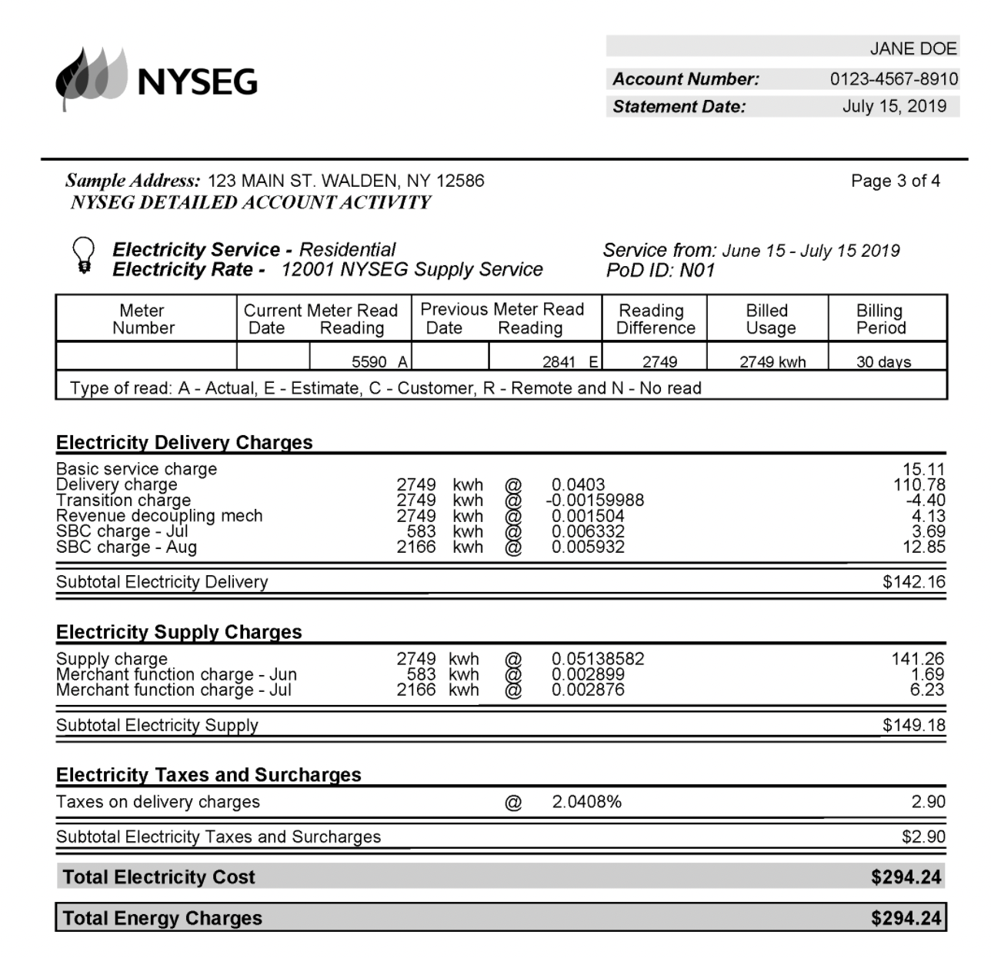




Enrollment Requirements
NYSEG
Customer Name
Service Address
Both Pod ID Number (PG3): Begins with N01 & 12- digit and account number (xxxx-xxxx-xxxx)
Rate Class
Residential vs. Commercial
Utility Bill Acceptance Criteria:
Every customer MUST provide an image of their utility bill at the time of sign-up
Recent bill copy (within 90 days)
Past due amount may not be greater than or equal to the current charges or final disconnect notice. (exception UCB)
Must be legible and easy to read

Slide 2
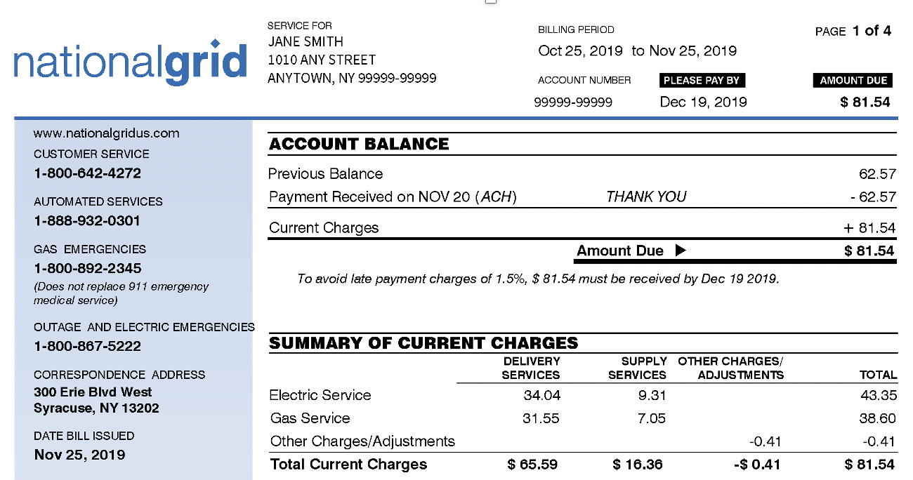
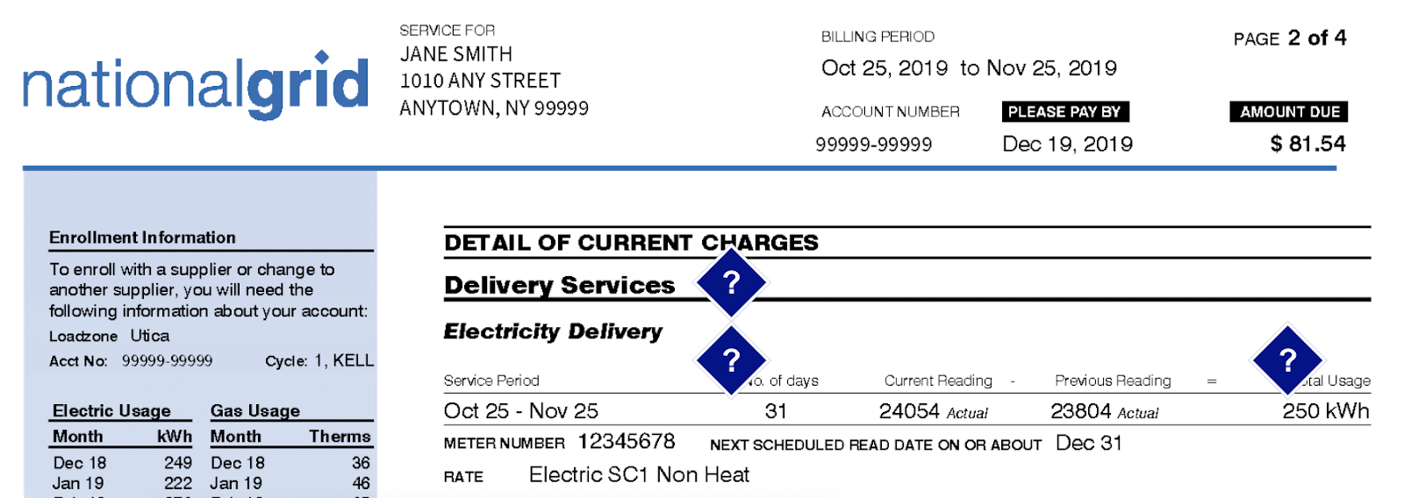
Enrollment Requirements
National Grid
Customer Name
Service Address
Account #: 10 Digits (xxxxx-xxxxx)
Rate Class
SC1 Residential vs. SC2 Commercial
Utility Bill Acceptance Criteria:
Every customer MUST provide an image of their utility bill at the time of sign-up
Recent bill copy (within 90 days)
Past due amount may not be greater than or equal to the current charges or final disconnect notice. (exception UCB)
Must be legible and easy to read

Slide 3
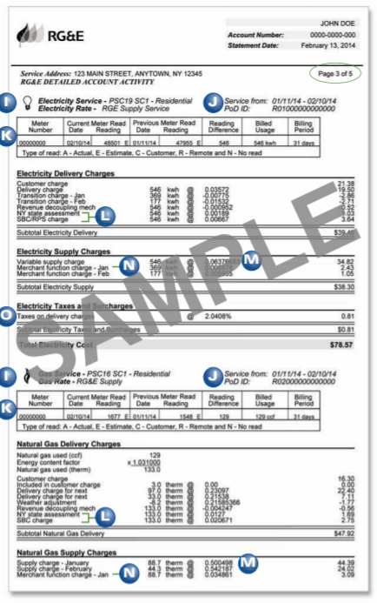
Enrollment Requirements
RG&E
Customer Name
Service Address
Pod ID Number (Page3): Begins with R01 &12-digit account number (xxxx-xxxx-xxxx)
Rate Class
Residential vs. Commercial
Utility Bill Acceptance Criteria:
Every customer MUST provide an image of their utility bill at the time of sign-up
Recent bill copy (within 90 days)
Past due amount may not be greater than or equal to the current charges or final disconnect notice. (exception UCB)
Must be legible and easy to read

