Slide 1

GOVERNMENT ARTS COLLEGE FOR WOMEN SALEM-8
DEPARTMENT OF COMPUTER SCIENCE
Notes:
This template can be used as a starter file for presenting training materials in a group setting.
Sections
Right-click on a slide to add sections. Sections can help to organize your slides or facilitate collaboration between multiple authors.
Notes
Use the Notes section for delivery notes or to provide additional details for the audience. View these notes in Presentation View during your presentation.
Keep in mind the font size (important for accessibility, visibility, videotaping, and online production)
Coordinated colors
Pay particular attention to the graphs, charts, and text boxes.
Consider that attendees will print in black and white or grayscale. Run a test print to make sure your colors work when printed in pure black and white and grayscale.
Graphics, tables, and graphs
Keep it simple: If possible, use consistent, non-distracting styles and colors.
Label all graphs and tables.

Slide 2
INTELLIGENT ADMISSIONS : THE FUTURE OF UNIVERSITY DECISION MAKING WITH MACHINE LEARING
PRESENTED ON
PRESENTED BY
TEAM LEADER : M.RANJINI
TEAM MATES : S.SARANYA
K.SANGEETHA
G.MADHUMITHA

Slide 3
REPORT

Slide 4
Introduction
1.1Overview
Our project is Admission predict using machine learning this topic says about the admissions in our day-today life for
example : Admissions in hospital, Admissions in college and etc…, we will have an subheadings of
1. GRE Score
2. TOEFL Score
3. University
4. SOP
5. LOR
6. CGPA
7. Research
8. Chance of Admit
1.2purpose
The aim of this project is to help students in short listing universities with their profiles. Machine learning algorithms are then used to train a model on this data, which can be used to predict the chances of future applicants being admitted.
Notes:
This is another option for an Overview slides using transitions.

Slide 5
With this project students can make more informed decisions about which universities to apply to, and universities can make more efficient use of their resources by focusing on the most promising applicants.
Problem definition & design timing
2.1 Empathy map

Slide 6
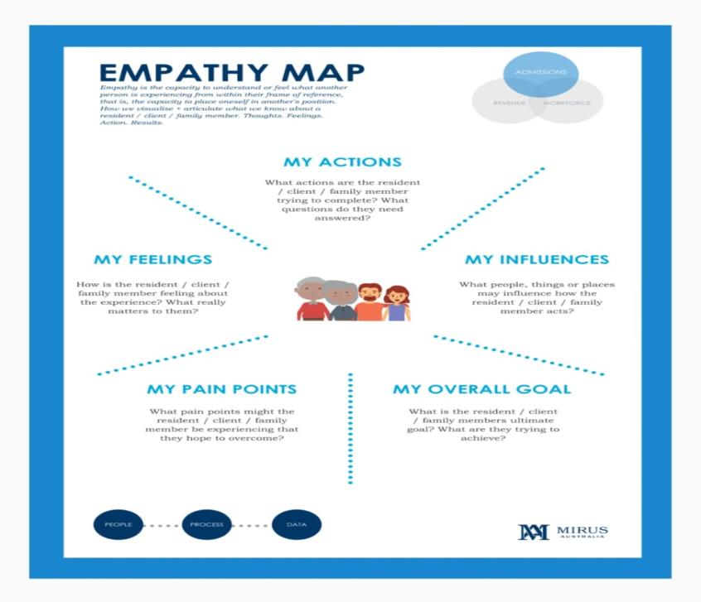

Slide 7
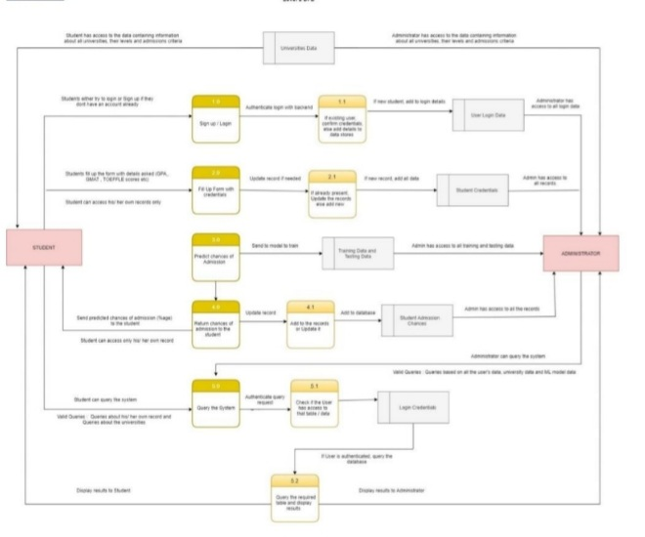
2.2 Ideation & Brainstorming map
Notes:
This is another option for an Overview slide.

Slide 8
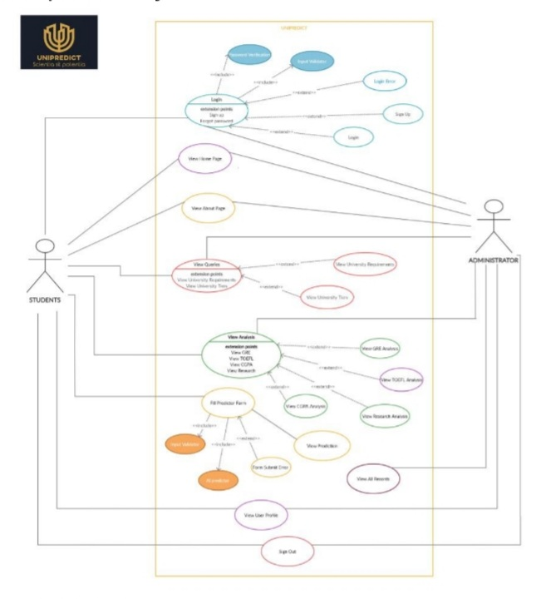
Notes:
What will the audience be able to do after this training is complete? Briefly describe each objective how the audience will benefit from this presentation.

Slide 9
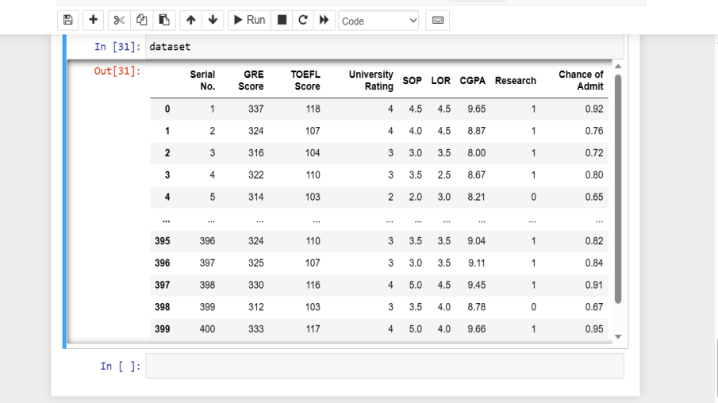
result
Notes:
Use a section header for each of the topics, so there is a clear transition to the audience.

Slide 10
Advantage and disadvantage
ADVANTAGE :
It helps students for making decision for choosing a right college.
Here the chance of occurrence of error is less when compared with the existing system.
It is fast ,efficient and reliable.
Avoids data redundancy and inconsistency.
Very user-friendly.
Easy accessibility of data.
DISADVANTAGE :
Required active internet connection.
System will provide inaccurate results if data entered incorrectly.
Application
To start we need collaborative ,industry-wide commitment to more equitable and exclusive admissions policies and practice.At the gathering ,teams imagined cross-cutting solutions as key to improving the admissions process,hanging on a collaborative approach action approach to change.
Notes:
If there is relevant video content, such as a case study video, demo of a product, or other training materials, include it in the presentation as well.

Slide 11
Conclusion
We conclude by suggest that the future of universities will be taking a crucial and leading role within a goverence milielu of many collaborating public and private agencies and organisation to be more inclusive ,reflective and restorative organisation.
Future scope
There is one segment named lab unit needed compter system to improve work.In this system ,we tried to make a simple application for user.We can change our system day by day as per user requirments will be changed .In future ,we want to implement below point in our system.
We can generate student attendance report.
We can generate graphical report of students result.
Notes:
Add a case study or class simulation to encourage discussion and apply lessons.

Slide 12
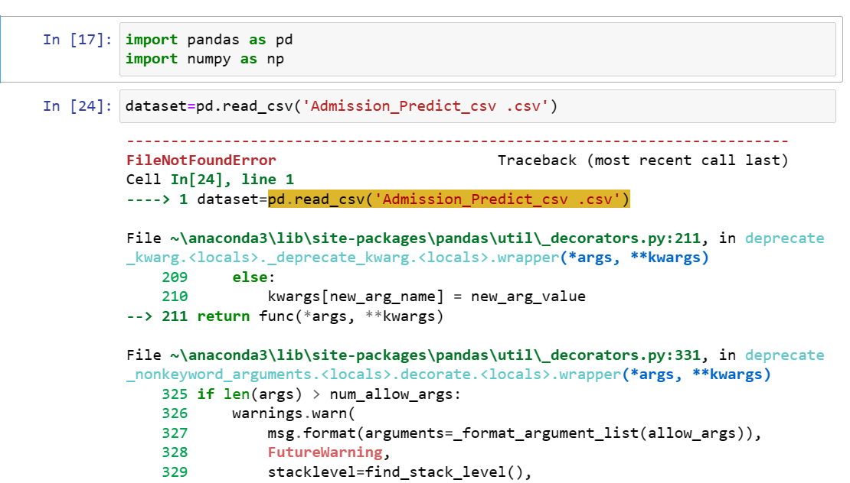
Appendix
Notes:
Discuss outcomes of the case study or class simulation.
Cover best practices.

Slide 13
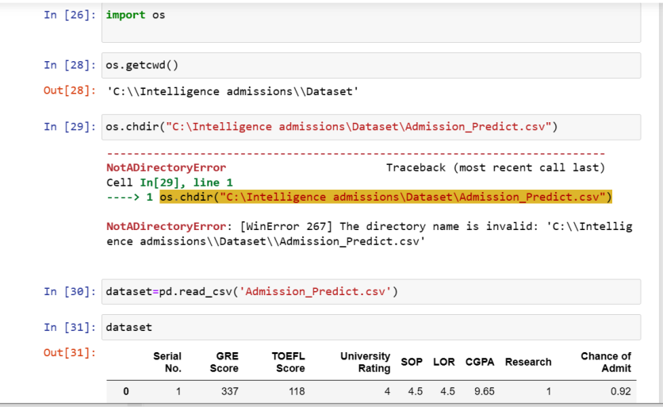
Notes:
Summarize presentation content by restating the important points from the lessons.
What do you want the audience to remember when they leave your presentation?
Save your presentation to a video for easy distribution (To create a video, click the File tab, and then click Share. Under File Types, click Create a Video.)

Slide 14
