Slide 1
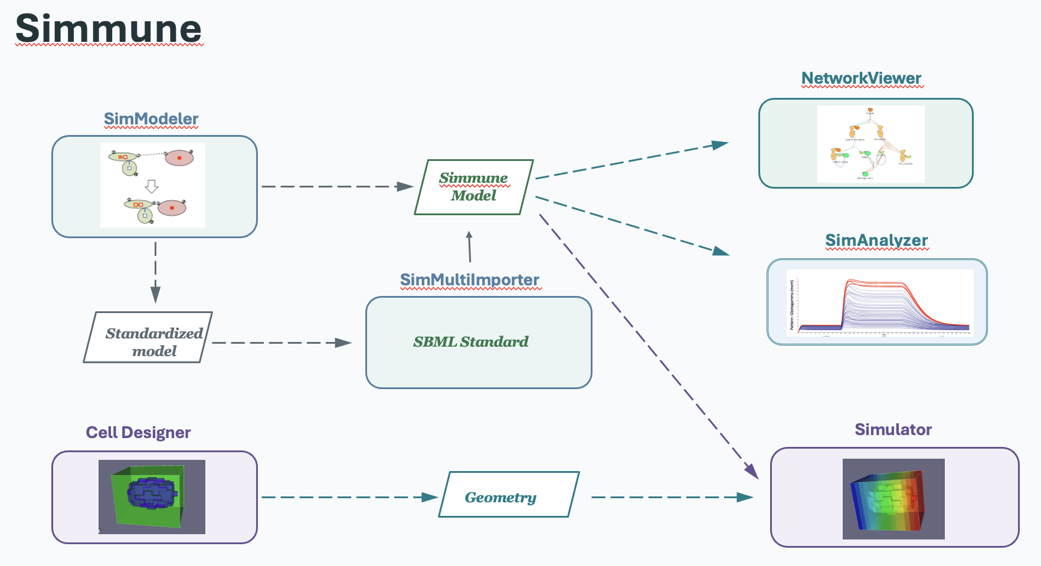
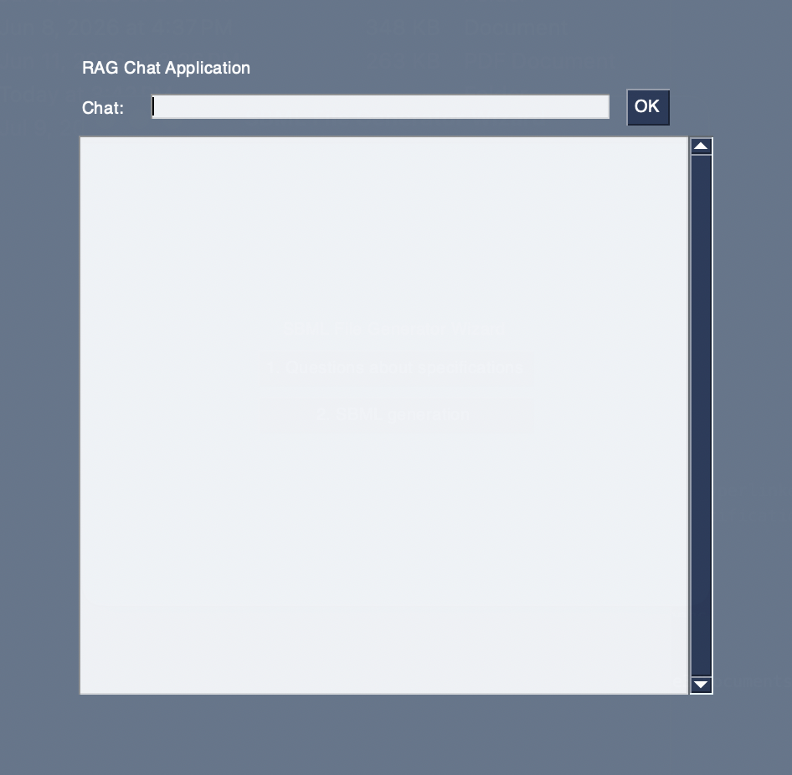
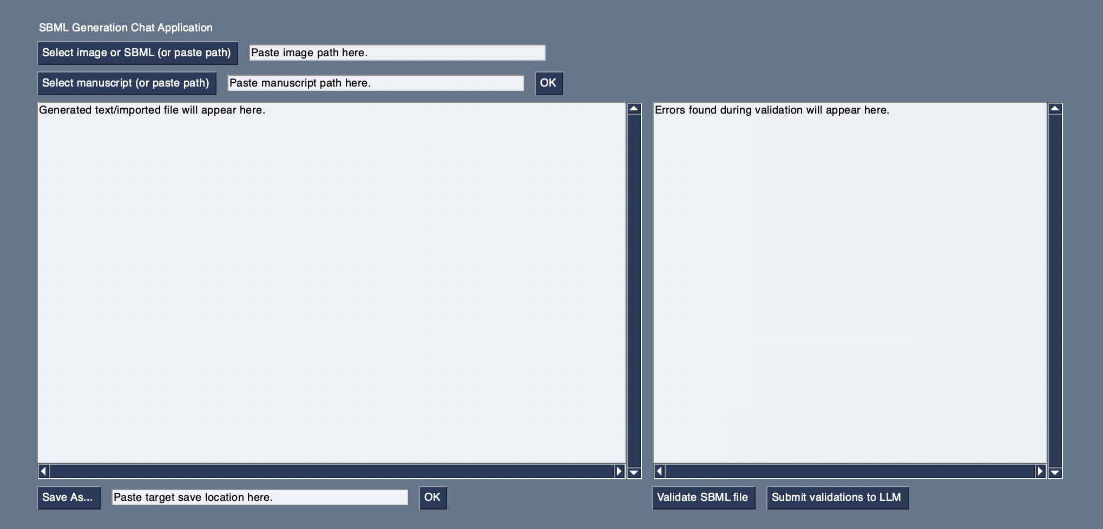
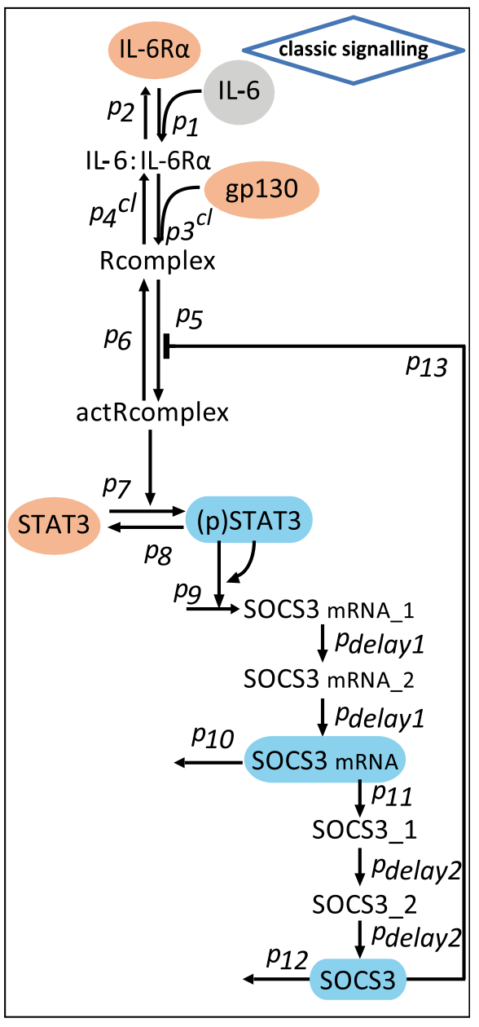
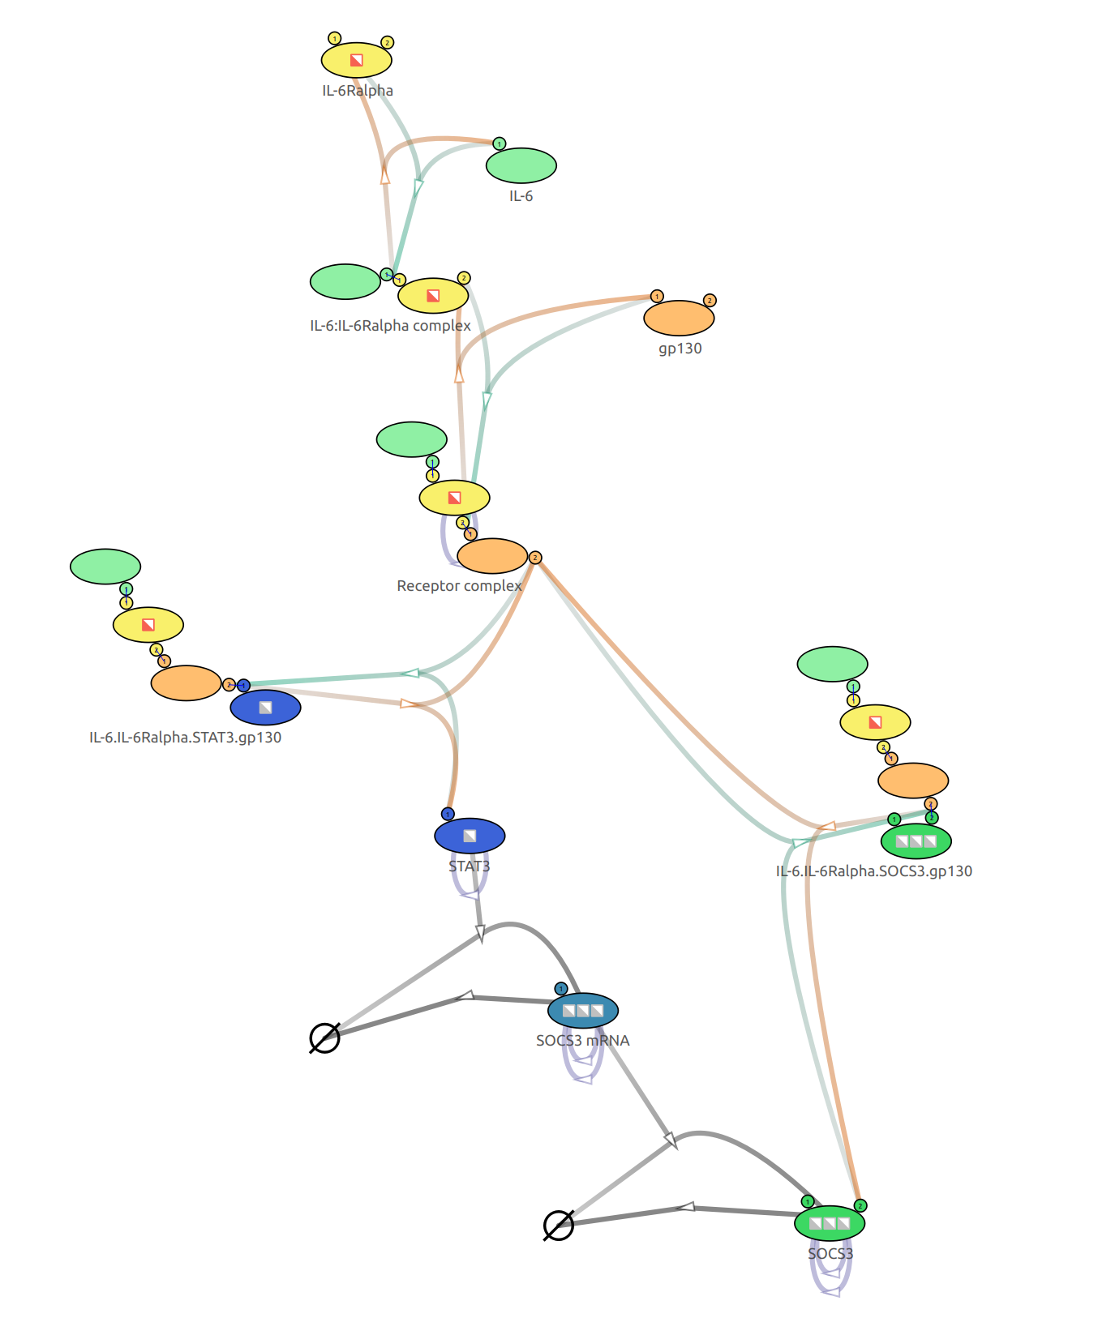



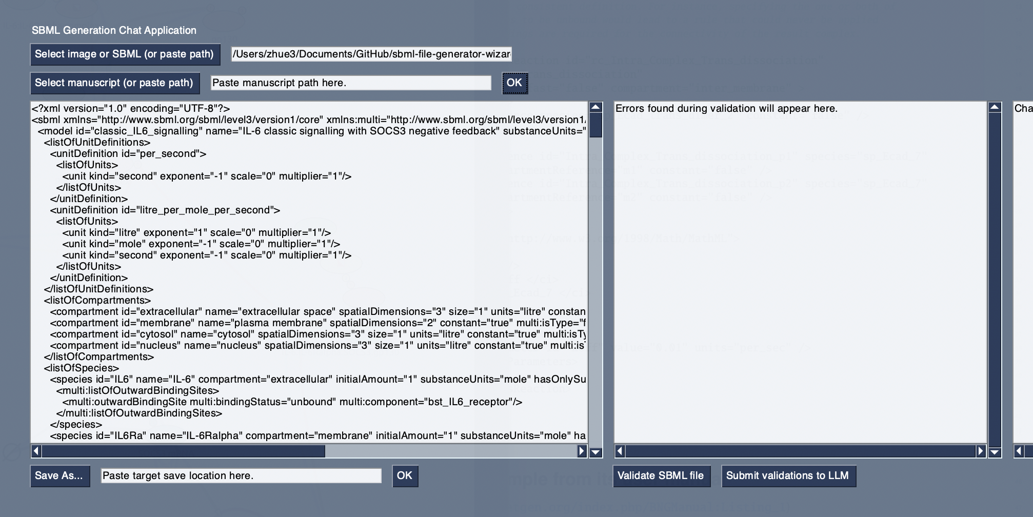
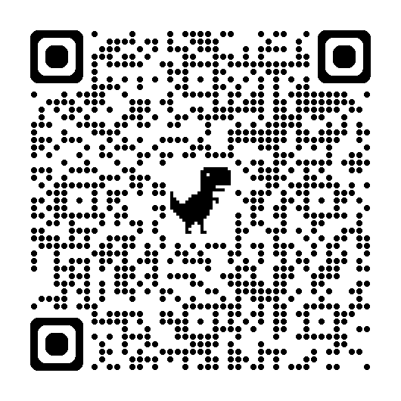
Biology in silico: LLM workflow translating signaling diagrams to Simmune models
Ethan Zhu, Fengkai Zhang, Martin Meier-Schellersheim
Laboratory of Immune System Biology (LISB), National Institute of Allergy and Infectious Diseases (NIAID), NIH, Bethesda, MD, USA.
Introduction & Background
Wizard & Simmune Interaction Diagram
Methods (cont.)
Rule-based modelling tools, such as Simmune, allow users to model reaction pathways, design cells, and simulate their behavior, all from their own computer²
However, in relation to Simmune specifically, which utilizes the Systems Biology Markup Language Multistate, Multicomponent, and Multicompartment Species package (SBML Multi) for importing and exporting, a lack of knowledge of this standard or XML in general may limit the user’s capability to fully use the software. We propose SBML Multi Generation Wizard to bridge this gap. The wizard allows users to:
Upload photos of cell signaling pathways to generate SBML Multi files using a large language model (LLM) workflow
Validate and explain errors and insights within the file
Ask SBML Multi questions in the wizard’s Q&A mode
Wizard
One drawback of using LLMs is that they are susceptible to hallucinations, where they generate false or inaccurate information³. This tendency is more prominent when dealing with niche topics or information, which SBML can fall under.
To combat this, we implement different optimization techniques.
Prompt engineering
Few shot prompting
Retrieval augmented generation (RAG)
Image
+
SBML Multi File
Manuscript
How do I make soup?
vs.
How do I make a low-sodium French onion soup?
Please give me a soup recipe I would like!
vs.
Here are examples of soups I like. Please give me a new soup recipe!
What’s the pH of egg yolks?
vs.
Here’s a book on food science. What’s the pH of egg yolks?
Conclusion & Future Work
Methods
Workflow (SBML generation)
Through SBML Multi Generation Wizard, we showcase a promising method of generating SBML Multi files from images, allowing users easier access to other Simmune tools, such as SimAnalyzer and the Simmune Simulator to simulate cell signaling pathways and other processes.
Future opportunities for extending the wizard’s capabilities could include:
Creating a ‘coach’ to explain errors found during validation and biological insights from the model.
Adding a history section for past requests
Pauses during generation to allow for the user to fill in fields that the LLM may detect it lacks from inputted information.
A combination of programming languages, libraries, and large-language models were used to make the wizard.
Programming languages
Python
3rd party libraries
Large-language models
gemma3 qwen3-embedding GPT 5.5
1. User selects image
(optional manuscript)
3. Multi file is imported into Simmune for user to interact with
Python
Ollama
PyMuPDF
NumPy
2a. Optional validation
loop
Acknowledgements & References
PySimpleGUI
libSBML
LangChain
I want to give special thanks to Fengkai Zhang, Martin Meier-Schellersheim, and Thorsten Prüstel for their incredible and friendly mentorship and guidance throughout my time here. I would like to thank the Laboratory of Immune System Biology, Division of Intramural Research, NIAID, and NIH for allowing me the opportunity to engage with this research and for supporting me throughout the process.
A special thank you as well to Miranda Knox, Kim Bradley, Adele Bartha, Angela Harris, Brandi Clarke, and DPSAC in their assistance regarding onboarding tasks and paperwork, and to the IT teams for their help in technology installation and setup. Thank you to OITE and NIAID ORTD in organizing orientation and other
2. SBML Multi file generated
For Q&A mode
For SBML generation
useful events for interns. A big thanks to NIAID RTB Biological Imaging for helping out with poster printing, and to Building 4 Housekeeping for keeping the building and offices tidy.
References ->

Slide 2
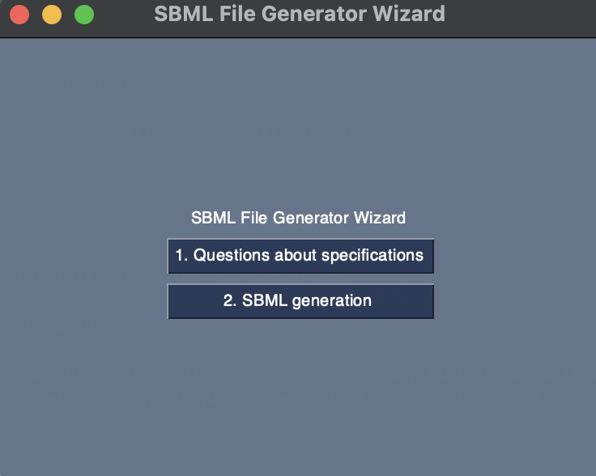
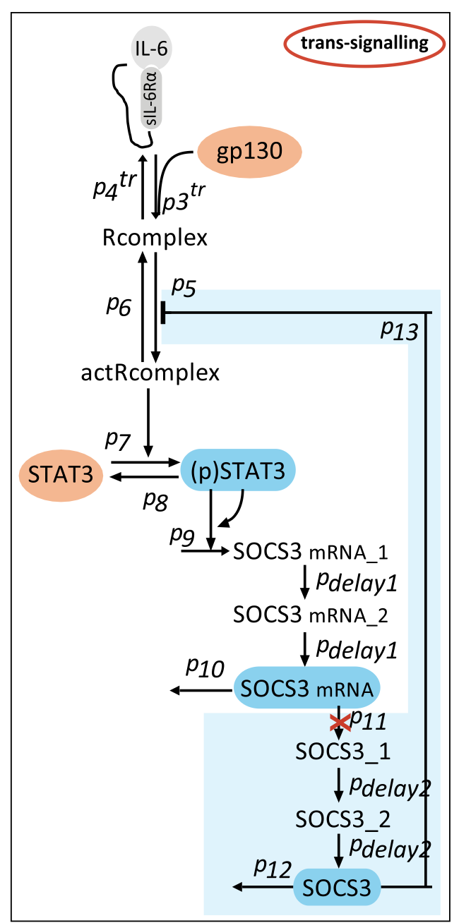
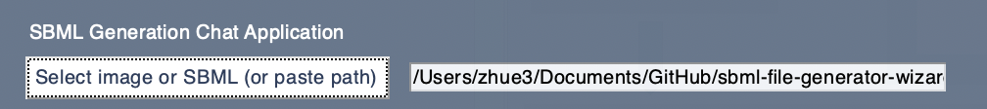
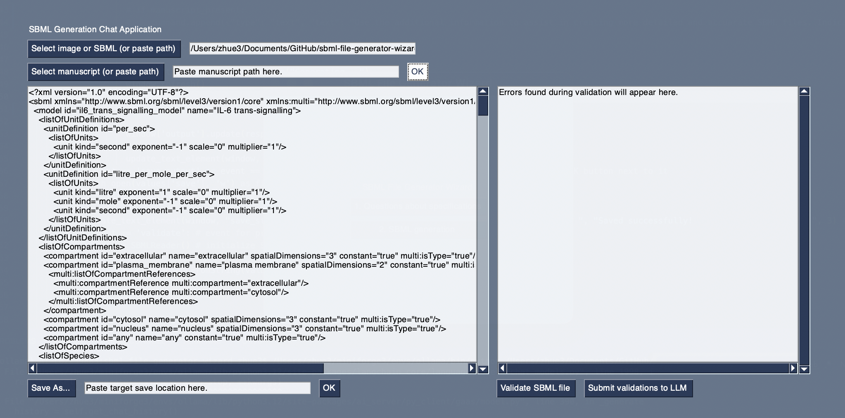
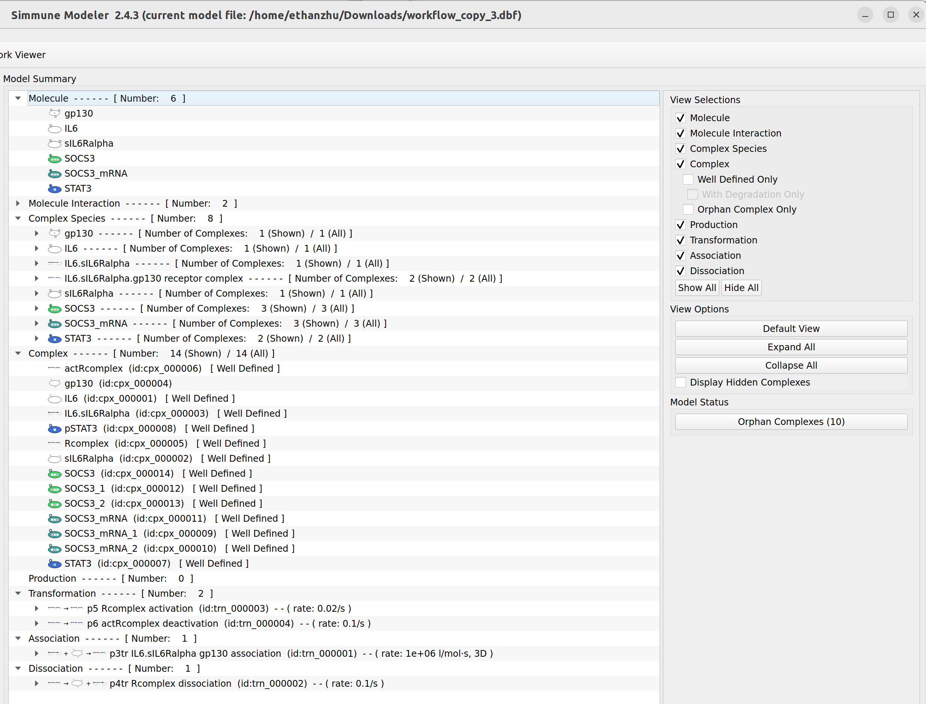
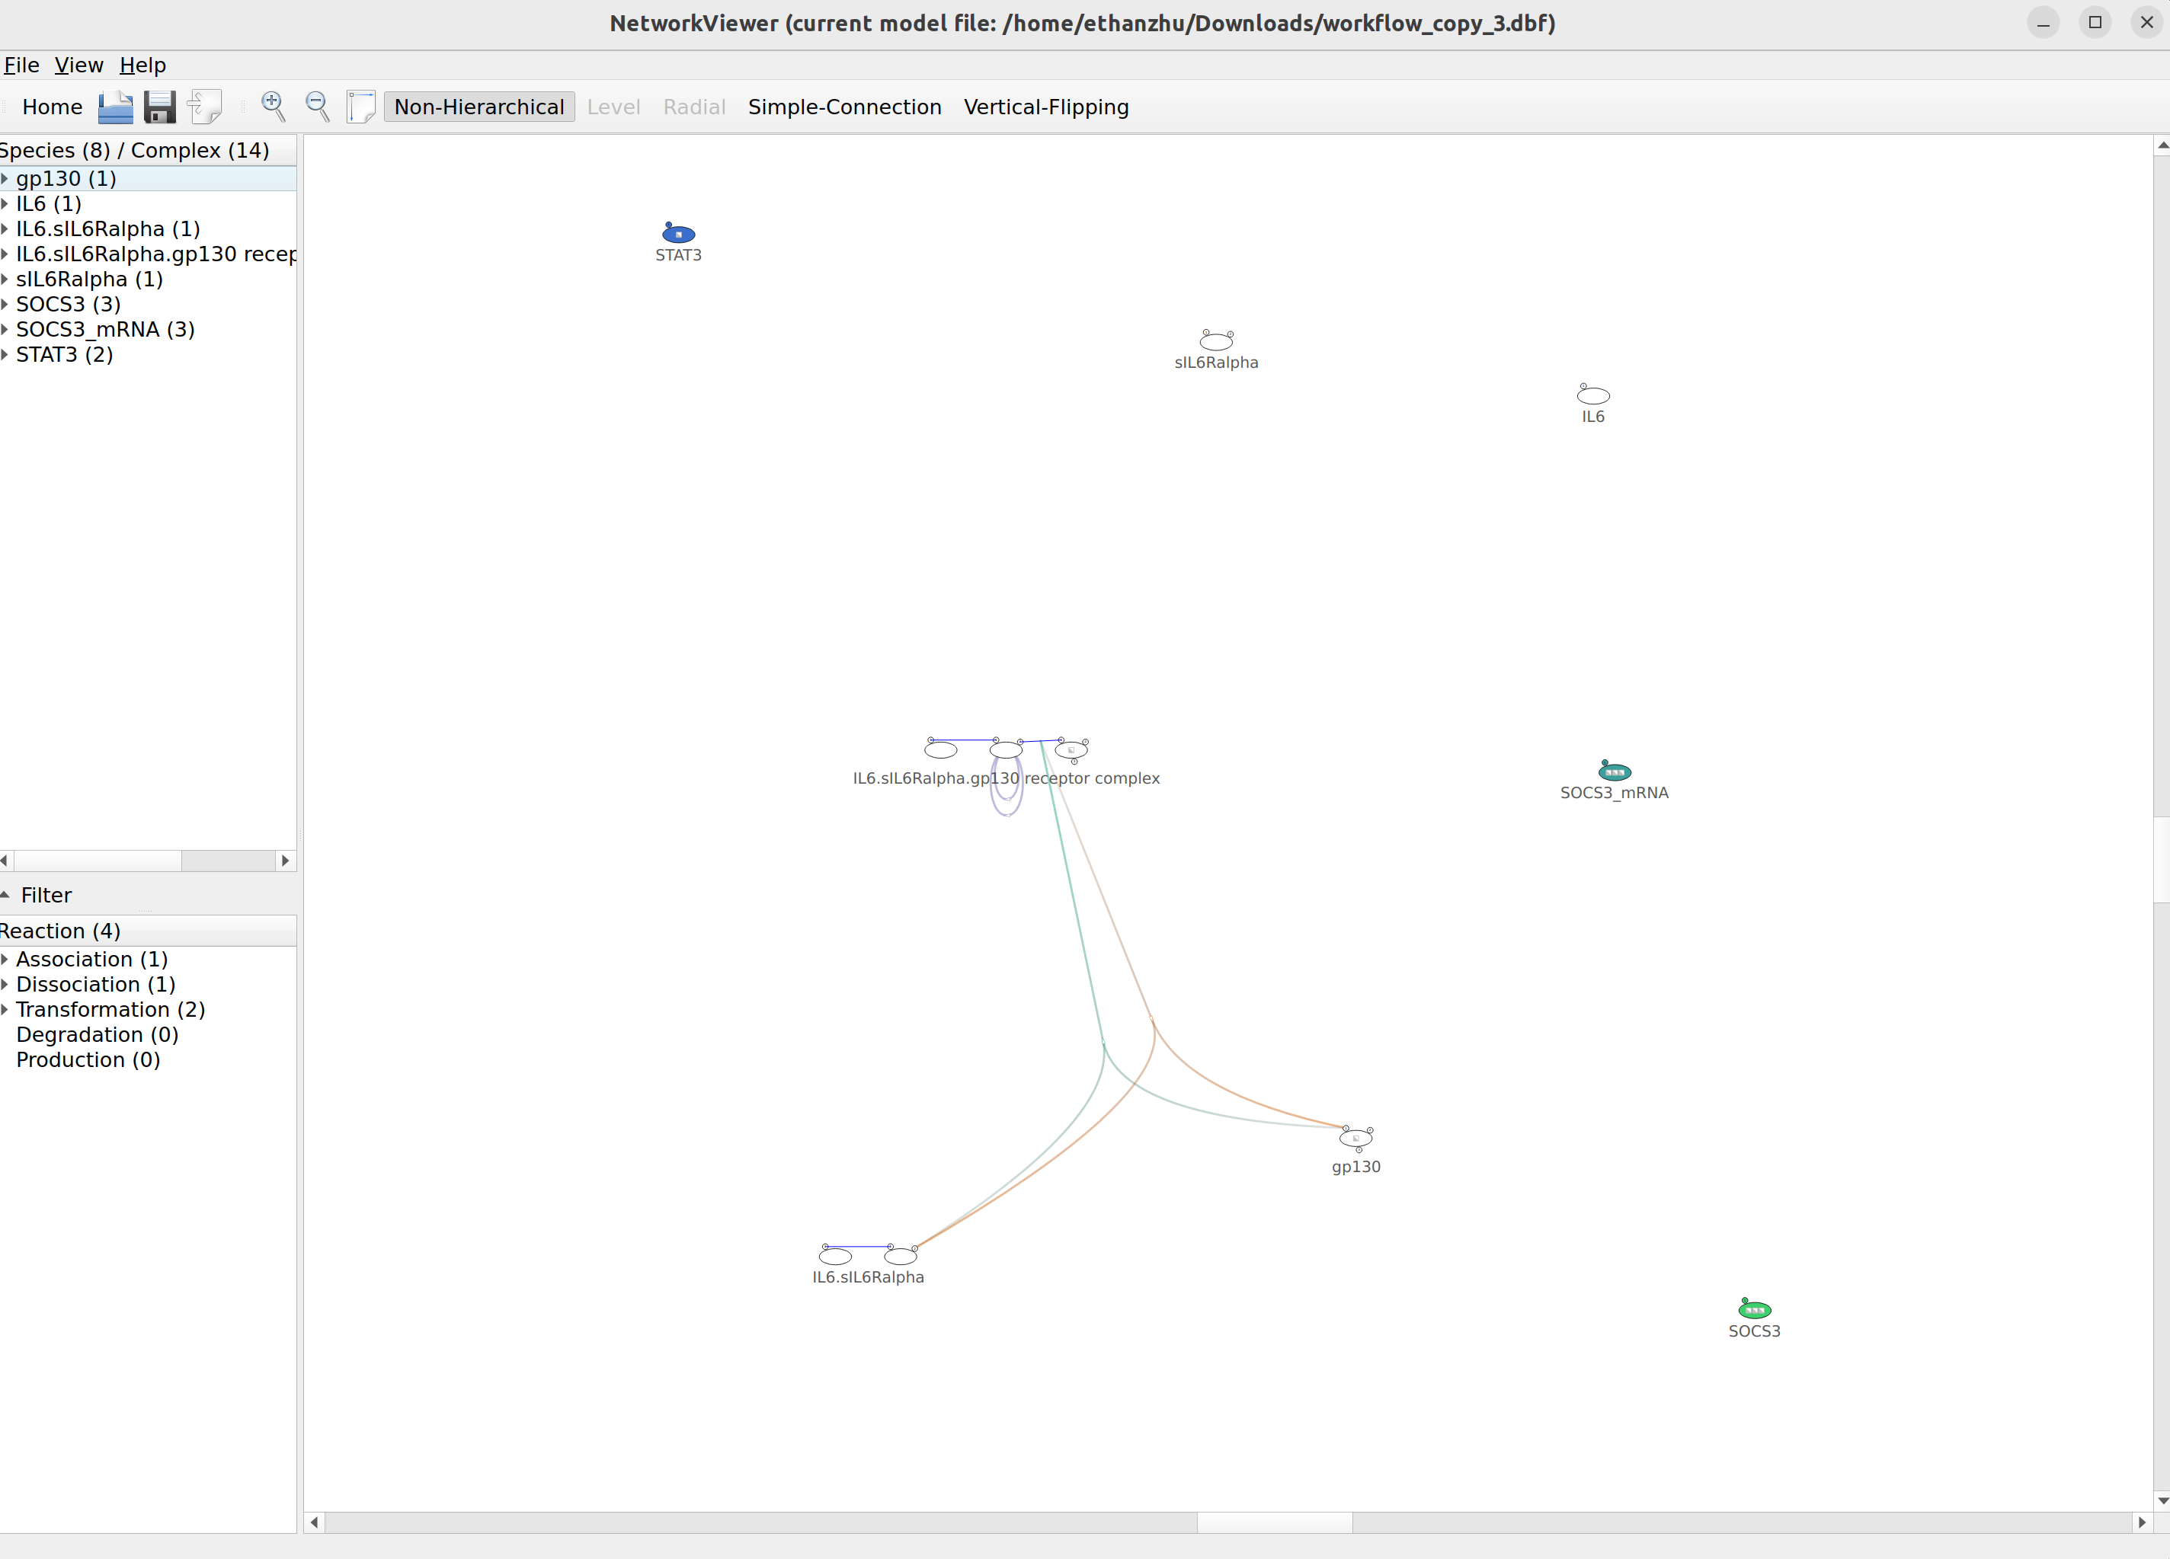
Biology in silico: LLM workflow translating signaling diagrams to Simmune models
Ethan Zhu, Fengkai Zhang, Martin Meier-Schellersheim
Laboratory of Immune System Biology (LISB), National Institute of Allergy and Infectious Diseases (NIAID), NIH, Bethesda, MD, USA.
Introduction & Background
Workflow
Methods (cont.)
Many molecular and cellular biologists rely on computational models or tools to simulate biological processes, such as signaling pathways, for a variety of reasons. Some may do so:
In the pursuit of quantitative biology¹
As a way around traditional barriers of time or cost, amongst other things, in relation to laboratory experiments
Tools such as the BioNetGen and Simmune accomplish this well, allowing users to model reaction pathways, design cells, and simulate their behavior, all from their computer².
However, in relation to Simmune specifically, which utilizes the Systems Biology Markup Language (SBML) standard and Multi package for importing and exporting, a lack of knowledge of this standard or XML in general may limit the user’s capability to fully use the software. We propose SBML Multi Generation Wizard to bridge this gap. The wizard allows users to:
Upload photos of cell signaling pathways to generate SBML Multi files using a large language model (LLM) workflow
Validate and explain errors and insights within the file
Ask questions about SBML Multi in the wizard’s secondary Q&A mode.
One drawback of using LLMs is that they are susceptible to hallucinations, where they generate false or inaccurate information³. This tendency is more prominent when dealing with niche topics or information, which SBML can fall under.
To combat this, we implement different optimization techniques.
Prompt engineering
Few shot prompting
Retrieval augmented generation (RAG)
How do I make soup?
vs.
How do I make a low-sodium French onion soup?
Please give me a soup recipe I would like!
vs.
Here are examples of soups I like. Please give me a new soup recipe!
What’s the pH of egg yolks?
vs.
Here’s a book on food science. What’s the pH of egg yolks?
Conclusion & Future Work
Methods
Workflow (SBML generation)
Through SBML Multi Generation Wizard, we showcase a promising method of generating SBML Multi files from images, allowing users easier access to other Simmune tools, such as SimAnalyzer and Simmune Simulator to simulate cell signaling pathways and other simulations.
Future opportunities for extending the wizard’s capabilities could include:
Creating a ‘coach’ to explain errors found during validation and biological insights from the model.
Adding a history section for past requests
Pauses during generation to allow for the user to fill in fields that the LLM may detect it lacks from inputted information.
A combination of programming languages, libraries, and large-language models were used to make the wizard.
Programming languages
Python
3rd party libraries
Ollama, PyMuPDF, NumPy, PySimpleGUI, libSBML, LangChain (other libraries used but played a minor role)
Large-language models
gemma3:4b, qwen3-embedding:8b, GPT 5.5 (high)
2. User inputs image
3. SBML Multi file generated (optional validation)
1. User selects image
Acknowledgements
I want to give special thanks to Fengkai Zhang, Martin Meier-Schellersheim, and Thorsten Prüstel for their incredible and friendly mentorship and guidance throughout my time here. I would like to thank the Laboratory of Immune System Biology, Division of Intramural Research, NIAID, and NIH for allowing me the opportunity to engage with this research and for supporting me throughout the process.
A special thank you as well to Miranda Knox, Kim Bradley, Adele Bartha, Angela Harris, Brandi Clarke, and DPSAC in their assistance regarding onboarding tasks and paperwork, and to the IT teams for their help in technology installation and setup. Thank you to OITE and NIAID ORTD in organizing orientation and other useful events for interns. A big thanks to NIAID RTB Biological Imaging for helping out with poster printing, and to Building 4 Housekeeping for keeping the building and offices tidy for us.
4. Multi file is imported into Simmune for user to interact with
For Q&A mode
For SBML generation

