Slide 1
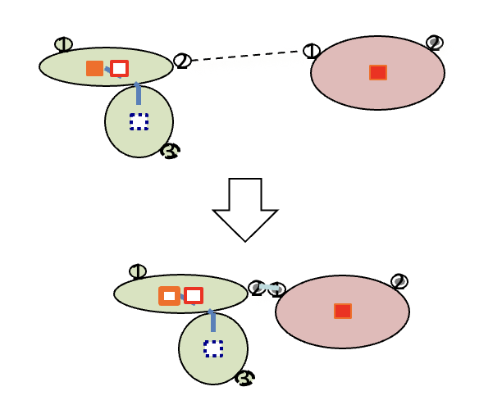
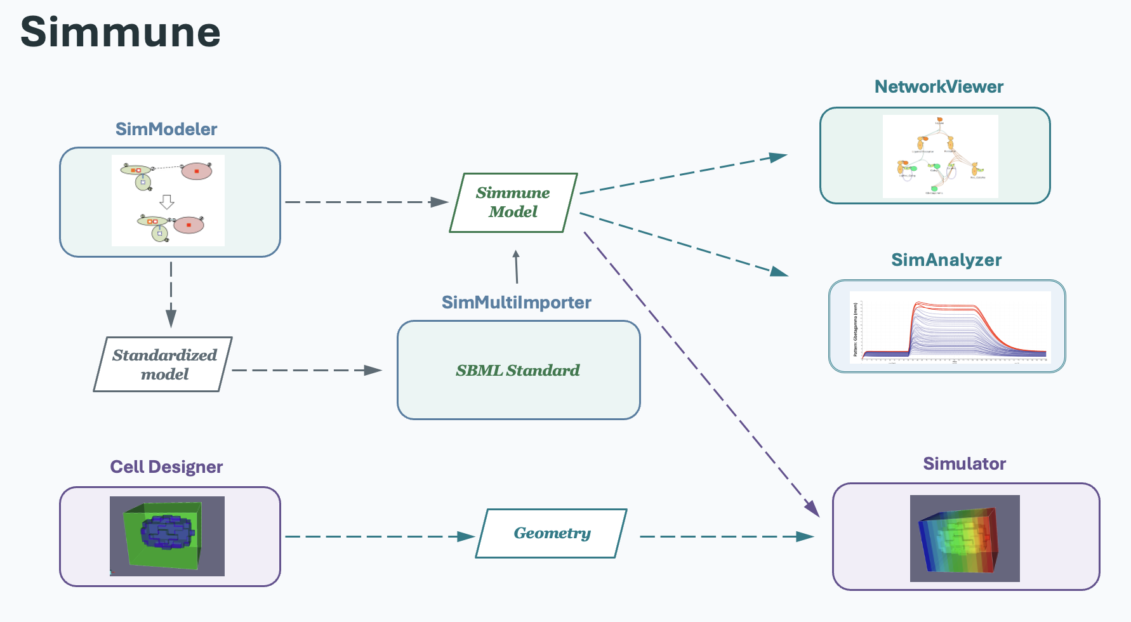
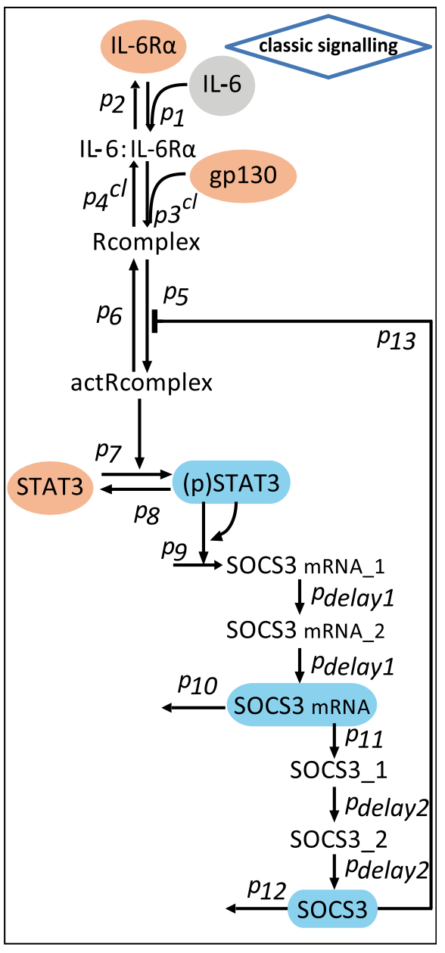
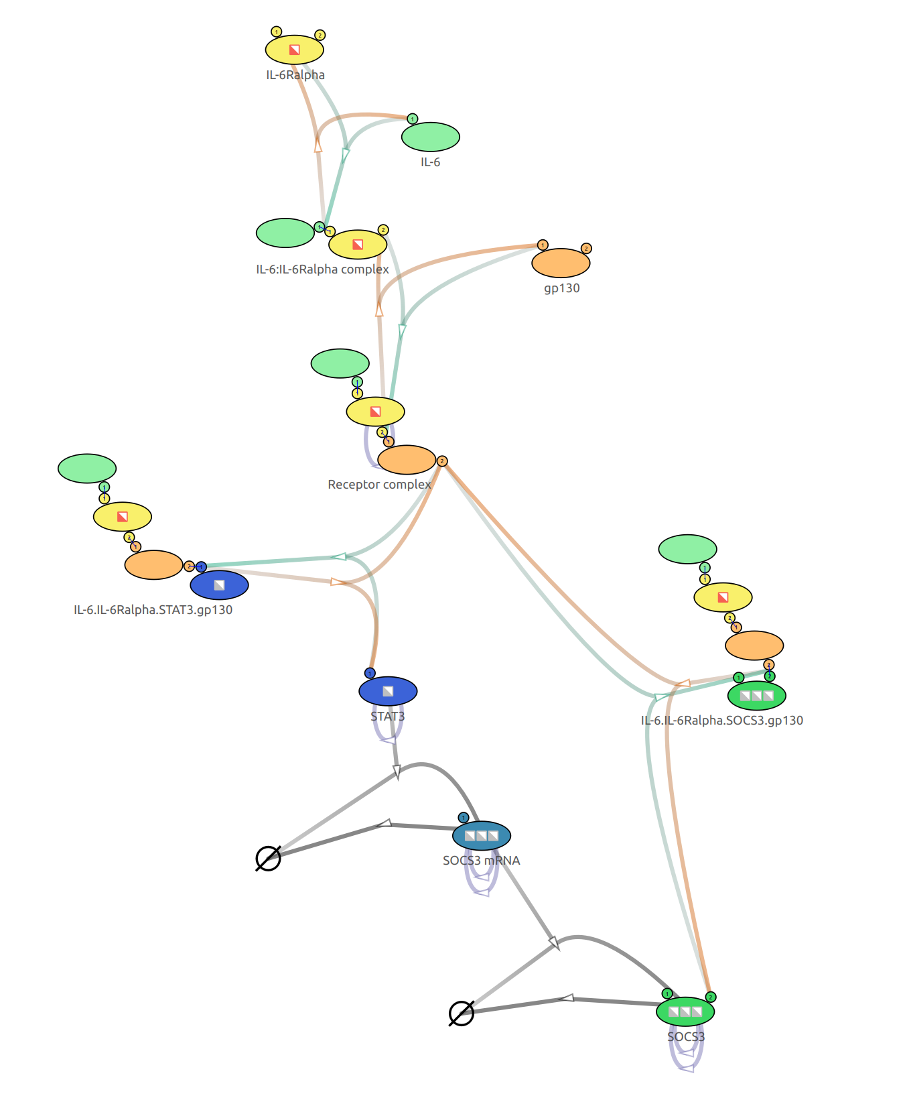



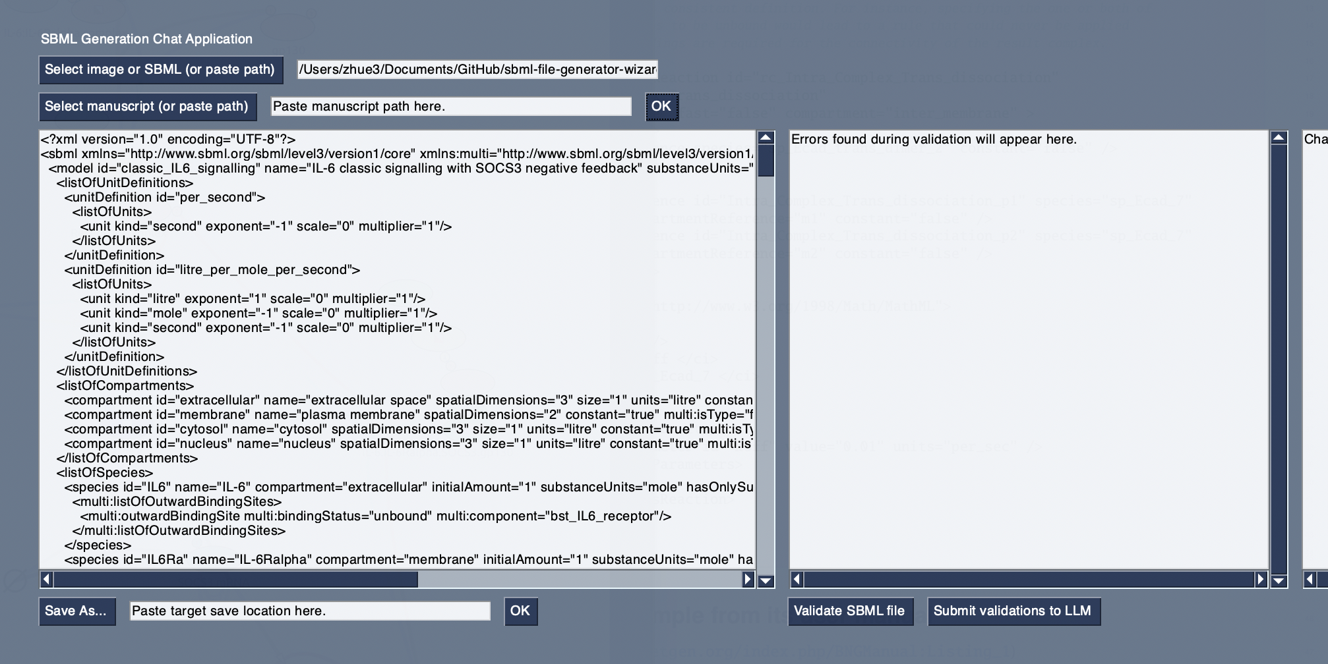
Biology In Silico: LLM Workflow Translating Signaling Diagrams to Simmune Models
Ethan Zhu, Fengkai Zhang, Martin Meier-Schellersheim
Computational Systems Biology Section, Laboratory of Immune System Biology (LISB), NIAID, NIH, Bethesda, MD, USA
Introduction & Background
Wizard & Simmune Interaction Diagram
Optimization Techniques
Rule-based modelling tools, such as Simmune, allow users to create models of cellular signaling pathways according to their bimolecular interactions. These tools then assemble the resulting reaction networks and provide functionalities to explore the pathways via simulations.
The Systems Biology Markup Language (SBML) and its Multistate, Multicomponent, and Multicompartment Species (Multi) can encode such model interactions and information.
However, manually creating these models can prove to be time-consuming. Given current advancements of AI, large language models (LLMs) may prove to be a promising option, as they are able to take in multimodal input and generate large amounts of text.
Thus, we describe the SBML Multi Generation Wizard for:
Uploading photos of cell signaling pathways to generate SBML Multi files which can be imported into Simmune.
Validating and fixing errors in the generated SBML Multi file.
Asking questions about SBML Multi in the wizard’s Q&A mode.
Simmune Model
Wizard (this project)
One drawback of using LLMs is that they are susceptible to hallucinations, where they generate false or inaccurate information. This tendency is more prominent when dealing with niche topics or information, which SBML Multi can fall under.
To combat this, we implement different optimization techniques.
Image
LLM
SBML Multi File
Manuscript
Prompt engineering
Tell me about the IL-6 pathway.
vs.
Tell me about the IL-6 pathway in regards to its role for inflammation.
Few shot prompting
Generate me an SBML Multi file of the IL-6 pathway.
vs.
Here are some example SBML Multi files. Please generate an IL-6 one!
Retrieval augmented generation (RAG)
Here’s the SBML Multi spec doc. What does speciesType mean here?
What does speciesType mean here in this file?
vs.
Conclusion & Future Work
Methods
SBML Generation Workflow (IL-6 Pathway)
Through SBML Multi Generation Wizard, we showcase a promising method of generating SBML Multi files from images, allowing users easier access to Simmune tools, such as the Simmune Modeler, SimAnalyzer and the Simmune Simulator, to simulate cell signaling pathways and other processes.
Future opportunities for extending the wizard’s capabilities could include:
Creating a ‘coach’ to explain errors found during validation and biological insights from the model.
Adding a history section for past requests.
Pauses during generation to allow for the user to fill in fields that the LLM may detect it lacks from inputted information.
A combination of programming languages, libraries, and large-language models were used to make the wizard.
Programming languages: Python
3rd party libraries:
Large-language models:
1. User selects image
(optional manuscript)
3. Multi file is imported into Simmune for user to interact with
Ollama
PyMuPDF
NumPy
2a. Optional validation
loop
Acknowledgements & References
PySimpleGUI
libSBML
LangChain
I want to give special thanks to Fengkai Zhang, Martin Meier-Schellersheim, and Thorsten Prüstel for their incredible and friendly mentorship and guidance throughout my time here. I would like to thank the LISB and NIAID/NIH for this opportunity and their support. Thank you to NIAID OCICB SEB for their help with GENESIS, the NIH and NIAID IT teams for their help with technology setup, and NIAID RTB Biological Imaging for helping with poster printing. This work was supported by the Intramural Research Program of NIAID, NIH.
Selected references:
Zhang F, Angermann BR, Meier-Schellersheim M. The Simmune Modeler visual interface for creating signaling networks based on bi-molecular interactions. Bioinformatics. 2013;29(9):1229–1230.
Cheng HC, Angermann BR, Zhang F, Meier-Schellersheim M. NetworkViewer: visualizing biochemical reaction networks with embedded rendering of molecular interaction rules. BMC Syst Biol. 2014;8:70.
Angermann BR, Klauschen F, Garcia AD, et al. Computational modeling of cellular signaling processes embedded into dynamic spatial contexts. Nat Methods. 2012;9(3):283–289.
Zhang F, Smith LP, Blinov ML, et al. Systems biology markup language (SBML) Level 3 package: multistate, multicomponent and multicompartment species, Version 1 Release 2. J Integr Bioinform. 2020;17(2–3):20200015.
Reeh H, Rudolph N, Billing U, et al. Response to IL-6 trans- and IL-6 classic signalling is determined by the ratio of the IL-6 receptor α to gp130 expression: fusing experimental insights and dynamic modelling. Cell Commun Signal. 2019;17(1):46.
gemma3 qwen3-embedding GPT 5.5
2. SBML Multi file generated
SBML Multi
For Q&A mode
For SBML generation

