Slide 1
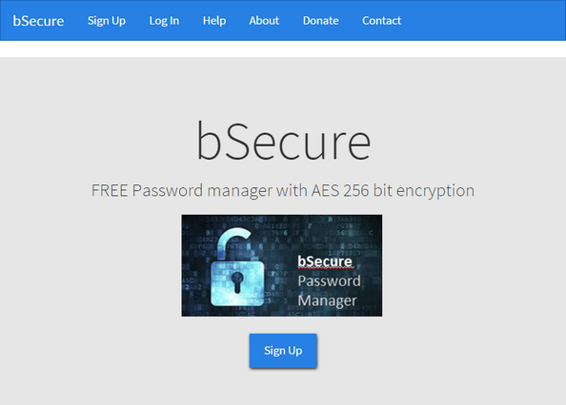
bSecure Help
User Help

Slide 2
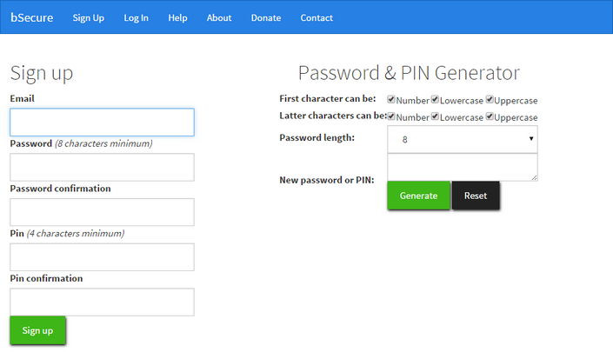
Sign Up
First time users should click the Sign Up button to create an account.
You should enter your Email address
Password
Pin
Press the “Sign-up” button to continue
The password and Pin generator is available in case you need help.
Describe why password and Pin are important

Slide 3
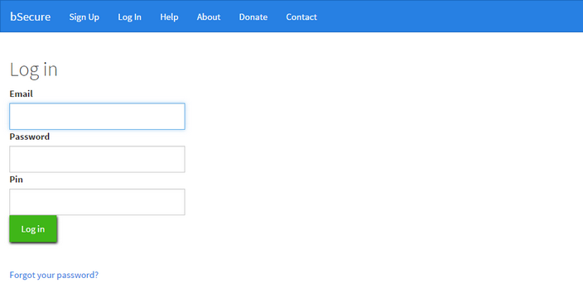
Log In
Enter your Email, password, and PIN
You will be notified if the information you provided is incorrect

Slide 4
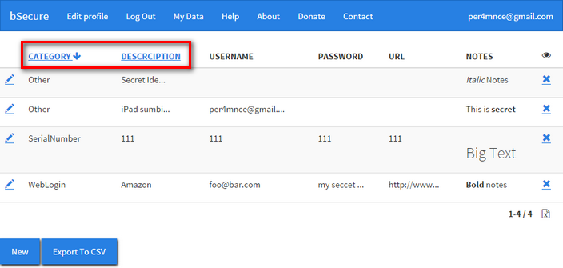
Sorting
Initially sorted by category
Click on Category or Description columns name to change the sort order. Data can be sorted ascending or descending. The arrow to the right of the column name shows the sort order.

Slide 5
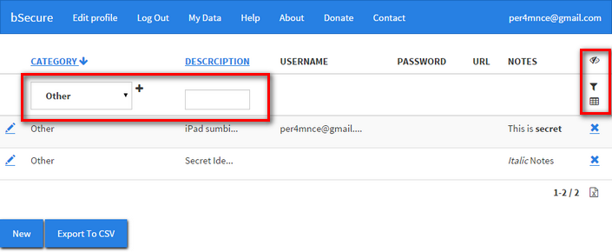

Filtering & Searching

Slide 6
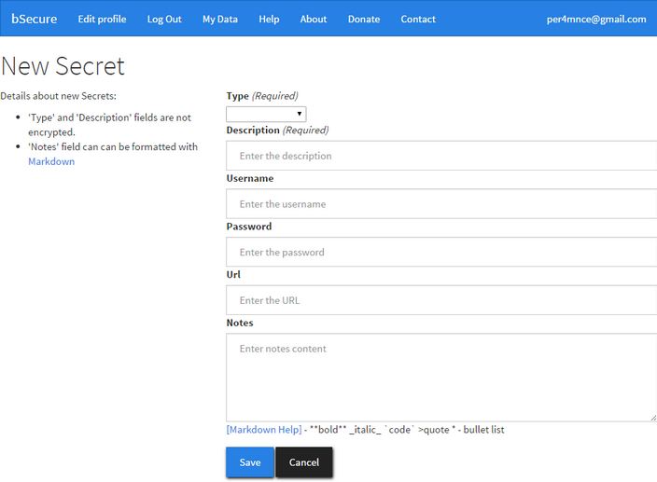
New Record

Slide 7
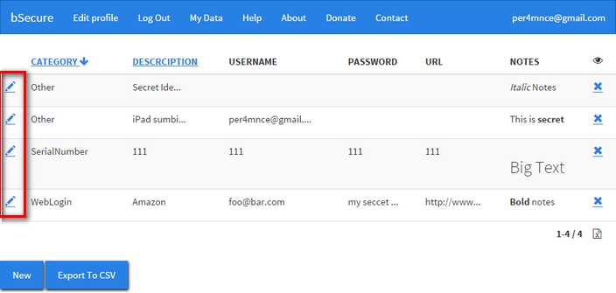
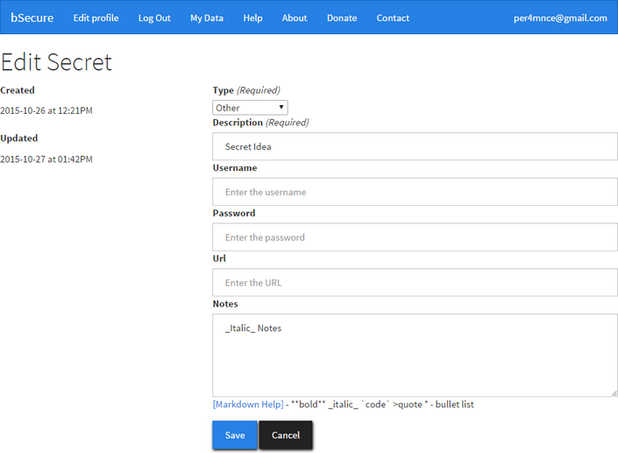
Editing Existing Records

Slide 8
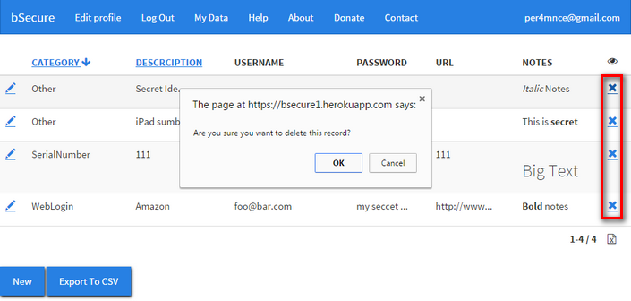
Deleting Records

Slide 9
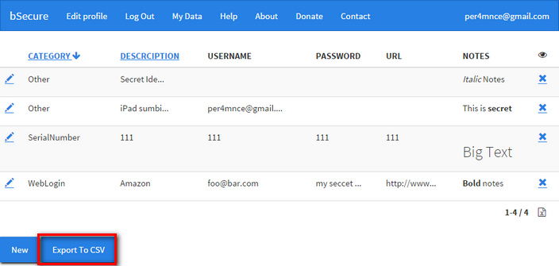
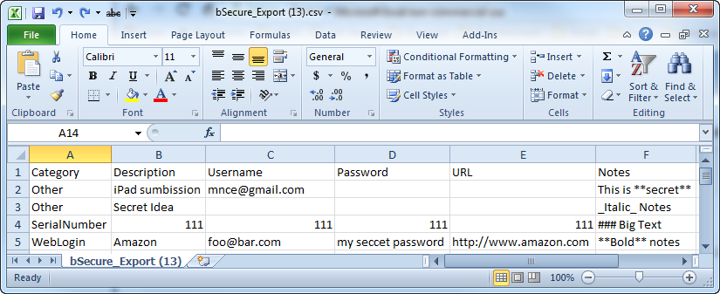
Export to CSV

Slide 10
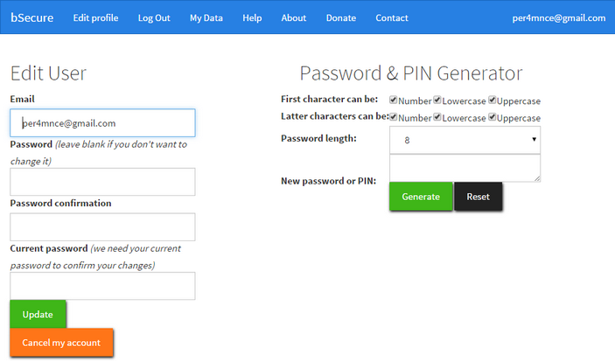
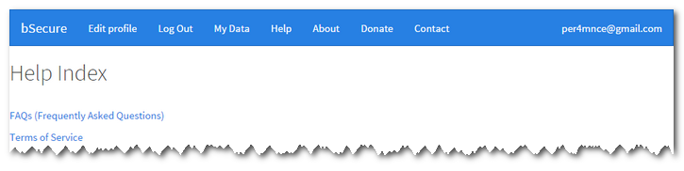
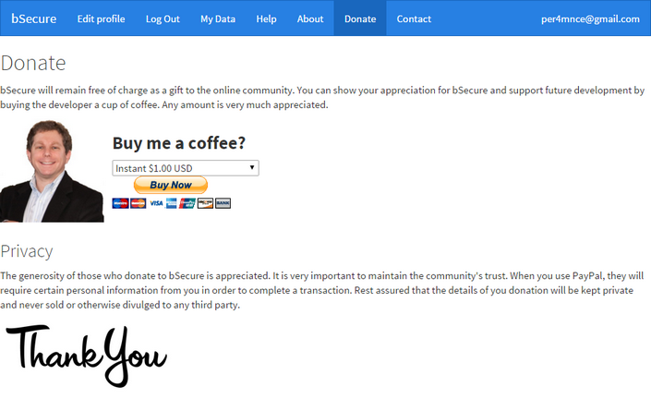
Pics

