Slide 1



Perak Technology Session
Unity 3D - Cross-platform Game Engine
Sponsor: Bandar Meru Raya Shop

Slide 2
Before We Start
Install Git
Open Command Prompt
Run this command
git clone https://github.com/peraktechnology/unity

Slide 3
Perak Technology
Perak ICT Community
Gather all ICT and technology expert from all over Perak.
Bring all ICT and technology event and program back to Perak State.
Boost ICT and technology industries in Perak.
Expose new technology and ICT services to Perak citizen.
Link: https://peraktechnology.com

Slide 4
Bandar Meru Raya Shop
Bandar Meru Raya Shop encourage startups and e-commerce entrepreneurs to do online business using social media.
Promote to Perak citizen for fully utilize the latest technology in daily life.
Turn Bandar Meru Raya into the centre of the online marketplace in Perak by the end of 2019.
Link: https://bandarmeruraya.com

Slide 5
Perak Technology Session
Knowledge sharing program for Perak Technology community
Run in different city in Perak every two month.
Sponsored by Bandar Meru Raya Shop and any other related company.
Allow Perak Technology community member to present any ICT and technology related stuff.
Open for sponsorship and support from local community
Link: http://telegram.me/peraktechnology

Slide 6
Unity 3D
Cross-platform game engine
Developed by Unity Technologies
Create both three-dimensional and two-dimensional games
Primary scripting API in C#
Deploy games across mobile, desktop, VR/AR, consoles or the Web
Link: https://unity3d.com
User Group: http://t.me/unitymalaysia

Slide 7
Github Perak Technology
https://github.com/peraktechnology

Slide 8
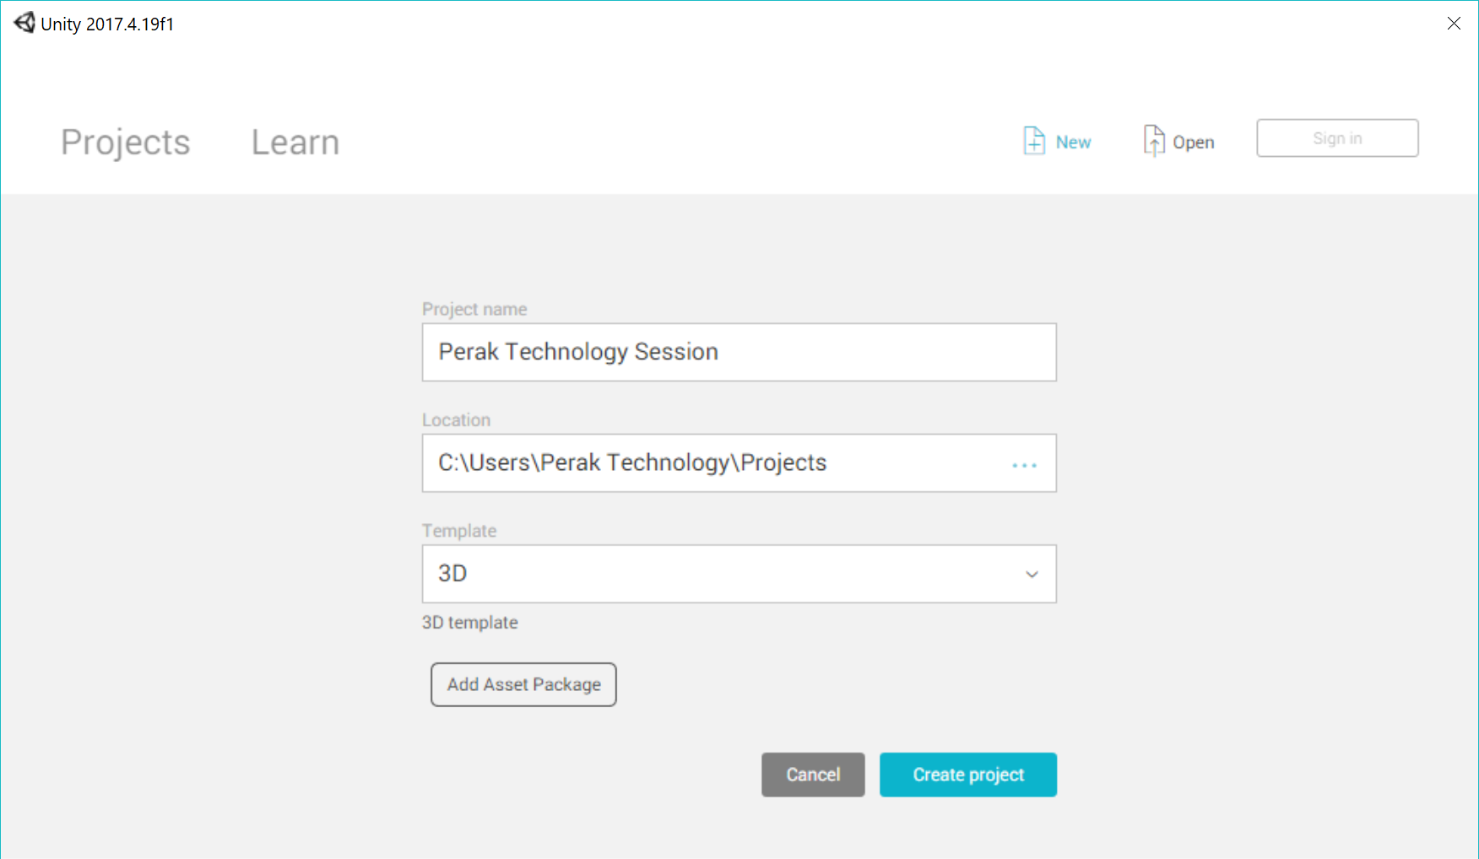
Creating A Project

Slide 9
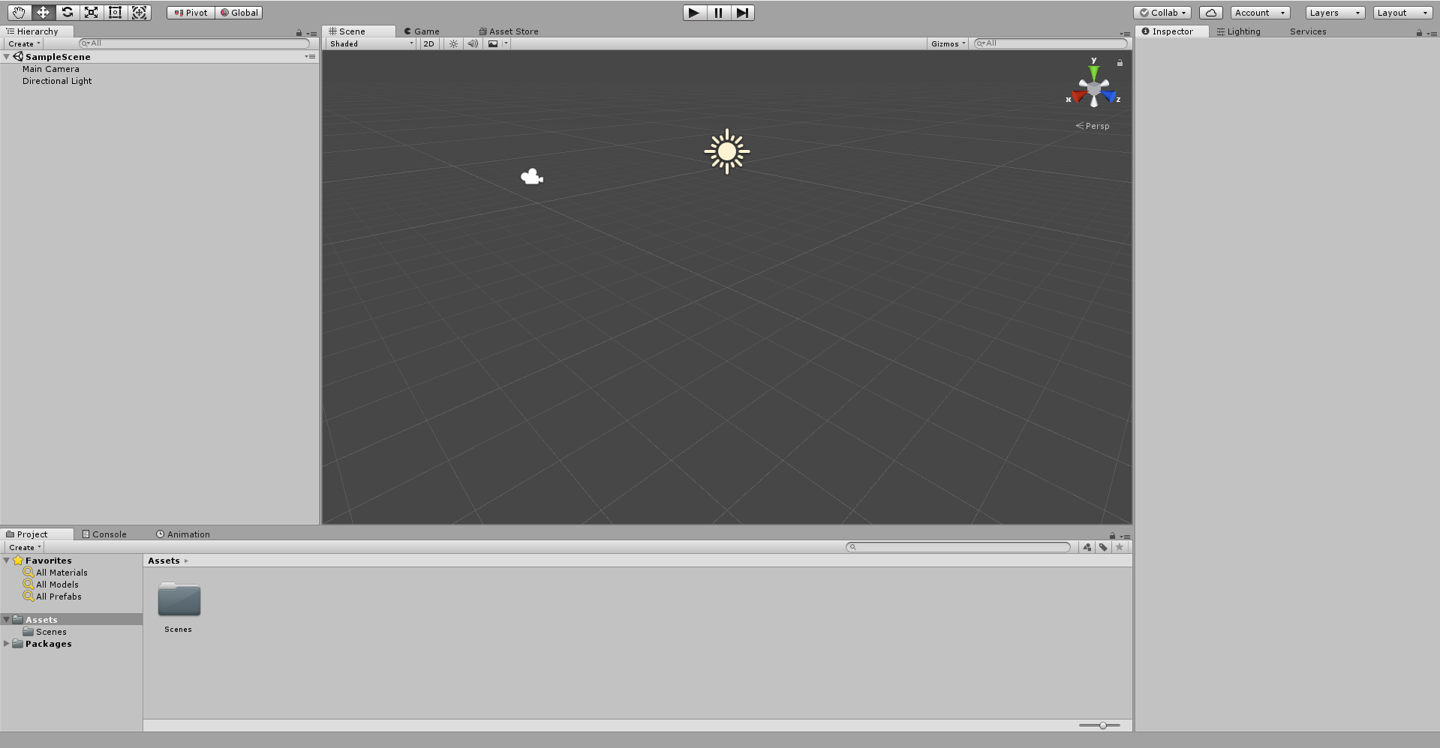
Interface

Slide 10
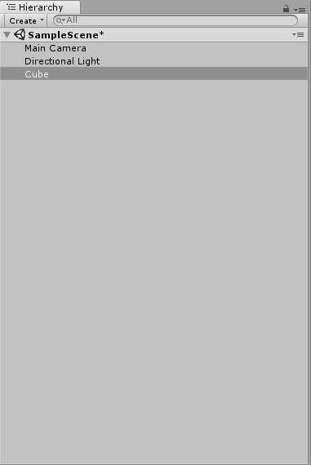
Hierarchy

Slide 11
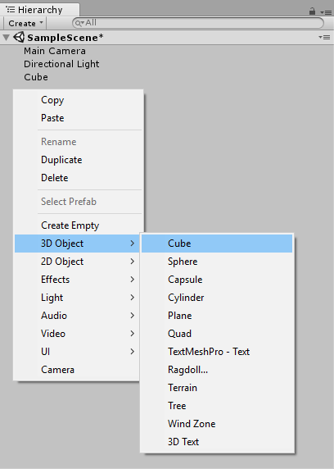
Create a Cube

Slide 12
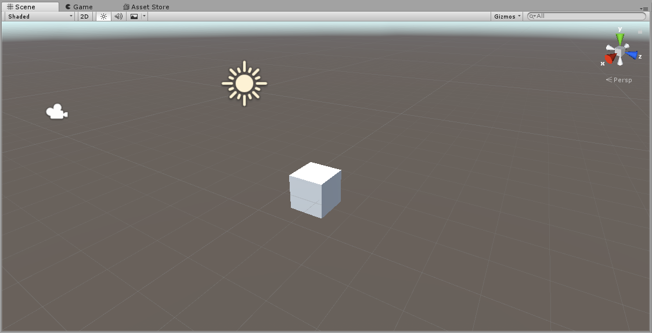
Scene/Game View

Slide 13
Navigating Scene View
Hand Tool: Click and drag to move scene and navigate world
Move Tool: Move objects within the world (X, Y, Z)
Rotate Tool: Rotate objects along the X, Y, or Z axis
Scale Tool: Scale object’s size either along an axis, or overall
Rect Tool: Mainly used for 2D games and UI elements
Universal Tool: Has functionality to move, rotate, and scale

Slide 14
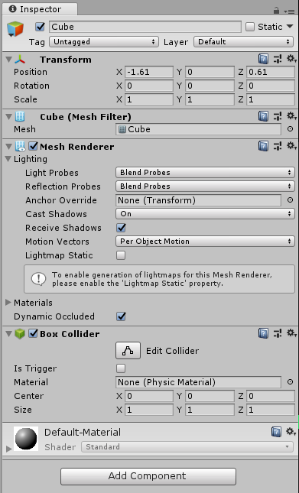
Inspector

Slide 15
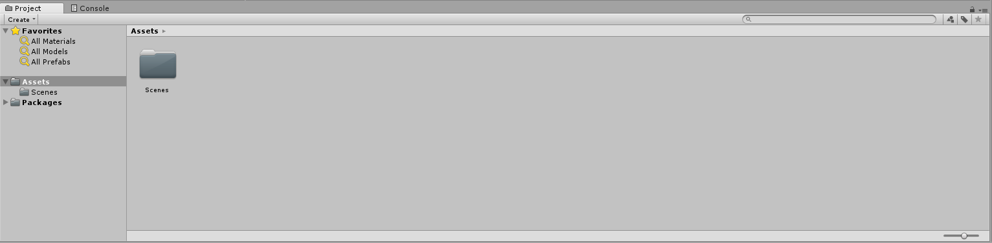
Project Window

Slide 16
Custom Layouts
Demo in Unity
Scale window size
Change window locations
Notes:
Show how to:
Scale Window size
Drag and drop windows

Slide 17
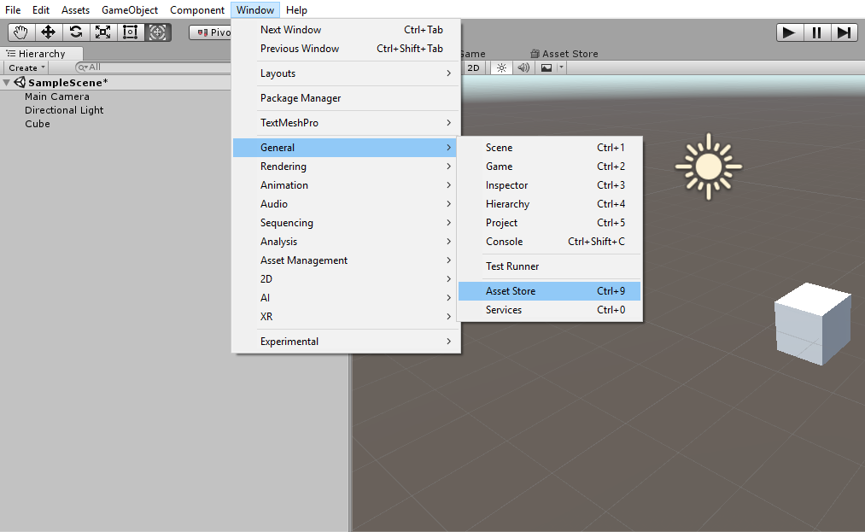
Adding Asset Store

Slide 18
Importing Assets from Store
Demo in Unity
Navigate to Props
Sort by FREE assets
Find asset pack (Low Poly Survival Essentials)
Download/Import pack
Notes:
Show how to:
Navigate to Props
Sort by FREE assets
Find asset pack
Download/Import pack

Slide 19
Adding Objects to Scene
In the Project Window, navigate to any assets
Drag and drop assets into scene and set location to (0,0,0)
Move camera to see scene in Game View

Slide 20
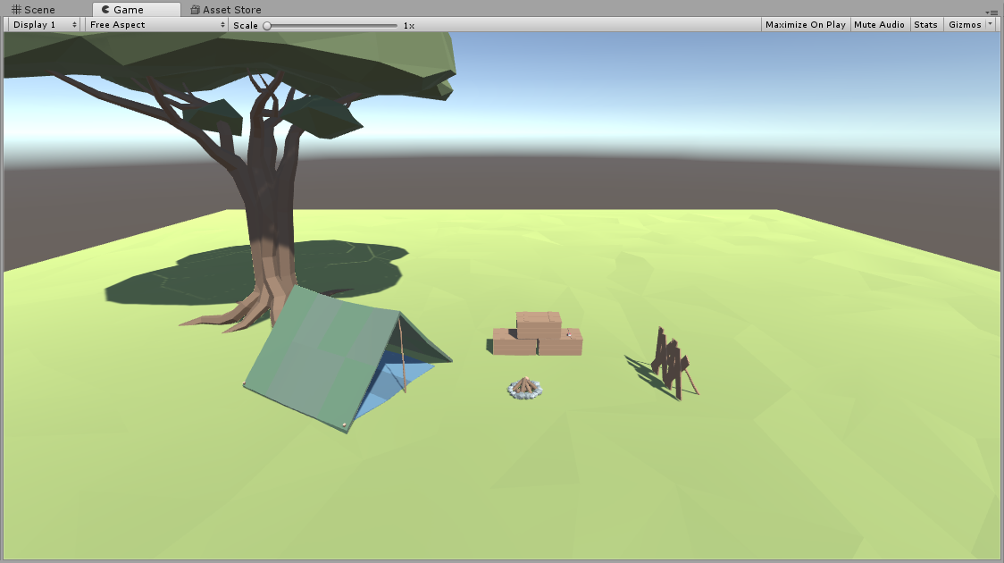

Slide 21
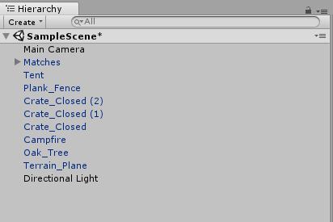
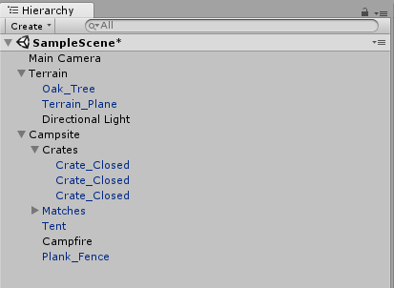
Scene Management
Use Empty Game Objects to create a “Folder Structure”
Before After

Slide 22
Using Prefabs
Prefabs are a valuable resource to use in developing your scene
A prefab is an object or a group of objects that can be saved for easy use and manipulation

Slide 23
Let's Start Building A Game
Install Git
Open Command Prompt
Run this command
git clone https://github.com/peraktechnology/unity
Create New Project
Copy all content into Assets folder

