Slide 1
Jumping for JS
Notes:
1

Slide 2
Today’s Class
Notes:
1

Slide 3
Objectives
In today’s class we’ll be covering:
Array Assignments
The Concept of For-Loops
The Art of Pseudo-Coding
Building Rock-Paper Scissors
Notes:
1

Slide 4
Basics Recap
Notes:
1

Slide 5
Deep Philosophy
What is JavaScript?
(And what is it used for?)
Notes:
1

Slide 6

JavaScript Definitions
JavaScript is the third of the three fundamental programming languages of the modern web (along with HTML, CSS)
JavaScript allows developers to create dynamic web applications capable of taking in user inputs, changing what’s displayed to users, animating elements, and much more.
Notes:
1

Slide 7
Please… Don’t Pick Me.
What is a Variable?
(And how do we declare one?)
Notes:
1

Slide 8
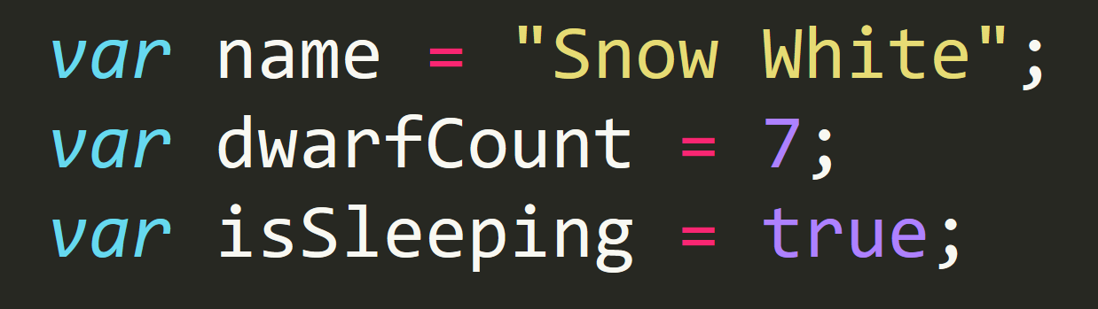
Basic Variables
Variables are the nouns of programming.
They are “things” (Numbers, Strings, Booleans, etc.)
They are composed of variable names and values
Notes:
1

Slide 9
Please… Don’t Pick Me.
What is meant by console.log?
(And how does it differ from an alert, prompt, or confirm?)
Notes:
1

Slide 10
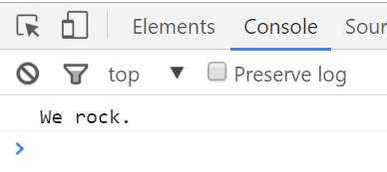
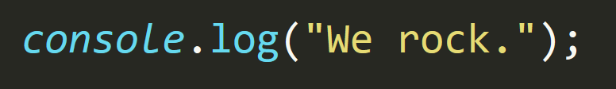
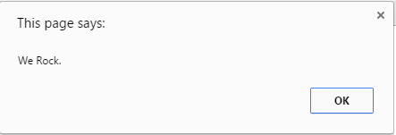
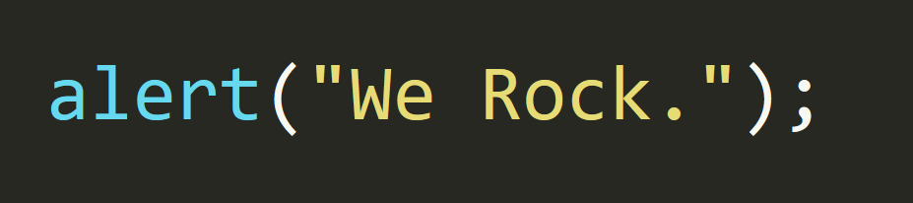
Basic Variables
Console.log displays discreetly to the debugger.
Alert displays a pop-up message to the user.
Notes:
1

Slide 11
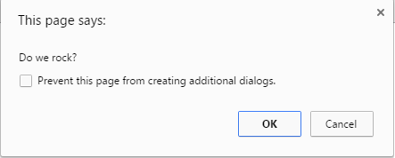
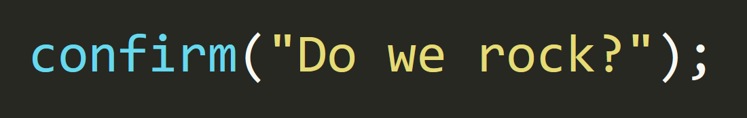
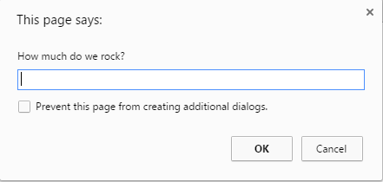
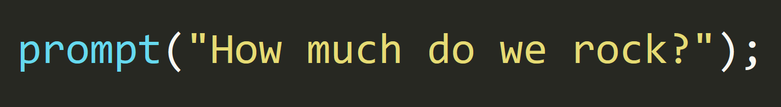
Basic Variables
Confirm displays a True/False popup.
Alert displays a prompt with a text-box input.
Notes:
1

Slide 12
Please… Don’t Pick Me.
How do we “write” text to the HTML itself?
Notes:
1

Slide 13
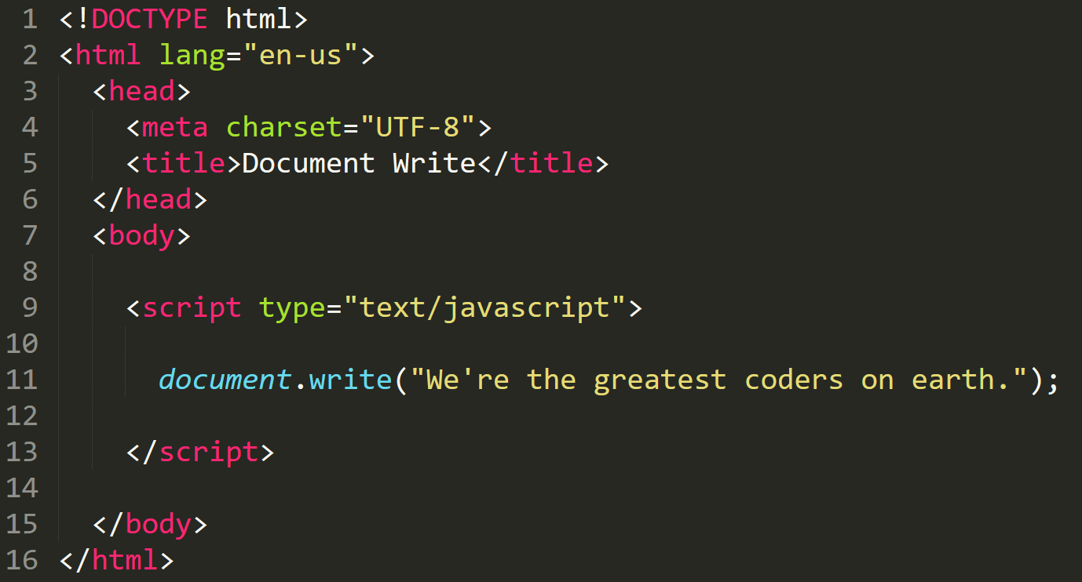

Writing to HTML
We can use JavaScript to directly write to the HTML page itself using document.write( ).
Later we will go over much more advanced approaches for writing HTML using JavaScript and jQuery.
Test.html (chrome)
Test.html
(sublime)

Slide 14
Please… Don’t Pick Me.
How do we check conditions?
Notes:
1

Slide 15
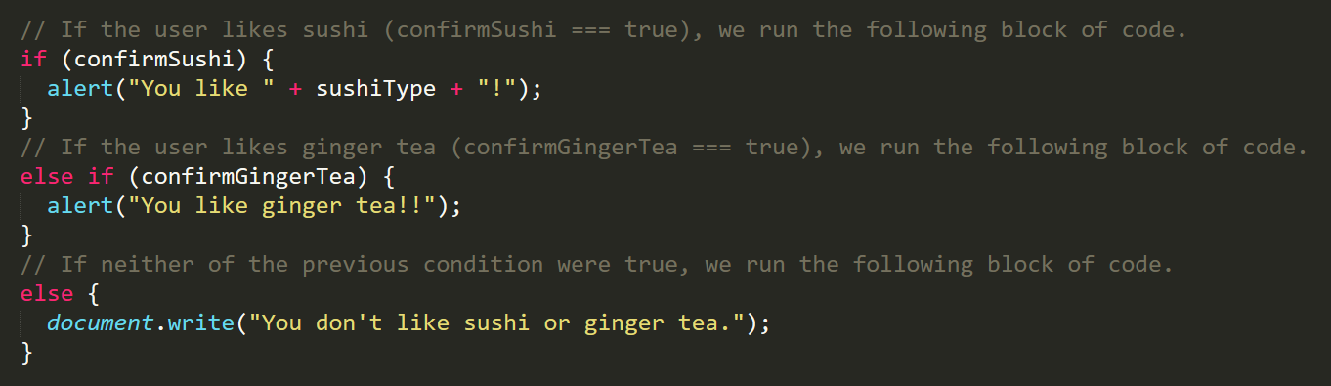
If/Else Statements
If/Else statements are critical.
Each statement is composed of an if, else-if, or else (keyword), a condition, and the resulting code in { } curly brackets.
Notes:
1

Slide 16
Please… Don’t Pick Me.
What is an array?
Notes:
1

Slide 17
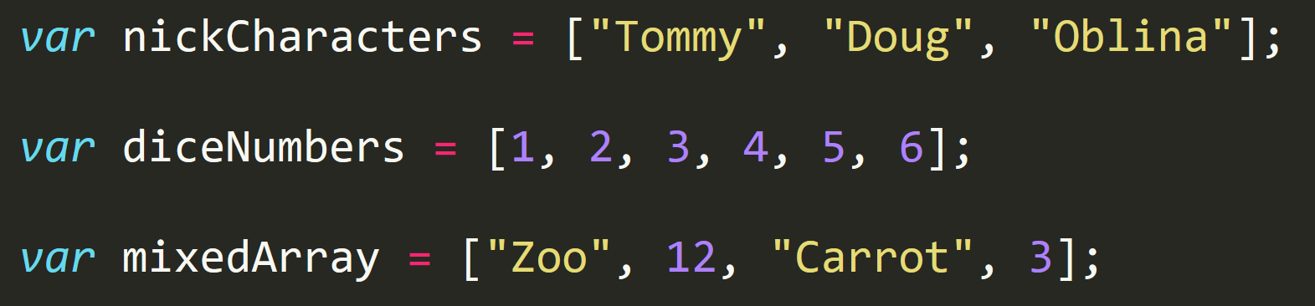
Basic Arrays
Arrays are a type of variable that are collections.
These collections can be made up of strings, numbers, booleans, other arrays, objects, anything.
Each element of the array is marked by an index. Indexes always start with 0.
Notes:
1

Slide 18
> YOUR TURN!!
Activity: 14-JS Dissect | Suggested Time: 3 min
14 - Code Dissection: Basic JS
Re-examine the file sent to you during yesterday’s class.
See if you can better understand how it works – after having gone through today’s class.
Prepare to share once the time is up.
Notes:
1

Slide 19
> YOUR TURN!!
15 - Code Creation: Array Logging
Follow the instructions provided in the file to console.log each of the names in the “coolPeople” variable.
Hint: You should be repeating the same line 6 times.
Be prepared to share once time is up.
Notes:
1

Slide 20
> YOUR TURN!!
16 - Code Creation: Array Setting
Follow the instructions in the file provided to convert each item in the array to lower case.
Make sure to only add in lines of code where instructed.
Hint: You will need to use the method .toLowerCase(). Research if you don’t remember how to use it.
Be prepared to share once time is up.
Notes:
1

Slide 21
For Loops
Notes:
1

Slide 22
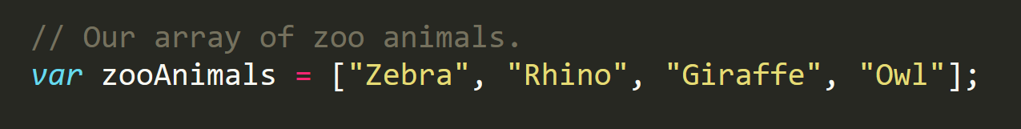
Back to The Zoo Pen
Array Name: zooAnimals
Zebra
Rhino
Giraffe
Owl
Index 0
Index 1
Index 2
Index 3
Notes:
1

Slide 23
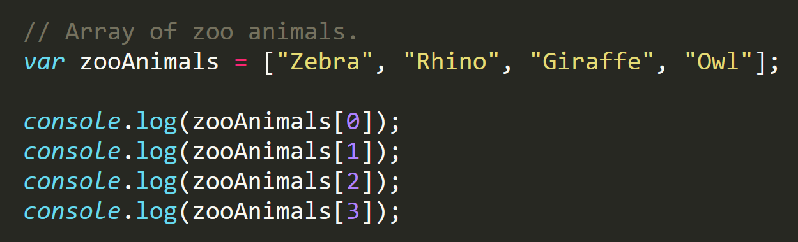
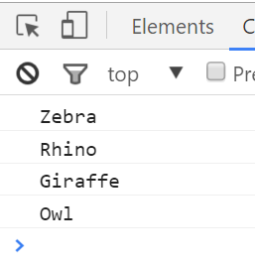
Back to The Zoo Pen (Logging)
Array Name: zooAnimals
Zebra
Rhino
Giraffe
Owl
Index 0
Index 1
Index 2
Index 3
Notes:
1

Slide 24

Please… Don’t Pick Me.
What’s wrong here?
Notes:
1

Slide 25
Don’t Repeat Yourself (DRY)
Repeated Code!
Let’s be more efficient
Notes:
1

Slide 26
> YOUR TURN!!
17 - Code Creation: For Loop Dissection
With a partner, spend a few moments trying to dissect the code sent to you.
Try to explain to one another what is happening with each line of code.
Feel free to do research if you are stumped. As a hint, look into the phrase: “For-Loop”.
Be prepared to share when time is up.
Notes:
1

Slide 27
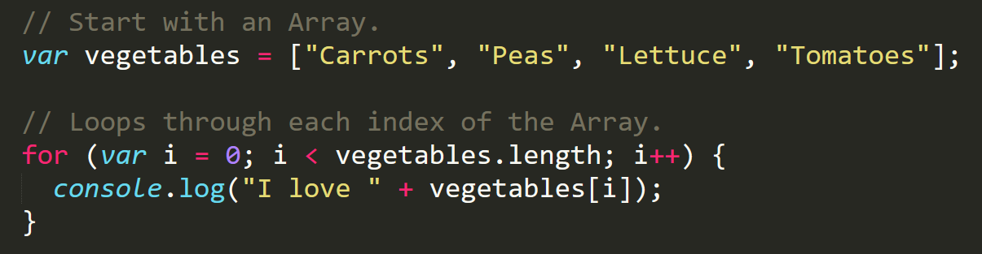
Enter the For-Loop
For loops are critical in programming.
We use for loops to run repeated blocks of code over a set period.
Each for loop is composed of a:
Variable declaration or counter (iterator)
A loop condition
An iteration (addition)
Notes:
1

Slide 28
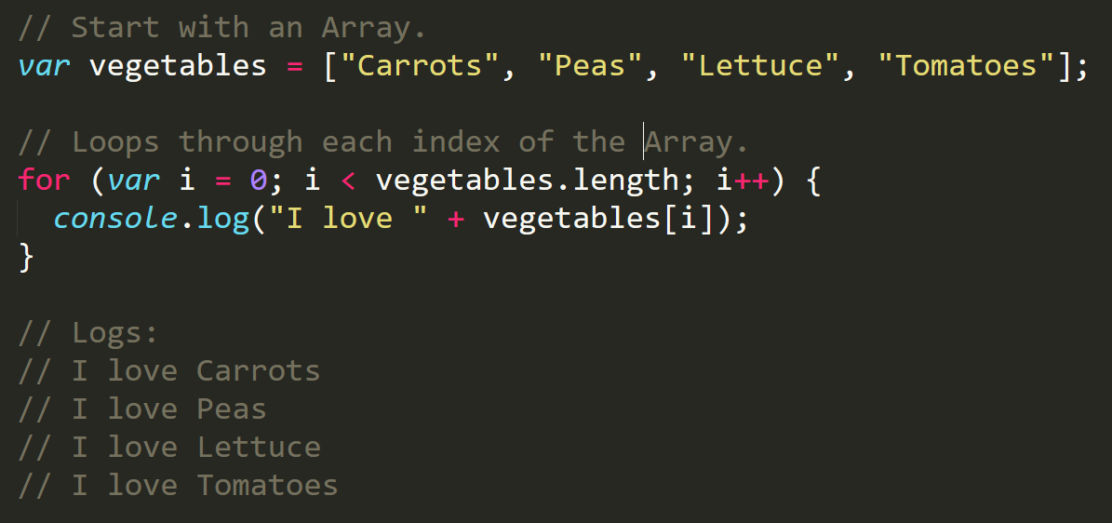
Enter the For-Loop
Iterator. Condition. Modifier.
Notes:
1

Slide 29
Enter the For-Loop
Code between the { } gets repeated each time the iterator is smaller than the condition. (i.e. in this case i < 4)
Notes:
1

Slide 30
Enter the For-Loop
Running the code “loops” through and prints each element in the array.
Notes:
1

Slide 31
Run That Loop
When i = 0 … console.log(“I love Carrots”)
Carrots
Peas
Lettuce
Tomatoes
Index 0
Index 1
Index 2
Index 3
Notes:
1

Slide 32
Run That Loop
When i = 1 … console.log(“I love Peas”)
Carrots
Peas
Lettuce
Tomatoes
Index 0
Index 1
Index 2
Index 3
Notes:
1

Slide 33
Run That Loop
When i = 2 … console.log(“I love Lettuce”)
Carrots
Peas
Lettuce
Tomatoes
Index 0
Index 1
Index 2
Index 3
Notes:
1

Slide 34
Run That Loop
When i = 3 … console.log(“I love Tomatoes”)
Carrots
Peas
Lettuce
Tomatoes
Index 0
Index 1
Index 2
Index 3
Notes:
1

Slide 35
> YOUR TURN!!
18 - Code Creation: For-Loop Zoo
Spend a few moments, re-writing the code below using a for-loop.
If you need help, use the code from the previous example as a guide.
Then try to explain to the person next to you how your code works.
Notes:
1

Slide 36
> YOUR TURN!!
19 - Code Creation: Another Loop (Time Permitting)
Starting from scratch, create a for loop that prints the following lines: I am 0 I am 1 I am 2 I am 3 I am 4
This time, don’t use an array!
Notes:
1

Slide 37
> YOUR TURN!!
20 - Code Creation: Hard Loop (Time Permitting)
Starting from scratch, write code that loops through the following array:
And console.logs the name of each animal on the farm.
Then using the .charAt() method (research it) check if the first letter in the animal’s name begins with a “c” or “o”. If it does, create an alert saying: “Starts with c or an o!”
Notes:
1

Slide 38
Events & DOM Manipulation
Instructor: Demo 21
(EventsExample.html)
Notes:
1

Slide 39
Rock Paper Scissors
Rest of Class!
Notes:
1

Slide 40
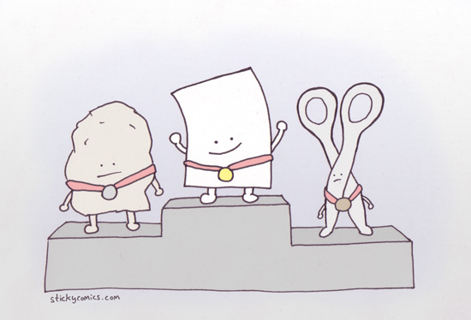
I’ma Beat You…
Play Rock Paper Scissors with the Person Next to You! Play 5 Rounds
Notes:
1

Slide 41
> YOUR TURN!!
22 - Code Creation: Pseudocode
With a partner, spend a few moments outlining all the steps and conditions that go into a single game of rock paper scissors.
Try to break it down into steps that you could “code out”.
Think of basic elements like loops, if-then statements, arrays, alerts, etc.
Be prepared to share your outlined approach.
Notes:
1

Slide 42
Basically a Coder!
You just pseudocoded!
Notes:
1

Slide 43
Basically a Coder!
Now… for the rest of the class YOU will be coding it out.
Notes:
1

Slide 44
Basically a Coder!
Don’t worry. We’ll be here to help you along the way.
Notes:
1

Slide 45
Demo Final Solution
Instructor: Demo 23
(rps-7.html)
Notes:
1

Slide 46
> YOUR TURN!!
23 - Code Creation: Coding out RPS
In groups of 4, begin the process of coding out the Rock-Paper-Scissors Game.
Do as much as you can on your own, but don't be afraid to ask for help if you feel your team is struggling.
Note: Don’t use “document.write” as it will delete the contents of your page including your Javascript. Use “document.querySelector” or “document.getElementById”, alongside either “innerHTML” or “textcontent”, to write to the DOM.
Note: Don’t worry. We know this will be very challenging. We also know that you won’t know where to start. In fact, we haven’t shown you EVERYTHING you need yet. But that’s okay. Accepting the confusion is a HUGE first step in becoming a coder.
Note to Instructor/TAs: Use the files in RPS-Coded to help guide students through the process. Feel free to present relevant code on the projector.
Notes:
<number>

Slide 47
Recap Activity
Notes:
<number>

Slide 48
Demo Questions
Let’s fill in the Missing Code (Together)
(Recap_UNSOLVED | 24-Recap)
Notes:
<number>

Slide 49
Questions
Notes:
<number>

