Slide 1

Basic Details of the Team and Problem Statement
Ministry/Organization Name/Student Innovation: Ministry of Environment
PS Code: 1392
Problem Statement Title:E-Waste Facility Locator
Team Name: ORIGIN
Team Leader Name: P V BRAHMA
Institute Code (AISHE): U_0020
Institute Name: KL UNIVERSITY
Theme Name: Smart Automation

Slide 2

Idea/Approach Details
Describe your idea/Solution/Prototype here:
Designing a web application to efficiently and responsibly handle electronic waste by providing structure and environment friendly approach to its disposal and management.
This solution addresses the growing problem of electronic waste while promoting responsible disposal practices.
A credit based management system , rewards individuals based on the constituents in the product like aluminum, cadmium, mercury etc.
Knowledge regarding the pros and cons of E-Waste

Slide 3
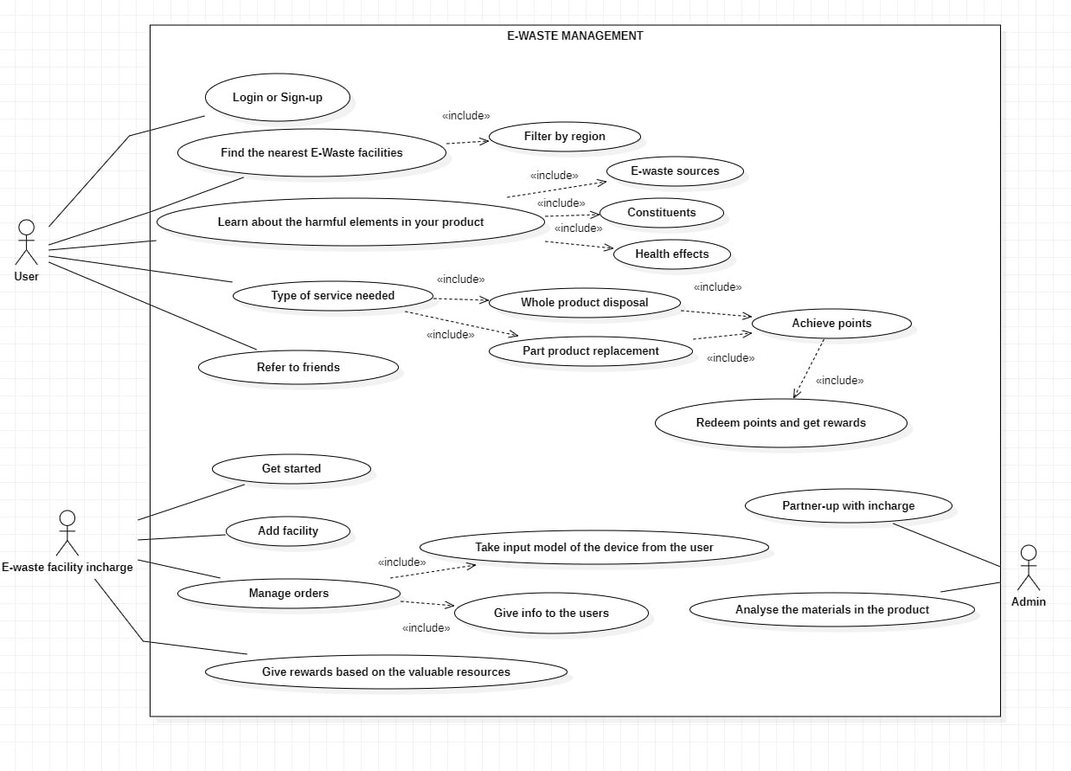

Slide 4
Idea/Approach Details
Describe your Dependencies / Show stopper here
Dependencies:
Environment Concerns
Safety and Health Regulations
Lack Of Market Demand
Environment Concerns
Public Adaptability
Resource Scarcity
Show Stopper:
E-waste user /Admin
Collection Network
Awareness and Education
Regulations and Compliance
Transportation
Economic Demands
E-waste Facilities Locations
Describe your Technology stack here:
PyCharm
Django
Google API
Figma
PostgreSQL

Slide 5
Team Member Details
Team Leader Name: P V BRAHMA
Branch (Btech/Mtech/PhD etc):Btech Stream (ECE, CSE etc):CSE Year (I,II,III,IV): III
Team Member 1 Name:S.JAYAPAUL NAIDU
Branch (Btech/Mtech/PhD etc):Btech Stream (ECE, CSE etc): CSE Year (I,II,III,IV): III
Team Member 2 Name: RUCHITHA CHAVA
Branch (Btech/Mtech/PhD etc):Btech Stream (ECE, CSE etc): CSE Year (I,II,III,IV): II
Team Member 3 Name: A.SAI BHAVYA REDDY
Branch (Btech/Mtech/PhD etc):Btech Stream (ECE, CSE etc): CSE Year (I,II,III,IV): II
Team Member 4 Name: M.NANDA KISHORE
Branch (Btech/Mtech/PhD etc):Btech Stream (ECE, CSE etc): CSE Year (I,II,III,IV): I
Team Member 5 Name:A. A.HARSHITH
Branch (Btech/Mtech/PhD etc):Btech Stream (ECE, CSE etc): ECE Year (I,II,III,IV): I
Team Mentor 1 Name: Type Your Name Here
Category (Academic/Industry): Sripath Roy Expertise (AI/ML/Blockchain etc) : Iot and open source Domain Experience (in years): Software
and real-world problem

