Slide 1
Git

Slide 2
Git Historia
Linux-kärnan utvecklades först med BitKeeper
Linux ‘community’ utvecklade sedan ett eget verktyg med fokus på
Snabbhet
Enkel design
Stakrt stöd för ickelinjär utveckling (tusentals parallella brancher)
Fullt distribuerad
Ha kapacitet att hantera stora projekt som linuxkärnan effektivt (speed and data size)
Notes:
https://git-scm.com/book/en/v2/Getting-Started-A-Short-History-of-Git
BitKeeper revoked its free-of charge status

Slide 3
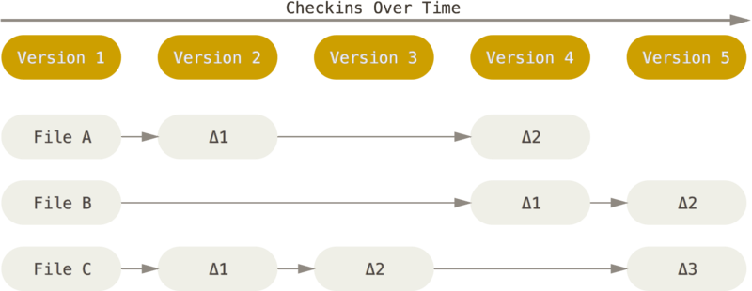
Git Basics
Hur SVN och Clearcase ser på data
Notes:
De flesta VCS (ex. SVN) ser på lagrad data som en lista av filer och ändringarna som är gjorda på varje fil över tid

Slide 4
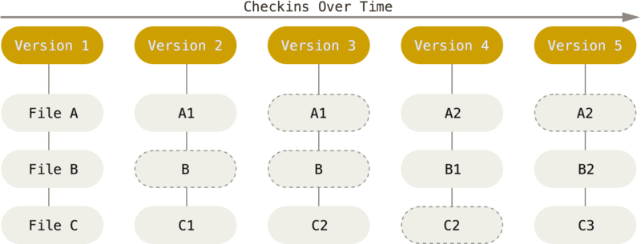
Git Basics
Git lagrar uppsättningar av ögonblicksbilder
Notes:
Vid varje commit lagras en ögonblicksbild av hur alla filer ser ut vid det tillfället och lagrar en referens till den ögonblicksbilden.
Om en fil inte ändras, sparar bara git en länkt till den föregående versionen av filen.
Git förhåller sig till sitt data som en ström av ögonblicksbilder.
Snapshot i git är motsvarande revision i SVN.

Slide 5
Git Basics
Git is Distributed Most operations are local. Central server not needed (but often used).
SVN and Clear Case Centralized server that is the ultimate source of truth. Network connection needed to central server.
Notes:
Git has integrity built in (everything is check-summed before it is stored and is then reffered to by that checksum)

Slide 6
Git Basics
Git är distribuerat
Mesta delen av arbetet sker lokalt.
En central server behövs inte, men används oftast.
SVN och Clear Case
En nätverksuppkoppling till en central server behövs alltid.
Notes:
Git has integrity built in (everything is check-summed before it is stored and is then reffered to by that checksum)

Slide 7
Git’s tre tillstånd
Committed
Modified
Staged
Notes:
Committed means that the data is safely stored in your local database.
Modified means that you have changed the file but have not committed it to your database yet.
Staged means that you have marked a modified file in its current version to go into your next commit snapshot.

Slide 8
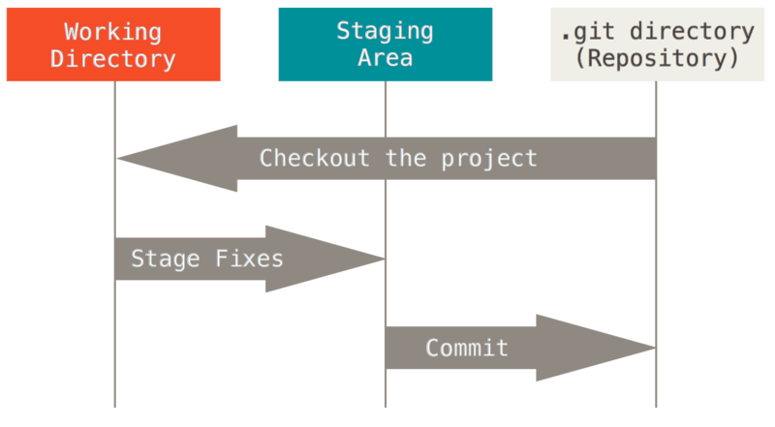
Git Basics
Huvudelarna i ett Git-projekt
Notes:
This slide might not be needed
You modify files in your working directory.
You stage the files, adding snapshots of them to your staging area.
You do a commit, which takes the files as they are in the staging area and stores that snapshot permanently to your Git directory.

Slide 9
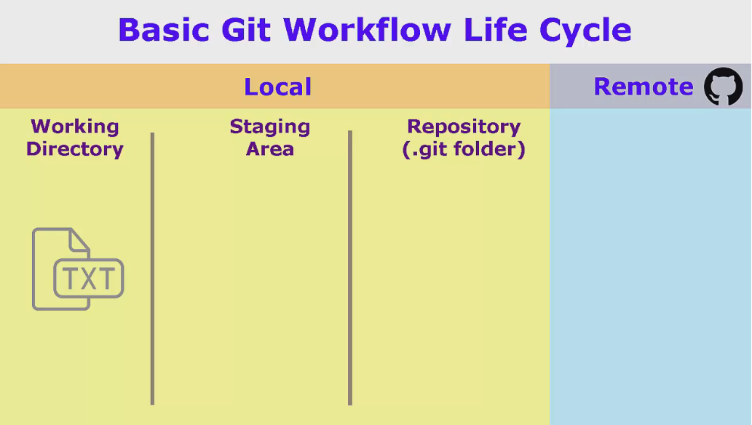
Git Basics(kanske ta bort)

Slide 10
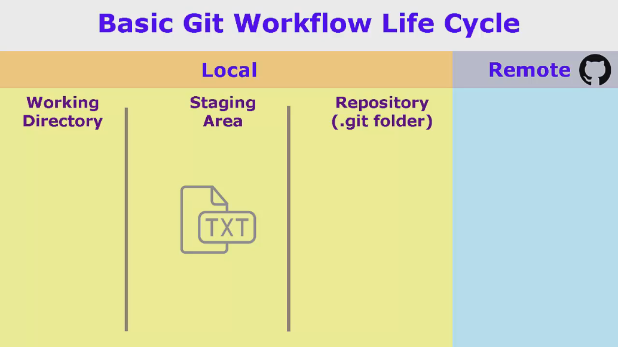
Git Basics(kanske ta bort)
Notes:
Split work into separate commits. You've probably many times opened a file to write a single-line fix, but at the same time you spotted that the formatting was wrong, some documentation could be improved, or some other unrelated fix. With other RCSes you'd have to write that down or commit it to memory, finish the fix you came for, commit that, and then return to fix the other stuff (or create a ball-of-mud commit with unrelated stuff). With Git you just fix all of it at once, and stage+commit the single line separately, with git add -i or git-gui.
Don't break the build. You're working on a complicated modification. So you try different things, some of which work better than others, some which break things. With Git you'd stage things when the modification made things better, and checkout (or tweak some more) when the modification didn't work. You won't have to rely on the editor's undo functionality, you can checkout the entire repo instead of just file-by-file, and any file-level mistakes (such as removing a file that has not been committed or saving+closing after a bad modification) does not lead to lots of work lost.

Slide 11
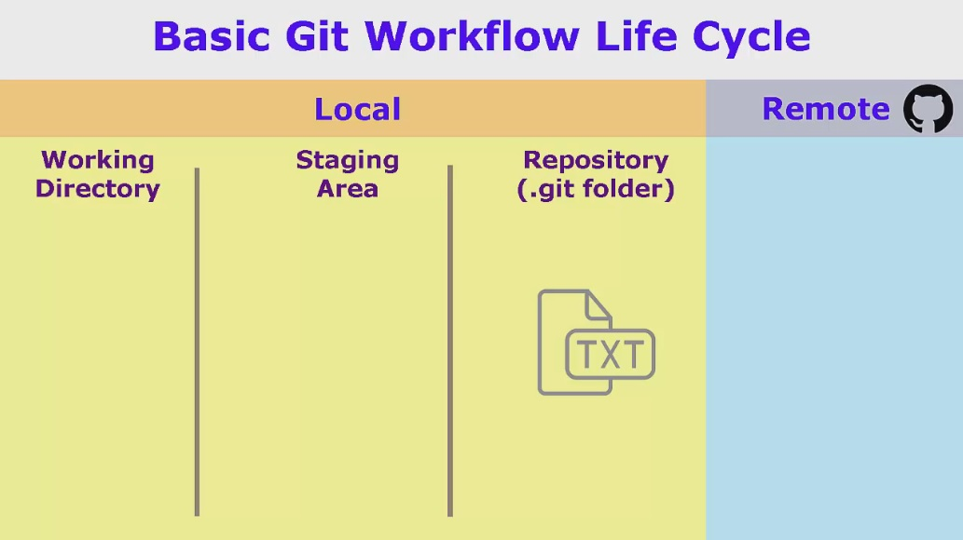
Git Basics(kanske ta bort)

Slide 12
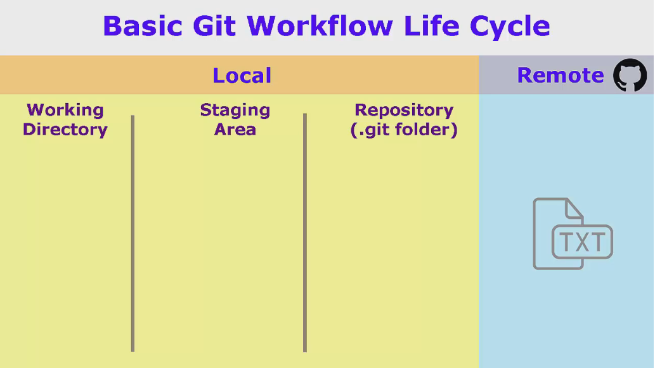
Git Basics(kanske ta bort)

Slide 13
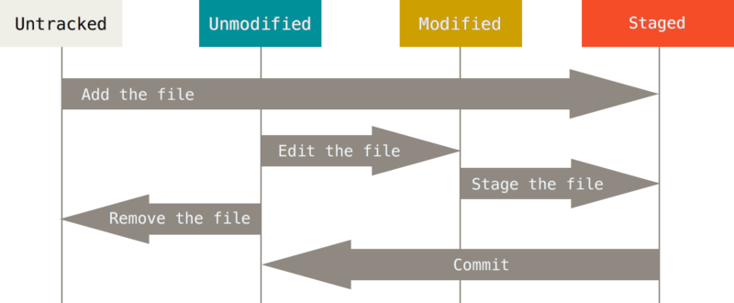
Git Basics
The three states of a file in git: committed, modified and staged.

Slide 14
Git Command Line
History
More features
Online help
Consistent
Terminal on Linux
Git Bash on windows
Notes:
Originally designed as a command line tool and graphical clients came later.
More and newer features in the command line.
Most often, git features are explained using the command line online.

