Slide 1
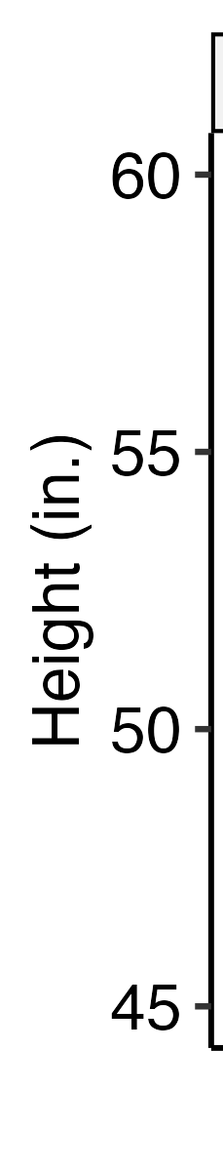
Age: 10
Age: 12
Charlie
River
Charlie
River

Slide 2
Age: 10
Age: 12
Charlie
River
Charlie
River

Slide 3
Age: 10
Age: 12
Charlie
River
Charlie
River

Slide 4
Age: 10
Age: 12
Charlie
River
Charlie
River

Slide 5
Charlie
River
10
12
10
12
Age
Age

Slide 6
Charlie
River
10
12
10
12
Age
Age

Slide 7
Charlie
River
10
12
10
12
Age
Age

Slide 8
Charlie
River
10
12
10
12
Age
Age

