Slide 1
Human cone light adaptation: From behavioral measurements to molecular mechanisms
Authors: Stockman, Andrew
Langendörfer, Micha
Smithson, Hannah E.
Sharpe, Lindsay T.
Journals: Journal of Vision
Year: 2006

Slide 2
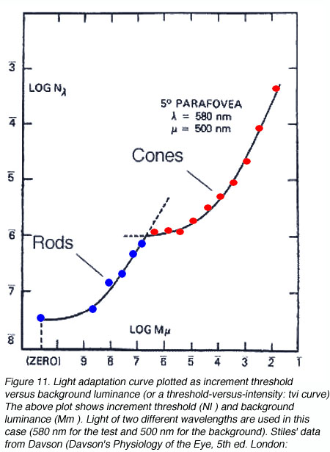
Background info…
Neurons in the visual pathways have dynamic ranges of no more than circa 10² from the level of noise to their ceiling response.
But, the human VS is able to operate over a > 10¹¹ range of environmental light levels.
It can achieve this partly by depending on a more sensitive rod-driven scotopic subsystem at low levels and on a less sensitive cone-driven photopic subsystem at high levels.

Slide 3
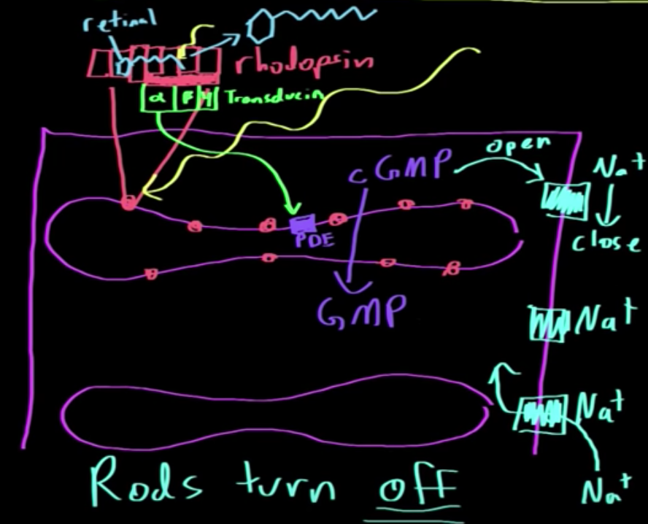
Background info…
The phototransduction cascade: Briefly, a photon hits a rhodopsin/photopsin protein which has inside a molecule called 11-cis-retinal. Light isomerizes this molecule into its all-trans form. This, in turn, change the conformation of rhodopsin and liberates the alpha-transducin molecule that then activates the effector molecule phosphodiesterase enzyme PDE, which reduces the amount of cGMP in favor of its GMP form. The reduction of cGMP results in the closure of Na⁺ channels, precipitating membrane hyperpolarization and the initialization of the neural response.
Source: https://www.khanacademy.org/science/health-and-medicine/nervous-system-and-sensory-infor/sight-vision/v/phototransduction-cascade

Slide 4
Objective
This article aims at investigating the mechanisms of photopic light adaptation.
A fundamental characteristic of human cone light adaptation is that the visual response speeds up as the light level increases!
Typically such changes are investigated by determining the Modulation sensitivity/threshold data. However, this offers only a partial picture of the effects of light adaptation. A complete picture requires knowledge of the accompanying reductions in visual delays.
Here, the researchers combine measures of phase delay and sensitivity obtained over an extensive range of adaptation levels.

Slide 5
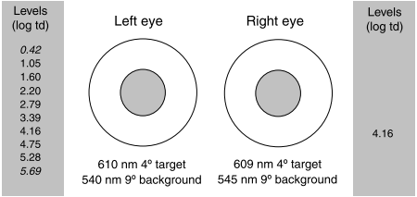
Methods
Subjects
Two males subjects participated. Both subjects were protanoptic (lack of L-cones) i.e. a form of colorblindness characterized by the defective perception of red.
Experimental conditions
Modulation threshold measurements:
Monocularly measured (left eye only).
A 4 deg diameter, 610-nm target was superimposed in the center of a larger 9 deg 540-nm background.
﻿The larger background was always six times more intense for the M-cones than the target. Thus,
This combination of target and background wavelengths and luminances was chosen to eliminate flicker detection by the S-cones and to saturate the rods.

Slide 6
Methods
Phase lag measurements:
Binocular experiment.
﻿The stimuli seen by the right eye were essentially the same: A 4- diameter, 609-nm target was super- imposed in the center of a 9- diameter, 545-nm back- ground.
Again, ﻿the larger background was always six times more intense for the M-cones than the target.

Slide 7
Methods
Experimental procedures
The observers light adapted to the target and background fields for at least 3 min prior to any data collection.
Modulation threshold measurements:
Method of adjustment.
Modulation is defined as (I_{max} – I_{min})/(I_{max} + I_{min}) and is given in terms of M-cone excitation. Another way to express threshold is in terms of flicker amplitude (I_{max} – I_{min}) in units of log td.
The subject task was to adjust the stimulus modulation until flicker appeared just at threshold.

Slide 8
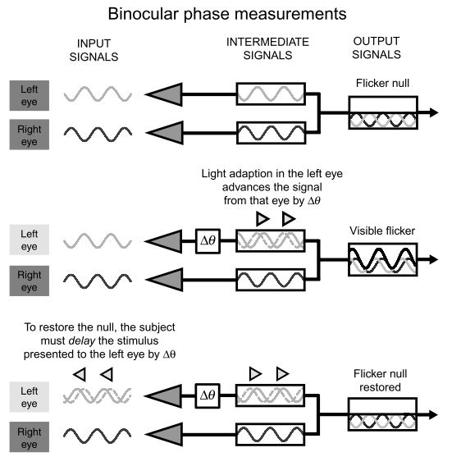
Methods
Phase lag measurements
Intraocular delays can be measured using a binocular flicker-cancellation technique.
Observers were instructed to vary the relative phase as well as the modulation of the two binocularly fused targets to abolish or minimize the subjective flicker.

Slide 9
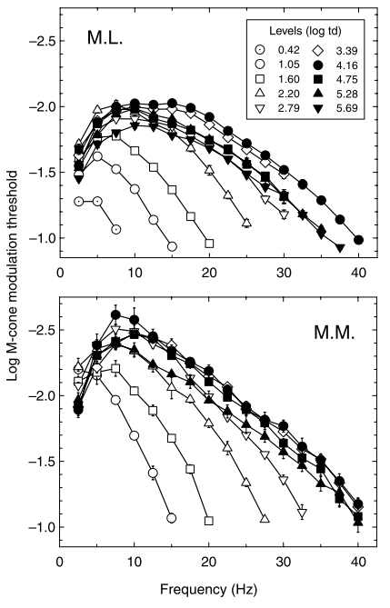
Results
M-cone modulation thresholds
Except at the lowest levels the curves are bandpass.
Below 4.16 log td, high-frequency sensitivity increases with intensity more than low-frequency sensitivity. Functions become broader and extent to higher frequencies.
Above 4.16 log td, the shape of the curves stay roughly constant. Weber law is hold!

Slide 10
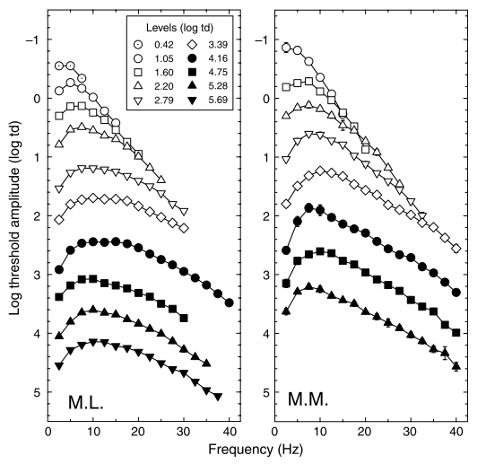
Results
Logarithmic M-cone threshold amplitudes
“high-frequency linearity” is observed between 0.42 and 2.79 log td for M.L. and between 1.05 and 3.39 log td for M.M.
﻿High-frequency linearity implies that the flicker signal at higher frequencies is largely unaffected by adaptation.
﻿Whether or not the high-frequency flicker signal is modified by adaptation can be better addressed by combining the usual amplitude measurements with phase measurements because the phase data can disambiguate changes in integration time, which typically affect phase, from changes in overall gain, which do not.

Slide 11
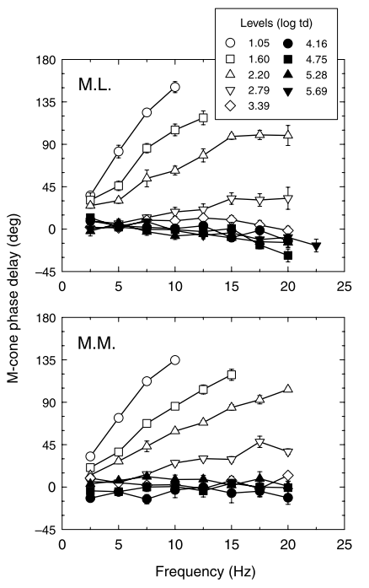
Results
M-cone phase lags
Relative phase delays in degrees between M-cone flicker presented to the left and right eyes.
The luminance level in right eye was fixed to 4.16 log td, whereas that in the left was varied.
﻿For both subjects, the responses in the left eye are delayed at levels below 4.16 log td because the eye is less light adapted than the right eye, whereas they are slightly advanced above 4.16 log td because the left eye is more light adapted.

Slide 12
Results
﻿Comparisons between the left and right figures show that large frequency-dependent changes in the shape of the amplitude (or modulation) sensitivity functions between levels are generally accompanied by large frequency-dependent changes in phase delay (open symbols). In contrast, frequency-independent changes (i.e., vertical shifts in the threshold amplitude functions with little or no changes in shape) are accompanied by little or no change in phase delay (closed symbols).
Also, ﻿If adaptation does not modify the high-frequency flicker signal (in accordance with high-frequency linearity), then the convergence of the threshold amplitude data seen in the figure to the left should be accompanied by the changes in phase delay between levels falling back toward (and eventually reaching) zero. There is, however, no clear evidence for such a fallback in the phase-delay data with increasing frequency seen in the right figure.

Slide 13
Model
The goal was to find a qualitative model of adaptation that required one or two intensity-dependent parameters.
The results showed two regions:
Below circa 4.16 log td → amplitude and phase-delay data show frequency-dependent changes.
Above circa 4.16 log td → adaptational levels are consistent with multiplicative scaling of the amplitude thresholds, as would be produced by bleaching (photopigment depletion).

Slide 14
Model
Psychophysical models and molecular mechanisms:
﻿When interpreting psychophysical data at the molecular level, it is convenient to categorize the molecular mechanisms according to their likely effects on modulation-sensitivity and phase-delay measurements.
Category A: mechanisms that speed up the visual response and shorten the visual integration time (e.g. ﻿the increase in the rate of cGMP hydrolysis mediated by the light-induced rise in the concentration of PDE6*)
Category B: mechanism that reduce the sensitivity independently of temporal frequency and have little effect in phase delay (e.g. pigment bleaching)
Category C: mechanism that increase overall sensitivity in a way that does not depend on temporal frequency and phase delay (e.g. the increase in the rate of cGMP synthesis).

Slide 15


Model
Adaptation below bleaching levels (< 4.16 log td)
They use the approach of modeling frequency-dependent changes in amplitude and phase by shortening the time constant (tau) of one or more (n) cascaded leaky integrating stages.
The amplitude response, A(f), of n cascaded leaky integrators is:
The formula for the phase response, P(f), is:

Slide 16
Model
Adaptation above bleaching levels (> 4.16 log td)
﻿Using standard steady-state bleaching equations, they calculate that levels of 3.39, 4.16, 4.75, 5.28, and 5.69 log td bleach approximately 11%, 42%, 74%, 91%, and 96% of the pigment, respectively, assuming a half-bleaching constant (I₀) of 4.30 log td and the fraction of unbleached pigment, p = I/(I + I₀). ﻿Thus, the effect of bleaching on sensitivity starts to become signifi- cant above circa 4.16 log photopic td.
﻿Then, they modeled the sensitivity losses between those levels as a multiplicative scaling of the amplitude thresholds (i.e., as vertical shifts of the logarithmic threshold amplitude functions without change of shape), which is consistent with the effects of photopigment depletion.

Slide 17
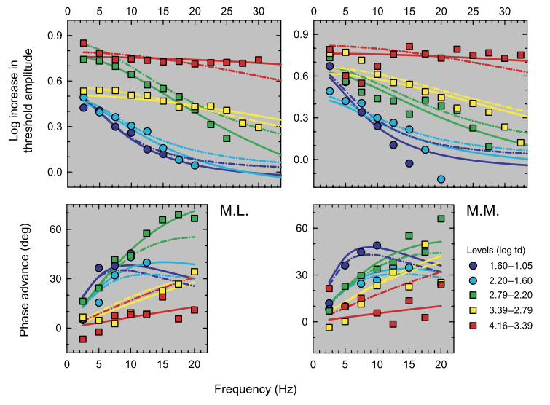
Modeling results
Model 1 (dashed line): time constant only. This model has only a single intensity-dependent parameter (tau). Good fit.
Model 2 (solid lines): time constant and scaling. This model has two intensity-dependent parameters (tau and scaling factor). Better fit.

Slide 18
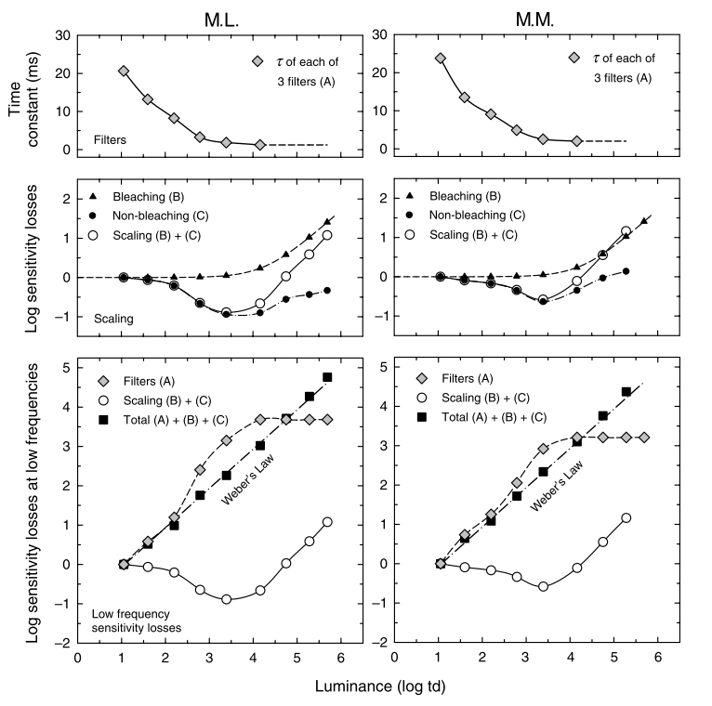
Model results
﻿Parameters for Model 2, the time-constant-and-scaling model
Upper panels: dependence of the time constant of each of the three integrating stages on luminance (A, gray diamonds). The time constants are assumed to remain constant above 4.16 log td (dashed line).
Middle panels: cumulative logarithmic sensitivity losses assumed to be caused by multiplicative scaling (B + C, open circles), subdivided into the losses calculated to be caused by photopigment depletion (B, filled diamonds) and by other factors (C, filled circles).
Lower panels: cumulative logarithmic sensitivity losses at low frequencies due to shortening time constants (A, gray diamonds) and sensitivity scaling (B + C, open circles, replotted from middle panels). The combined low-frequency losses (A + B + C, filled squares) agree with Weber’s law (dotted-dashed lines).

Slide 19
Conclusions
Adding the phase information to the sensitivity modulation gives a more thorough picture of light adaptation mechanisms. For example, the “high-frequency linearity” was not observed in the data.
﻿As the cone visual system light adapts over 5 log units of intensity, the accompanying changes in amplitude sensitivity and phase delay can be accounted for by a cascade of three leaky integrators, the time constants of which shorten with adaptation, and frequency independent sensitivity scaling.

