Slide 1


Slide 2

C-OVERCHARGED

Slide 3

The past and present.
Others
C-Reload
Integration of virtual machinery.
User interface without personality.
Total ecosystem closure.
Compiler.
Full and customizable front end.
Full compatibility with any device.
Sampling of precise errors, by means of syntactic analyzer and lexical

Slide 4
WE PRESENT ITS EVOLUTION
C-OVERCHARGED
AST Optimization
Native Code x86_64
Intermediate Code (TAC)
Super fast Linux linker.
Full compatibility with any device.
Interactive Execution (Dynamic inputs and outputs with printf and scanf).

Slide 5
Arquitecture
C-Overcharged
Source Code
Lexer
Parser LALR(1)
Semantic Analysis (AST)
Intermediate Code (TAC)
Optimizer (Optimized AST)
x86_64 Assembly
Linker (GCC/SO)
Executable (a.out)

Slide 6
Optimized code
Constant Folding
Algebraic simplification
Loop Unrolling
Cycle acceleration with fixed limits.
Mathematical precalculation at compile time.
Elimination of logical redundancies
for(int i = 0; i < 3; i++) {
printf("i: %d\n", i);
}
x = 10 * 2 + 2 + 8 + x
x = y * 0
x = 0
x = y + 0
x = y
printf("i: %d\n", 0);
printf("i: %d\n", 1);
printf("i: %d\n", 2);
x = 30 + x
x = y * 1
x = y

Slide 7
Intermediate Code (TAC)
Binary Operation: t0 = x op b
Unary Operation: t0 = op x
Simple Assignment: x = y
Conditional Goto: IfFalse t0 Goto L
Function Declaration
Function Call
External Function: printf
External Function:: scanf
Optimized TAC
Code C
t0 = (x == 5)
IfFalse t0 Goto L_FIN
y = 10
L_FIN:
y = 15
if (x == 5) {
y = 10;
}
y = 15;
Quadruplar Representation: The universal bridge in memory that connects C to the assembler.
Jump Efficiency: The IfFalse logic saves us from unnecessary GOTO instructions, speeding up machine cycles.
I/O Abstraction: Specialized handling from the TAC to prepare memory for the printf and scanf functions.

Slide 8
x86_64 Assembler
Assembly translation (x86_64):
Quadruple TAC (Sum):
mov rax, qword [rbp - 8] ;
mov rbx, qword [rbp - 16] ;
add rax, rbx ;
mov qword [rbp - 24], rax ;
( "+", "a", "b", "t0" )
Direct Translation: Exact mapping of intermediate operations to actual hardware instructions, using the processor's native registers (mov, add, push).
Industry Adherence: Full compliance with the System V ABI standard for function calls and register usage in Linux systems.

Slide 9
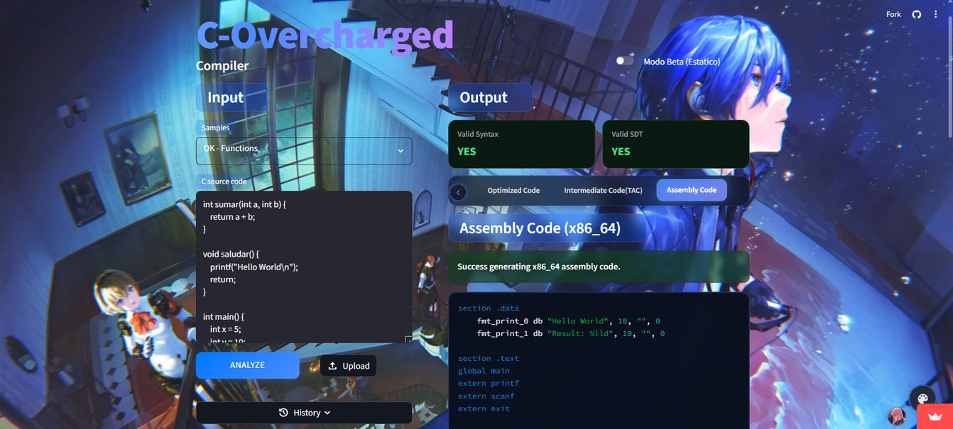
Cloud Execution
Dynamic Linker (GCC)
Full portability
Build server integrated directly into the web platform.

Slide 10
Subscription Plans
OFFER: $5/month (3 months)
Free-load
University
Pro-load
$0 USD/month
-50% OFF
$15 USD/month
Full analysis (Lexical, Semantic, Visual SDT, Optimized Code, TAC, ASM).
Standard interface (static).
Limit of 5 to 10 compilations per day.
All Pro benefits at half price.
Rate guaranteed for 3 years.
Requires an application via institutional email, including proof of enrollment and academic transcript.
Unlimited builds.
Customizable web interface (image/video backgrounds).
Full report downloads (.JSON, .ASM, and .out binaries).
Priority technical support.

Slide 11

The true cost of the code
Business level
Industry and Student Level
Stripe: 31.1% of development time is spent fixing bugs and addressing technical debt.
CISQ: $2 billion in annual losses due to substandard software.
The Limits of AI: It generates code quickly, but struggles with system architecture and memory management.
Dropout Rates: Outdated compilers (gcc) lead to frustration. 30–40% dropout rate in the first semesters.
The IoT Boom: C is the go-to language for microcontrollers. Real engineers are needed.
IBM Metric: Fixing a bug in production is 100 times more expensive than fixing it during the design phase.

Slide 12
Thank you for your attention
Espinoza Matamoros Percival Ulises
Flores Colín Víctor Jaziel
García Cortés Adolfo de Jesús
Lara Hernández Angel Husiel
Lugo Manzano Rodrigo
Contact:
www.pepecorp.com.mx
soporte@pepecorp.com.mx
+52 55 1234 5678

