Slide 1

Sinhgad College of Engineering, Pune
Department of Computer Engineering
MINI PROJECT
ON
“Salary Prediction Using AMCAT” “Evaluation”
Subject - Skills Development Laboratory
(TE Computer Engineering)
Presentation By-
Rushi Chaudhari 305205
Ruturaj Chavan 305206
Sujit Chavan 305207
Pratik Karad 305222
Guided By –
Prof. S. H. Sheikh

Slide 2
Contents
Abstract
Problem Statement
Introduction
Linear Regression
Lasso Linear Model
Software & Hardware Requirements
Methodology
Result
Conclusion
Reference

Slide 3
Abstract
More than a million engineers enter the global workforce every year. A relevant question is what determines the jobs and salaries these engineers are offered right after graduation. Previous studies have shown the influence of various factors such as college reputation, grades, the field one specializes in and market conditions for specific industries. An important input which such analyses do not have is a standardized measures of job skills done at the time of completion of studies. The data could be used to make an accurate salary predictor, but also understand what influences salary and job titles in the labour market.

Slide 4
Problem Statement
For every engineer, AMEO dataset provides anonymised bio data information along with their respective skill scores and employment outcome information. Specifically, the following information is available for every engineer:
Scores on Aspiring Minds' AMCAT - a standardized test of job skills. The test includes cognitive, domain and personality assessments.
Personal information like gender and date of birth.
Pre-university information like 10th and 12th grade marks, board of education and 12-th grade graduation year.
University information like GPA, college minor, college reputation proxy, graduation year and college location.
Using these above four categories of data, we are predicting the salary of newly appeared candidate.

Slide 5
Introduction
Dataset of engineers includes information about their credentials.
High school grades, college GPA, Degree, English proficiency, AMCAT score (a standardized test in India to measure students skills), personal skills (derived from a personality test) , Designation and so on.
To narrow down our question, we look at starting salary.
Our analysis depicts how these variables interact with salary.
We predict the salary for new candidates knowing their credentials
By using Lasso Linear regression models, we’re predicting salary.

Slide 6
Linear Regression
Here is the formal definition, “Linear Regression is an approach for modeling the relationship between a scalar dependent variable y and one or more explanatory variables (or independent variables) denoted X”

Slide 7
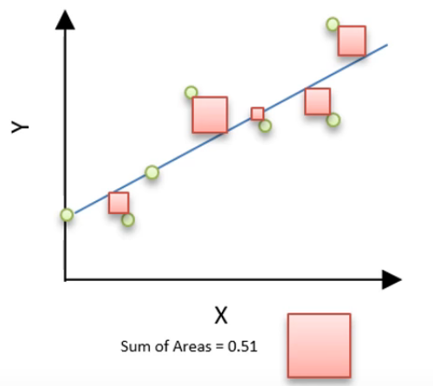
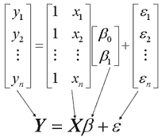
Fig.Basic Generalized Equation Of Linear Regression
Fig of General Regression Model

Slide 8
Lasso Linear Model
In statistics and machine learning, lasso (least absolute shrinkage and selection operator) (also Lasso or LASSO) is a regression analysis method that performs both variable selection and regularization in order to enhance the prediction accuracy and interpretability of the statistical model it produces.
Though originally defined for ordinary least squares, lasso regularization is easily extended to a wide variety of statistical models including generalized linear models, generalized estimating equations in a straightforward fashion. Lasso’s ability to perform subset selection relies on the form of the constraint and has a variety of interpretations including in terms of geometry.

Slide 9

Equation Of Lasso Linear Regression Model
Suppose equation of Model is y=Bo+B1*x1
Here loss term which is L2 Norm.
        Where L2 Norm is Under Root Of (square(Bo)+square(B1))
Here Penalty term is in the form of L1 Norm.
Where L1 Norm is Sum of values of coefficient

Slide 10
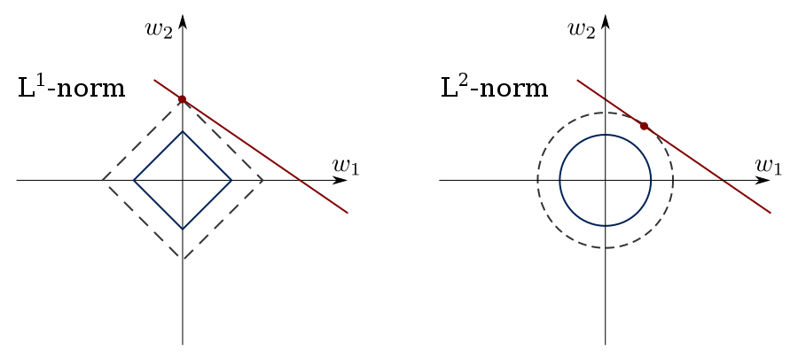
Lasso regression performs L1 regularization, i.e. it adds a factor of sum of absolute value of coefficients in the optimization objective. Thus, lasso regression optimizes the following:
Objective = SSE + α * (sum of absolute value of coefficients)
Here, α (alpha) works similar to that of ridge and provides a trade-off between balancing SSE and magnitude of coefficients.

Slide 11
Software & Hardware Requirements
Software
1. matplotlib
2. linear_model
3. sklearn-train_test_split
4. LabelEncoder
5. pandas
6. numpy
Hardware
1. Node Component (PC/Laptop)

Slide 12
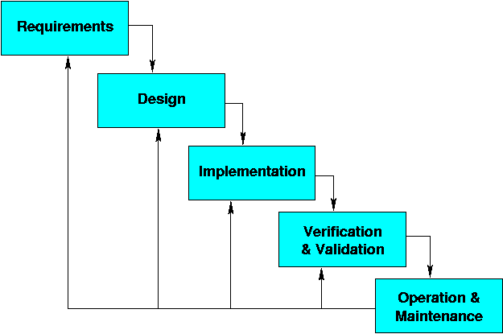
Process Model:

Slide 13
Start
Methodology:
Enter list of known Professional Skills
Pass the skills to Lasso Linear algorithm
Fit the passed values to imported linear model
Predict the Salary
Stop

Slide 14
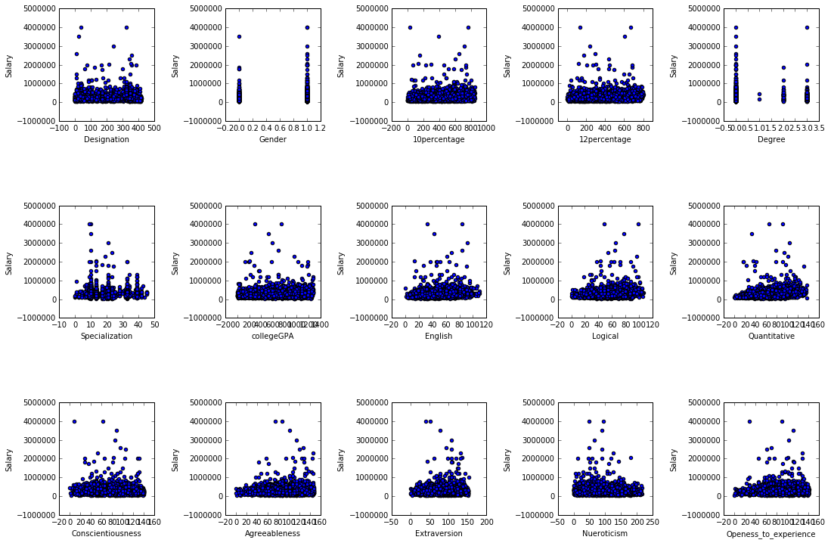
Result
Graph of Features VS Salary

Slide 15
Conclusion
In this project we looked at a dataset of engineering candidates in India. Each individuals’ credentials along with job salary is provided in the dataset. After cleaning up the data and feature engineering, we ended up having 15 features.
First we used regression to predict salary for each individual. Out of all Regression Models we used Lasso Linear Regression Model due to smaller root mean square error. We observed that Designation, Gender, 10Th%, 12Th%, Degree, Specialization, collegeGPA, English, Logical, Quant, conscientiousness, agreeableness, extraversion, nueroticism, openess_to_experience .etc predominantly affect the salary.

Slide 16
References
http://scikit-learn.org/stable/modules/linear_model.html#lasso
https://pandas.pydata.org/pandasdocs/stable/generated/pandas.read_csv.html
https://matplotlib.org/api/pyplot_api.html
https://matplotlib.org/devdocs/api/_as_gen/matplotlib.pyplot.scatter.html

