Slide 1
Quantum-enhanced Support Vector Machine (QSVM)
By Percy, Joe, Homayoun, and Peng
Notes:
Greetings

Slide 2
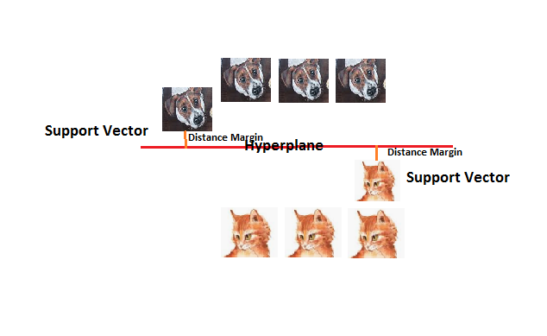
Support Vector Machines (SVM)
SVM is a classification algorithm and a supervised learning model:
Pattern recognition
Data mining
The goal is to design a hyperplane that classifies all training vectors into two classes
Notes:
SVM is a supervised classification algorithm that is used in machine learning for pattern recognition and data mining.
The goal of applying SVMs is to find the best line in two dimensions or the best hyperplane in more than two dimensions in order to help us separate our space into classes.
Here we can see an example of two classes: the dog and cat classes separated by a hyperplane

Slide 3
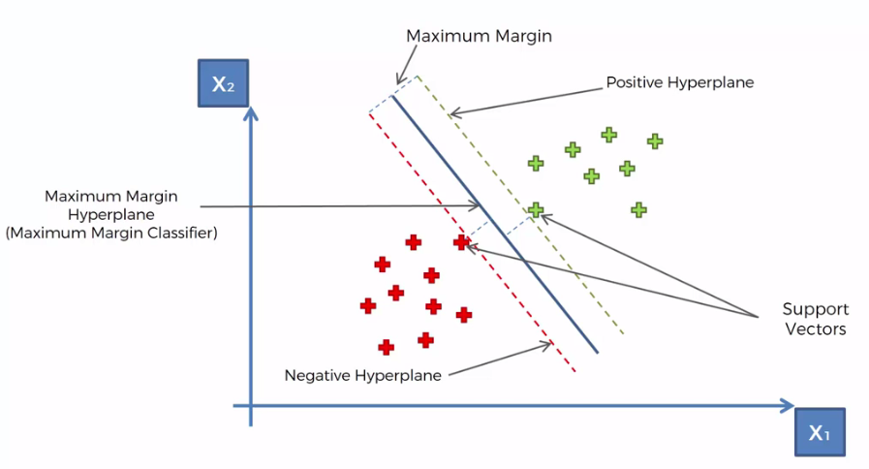
KEY CONCEPTS
The line that separates the two classes is called hyperplane
The margin is the distance between the hyperplane and the closest elements from this hyperplane
Support vectors are vector points closest to the hyperplane
Example of a linear classification
Notes:
Some key concepts to keep in mind is the hyperplane, margin and support vectors.
The hyperplane is the line that separates the two classes
The margin is the maximum distance between data points of both classes
and supports vectors are vector points that are closer to the hyperplane and influence the position and orientation of the hyperplane
Here is an linear classification example: in the middle, there is a hyperplane that separates the two classes and on the side of the hyperplane are the support vectors.
We always try to find a plane with the maximum margin. For example, finding the maximum distance between data points of both classes. This provides some reinforcement for future data to be classified with more confidence.

Slide 4
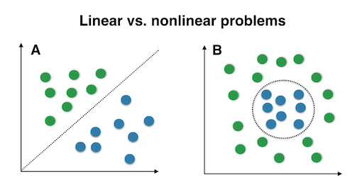
Non-linear classifications
Some data cannot be separated by a hyperplane in its original space
We can transform a non-linear classification into a linear classification using the kernel function
Notes:
However, not all data can be classified with a linear function in its original space. To solve this, we can use the kernel function to get a linear classification from a non-linear classification.
This example illustrates a linear and non-linear problems.

Slide 5
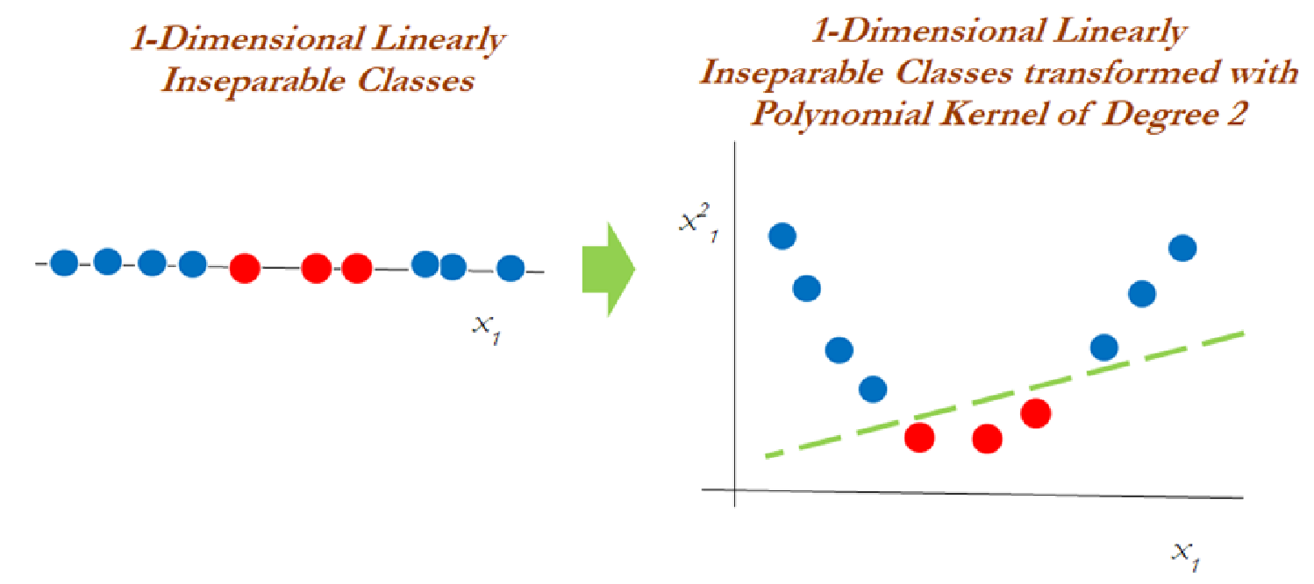
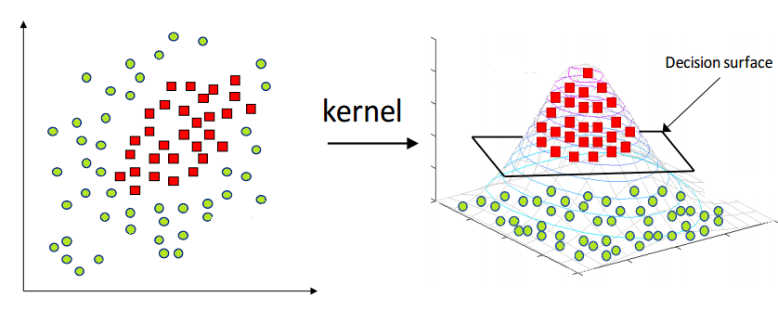
Kernel Function
SVM can perform non-linear classifications by using the kernel function or kernel trick, which maps the inputs into high-dimensional features (feature map)
1D to 2D
2D to 3D
Notes:
The SVM uses the kernel function to map non-linear classifications into higher dimensional spaces which are called feature maps.
In the left example we can see two non-separable classes in an one dimensional space that is transformed into a 2 dimensional space with separable classes.
Similarly, on the right we see a 2-D transformation to a 3D space.

Slide 6
Kernel Function cont.
Higher dimensional space is computationally expensive
The kernel function reduces the computational cost by avoiding the direct transformations of data points and calculating the distance of two points in a higher dimension directly
For example, applying the dot product between two vectors so every point is mapped into a higher dimensional space and thus transforming a non-linear space into a linear space
Notes:
Often transforming into a higher dimensional space is computationally expensive
The kernel function reduces the computational cost by avoiding the direct transformations of data points and calculating the distance of two points in a higher dimension directly
This is done by taking input vectors in the original space and returning the dot product of the vectors in the feature space
For example, applying the dot product between two vectors so every point is mapped into a higher dimensional space and thus transforming a non-linear space into a linear space

Slide 7
Quantum Support Vector Machines (QSVM)
Classification problems for computing the kernel is not efficient classically
Computational resources will exponentially increase with the size of the problem
This can be solved in a quantum processor by a direct estimation of the kernel in the feature space
It consist of a training phase (where the kernel is calculated and the support vectors are obtained)
Test or classification phase (where new unlabeled data is classified according to the solution found in the training phase)
Quantum kernel is equivalent to the classical kernel function
Notes:
QSVM uses qubits to calculate the kernel and classify the training data in a Hilbert space. This is a response to the fact that when we have lots of features and data, the task of calculating the distances in a higher dimension are computationally expensive and we can use qubits to improve the performance. For each feature, we represent it with a qubit so one can make a guess with lots of features, how many qubits we will need. Because the current progress is to have quantum computers with at most 50 qubits, we need to use feature reduction methods such as PCA to to reduce the number of features to a feasible number. So for our training phase, we use a quantum kernel.

Slide 8
Quantum Classification
To perform a quantum classification, it requires 3 steps.
Convert classical data to quantum data
Process the data
Apply measurements to read the output
Notes:
To perform quantum classification, we need 3 steps.
First step is to convert classical data to quantum data. When we talk about SVM inputs, quantum computers are not able to take the data directly and we need to convert the classical data into quantum data. This is done by taking the data and converting it to Hilbert space which is done by using quantum gates.
Second step is to actually process the data and apply the kernel.
Last step is to apply the measurements on qubits to find out about their value.
We use QSVM package in Qiskit for our demonstration.

Slide 9
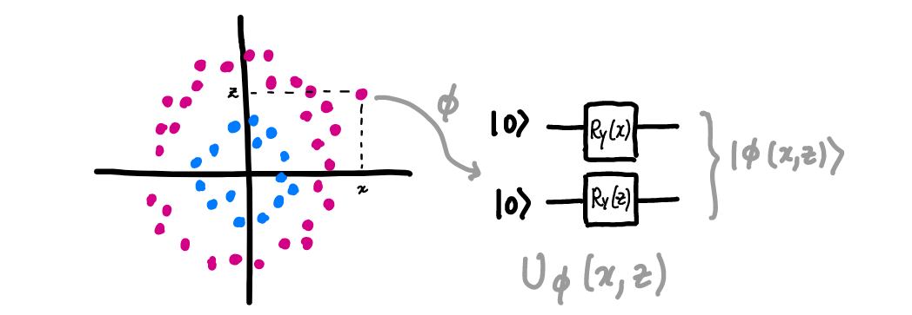
Quantum Feature Maps
To convert the classical data into quantum data, we can use a Quantum feature map
Let 𝓧 be a set of input data
Let 𝓕 be the vector space
Let 𝝓(phi) be the feature map
𝝓 is a function that acts as 𝝓 : 𝓧→𝓕
The map transforms x→|φ(x)〉by way of a unitary transformation Uᵩ(x)
Notes:
Feature map in general is a type of transformation from one space to another, for example in classical SVM when we transform the data from 2 dimensions to 3, we are referring to the function transformer as feature map.
Now, quantum feature maps are a type of function that take the classical data and convert it to quantum data. These transformations should be unitary and one to one so we can go back and forth and have one representation of each data point in any of the spaces.

Slide 10
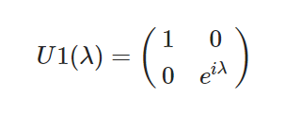
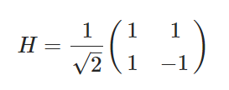
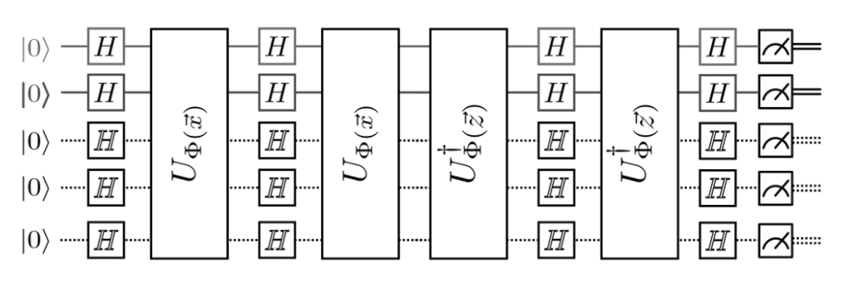
Quantum Feature Maps cont.
We want to represent the classical data into a Hilbert Space: the feature map takes inputs and does some gate operations.
U is a matrix and H is a matrix
The output is represented in quantum data.
The quantum data are then used to build the kernel of the SVM
Qubits
Quantum data
Notes:
Thee key to feature maps are the gate operations it makes. Just like a classical gate, a quantum gate takes some inputs and gives out the output. However, here the gates take qubits as inputs and the final output is quantum data which is then used to build the kernel

Slide 11
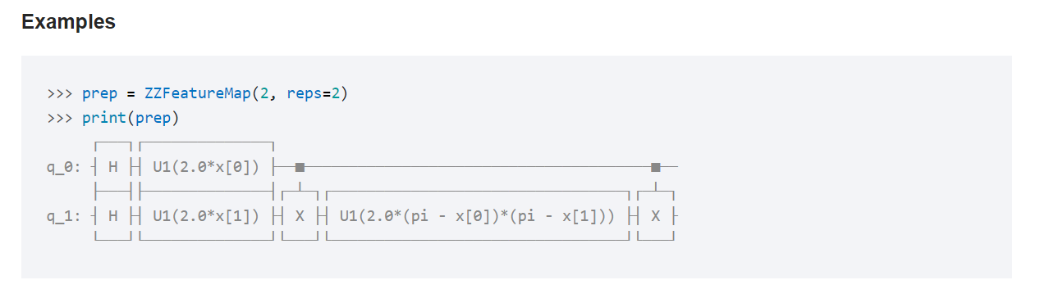
ZZFeatureMap
ZZFeatureMap is used in our code.
The initial segment of the ZZFeatureMap is a default setting and the next segment creates the entanglement state.
The number of qubits is equivalent to the number of features. For example, in a stock market with 10 features such as the opening price, closing price, time, etc. would require 10 qubits.
Processing the data and measuring the output are done by the QSVM package in Qiskit.
Entanglement
Default initial segment
Notes:
There exist different types of feature maps that could be used. In our code, we utilized the ZZFeatureMap which a second order Pauli-Z evolution circuit. The main point here is that this featuremap allows for entanglement.
As mentioned before, the number of qubits should be equal to the number of features used.

Slide 12


Comparing SVM Results and QSVM
The SVM Time Complexity:
N: the dimension of the feature space
M: Number of training vectors
𝝐: The accuracy

Slide 13
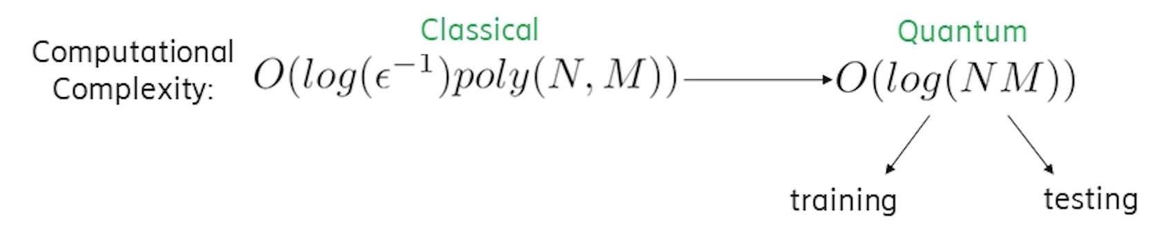
Comparing SVM Results and QSVM
The QSVM Time Complexity:
Grover’s Search based(2003) -----Quadratic speedup
HHL based(2013) -----Exponential speedup

Slide 14
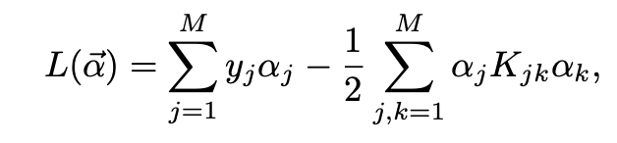




Comparing SVM Results and QSVM
Solve SVM
Points: -------->
Maximize: --------->
Classically inner product take
SWAP-test: --------->

Slide 15
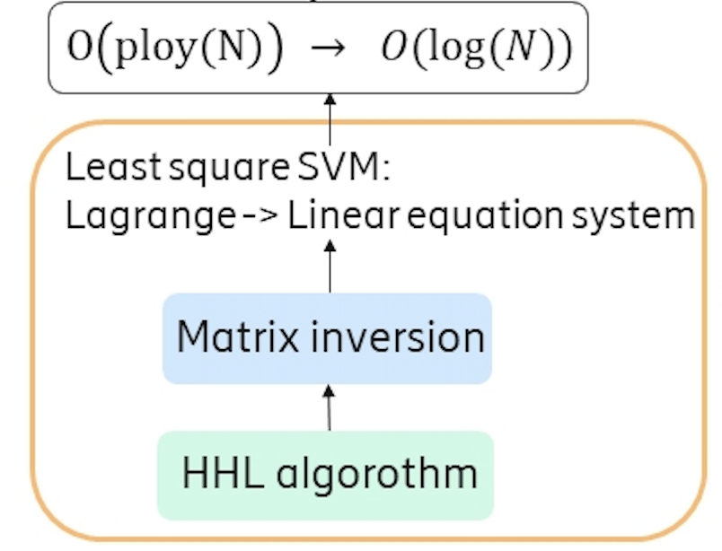
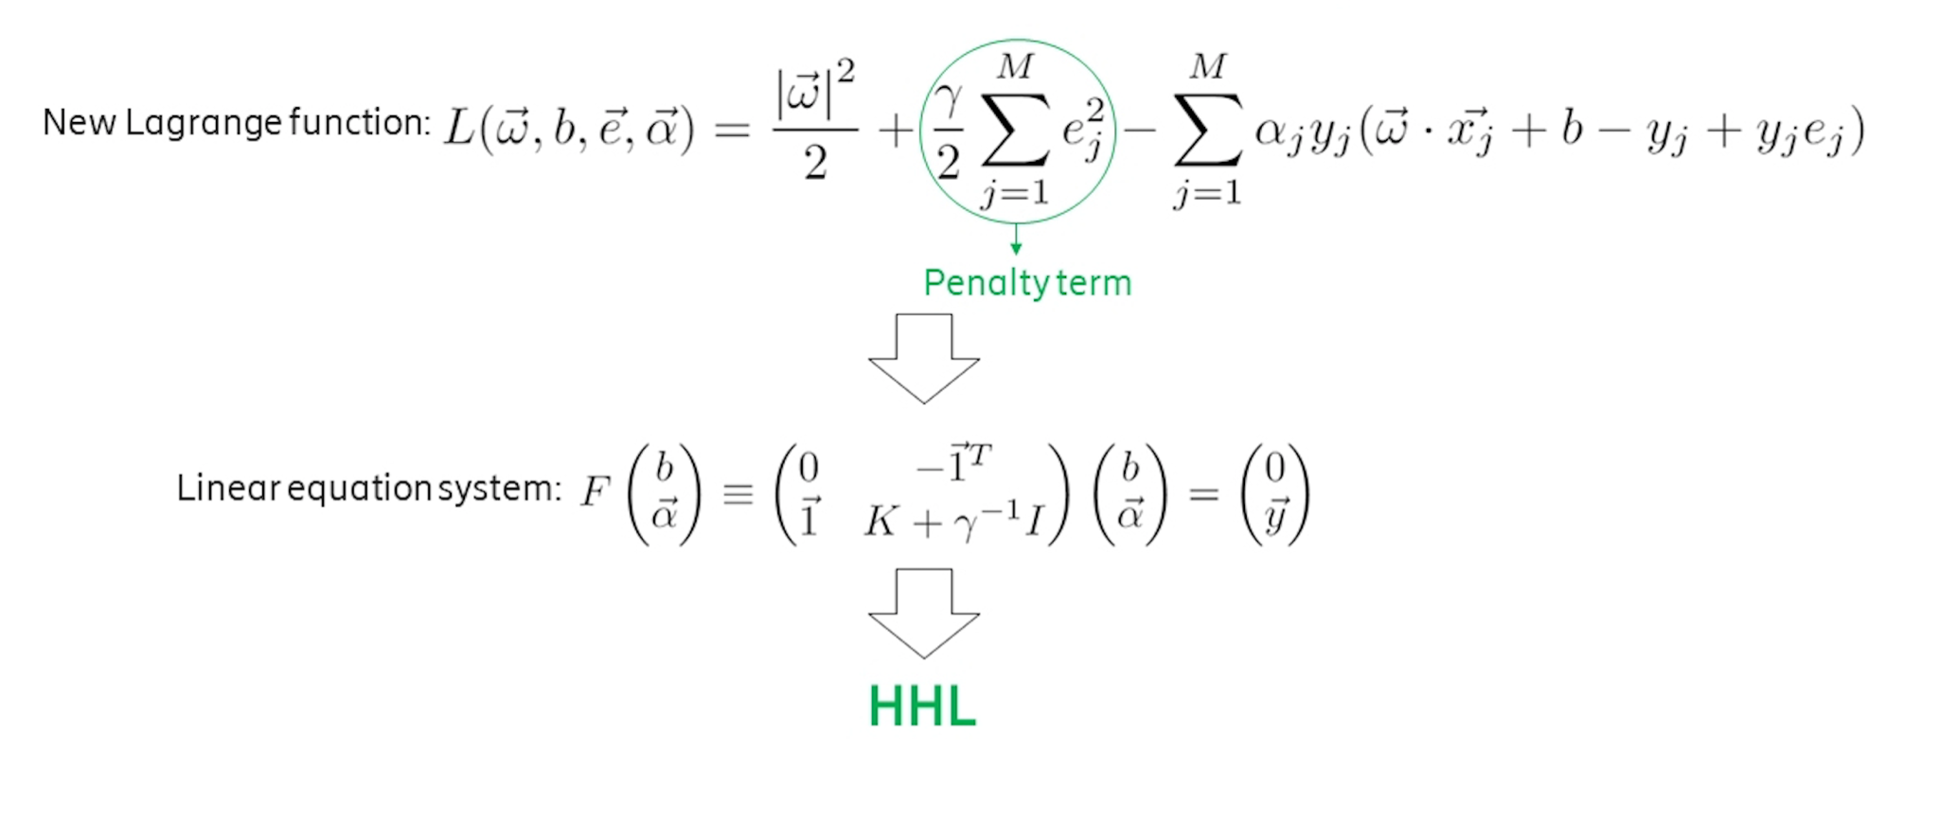
Comparing SVM Results and QSVM
Least Square SVM:

Slide 16


Comparing SVM Results and QSVM
Result:
https://arxiv.org/pdf/1307.0471.pdf
https://blog.csdn.net/m0_37622530/article/details/88851497

