Slide 1
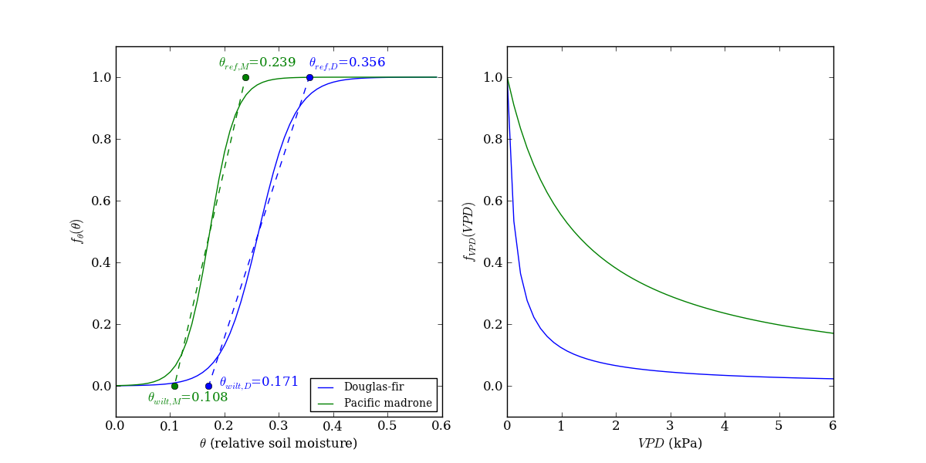
Figure 1. Stomatal response functions for theta and VPD.

Slide 2


Slide 3
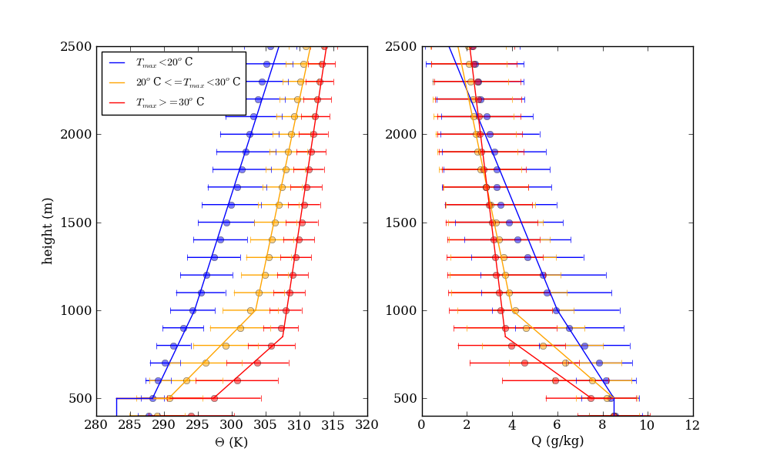
Figure 2.

Slide 4
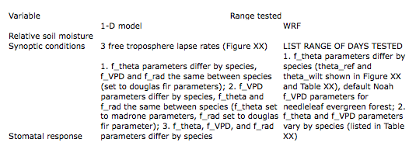
Table 2.

Slide 5
Figure 3. WRF model domain and experimental region.
NOT MADE YET.

Slide 6
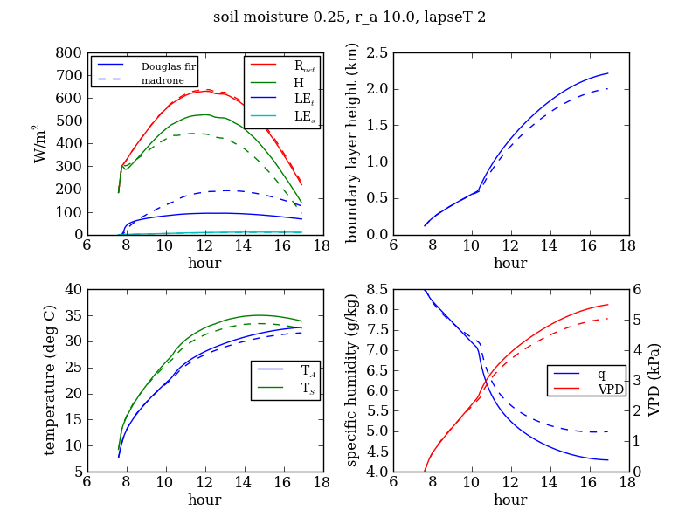
Figure 4.

Slide 7
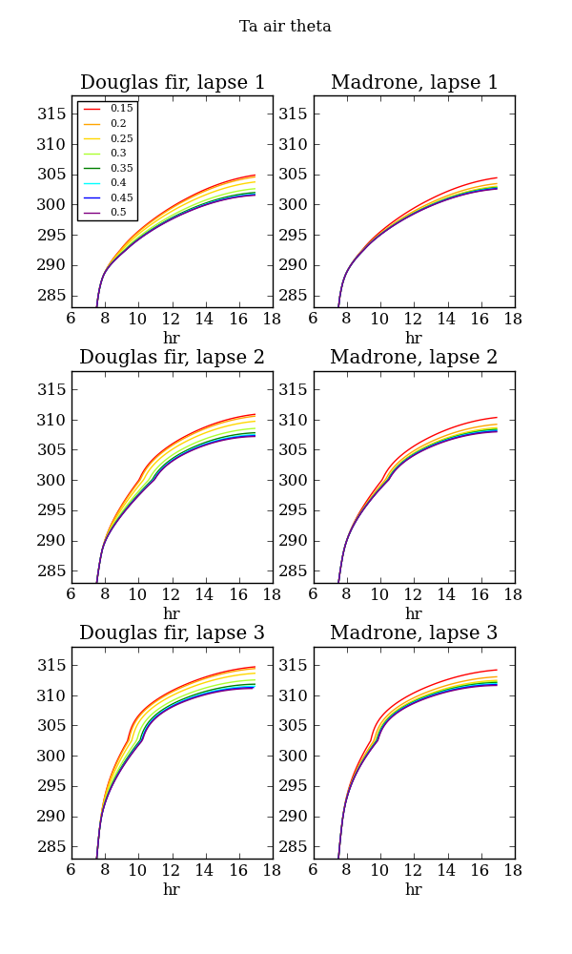
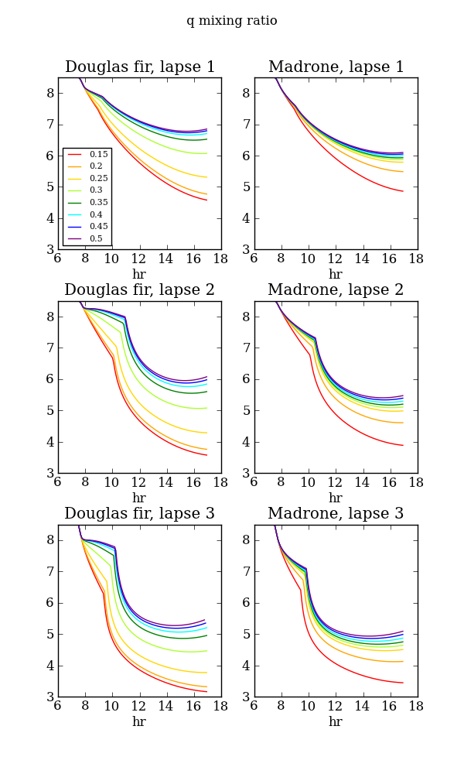
Figure 5.
Figure 6.

Slide 8
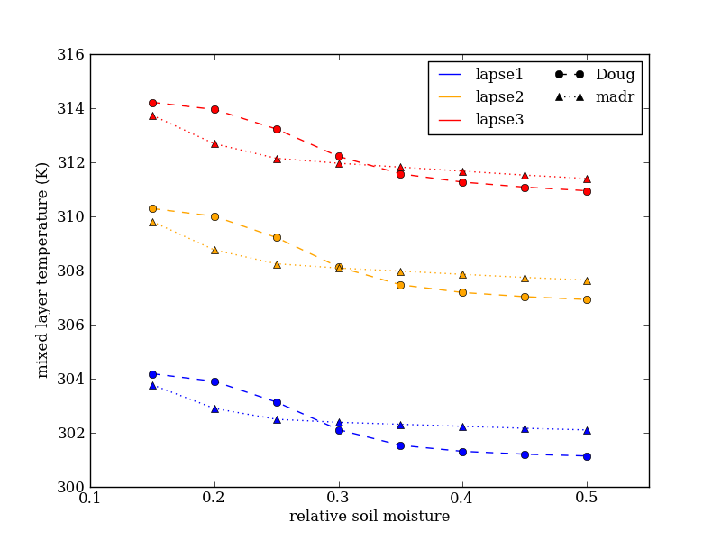
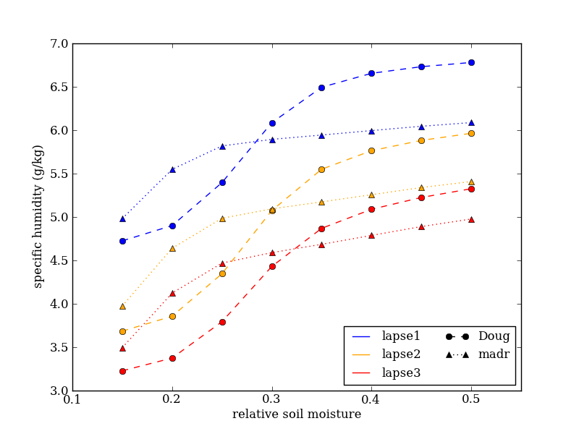
Figure 7.

Slide 9
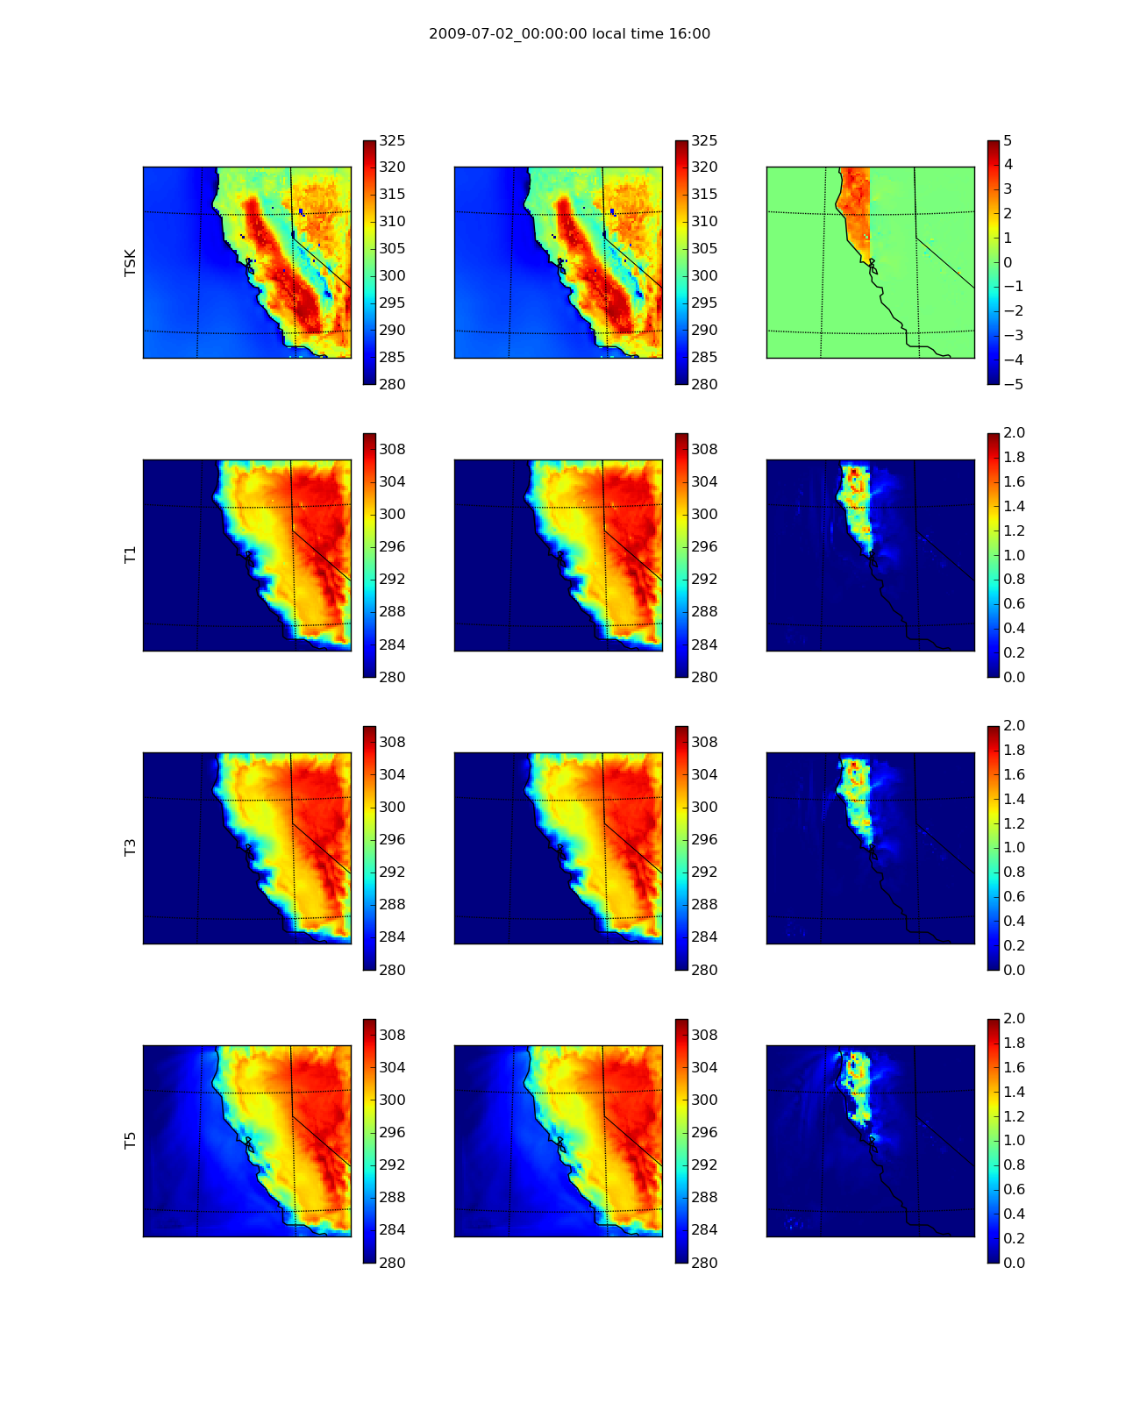
Figure 8.
Doug
Madr
Doug - Madr
Skin T
T atm lev 1
T atm lev 3
T atm lev 5

Slide 10
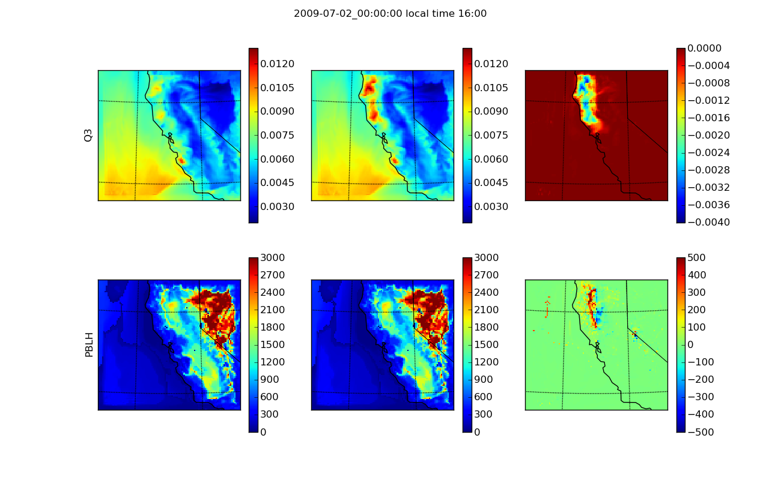
Figure 9.
Doug
Madr
Doug - Madr
Q atm lev 3

Slide 11
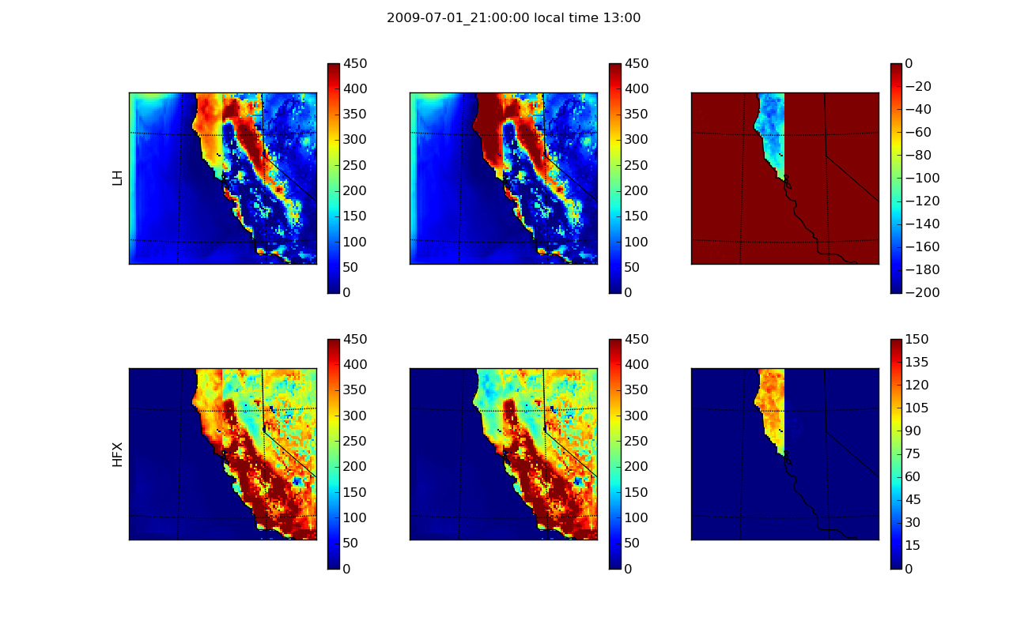
Figure 10.
Doug
Madr
Doug - Madr

