Slide 1
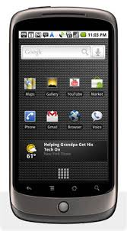
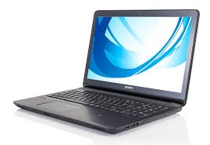
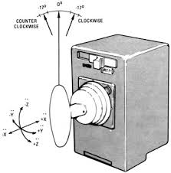
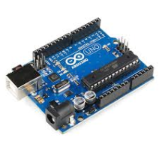
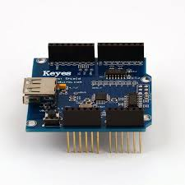
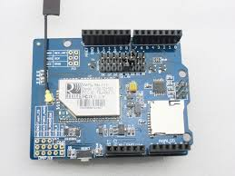
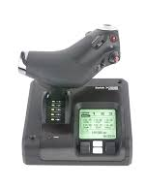
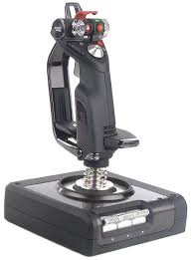
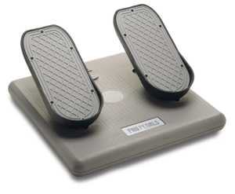
MCP/mobile WiFi Hub
USB/ADK
or WiFi
WiFi
X/Y/Z
OrbConnect
USB
THC
Orbiter
Master
Throttle
Rudder pedals (yaw)
RHC (pitch/roll/yaw)
Orbiter Simpit Integrated Motion Controller
Designer: Ronald Houde

