Slide 1

EOSFACTORY
SMART-CONTRACT DEVELOPMENT & TESTING IDE
Presented by

Slide 2
An integrated development environment (IDE) is a software application that provides comprehensive facilities to computer programmers for software development. An IDE normally consists of a source code editor, build automation tools, and a debugger.
Wikipedia

Slide 3
EOSIO INFRASTRUCURE
nodeos
cleos
teos
eosf
Node
Clients
Tools
eosjs
scatter
keosd

Slide 4
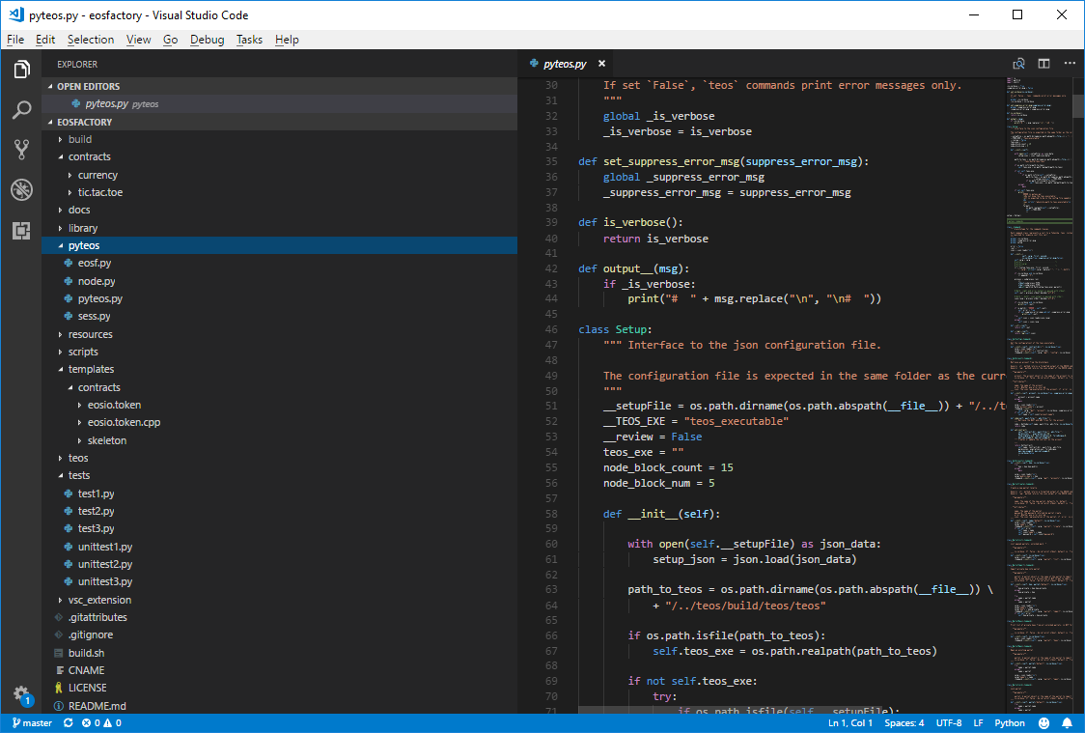
eosFactory COMPONENTS

Slide 5
Main features in v1.0
Standard unit-testing framework
Support for user-defined workspaces
Support for debugging
Preliminary code verification
Visual Studio Code integration

Slide 6
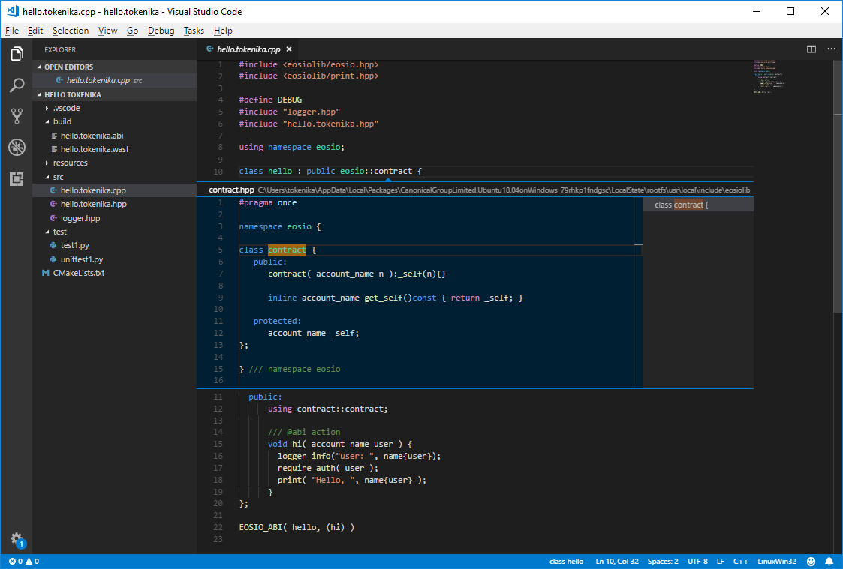
eosFactory IntelliSense

Slide 7
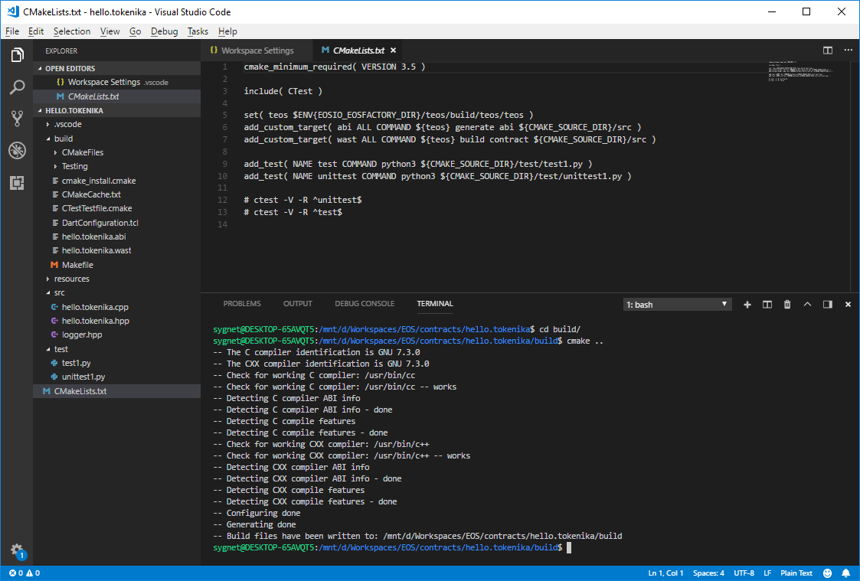
eosFactory CMAKE SUPPORT

Slide 8
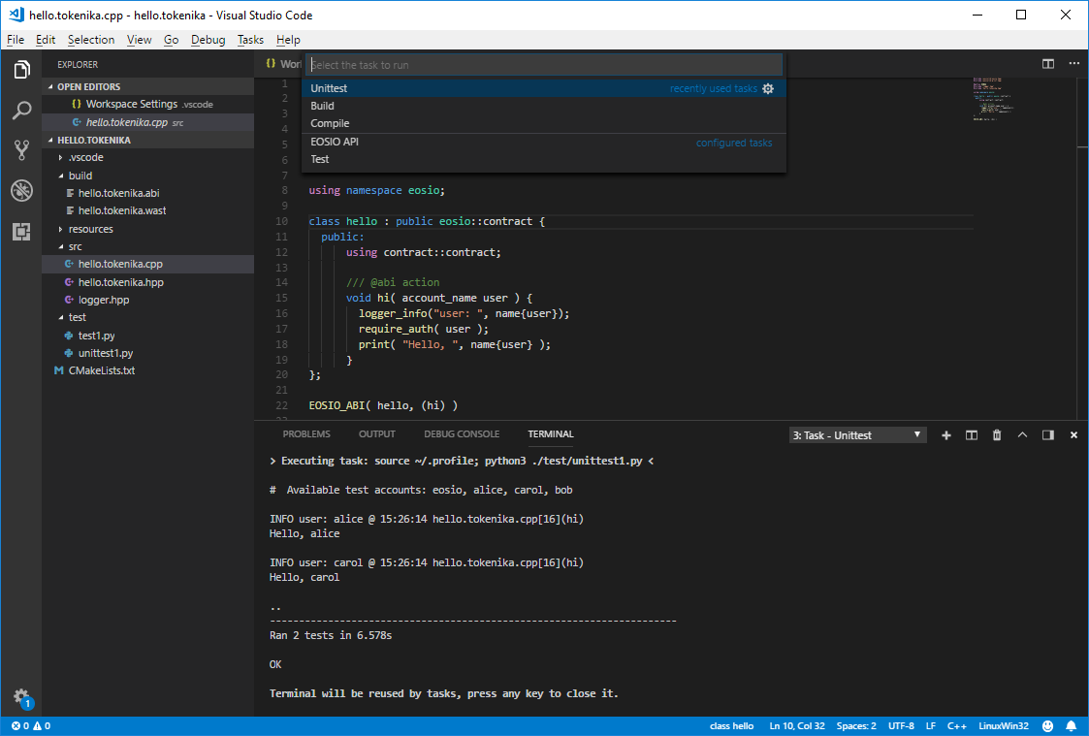
eosFactory UNIT TESTS

Slide 9
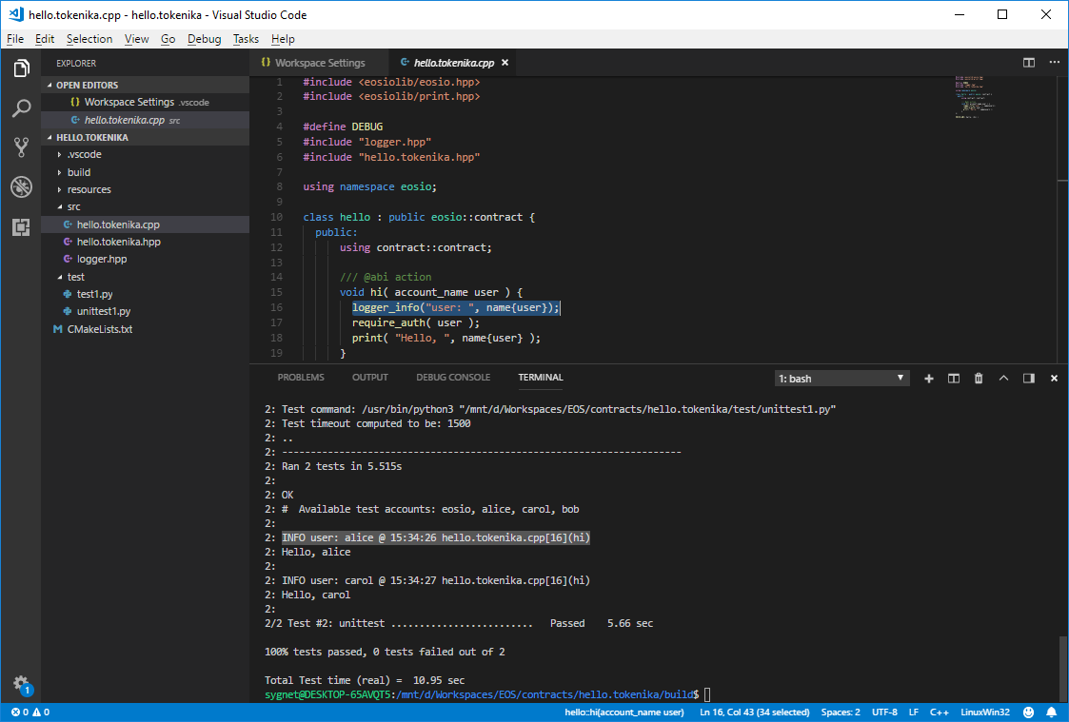
eosFactory DEBUGGING

Slide 10
Thank you
Any questions?
EOSFACTORY
eosfactory.io
github.com/tokenika/eosfactory
Presented by
tokenika.io contact@tokenika.io

