Slide 1
Executive Business Review
Signature Tier
Lennar Corporation
August 1-31, 2025 (31 days)
Report Date: November 5, 2025
DECEMBER 2025
©2025 CRITICAL START
EBR

Slide 2
ESCALATION REPORT
CRITICAL START
2
Executive Summary
A comprehensive view of your security posture and the value delivered this period
DECEMBER 2025
©2025 CRITICAL START
EBR

Slide 3
ESCALATION REPORT
CRITICAL START
3
Security Posture Overview
THREAT CONTAINMENT
RESPONSE SPEED
DETECTION QUALITY
100%
34%
9.0%
11 threats contained, zero breaches
Faster than industry (126m vs 192m)
False positive rate
24/7 COVERAGE
AUTOMATION
OPERATIONAL SCALE
158
86%
2,110
After-hours escalations (59% of total)
Automated escalations (229 of 267)
Alerts triaged, 1,690 client-touch
DECEMBER 2025
©2025 CRITICAL START
EBR

Slide 4
ESCALATION REPORT
CRITICAL START
4
Value & Performance Details
MODELED COST EXPOSURE AVOIDED
OPERATIONAL EFFICIENCY
$7.55M
420
Breach exposure: $7.34M | Coverage: $163K | Analyst hours: $38K
Incidents closed end-to-end by CS SOC
MTTR
MTTD
INDUSTRY COMPARISON
126m
4m
34%
Mean Time to Respond (P90: 87m)
Mean Time to Detect
Faster response, 36% faster detection
DECEMBER 2025
©2025 CRITICAL START
EBR

Slide 5
ESCALATION REPORT
CRITICAL START
5
Value Delivered
Quantifying the business impact: cost avoidance, operational efficiency, and breach prevention
DECEMBER 2025
©2025 CRITICAL START
EBR

Slide 6
ESCALATION REPORT
CRITICAL START
6
Modeled Cost Exposure Avoided
~$7.55M
Modeled cost exposure avoided across operations, coverage, and threat containment
Illustrative impact only; not redeployable budget
DECEMBER 2025
©2025 CRITICAL START
EBR

Slide 7
ESCALATION REPORT
CRITICAL START
7
Value Delivered - Breakdown
Security Operations
24/7 Coverage
Threat Prevention
452 analyst hours delivered
744 hours of monitoring
11 intrusions contained
~$38K equivalent
~$163K equivalent
~$7.34M breach exposure avoided
Methodology: Cost equivalents based on industry-standard rates for SOC analyst time, 24/7 monitoring infrastructure, and average breach cost per incident.
DECEMBER 2025
©2025 CRITICAL START
EBR

Slide 8
ESCALATION REPORT
CRITICAL START
8
Security Outcomes This Period
• 2,110 Alerts Triaged
• 1,690 Client-Touch Decisions
• 420 Closed End-to-End
• 11 True Threats Contained
• 34% Faster Than Industry
• 87-Minute P90 Response
• 158 After-Hours Escalations
• 744 Hours of Coverage
DECEMBER 2025
©2025 CRITICAL START
EBR

Slide 9
ESCALATION REPORT
CRITICAL START
9
Protection Achieved
Measurable outcomes that exceed industry standards and reduce your breach risk
DECEMBER 2025
©2025 CRITICAL START
EBR

Slide 10
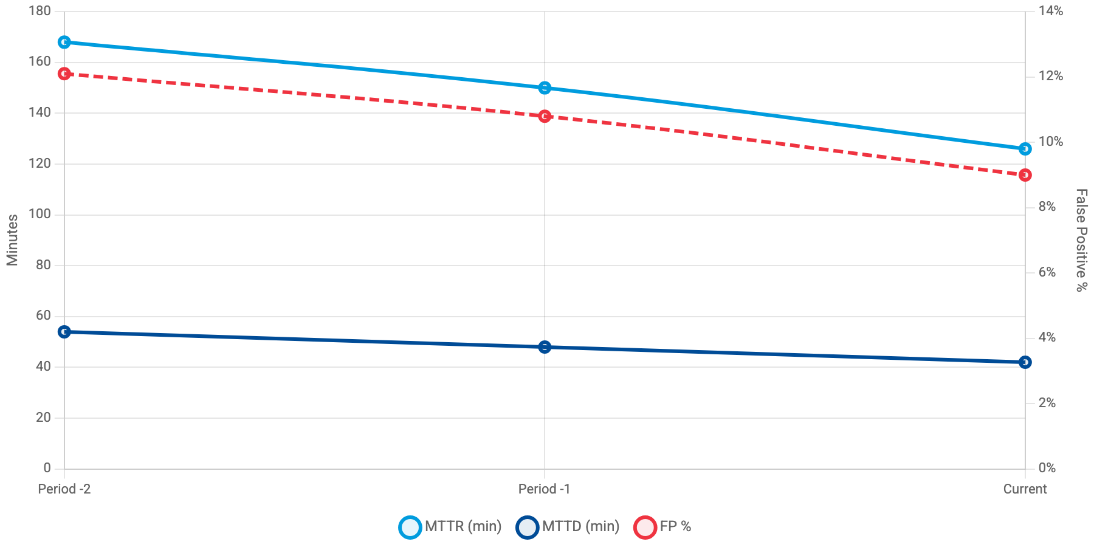
ESCALATION REPORT
CRITICAL START
10
Getting Better Every Period
MTTR (blue) | MTTD (navy) | FP% (red dashed)
MTTR decreased 25% to 126 minutes, MTTD improved 22% to 42 minutes
DECEMBER 2025
©2025 CRITICAL START
EBR

Slide 11
ESCALATION REPORT
CRITICAL START
11
Industry Comparison
Metric
Your Performance
Industry Average
Difference
MTTR (minutes)
126
192
34% Better
MTTD (minutes)
42
66
36% Better
Incidents/Day
8.9
11.4
22% Better
DECEMBER 2025
©2025 CRITICAL START
EBR

Slide 12
ESCALATION REPORT
CRITICAL START
12
Response Efficiency
Containment Rate
Playbook Automation
Analyst Escalation
98%
86%
14%
(262 of 267)
(229 incidents)
(38 incidents)
DECEMBER 2025
©2025 CRITICAL START
EBR

Slide 13
ESCALATION REPORT
CRITICAL START
13
Detection Quality
True Threat Precision
Signal Fidelity
31.4%
91%
False Positive Rate
Client-Validated
9.0%
86.9%
Signal quality improved: false positives fell from 10.8% to 9.0%
DECEMBER 2025
©2025 CRITICAL START
EBR

Slide 14
ESCALATION REPORT
CRITICAL START
14
Threat Landscape
Understanding the threats we're seeing and how we're adapting to protect your organization
DECEMBER 2025
©2025 CRITICAL START
EBR

Slide 15
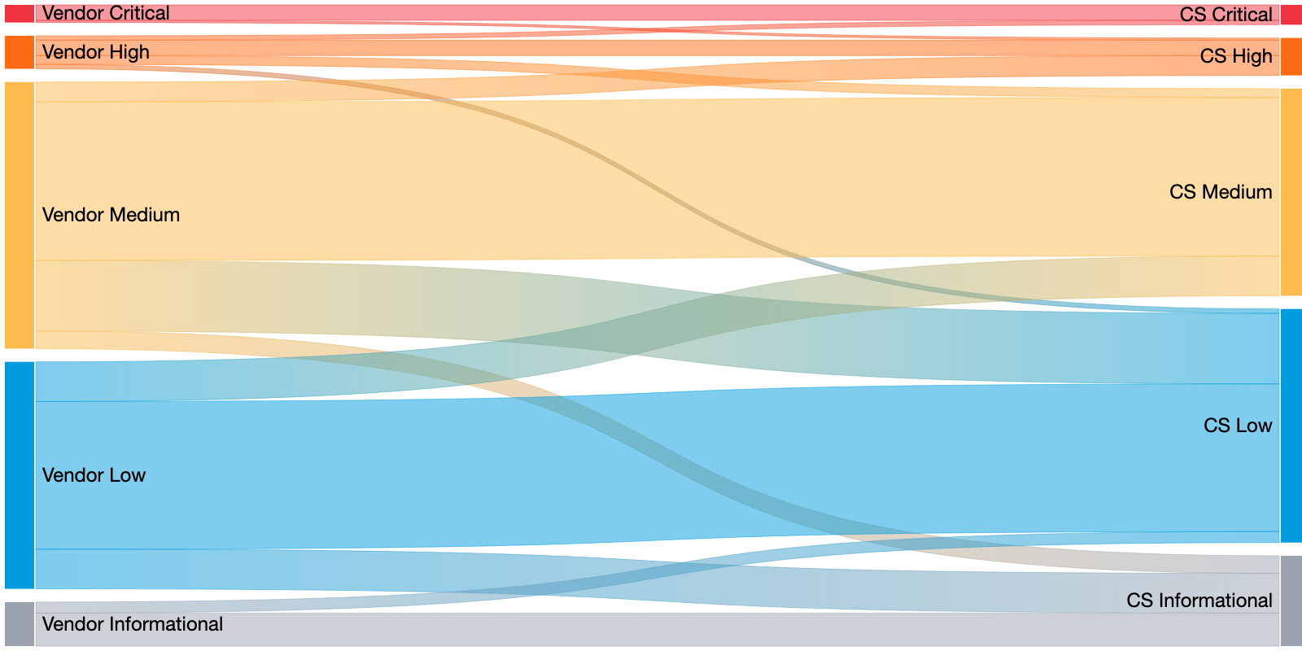
ESCALATION REPORT
CRITICAL START
15
Severity Alignment Flow
Vendor-reported criticality vs. Critical Start adjudication
267 escalations
34
65
168
Upgraded
De-escalated
Aligned
Source: Vendor Severity (col 45) vs. Current Priority (col 13)
DECEMBER 2025
©2025 CRITICAL START
EBR
• 34 escalations upgraded (12.7%) - CS raised severity based on business impact
• 65 escalations de-escalated (24.3%) - CS reduced noise from vendor over-classification

Slide 16
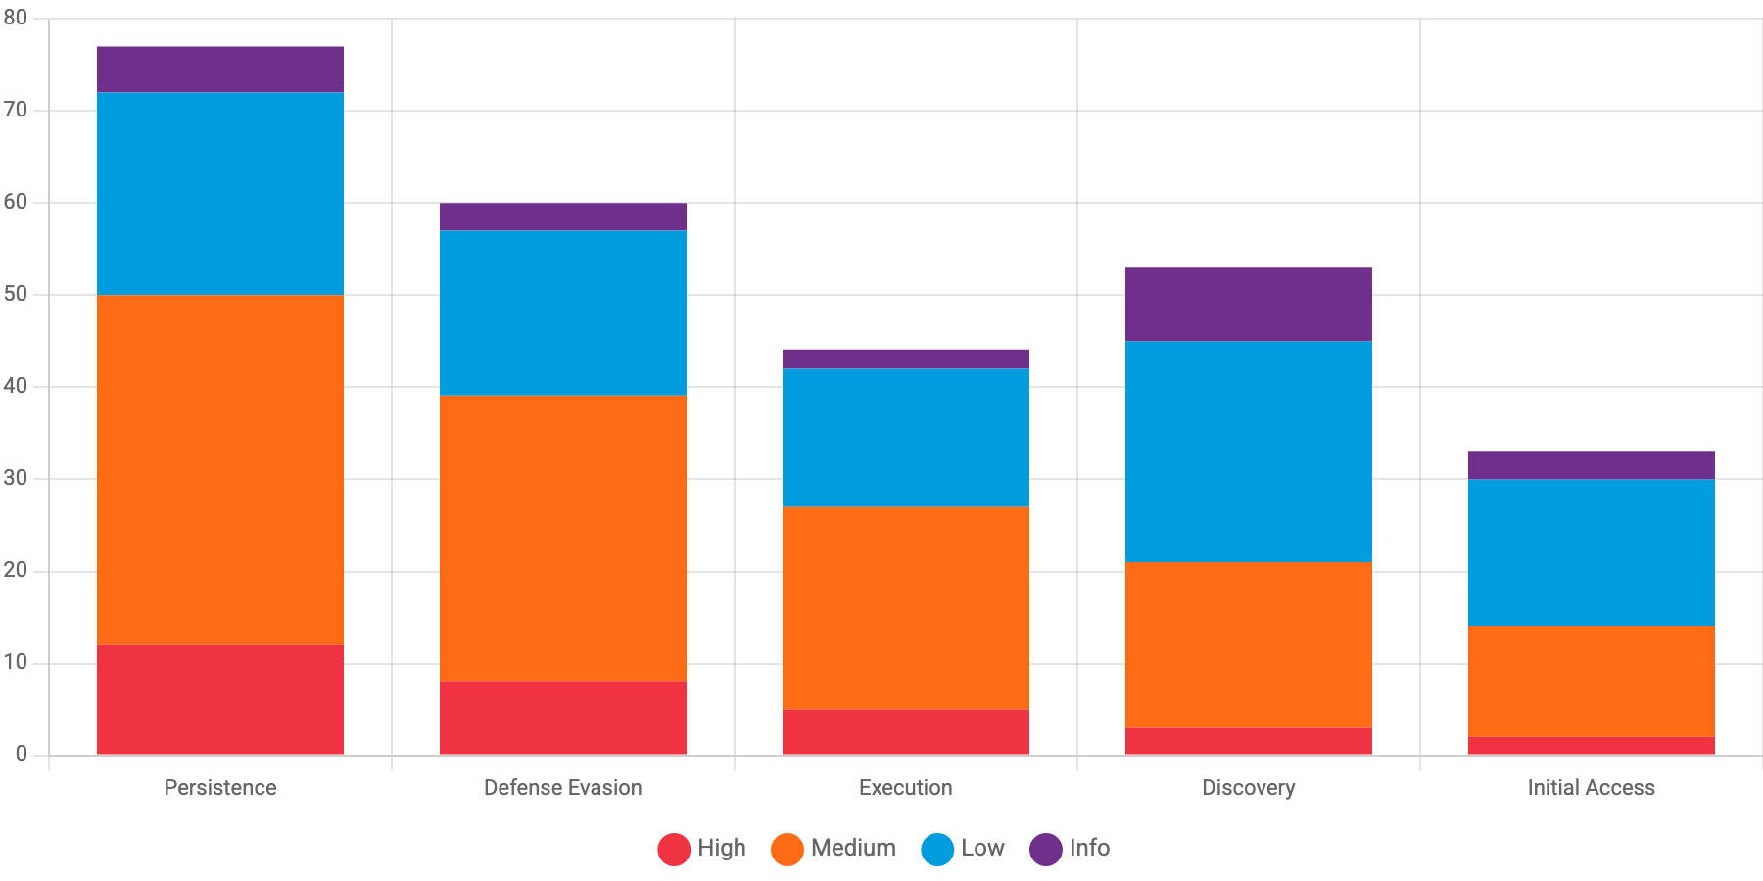
ESCALATION REPORT
CRITICAL START
16
Threat Landscape by Tactic & Severity
High (red) | Medium (orange) | Low (blue) | Info (gray)
Source: MITRE ATT&CK Tactic (col X) and Current Priority (col 13)
DECEMBER 2025
©2025 CRITICAL START
EBR
Persistence tactics generated 77 escalations with 12 high-severity cases (15.6%)

Slide 17
ESCALATION REPORT
CRITICAL START
17
Detection Sources & Quality
Palo Alto Cortex XDR
Microsoft Sentinel
CrowdStrike Falcon
189 incidents (70.8%)
52 incidents (19.5%)
26 incidents (9.7%)
FP Rate: 11.2%
FP Rate: 5.8%
FP Rate: 7.7%
Above threshold
Good
Good
DECEMBER 2025
©2025 CRITICAL START
EBR

Slide 18
ESCALATION REPORT
CRITICAL START
18
Insights & Continuous Improvement
How we're evolving our partnership to advance your security maturity
DECEMBER 2025
©2025 CRITICAL START
EBR

Slide 19
ESCALATION REPORT
CRITICAL START
19
Prioritized Improvement Plan
HIGH
Item 1 - Detection Tuning
Palo Alto Cortex XDR false positive rate is 11.2%, exceeding the 10.0% threshold
Owner: CS SOC + Lennar Security Team | Target: Next 30 days
Expected Impact: Reduce escalations by ~20%
MEDIUM
Item 2 - Automation Opportunity
Manual escalations at 14% exceed 12% target. 38 incidents required analyst judgment
Owner: CS SOC Engineering | Target: Next 60 days
Expected Impact: Reduce manual review burden
HIGH
Item 3 - Threat Focus
DECEMBER 2025
©2025 CRITICAL START
EBR
Persistence + Defense Evasion account for 67% of high-severity incidents
Owner: Joint - CS Threat Intel + Lennar | Target: Ongoing
Expected Impact: Improved detection of advanced threats

Slide 20
ESCALATION REPORT
CRITICAL START
20
Operational Insights
After-Hours Coverage
Collaboration Quality
After Hours Calls: 18% (136 of 756)
Average Touches per Incident: 2.3
Weekend Calls: 15% (22 of 147)
Active Client Participation: 72%
Total Off-Hours Calls: 158
Client-Led Closures: 21%
82.5% of after-hours alerts handled by CS SOC without requiring customer notification
DECEMBER 2025
©2025 CRITICAL START
EBR

Slide 21
ESCALATION REPORT
CRITICAL START
21
After-Hours Customer Notifications
158
129 Weeknights
29 Weekends
After-Hours Escalations
744 hours of nonstop coverage · 86% auto-routed via playbooks
What This Means for Your Organization
Your team received continuous protection outside business hours. 158 incidents were detected and escalated while your team was off-duty, with 86% automatically routed through playbooks—minimizing manual intervention and ensuring no threats went unaddressed.
DECEMBER 2025
©2025 CRITICAL START
EBR

Slide 22
ESCALATION REPORT
CRITICAL START
22
Response Efficiency
Critical
High
Medium
Low
67m
67m
126m
52m
Target: 30m ⚠
Target: 60m ⚠
Target: 180m ✓
Target: 240m ✓
P90 Response Time: 87 minutes
90% of incidents responded to within 87 minutes—34% faster than industry median (192m)
What This Means: Faster response times mean threats are contained before they can spread. Your 34% advantage translates to reduced risk exposure and better business continuity.
DECEMBER 2025
©2025 CRITICAL START
EBR

Slide 23
ESCALATION REPORT
CRITICAL START
23
Collaboration Quality
2.3
72%
21%
Average Touches
Client Participation
Client-Led Closures
interactions per incident
of incidents with client input
closed by your team
What This Means for Your Organization
Effective collaboration means faster threat resolution. With 72% client participation and 21% client-led closures, your team is actively engaged in the security process while Critical Start handles the heavy lifting.
DECEMBER 2025
©2025 CRITICAL START
EBR

Slide 24
ESCALATION REPORT
CRITICAL START
24
Detection Quality
31.4%
91%
86.9%
True Threat Precision
Signal Fidelity
Client Validated
of escalations were real threats
noise filtered out
confirmed by your team
False Positive Rate: 9.0% ✓ Within target
What This Means: High detection quality means less noise for your team. With 91% signal fidelity, Critical Start filters out the false alarms so your analysts focus only on real threats.
DECEMBER 2025
©2025 CRITICAL START
EBR

Slide 25
ESCALATION REPORT
CRITICAL START
25
Security Outcomes This Period
2,110
11
Alerts Triaged
Threats Contained
1,690 guided · 420 closed end-to-end
100% contained · zero breaches
34%
$7.55M
Faster Than Peers
Cost Exposure Avoided
126m MTTR vs 192m industry
Modeled operational + breach avoidance
DECEMBER 2025
©2025 CRITICAL START
EBR

Slide 26
ESCALATION REPORT
CRITICAL START
26
Key Takeaways: This Period
✓
34% faster response than industry peers—threats are contained before spreading
✓
100% threat containment with zero breaches this period across 11 true positive incidents
✓
$7.55M in modeled cost exposure avoided through proactive security operations
✓
158 after-hours escalations handled seamlessly with 86% automation
DECEMBER 2025
©2025 CRITICAL START
EBR

Slide 27
ESCALATION REPORT
CRITICAL START
27
Forward Direction
Strategic recommendations to strengthen your security posture and maximize partnership value
DECEMBER 2025
©2025 CRITICAL START
EBR

Slide 28
ESCALATION REPORT
CRITICAL START
28
Looking Ahead
Next Period Targets
✓ Trim Palo Alto XDR false positives from 11.2% to 10% threshold (~4 fewer escalations)
✓ Reduce manual escalations from 38 (14%) to 32 or fewer (12% target)
Strategic Focus
✓ Proactive hunts targeting Persistence and Defense Evasion tactics
✓ Additional playbook coverage for analyst-escalated scenarios
Your Partnership
Questions? Your Customer Success Manager is here to help.
Report generated: November 5, 2025 | Data sources: Escalation Details Report
DECEMBER 2025
©2025 CRITICAL START
EBR

