Slide 1
Escalation to Client Details Report
Signature Tier
Lennar Corporation
August 1-31, 2025 (31 days)
Report Date: November 5, 2025

Slide 2
Executive Summary
267 Incidents Escalated
Average 8.9 per day requiring your team's attention
CS SOC triaged 2,110 alerts this period—1,690 (80%) guided with your team and 420 closed end-to-end

Slide 3
Period Highlights
Threat Outcomes
Response Advantage
11 threats contained, zero breaches
34% faster MTTR vs peers (126m vs 192m)
24/7 Protection
Detection Quality
59% of escalations handled after-hours
9.0% false positive rate

Slide 4
Modeled Cost Exposure Avoided
~$7.55M
Modeled cost exposure avoided across operations, coverage, and threat containment
Illustrative impact only; not redeployable budget

Slide 5
Value Delivered - Breakdown
Security Operations
24/7 Coverage
Threat Prevention
452 analyst hours delivered
744 hours of monitoring
11 intrusions contained
~$38K equivalent
~$163K equivalent
~$7.34M breach exposure avoided
Methodology: Cost equivalents based on industry-standard rates for SOC analyst time, 24/7 monitoring infrastructure, and average breach cost per incident.

Slide 6
Security Outcomes This Period
• 2,110 Alerts Triaged
• 1,690 Client-Touch Decisions
• 420 Closed End-to-End
• 11 True Threats Contained
• 34% Faster Than Industry
• 87-Minute P90 Response
• 158 After-Hours Escalations
• 744 Hours of Coverage

Slide 7
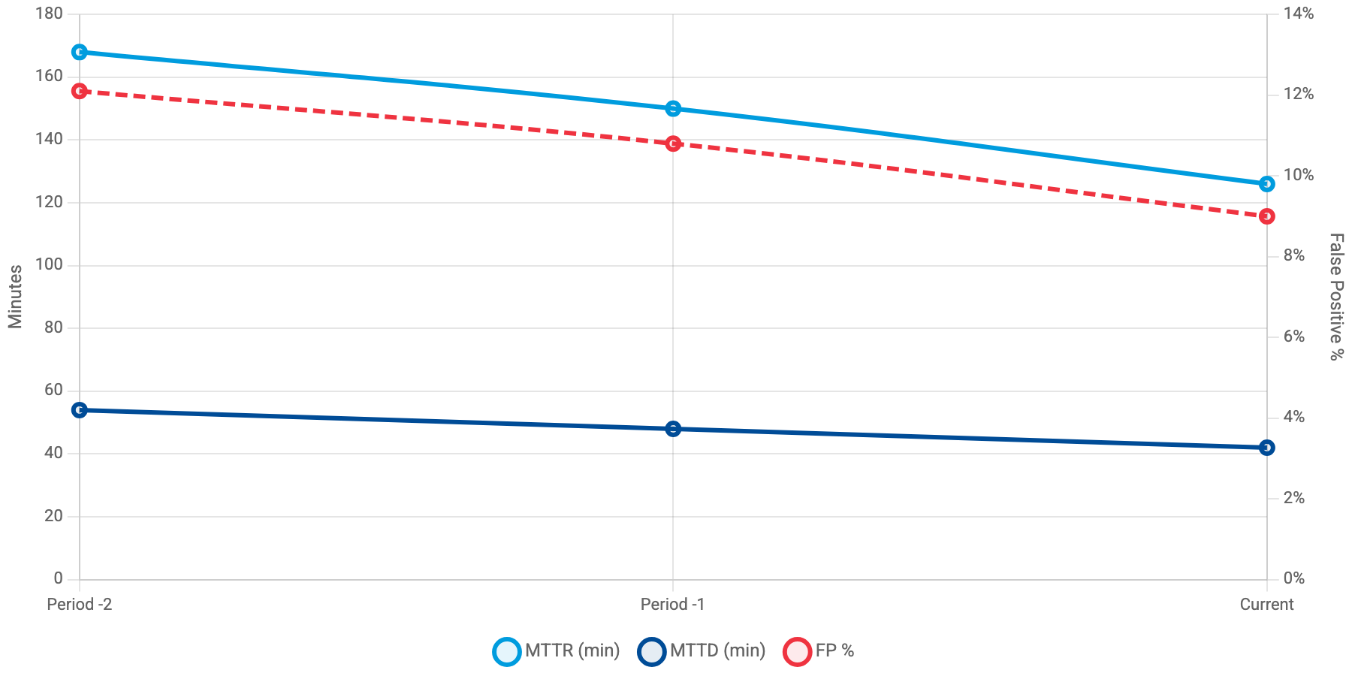
Getting Better Every Period
MTTR (blue) | MTTD (navy) | FP% (red dashed)
MTTR decreased 25% to 126 minutes, MTTD improved 22% to 42 minutes

Slide 8
Industry Comparison
Metric
Your Performance
Industry Average
Difference
MTTR (minutes)
126
192
34% Better
MTTD (minutes)
42
66
36% Better
Incidents/Day
8.9
11.4
22% Better

Slide 9
Response Efficiency
Containment Rate
Playbook Automation
Analyst Escalation
98%
86%
14%
(262 of 267)
(229 incidents)
(38 incidents)

Slide 10
Detection Quality
True Threat Precision
Signal Fidelity
31.4%
91%
False Positive Rate
Client-Validated
9.0%
86.9%
Signal quality improved: false positives fell from 10.8% to 9.0%

Slide 11
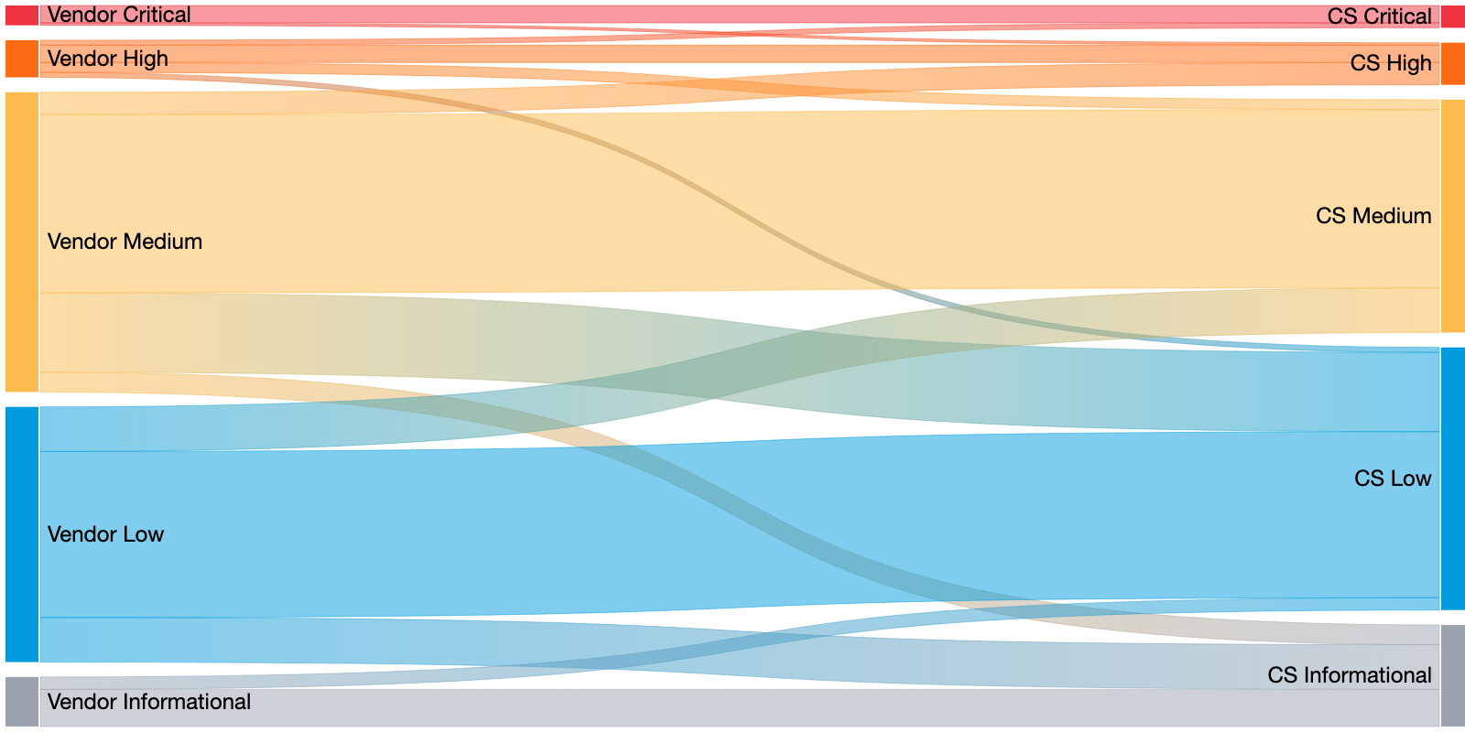
Severity Alignment Flow
Vendor-reported criticality vs. Critical Start adjudication
267 escalations
34
Upgraded
65
De-escalated
168
Aligned
• 34 escalations upgraded (12.7%) - CS raised severity based on business impact
• 65 escalations de-escalated (24.3%) - CS reduced noise from vendor over-classification

Slide 12
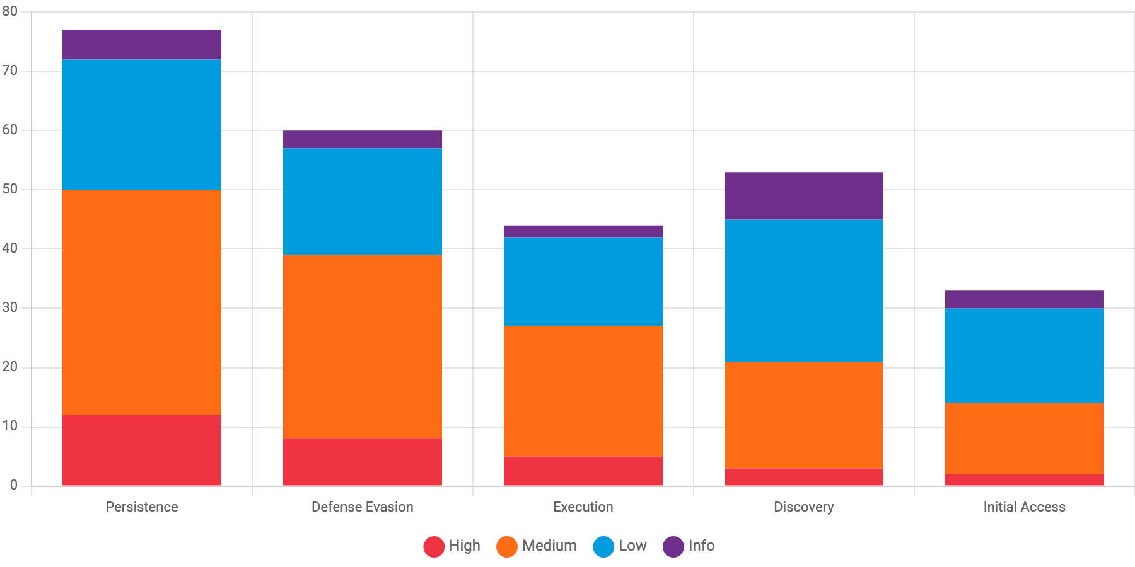
Threat Landscape by Tactic & Severity
High (red) | Medium (orange) | Low (blue) | Info (gray)
Persistence tactics generated 77 escalations with 12 high-severity cases (15.6%)

Slide 13
Detection Sources & Quality
Palo Alto Cortex XDR
Microsoft Sentinel
CrowdStrike Falcon
189 incidents (70.8%)
52 incidents (19.5%)
26 incidents (9.7%)
FP Rate: 11.2%
FP Rate: 5.8%
FP Rate: 7.7%
Above threshold
Good
Good

Slide 14
Prioritized Improvement Plan
HIGH
Item 1 - Detection Tuning
Palo Alto Cortex XDR false positive rate is 11.2%, exceeding the 10.0% threshold
Owner: CS SOC + Lennar Security Team | Target: Next 30 days
Expected Impact: Reduce escalations by ~20%
MEDIUM
Item 2 - Automation Opportunity
Manual escalations at 14% exceed 12% target. 38 incidents required analyst judgment
Owner: CS SOC Engineering | Target: Next 60 days
Expected Impact: Reduce manual review burden
HIGH
Item 3 - Threat Focus
Persistence + Defense Evasion account for 67% of high-severity incidents
Owner: Joint - CS Threat Intel + Lennar | Target: Ongoing
Expected Impact: Improved detection of advanced threats

Slide 15
Operational Insights
After-Hours Coverage
Collaboration Quality
After Hours Calls: 18% (136 of 756)
Average Touches per Incident: 2.3
Weekend Calls: 15% (22 of 147)
Active Client Participation: 72%
Total Off-Hours Calls: 158
Client-Led Closures: 21%
82.5% of after-hours alerts handled by CS SOC without requiring customer notification

Slide 16
Looking Ahead
Next Period Targets
✓ Trim Palo Alto XDR false positives from 11.2% to 10% threshold (~4 fewer escalations)
✓ Reduce manual escalations from 38 (14%) to 32 or fewer (12% target)
Strategic Focus
✓ Proactive hunts targeting Persistence and Defense Evasion tactics
✓ Additional playbook coverage for analyst-escalated scenarios
Your Partnership
Questions? Your Customer Success Manager is here to help.
Report generated: November 5, 2025 | Data sources: Escalation Details Report

