Slide 1
ESCALATION TO CLIENT
DETAILS REPORT
Signature Tier
Lennar Corporation
August 1-31, 2025 (31 days)
Report Date: November 5, 2025
JANUARY 2026
©2025 CRITICAL START
EBR

Slide 2
ESCALATION REPORT
CRITICAL START
2
Executive Summary
A comprehensive view of your security posture and the value delivered this period
JANUARY 2026
©2025 CRITICAL START
EBR

Slide 3
ESCALATION REPORT
CRITICAL START
3
Executive Dashboard
THREATS CONTAINED
RESPONSE ADVANTAGE
CLOSED E2E
11
34%
420
100% contained, zero breaches
Faster than industry (126m vs 192m)
Incidents resolved without client action
ALERTS TRIAGED
AFTER-HOURS
FALSE POSITIVE RATE
2,110
158
9.0%
1,690 guided decisions
59% of escalations
86% auto-routed
Your Security Posture at a Glance
Every metric meeting or exceeding targets—your organization is well-protected.
JANUARY 2026
©2025 CRITICAL START
EBR

Slide 4
ESCALATION REPORT
CRITICAL START
4
Value Delivered
Quantifying the business impact: cost avoidance, operational efficiency, and breach prevention
JANUARY 2026
©2025 CRITICAL START
EBR

Slide 5
ESCALATION REPORT
CRITICAL START
5
Value Delivered
Security Operations
~$38K
~$7.5M
452 analyst hours
24/7 Coverage
~$163K
Cost Exposure Avoided
744 hours monitoring
Modeled operational, coverage, and breach avoidance
Threat Prevention
~$7.3M
11 threats contained
Illustrative impact only; not redeployable budget. Based on industry-standard rates.
JANUARY 2026
©2025 CRITICAL START
EBR

Slide 6
ESCALATION REPORT
CRITICAL START
6
Security Operations Pipeline
INPUTS
ACTIONS
OUTCOMES
2,110
267
11
Alerts Received
Escalated
Threats Contained
158
1,690
100%
After-Hours
Client-Touch
Containment Rate
744h
420
126m
Coverage
Closed E2E
Avg Response
The Pipeline in Action
From raw alerts to zero breaches—every threat contained, every risk mitigated.
JANUARY 2026
©2025 CRITICAL START
EBR

Slide 7
ESCALATION REPORT
CRITICAL START
7
Protection Achieved
Measurable outcomes that exceed industry standards and reduce your breach risk
JANUARY 2026
©2025 CRITICAL START
EBR

Slide 8
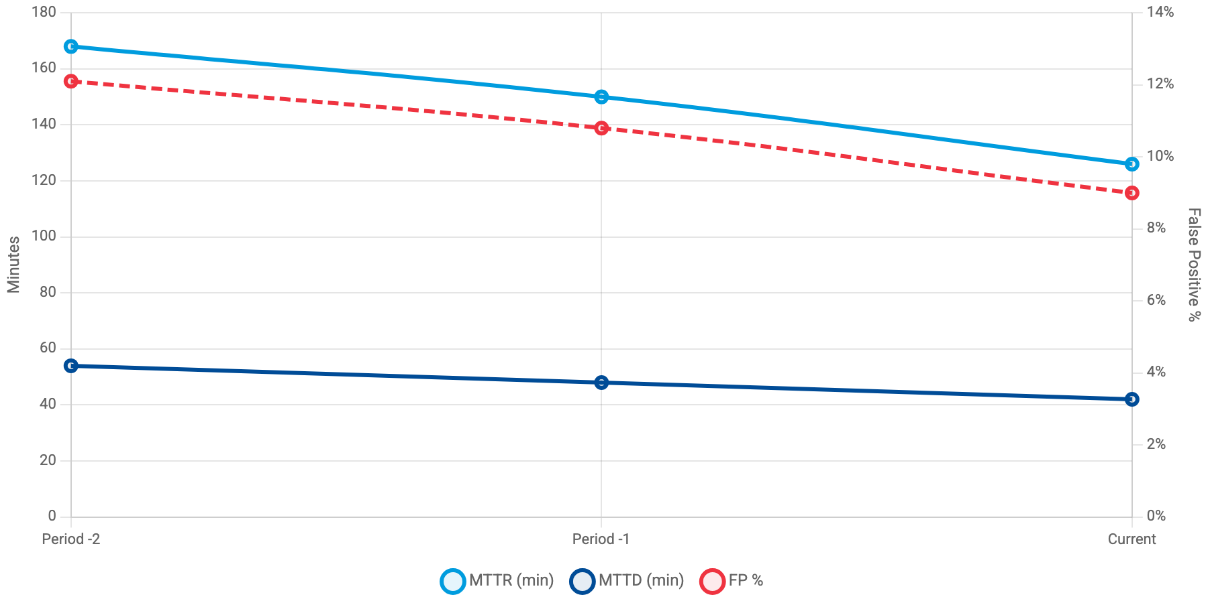
ESCALATION REPORT
CRITICAL START
8
Getting Better Every Period
MTTR (blue) | MTTD (navy) | FP% (red dashed)
MTTR decreased 25% to 126 minutes, MTTD improved 22% to 42 minutes
JANUARY 2026
©2025 CRITICAL START
EBR

Slide 9
ESCALATION REPORT
CRITICAL START
9
Industry Comparison
Metric
Your Performance
Industry Average
Difference
MTTR (minutes)
126
192
34% Better
MTTD (minutes)
42
66
36% Better
Incidents/Day
8.9
11.4
22% Better
Outperforming Industry Benchmarks
Faster response, better detection, and lower risk—exceeding standards across all metrics.
JANUARY 2026
©2025 CRITICAL START
EBR

Slide 10
ESCALATION REPORT
CRITICAL START
10
Response & Detection Quality
Containment Rate
98%
True Threat
Signal Fidelity
262 of 267
31.4%
91%
Playbook Automation
86%
229 incidents
False Positive
Client-Validated
9.0%
86.9%
Analyst Escalation
14%
38 incidents
Signal quality improved: FP rate at 9.0% with 98% containment
JANUARY 2026
©2025 CRITICAL START
EBR

Slide 11
ESCALATION REPORT
CRITICAL START
11
Threat Landscape
Understanding the threats we're seeing and how we're adapting to protect your organization
JANUARY 2026
©2025 CRITICAL START
EBR

Slide 12
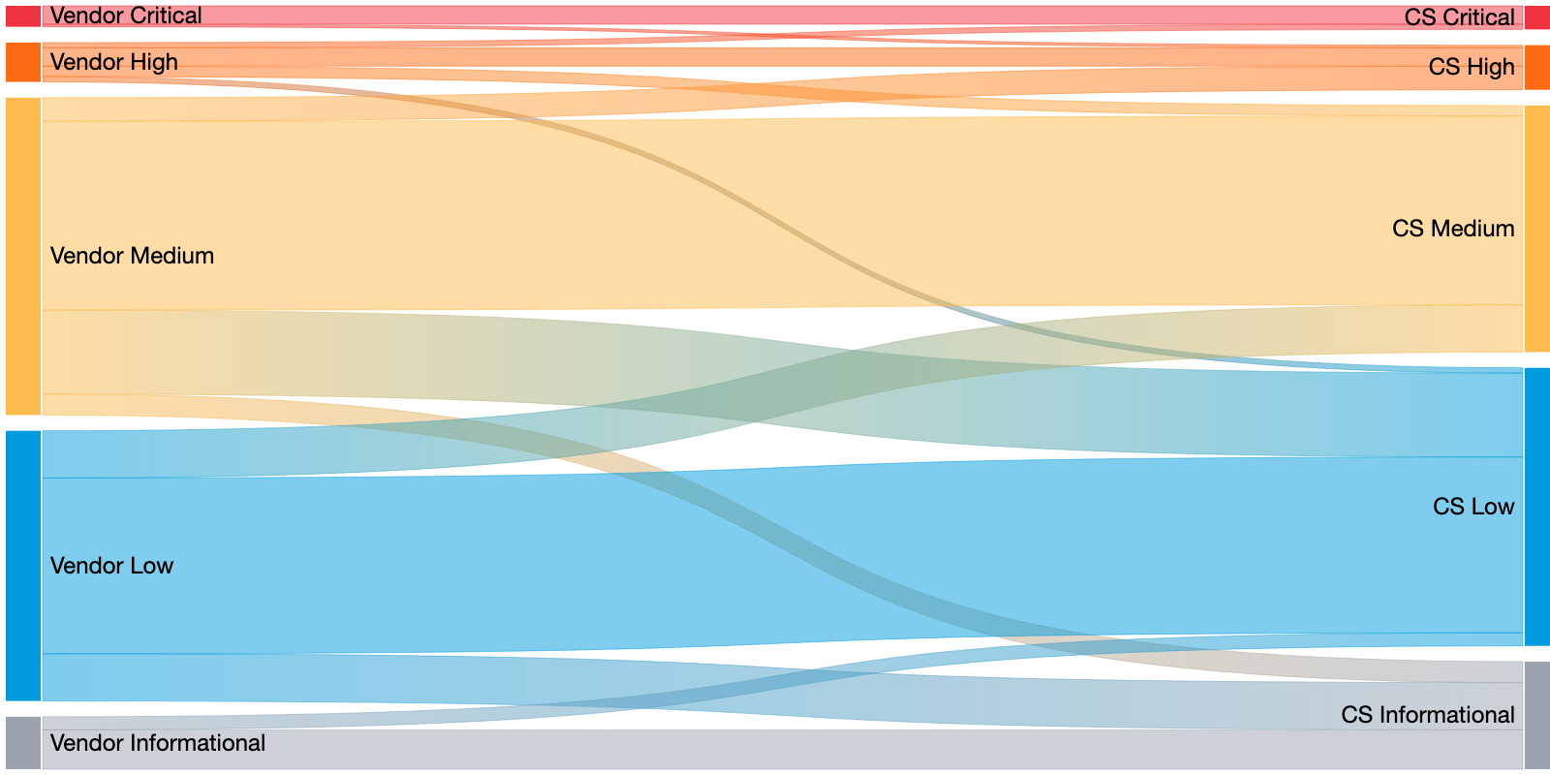
ESCALATION REPORT
CRITICAL START
12
Severity Alignment Flow
Vendor-reported criticality vs. Critical Start adjudication
267 escalations
34
65
168
Upgraded
De-escalated
Aligned
Source: Vendor Severity (col 45) vs. Current Priority (col 13)
JANUARY 2026
©2025 CRITICAL START
EBR
• 34 escalations upgraded (12.7%) - CS raised severity based on business impact
• 65 escalations de-escalated (24.3%) - CS reduced noise from vendor over-classification

Slide 13
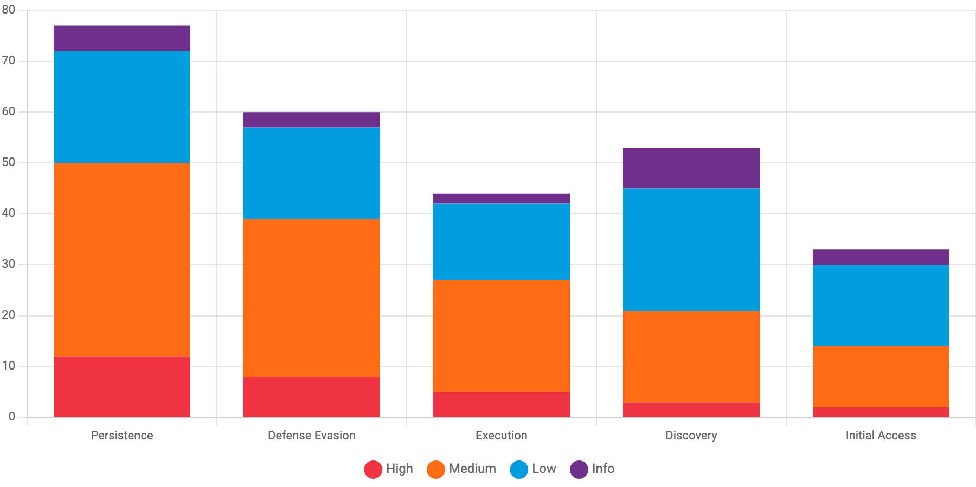
ESCALATION REPORT
CRITICAL START
13
Threat & Detection Sources
Palo Alto Cortex XDR
FP: 11.2%
189 incidents (70.8%)
Microsoft Sentinel
FP: 5.8%
52 incidents (19.5%)
High | Medium | Low | Info
CrowdStrike Falcon
FP: 7.7%
Persistence: 77 escalations, 12 high-severity
26 incidents (9.7%)
Tuning opportunity: Palo Alto Cortex XDR at 11.2% FP rate
JANUARY 2026
©2025 CRITICAL START
EBR

Slide 14
ESCALATION REPORT
CRITICAL START
14
Insights & Continuous Improvement
How we're evolving our partnership to advance your security maturity
JANUARY 2026
©2025 CRITICAL START
EBR

Slide 15
ESCALATION REPORT
CRITICAL START
15
Prioritized Improvement Plan
HIGH
Item 1 - Detection Tuning
Palo Alto Cortex XDR false positive rate is 11.2%, exceeding the 10.0% threshold
Owner: CS SOC + Lennar Security Team | Target: Next 30 days
Expected Impact: Reduce escalations by ~20%
MEDIUM
Item 2 - Automation Opportunity
Manual escalations at 14% exceed 12% target. 38 incidents required analyst judgment
Owner: CS SOC Engineering | Target: Next 60 days
Expected Impact: Reduce manual review burden
HIGH
Item 3 - Threat Focus
JANUARY 2026
©2025 CRITICAL START
EBR
Persistence + Defense Evasion account for 67% of high-severity incidents
Owner: Joint - CS Threat Intel + Lennar | Target: Ongoing
Focus Areas for Continuous Improvement
Three targeted actions to reduce noise, improve detection, and strengthen your security posture.
Expected Impact: Improved detection of advanced threats

Slide 16
ESCALATION REPORT
CRITICAL START
16
Operational Coverage
158
Collaboration Quality
2.3
Average Touches
per incident
After-Hours Escalations
72%
Client Participation
with client input
129 weeknights · 29 weekends
744 hours coverage · 86% auto-routed
21%
Client-Led Closures
closed by team
Continuous protection: 158 off-hours incidents handled with 72% client engagement
JANUARY 2026
©2025 CRITICAL START
EBR

Slide 17
ESCALATION REPORT
CRITICAL START
17
Forward Direction
Strategic recommendations to strengthen your security posture and maximize partnership value
JANUARY 2026
©2025 CRITICAL START
EBR

Slide 18
ESCALATION REPORT
CRITICAL START
18
Key Takeaways: This Period
✓
34% faster response than industry peers—threats are contained before spreading
✓
100% threat containment with zero breaches this period across 11 true positive incidents
✓
Millions in modeled cost exposure avoided through proactive security operations
✓
158 after-hours escalations handled seamlessly with 86% automation
JANUARY 2026
©2025 CRITICAL START
EBR
Bottom Line
Faster response, complete containment, measurable value—your security investment is delivering.

Slide 19
ESCALATION REPORT
CRITICAL START
19
Looking Ahead
Next Period Targets
✓ Trim Palo Alto XDR false positives from 11.2% to 10% threshold (~4 fewer escalations)
✓ Reduce manual escalations from 38 (14%) to 32 or fewer (12% target)
Strategic Focus
✓ Proactive hunts targeting Persistence and Defense Evasion tactics
✓ Additional playbook coverage for analyst-escalated scenarios
Your Partnership
Questions? Your Customer Success Manager is here to help.
Report generated: November 5, 2025 | Data sources: Escalation Details Report
JANUARY 2026
©2025 CRITICAL START
EBR
Strategic Path Forward
Targeted recommendations to strengthen your security posture and maximize partnership value.

Slide 20
ESCALATION REPORT
CRITICAL START
20
Thank You
Questions? We're here to help.
Your Customer Success Manager
support@criticalstart.com
www.criticalstart.com
Report Date: November 5, 2025
JANUARY 2026
©2025 CRITICAL START
EBR

