Slide 1
Natural-Language Queries Against Our EDW
A proof-of-concept, and what it tells us about where we go next
EDW Architecture Review
Presented to: Director, Architect, Engineers, QA
30 minutes + 10-minute live demo
RSCS - EDW Natural-Language Query POC
1 / 14

Slide 2
Agenda
1
The problem we are trying to solve
2
Today's EDW - where we are
3
The vision - Gold and Platinum in Microsoft Fabric
4
The POC - what I built and why
5
Live demo - 3 questions, easy to hard
6
The real future - Fabric Data Agents + Azure OpenAI
7
What I want from you today
RSCS - EDW Natural-Language Query POC
2 / 14

Slide 3
The problem
Our data is rich. Access is not.
Learning curve
HR says it takes roughly two years of experience before a new analyst can confidently talk about our data model. That is two years of onboarding tax on every new hire.
Gatekeeping bottleneck
Business users with questions file tickets. Engineers write SQL. Reports get built. A 10-minute question becomes a 3-day turnaround.
Reports don't cover everything
Power BI reports answer the top 80%. The remaining 20% - the ad-hoc, one-off, 'what if' questions - fall through the cracks.
RSCS - EDW Natural-Language Query POC
3 / 14

Slide 4
Today's EDW
Medallion architecture on SQL Server 2022 and SSAS
Bronze
Silver
Gold
Platinum
Raw ingest
Cleansed, conformed
Star schema on SQL Server 2022
SSAS OLAP cubes
Consumers
Power BI • Excel • SSMS ad-hoc • Tickets to the EDW team
What is not in this picture
A way for someone to ask a question in plain English and get an answer.
Every path to the data still requires SQL, DAX, or a filed ticket.
RSCS - EDW Natural-Language Query POC
4 / 14

Slide 5
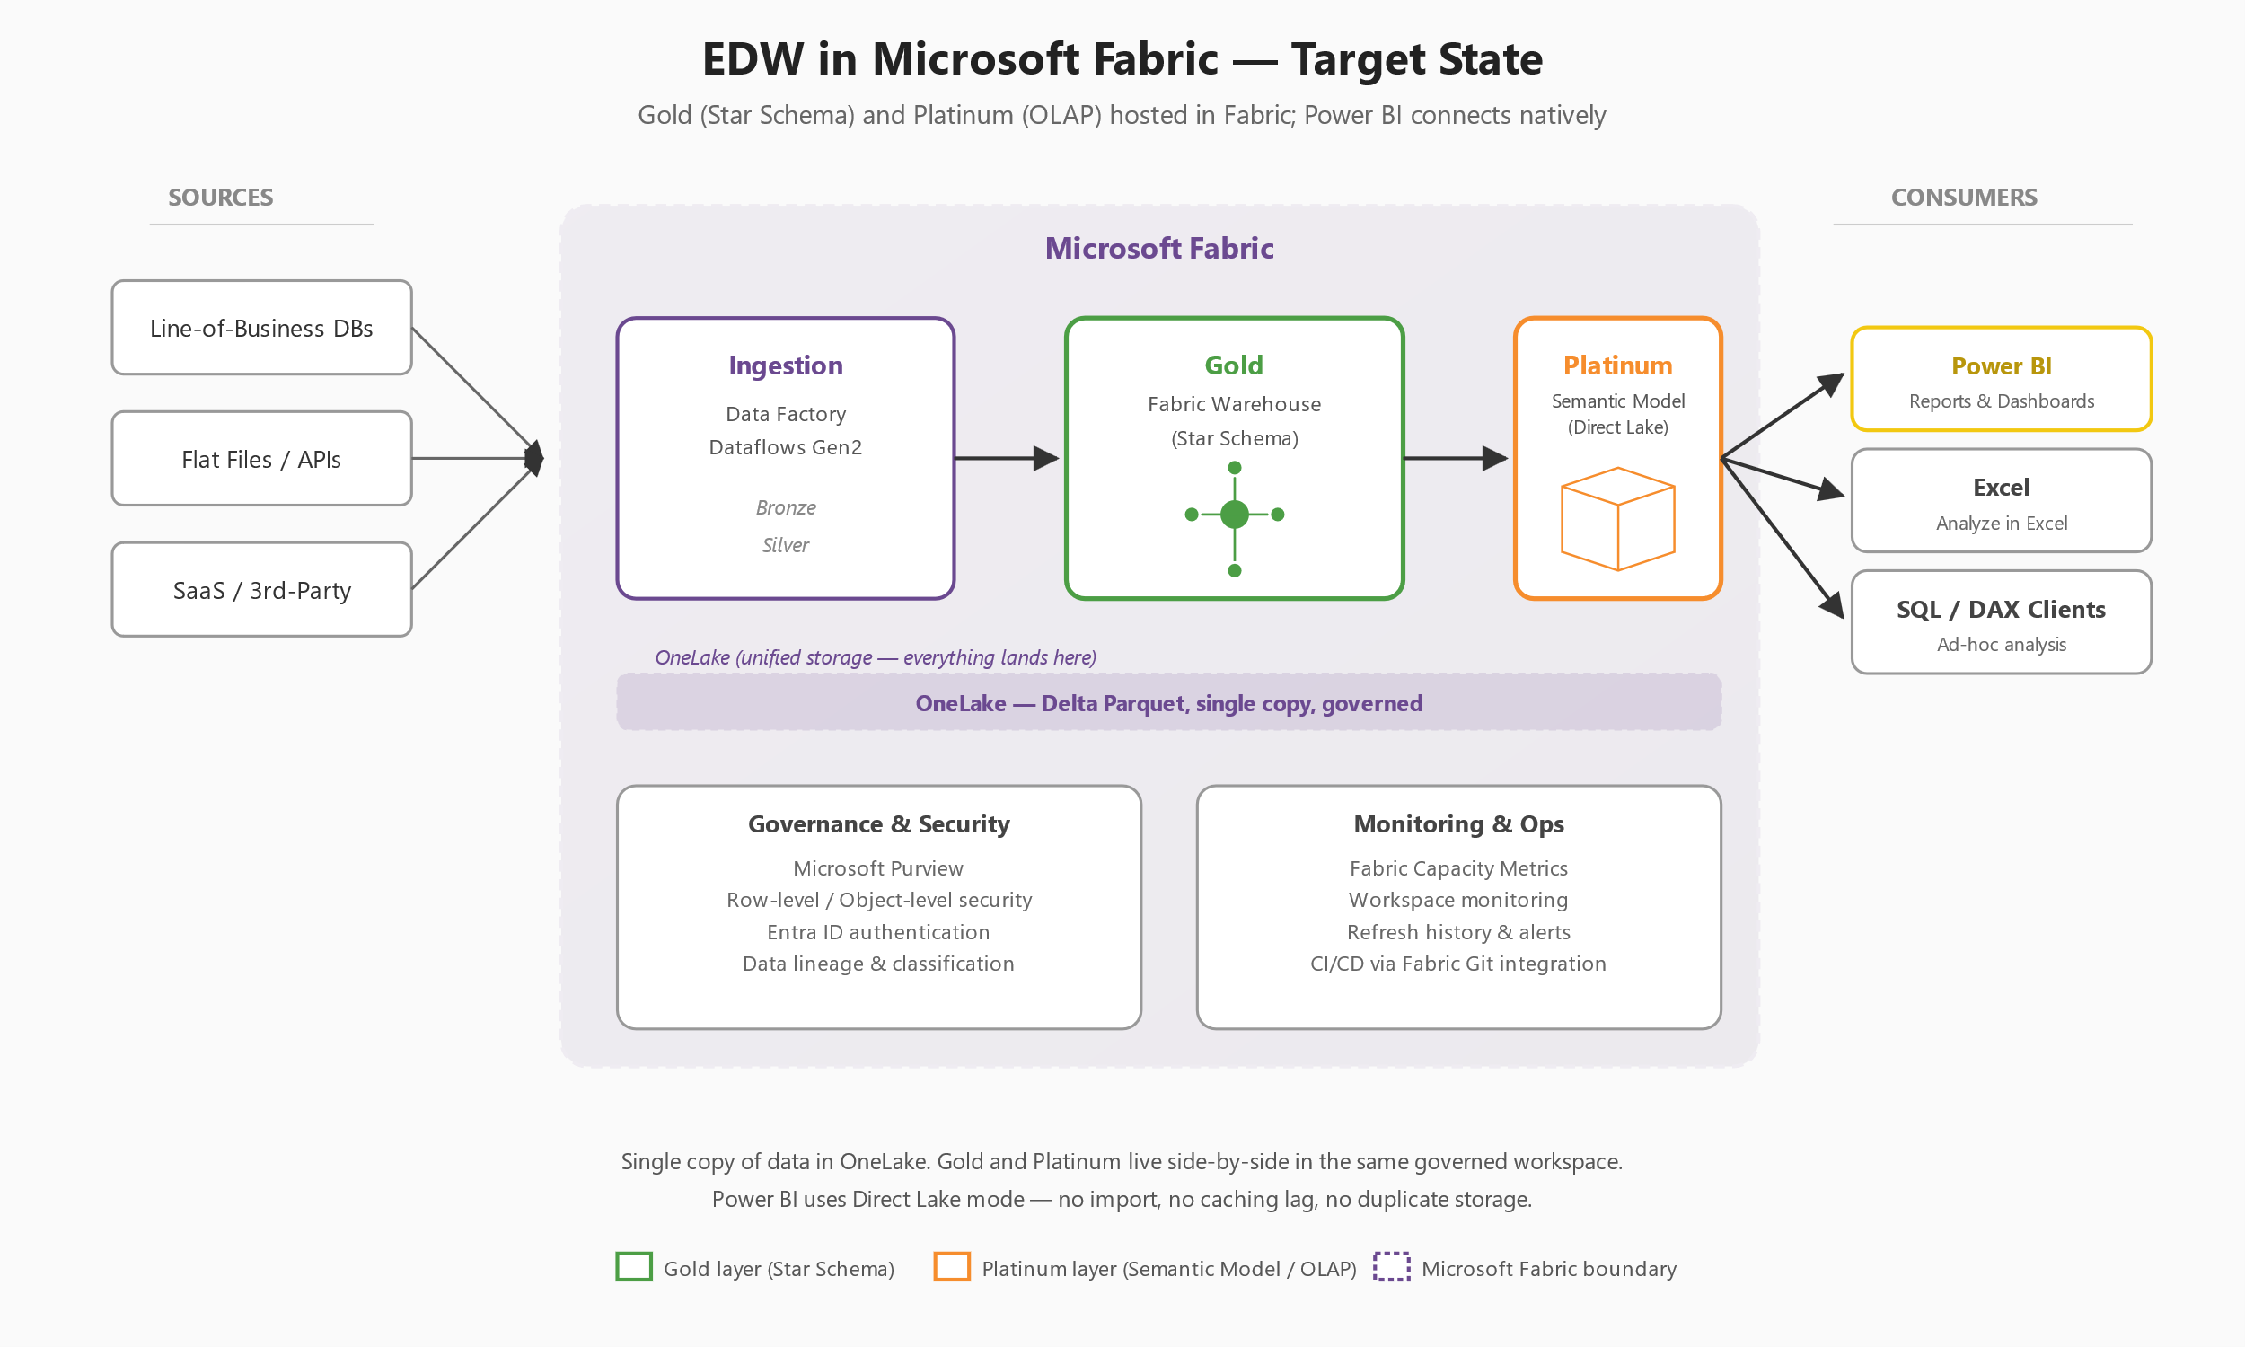
The vision - Gold and Platinum in Microsoft Fabric
The plan getting the most attention today: lift Gold and Platinum into Fabric; Power BI connects natively.
RSCS - EDW Natural-Language Query POC
5 / 14

Slide 6
Why Fabric - and why it is a hard sell
What Fabric buys us
Why it is hard to sell
•
OneLake - one governed copy of data, no duplication
•
Licensing cost - capacity SKUs are not cheap
•
Direct Lake - Power BI without import lag or refresh windows
•
Migration risk - moving Gold and Platinum is real work
•
Built-in governance via Purview and Entra ID
•
Team ramp-up - new tooling, new monitoring, new CI/CD
•
Unlocks Fabric Data Agents + Azure OpenAI for free
•
Perceived as 'just another rebrand' of synapse/PBI Premium
•
CI/CD through Fabric Git integration
•
No compelling AI story yet - until today
The missing pitch
Fabric's AI story is the strongest argument no one is making yet. Data Agents and Azure OpenAI natively grounded on our own semantic model change the conversation from 'migration project' to 'capability unlock'. That is what this POC is meant to show.
RSCS - EDW Natural-Language Query POC
6 / 14

Slide 7
The POC - what I built
A .NET 10 REST service that takes a plain-English question and returns generated T-SQL + a plain-English answer.
1. Question
2. Schema
3. Generate SQL
4. Safety check
5. Execute
6. Synthesize
HTTP POST
sys.* catalog + FK chains
Local LLM (Ollama)
SELECT-only guardrail
Read-only transaction
LLM to plain English
Design principles
Schema-agnostic
No table names, column names, or join hints in code or config. Point it at any SQL Server database.
FK chain walking
Annotates columns with reachable terminal tables - solves multi-hop join hallucinations generically.
Two-model pipeline
One model generates SQL, a second model synthesizes the human answer - each tuned for its job.
3-attempt retry
If generated SQL fails to execute, regenerate with the error message in the next prompt.
Read-only
SELECT-only regex guard. Blocked keyword list. Read-only transaction. No caching, no history, no faking.
RSCS - EDW Natural-Language Query POC
7 / 14

Slide 8
Before the demo - things you should know
It will be slow
A 7B-parameter model running on 8 GB of VRAM on a workstation. Expect 30-90 seconds per question. Azure OpenAI does this in 2-4 seconds.
It will sometimes fail
Local models hallucinate. The safety guard catches destructive SQL. The retry loop recovers from most execution errors. Some questions still won't land cleanly.
It is not a replacement for reports
This is a research aid and a learning aid. The SQL it returns helps users understand how to ask their own questions. Decisions should still be grounded in reviewed reports.
It is a learning shortcut
Two-year ramp on our data model? This lets a new hire ask 'what tables do I join to find X' and get a working answer today.
RSCS - EDW Natural-Language Query POC
8 / 14

Slide 9
Live demo - three questions
Each question is pre-loaded in a Postman tab. I'll also take one question from the audience.
Easy
"How many products do we sell?"
Single table, single aggregate. Validates the pipeline end-to-end.
Medium
"What are our top 5 product categories by total sales amount?"
Multi-table join, GROUP BY, ORDER BY, TOP. This is the FK chain walking test.
Hard
"Which resellers had the highest year-over-year sales growth between 2012 and 2013?"
Date arithmetic, self-join or CTE, percentage calculation, filtering. The stress test.
Plus one audience question - bring your best AdventureWorks curveball.
RSCS - EDW Natural-Language Query POC
9 / 14

Slide 10
DEMO
Switch to Postman
approx. 10 minutes
RSCS - EDW Natural-Language Query POC
10 / 14

Slide 11
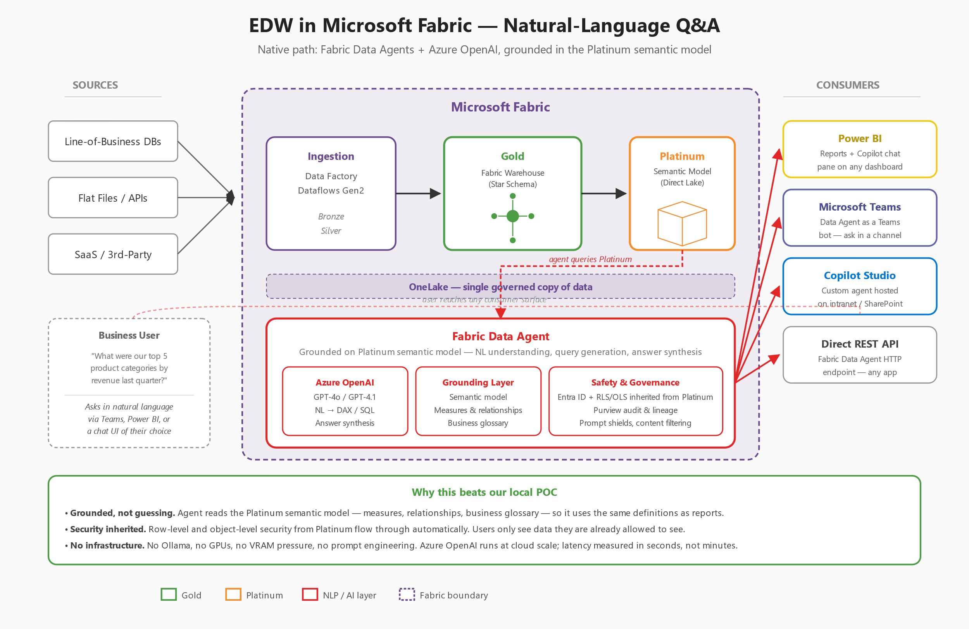
The real future - native Fabric Data Agents
Everything the POC does, but grounded on the Platinum semantic model and powered by Azure OpenAI.
RSCS - EDW Natural-Language Query POC
11 / 14

Slide 12
POC vs. the Fabric-native path
Dimension
Today's POC
Fabric Data Agent
Model
Local Ollama 7B
Azure OpenAI GPT-4o
Grounding
Raw schema + FK walk
Platinum semantic model + glossary
Latency
30-90 seconds
2-4 seconds
Security
Connection-string user
Entra ID + RLS/OLS inherited
Audit and lineage
None
Purview, built-in
Hosting
Your workstation
Microsoft-managed
Maintenance
Me
Near zero
Bottom line
The POC answers 'is this possible?' - yes. Fabric answers 'is this supportable?' - also yes, and without any of the infrastructure we had to build by hand. Every bullet on the right is checked by Microsoft, not by us.
RSCS - EDW Natural-Language Query POC
12 / 14

Slide 13
An honest note on MCP
VSLive! sent me down a rabbit hole. Here is where I landed.
What MCP actually is
A standard transport (JSON-RPC) that lets external LLM clients - Claude Desktop, VS Code Copilot, Cursor - invoke tools and read data from proprietary systems. The client is an AI assistant someone else built.
What I built
A REST service that uses a local LLM to translate questions into SQL. No external LLM client is involved. Nothing on the other side of the wire speaks MCP to us. The 'MCP' in the project name is vocabulary, not protocol.
So do we need MCP for this? No.
For business-user self-service BI, MCP is the wrong layer. The POC works; it just needs a rename - not a rewrite. See REFACTOR.md for the mechanical change set.
Where MCP would actually shine
If we wanted our EDW queryable from inside Claude, VS Code, or Cursor for developers and analysts - that is a real, legitimate MCP use case. Different audience than this project, but worth keeping on the roadmap.
RSCS - EDW Natural-Language Query POC
13 / 14

Slide 14
What I want from you today
Not a go/no-go. A gut check and a direction.
Feedback
Does this look like something our users would actually use? Where does it feel fragile? What would you not trust?
Use cases
Which corners of our data model would benefit most? Where is the 2-year learning curve hurting us right now?
The ask
Help me build the case for Fabric. If the AI story moves the needle for your stakeholders, say so - that is the argument I am missing.
Clear lane
Agreement that this is a research/learning aid, not a replacement for governed reports. Decisions still come from reviewed BI.
Thank you - questions?
RSCS - EDW Natural-Language Query POC
14 / 14

