Slide 1


Airbnb Property Investment
FOR DISCUSSION
Insights & Recommendation Report
Saurabh Dev
Krish Pillai
Durga Prasad
Team A – TDAI DA360 Live

Slide 2
Context This report aims to find the best neighborhood clusters in Washington D.C. for Airbnb property investment.
Background
Objective
Data & Assumption
Client want to invest in Airbnb properties in Washington DC area. He wants to know;
Whether it would be a good investment
What neighborhoods to focus
What type of properties are most suitable
Objective 1: Is Washington DC a good place to invest
Objective 2: If yes, what is the best demographics for investment
Object 3: Which neighborhoods in Washington DC has the most listings
Dataset:
The dataset is from scraped data of listings from Airbnb.
The dataset has 3724 rows with one listing each.
The dataset shows information such as a unique listing id, location, price, review ratings etc.
The dataset needs to be cleaned, and assumptions needs to be made to find out revenue generated.
Assumptions:
Each booking always has two guests, unless the listing only accommodates one.
The booking is always for the minimum number of days allowed.
Only half of the bookings generate a review.
Column to be used: Column BF, “price:” The price for a one-night stay

Slide 3
Approach A 5-step approach was taken to develop this report starting from defining the question to visualizing the data.
Focus of today’s presentation
Define
Collect
Clean
Analyze
Present & Share
Client want to invest in Airbnb properties in Washington DC area. He wants to know;
Whether it would be a good investment
What neighborhoods to focus
What type of properties are most suitable
The dataset is from scraped data of listings from Airbnb.
The data has 3724 rows with one listings each.
The dataset shows information such as a unique listing id, location, price, review ratings etc.
The dataset has missing values in columns like reviews, and some duplicate values. Therefore, the data needs to be cleaned.
The data was analysed from different angles to derive various insights;
Actual and potential revenues of the listings were calculated based on assumptions detailed before.
A revenue score was assigned to find out neighbourhoods that generate revenue closer to potential revenues
Average revenue per property and revenue score was used to identify potential investments.
The following final insights are shared with the client;
The growth in the area in the last 12 months.
Potential of growth based on current revenue and potential earnings
Best neighbourhoods and property types of investments
Neighbourhood with the most listings

Slide 4
Recommendation Summary Based on our analysis, we propose the following recommendations
1
Enter the Washington DC market
The market shows significant growth in listings and revenue in the last 12 months.
Competition is lesser in Washington DC for Airbnb properties
2
Cleveland Park, Woodley Park, Massachusetts Avenue Heights, Woodland-Normanstone Terrace
This neighborhood has the highest revenue generation per property
Their current earnings are near full potential earnings
3
Apartments & Condos are the best property types to invest
They generate the most revenue
They sit closer to their full earning potential
Potential earnings are maximum earnings that a property can get if booked 365 days a years

Slide 5
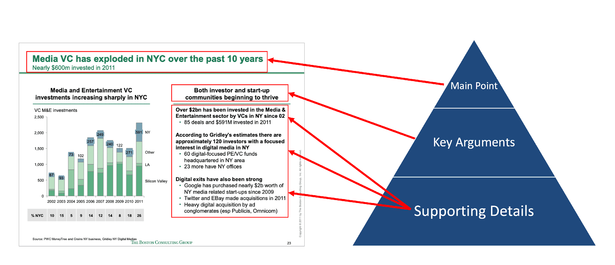
Recommendation #1 Client should enter the Washington DC Airbnb market
FOR GUIDANCE ONLY
Start with their main idea in the title
Last 12 Months Growth In Washington DC Area
The number of listings in the area increased from 102 to 227 in the last 12 months. That’s a growth of 122.55%.
The number of bookings has increased from 368 per month to 2496. That’s a growth of 578.26%.
Then they break that main idea into two component parts
By breaking the title into two different components (i.e. key arguments), it makes it easier for the audience to understand how we reached the main conclusion
Then taking it one level deeper, they’ve broken each of the two subtitles out further with additional bullet points and a chart. In other words, the bullet points and the chart each serve as supporting points that provide support for the key arguments, which (wait for it) provide support for the main idea.
Bar Chart - Use this when you’re trying to show how categories compare with each other (e.g. compare sales between companies)
Column Chart - This is also good for comparing categories, but is best when comparing these categories over time (e.g. compare sales between years)
Pie Chart - Use this when you’re trying to compare a category or group of categories with the total (e.g. 80% of smartphone users prefer to use a case). Do not use this to compare the categories with each other.
Line Chart - This chart is good for showing changes over time, especially changes that do not “reset” after each period (e.g. show headcount by year)
Scatter Plot - Use this chart to show correlation between two variables (e.g. show that higher income is correlated with higher overall spend)
Draw attention to the important parts of this slide:
Red circles/lines for highlighting important parts of the slides
Bold numbers to highlight them
Bold keywords in the bullet points help draw attention to the important text
The title is a larger font than all the other text on the slide, and it has a big blue line underneath to separate it from the rest of the text

Slide 6
Recommendation #1 Client should enter the Washington DC Airbnb market
FOR GUIDANCE ONLY
Start with their main idea in the title
Last 12 Months Growth In Washington DC Area
The total revenue generated by the properties increased from $77912 to $515210 in the last 12 months.
This growth shows that there is a consistent increase in demand even with increasing number of listings.
Then they break that main idea into two component parts
By breaking the title into two different components (i.e. key arguments), it makes it easier for the audience to understand how we reached the main conclusion
The consistent increase in bookings and revenue irrespective of the increase in the no. of listings shows that Washington DC has high potential for growth.
Then taking it one level deeper, they’ve broken each of the two subtitles out further with additional bullet points and a chart. In other words, the bullet points and the chart each serve as supporting points that provide support for the key arguments, which (wait for it) provide support for the main idea.
Bar Chart - Use this when you’re trying to show how categories compare with each other (e.g. compare sales between companies)
Column Chart - This is also good for comparing categories, but is best when comparing these categories over time (e.g. compare sales between years)
Pie Chart - Use this when you’re trying to compare a category or group of categories with the total (e.g. 80% of smartphone users prefer to use a case). Do not use this to compare the categories with each other.
Line Chart - This chart is good for showing changes over time, especially changes that do not “reset” after each period (e.g. show headcount by year)
Scatter Plot - Use this chart to show correlation between two variables (e.g. show that higher income is correlated with higher overall spend)
Draw attention to the important parts of this slide:
Red circles/lines for highlighting important parts of the slides
Bold numbers to highlight them
Bold keywords in the bullet points help draw attention to the important text
The title is a larger font than all the other text on the slide, and it has a big blue line underneath to separate it from the rest of the text

Slide 7
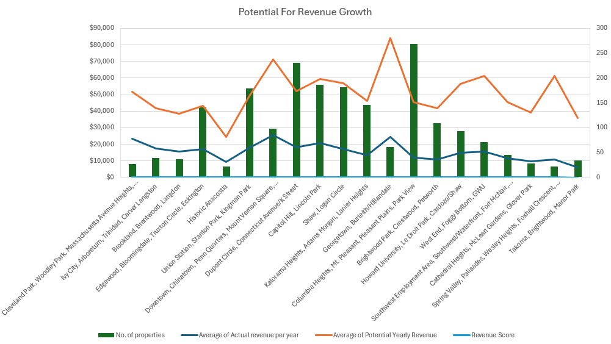
Recommendation #1 Client should enter the Washington DC Airbnb market
FOR GUIDANCE ONLY
Start with their main idea in the title
Earning Potential for Neighborhoods
Most if the neighborhoods are not earning as much as they can. This shows that there is untapped potential for growth.
Then they break that main idea into two component parts
By breaking the title into two different components (i.e. key arguments), it makes it easier for the audience to understand how we reached the main conclusion
Then taking it one level deeper, they’ve broken each of the two subtitles out further with additional bullet points and a chart. In other words, the bullet points and the chart each serve as supporting points that provide support for the key arguments, which (wait for it) provide support for the main idea.
Bar Chart - Use this when you’re trying to show how categories compare with each other (e.g. compare sales between companies)
Column Chart - This is also good for comparing categories, but is best when comparing these categories over time (e.g. compare sales between years)
Pie Chart - Use this when you’re trying to compare a category or group of categories with the total (e.g. 80% of smartphone users prefer to use a case). Do not use this to compare the categories with each other.
Line Chart - This chart is good for showing changes over time, especially changes that do not “reset” after each period (e.g. show headcount by year)
Scatter Plot - Use this chart to show correlation between two variables (e.g. show that higher income is correlated with higher overall spend)
Draw attention to the important parts of this slide:
Red circles/lines for highlighting important parts of the slides
Bold numbers to highlight them
Bold keywords in the bullet points help draw attention to the important text
The title is a larger font than all the other text on the slide, and it has a big blue line underneath to separate it from the rest of the text

Slide 8
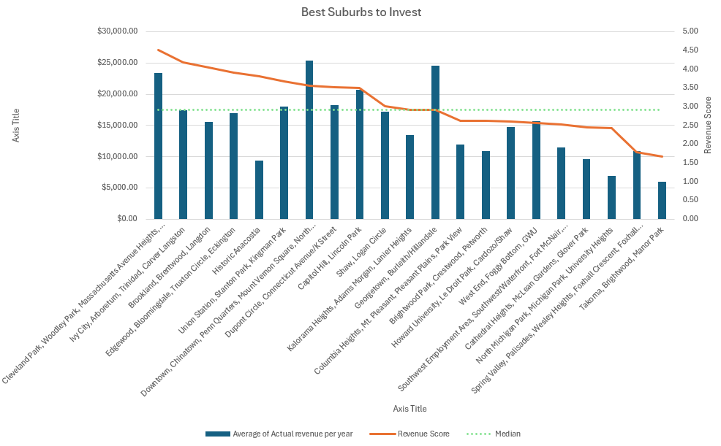
Recommendation #2 Cleveland Park, Woodley Park, Massachusetts Avenue Heights, Woodland-Normanstone Terrace are the best neighborhoods for investment
FOR GUIDANCE ONLY
Start with their main idea in the title
Earning Potential for Neighborhoods
A revenue score was calculated for each suburb out of 10, by dividing the current revenue with potential revenue.
Based on this score the neighbourhoods that earn near to their potential are identified.
The neighbourhoods that score above median score are good for investments.
Then they break that main idea into two component parts
By breaking the title into two different components (i.e. key arguments), it makes it easier for the audience to understand how we reached the main conclusion
Then taking it one level deeper, they’ve broken each of the two subtitles out further with additional bullet points and a chart. In other words, the bullet points and the chart each serve as supporting points that provide support for the key arguments, which (wait for it) provide support for the main idea.
Bar Chart - Use this when you’re trying to show how categories compare with each other (e.g. compare sales between companies)
Column Chart - This is also good for comparing categories, but is best when comparing these categories over time (e.g. compare sales between years)
Pie Chart - Use this when you’re trying to compare a category or group of categories with the total (e.g. 80% of smartphone users prefer to use a case). Do not use this to compare the categories with each other.
Line Chart - This chart is good for showing changes over time, especially changes that do not “reset” after each period (e.g. show headcount by year)
Scatter Plot - Use this chart to show correlation between two variables (e.g. show that higher income is correlated with higher overall spend)
Draw attention to the important parts of this slide:
Red circles/lines for highlighting important parts of the slides
Bold numbers to highlight them
Bold keywords in the bullet points help draw attention to the important text
The title is a larger font than all the other text on the slide, and it has a big blue line underneath to separate it from the rest of the text

Slide 9
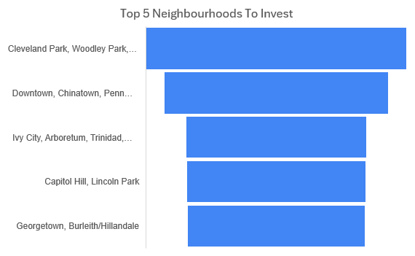
Recommendation #2 Cleveland Park, Woodley Park, Massachusetts Avenue Heights, Woodland-Normanstone Terrace are the best neighborhoods for investment
FOR GUIDANCE ONLY
Start with their main idea in the title
Top 5 Neighborhoods for Investments
A ‘top choice score’ was calculated by multiplying the current avg. earnings from a neighborhood with its ‘revenue score’.
This new score system helped to identify neighborhoods that are the best in terms of avg. revenue and closeness to their earning potential.
Then they break that main idea into two component parts
By breaking the title into two different components (i.e. key arguments), it makes it easier for the audience to understand how we reached the main conclusion
Then taking it one level deeper, they’ve broken each of the two subtitles out further with additional bullet points and a chart. In other words, the bullet points and the chart each serve as supporting points that provide support for the key arguments, which (wait for it) provide support for the main idea.
Bar Chart - Use this when you’re trying to show how categories compare with each other (e.g. compare sales between companies)
Column Chart - This is also good for comparing categories, but is best when comparing these categories over time (e.g. compare sales between years)
Pie Chart - Use this when you’re trying to compare a category or group of categories with the total (e.g. 80% of smartphone users prefer to use a case). Do not use this to compare the categories with each other.
Line Chart - This chart is good for showing changes over time, especially changes that do not “reset” after each period (e.g. show headcount by year)
Scatter Plot - Use this chart to show correlation between two variables (e.g. show that higher income is correlated with higher overall spend)
Draw attention to the important parts of this slide:
Red circles/lines for highlighting important parts of the slides
Bold numbers to highlight them
Bold keywords in the bullet points help draw attention to the important text
The title is a larger font than all the other text on the slide, and it has a big blue line underneath to separate it from the rest of the text

Slide 10
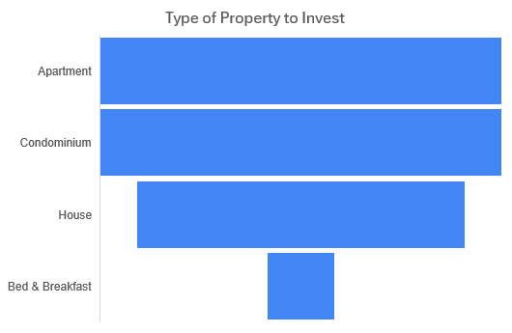
Recommendation #2 Cleveland Park, Woodley Park, Massachusetts Avenue Heights, Woodland-Normanstone Terrace are the best neighborhood group for investment
FOR GUIDANCE ONLY
Start with their main idea in the title
Top Property Types for Investments
The property types from top 5 neighborhoods listed in the previous slide was selected.
A ‘top choice score’ was calculated by multiplying the current avg. earnings from a property type with its ‘revenue score’.
This new score system helped to identify properties that are the best in terms of avg. revenue and closeness to their earning potential.
Then they break that main idea into two component parts
By breaking the title into two different components (i.e. key arguments), it makes it easier for the audience to understand how we reached the main conclusion
Then taking it one level deeper, they’ve broken each of the two subtitles out further with additional bullet points and a chart. In other words, the bullet points and the chart each serve as supporting points that provide support for the key arguments, which (wait for it) provide support for the main idea.
Bar Chart - Use this when you’re trying to show how categories compare with each other (e.g. compare sales between companies)
Column Chart - This is also good for comparing categories, but is best when comparing these categories over time (e.g. compare sales between years)
Pie Chart - Use this when you’re trying to compare a category or group of categories with the total (e.g. 80% of smartphone users prefer to use a case). Do not use this to compare the categories with each other.
Line Chart - This chart is good for showing changes over time, especially changes that do not “reset” after each period (e.g. show headcount by year)
Scatter Plot - Use this chart to show correlation between two variables (e.g. show that higher income is correlated with higher overall spend)
Draw attention to the important parts of this slide:
Red circles/lines for highlighting important parts of the slides
Bold numbers to highlight them
Bold keywords in the bullet points help draw attention to the important text
The title is a larger font than all the other text on the slide, and it has a big blue line underneath to separate it from the rest of the text

Slide 11
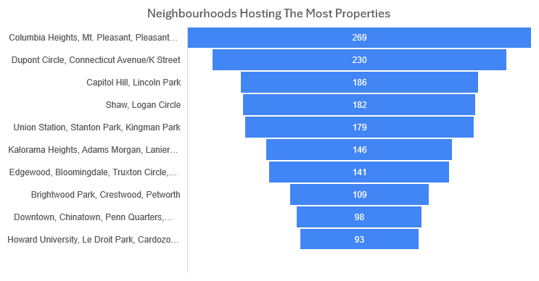
Prompt #3 Neighborhoods Hosting The Most Listings
FOR GUIDANCE ONLY
Start with their main idea in the title
Then they break that main idea into two component parts
By breaking the title into two different components (i.e. key arguments), it makes it easier for the audience to understand how we reached the main conclusion
Then taking it one level deeper, they’ve broken each of the two subtitles out further with additional bullet points and a chart. In other words, the bullet points and the chart each serve as supporting points that provide support for the key arguments, which (wait for it) provide support for the main idea.
Bar Chart - Use this when you’re trying to show how categories compare with each other (e.g. compare sales between companies)
Column Chart - This is also good for comparing categories, but is best when comparing these categories over time (e.g. compare sales between years)
Pie Chart - Use this when you’re trying to compare a category or group of categories with the total (e.g. 80% of smartphone users prefer to use a case). Do not use this to compare the categories with each other.
Line Chart - This chart is good for showing changes over time, especially changes that do not “reset” after each period (e.g. show headcount by year)
Scatter Plot - Use this chart to show correlation between two variables (e.g. show that higher income is correlated with higher overall spend)
Draw attention to the important parts of this slide:
Red circles/lines for highlighting important parts of the slides
Bold numbers to highlight them
Bold keywords in the bullet points help draw attention to the important text
The title is a larger font than all the other text on the slide, and it has a big blue line underneath to separate it from the rest of the text

Slide 12
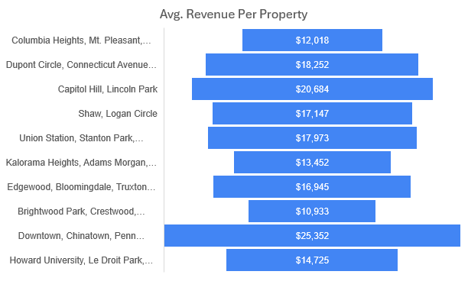
Prompt #3 Neighborhoods Hosting The Most Listings
FOR GUIDANCE ONLY
Start with their main idea in the title
Then they break that main idea into two component parts
By breaking the title into two different components (i.e. key arguments), it makes it easier for the audience to understand how we reached the main conclusion
Then taking it one level deeper, they’ve broken each of the two subtitles out further with additional bullet points and a chart. In other words, the bullet points and the chart each serve as supporting points that provide support for the key arguments, which (wait for it) provide support for the main idea.
Bar Chart - Use this when you’re trying to show how categories compare with each other (e.g. compare sales between companies)
Column Chart - This is also good for comparing categories, but is best when comparing these categories over time (e.g. compare sales between years)
Pie Chart - Use this when you’re trying to compare a category or group of categories with the total (e.g. 80% of smartphone users prefer to use a case). Do not use this to compare the categories with each other.
Line Chart - This chart is good for showing changes over time, especially changes that do not “reset” after each period (e.g. show headcount by year)
Scatter Plot - Use this chart to show correlation between two variables (e.g. show that higher income is correlated with higher overall spend)
Draw attention to the important parts of this slide:
Red circles/lines for highlighting important parts of the slides
Bold numbers to highlight them
Bold keywords in the bullet points help draw attention to the important text
The title is a larger font than all the other text on the slide, and it has a big blue line underneath to separate it from the rest of the text

Slide 13
Prompt #3 Neighborhoods Hosting The Most Listings
FOR GUIDANCE ONLY
Start with their main idea in the title
Then they break that main idea into two component parts
By breaking the title into two different components (i.e. key arguments), it makes it easier for the audience to understand how we reached the main conclusion
Then taking it one level deeper, they’ve broken each of the two subtitles out further with additional bullet points and a chart. In other words, the bullet points and the chart each serve as supporting points that provide support for the key arguments, which (wait for it) provide support for the main idea.
Bar Chart - Use this when you’re trying to show how categories compare with each other (e.g. compare sales between companies)
Column Chart - This is also good for comparing categories, but is best when comparing these categories over time (e.g. compare sales between years)
Pie Chart - Use this when you’re trying to compare a category or group of categories with the total (e.g. 80% of smartphone users prefer to use a case). Do not use this to compare the categories with each other.
Line Chart - This chart is good for showing changes over time, especially changes that do not “reset” after each period (e.g. show headcount by year)
Scatter Plot - Use this chart to show correlation between two variables (e.g. show that higher income is correlated with higher overall spend)
Draw attention to the important parts of this slide:
Red circles/lines for highlighting important parts of the slides
Bold numbers to highlight them
Bold keywords in the bullet points help draw attention to the important text
The title is a larger font than all the other text on the slide, and it has a big blue line underneath to separate it from the rest of the text

Slide 14
Appendix

Slide 15
Appendix A Data cleaning and quality check
Deleted 78 unwanted Columns
Columns containing URLs.
Columns containing long descriptions.
Columns containing single data or no data.
Columns containing data that add no value to our analysis.
Filtering and Further cleaning
Corrected some Typo errors in “city” and “state” column such as “Washington DC” in both city and state column.
Filtered out data only for “DC” state and “Washington” city.
Added Columns
Actual revenue per year, Potential Yearly Revenue , Is this a revenue generating property , Monthly Revenue , Revenue Score , Top choice score

Slide 16
Appendix B Data calculations
Assumptions
No. bookings per month = Twice the no. reviews per month.
Each booking stayed for a minimum night(s) available per listing.
Data Normalization
Each neighborhood revenue is normalized based on the number of listings.
Calculations
Actual revenue per year = ROUNDUP(2 X reviews_per_month) x price x min_nights x 12
Potential Yearly Revenue = price x 365
Revenue Score = (Actual revenue/potential revenue)x10
Top choice score = revenue score x avg. revenue of neighbourhoods
‹#›

