Slide 1
Classifier Calibration
MaVi Research Group Meeting
Miquel Perelló Nieto
19th January 2023

Slide 2
Classifier Calibration
What is classifier calibration?
Why is it important?
How to measure?
Are classifiers calibrated?
Calibration methods.
Conclusion.
Table of content

Slide 3
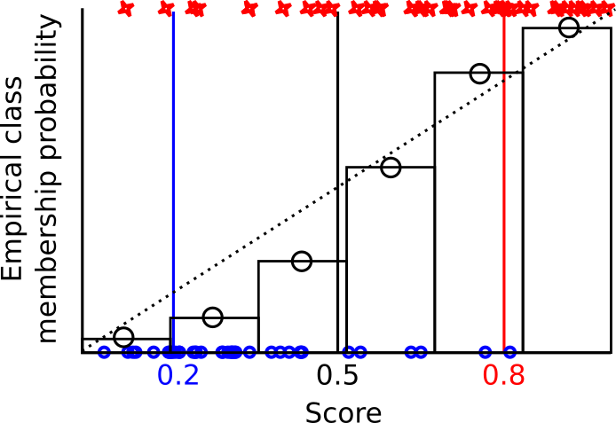
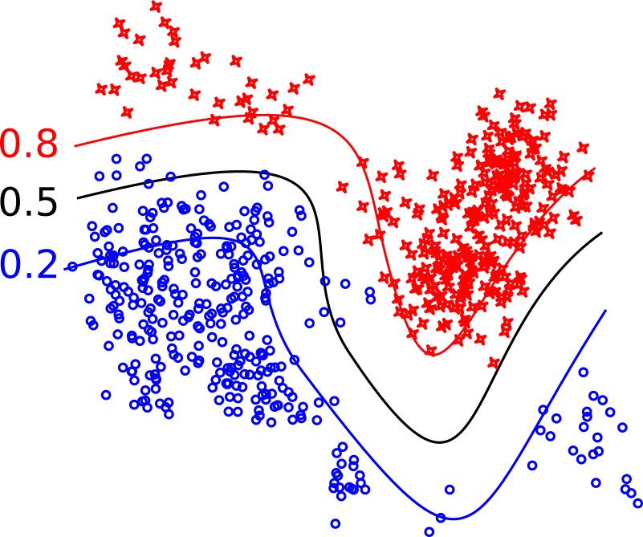
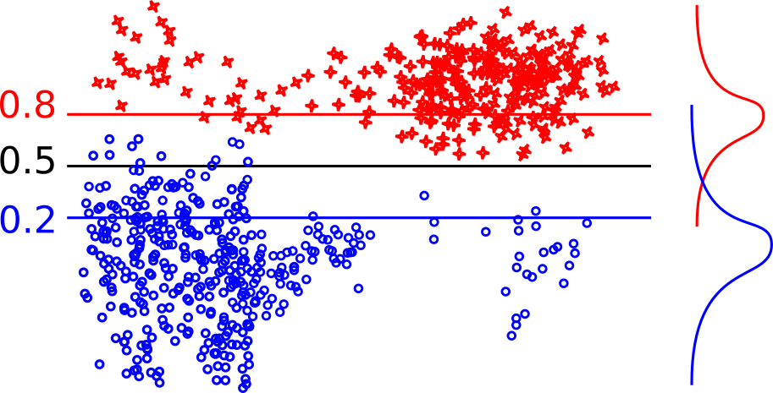

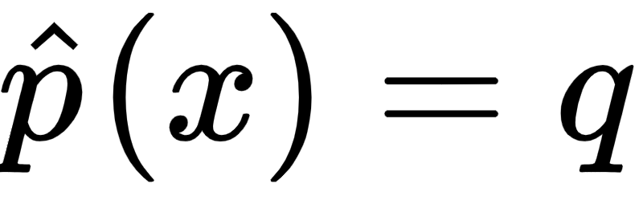

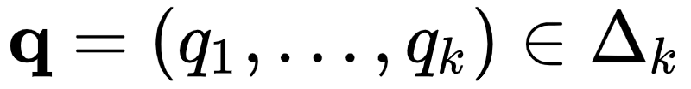
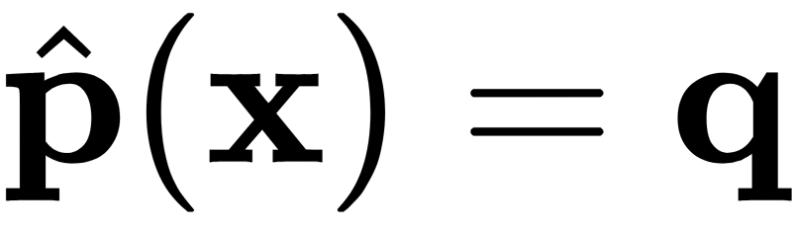
1. What is Classification Calibration?
(c) Reliability diagram
Deviation to diagonal indicates
miss-calibration
(a) Decision boundary and iso-hyperplanes of a probability estimator.
(b) Projection to an orthogonal vector
A probabilistic classifier is: (A) binary-calibrated if for any prediction q the proportion of positives among all instances x getting the same prediction are
(B) multiclass-calibrated if for any prediction vector , the proportions of classes among all possible instances x getting the same prediction are

Slide 4
2. Why is calibration important? Optimal decision making
Cost Matrix | Predicted True | P. False
Actual True | -1£ | 100£
Actual False | 50£ | 0£
Population proportion
50%
50%
Changes on costs
Changes on class proportions
It also allows the decision to abstain
Cost Matrix | Predicted True | P. False
Actual True | -10£ | 90£
Actual False | 40£ | -5£
Abstain
50£
30£
Population proportion
70%
30%

Slide 5
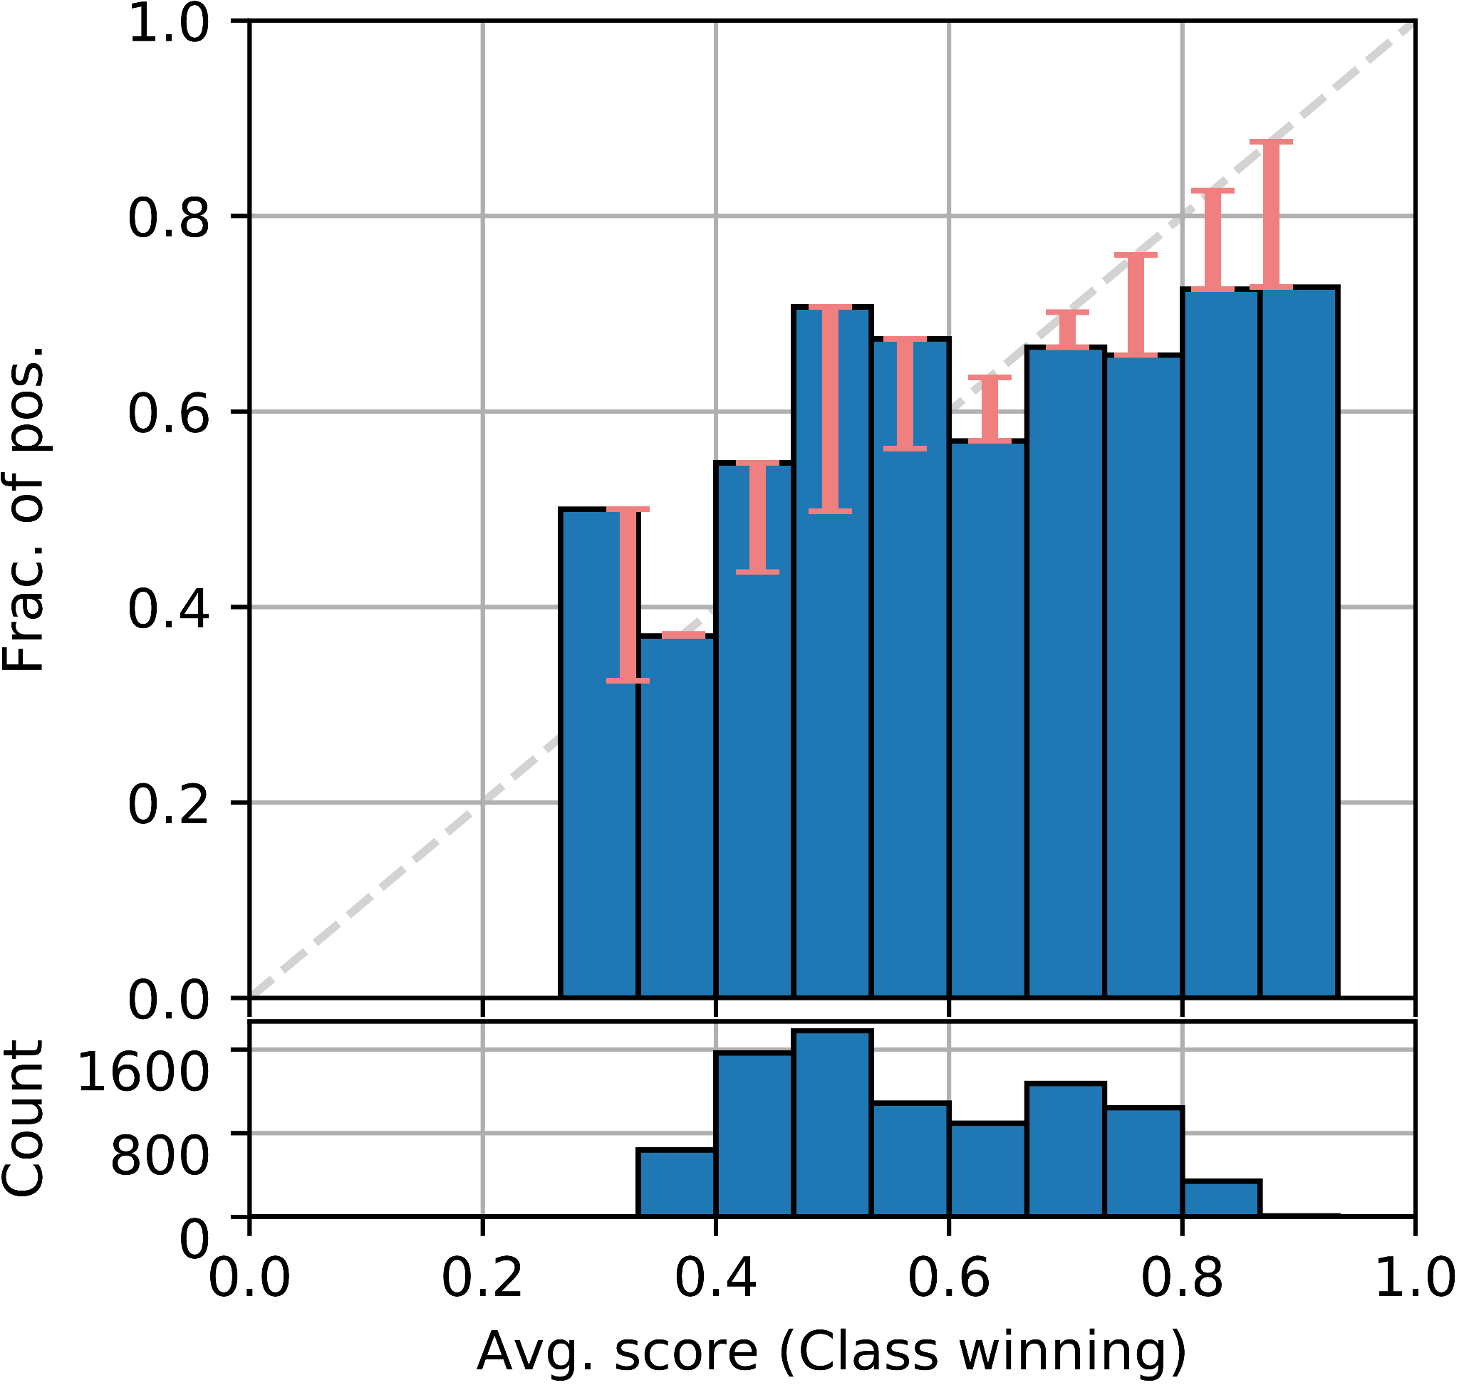


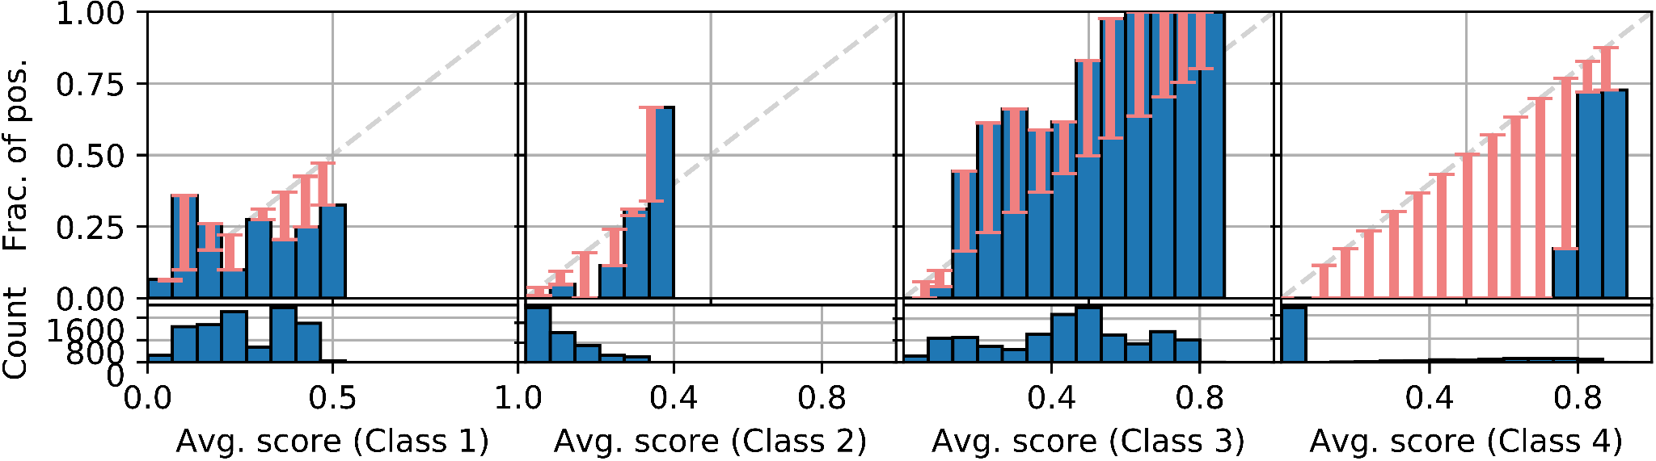
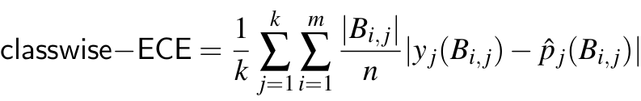
3. How to measure calibration?
Confidence-calibrated if
Confidence
Calibration Error
Maximum Calibration Error counterparts
Empirically measured as
Calibration Error
Per class
Classwise-calibrated if
Empirically measured as
Every proper loss is minimised by the canonical calibration function (eg. log-loss and Brier score).

Slide 6
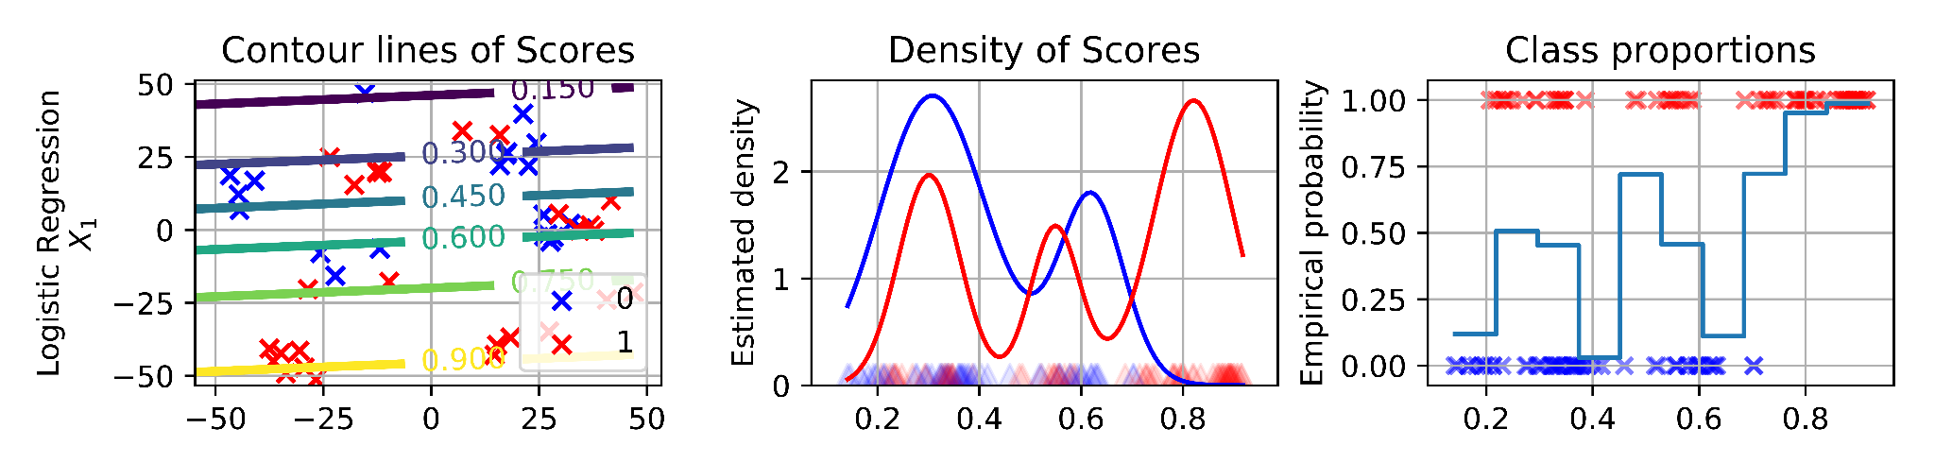
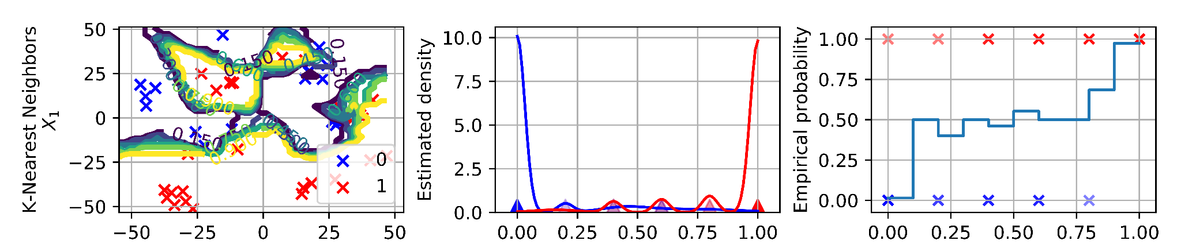
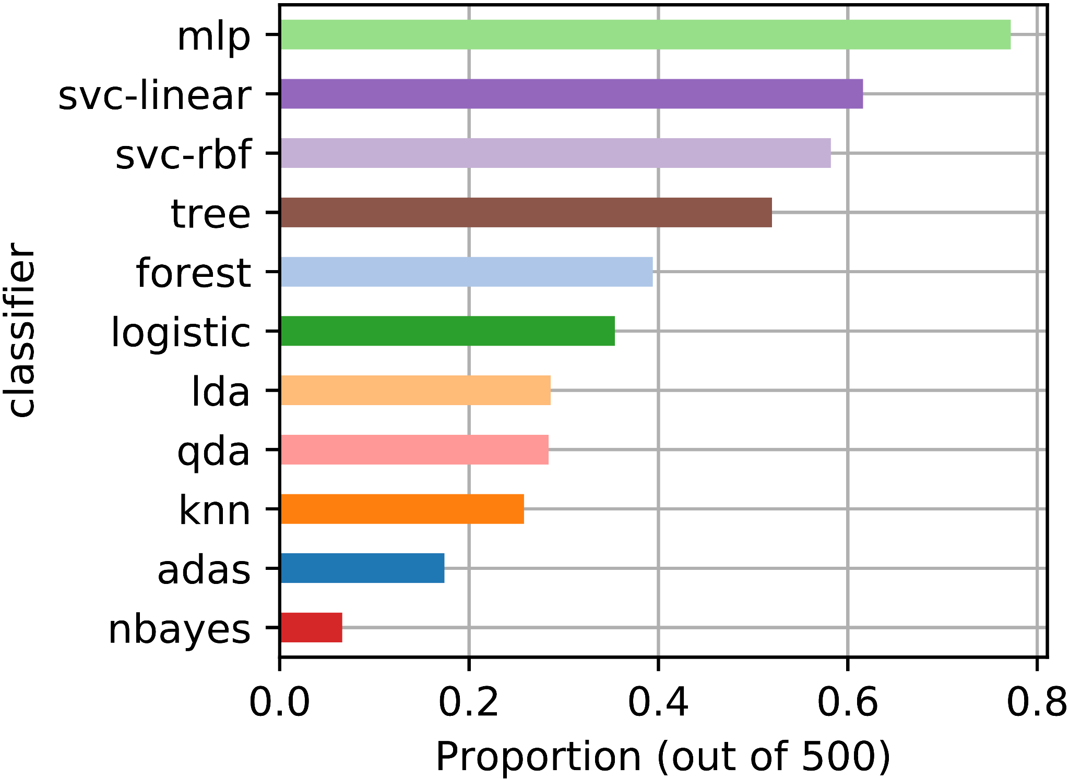
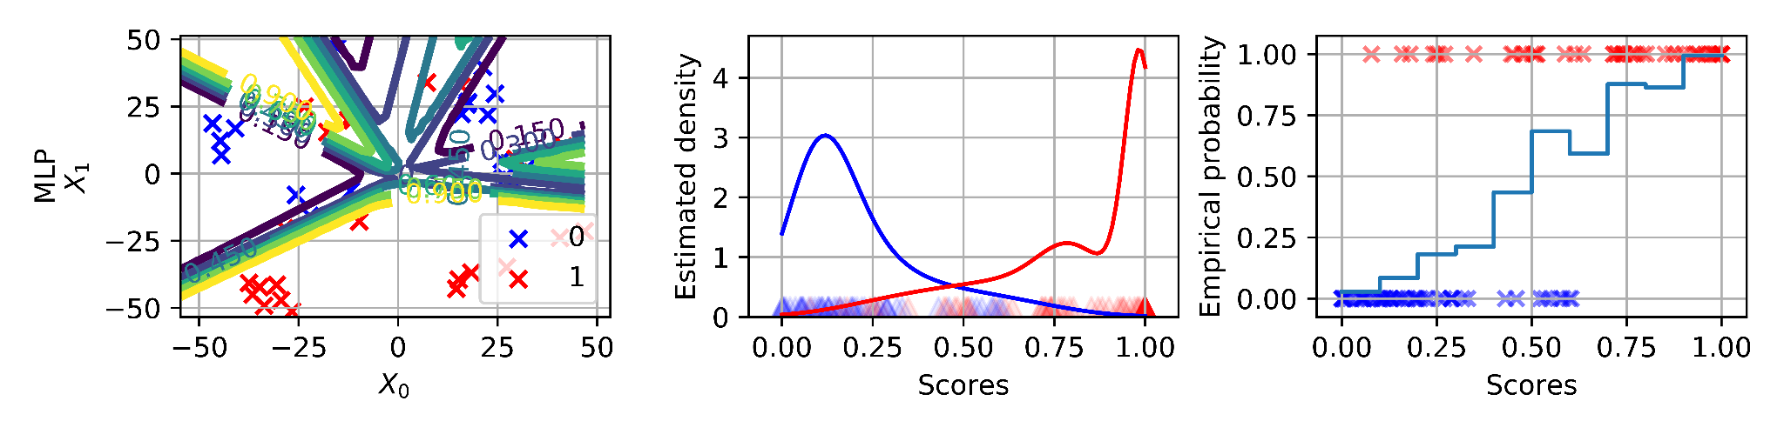
4. Are classifiers calibrated? Simple examples.
- Empirical evaluation:
- 21 datasets and 11 classifiers
- 5 times 5-fold-crossval.
p-cw-ece

Slide 7
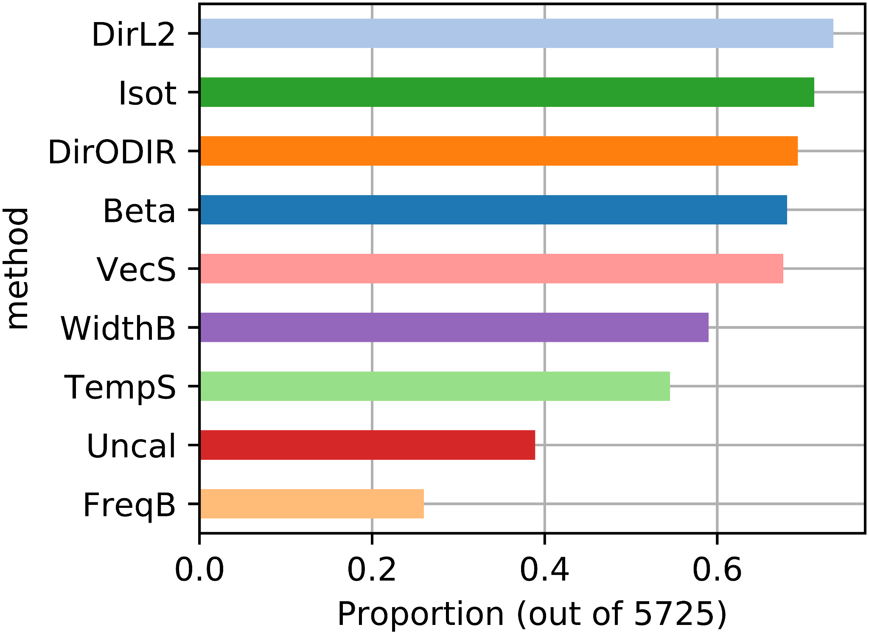
5. Calibration methods
21 datasets, 11 classifiers = 231 settings to compare 8 calibration methods
5 times 5-fold-crossval and inner 3-fold-crossval
Binary | Multiclass
Empirical binning [1] Platt scaling [3] Isotonic regression [2] Beta calibration [4] Bayesian binning into quantiles [7] | One-vs-rest counterparts Temperature scaling [5] Vector scaling [5] Matrix scaling [5] Dirichlet calibration [6]
p-cw-ece

Slide 8
Classifier Calibration
Classifier calibration adjusts the probabilities output by a classifier to be more precise.
Optimal decision making under changing operating conditions.
Multiple measures with their caveats.
MLP, decision trees, SVMs with Platt scaling and ensembles are among the best calibrated classifiers.
Multiple calibration methods can still improve their estimations.
Conclusion

Slide 9
References
[1] Zadrozny, B., & Elkan, C. (2001). Obtaining calibrated probability estimates from decision trees and naive Bayesian classifiers. 18th International Conference on Machine Learning (ICML’01), 609–616.
[2] Niculescu-Mizil, A., & Caruana, R. (2005). Predicting good probabilities with supervised learning. 22nd International Conference on Machine Learning (ICML’05), 625–632.
[3] Platt, J. (2000). Probabilities for SV Machines. In A. J. Smola, P. Bartlett, B. Schölkopf, & D. Schuurmans (Eds.), Advances in Large-Margin Classifiers (pp. 61--74). MIT Press.
[4] Kull, M., Silva Filho, T. D. Menezes., & Flach, P. (2017). Beyond Sigmoids: How to obtain well-calibrated probabilities from binary classifiers with beta calibration. Electronic Journal of Statistics, 11(2), 5052–5080.
[5] Guo, C., Pleiss, G., Sun, Y., & Weinberger, K. Q. (2017, June 14). On Calibration of Modern Neural Networks. Thirty-Fourth International Conference on Machine Learning.
[6] Kull, M., Perello-Nieto, M., Kängsepp, M., Filho, T. S., Song, H., & Flach, P. (2019). Beyond temperature scaling: Obtaining well-calibrated multiclass probabilities with Dirichlet calibration. In H. Wallach, H. Larochelle, A. Beygelzimer, F. Alché-Buc, E. Fox, & R. Garnett (Eds.), Advances in Neural Information Processing Systems (pp. 12316–12326). Curran Associates, Inc.
[7] Naeini, M. P., Cooper, G. F., Hauskrecht, M., Naeini, P., Cooper, G. F., & Hauskrecht, M. (2015). Obtaining Well Calibrated Probabilities Using Bayesian Binning. 29th AAAI Conference on Artificial Intelligence, 2015, 2901–2907

