Slide 1
EDRMS Dashboard
For monitoring and reporting

Slide 2
Objective
The EDRMS Dashboard should be a tool to facilitate the ongoing monitoring of the:
number of active EDRMS SharePoint sites
usage of EDRMS SharePoint sites by department/office/RM/project
Application of the Institutional File Plan
Compliance with AO4.08
Application of the RRDS
Disposal processing
The objective of the dashboard is beyond the delivery of the EDRMS project and is a key deliverable of the project.

Slide 3
Audience
Audience caveat | Required for
Management | Oversight
HoDs / CDs / ROs | Mandate compliance Enable the provision of support and advocacy
Leadership | Division / team / unit level advocacy
General users | Insights
CSIS – IR | Operational monitoring and support
DRGC | Governance level monitoring capability
ORM | Risk management factors and statistics.

Slide 4
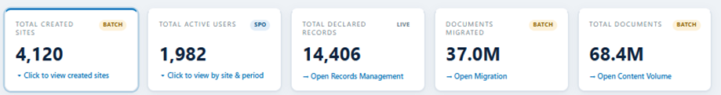
Overview – top panel
I propose that this is not presented as a total (because it will be 1000’s). I propose that this is broken down into:
Number of active EDRMS SharePoint sites (Department, RM, office)
Number of active EDRMS SharePoint sites for Nonsovereign projects
Number of active EDRMS SharePoint sites for Sovereign projects
We want users to know that information is consolidated!
We do not want to encourage migration so I am not sure that this is relevant as a top panel highlight?
Also, I do not think this will be required beyond the project. This is not a Project dashboard.

Slide 5
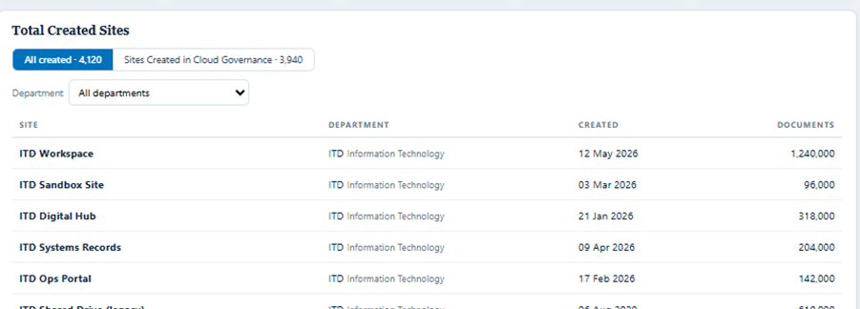
Overview – Total created sites
Will there be EDRMS sites NOT created in Cloud Governance? If not, what is the value of this? I do not think users will understand what this means?
I think it would be more beneficial to list all departments/offices/RMs alphabetically and then provide stats for each:
Number of sites
Number of users (for context)
Number of documents
Number of records
Number of physical counterparts
Can each of these be used to arrange in order, e.g. by number of documents, by number of records, by number of users?
There will be many sites. As suggested on slide 4 – this needs to be broken down into departments/RMs/offices/Projects

Slide 6
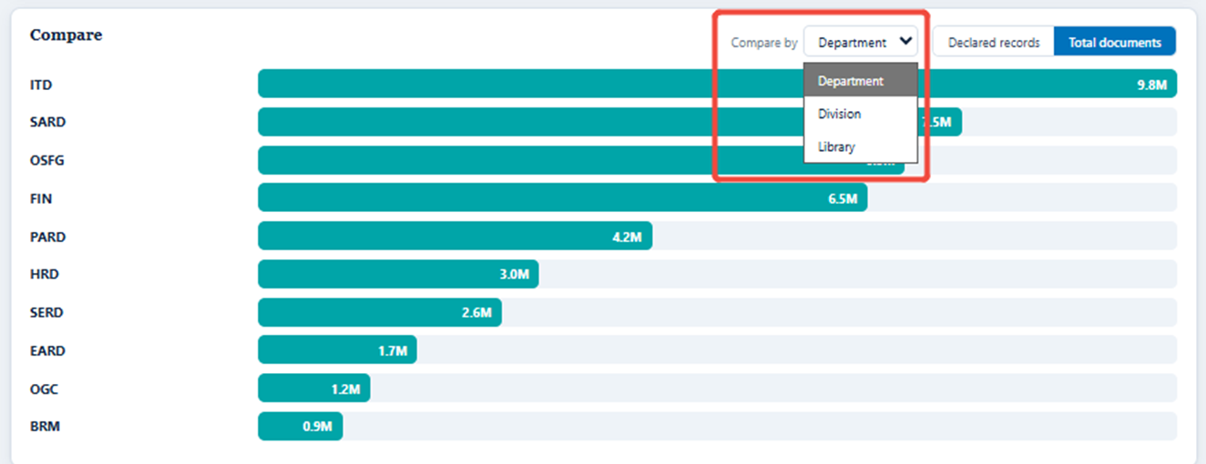
Overview - Compare
How is the comparison going to be helpful from a project site perspective?
Compare by library – Is this relevant here? How do you intend to show 100s of library options
Larger departments with more users will obviously have more documents and more records… as well as comparing docs/records which is obvious, can we also compare using analysis and context?
Eg: Compare departments by number of users against number of documents against number of records declared?

Slide 7
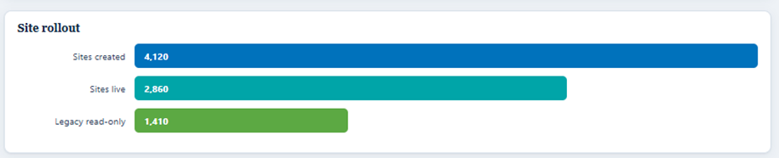
Overview – Site rollout
Only relevant to the Project. Will not be needed once project is completed.
Suggest removing from EDRMS Dashboard.

Slide 8
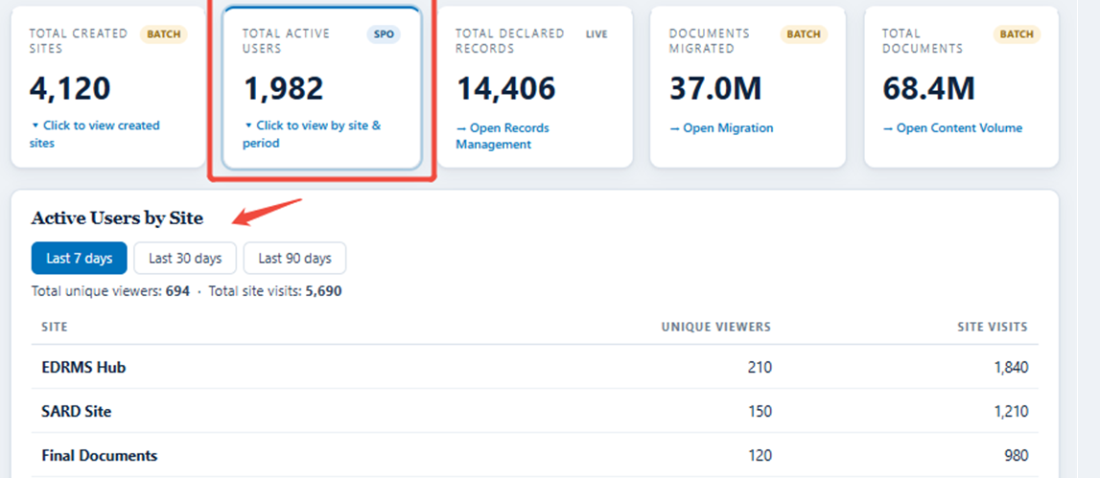
Overview – Active users per site
Suggest incorporating it into the table for total number of sites.
Also suggest providing breakdown on the Department dashboard.

Slide 9
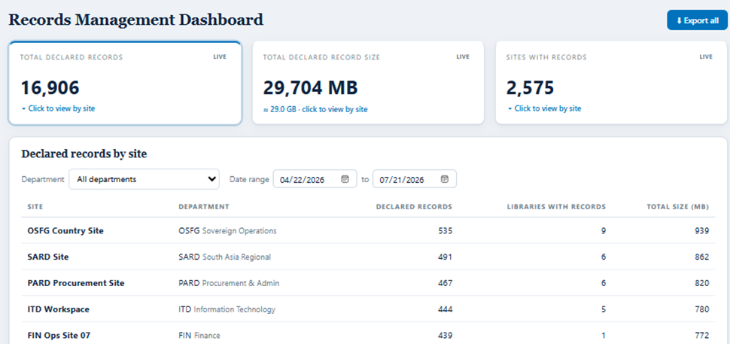
Records management dashboard
The stats are relevant to the Overview dashboard.
It does not provide additional insights….

Slide 10
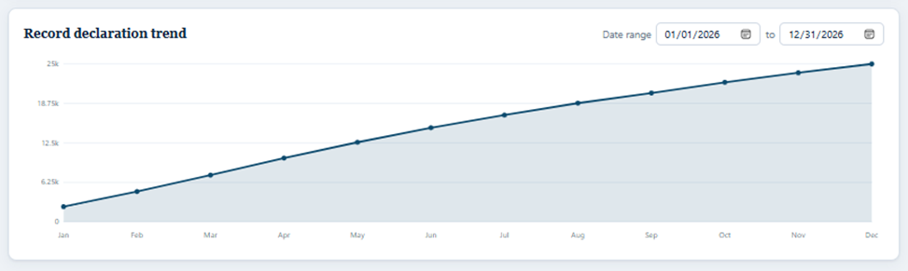
Records management dashboard
Really useful – I like the date range as well. What would be the default (current year?)
This should be on the Overview dashboard for Bankwide trend.
Should also be able to see the trend per department/office/RM/Projects

Slide 11
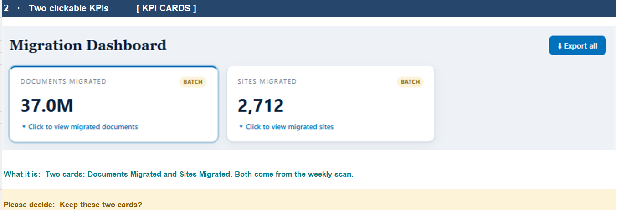
Migration dashboard
I do not believe this is required at all.

Slide 12
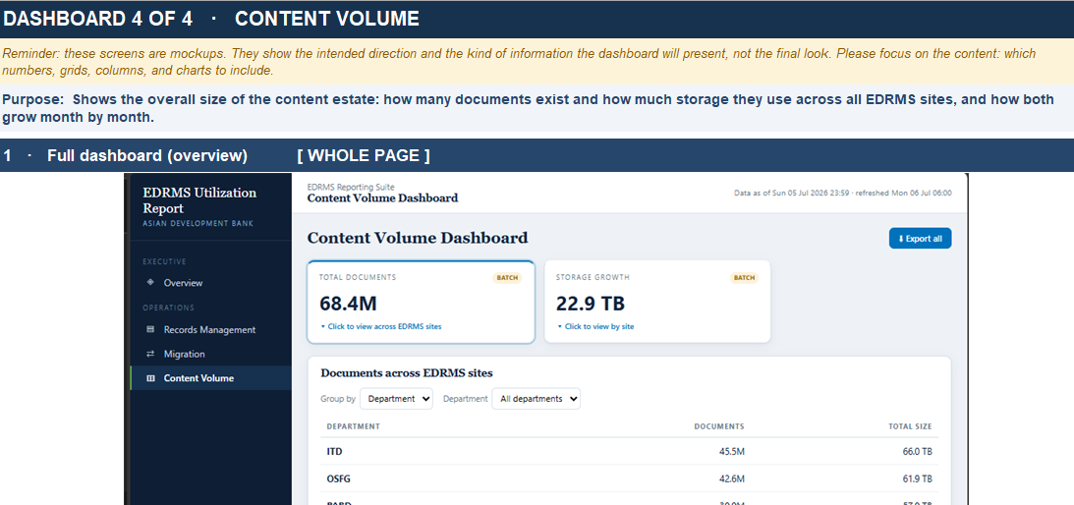
Content volume dashboard
There is no new information derived from this except the total size of documents and storage growth.
Perhaps this could be amalgamated somewhere?

Slide 13
EDRMS insights dashboard key views (using linked data)
Bankwide oversight
Department insights
Detailed profile, site-level details, users, library usage, compliance, disposal, program dates
Project insights
project dashboard for Sovereign and Nonsovereign project sites
Institutional File Plan insights
Term usage, library mapping, documents, records, physical counterparts by term
Retention and disposal insights
Records due for disposal, overdue disposal, disposed records, retention labels / RRDS
Records and archive holdings
Physical holdings, transfers to RAC, storage requests and retrievals

Slide 14
EDRMS insights dashboard key views
Key View | Answers the Question | Output | Action
Bank-wide Oversight | How is EDRMS performing across ADB? | Bank-wide EDRMS adoption, usage, compliance, and trends across departments ADB | Identify departments requiring support, monitor overall adoption, generate required reports.
Department Insights | How is a specific department managing its records? | Detailed view of a department's profile, sites and users activities, records compliance, conventions, and disposal readiness. | Follow up with focals, address compliance gaps, schedule training, review conventions, plan records management activities.
Project Insights | Are project sites being used and maintained appropriately? | Site usage, records compliance and other information for Sovereign and Nonsovereign project sites. | Monitor recordkeeping practices, support project teams.
Institutional File Plan Insights | Are users classifying records correctly? | Visibility on how File Plan terms are being applied across sites and libraries. | Identify underused terms, validate file plan application, improve site design, update conventions if needed.
Retention and Disposal Insights | What records require action under the RRDS? | Records due for disposal, retention label application, disposal status and compliance. | Initiate disposal reviews, monitor retention compliance, prioritize departments with upcoming or overdue disposal actions.
Records and Archive Holdings | What records and archives are being managed by RAC? | Physical records holdings, archival collections, transfers to RAC, and retrieval activity. | Plan storage requirements, monitor transfer activities, support retrieval requests, identify records for archival review.

Slide 15
EDRMS Bank-wide oversights
Top panel stats:
Number of active EDRMS SharePoint sites for Department, RM, office
Number of active EDRMS SharePoint sites for Nonsovereign projects
Number of active EDRMS SharePoint sites for Sovereign projects
Total number of EDRMS users
Total number of documents in EDRMS
Total number of records declared in EDRMS
Total number of physical counterparts identified

Slide 16
EDRMS Bank-wide oversights
Overview of EDRMS sites
Department / office / RM | Number of EDRMS SharePoint sites | Total number of documents | Total number of records declared | Total number of physical counterparts
Alphabetical list of all Departments, offices, RMs. | # | # | # | #
Nonsovereign projects | # | # | # | #
Sovereign projects | # | # | # | #
Note: Each department/office/RM name should be clickable so that when you click on the name, it opens the Dashboard for that department/office/RM. The Nonsovereign projects / sovereign projects should also be clickable, taking the user to Project insights.

Slide 17
EDRMS Bank-wide oversights
Comparison
See comments on slide 6
Note: Required comparisons:
Active users / number of documents
Active users / number of records declared
Number of documents / number of records declared.

Slide 18
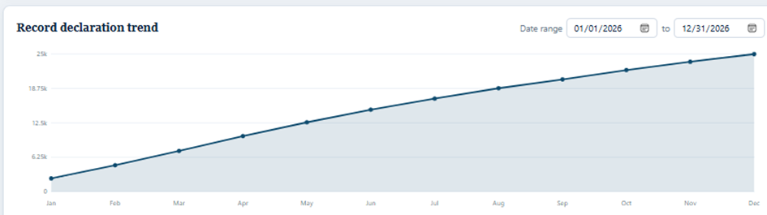
EDRMS Bank-wide oversights
4. Bankwide record declaration trend

Slide 19
EDRMS Department insights
Top panel stats:
Go-Live date
Total number of sites
Total number of EDRMS users
Total number of documents in EDRMS
Total number of records declared in EDRMS
Total number of physical counterparts identified

Slide 20
EDRMS Department insights
Overview of EDRMS sites
Name of sites | Site owners | Number of documents | Number of records | Number of physical counterparts
Site 1 | Names | # | # | #
Site 2 | Names | # | # | #
Site 3 | Names | # | # | #

Slide 21
EDRMS Department insights
Users
 | Total number of users (staff) | Total number of users (Contractorsand consultants) | Completion of training | Onboarded since go-live.
Site 1 | # | # | # | #
Site 2 | # | # | # | #
Site 3 | # | # | # | #

Slide 22
EDRMS Department insights
Visitors
 | Total number of visitors | Visitors (external) | Visitors (internal) by department
Site 1 | # | # | #
Site 2 | # | # | #
Site 3 | # | # | #

Slide 23
EDRMS Department insights
Compliance review – record declaration
 | Total number of records declared | Total number of users declaring records | Number of records declared per division | Number of users declaring records per division
Site 1 | # | # | # | #
Site 2 | # | # | # | #
Site 3 | # | # | # | #

Slide 24
EDRMS Department insights
6. Record declaration trend (per department/office/rm/project)

Slide 25
EDRMS Department insights
7. Library usage
Heading | Library name | Number of users | Number of documents | Number of records declared | Number of physical counterparts
e.g. Programs and operations | Country planning | # | # | # | #

Slide 26
EDRMS Department insights
8. Conventions
Link
Date of approval
Last updated

Slide 27
EDRMS Department insights
9. Disposal
Library name | Number of records due for disposal | Next due date for disposal | Disposal approver
e.g. Country planning | # | Date | Name

Slide 28
EDRMS Department insights
10. Records management program dates:
CSIS-IR audit of EDRMS:
Convention review:
Physical records review:
Refresher training due date:
Focals CoP schedule:

Slide 29
EDRMS Institutional File Plan insights
Top panel stats:
Total terms
Total Administration terms
Total People management terms
Total Programs and operations terms

Slide 30
EDRMS Institutional File Plan insights
1. Administration terms
Term (Top level) | Number of libraries provisioned | Number of documents | Number of records declared | Number of physical counterparts
.
2. People management terms
Term (Top level) | Number of libraries provisioned | Number of documents | Number of records declared | Number of physical counterparts
.

Slide 31
EDRMS Institutional File Plan insights
3. Programs and operations terms
Term (Top level) | Number of libraries provisioned | Number of documents | Number of records declared | Number of physical counterparts
.
4. Other terms
Term (Top level) | Number of libraries provisioned | Number of documents | Number of records declared | Number of physical counterparts
.

Slide 32
EDRMS Retention and disposal insights
1. Temporary retention
Term (Top level) | Number of libraries provisioned | Number of records declared | Retention label | Number of records due for disposal | Number of records disposed
.
2. Permanent retention.
Term (Top level) | Number of libraries provisioned | Number of documents | Number of records declared | Number of physical counterparts
.

Slide 33
Records and archives holdings
RAC suggestions?

Slide 34
EDRMS Bank-wide oversights
Slide 1
57
Total Number of active EDRMS SharePoint sites for Department, RM, office
Total Number of active EDRMS SharePoint sites for Sovereign projects
Total Number of active EDRMS SharePoint sites for Nonsovereign projects
Total number of EDRMS users
Total number of documents in EDRMS
Total number of records declared in EDRMS
Total number of physical counterparts identified
Total number of records due for disposal
Retention and disposal insights
Institutional File Plan insights
Bankwide record declaration trend

Slide 35
EDRMS Bank-wide oversights
Number of active EDRMS SharePoint sites for Department, RM, office
Department / office / RM | Number of EDRMS SharePoint sites | Total number of documents | Total number of records declared | Total number of physical counterparts
Alphabetical list of all Departments, offices, RMs. | # | # | # | #
BIOC - Office of Business Intelligence and Operations Coordination
BPMSD - Budget, People, and Management Systems Department
CCSD - Climate Change and Sustainable Development Department
Etc.
Note: Each department/office/RM name should be clickable so that when you click on the name, it opens the Dashboard for that department/office/RM. The Nonsovereign projects / sovereign projects should also be clickable, taking the user to Project insights.
Include indicators for no. of sites created, sites deleted, sites archived, inactive site for 90 days

Slide 36
EDRMS Bank-wide oversights
Total Number of active EDRMS SharePoint sites for Sovereign projects
Sovereign projects | Number of EDRMS SharePoint sites | Total number of documents | Total number of records declared | Total number of physical counterparts
Sovereign projects (format?) Project Number Project Name? | # | # | # | #
54461-003 Loan 4723-INO: Boosting Productivity Through Human Capital Development (Subprogram 3)
58499-001 Grant 0998-NEP: 2024 Floods and Landslides Emergency Response
57318-001 Grant 0923-VAN: Tropical Cyclone Lola Emergency Response Project
Etc.
Note: Each department/office/RM name should be clickable so that when you click on the name, it opens the Dashboard for that department/office/RM. The Nonsovereign projects / sovereign projects should also be clickable, taking the user to Project insights.

Slide 37
EDRMS Bank-wide oversights
Total Number of active EDRMS SharePoint sites for Nonsovereign projects
Nonsovereign projects | Number of EDRMS SharePoint sites | Total number of documents | Total number of records declared | Total number of physical counterparts
Nonsovereign projects (format?) Project Number Project Name | # | # | # | #
57298-002 TA 10304-PAK: Bio Tech Energy Sustainable Aviation Fuel Project
56189-001 Tiger Digital Infrastructure for Rural Connectivity Project
55106-001 ECOM COVID-19 Smallholder Farmer Climate Resilience and Livelihood Support Project
Etc.
Note: Each department/office/RM name should be clickable so that when you click on the name, it opens the Dashboard for that department/office/RM. The Nonsovereign projects / sovereign projects should also be clickable, taking the user to Project insights.

Slide 38
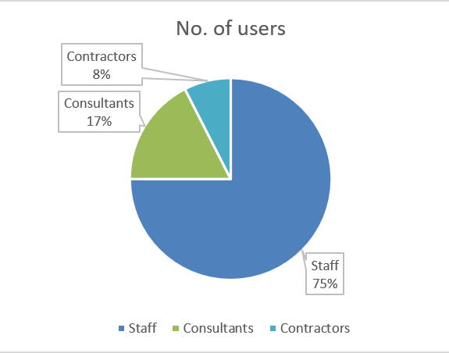
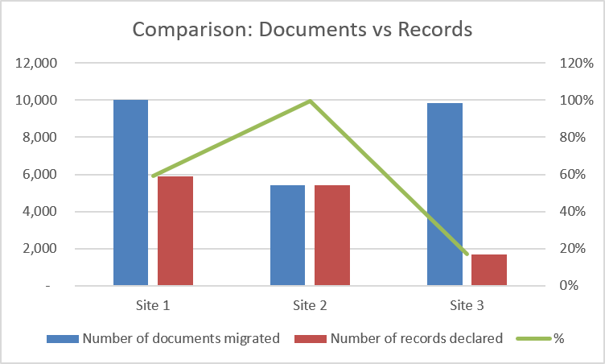
[Project Name] Tropical Cyclone Lola Emergency Response Project
Project Insights
Slide 1
Note: Clickable top panel stats to show data; see Departmental Insights for template
Facility Type: Sovereign |  |  |  | Project Number: 57318-001
Project Type / Modality of Assistance: Grant |  |  |  | Modality Number: 0923
Country / Economy: Vanuatu |  |  |  | Project Status: Closed
Effectivity Date: 13 Dec 2023 |  |  |  | Closing Date (Actual): 10 Sep 2024
Total number of sites created | Total number of EDRMS users | Total number of site visitors | Total number of documents in EDRMS |  | Total number of records declared in EDRMS | Total number of physical counterparts identified | Total number of records due for disposal
3
46
19
10,684
9,596
156
2
Notes:
Source: 57318-001: Tropical Cyclone Lola Emergency Response Project | Asian Development Bank

Slide 39
Total number of EDRMS users
EDRMS Bank-wide oversights
Department / office / RM | Total number of users (staff) | Total number of users (Contractors) | Total number of users (Consultants) | Completion of training | Onboarded since go-live.
Alphabetical list of all Departments, offices, RMs. | # | # | # | # | #
BIOC - Office of Business Intelligence and Operations Coordination
BPMSD - Budget, People, and Management Systems Department
CCSD - Climate Change and Sustainable Development Department
Etc.
Include indicators for % of active users, Number of users who have never accessed EDRMS (for re-training) or have not accessed in the last 90 days (candidate for cleanup)

Slide 40
Total number of documents in EDRMS
EDRMS Bank-wide oversights
Department / office / RM | Number of documents created / uploaded | Number of users creating documents | Documents size (in GB)
Alphabetical list of all Departments, offices, RMs. | # | # | #
BIOC - Office of Business Intelligence and Operations Coordination
BPMSD - Budget, People, and Management Systems Department
CCSD - Climate Change and Sustainable Development Department
Etc.
Include indicators for new documents created month-on-month per department, division
Average monthly storage growth in content

Slide 41
Total number of records declared in EDRMS
EDRMS Bank-wide oversights
Department / office / RM | Total number of records declared | Total number of users declaring records | Number of records declared per division | Number of users declaring records per division
Alphabetical list of all Departments, offices, RMs. | # | # | # | #
BIOC - Office of Business Intelligence and Operations Coordination | # | # | # | #
BPMSD - Budget, People, and Management Systems Department | # | # | # | #
CCSD - Climate Change and Sustainable Development Department
Etc.
Include indicators for new records declared, % of users declaring records, month-on-month per department, division
Highlight departments/ offices / RMs with zero record declarations Record declaration rate (%) compared to documents created

Slide 42
Total number of physical counterparts identified
EDRMS Bank-wide oversights
Department / office / RM | Total number of physical records declared | Total number of users declaring records | Number of records declared per division | Number of users declaring records per division
Alphabetical list of all Departments, offices, RMs. | # | # | # | #
BIOC - Office of Business Intelligence and Operations Coordination | # | # | # | #
BPMSD - Budget, People, and Management Systems Department | # | # | # | #
CCSD - Climate Change and Sustainable Development Department
Etc.
Include indicators for no. of physical records declared month-on-month per department, division
Physical counterpart completion rate (no. of records turned over for RAC storage vs. no. of records declared with physical counterpart)

Slide 43
Total number of records due for disposal
EDRMS Bank-wide oversights
Department / office / RM | Number of records due for disposal | Next due date for disposal | Disposal approver | With physical counterpart? | Status (Approved) | Status (Declined) | Status (Extended)
Alphabetical list of all Departments, offices, RMs. | # | Date | Name | (Yes/No) | # | # | #
BIOC - Office of Business Intelligence and Operations Coordination
BPMSD - Budget, People, and Management Systems Department
CCSD - Climate Change and Sustainable Development Department
Etc.
Include indicators for records disposed month-on-month per department, division
List of overdue disposal actions, pending approvals
Disposal completion rate % (including physical counterparts)
List of upcoming records due for next quarter (for planning and advance notice)

Slide 44
Retention and disposal insights
Slide 1
EDRMS Bank-wide oversights
EDRMS Retention and disposal insights
Heading | Departments / Offices / RMs provisioned | Number of libraries provisioned | Number of records declared | Number of physical counterparts | Number of records due for disposal | Number of records disposed
Permanent retention | list | # | # | # | # | #
Temporary retention
Total

Slide 45
Retention and disposal insights
EDRMS Retention and disposal insights
EDRMS Retention and disposal insights - Permanent retention
Term (Top level) | Departments / Offices / RMs provisioned | Number of libraries provisioned | Number of documents | Number of records declared | Number of physical counterparts
. | list

Slide 46
Retention and disposal insights
EDRMS Retention and disposal insights
EDRMS Retention and disposal insights - Temporary retention
Term (Top level) | Departments / Offices / RMs provisioned | Number of libraries provisioned | Number of records declared | Number of physical counterparts | Retention label | Number of records due for disposal | Number of records disposed
. | list |  |  |  | 5, 10, 20, 5, etc. years

Slide 47
Institutional File Plan insights
Slide 1
EDRMS Bank-wide oversights
EDRMS Institutional File Plan insights
Heading | Total terms | Departments / Offices / RMs provisioned | Number of libraries provisioned | Number of documents | Number of records declared | Number of physical counterparts
Total Institutional Management terms | # | list | # | # | # | #
Total Administration terms
Total People management terms
Total Programs and operations terms
Total other terms
Total terms

Slide 48
Institutional File Plan insights
EDRMS Institutional File Plan insights
EDRMS Institutional File Plan insights - Institutional Management
Total terms (Top level) | Total Number of libraries provisioned | Total Number of documents | Total Number of records declared | Total Number of physical counterparts
Term (Top level) | Departments / Offices / RMs provisioned | Number of libraries provisioned | Number of documents | Number of records declared | Number of physical counterparts
. Annual Meetings | list | # | # | # | #
Include indicators (no. of and list) for
top most-used terms (usage pattern) in terms of documents created and records declared
least-used and unused terms (candidates for review and deletion)
New libraries created outside convention
Request for new library creation and/or deletion?
Request for new term?

Slide 49
Institutional File Plan insights
EDRMS Institutional File Plan insights
EDRMS Institutional File Plan insights - Administration
Total terms (Top level) | Total Number of libraries provisioned | Total Number of documents | Total Number of records declared | Total Number of physical counterparts
Term (Top level) | Departments / Offices / RMs provisioned | Number of libraries provisioned | Number of documents | Number of records declared | Number of physical counterparts
. Budgeting | list | # | # | # | #
Include indicators (no. of and list) for
top most-used terms (usage pattern) in terms of documents created and records declared
least-used and unused terms (candidates for review and deletion)
New libraries created outside convention
Request for new library creation and/or deletion?
Request for new term?

Slide 50
Institutional File Plan insights
EDRMS Institutional File Plan insights
EDRMS Institutional File Plan insights - People management
Total terms (Top level) | Total Number of libraries provisioned | Total Number of documents | Total Number of records declared | Total Number of physical counterparts
Term (Top level) | Departments / Offices / RMs provisioned | Number of libraries provisioned | Number of documents | Number of records declared | Number of physical counterparts
. Learning and Development | list | # | # | # | #
Include indicators (no. of and list) for
top most-used terms (usage pattern) in terms of documents created and records declared
least-used and unused terms (candidates for review and deletion)
New libraries created outside convention
Request for new library creation and/or deletion?
Request for new term?

Slide 51
Institutional File Plan insights
EDRMS Institutional File Plan insights
EDRMS Institutional File Plan insights - Programs and operations terms
Total terms (Top level) | Total Number of libraries provisioned | Total Number of documents | Total Number of records declared | Total Number of physical counterparts
Term (Top level) | Departments / Offices / RMs provisioned | Number of libraries provisioned | Number of documents | Number of records declared | Number of physical counterparts
. Portfolio Management | list | # | # | # | #
Include indicators (no. of and list) for
top most-used terms (usage pattern) in terms of documents created and records declared
least-used and unused terms (candidates for review and deletion)
New libraries created outside convention
Request for new library creation and/or deletion?
Request for new term?

Slide 52
Institutional File Plan insights
EDRMS Institutional File Plan insights
EDRMS Institutional File Plan insights - Other terms
Total terms (Top level) | Total Number of libraries provisioned | Total Number of documents | Total Number of records declared | Total Number of physical counterparts
Term (Top level) | Departments / Offices / RMs provisioned | Number of libraries provisioned | Number of documents | Number of records declared | Number of physical counterparts
. Photos and Audiovisual | list | # | # | # | #
Include indicators (no. of and list) for
top most-used terms (usage pattern) in terms of documents created and records declared
least-used and unused terms (candidates for review and deletion)
New libraries created outside convention
Request for new library creation and/or deletion?
Request for new term?

Slide 53
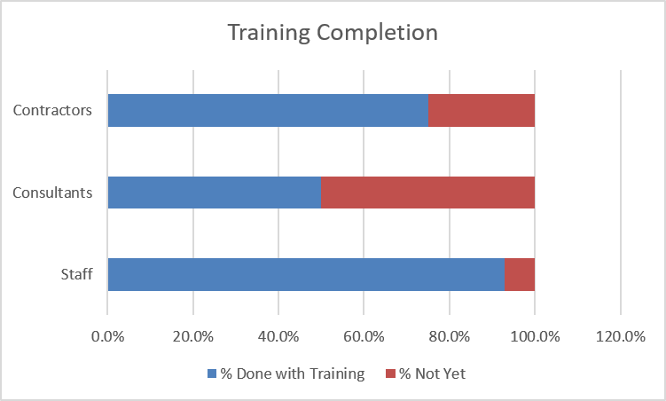
BPMSD - Budget, People, and Management Systems Department
Slide 1
Note: Clickable top panel stats to show data
Go-Live date: [Year Month Date]
Total number of sites created | Total number of EDRMS users | Total number of site visitors | Total number of documents in EDRMS | Total number of records declared in EDRMS | Total number of physical counterparts identified | Total number of records due for disposal
3
46
19
10,684
9,596
156
2
Approved SharePoint site, library, and folder convention Date of approval | Last updated | Version no.
List of SharePoint sites and Library Usage Institutional Management Site 2 Site 3
Records management program | Date | Status
CSIS-IR audit of EDRMS: | 8-Aug-26 | Done
Convention review:
Physical records review:
Refresher training due date:
Focals CoP schedule:

Slide 54
BPMSD - Budget, People, and Management Systems Department
EDRMS Department insights
Users and Activity
Total number of active users (% compared to total no. of staff) | Total number of staff | Total number of staff (#, %) | Total number of contractors (#, %) | Total number of consultants (#, %) | Training completion rate (%)
 | Total number of users (staff) | Total number of users (Contractors) | Total number of users (Consultants) | Completion of training | Onboarded since go-live.
Division 1 | # | # | # | # | #
Division 2 | # | # | # | # | #
Division 3 | # | # | # | # | #
Include indicators for month-on-month per department, division: no. of active users, no. of users who have not accessed their site (is this possible? This is to track those that may have already transferred or left the Bank), no. of new users (to list for onboarding)
Source: Database of end users? Owned and maintained by?
Name | Staff status Dropdown: Staff, Contractor, Consultant, External party given access? | Onboarded since go-live (yes / no) | Training completed? (yes / no) | Date completed (dd-mmm-yy) | Notes

Slide 55
BPMSD - Budget, People, and Management Systems Department
EDRMS Department insights
EDRMS sites
Total number of sites created | Total number of documents in EDRMS | Total number of records declared in EDRMS | Total number of physical counterparts identified | Total number of records due for disposal
Name of sites | Site owners | Number of documents | Number of records | Number of physical counterparts | Number of records due for disposal
Institutional Management | Names | # | # | #
Site 2 | Names | # | # | #
Site 3 | Names | # | # | #
Include indicators per department, division:
No. and list of sites with no activity in 90 days
Records declared month-on-month

Slide 56
BPMSD - Budget, People, and Management Systems Department
EDRMS Department insights
Site visitors
Total number of visitors | Total number of visitors (external) (#, %) | Total number of visitors (internal) (#, %) | Total number of access requests granted (#, %) | Total number of access requests denied (#, %)
Is this data available in SharePoint/Cloud Governance?
 | Total number of visitors | Visitors (external) | Visitors (internal) by department | Access requests granted | Access requests denied
Institutional Management | # | # | # | # | #
Site 2 | # | # | # | # | #
Site 3 | # | # | # | # | #

Slide 57
BPMSD - Budget, People, and Management Systems Department
EDRMS Department insights
Total number of documents in EDRMS
Total number of of documents migrated | Total number of users migrating documents | Total migrated documents size (in GB?)
 | Number of documents created /uploaded | Number of users creating documents | Documents size (in GB)
Institutional Management | # | # | #
Site 2 | # | # | #
Site 3 | # | # | #

Slide 58
BPMSD - Budget, People, and Management Systems Department
EDRMS Department insights
Records declaration
Total number of of records declared | Total number of users declaring records | Total declared record size (in GB)
Proposed table:
 | Number of records declared | Number of users declaring records
Institutional Management
Division 1
Division 2
Division 3
Site 2
Division 1
Division 2
Division 3
 | Total number of records declared | Total number of users declaring records | Number of records declared per division | Number of users declaring records per division
Institutional Management | # | # | # | #
Site 2 | # | # | # | #
Site 3 | # | # | # | #
Include indicators per site, per division:
No. and list of sites with no declared record in 90 days
Records declared month-on-month, declaration rate per site (%)
Note: Collapsible rows for divisions

Slide 59
BPMSD - Budget, People, and Management Systems Department
EDRMS Department insights
Physical Counterpart
Total number of of records declared | Total number of users declaring records | Total declared record size (in GB)
 | Total number of records declared | Total number of users declaring records | Number of records declared per division | Number of users declaring records per division
Institutional Management | # | # | # | #
Site 2 | # | # | # | #
Site 3 | # | # | # | #
Include indicators for no. of physical records declared month-on-month per division
Physical counterpart completion rate (no. of records turned over for RAC storage vs. no. of records declared with physical counterpart)

Slide 60
BPMSD - Budget, People, and Management Systems Department
EDRMS Department insights
Disposal
Total number of records due for disposal | Total number of records disposed (can this be expanded per year, month) | Total disposed record size (in GB)
Library name | Number of records due for disposal | Next due date for disposal | Disposal approver | With physical counterpart? | Status (Approved) | Status (Declined) | Status (Extended)
e.g. Country planning | # | Date | Name | (Yes/No) | # | # | #

Slide 61
BPMSD - Budget, People, and Management Systems Department
EDRMS Department insights
Departmental Library usage - Institutional Management
Total Library names | Total Number of libraries provisioned | Total Number of documents | Total Number of records declared | Total Number of physical counterparts
Library names | Number of users | Number of documents | Number of records declared | Number of physical counterparts
. Annual Meetings | # | # | # | #
Include indicators per library, per division:
No. and list of libraries with no declared record in 90 days
Records declared month-on-month, declaration rate per site (%)

Slide 62
BPMSD - Budget, People, and Management Systems Department
Departmental Library usage
Departmental Library usage - Institutional Management
Total Library names | Total Number of libraries provisioned | Total Number of documents | Total Number of records declared | Total Number of physical counterparts
Library names | Number of users | Number of documents | Number of records declared | Number of physical counterparts
. Annual Meetings | # | # | # | #

Slide 63
BPMSD - Budget, People, and Management Systems Department
Departmental Library usage
Departmental Library usage - Administration
Total Library names | Total Number of libraries provisioned | Total Number of documents | Total Number of records declared | Total Number of physical counterparts
Library names | Number of users | Number of documents | Number of records declared | Number of physical counterparts
. Budgeting | # | # | # | #

Slide 64
BPMSD - Budget, People, and Management Systems Department
Departmental Library usage
Departmental Library usage - People management
Total Library names | Total Number of libraries provisioned | Total Number of documents | Total Number of records declared | Total Number of physical counterparts
Library names | Number of users | Number of documents | Number of records declared | Number of physical counterparts
. Learning and Development | # | # | # | #

Slide 65
BPMSD - Budget, People, and Management Systems Department
Departmental Library usage
Departmental Library usage - Programs and operations terms
Total Library names | Total Number of libraries provisioned | Total Number of documents | Total Number of records declared | Total Number of physical counterparts
Library names | Number of users | Number of documents | Number of records declared | Number of physical counterparts
. Portfolio Management | # | # | # | #

Slide 66
BPMSD - Budget, People, and Management Systems Department
Departmental Library usage
Departmental Library usage - Other terms
Total Library names | Total Number of libraries provisioned | Total Number of documents | Total Number of records declared | Total Number of physical counterparts
Library names | Number of users | Number of documents | Number of records declared | Number of physical counterparts
. Photos and Audiovisual | # | # | # | #

Slide 67
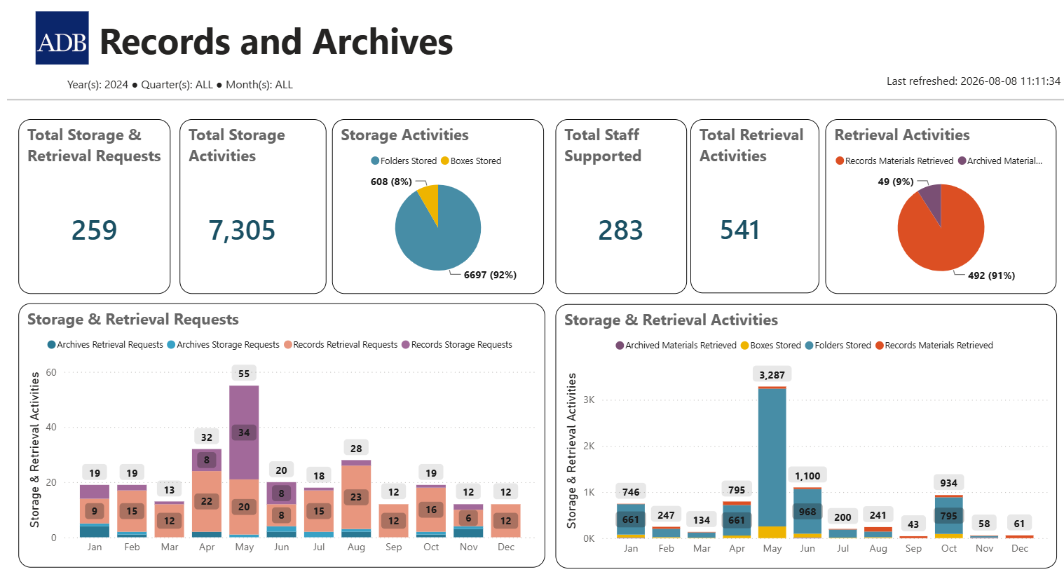
Records and archive holdings
Slide 1
Screenshot from IR Dashboard
We would also like to learn what is available in Opus and how we can apply the features for our dashboard.
Retrieval as processed from eServe, retrieval here should reflect physical records/archives that are removed from the holdings

Slide 68
Records and archive holdings
Records and Archives holdings
Storage
Total Requests (year, month) | Total number of requestors (departments) (year, month) | Total number of requestors (RMs) (year, month) | Total number of boxes stored (year, month) | Total number of folders stored (year, month)
Location | No. of requests | Total number of requestors (departments) (year, month) | Total number of requestors (RMs) (year, month) | Total number of boxes stored (year, month) | Total number of folders stored (year, month) | Remarks
Archives Room
Records Center
Offsite Storage
Include indicators for no. of new boxes and folders stored month-on-month per department
No. and list of outstanding/pending requests/physical records awaiting transfer, physical counterparts identified but not transferred
Can room capacity and % available storage capacity be included?

Slide 69
Records and archive holdings
Records and Archives holdings
Retrieval
Total Requests (year, month) | Total number of requestors (departments) (year, month) | Total number of requestors (RMs) (year, month) | Total number of boxes stored (year, month) | Total number of folders stored (year, month)
Location | No. of requests | Total number of requestors (departments/ RMS) (year, month) | Total number of boxes retrieved (year, month) | Total number of folders retrieved (year, month) | Status (Loan, Return to owner, For Disposal) | Remarks
Archives Room
Records Center
Offsite Storage
Include indicators for no. of retrieval requests and no. of boxes / folders retrieved month-on-month per department
No. and list of outstanding/pending requests
No. of boxes / folders disposed
Can room activities here update the capacity and % available storage capacity (freed up storage)?

