Slide 1
EDRMS Utilization Report, Release 1
Every card and breakdown on the Floot design, what each item shows, its status, and what we still need to ask, clarify or obtain
Bank-wide Oversight and Department Insights | 6 October 2026

Slide 2
How to read this deck
Each slide shows one card with its breakdown open, beside a table of the items it contains. Every item carries one of four statuses:
Agreed, sourced
Agreed, demo figure
Needs clarification
Still lacking
RAC agreed it, and the source is proven on the test tenant. Needs only the production export.
RAC agreed it and the source is known, but the number on screen is demo data until production data is loaded.
Built, but a decision or definition is still open. Someone has to answer before it is final.
Missing data or a source that does not exist yet. Cannot be produced until it is supplied.
The one thing to know before reading the numbers
Only the site counts are measured: 1,032 EDRMS sites, 1,030 of them with a department, 240 shared between departments. They come from the Cloud Governance Workspace report on the test tenant. Every other figure in this deck is demo data that shows the shape of the report. The real numbers arrive with the production exports, the first being the Cloud Governance Workspace report from Leah Bancale.

Slide 3
Bank-wide Oversight
4 cards, each with its breakdown, then 3 panels: physical counterparts, comparison and the records declaration trend

Slide 4
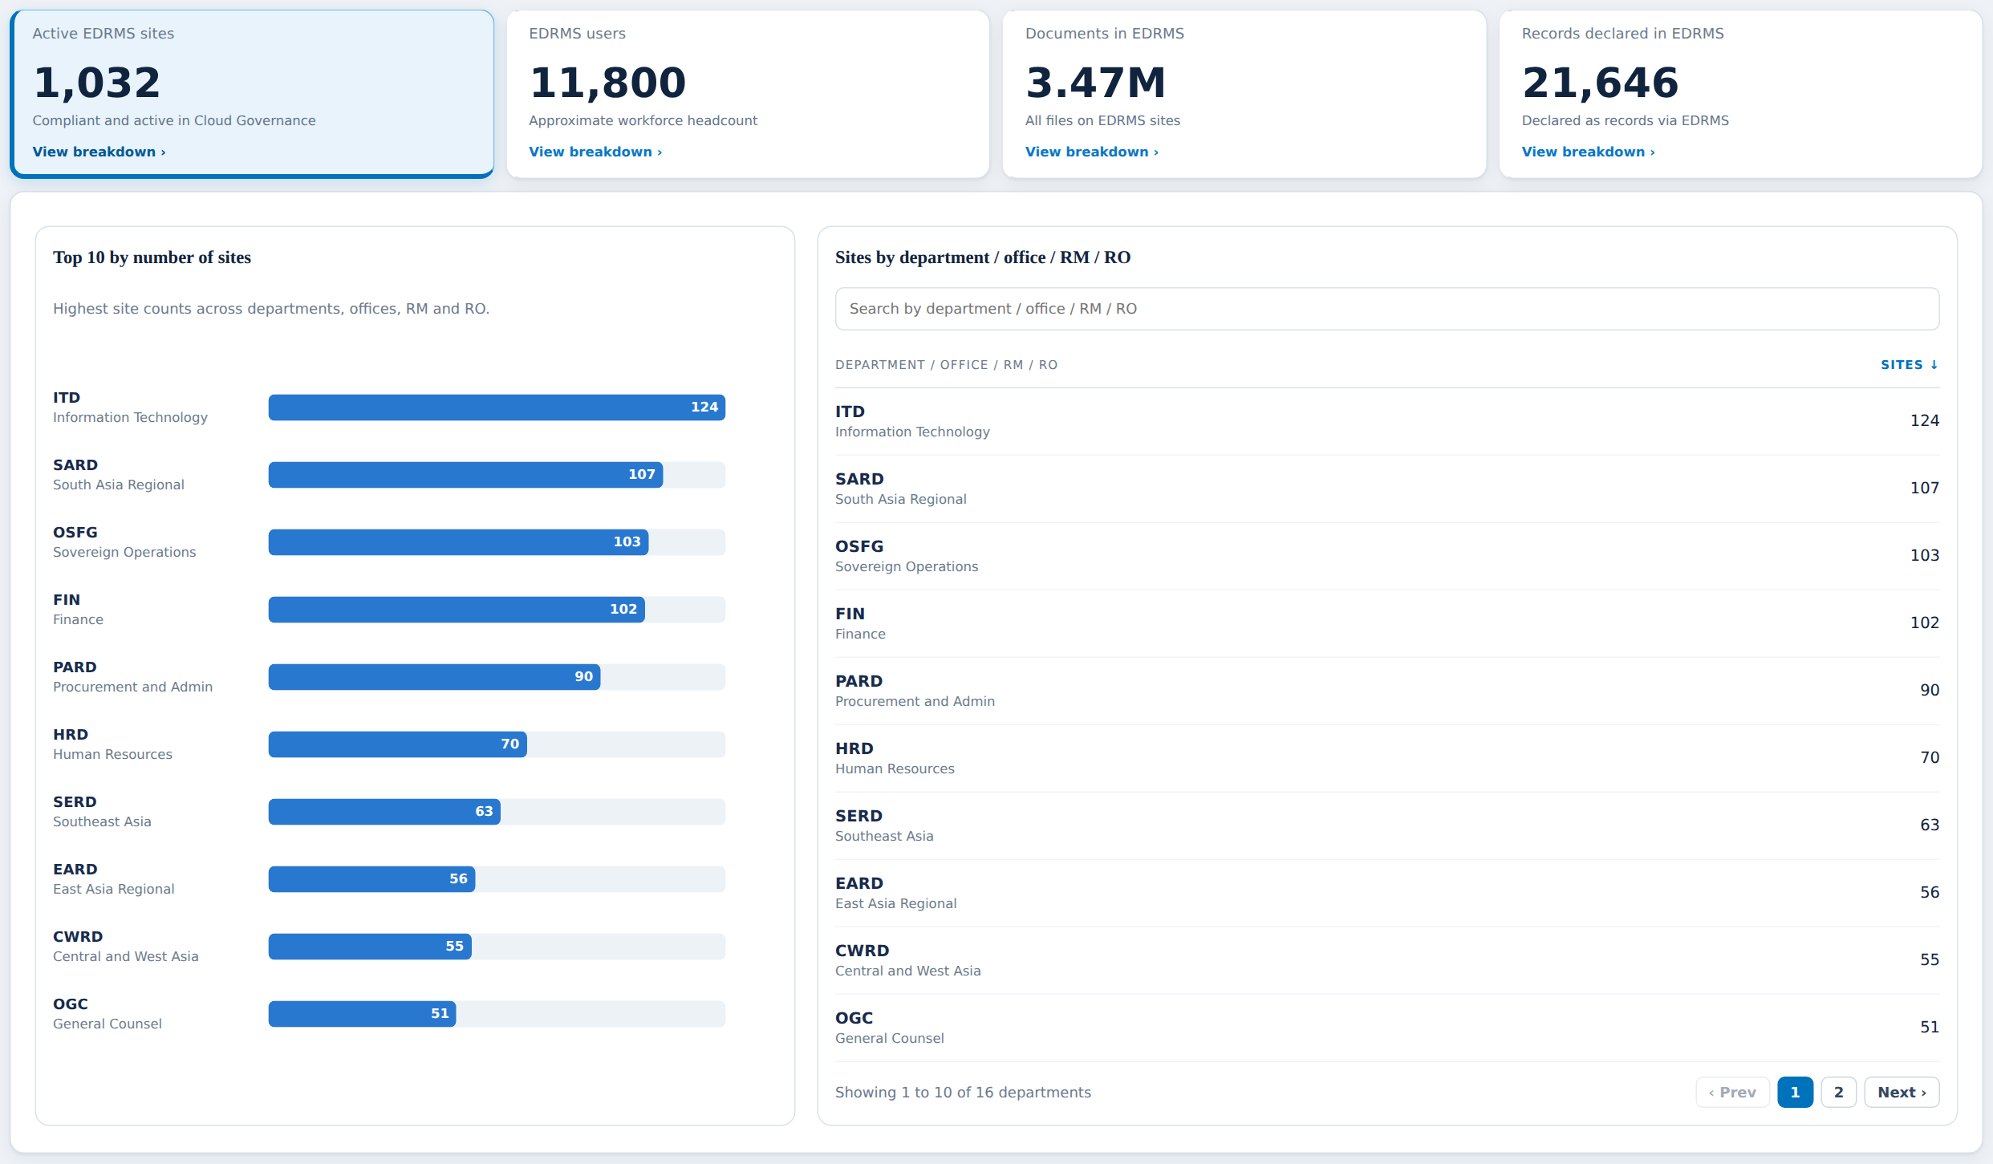
Active EDRMS sites
Card 1 of 4: 1,032 compliant and active sites, with the top 10 chart and the sites table
Item | What it shows | Status | Ask, clarify or still lacking
Active EDRMS sites card (1,032) | Sites marked EDRMS in Cloud Governance (EDRMS Site Type). Project sites excluded, RAC item 1 | Agreed, sourced | Ask Leah Bancale for the PRODUCTION Workspace report. Confirm converted sites are recorded the same way as created ones
Top 10 by number of sites | Ranked bars, units with the most EDRMS sites | Agreed, sourced | None. Follows the sites table
Sites by Department / Office / RM / RO | Searchable, paged table, from Cloud Governance Department | Agreed, sourced | 240 shared sites count to the FIRST listed department (RAC, 21 Sep). 2 sites have no department: ask RAC who owns them
Default sort of the table | Opens sorted by site count, highest first | Needs clarification | Conflicts with the 27 Aug instruction that every table opens on its first column. Confirm which rule wins

Slide 5
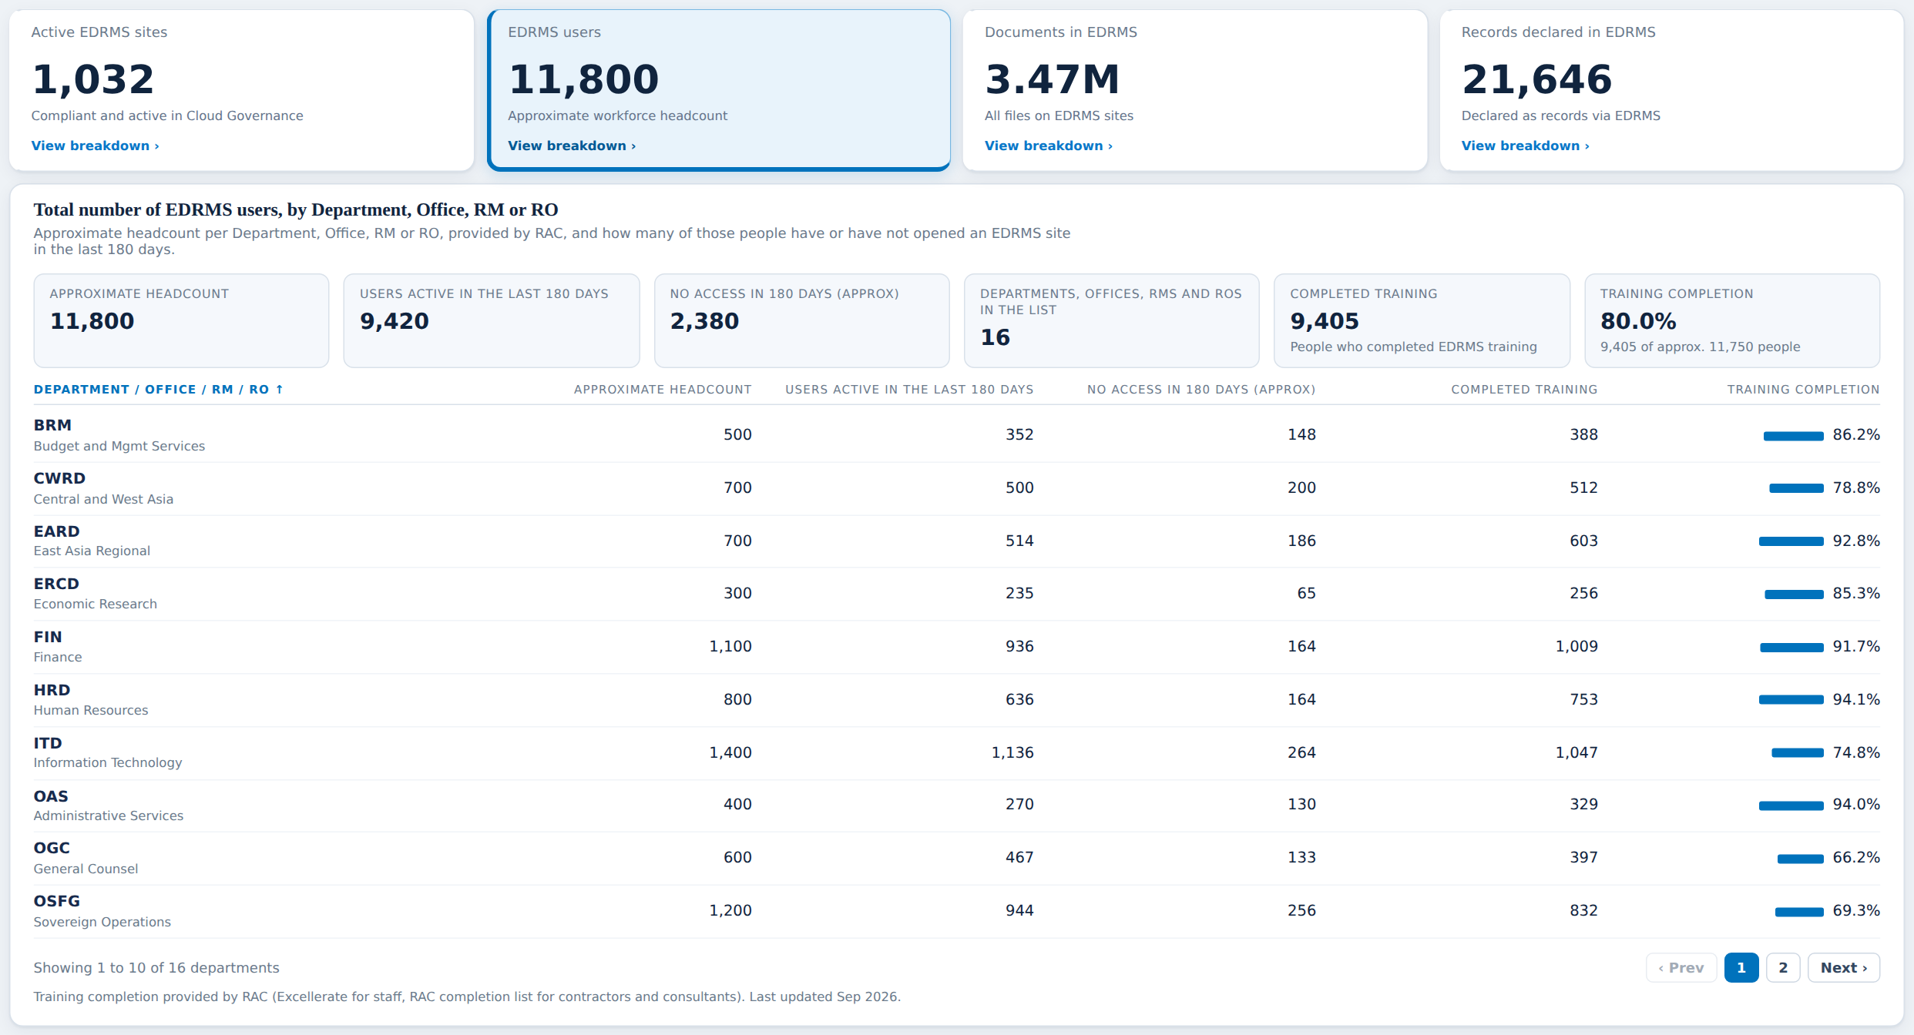
EDRMS users
Card 2 of 4: approximate workforce headcount, with users active, no access and training
Item | What it shows | Status | Ask, clarify or still lacking
EDRMS users card (11,800) | Rounded headcount per unit, RAC items 2 and 23. A reference value, not a measurement | Still lacking | The per-unit numbers are PLACEHOLDERS. Need RAC’s real headcount list (item 24)
Users active in last 180 days (9,420) | People who opened an EDRMS site. SharePoint activity report, 180 days is the longest window it serves | Agreed, demo figure | Production activity report export. Confirm 180 days is the threshold RAC wants (item 26)
No access in 180 days (2,380) | Headcount minus active users | Agreed, demo figure | Depends on the real headcount list
Completed training (9,405) and completion (80.0%) | Training completion from RAC: Excellerate for staff, RAC list for contractors and consultants | Needs clarification | Says "of approx. 11,750" while the card says 11,800: same base must be used. Who sends the list, and how often?
Staff, contractor, consultant split | RAC items 27 to 29 | Still lacking | Not on the page. Ask RAC whether Active Directory can give this split

Slide 6
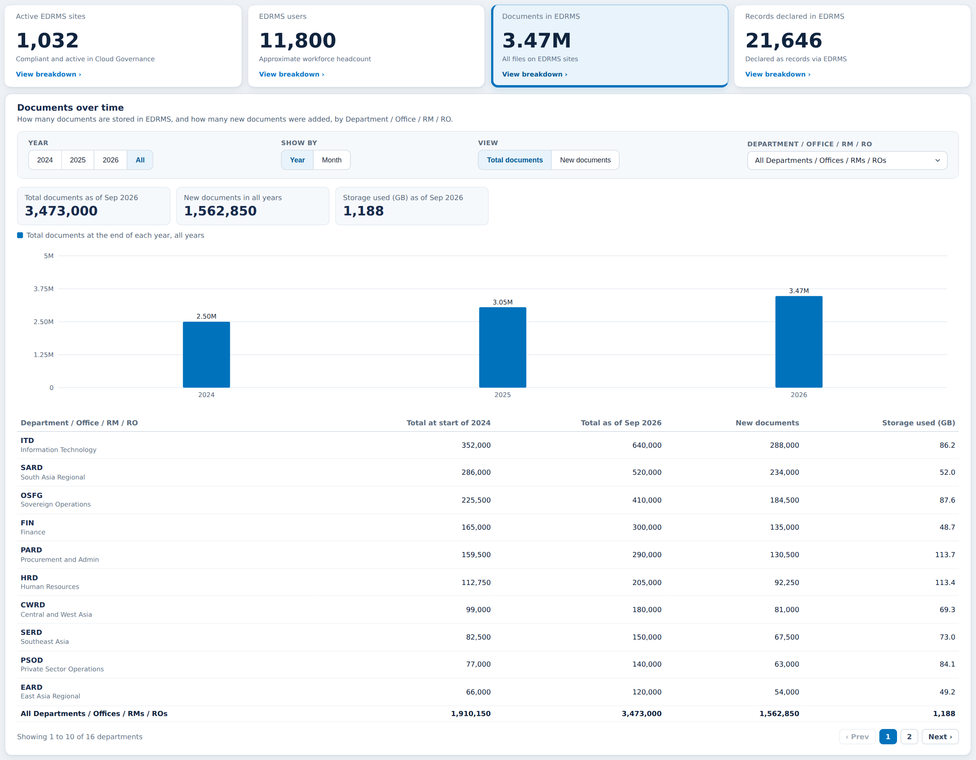
Documents in EDRMS
Card 3 of 4: documents and storage, with the month-by-month history
Item | What it shows | Status | Ask, clarify or still lacking
Documents card (3.47M) | Files on EDRMS sites, from File Count in the SharePoint site usage report | Agreed, demo figure | Production usage export. Test tenant holds 32,833 files
Documents and storage by unit | Documents and Storage used (GB) per Department / Office / RM / RO | Still lacking | Cannot be joined yet: the usage export hides site URLs. M365 admin must clear "Display concealed user, group and site names" and re-export
Storage used (1,188 GB) | Storage Used, also in Cloud Governance per site | Agreed, demo figure | Production export
Documents month by month (Jan 2024 to Sep 2026) | Total at start, total now and new documents per unit | Needs clarification | History before the first monthly snapshot does not exist. Agree whether the series starts from go-live of the refresh job

Slide 7
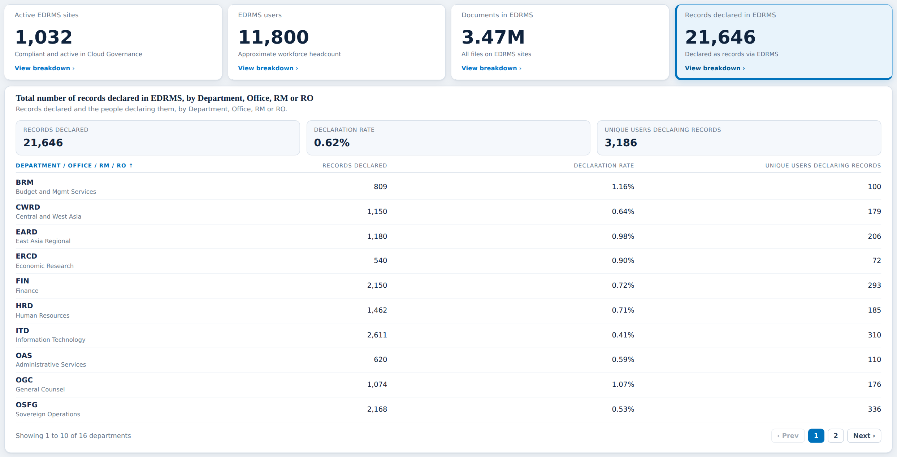
Records declared in EDRMS
Card 4 of 4: records declared, declaration rate and the people declaring
Item | What it shows | Status | Ask, clarify or still lacking
Records declared card (21,646) | Rows in the EDRMS database table Records (drm-npr). Declared records only | Agreed, demo figure | Production database access. UAT holds about 1,990 rows
Declaration rate (0.62%) | Records declared divided by documents | Still lacking | Waits on the document figure per unit, which waits on the concealed-names fix
Unique users declaring (3,186) | Distinct people who declared a record | Agreed, demo figure | One SQL query, never yet run: COUNT(DISTINCT CreatedBy). Ask the dev team to run it
Records per unit | Records follow their site to a department through the site URL | Agreed, sourced | None beyond the production export

Slide 8
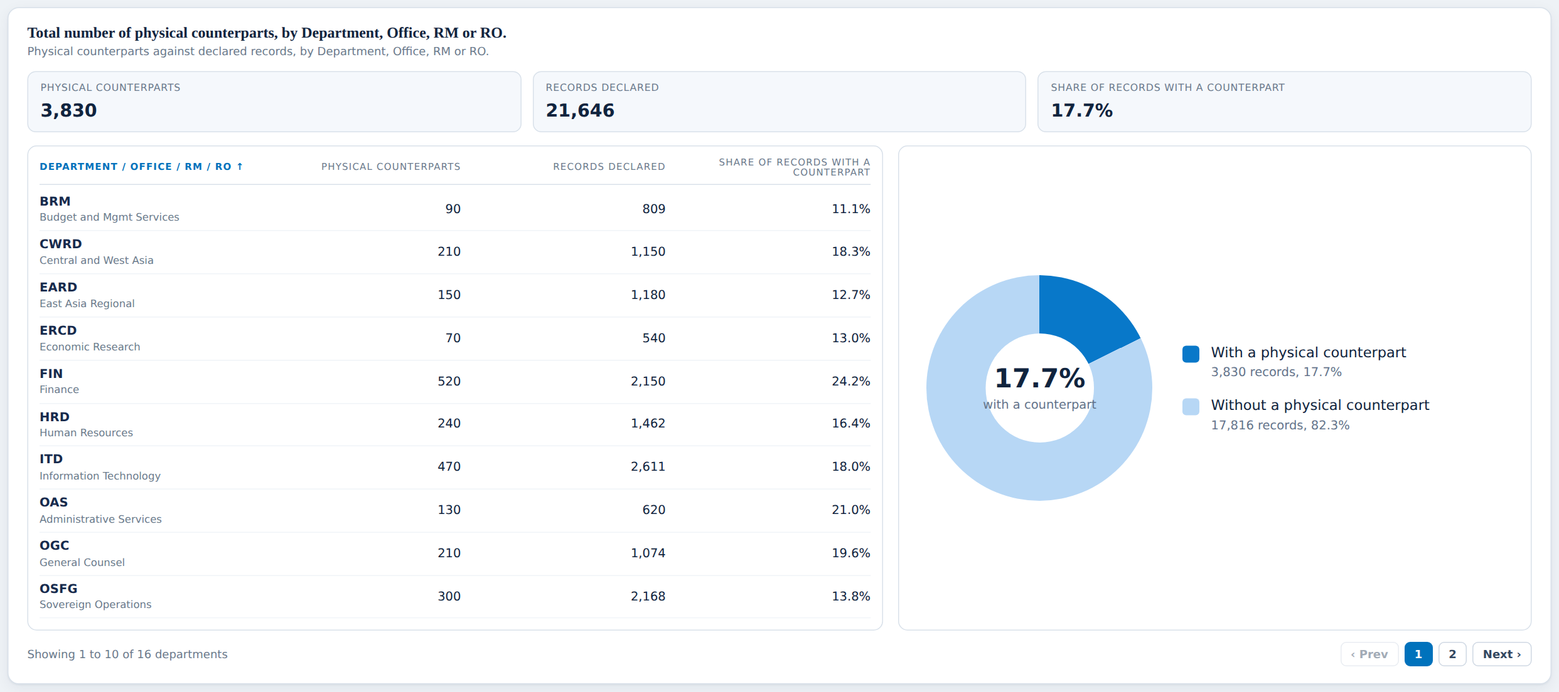
Physical counterparts
Panel: records that also exist on paper, items 44 to 46 (agreed)
Item | What it shows | Status | Ask, clarify or still lacking
Physical counterparts (3,830) | Declared records flagged as also existing on paper | Agreed, demo figure | Confirm which field marks a counterpart in production (term set Physical Status)
Share with a counterpart (17.7%) | Counterparts divided by records declared, with donut chart | Agreed, demo figure | Follows the two figures above
Counterparts by unit table | Counterparts, records and share per Department / Office / RM / RO | Agreed, demo figure | None beyond the production data

Slide 9
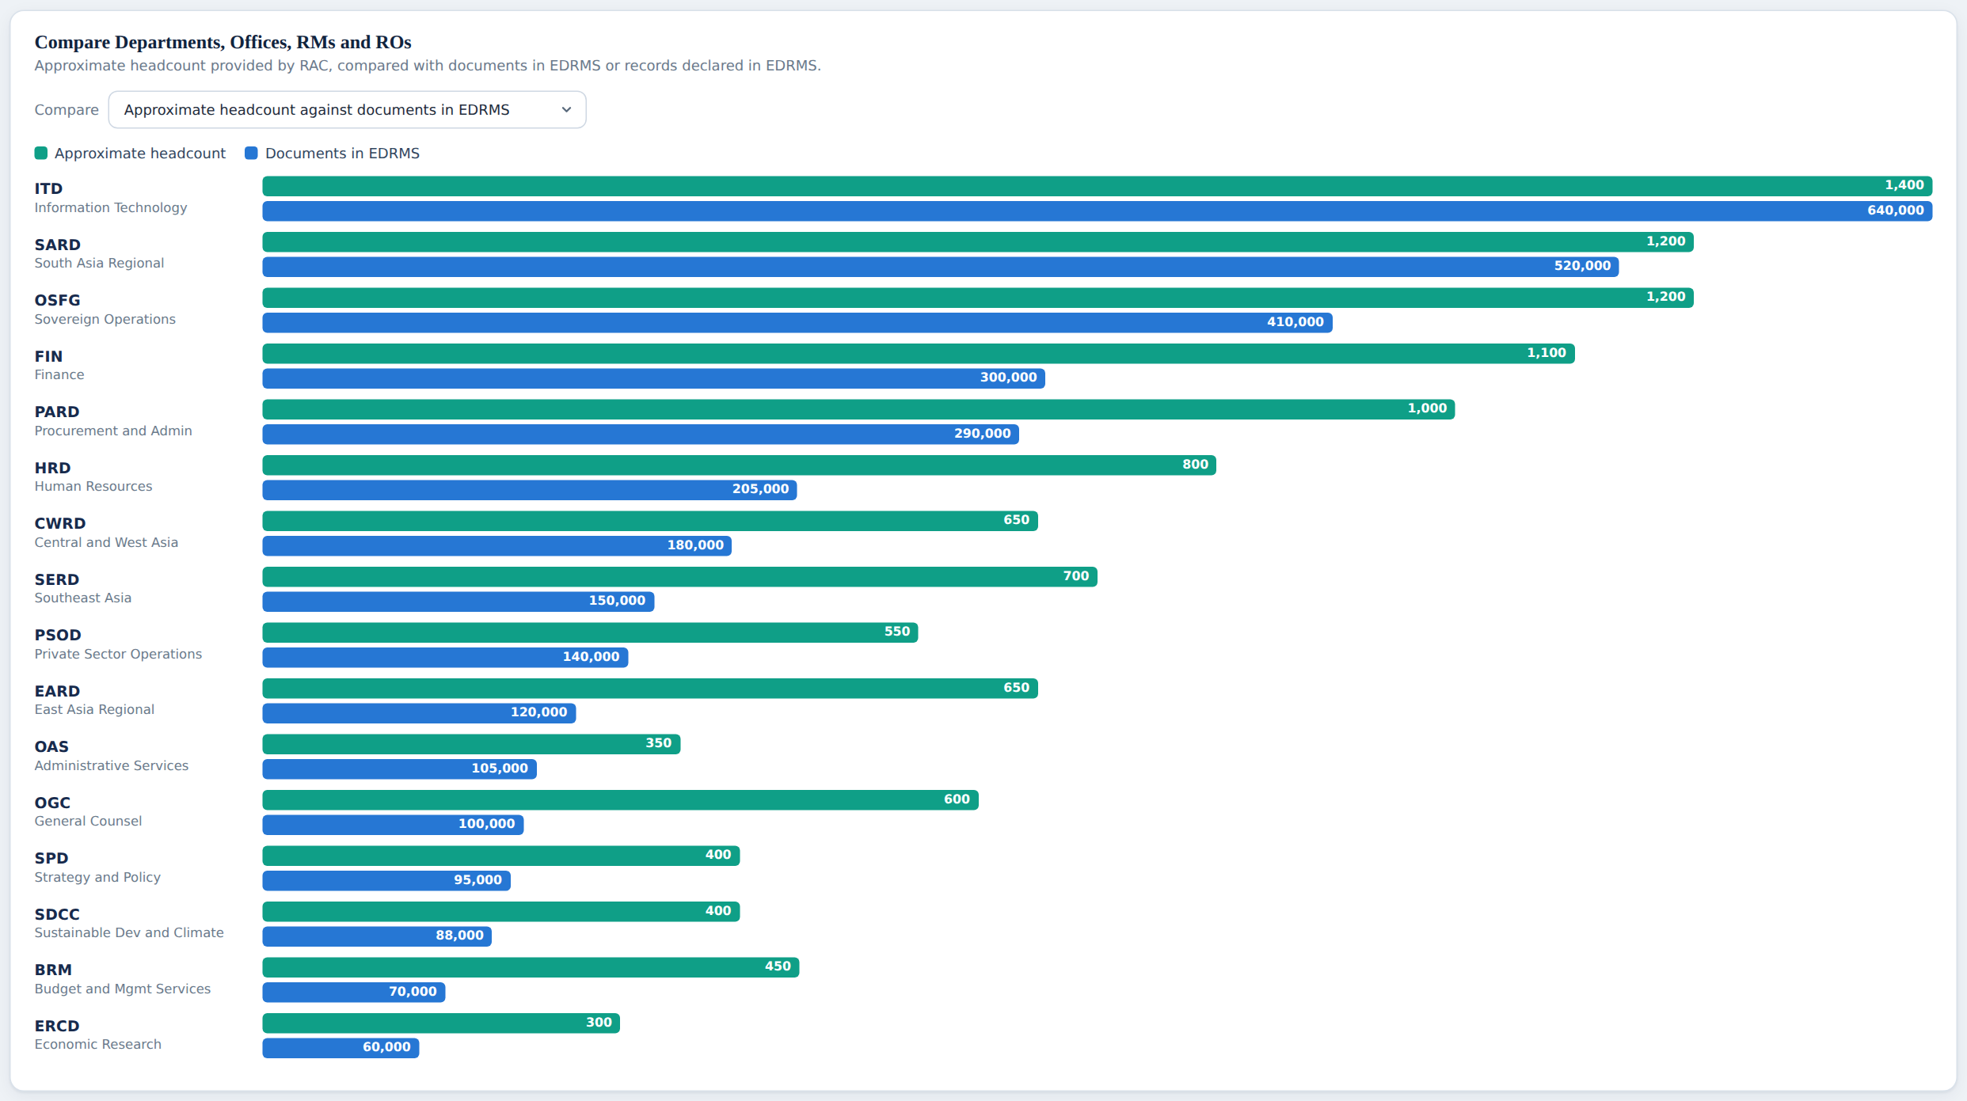
Comparison
Panel: approximate headcount against documents or records, items 61 and 62
Item | What it shows | Status | Ask, clarify or still lacking
Headcount against documents | Paired bars per unit, each measure on its own scale | Needs clarification | RAC’s condition was "if sourced authoritatively". Does a typed headcount list count?
Headcount against records | Same, with records declared | Needs clarification | Same question
Headcount values | The green bars | Still lacking | Chart shows unrounded values (CWRD 650) while the users table rounds (CWRD 700). One rule needed, and RAC’s real list

Slide 10
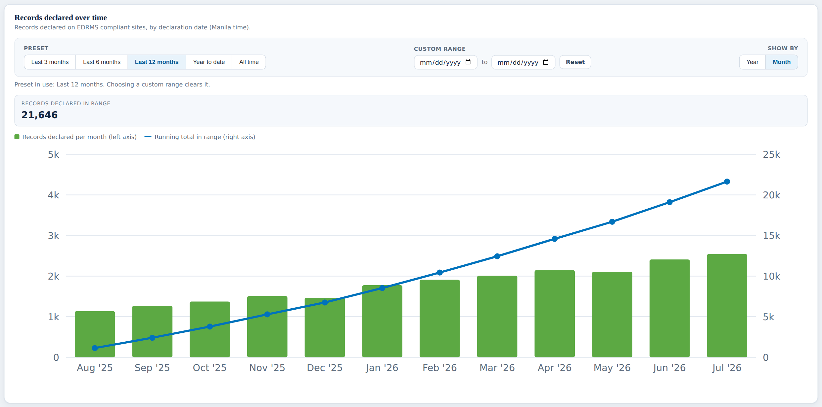
Records declaration trend
Panel: records declared per month and the running total
Item | What it shows | Status | Ask, clarify or still lacking
Presets and custom range | Last 3, 6, 12 months, year to date, all time, or a date range | Agreed, sourced | None
Per month bars and running total | By declaration date, Manila time, from the Records table | Agreed, demo figure | Production database. Monthly figures shown are demo
Records declared in range | Total for the chosen range | Agreed, demo figure | Follows the series

Slide 11
Department Insights
The department profile, 5 cards each with its breakdown, then library usage

Slide 12
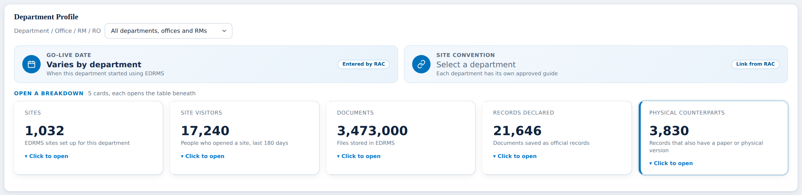
Department profile
The department picker, Go-Live date and site convention
Item | What it shows | Status | Ask, clarify or still lacking
Department picker | Filters the whole dashboard by Department / Office / RM / RO | Agreed, sourced | None
Go-Live date | When the department started using EDRMS. Manual input by RAC, item 11 | Still lacking | Dates on screen are placeholders. Need RAC’s list. Site Created Time is NOT the go-live date
Site convention | Link to each department’s approved site guide, item 10 | Still lacking | Need the link for each department from RAC

Slide 13
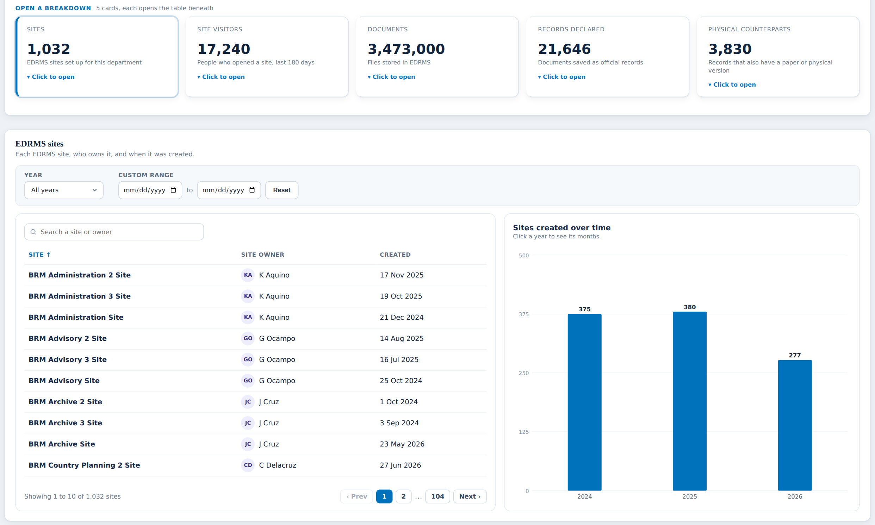
Sites
Card 1 of 5: EDRMS sites, owners and creation dates
Item | What it shows | Status | Ask, clarify or still lacking
Sites card (1,032) | EDRMS sites for the chosen department | Agreed, sourced | Production Workspace report
Site, owner, created | From Cloud Governance: Primary Business Owner and Created Time | Agreed, sourced | Created Time is when the site was made, not when it joined EDRMS
Sites created over time | Sites per year, click a year for its months | Agreed, sourced | None
Year and custom range filter | Narrows the table and chart by creation date | Agreed, sourced | None

Slide 14
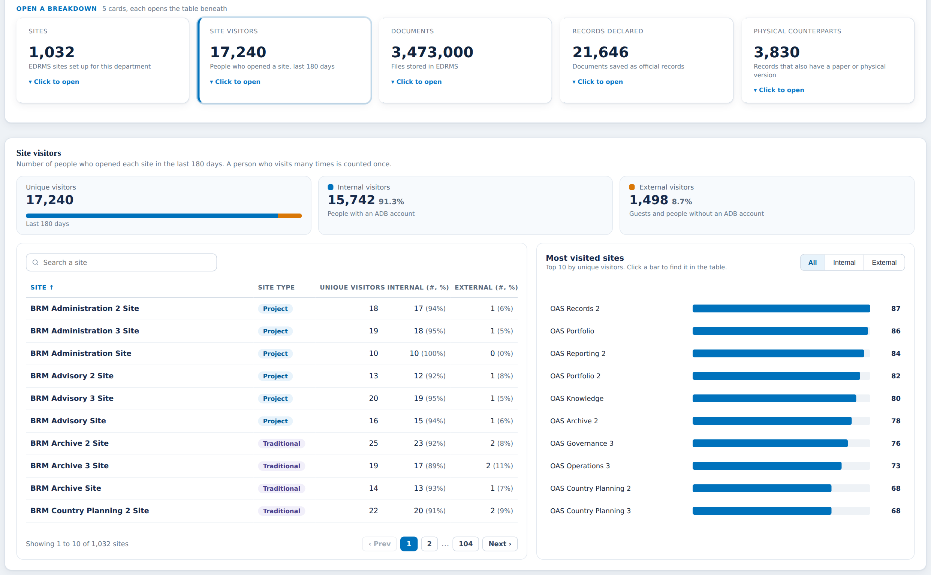
Site visitors
Card 2 of 5: unique people who opened each site, last 180 days
Item | What it shows | Status | Ask, clarify or still lacking
Site visitors card (17,240) | Unique people, not visits (item 4). Graph site analytics, actorCount | Agreed, demo figure | Production. One test site gave 5,535 visits from 12 people, so the label must stay "people"
Internal and external split | ADB account against guests, items 39 and 40 | Still lacking | Shown with demo numbers, but no source for the split is proven. Ask whether audit logs may be used
Site type column | Project or Traditional | Needs clarification | Project sites appear here although RAC item 1 excluded them from the 1,032. Which is right?
Most visited sites | Top 10 by unique visitors, all, internal or external | Agreed, demo figure | Follows the visitor data

Slide 15
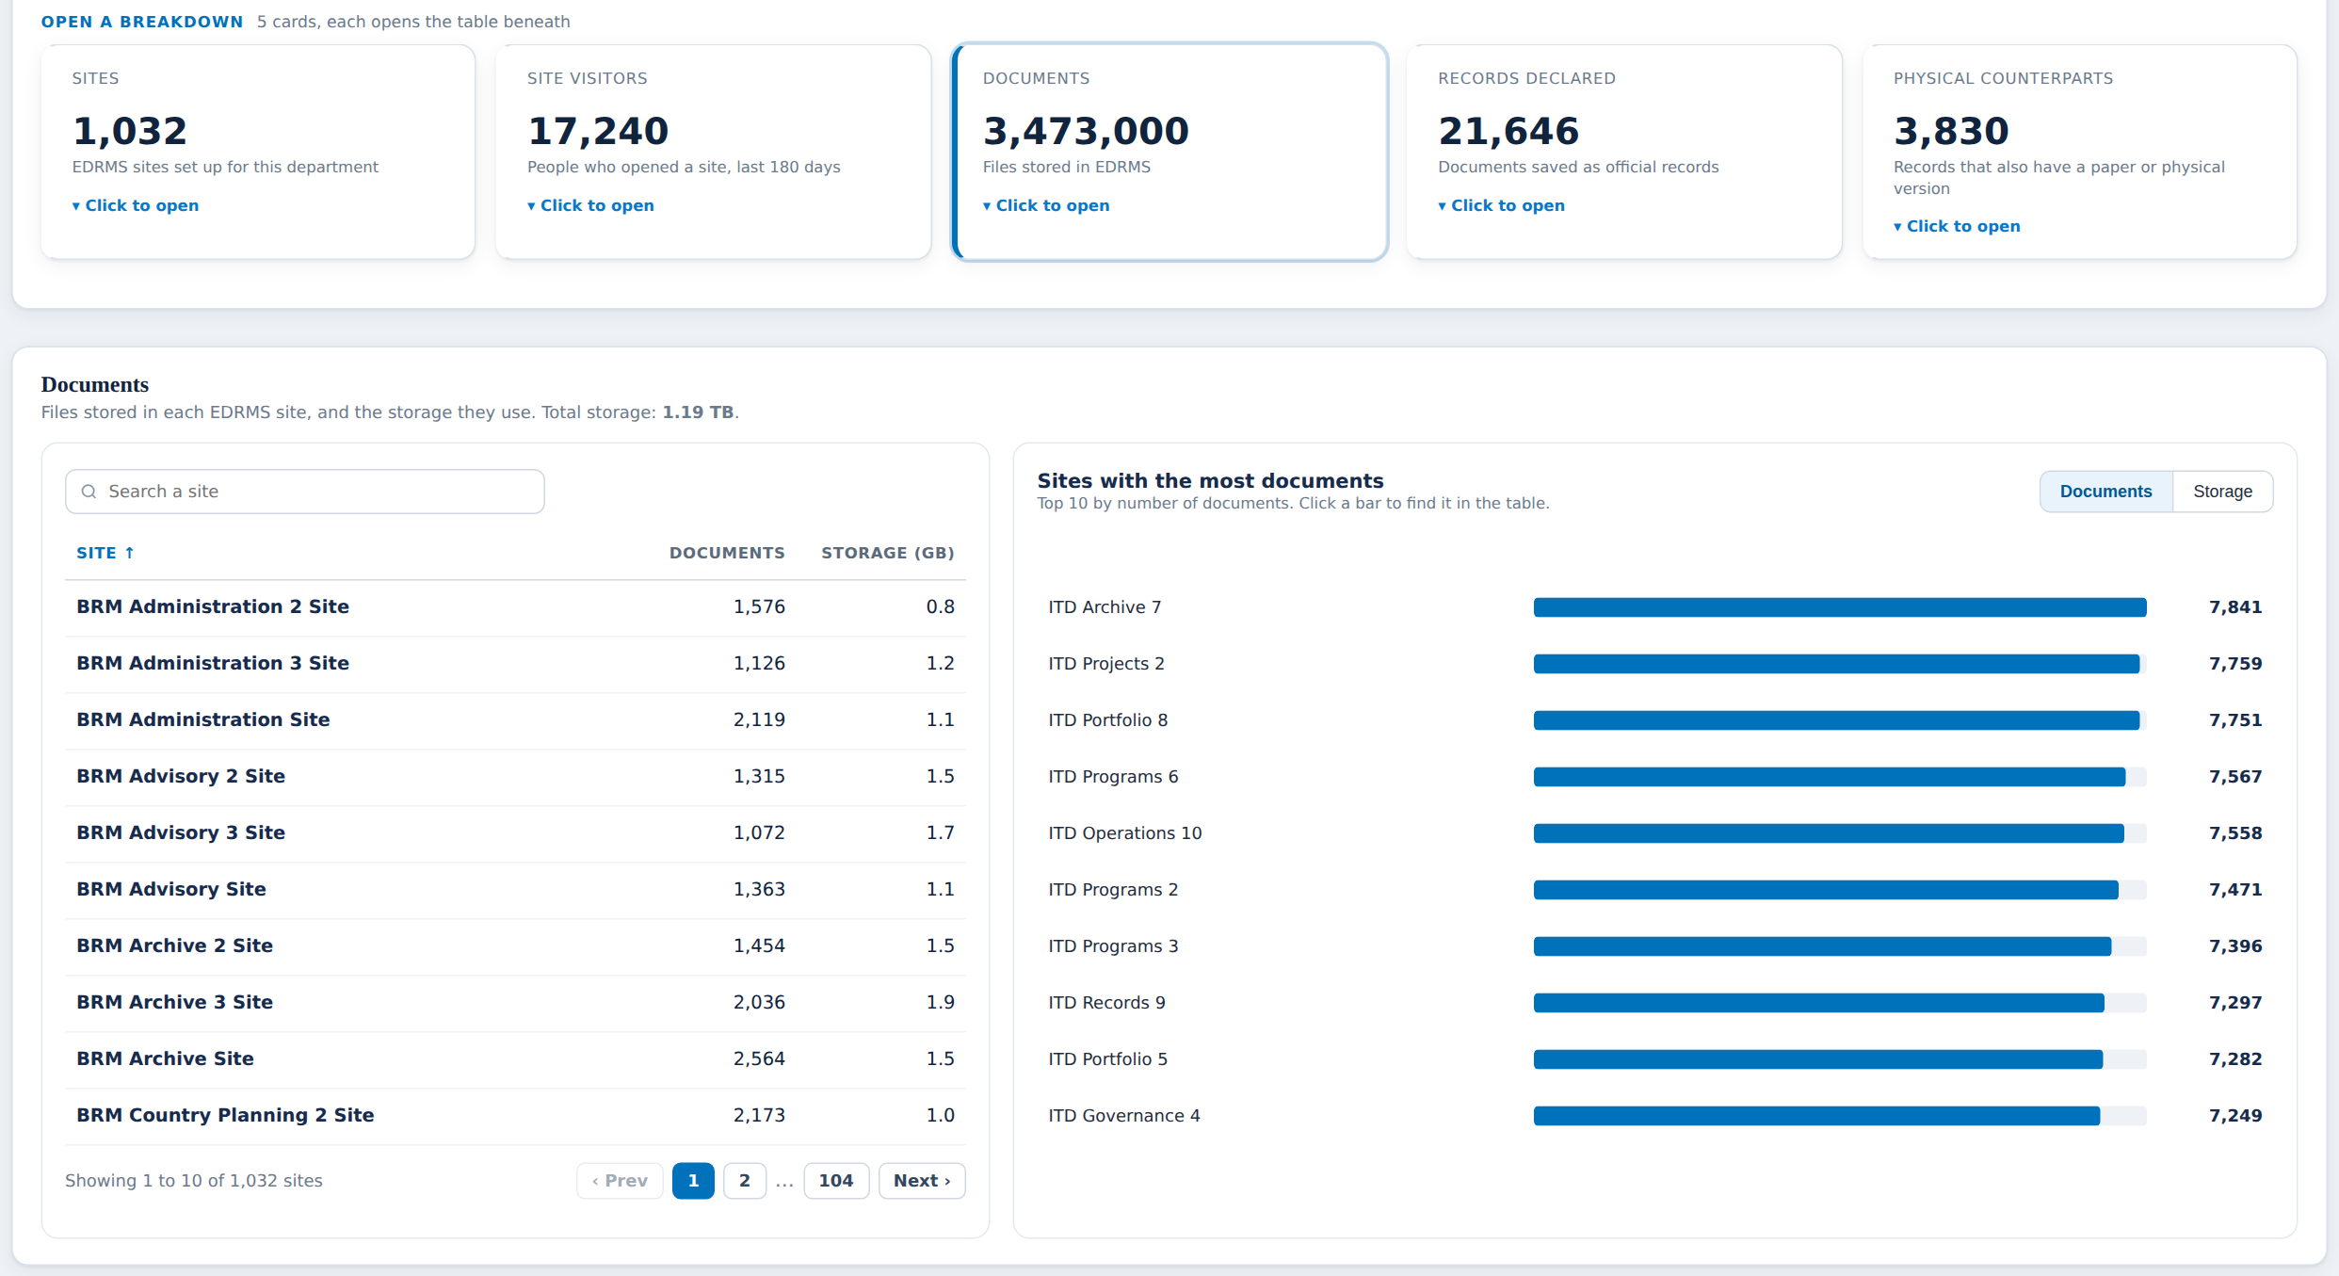
Documents
Card 3 of 5: files and storage per site
Item | What it shows | Status | Ask, clarify or still lacking
Documents card (3,473,000) | Files stored in EDRMS for the department | Agreed, demo figure | Production usage export
Documents and storage per site | File Count and storage for each EDRMS site | Still lacking | Same blocker as Bank-wide: concealed site names stop the join. M365 admin setting

Slide 16
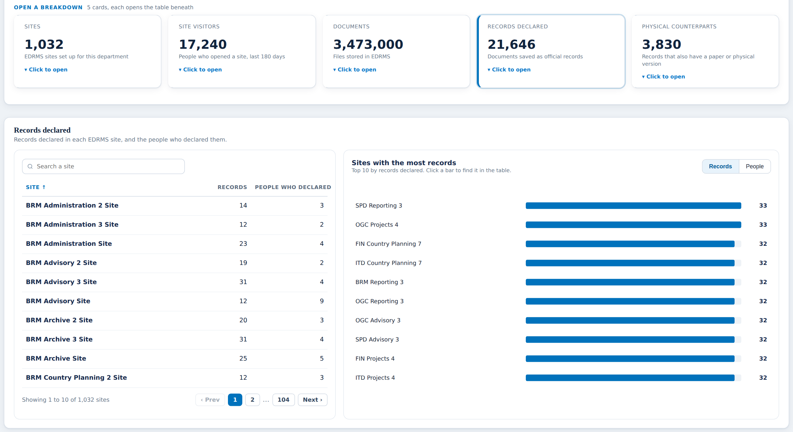
Records declared
Card 4 of 5: records and the people who declared them, per site
Item | What it shows | Status | Ask, clarify or still lacking
Records declared card (21,646) | Records table, for the department | Agreed, demo figure | Production database
Records and people per site | Records declared and distinct people declaring, per site | Agreed, demo figure | Run the COUNT(DISTINCT CreatedBy) query per site

Slide 17
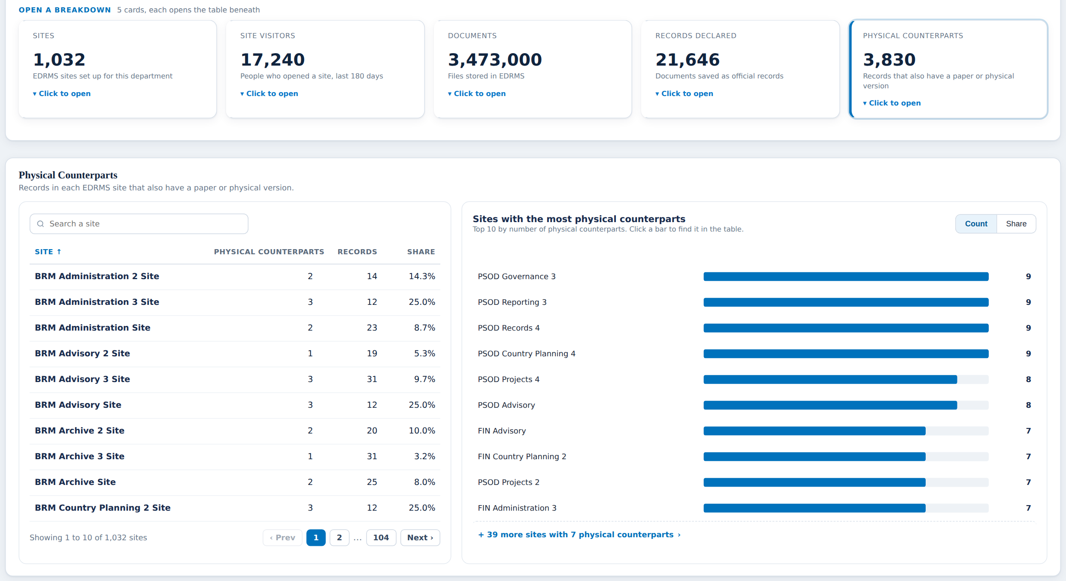
Physical counterparts
Card 5 of 5: records that also have a paper version, per site
Item | What it shows | Status | Ask, clarify or still lacking
Physical counterparts card (3,830) | Records with a paper or physical version | Agreed, demo figure | Confirm the production field, as on Bank-wide
Counterparts, records and share per site | Per-site table with share | Agreed, demo figure | None beyond production data

Slide 18
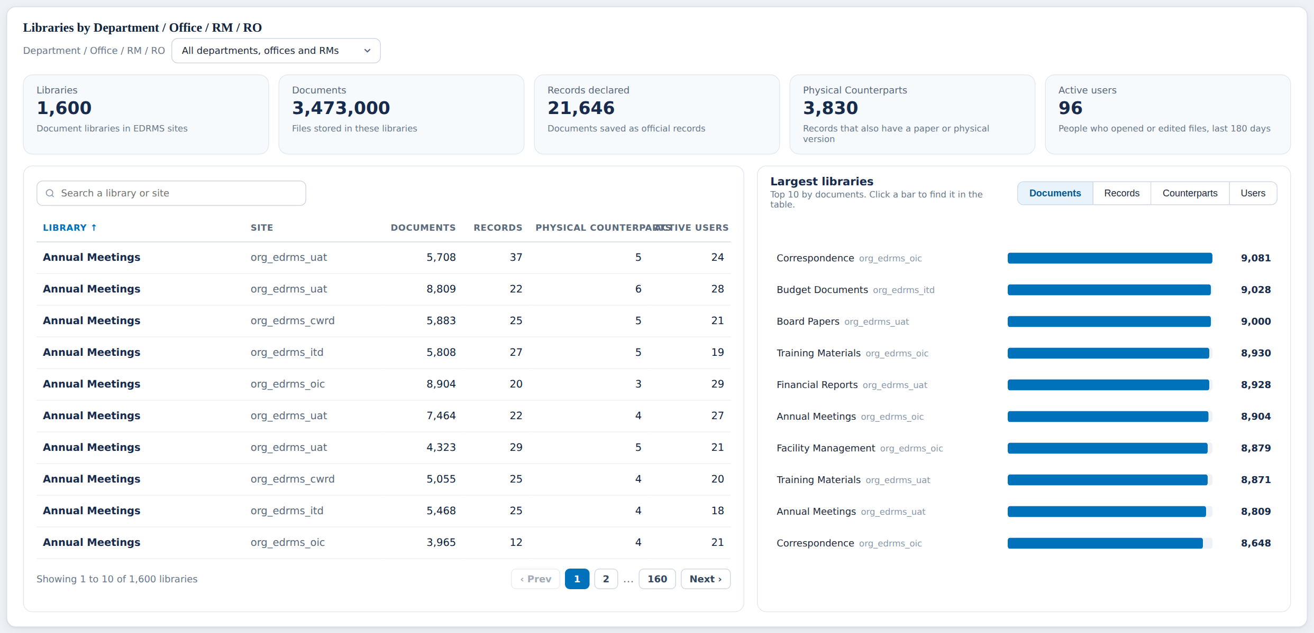
Library usage
Panel: libraries by Department / Office / RM / RO
Item | What it shows | Status | Ask, clarify or still lacking
Libraries (1,600) | Document libraries in EDRMS sites | Agreed, demo figure | Needs the weekly library scan, not yet built
Documents, records, counterparts per library | Per-library table and Largest libraries chart | Agreed, demo figure | Same weekly scan
Active users per library (96) | People who opened or edited files in the library | Still lacking | Microsoft 365 reports activity per SITE, never per library (item 81). No known source: agree to drop or mark Not captured
Table headings | Column headings | Needs clarification | "Physical counterparts" overlaps "Active users" in the table heading. Layout fix needed in Floot

Slide 19
What to ask, and who to ask
RAC
Leah Bancale, Cloud Governance
Microsoft 365 admin
Dev team
Real headcount per unit (24), one rounding rule
Go-Live dates and site convention links
Does a typed headcount count as "sourced authoritatively"?
Staff, contractor, consultant split from AD? (27 to 29)
Inactivity threshold 180 days? (26)
Project sites in or out of the 1,032?
Owners of the 2 sites with no department
PRODUCTION Workspace report export, the highest value file
Are converted sites recorded the same way as created ones?
Clear "Display concealed user, group and site names", then re-export the site usage report
Production SharePoint activity report
Run COUNT(DISTINCT CreatedBy) on the Records table
Build the weekly site and library scan
Confirm the physical counterpart field

