Slide 1
EDRMS Utilization Report
Walking through the working prototype, screen by screen — and what we still need from you
6
249
188
16
key views
things you asked for
built so far
waiting on a later release
Client workshop · 22 August 2026 · Prototype, not final
Notes:
Open by saying what this session is for: we built a working prototype from your slides, we want to walk it with you, and we have 27 questions where we are stuck without you. Set expectations: nothing here is final. This is exactly the point where changing things is cheap.

Slide 2
BEFORE WE START
How to read every slide from here on
BUILT
On the screen and running on real data. Nothing needed from you.
LEFT SIDE
The actual screen
A real screenshot of the working prototype. Everything you see is clickable in the live version — we can open it at any point if you want to poke at something.
PLACEHOLDER
The screen is built and correct, but the numbers on it are made up, because we have no source yet. It will look real. It is not.
RIGHT SIDE
Your checklist for that screen
NEEDS YOU
Not built. We are stuck until you answer a question. These are what today is really for.
Every item you asked for on that screen, and whether it is there. Nothing has been left off the list.
LATER RELEASE
Not built, and not something you can answer today. The feature it depends on has not shipped yet. We come back to these at the end.
Please stop me the moment something does not look right. That is far more useful to us today than politeness at the end.
Notes:
Spend a full minute on the amber category. It is the one that causes trouble later — a screen that looks finished but is running on invented numbers. Say plainly: if you see a number today, assume it is illustrative unless the checklist says BUILT.

Slide 3
THE SHAPE OF THE REPORT
Six views, each answering one question
1
Bank-wide Oversight
2
Department Insights
3
Project Insights
How is EDRMS being used across the whole bank?
How is one department using EDRMS?
Are project sites being kept up to recordkeeping standards?
44 of 65 built · 7 later release
59 of 84 built · 6 later release
21 of 21 built
4
Institutional File Plan
5
Retention and Disposal
6
Records and Archive Holdings
Is the file plan actually being used?
What must be kept forever, and what is coming up for disposal?
What is in the physical archive, and what is moving in and out?
22 of 26 built
18 of 27 built · 1 later release
24 of 26 built · 2 later release
Notes:
Give one sentence per view, no more. The point of this slide is that they can see the whole shape before you dive in, and can tell you now if a view is missing or misnamed.

Slide 4
WHERE WE ARE
188 of the 249 things you asked for are built
76%
Built
Working in the prototype today
45
Waiting on you
Questions only you can answer
16
Waiting on a release
Disposal and Physical Records. Not a data problem.
Notes:
Do not let them read the chart as a report card on the team. Frame it the other way round: the 61 red items are almost all one of three missing sources, and they are the only people who can point us at them.

Slide 5
SEQUENCING
Two of the six views are waiting on a release, not on data
Four dashboards can be finished on the Utilization work alone. The other two depend on things that do not exist in the system yet — so the honest plan is to sequence them, not to force them.
NOW
NEXT
AFTER THAT
Utilization
Disposal release
Physical Records release
Bank-wide Oversight
Retention & Disposal — the disposal half
Records & Archive Holdings, in full
Department Insights
Disposal approver and outcome, bank-wide
Storage, retrieval and capacity
Project Insights
Disposal approver and outcome, per department
Boxes and folders held by RAC
Institutional File Plan
Retention & Disposal — the retention half
Deliverable on this programme, once the open questions are answered.
14 items. Disposal is not built in EDRMS yet: no approval screen, no field to record an outcome.
26 items. This dashboard is about paper, and the physical work comes after Utilization.
Nothing is being dropped. The screens for the later two are already drawn — they switch on when the feature behind them exists.
Notes:
This is the most important slide in the deck and it comes early on purpose. If they take one thing away, it is that two dashboards are sequenced, not failed. Say it in their language: the report cannot show a disposal outcome because nobody can record a disposal outcome yet. That is not a reporting gap, it is a feature that has not shipped. Do not apologise here. This is a normal delivery decision and presenting it as one is what makes them accept it.

Slide 6
VIEW 1 OF 6
Bank-wide Oversight
44
of 65 built
How is EDRMS being used across the whole bank?
14 need your input
7 wait on the next release
9 screens to walk through
Notes:
Pause here. Ask whether this is still the right question for this view before showing any screen — if the question is wrong, everything after it is wrong too.

Slide 7
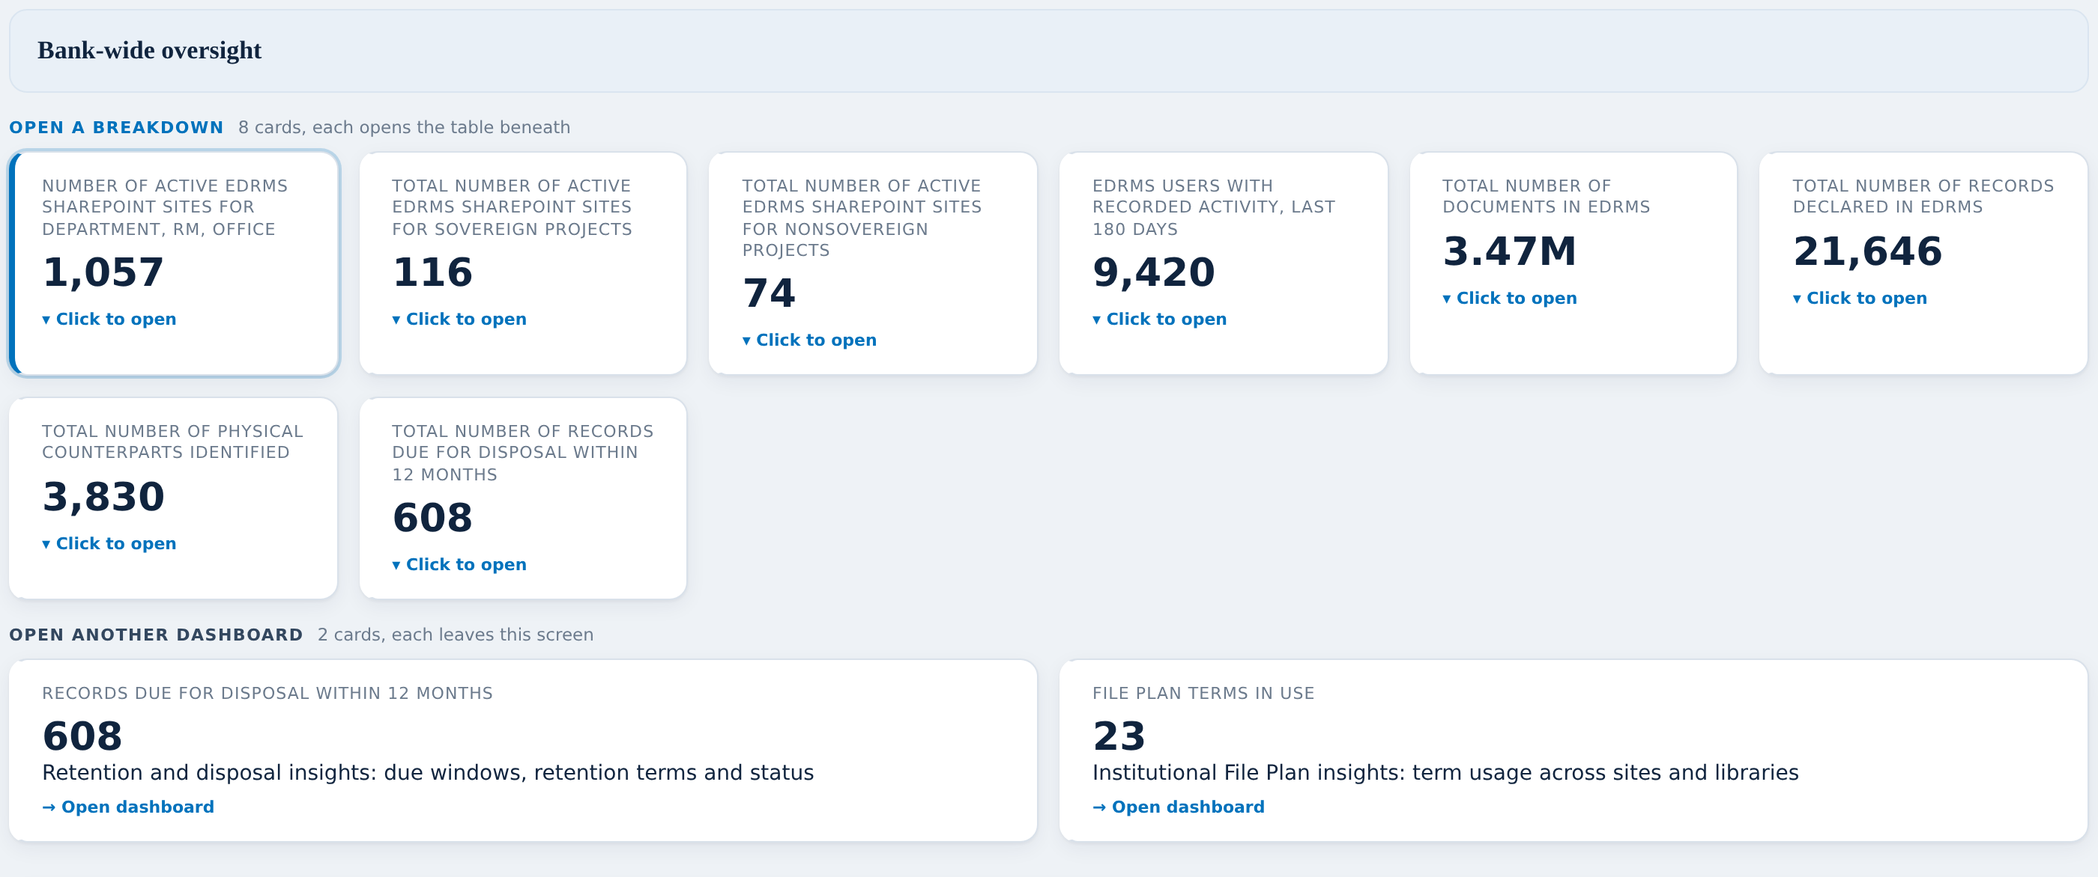
BANK-WIDE OVERSIGHT
The ten headline figures
WHAT YOU ASKED FOR ON THIS SCREEN
BUILT
Number of active EDRMS SharePoint sites for Department, RM, office
BUILT
Total number of EDRMS users
BUILT
Total number of documents in EDRMS
BUILT
Total number of records declared in EDRMS
BUILT
Total number of physical counterparts identified
BUILT
Total number of records due for disposal
BUILT
Retention and disposal insights (navigation tile)
BUILT
Institutional File Plan insights (navigation tile)
BUILT
Total number of active EDRMS SharePoint sites for Sovereign projects
BUILT
Total number of active EDRMS SharePoint sites for Nonsovereign projects
Every figure the client drew on slide 34 is on this one strip.
The two grey tiles are doors, not numbers: they open the other dashboards.
Two labels changed. I will explain why on the questions slide.
Notes:
The ten headline figures On the checklist: 10 items, 10 built, 0 needing them. Talking points: - Every figure the client drew on slide 34 is on this one strip. - The two grey tiles are doors, not numbers: they open the other dashboards. - Two labels changed. I will explain why on the questions slide. Nothing red on this screen. Say so out loud; it builds credit for the screens where there is.

Slide 8
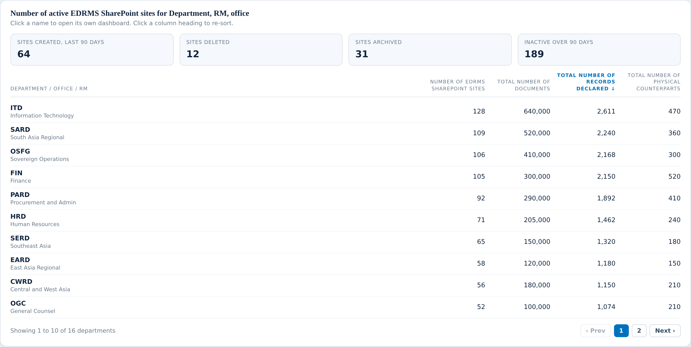
BANK-WIDE OVERSIGHT
Sites, department by department
WHAT YOU ASKED FOR ON THIS SCREEN
BUILT
Department / office / RM
BUILT
Number of EDRMS SharePoint sites
BUILT
Total number of documents
BUILT
Total number of records declared
BUILT
Total number of physical counterparts
BUILT
Each name clickable into that unit's dashboard
BUILT
Indicator: no. of sites created
BUILT
Indicator: no. of sites deleted
BUILT
Indicator: no. of sites archived
BUILT
Indicator: inactive site for 90 days
Click any figure on the strip above and the table underneath changes.
Every department name opens that department’s own dashboard.
The four indicators on the right are sites created, deleted, archived and gone quiet.
Notes:
Sites, department by department On the checklist: 10 items, 10 built, 0 needing them. Talking points: - Click any figure on the strip above and the table underneath changes. - Every department name opens that department’s own dashboard. - The four indicators on the right are sites created, deleted, archived and gone quiet. Nothing red on this screen. Say so out loud; it builds credit for the screens where there is.

Slide 9
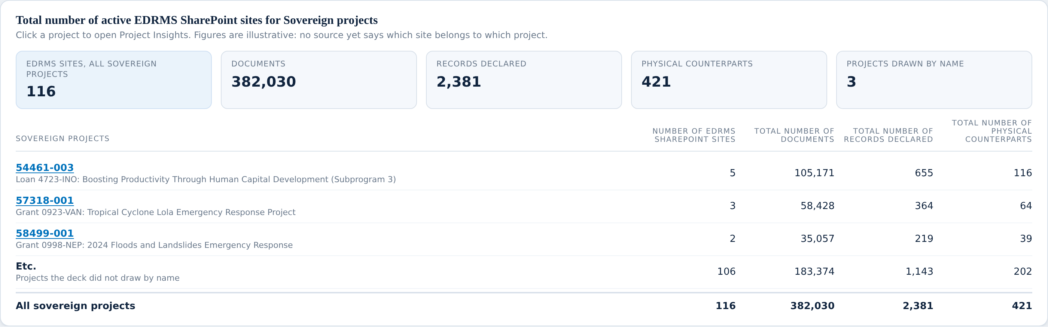
BANK-WIDE OVERSIGHT
Project sites, sovereign and nonsovereign
WHAT YOU ASKED FOR ON THIS SCREEN
BUILT
Sovereign project site list, all columns
BUILT
Nonsovereign project site list, all columns
BUILT
Project rows clickable into Project Insights
The client asked for these as two separate lists. Both are here.
Any project row opens Project Insights for that project.
The bottom row is the facility total, because their own slide ends the list with “Etc.”
Notes:
Project sites, sovereign and nonsovereign On the checklist: 3 items, 3 built, 0 needing them. Talking points: - The client asked for these as two separate lists. Both are here. - Any project row opens Project Insights for that project. - The bottom row is the facility total, because their own slide ends the list with “Etc.” Nothing red on this screen. Say so out loud; it builds credit for the screens where there is.

Slide 10
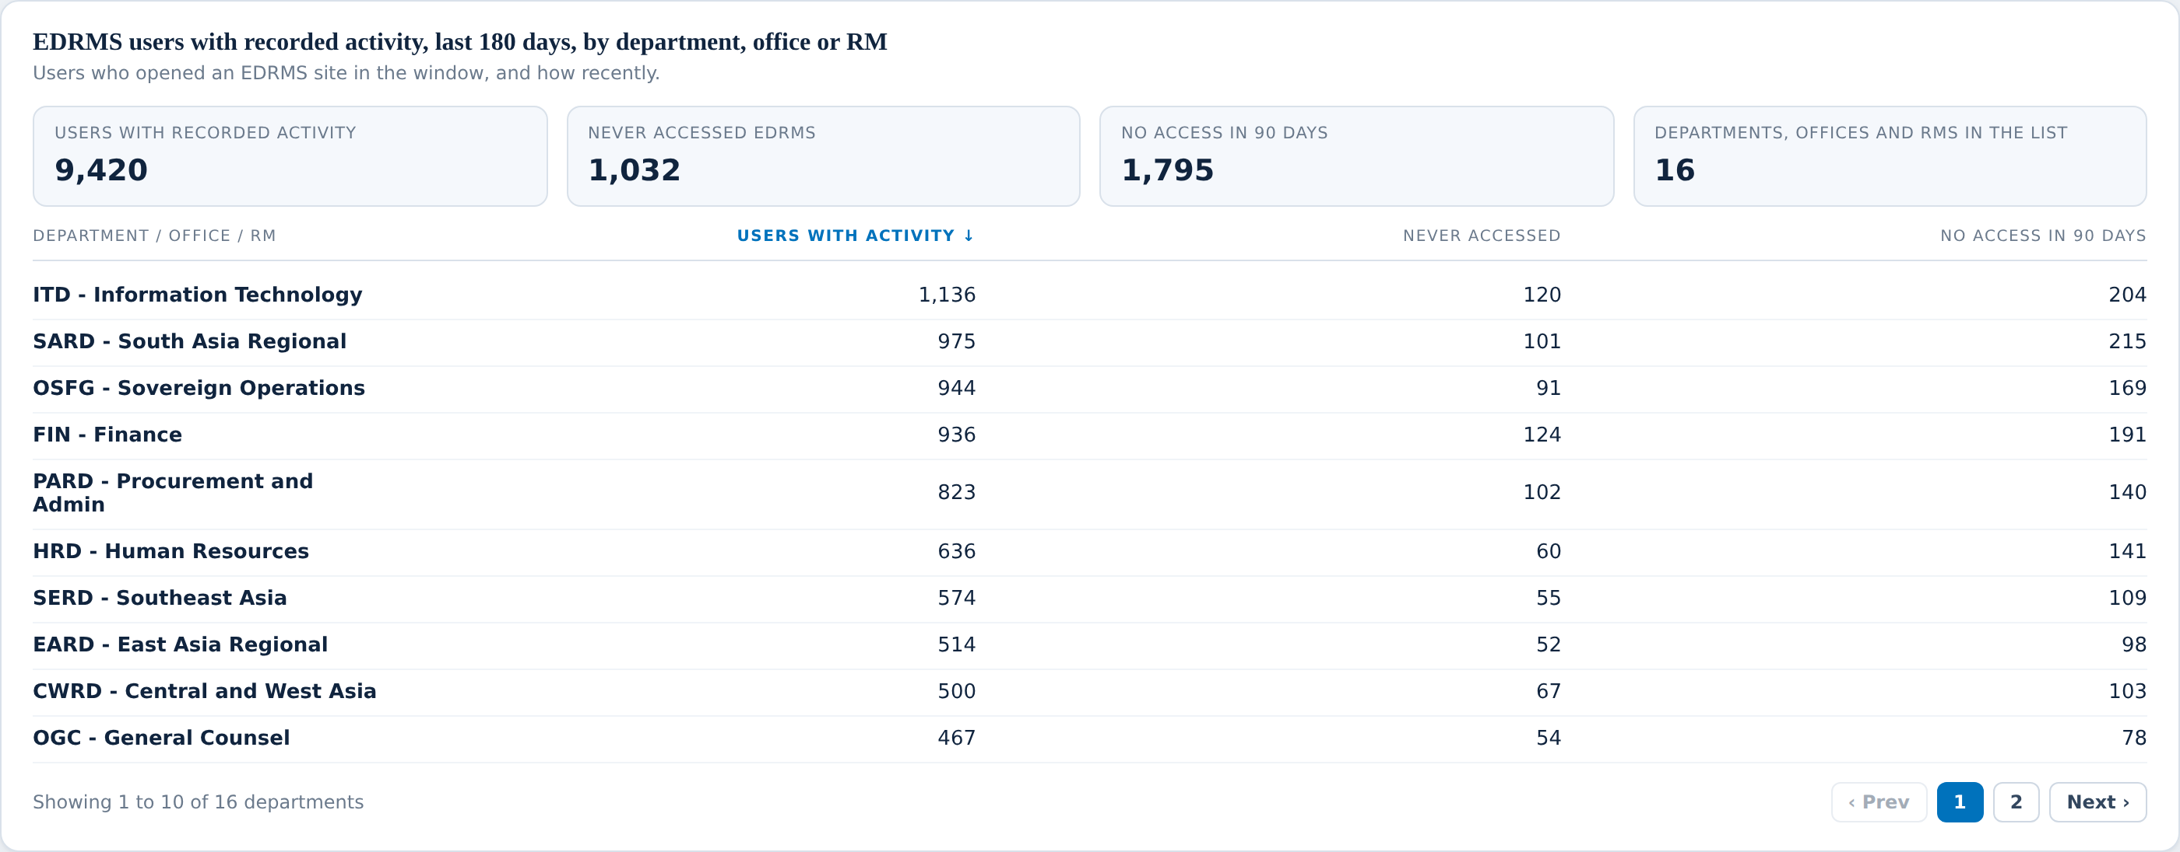
BANK-WIDE OVERSIGHT
Users
WHAT YOU ASKED FOR ON THIS SCREEN
BUILT
Total number of users, count
BUILT
Indicator: % of active users
BUILT
Indicator: never accessed EDRMS
BUILT
Indicator: not accessed in 90 days
NEEDS YOU
Total number of users (staff)
NEEDS YOU
Total number of users (Contractors)
NEEDS YOU
Total number of users (Consultants)
NEEDS YOU
Completion of training
NEEDS YOU
Onboarded since go-live
NEEDS YOU
User to department mapping
We can see who has actually used EDRMS. We cannot see who they are.
Six of the ten things asked for here need something from you.
This is the biggest single gap in the whole report.
Notes:
Users On the checklist: 10 items, 4 built, 6 needing them. Talking points: - We can see who has actually used EDRMS. We cannot see who they are. - Six of the ten things asked for here need something from you. - This is the biggest single gap in the whole report. Do not solve the red items here — say "we come back to this in three slides" and keep moving.

Slide 11
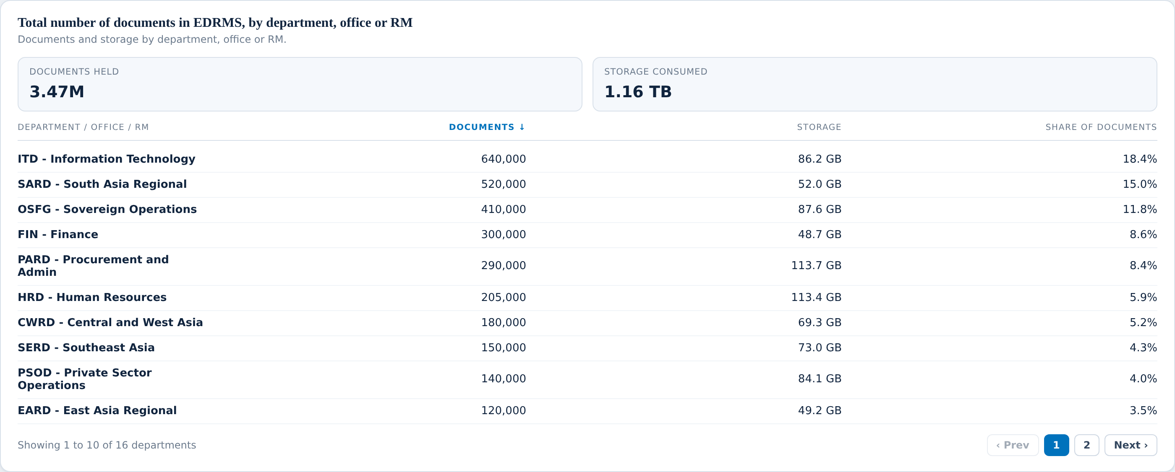
BANK-WIDE OVERSIGHT
Documents
WHAT YOU ASKED FOR ON THIS SCREEN
BUILT
Number of documents created / uploaded
BUILT
Documents size (in GB)
NEEDS YOU
Number of users creating documents
NEEDS YOU
Indicator: new documents month on month
NEEDS YOU
Indicator: average monthly storage growth
NEEDS YOU
Per division breakdown
Document counts and storage size are solid and come from real data.
What is missing is history: we can show today, not the trend.
“Per division” appears again here. It appears on six screens in total.
Notes:
Documents On the checklist: 6 items, 2 built, 4 needing them. Talking points: - Document counts and storage size are solid and come from real data. - What is missing is history: we can show today, not the trend. - “Per division” appears again here. It appears on six screens in total. Do not solve the red items here — say "we come back to this in three slides" and keep moving.

Slide 12
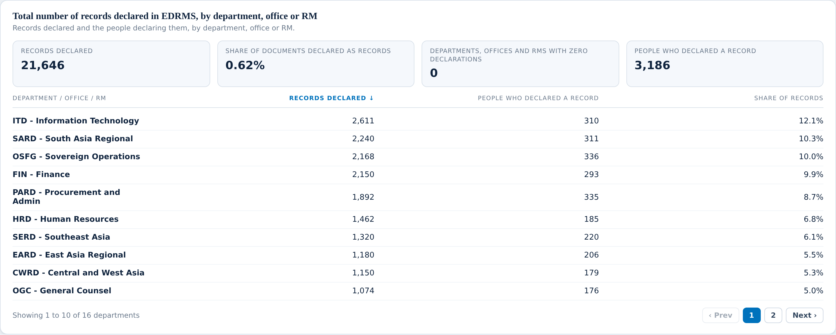
BANK-WIDE OVERSIGHT
Records declared
WHAT YOU ASKED FOR ON THIS SCREEN
BUILT
Total number of records declared
BUILT
Total number of users declaring records
BUILT
Indicator: zero record declarations
BUILT
Indicator: declaration rate against documents
NEEDS YOU
Number of records declared per division
NEEDS YOU
Number of users declaring records per division
This is the number the whole programme is judged on.
The declaration rate compares records declared against documents held.
Departments with zero declarations are flagged so they can be chased.
Notes:
Records declared On the checklist: 6 items, 4 built, 2 needing them. Talking points: - This is the number the whole programme is judged on. - The declaration rate compares records declared against documents held. - Departments with zero declarations are flagged so they can be chased. Do not solve the red items here — say "we come back to this in three slides" and keep moving.

Slide 13
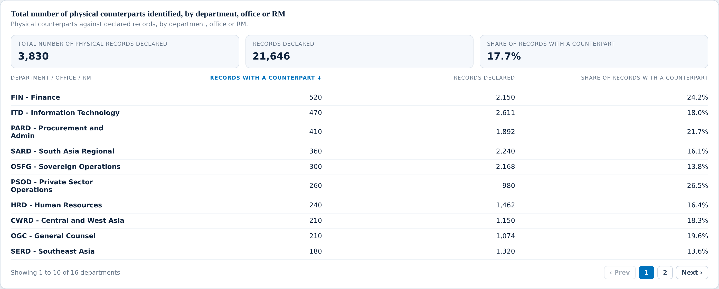
BANK-WIDE OVERSIGHT
Physical counterparts
WHAT YOU ASKED FOR ON THIS SCREEN
BUILT
Total number of physical records declared
BUILT
Total number of users declaring records
BUILT
Share of records with a counterpart
NEEDS YOU
Per division, two columns
NEEDS YOU
Indicator: physical counterpart completion rate (turned over to RAC)
A physical counterpart is a declared record that also exists on paper.
This is the bridge between this report and what RAC holds in its rooms.
What we cannot show is whether the paper actually reached RAC.
Notes:
Physical counterparts On the checklist: 5 items, 3 built, 2 needing them. Talking points: - A physical counterpart is a declared record that also exists on paper. - This is the bridge between this report and what RAC holds in its rooms. - What we cannot show is whether the paper actually reached RAC. Do not solve the red items here — say "we come back to this in three slides" and keep moving.

Slide 14
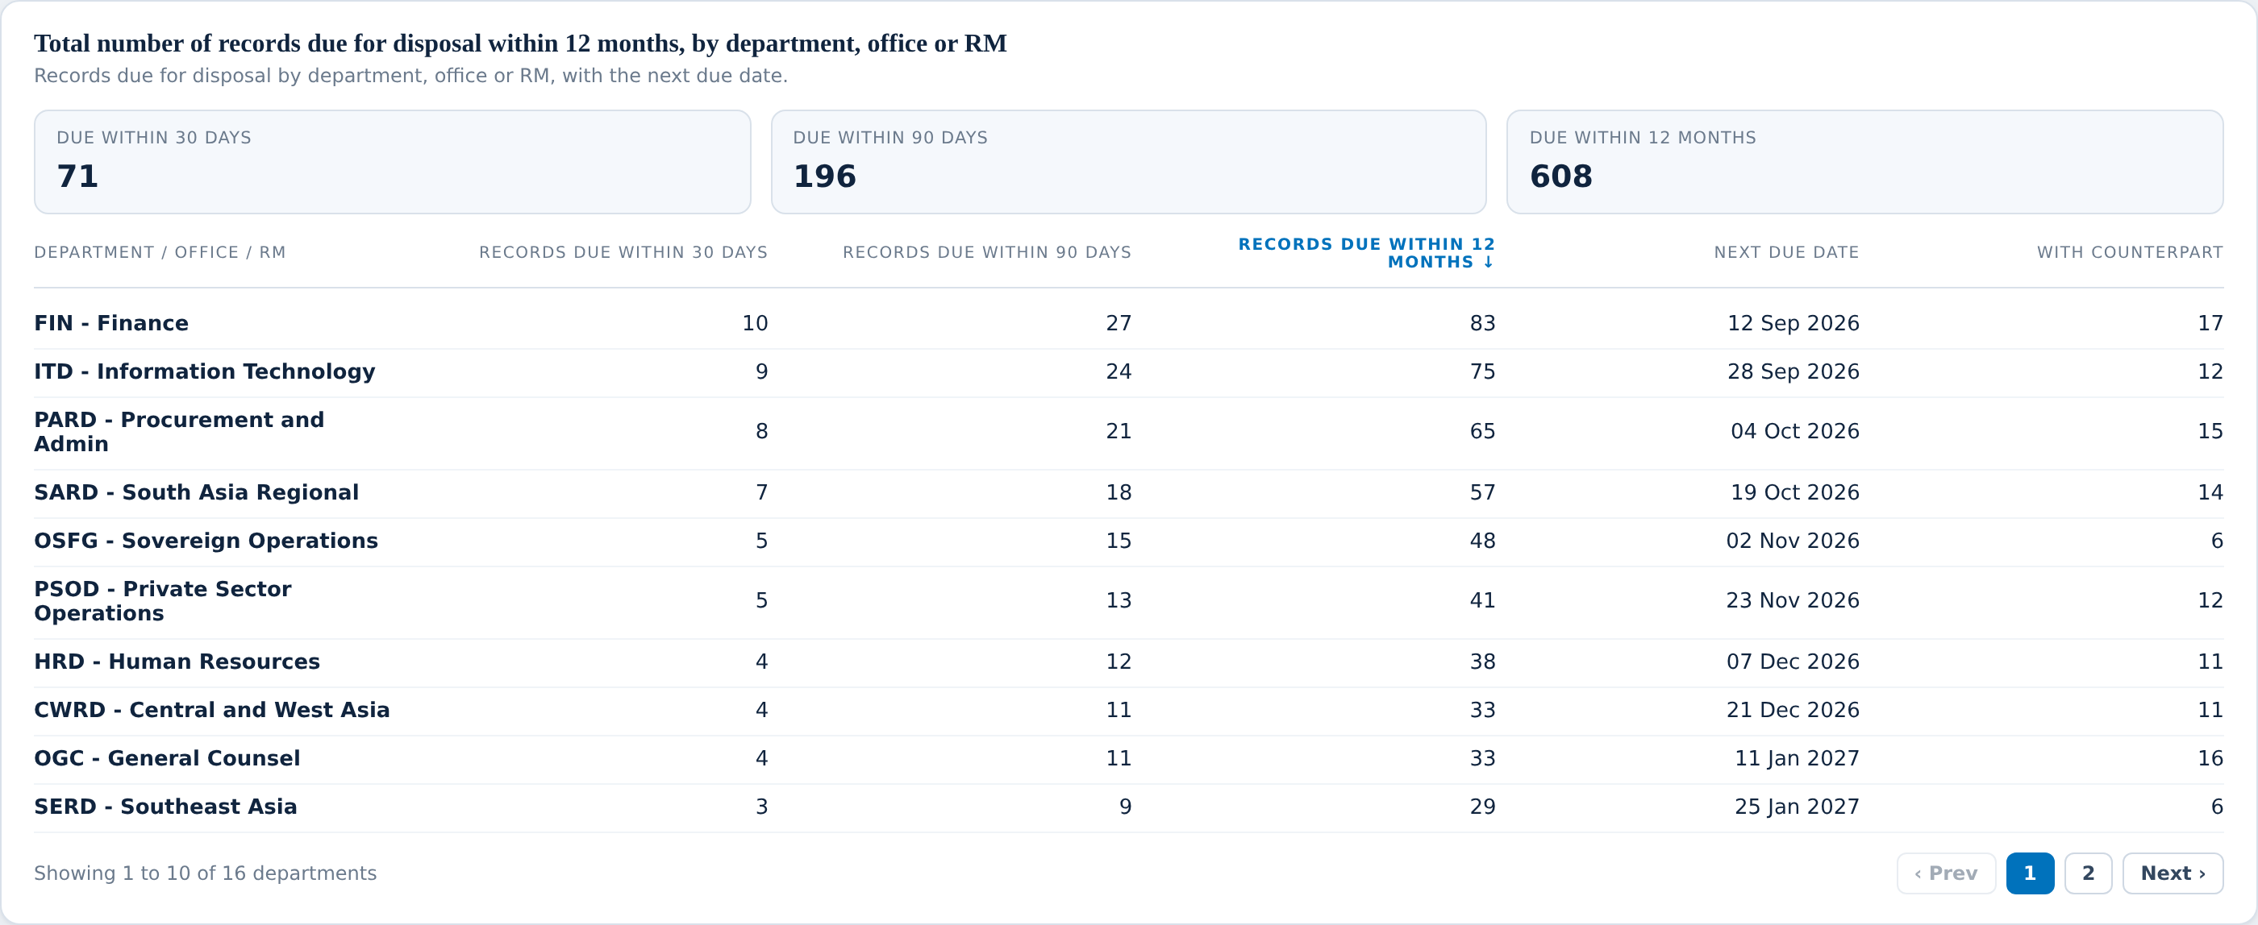
BANK-WIDE OVERSIGHT
Records due for disposal
WHAT YOU ASKED FOR ON THIS SCREEN
BUILT
Number of records due for disposal
BUILT
Next due date for disposal
BUILT
With physical counterpart?
BUILT
Indicator: upcoming next quarter
LATER RELEASE
Disposal approver
LATER RELEASE
Status (Approved)
LATER RELEASE
Status (Declined)
LATER RELEASE
Status (Extended)
LATER RELEASE
Indicator: records disposed month on month
LATER RELEASE
Indicator: overdue actions, pending approvals
LATER RELEASE
Indicator: disposal completion rate
We can show what is due, and when. That part is solid.
We cannot show what happened next, because nothing records an outcome.
Seven of the eleven items here are waiting on that one gap.
Notes:
Records due for disposal On the checklist: 11 items, 4 built, 7 needing them. Talking points: - We can show what is due, and when. That part is solid. - We cannot show what happened next, because nothing records an outcome. - Seven of the eleven items here are waiting on that one gap. Do not solve the red items here — say "we come back to this in three slides" and keep moving.

Slide 15
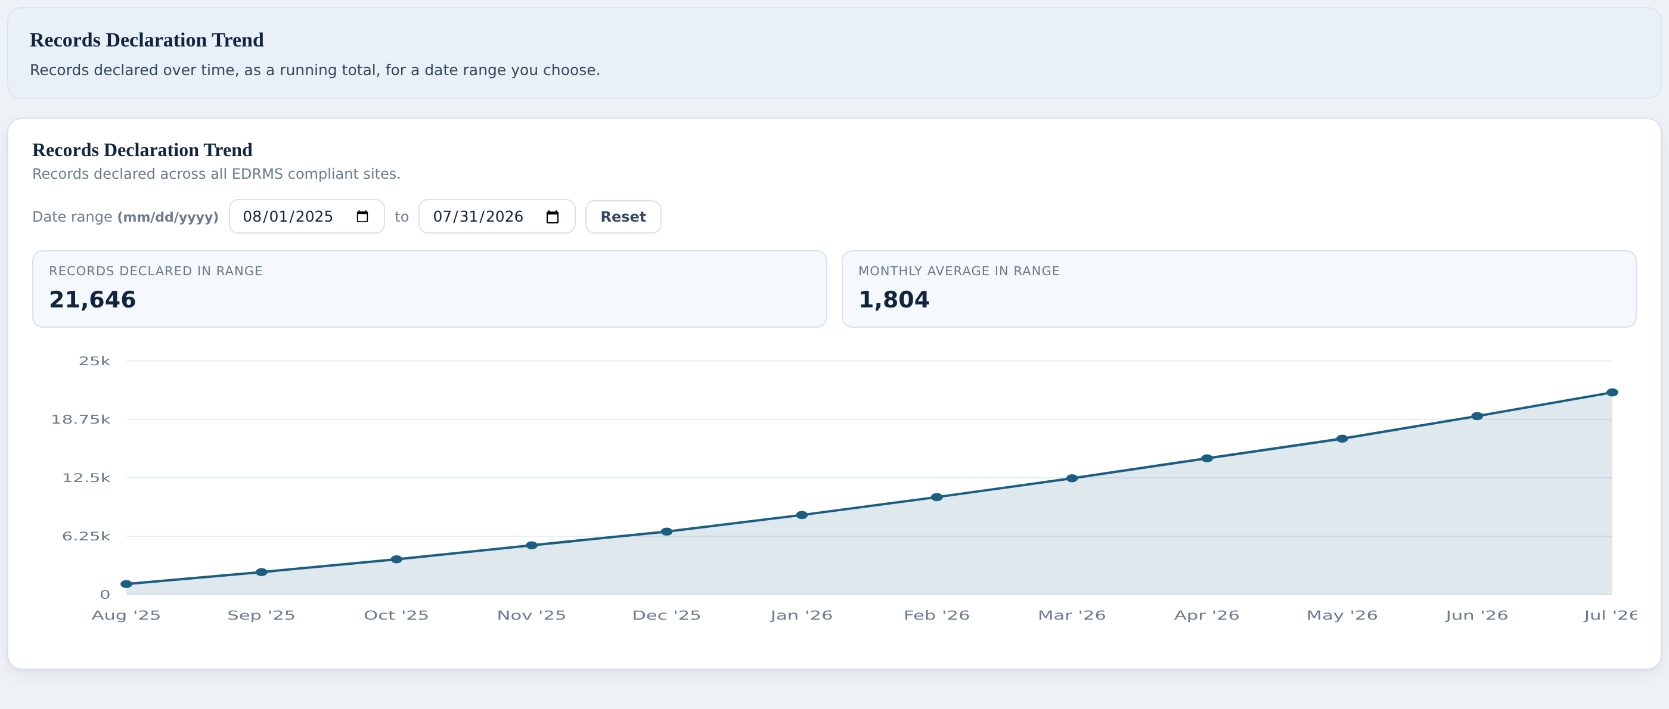
BANK-WIDE OVERSIGHT
Trends and comparisons
WHAT YOU ASKED FOR ON THIS SCREEN
BUILT
Comparison, three named ratios
BUILT
Bank-wide records declaration trend, cumulative
BUILT
Records declared in range
BUILT
Monthly average in range
The curve is cumulative, so the last point is the running total to date.
You can set any date range and the two figures beneath update.
The comparison panel above ranks departments on three named ratios.
Notes:
Trends and comparisons On the checklist: 4 items, 4 built, 0 needing them. Talking points: - The curve is cumulative, so the last point is the running total to date. - You can set any date range and the two figures beneath update. - The comparison panel above ranks departments on three named ratios. Nothing red on this screen. Say so out loud; it builds credit for the screens where there is.

Slide 16
BANK-WIDE OVERSIGHT
What we need from you (1 of 2)
THE QUESTION
WHY WE ARE STUCK
WHAT WOULD UNBLOCK IT
1
Who is staff, who is a consultant, and who is a contractor?
The report can see that 1,200 people used EDRMS. It cannot see what kind of person each one is, so we cannot split any user figure three ways as you asked.
Is there a list somewhere — HR, or a directory — that says which category each person falls into? Even a monthly export would do.
2
Which department does each person belong to?
Same problem. We can count people, but we cannot say a person belongs to SARD rather than HRD, so “users per department” cannot be built.
Where is that held today, and could we read it?
3
Who has completed EDRMS training?
You asked for a training completion figure on two screens. Nothing we can reach records training.
Who keeps the training records, and in what form?
4
Who joined since go-live?
We can see activity, but not a start date, so “onboarded since go-live” cannot be counted.
Is a joining date recorded anywhere we could match to a person?
5
What counts as a division?
“Per division” appears on six different screens. We can group by department today, but nothing tells us which division inside a department a site or a person belongs to.
Is there an agreed list of divisions, and does something already tag sites or people with one?
Notes:
Read the question in the left column out loud, then stop talking. Do not fill the silence with the middle column unless they ask why. What a good answer sounds like: a system name, a person's name, or "it's in a spreadsheet". Any of those three is a win. "We'll look into it" is not — get a name against it before moving on.

Slide 17
BANK-WIDE OVERSIGHT
What we need from you (2 of 2)
THE QUESTION
WHY WE ARE STUCK
WHAT WOULD UNBLOCK IT
Can we keep a monthly history?
Several of your indicators are month-on-month — new documents, storage growth, records disposed. Today we can only see the current position, not last month’s.
This one we can solve ourselves by taking a monthly snapshot. We just need your agreement to start, because the history only builds from the day we begin.
6
Who approves a disposal, and what did they decide?
The report can show what is due for disposal. It cannot show approved, declined or extended, because the system has nowhere to record that decision.
How is a disposal approved today — email, a form, a meeting? If we know where the decision lives, we can work out how to bring it in.
7
How do we know a paper file actually reached RAC?
We can see which records are marked as having a paper counterpart. We cannot see whether that paper was handed over.
Does RAC record what it receives, and could we match that back to the record in EDRMS?
8
How many people are creating documents?
We can count documents. Counting the distinct people who created them needs a different kind of report than the one we have access to.
This is one for us to solve, but it may need a change request. Flagging it so it is not a surprise later.
9
Notes:
Read the question in the left column out loud, then stop talking. Do not fill the silence with the middle column unless they ask why. What a good answer sounds like: a system name, a person's name, or "it's in a spreadsheet". Any of those three is a win. "We'll look into it" is not — get a name against it before moving on.

Slide 18
VIEW 2 OF 6
Department Insights
59
of 84 built
How is one department using EDRMS?
19 need your input
6 wait on the next release
9 screens to walk through
Notes:
Pause here. Ask whether this is still the right question for this view before showing any screen — if the question is wrong, everything after it is wrong too.

Slide 19
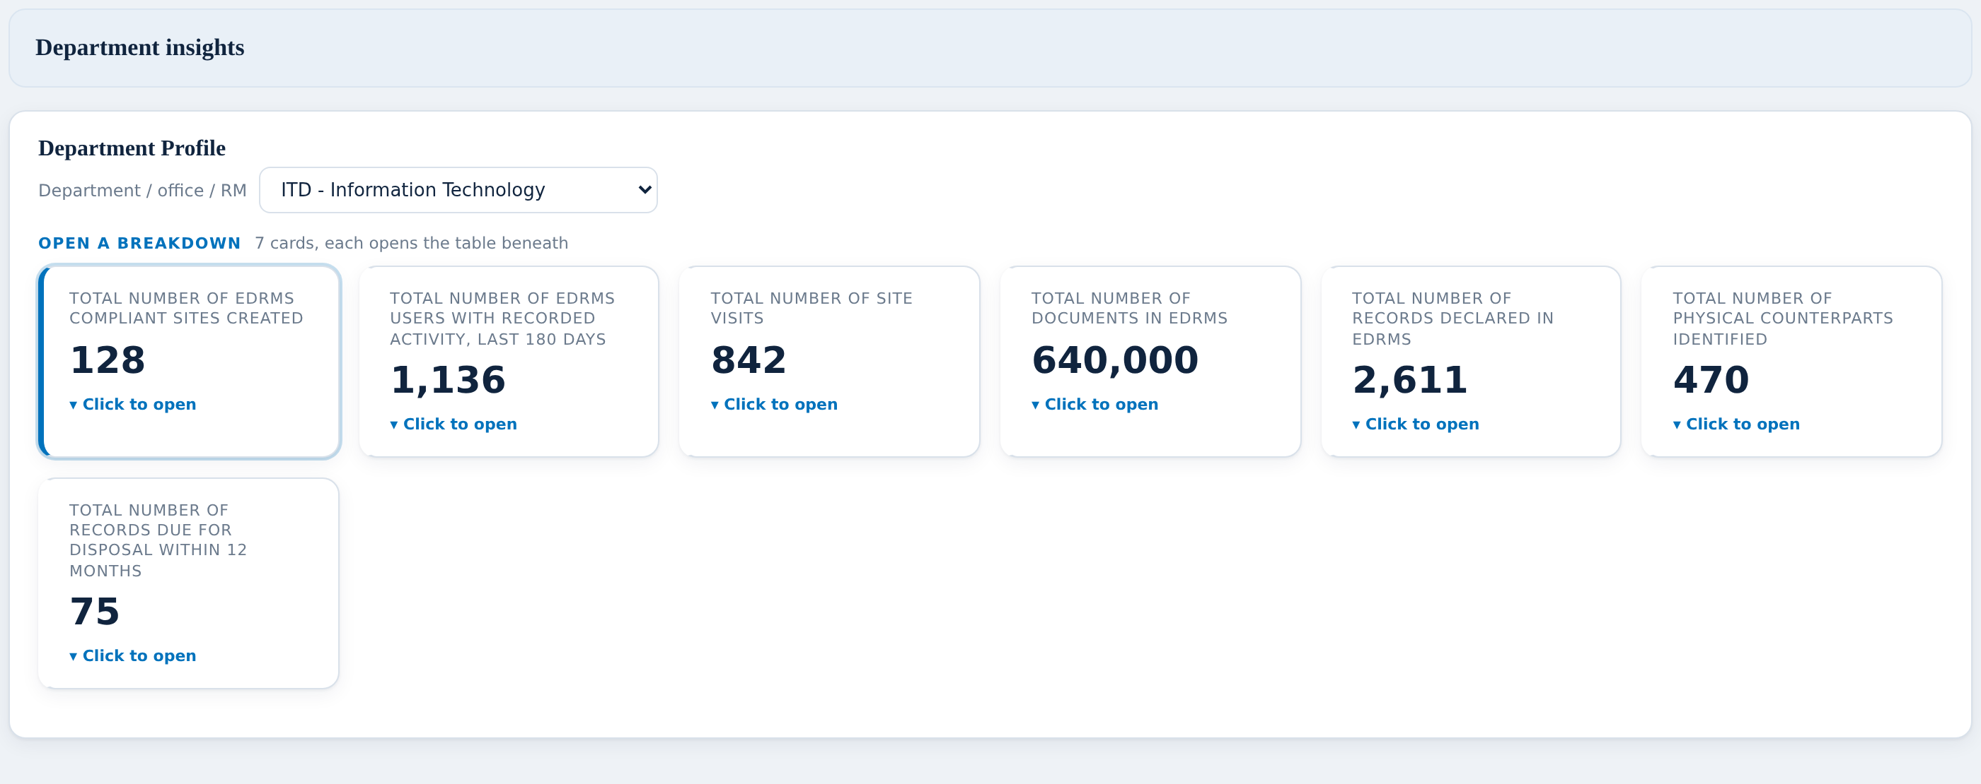
DEPARTMENT INSIGHTS
The department profile
WHAT YOU ASKED FOR ON THIS SCREEN
BUILT
Department picker driving the whole screen
BUILT
Total number of sites created
BUILT
Total number of EDRMS users
BUILT
Total number of site visitors
BUILT
Total number of documents in EDRMS
BUILT
Total number of records declared in EDRMS
BUILT
Total number of physical counterparts identified
BUILT
Total number of records due for disposal
BUILT
Clickable top panel stats
NEEDS YOU
Approved SharePoint site, library and folder convention
NEEDS YOU
Go-Live date
Pick a department at the top and every figure on the screen follows it.
The same seven headline figures as bank-wide, narrowed to one unit.
Two things are missing from the profile: the naming convention and the go-live date.
Notes:
The department profile On the checklist: 11 items, 9 built, 2 needing them. Talking points: - Pick a department at the top and every figure on the screen follows it. - The same seven headline figures as bank-wide, narrowed to one unit. - Two things are missing from the profile: the naming convention and the go-live date. Do not solve the red items here — say "we come back to this in three slides" and keep moving.

Slide 20
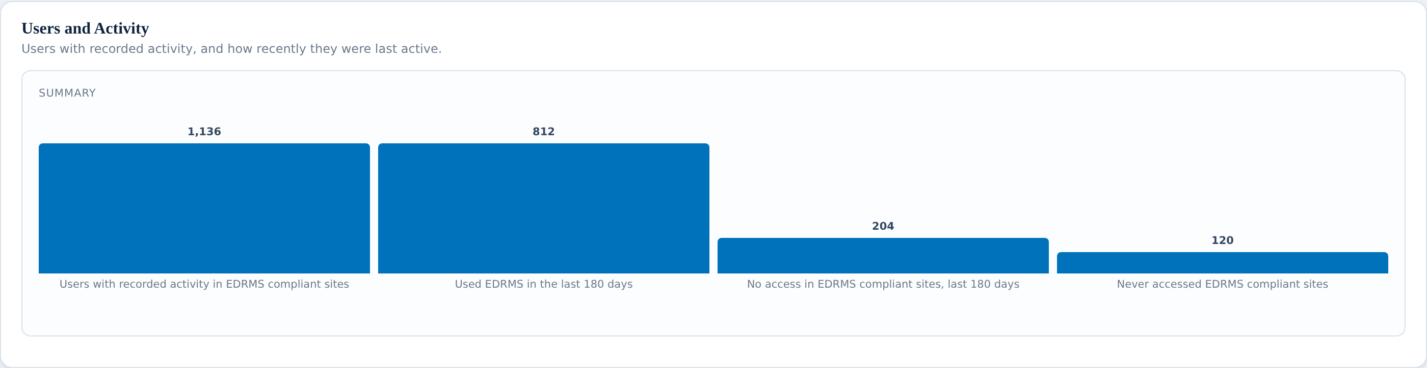
DEPARTMENT INSIGHTS
Users and activity
WHAT YOU ASKED FOR ON THIS SCREEN
BUILT
Total number of active users
BUILT
Used EDRMS in the last 180 days
BUILT
No access in EDRMS compliant sites, last 180 days
BUILT
Never accessed EDRMS compliant sites
NEEDS YOU
Total number of staff
NEEDS YOU
Total number of contractors (#, %)
NEEDS YOU
Total number of consultants (#, %)
NEEDS YOU
Training completion rate (%)
Used in the last 180 days, gone quiet, never touched it — all three are here.
The same user-type gap as bank-wide appears again.
Training completion is asked for here too.
Notes:
Users and activity On the checklist: 8 items, 4 built, 4 needing them. Talking points: - Used in the last 180 days, gone quiet, never touched it — all three are here. - The same user-type gap as bank-wide appears again. - Training completion is asked for here too. Do not solve the red items here — say "we come back to this in three slides" and keep moving.

Slide 21
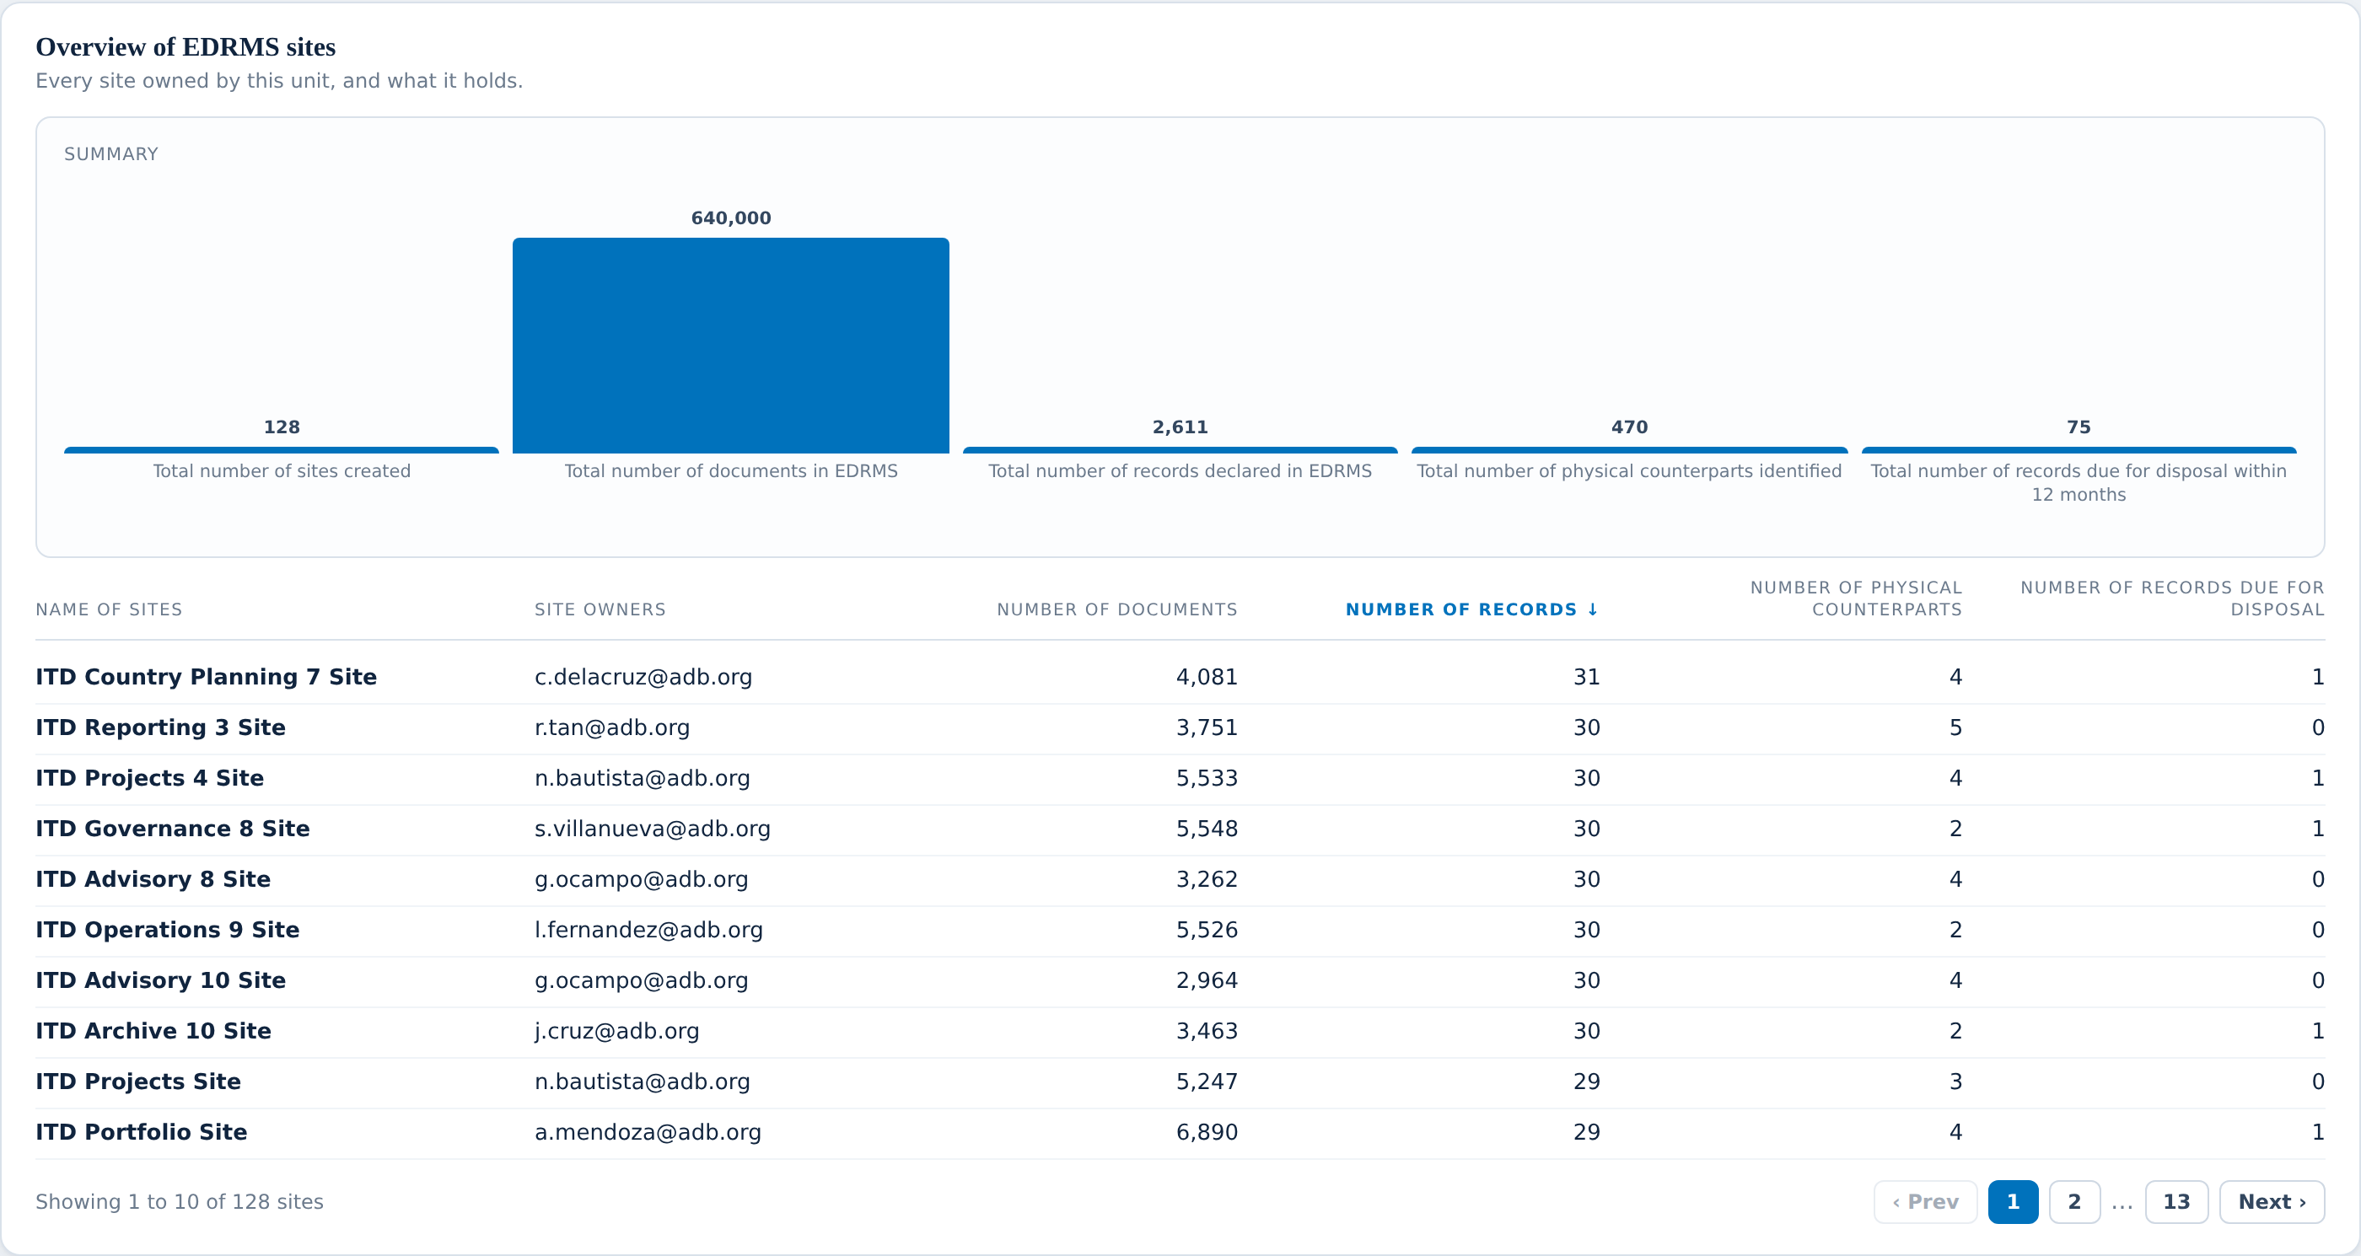
DEPARTMENT INSIGHTS
This department’s sites
WHAT YOU ASKED FOR ON THIS SCREEN
BUILT
Total number of sites created
BUILT
Total number of documents in EDRMS
BUILT
Total number of records declared in EDRMS
BUILT
Total number of physical counterparts identified
BUILT
Total number of records due for disposal within 12 months
BUILT
Name of sites
BUILT
Site owners
BUILT
Number of documents
BUILT
Number of records
BUILT
Number of physical counterparts
BUILT
Number of records due for disposal
Every site the department owns, with its owner named.
All six columns the client drew are present.
This screen is complete — nothing red on it.
Notes:
This department’s sites On the checklist: 11 items, 11 built, 0 needing them. Talking points: - Every site the department owns, with its owner named. - All six columns the client drew are present. - This screen is complete — nothing red on it. Nothing red on this screen. Say so out loud; it builds credit for the screens where there is.

Slide 22
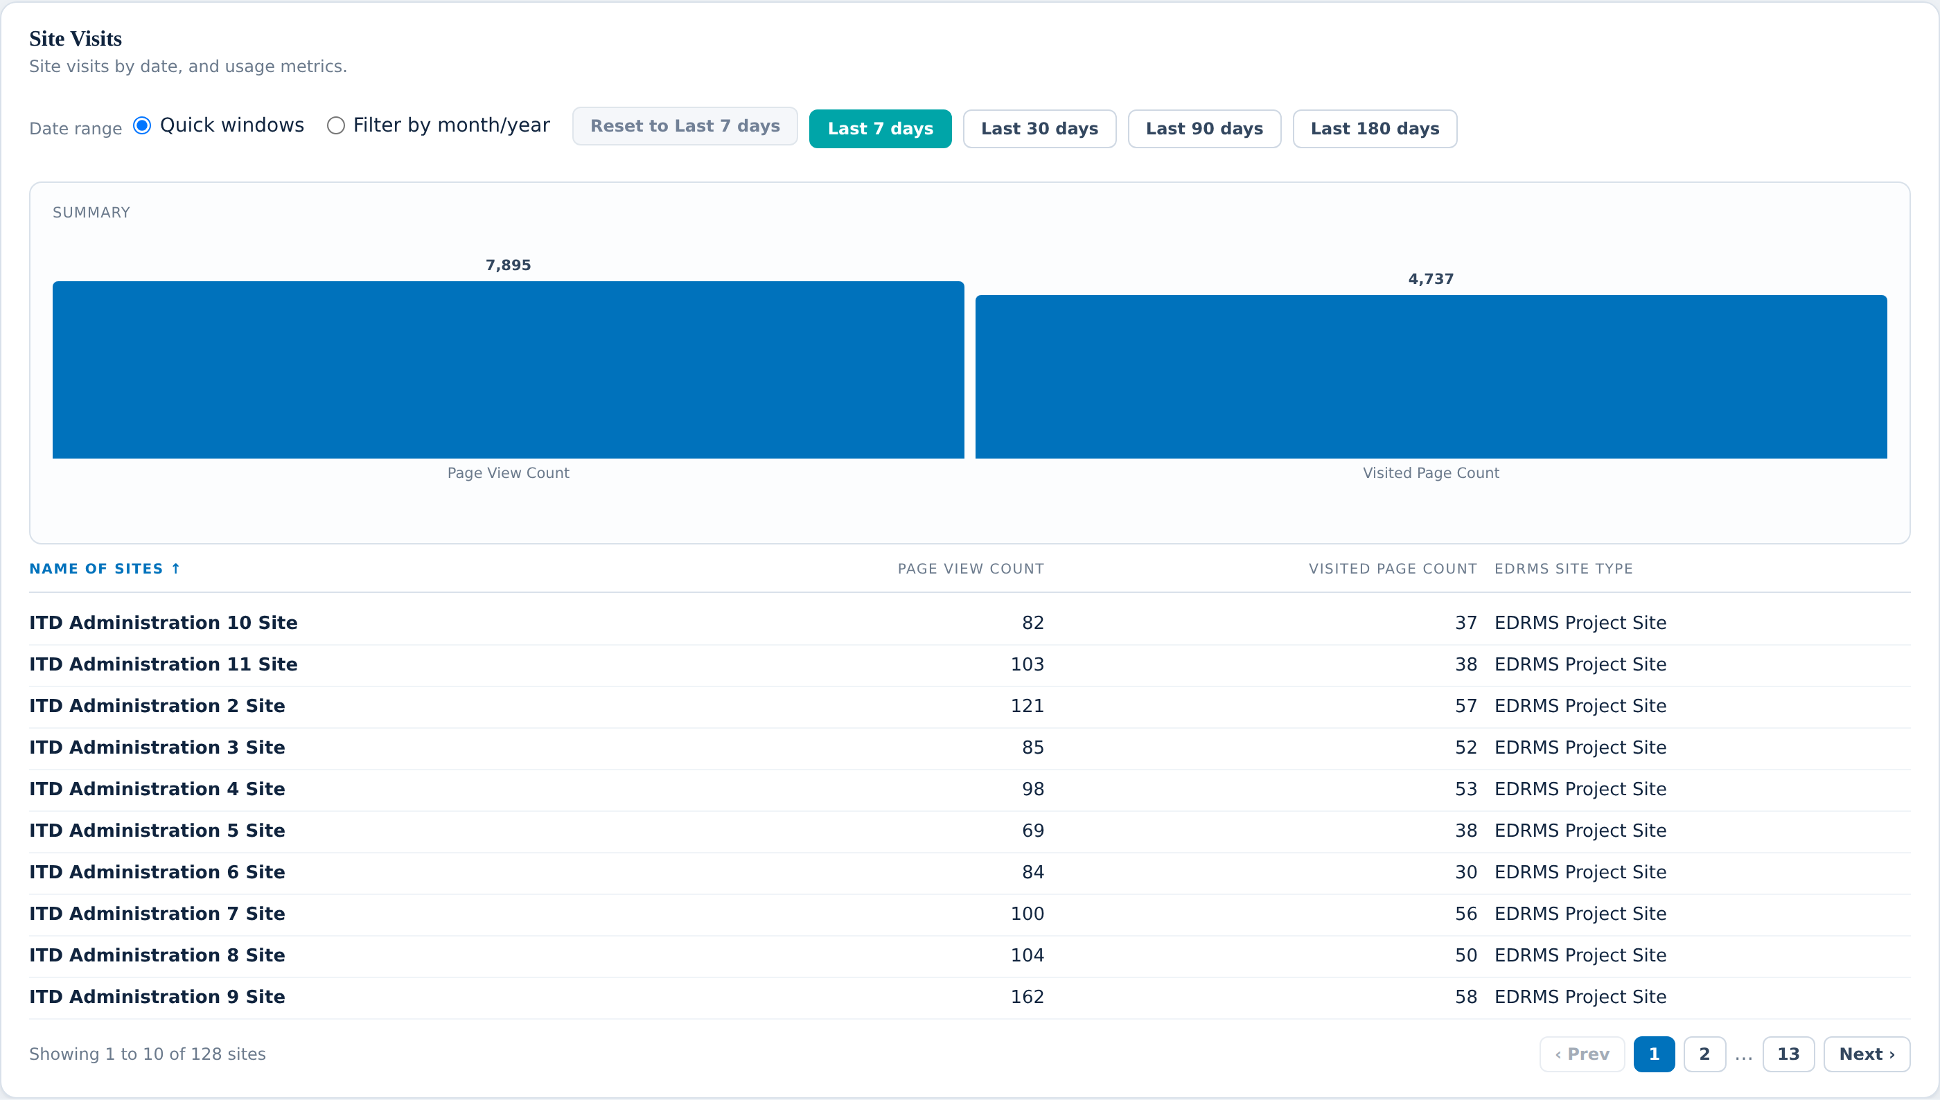
DEPARTMENT INSIGHTS
Site visitors
WHAT YOU ASKED FOR ON THIS SCREEN
BUILT
Total number of visitors
BUILT
Site visits table, by site
BUILT
Page View Count
BUILT
Visited Page Count
BUILT
Quick Windows (Last 7,30,90,180 days)
BUILT
Filter by month/year
BUILT
Name of sites
BUILT
Page View Count
BUILT
Visited Page Count
BUILT
EDRMS Site Type
NEEDS YOU
Total number of visitors (external) (#, %)
NEEDS YOU
Total number of visitors (internal) (#, %)
NEEDS YOU
Total number of access requests granted (#, %)
NEEDS YOU
Total number of access requests denied (#, %)
Page views and unique pages, per site, with quick date windows.
You can also pick any month and year.
What we cannot yet do is separate ADB people from outsiders.
Notes:
Site visitors On the checklist: 14 items, 10 built, 4 needing them. Talking points: - Page views and unique pages, per site, with quick date windows. - You can also pick any month and year. - What we cannot yet do is separate ADB people from outsiders. Do not solve the red items here — say "we come back to this in three slides" and keep moving.

Slide 23
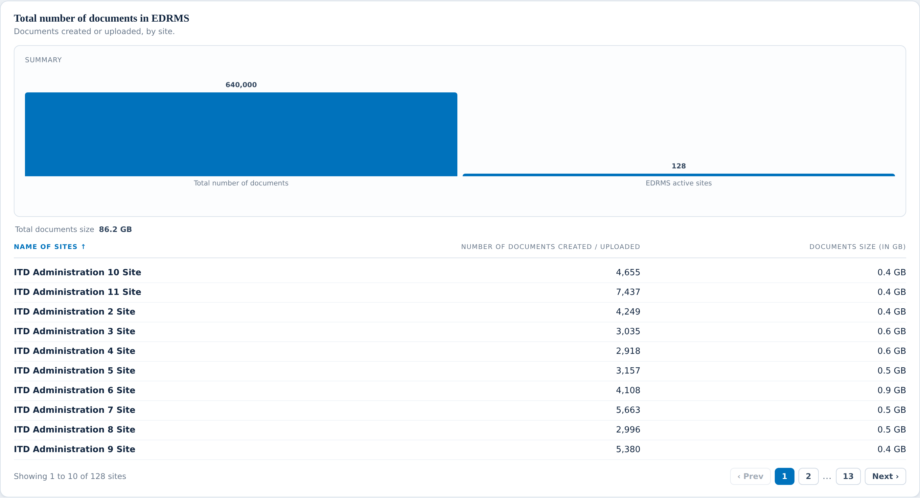
DEPARTMENT INSIGHTS
Documents
WHAT YOU ASKED FOR ON THIS SCREEN
BUILT
Number of documents created / uploaded
BUILT
EDRMS Active Sites
BUILT
Total documents size
BUILT
Name of sites
BUILT
Number of documents created / uploaded
BUILT
Documents size (in GB)
NEEDS YOU
Number of users creating documents
Counts and storage size, per site.
Solid and sourced, apart from one item.
Same “how many people are creating documents” question as bank-wide.
Notes:
Documents On the checklist: 7 items, 6 built, 1 needing them. Talking points: - Counts and storage size, per site. - Solid and sourced, apart from one item. - Same “how many people are creating documents” question as bank-wide. Do not solve the red items here — say "we come back to this in three slides" and keep moving.

Slide 24
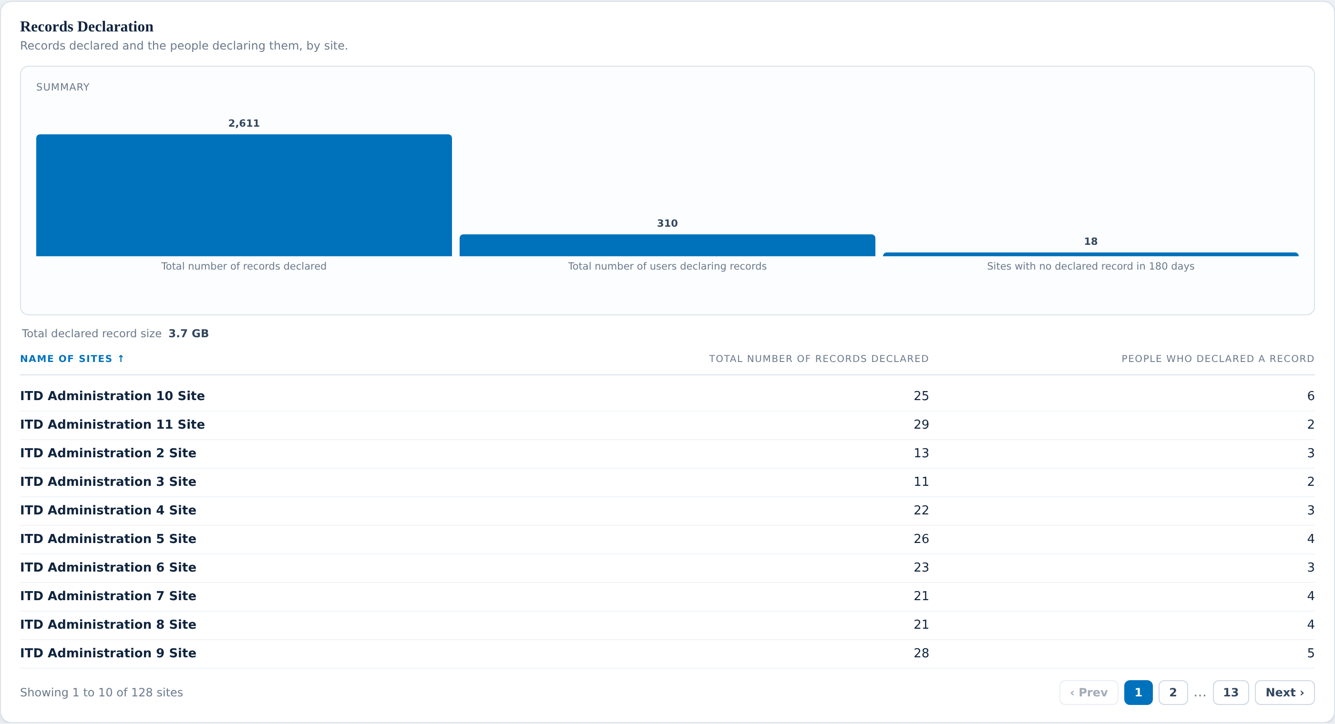
DEPARTMENT INSIGHTS
Records declaration
WHAT YOU ASKED FOR ON THIS SCREEN
BUILT
Total number of records declared
BUILT
Total number of users declaring records
BUILT
Sites with no declared record in 180 days
BUILT
Total number of records declared
BUILT
Total number of users declaring records
BUILT
Total declared record size (in GB)
NEEDS YOU
Number of records declared per division
NEEDS YOU
Number of users declaring records per division
Records declared, people declaring, and total declared size.
Sites that have declared nothing in 180 days are flagged.
Only the two per-division items are missing.
Notes:
Records declaration On the checklist: 8 items, 6 built, 2 needing them. Talking points: - Records declared, people declaring, and total declared size. - Sites that have declared nothing in 180 days are flagged. - Only the two per-division items are missing. Do not solve the red items here — say "we come back to this in three slides" and keep moving.

Slide 25
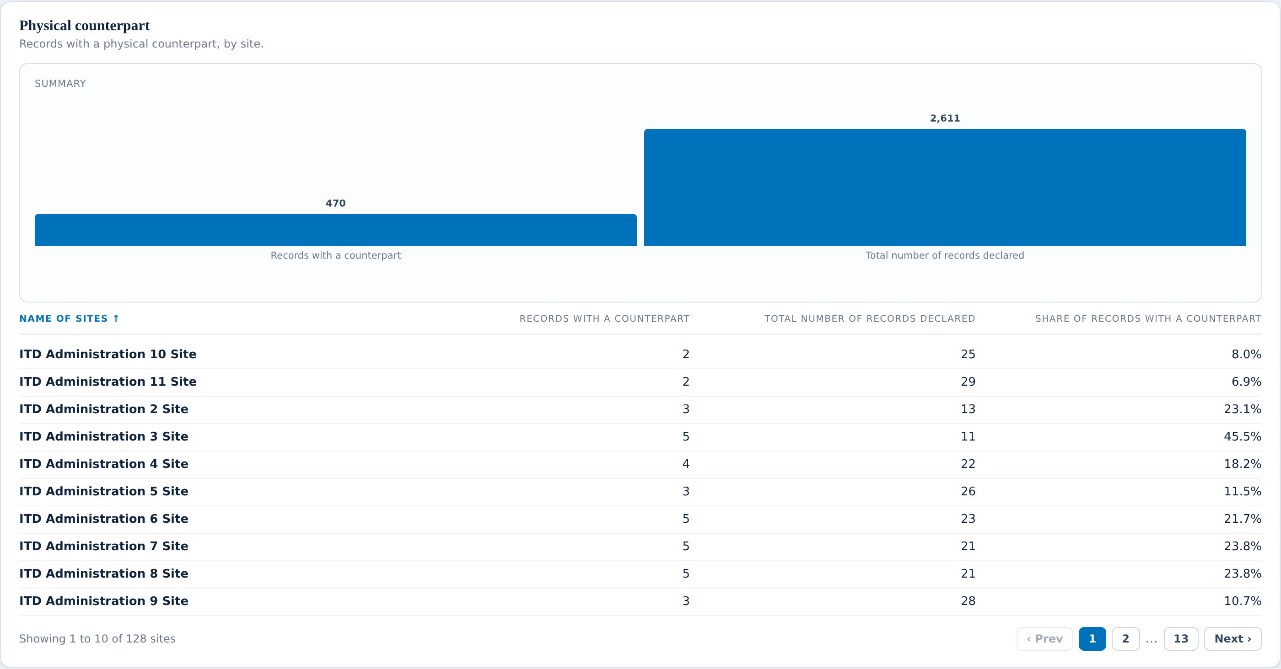
DEPARTMENT INSIGHTS
Physical counterparts
WHAT YOU ASKED FOR ON THIS SCREEN
BUILT
Records with a counterpart, by site
BUILT
Total number of records declared
BUILT
Share of records with a counterpart
NEEDS YOU
Per division, two columns
NEEDS YOU
Physical counterpart completion rate (turned over to RAC)
Which sites hold records with a paper copy, and what share that is.
Same handover gap as bank-wide.
Note items 60 and 61 sit under this heading in the workbook.
Notes:
Physical counterparts On the checklist: 5 items, 3 built, 2 needing them. Talking points: - Which sites hold records with a paper copy, and what share that is. - Same handover gap as bank-wide. - Note items 60 and 61 sit under this heading in the workbook. Do not solve the red items here — say "we come back to this in three slides" and keep moving.

Slide 26
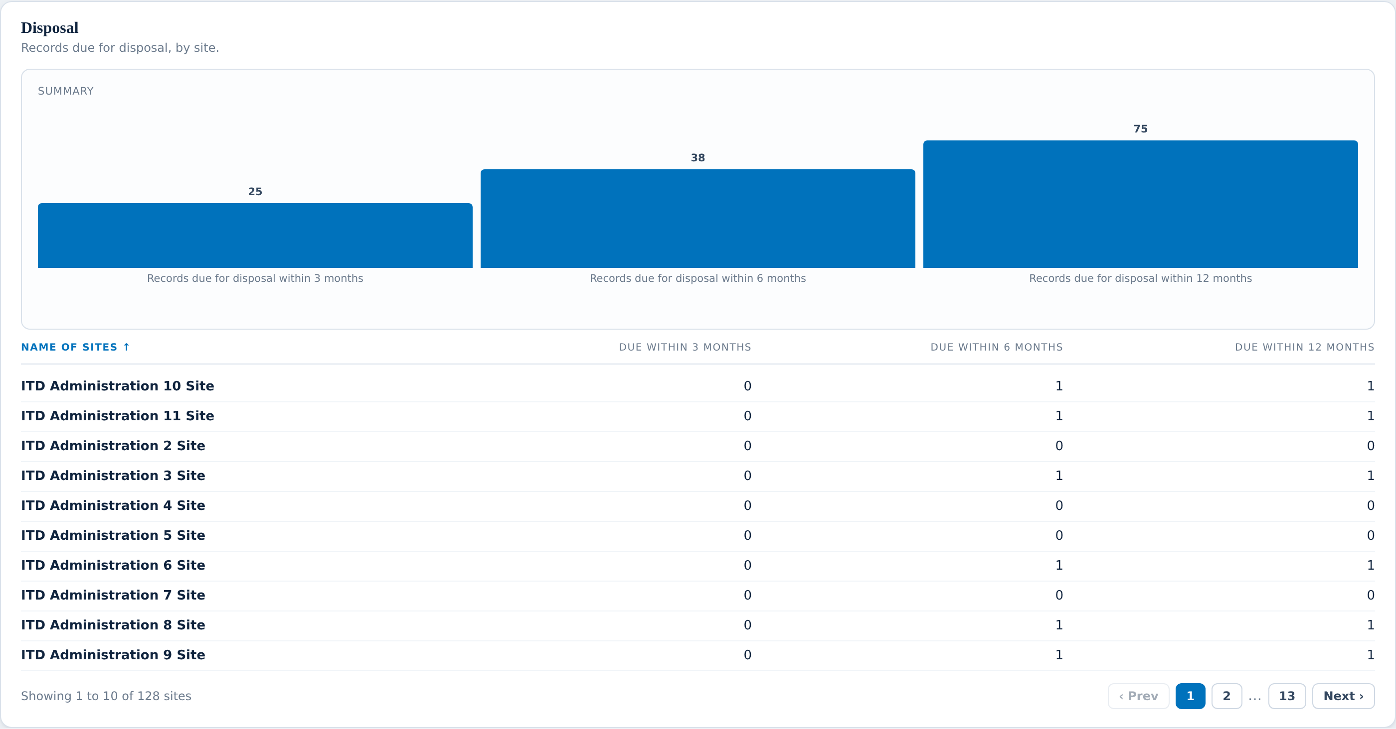
DEPARTMENT INSIGHTS
Disposal
WHAT YOU ASKED FOR ON THIS SCREEN
BUILT
Records due for disposal within 3 months
BUILT
Records due for disposal within 6 months
BUILT
Records due for disposal within 12 months
BUILT
Number of records due for disposal
BUILT
Next due date for disposal
BUILT
With physical counterpart?
LATER RELEASE
Disposal approver
LATER RELEASE
Status (Approved)
LATER RELEASE
Status (Declined)
LATER RELEASE
Status (Extended)
LATER RELEASE
Total number of records disposed, per year and month
LATER RELEASE
Total disposed record size (in GB)
Due within three, six and twelve months, all three windows.
Next due date and whether there is paper alongside.
Six of the twelve items wait on the same disposal-outcome gap.
Notes:
Disposal On the checklist: 12 items, 6 built, 6 needing them. Talking points: - Due within three, six and twelve months, all three windows. - Next due date and whether there is paper alongside. - Six of the twelve items wait on the same disposal-outcome gap. Do not solve the red items here — say "we come back to this in three slides" and keep moving.

Slide 27
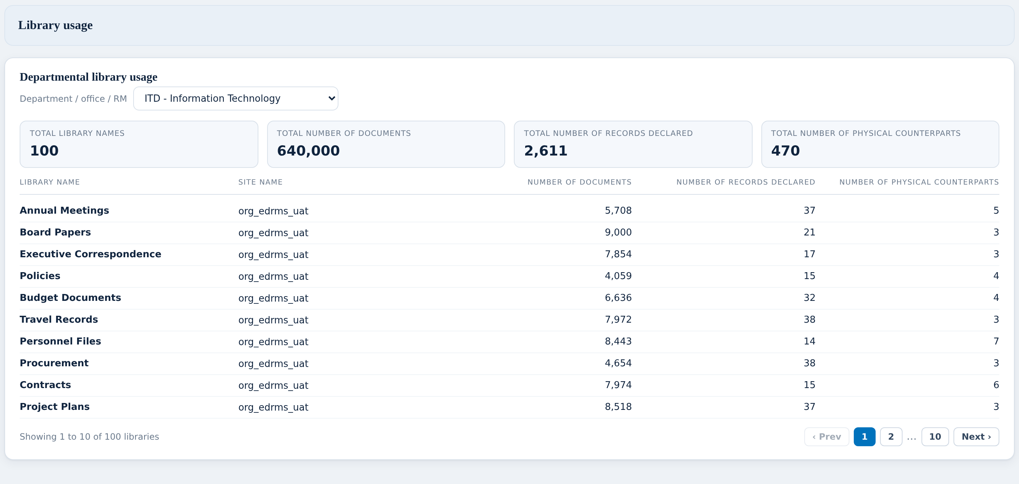
DEPARTMENT INSIGHTS
Library usage
WHAT YOU ASKED FOR ON THIS SCREEN
BUILT
Library names
BUILT
Number of documents
BUILT
Number of records declared
BUILT
Number of physical counterparts
NEEDS YOU
Category picker across the six categories
NEEDS YOU
Number of users per library
NEEDS YOU
Indicators per library, per division
NEEDS YOU
Programme dates
The client drew this as six screens, one per file plan category.
We have the library table. We cannot yet group libraries by category.
That is the same file plan gap we will see on the next dashboard.
Notes:
Library usage On the checklist: 8 items, 4 built, 4 needing them. Talking points: - The client drew this as six screens, one per file plan category. - We have the library table. We cannot yet group libraries by category. - That is the same file plan gap we will see on the next dashboard. Do not solve the red items here — say "we come back to this in three slides" and keep moving.

Slide 28
DEPARTMENT INSIGHTS
What we need from you (1 of 2)
THE QUESTION
WHY WE ARE STUCK
WHAT WOULD UNBLOCK IT
1
What is the approved naming convention?
You asked us to show whether sites, libraries and folders follow the approved convention. We have never been shown what the convention actually is.
Is it written down? If we have the rule, we can check every site against it automatically.
2
When did each department go live?
The profile has a space for a go-live date, but nothing records one.
Is there a rollout schedule we could use — even a spreadsheet?
3
Who is an ADB person and who is an outside visitor?
We can count visits to a site. We cannot tell whether the visitor was ADB staff or someone external, so the internal / external split cannot be built.
Same underlying question as the user types on the last dashboard. One answer would unlock both.
4
Where are access requests recorded?
You asked how many requests for access were granted and how many were denied. Nothing we reach records either.
When someone asks for access to a site, where does that request go, and is the outcome kept?
5
Which libraries belong to which file plan category?
You drew library usage as six screens, one per category. We can list the libraries; we cannot say which category each one belongs to.
Is that mapping written down anywhere, or does it live in someone’s head?
Notes:
Read the question in the left column out loud, then stop talking. Do not fill the silence with the middle column unless they ask why. What a good answer sounds like: a system name, a person's name, or "it's in a spreadsheet". Any of those three is a win. "We'll look into it" is not — get a name against it before moving on.

Slide 29
DEPARTMENT INSIGHTS
What we need from you (2 of 2)
THE QUESTION
WHY WE ARE STUCK
WHAT WOULD UNBLOCK IT
What are the programme dates?
The deck refers to programme milestones. We have no dates to plot against.
Can we have the agreed milestone dates, so progress can be shown against plan?
6
Notes:
Read the question in the left column out loud, then stop talking. Do not fill the silence with the middle column unless they ask why. What a good answer sounds like: a system name, a person's name, or "it's in a spreadsheet". Any of those three is a win. "We'll look into it" is not — get a name against it before moving on.

Slide 30
VIEW 3 OF 6
Project Insights
21
of 21 built
Are project sites being kept up to recordkeeping standards?
nothing outstanding on the checklist
3 screens to walk through
Notes:
Pause here. Ask whether this is still the right question for this view before showing any screen — if the question is wrong, everything after it is wrong too.

Slide 31
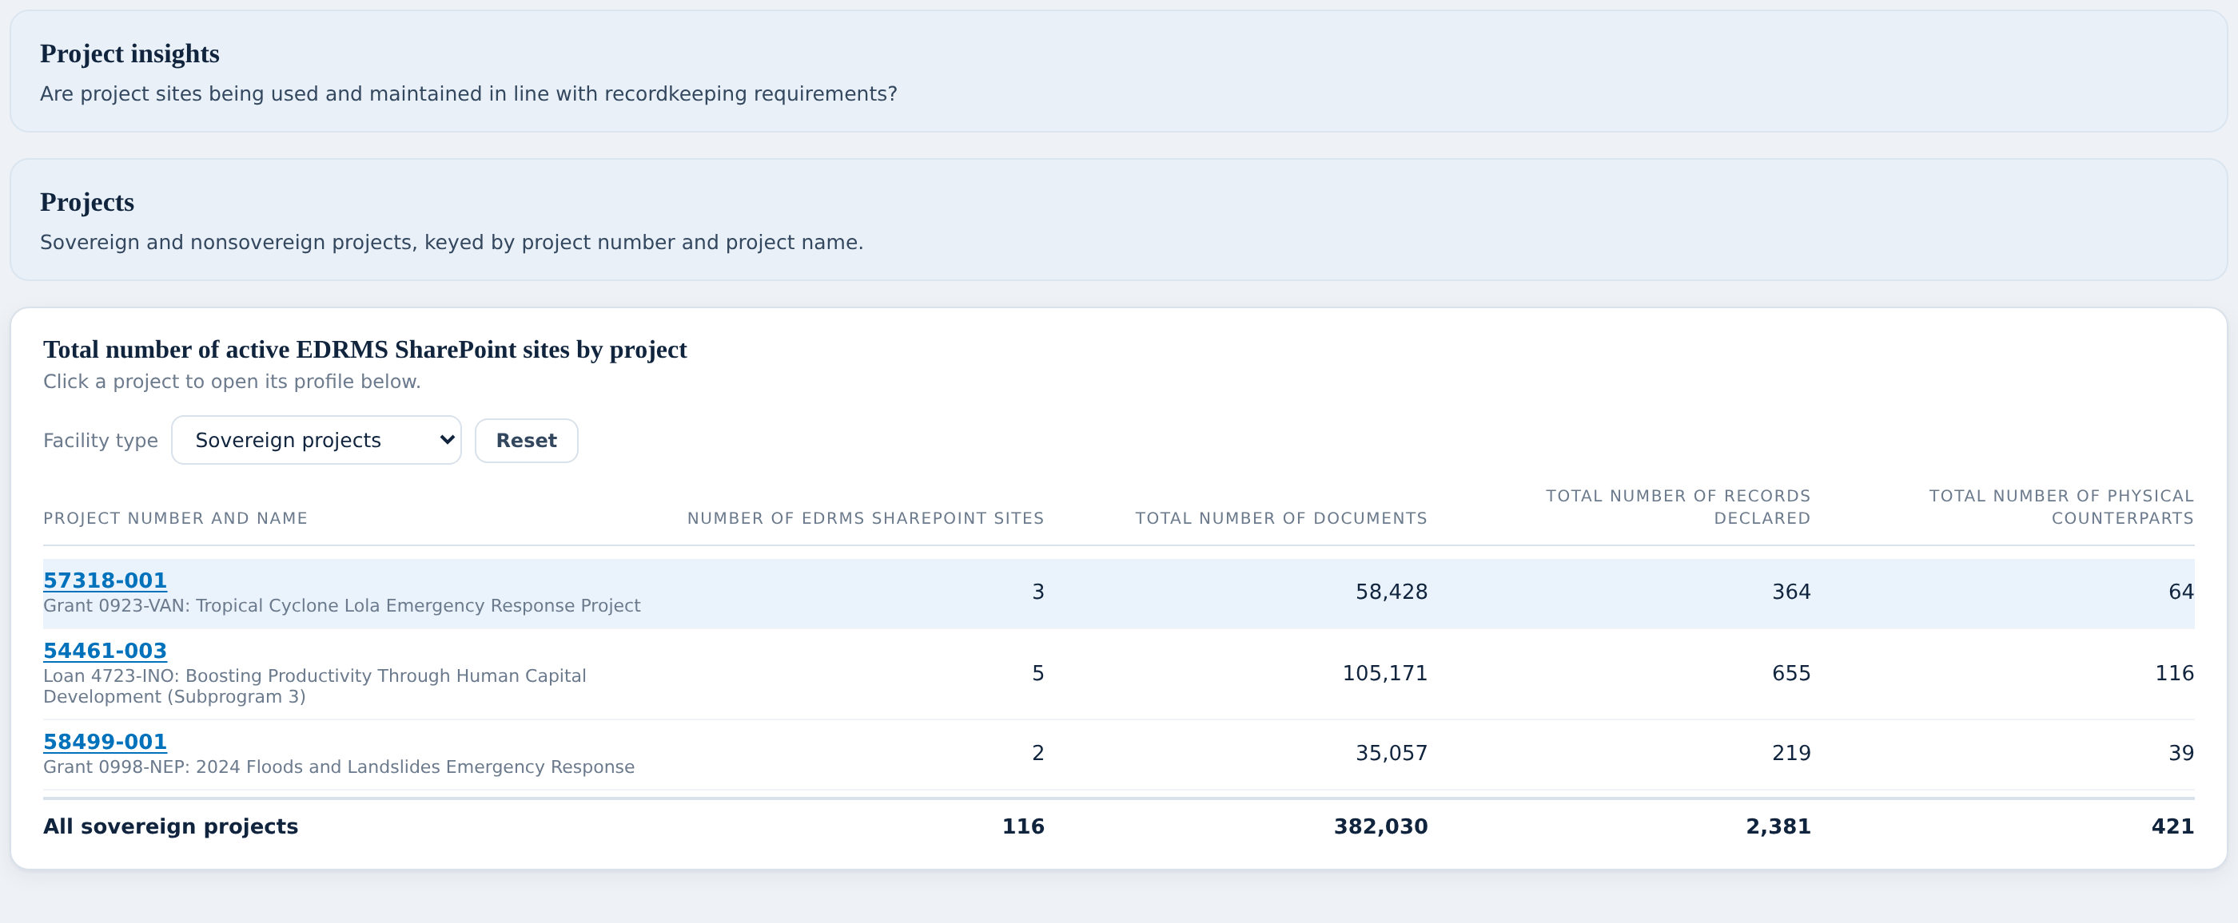
PROJECT INSIGHTS
The project list
WHAT YOU ASKED FOR ON THIS SCREEN
BUILT
Project Insights, as one of the six required key views
BUILT
Sovereign project site list
BUILT
Nonsovereign project site list
Sovereign and nonsovereign, switched with the picker.
Click any project to open its profile below.
The totals reconcile: named projects sit inside the facility total, which sits inside bank-wide.
Notes:
The project list On the checklist: 3 items, 3 built, 0 needing them. Talking points: - Sovereign and nonsovereign, switched with the picker. - Click any project to open its profile below. - The totals reconcile: named projects sit inside the facility total, which sits inside bank-wide. Nothing red on this screen. Say so out loud; it builds credit for the screens where there is.

Slide 32
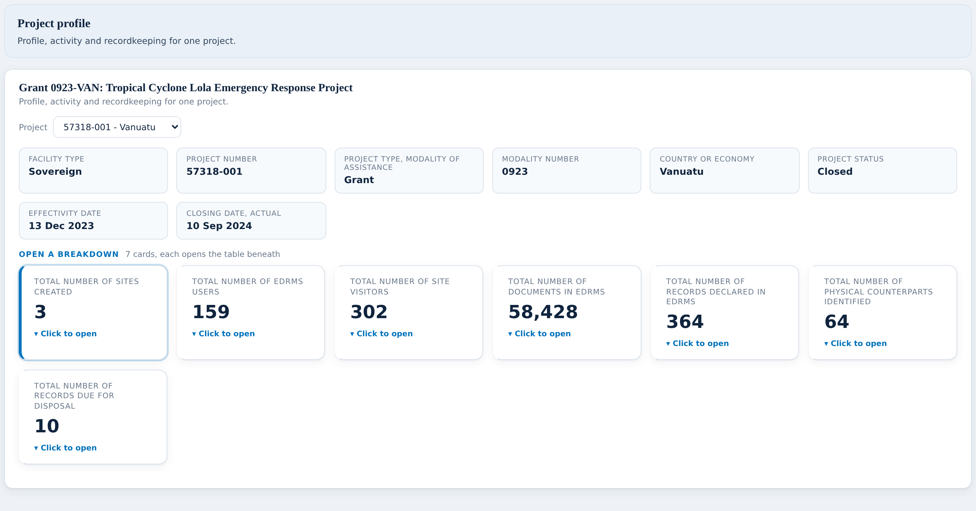
PROJECT INSIGHTS
The project profile and its seven figures
WHAT YOU ASKED FOR ON THIS SCREEN
BUILT
Facility type
BUILT
Modality
BUILT
Country
BUILT
Status
BUILT
Effectivity date
BUILT
Closing date
BUILT
Project number
BUILT
Project name
BUILT
Sites for this project
BUILT
Users for this project
BUILT
Site visits for this project
BUILT
Documents for this project
BUILT
Records declared for this project
BUILT
Physical counterparts for this project
BUILT
Records due for disposal for this project
All eight profile fields the client drew, in their order.
All seven figures are clickable and open a table site by site.
The site rows always add back up to the project total.
Notes:
The project profile and its seven figures On the checklist: 15 items, 15 built, 0 needing them. Talking points: - All eight profile fields the client drew, in their order. - All seven figures are clickable and open a table site by site. - The site rows always add back up to the project total. Nothing red on this screen. Say so out loud; it builds credit for the screens where there is.

Slide 33
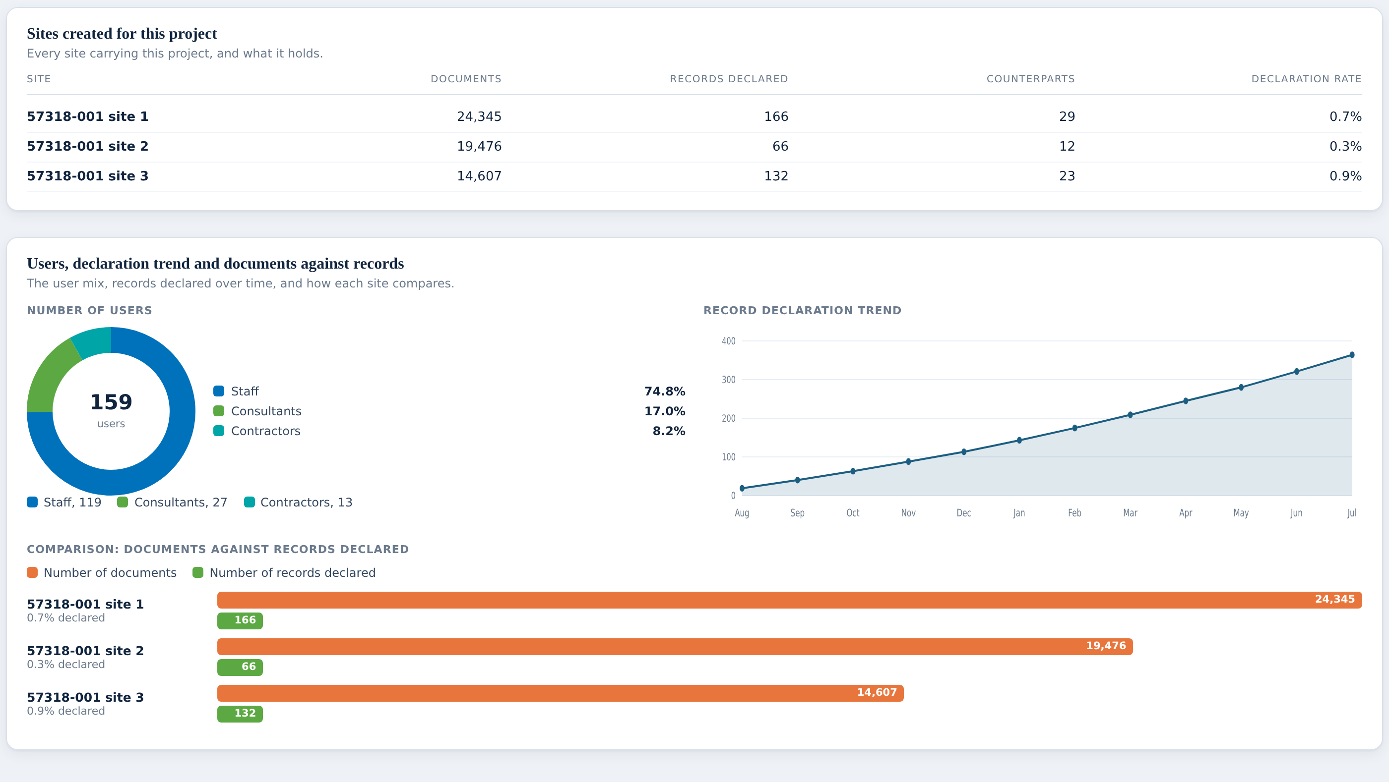
PROJECT INSIGHTS
The three charts
WHAT YOU ASKED FOR ON THIS SCREEN
BUILT
Users pie, split staff / consultants / contractors
BUILT
Cumulative declaration trend for this project
BUILT
Documents against records declared, site by site, with declaration rate
User mix uses the client’s own three-way split.
The curve is cumulative, so it ends at the project’s declared total.
The bottom chart shows why one site declares everything and another almost nothing.
Notes:
The three charts On the checklist: 3 items, 3 built, 0 needing them. Talking points: - User mix uses the client’s own three-way split. - The curve is cumulative, so it ends at the project’s declared total. - The bottom chart shows why one site declares everything and another almost nothing. Nothing red on this screen. Say so out loud; it builds credit for the screens where there is.

Slide 34
PROJECT INSIGHTS
What we need from you
THE QUESTION
WHY WE ARE STUCK
WHAT WOULD UNBLOCK IT
Which SharePoint site belongs to which project?
This is the one that matters. Nothing today connects a SharePoint site to a project number, so every figure on this dashboard is a placeholder — the layout is right, the numbers are invented.
Is there a list anywhere, even a spreadsheet someone keeps by hand? If sites are named to a pattern that includes the project number, that would work too.
1
Where do the eight project details come from?
Facility type, modality, country, status, effectivity and closing dates — these clearly live in an ADB project system, but that system has never been named in this work.
Which system holds them, and who owns it? Once we know, we can ask for a feed.
2
Notes:
Read the question in the left column out loud, then stop talking. Do not fill the silence with the middle column unless they ask why. What a good answer sounds like: a system name, a person's name, or "it's in a spreadsheet". Any of those three is a win. "We'll look into it" is not — get a name against it before moving on.

Slide 35
VIEW 4 OF 6
Institutional File Plan
22
of 26 built
Is the file plan actually being used?
4 need your input
5 screens to walk through
Notes:
Pause here. Ask whether this is still the right question for this view before showing any screen — if the question is wrong, everything after it is wrong too.

Slide 36
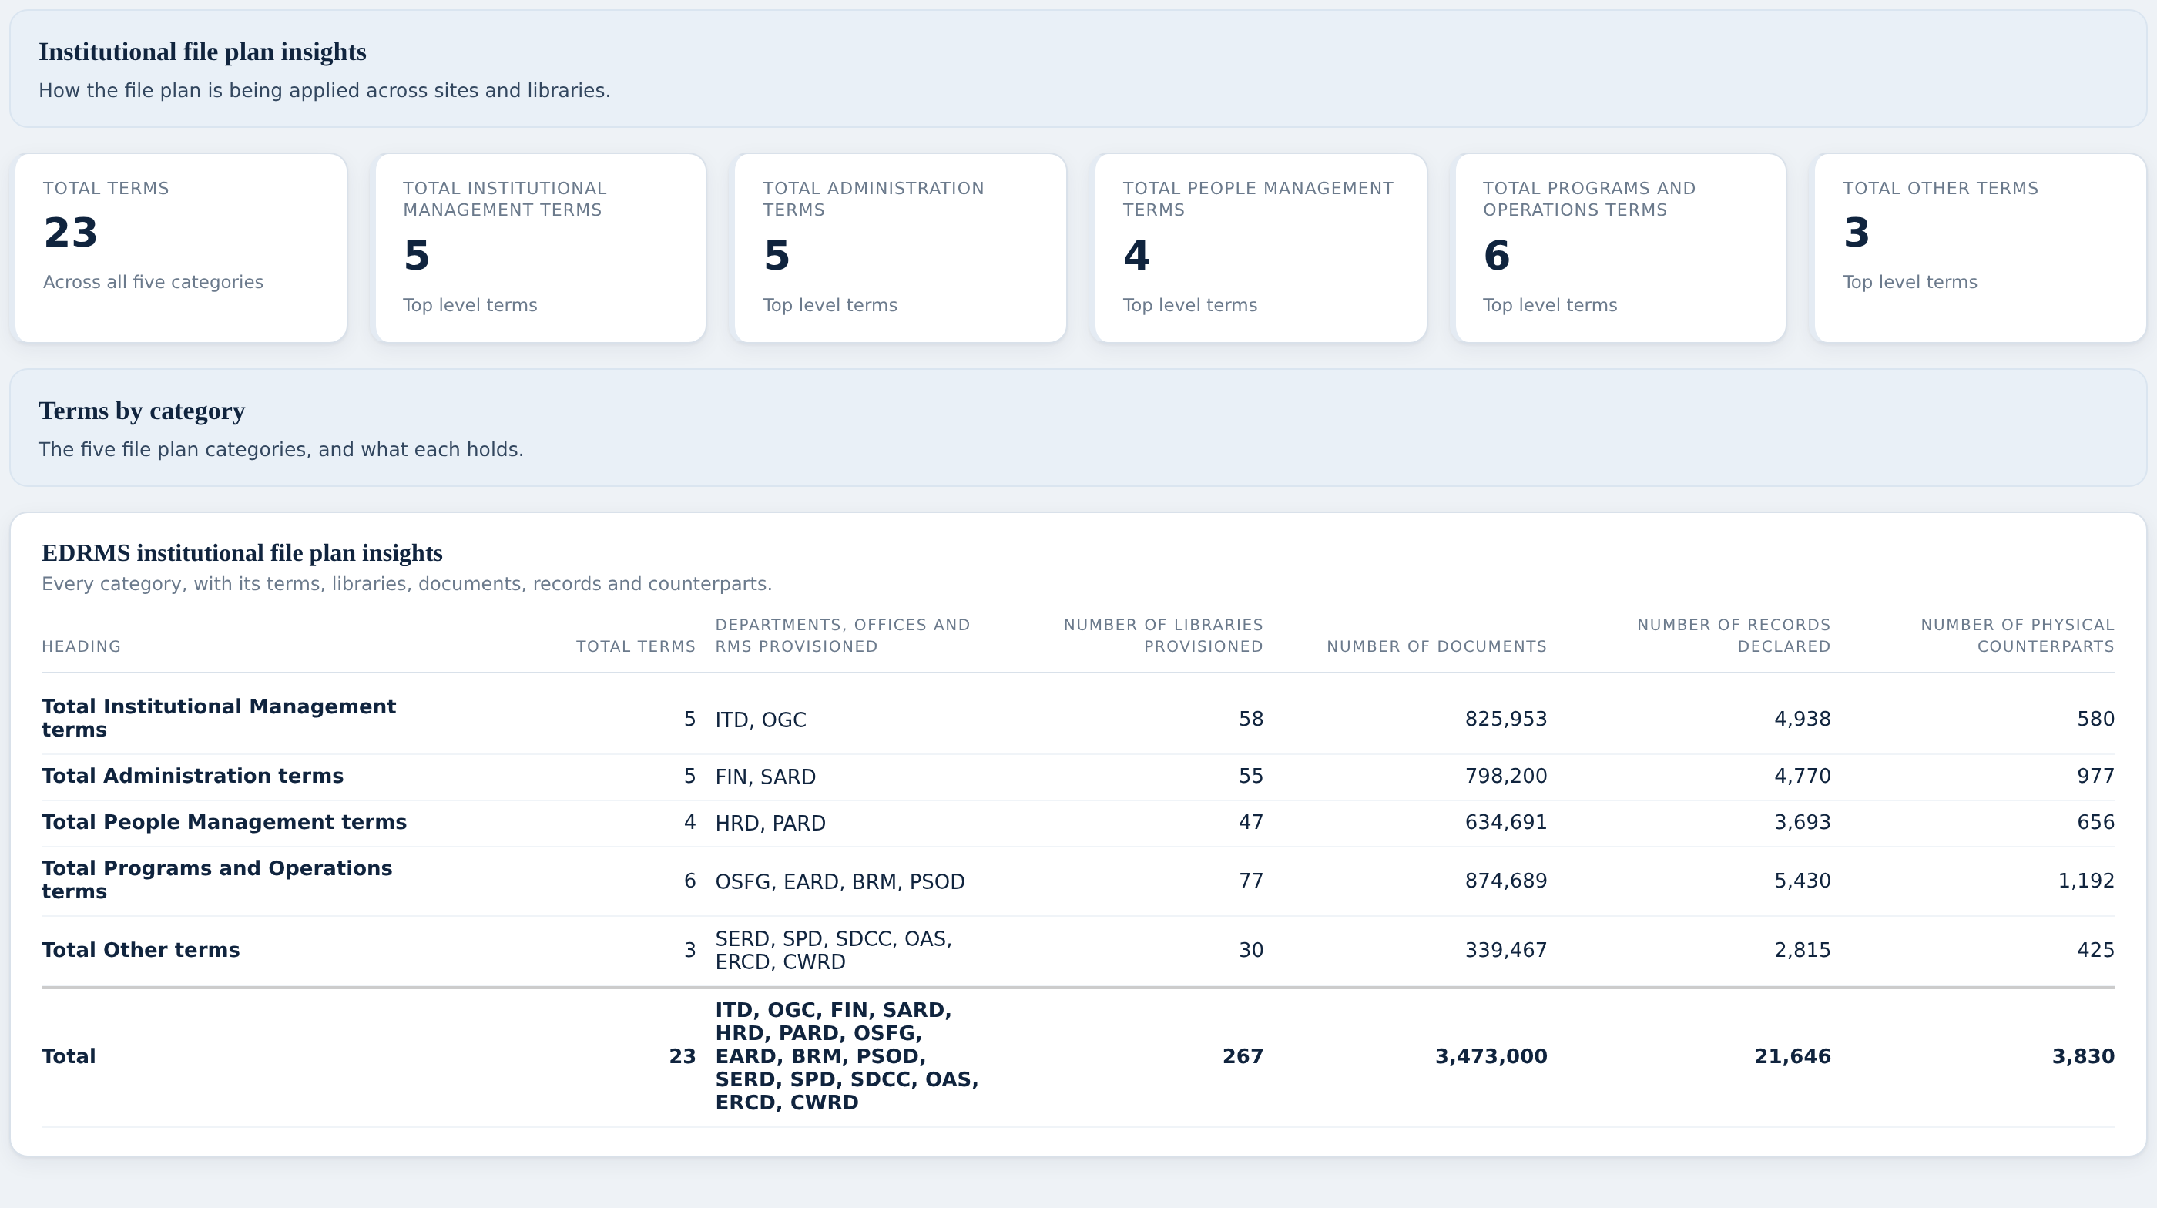
INSTITUTIONAL FILE PLAN
The five categories
WHAT YOU ASKED FOR ON THIS SCREEN
PLACEHOLDER
Total Institutional Management terms
PLACEHOLDER
Total Administration terms
PLACEHOLDER
Total People management terms
PLACEHOLDER
Total Programs and operations terms
PLACEHOLDER
Total other terms
PLACEHOLDER
Total terms
PLACEHOLDER
Departments / Offices / RMs provisioned
PLACEHOLDER
Number of libraries provisioned
PLACEHOLDER
Number of documents
PLACEHOLDER
Number of records declared
PLACEHOLDER
Number of physical counterparts
Five categories and a total, with the client’s own column names.
The total row is checked against the bank-wide figures automatically.
The department column is assigned, not measured. That is the gap on this dashboard.
Notes:
The five categories On the checklist: 11 items, 11 built, 0 needing them. Talking points: - Five categories and a total, with the client’s own column names. - The total row is checked against the bank-wide figures automatically. - The department column is assigned, not measured. That is the gap on this dashboard. Nothing red on this screen. Say so out loud; it builds credit for the screens where there is.

Slide 37
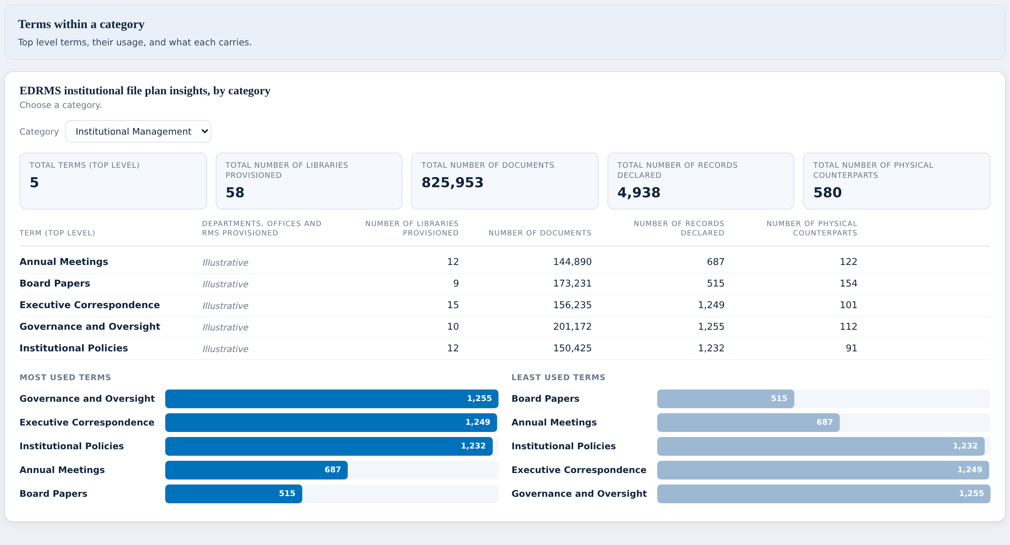
INSTITUTIONAL FILE PLAN
Inside one category
WHAT YOU ASKED FOR ON THIS SCREEN
PLACEHOLDER
Term (Top level) list per category
PLACEHOLDER
Category screens, all five present
NEEDS YOU
A notice saying what is missing behind this dashboard
NEEDS YOU
Departments / Offices / RMs provisioned, per term
PLACEHOLDER
Number of libraries provisioned, per term
PLACEHOLDER
Number of documents, per term
PLACEHOLDER
Number of records declared, per term
PLACEHOLDER
Number of physical counterparts, per term
The client drew five screens. We built one screen with a category picker.
Five figures at the top, then every top-level term underneath.
Most used and least used terms are charted below the table.
Notes:
Inside one category On the checklist: 8 items, 6 built, 2 needing them. Talking points: - The client drew five screens. We built one screen with a category picker. - Five figures at the top, then every top-level term underneath. - Most used and least used terms are charted below the table. Do not solve the red items here — say "we come back to this in three slides" and keep moving.

Slide 38
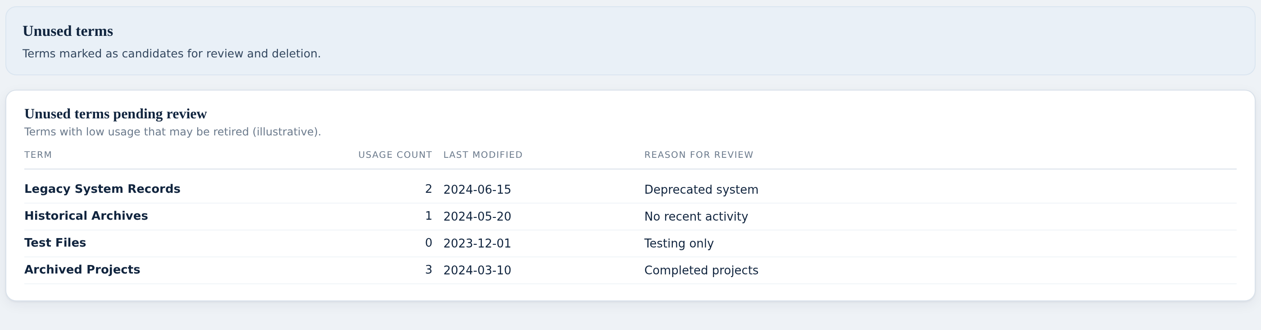
INSTITUTIONAL FILE PLAN
Unused terms
WHAT YOU ASKED FOR ON THIS SCREEN
PLACEHOLDER
Indicator: top most used terms
PLACEHOLDER
Indicator: least used and unused terms
Terms nobody is using, with when they were last touched and why they are flagged.
This is the list you would work from when tidying the file plan.
The figures are illustrative until we can measure real usage.
Notes:
Unused terms On the checklist: 2 items, 2 built, 0 needing them. Talking points: - Terms nobody is using, with when they were last touched and why they are flagged. - This is the list you would work from when tidying the file plan. - The figures are illustrative until we can measure real usage. Nothing red on this screen. Say so out loud; it builds credit for the screens where there is.

Slide 39
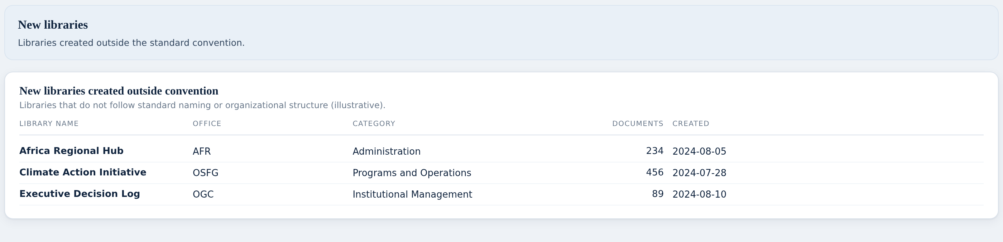
INSTITUTIONAL FILE PLAN
Libraries created outside convention
WHAT YOU ASKED FOR ON THIS SCREEN
PLACEHOLDER
Indicator: new libraries created outside convention
Libraries that do not follow the standard pattern.
To make this real we need the convention itself.
Same question as on Department Insights.
Notes:
Libraries created outside convention On the checklist: 1 items, 1 built, 0 needing them. Talking points: - Libraries that do not follow the standard pattern. - To make this real we need the convention itself. - Same question as on Department Insights. Nothing red on this screen. Say so out loud; it builds credit for the screens where there is.

Slide 40
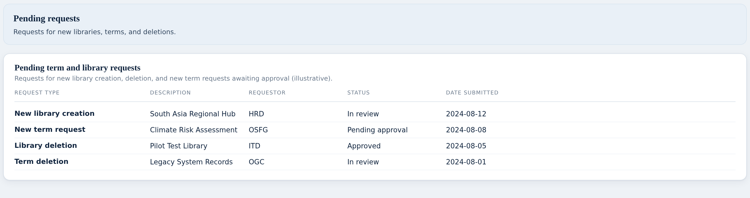
INSTITUTIONAL FILE PLAN
Requests waiting for a decision
WHAT YOU ASKED FOR ON THIS SCREEN
PLACEHOLDER
Request for new library creation and/or deletion
PLACEHOLDER
Request for new term
NEEDS YOU
Where the Institutional File Plan actually lives
NEEDS YOU
How a library or document is known to use a term
New library, new term, and both kinds of deletion, in one place.
Requestor, status and date submitted on every row.
The last two rows are the gaps that govern this whole dashboard.
Notes:
Requests waiting for a decision On the checklist: 4 items, 2 built, 2 needing them. Talking points: - New library, new term, and both kinds of deletion, in one place. - Requestor, status and date submitted on every row. - The last two rows are the gaps that govern this whole dashboard. Do not solve the red items here — say "we come back to this in three slides" and keep moving.

Slide 41
INSTITUTIONAL FILE PLAN
What we need from you
THE QUESTION
WHY WE ARE STUCK
WHAT WOULD UNBLOCK IT
Where does the official file plan live?
Every term you can see on these screens is our own example. Nothing in this work has ever named the system that holds the real institutional file plan.
Which system is it? If it is a document rather than a system, that is fine too — we just need to know.
1
How do we know a library is using a term?
This is the technical heart of the problem, put simply: the system knows which library a document sits in, but nothing says which file plan category that library belongs to. Without that link, no figure on this dashboard can be measured.
Is that mapping recorded anywhere? If not, is there a rule we could apply — for example, does the library name tell you the category?
2
Where are new term and new library requests raised?
The screen shows requests waiting for a decision. We invented them, because we do not know where real ones are submitted.
When someone wants a new term or a new library, what do they do today?
3
Should the screen say what is missing?
Until yesterday this dashboard carried a notice explaining that the figures were placeholders. It has been taken off.
For the workshop — do you want that notice back on screen, or is it enough that it is tracked in the checklist?
4
Notes:
Read the question in the left column out loud, then stop talking. Do not fill the silence with the middle column unless they ask why. What a good answer sounds like: a system name, a person's name, or "it's in a spreadsheet". Any of those three is a win. "We'll look into it" is not — get a name against it before moving on.

Slide 42
VIEW 5 OF 6
Retention and Disposal
18
of 27 built
What must be kept forever, and what is coming up for disposal?
8 need your input
1 wait on the Disposal release
4 screens to walk through
Notes:
Pause here. Ask whether this is still the right question for this view before showing any screen — if the question is wrong, everything after it is wrong too.

Slide 43
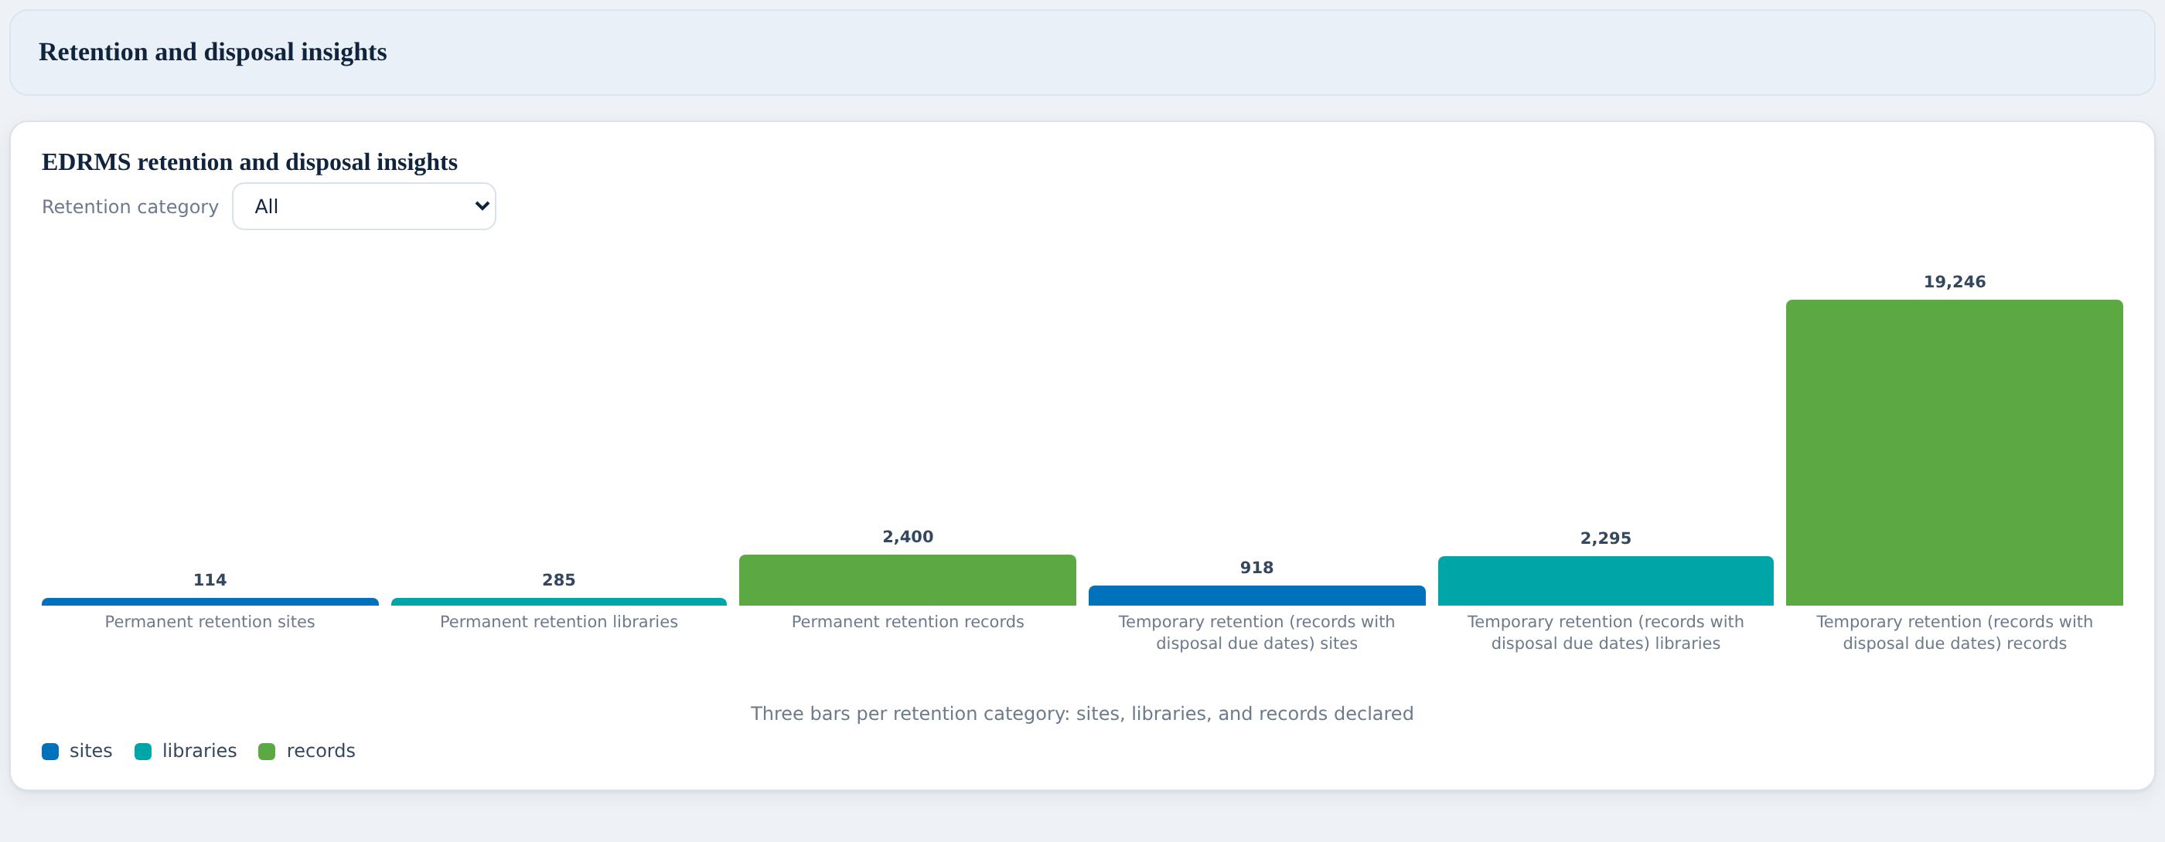
RETENTION AND DISPOSAL
Permanent against temporary
WHAT YOU ASKED FOR ON THIS SCREEN
BUILT
Permanent retention sites
BUILT
Permanent retention libraries
BUILT
Permanent retention records
BUILT
Temporary retention sites
BUILT
Temporary retention libraries
BUILT
Temporary retention records
NEEDS YOU
Departments / Offices / RMs provisioned
NEEDS YOU
Number of libraries provisioned
NEEDS YOU
Number of records declared
NEEDS YOU
Number of physical counterparts
NEEDS YOU
Number of records due for disposal
NEEDS YOU
Number of records disposed
Six figures: sites, libraries and records, split permanent and temporary.
This is the closest match of the six to something we already had built.
The summary table the client drew on slide 44 was taken off. That needs your view.
Notes:
Permanent against temporary On the checklist: 12 items, 6 built, 6 needing them. Talking points: - Six figures: sites, libraries and records, split permanent and temporary. - This is the closest match of the six to something we already had built. - The summary table the client drew on slide 44 was taken off. That needs your view. Do not solve the red items here — say "we come back to this in three slides" and keep moving.

Slide 44
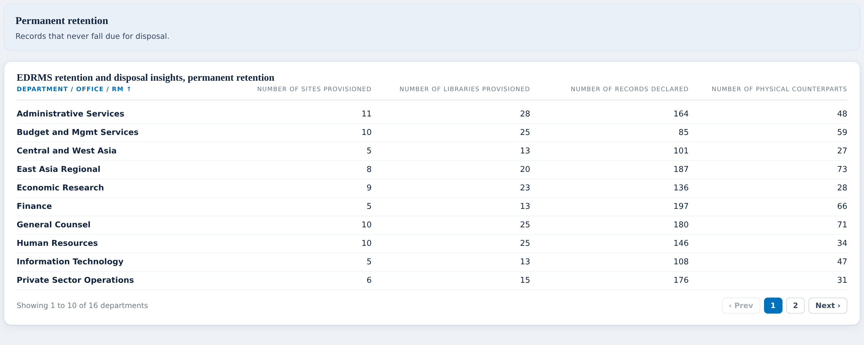
RETENTION AND DISPOSAL
Permanent retention
WHAT YOU ASKED FOR ON THIS SCREEN
NEEDS YOU
Term (Top level)
BUILT
Departments / Offices / RMs provisioned
BUILT
Number of sites provisioned
BUILT
Number of libraries provisioned
BUILT
Number of records declared
BUILT
Number of physical counterparts
Everything that must be kept indefinitely, department by department.
All five columns the client asked for are here.
One column is missing: the file plan term.
Notes:
Permanent retention On the checklist: 6 items, 5 built, 1 needing them. Talking points: - Everything that must be kept indefinitely, department by department. - All five columns the client asked for are here. - One column is missing: the file plan term. Do not solve the red items here — say "we come back to this in three slides" and keep moving.

Slide 45
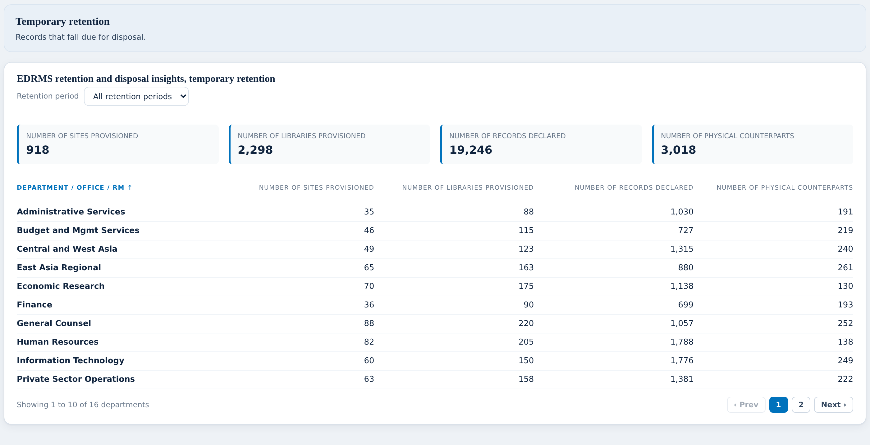
RETENTION AND DISPOSAL
Temporary retention
WHAT YOU ASKED FOR ON THIS SCREEN
NEEDS YOU
Term (Top level)
BUILT
Departments / Offices / RMs provisioned
BUILT
Number of sites provisioned
BUILT
Number of libraries provisioned
BUILT
Number of records declared
BUILT
Number of physical counterparts
BUILT
Retention filter (All, 3, 5, 7, 10, others. years)
LATER RELEASE
Number of records disposed
Same shape, for records with an end date.
The retention filter lets you look at just the seven-year records, or just the ten-year.
What we cannot show is anything that has already been disposed of.
Notes:
Temporary retention On the checklist: 8 items, 6 built, 2 needing them. Talking points: - Same shape, for records with an end date. - The retention filter lets you look at just the seven-year records, or just the ten-year. - What we cannot show is anything that has already been disposed of. Do not solve the red items here — say "we come back to this in three slides" and keep moving.

Slide 46
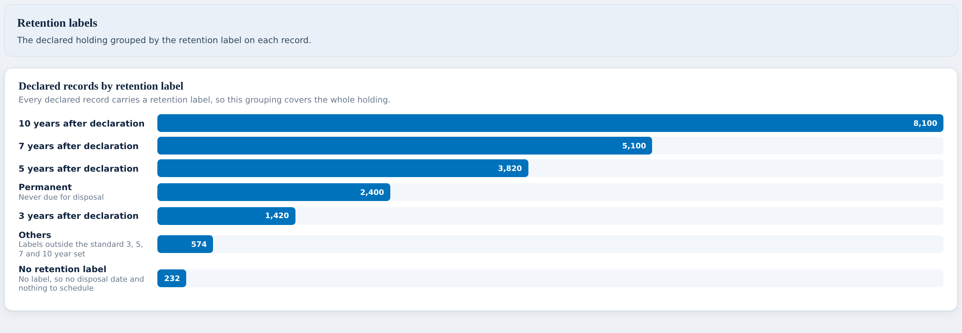
RETENTION AND DISPOSAL
Retention labels
WHAT YOU ASKED FOR ON THIS SCREEN
BUILT
Declared records by retention label
Every declared record grouped by the label actually applied to it.
This comes from real data — it is one of the most solid panels in the report.
It is also a good check: labels nobody expected will show up here.
Notes:
Retention labels On the checklist: 1 items, 1 built, 0 needing them. Talking points: - Every declared record grouped by the label actually applied to it. - This comes from real data — it is one of the most solid panels in the report. - It is also a good check: labels nobody expected will show up here. Nothing red on this screen. Say so out loud; it builds credit for the screens where there is.

Slide 47
RETENTION AND DISPOSAL
Retention works today. Disposal is not in the system yet.
WHAT WORKS TODAY
WHAT CANNOT WORK YET, AND WHY
✓
Retention labels are being applied to records right now, and we can read them.
✕
There is no screen in EDRMS where somebody approves a disposal.
✓
We can show what is permanent, what is temporary, and when each item falls due.
✕
There is no field anywhere that records approved, declined or extended.
✓
That half of this dashboard is real and working.
✕
So nothing can tell the report that a disposal actually happened.
WHAT WE PROPOSE
14
We propose building the retention half now, and the disposal half once the Disposal release ships. The screens are already drawn and waiting — when the feature exists, they fill in.
items move to the
Disposal release
Notes:
The sequencing case for Retention and Disposal. Lead with the green column. They need to hear what does work before they hear what does not, or the whole thing sounds like an excuse. Then the blue column, stated as fact, not apology: the feature does not exist yet. Then stop and ask directly: "Are you comfortable with us sequencing this?" Get a yes or a no in the room. If they push back, the fallback is on the next slide — we can build the screens now and leave them empty, but empty screens get quoted as zero, and that is worse than not shipping them.

Slide 48
RETENTION AND DISPOSAL
What we need from you
THE QUESTION
WHY WE ARE STUCK
WHAT WOULD UNBLOCK IT
Can we agree the disposal half follows the Disposal release?
This is not a data problem we can solve by looking harder. Disposal is not built in EDRMS yet — there is no approval screen and no field to record an outcome. Fourteen items across three dashboards are waiting on that one release.
We build the screens now so they are ready, and switch them on when Disposal ships. Nothing is wasted and nothing is invented in the meantime.
1
Do you still want the slide 44 summary table?
Your slide 44 had a table across the top with six columns. It was taken out of the prototype because most of its columns repeat what the screens below already show.
Do you want it back, or is the current layout clearer? Your call — we can put it back easily.
2
Should retention be shown per file plan term?
Slides 45 and 46 both start with a “Term (top level)” column. We cannot fill it for the same reason as the file plan dashboard — nothing links a record to a term.
If the file plan question gets answered, this fills itself in. Same root cause.
3
Notes:
Read the question in the left column out loud, then stop talking. Do not fill the silence with the middle column unless they ask why. What a good answer sounds like: a system name, a person's name, or "it's in a spreadsheet". Any of those three is a win. "We'll look into it" is not — get a name against it before moving on.

Slide 49
VIEW 6 OF 6
Records and Archive Holdings
24
of 26 built
What is in the physical archive, and what is moving in and out?
2 wait on the Physical Records release
4 screens to walk through
Notes:
Pause here. Ask whether this is still the right question for this view before showing any screen — if the question is wrong, everything after it is wrong too.

Slide 50
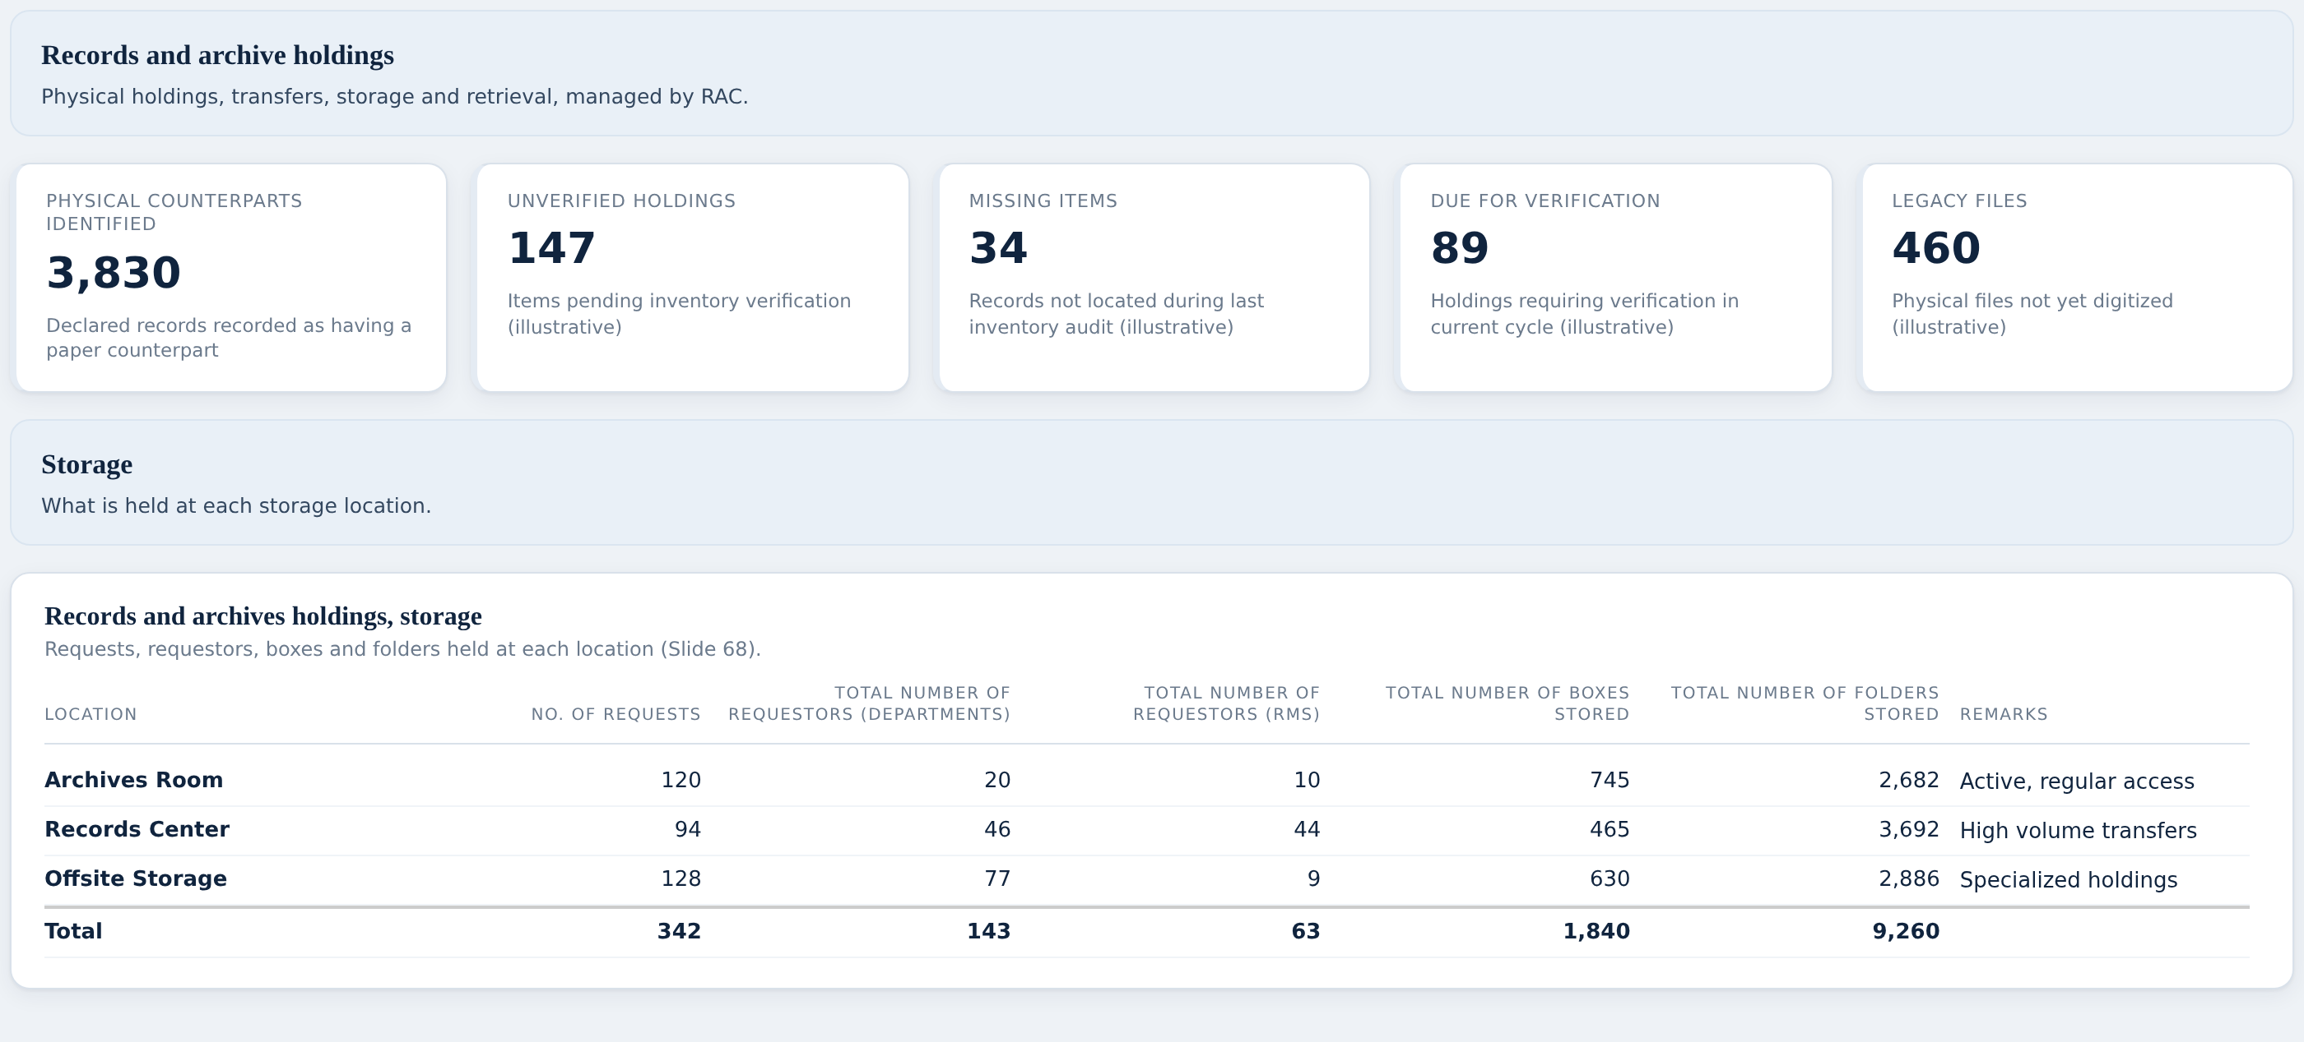
RECORDS AND ARCHIVE HOLDINGS
What we can and cannot see
WHAT YOU ASKED FOR ON THIS SCREEN
PLACEHOLDER
Records and Archive Holdings, as a key view
PLACEHOLDER
The two tables drawn with the client's own column headings
One figure here is real: the count of records with a paper counterpart.
Everything else on this dashboard is a placeholder.
This is the dashboard with the least data behind it, and the most to discuss.
Notes:
What we can and cannot see On the checklist: 2 items, 2 built, 0 needing them. Talking points: - One figure here is real: the count of records with a paper counterpart. - Everything else on this dashboard is a placeholder. - This is the dashboard with the least data behind it, and the most to discuss. Nothing red on this screen. Say so out loud; it builds credit for the screens where there is.

Slide 51
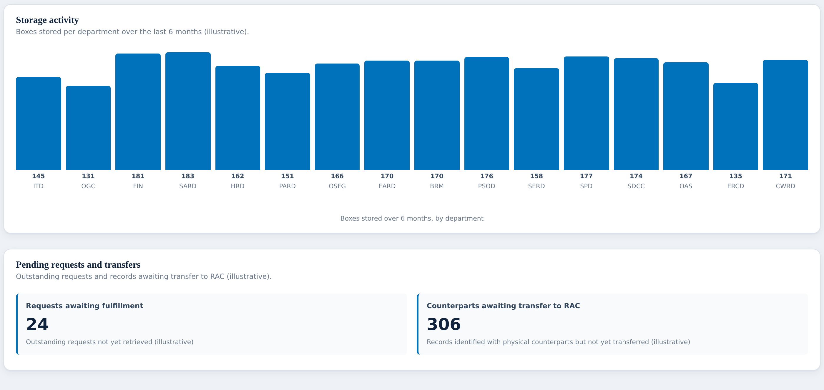
RECORDS AND ARCHIVE HOLDINGS
Storage
WHAT YOU ASKED FOR ON THIS SCREEN
PLACEHOLDER
Location, as Archives Room / Records Center / Offsite Storage
PLACEHOLDER
No. of requests
PLACEHOLDER
Total number of requestors (departments)
PLACEHOLDER
Total number of requestors (RMs)
PLACEHOLDER
Total number of boxes stored
PLACEHOLDER
Total number of folders stored
PLACEHOLDER
Remarks
PLACEHOLDER
Indicator: new boxes and folders month on month per department
PLACEHOLDER
No. and list of outstanding / pending requests
PLACEHOLDER
Physical counterparts identified but not transferred
PLACEHOLDER
Room capacity and % available storage capacity
All seven columns from your slide 68, with your own wording.
Three locations: Archives Room, Records Center, Offsite Storage.
Below it, storage activity by department and how full each room is.
Notes:
Storage On the checklist: 11 items, 11 built, 0 needing them. Talking points: - All seven columns from your slide 68, with your own wording. - Three locations: Archives Room, Records Center, Offsite Storage. - Below it, storage activity by department and how full each room is. Nothing red on this screen. Say so out loud; it builds credit for the screens where there is.

Slide 52
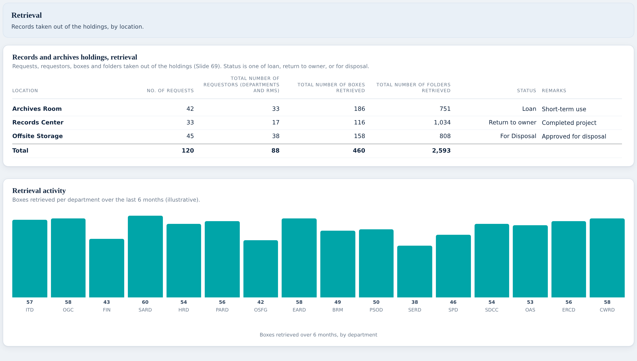
RECORDS AND ARCHIVE HOLDINGS
Retrieval
WHAT YOU ASKED FOR ON THIS SCREEN
PLACEHOLDER
Location
PLACEHOLDER
No. of requests
PLACEHOLDER
Total number of requestors (departments / RMs)
PLACEHOLDER
Total number of boxes retrieved
PLACEHOLDER
Total number of folders retrieved
PLACEHOLDER
Status: Loan, Return to owner, For Disposal
PLACEHOLDER
Remarks
All seven columns from your slide 69.
Status uses your own three words: Loan, Return to owner, For Disposal.
Everything on this table is invented, because we cannot reach the request system.
Notes:
Retrieval On the checklist: 7 items, 7 built, 0 needing them. Talking points: - All seven columns from your slide 69. - Status uses your own three words: Loan, Return to owner, For Disposal. - Everything on this table is invented, because we cannot reach the request system. Nothing red on this screen. Say so out loud; it builds credit for the screens where there is.

Slide 53
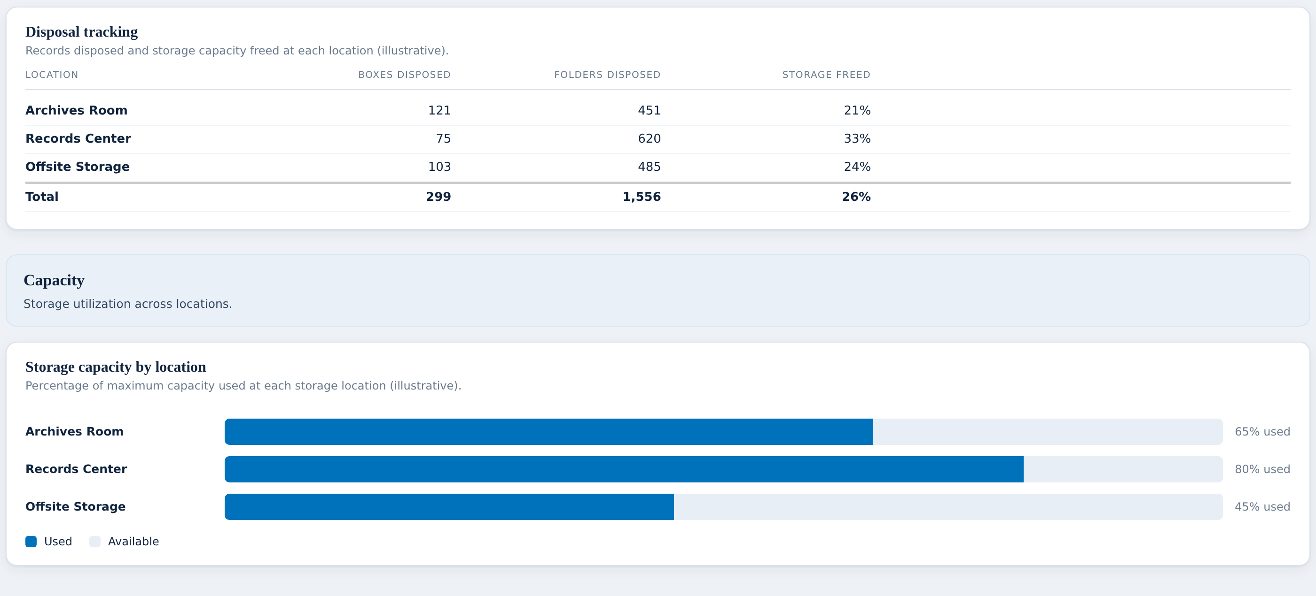
RECORDS AND ARCHIVE HOLDINGS
Activity, disposal and capacity
WHAT YOU ASKED FOR ON THIS SCREEN
PLACEHOLDER
Indicator: retrieval requests and boxes / folders retrieved month on month per department
PLACEHOLDER
No. and list of outstanding / pending requests
PLACEHOLDER
No. of boxes / folders disposed
PLACEHOLDER
Can room activities update capacity and freed up storage?
LATER RELEASE
Retrieval as processed from eServe
LATER RELEASE
What is available in Opus and how we can apply it
Retrieval by department, what was disposed, and how much space that freed.
The layout answers every indicator you asked for.
None of it is measured yet. That is what the questions slide is for.
Notes:
Activity, disposal and capacity On the checklist: 6 items, 4 built, 2 needing them. Talking points: - Retrieval by department, what was disposed, and how much space that freed. - The layout answers every indicator you asked for. - None of it is measured yet. That is what the questions slide is for. Do not solve the red items here — say "we come back to this in three slides" and keep moving.

Slide 54
RECORDS AND ARCHIVE HOLDINGS
This one is about paper, and paper comes after Utilization.
WHAT WORKS TODAY
WHAT CANNOT WORK YET, AND WHY
✓
One figure here is real: how many declared records are marked as having a paper copy.
✕
Boxes, folders, rooms, requests and retrievals live in the physical world.
✓
That is the bridge between this report and what RAC physically holds.
✕
The systems that will track them are part of the Physical Records work, which comes after Utilization.
✓
The layout answers every column and every indicator you drew.
✕
Nothing we can reach today holds any of it, so every figure on this screen is invented.
WHAT WE PROPOSE
26
We propose treating this dashboard as a Physical Records deliverable rather than a Utilization one. Showing it now would mean showing you numbers we made up, and those have a way of being quoted back as real.
items move to the
Physical Records release
Notes:
The sequencing case for Records and Archive Holdings. Lead with the green column. They need to hear what does work before they hear what does not, or the whole thing sounds like an excuse. Then the blue column, stated as fact, not apology: the feature does not exist yet. Then stop and ask directly: "Are you comfortable with us sequencing this?" Get a yes or a no in the room. If they push back, the fallback is on the next slide — we can build the screens now and leave them empty, but empty screens get quoted as zero, and that is worse than not shipping them.

Slide 55
RECORDS AND ARCHIVE HOLDINGS
What we need from you
THE QUESTION
WHY WE ARE STUCK
WHAT WOULD UNBLOCK IT
Can we agree this dashboard follows the Physical Records release?
Everything on it — boxes, folders, rooms, requests — is physical, and the systems that will hold that information come with the Physical Records work, after Utilization. Building it now means inventing all 26 figures.
Keep the layout as the agreed specification, sign it off today if you are happy with it, and build it when the physical side has real sources behind it.
1
When someone asks RAC for a box, where does that go?
Your slide 67 mentions eServe. Nothing in this work has ever reached it. Even after the Physical release we will need this answered.
Can we see what eServe holds, and who would we ask for access? Worth starting the conversation now so it is not the thing that delays the physical build later.
2
What does RAC actually keep today, and where?
Boxes, folders, which room they are in, how full each room is. It may live in a spreadsheet, or on paper, or in somebody’s head.
Whatever the answer, it is the starting point for the physical work. A spreadsheet is a perfectly good answer.
3
Notes:
Read the question in the left column out loud, then stop talking. Do not fill the silence with the middle column unless they ask why. What a good answer sounds like: a system name, a person's name, or "it's in a spreadsheet". Any of those three is a win. "We'll look into it" is not — get a name against it before moving on.

Slide 56
PULLING IT TOGETHER
The three answers that unlock almost everything
Who is who
WHAT IT UNBLOCKS
18
Unlocks every user split on Bank-wide and Department Insights, plus the internal / external visitor question.
A list that says, for each person, whether they are staff, a consultant or a contractor — and which department they sit in.
Which site belongs to which project
WHAT IT UNBLOCKS
21
Turns the whole of Project Insights from a layout into a working dashboard.
Anything that connects a SharePoint site to a project number. A spreadsheet is fine.
Where a disposal is recorded
WHAT IT UNBLOCKS
15
Closes the largest single gap across Bank-wide, Department Insights and Retention & Disposal.
Somewhere that says a record was actually disposed of, and who approved it.
The other 24 questions matter, but these three account for 54 of the 61 outstanding items between them.
Notes:
If the room is running short on time, this is the slide to land. Everything else can go to email; these three cannot.

Slide 57
BEFORE WE FINISH
Three decisions we would like from you today
Accept the four dashboards that are ready
Bank-wide Oversight, Department Insights, Project Insights and the Institutional File Plan. They are built. Once the open questions are answered, they run on real data.
What we need: a yes, and a name against each open question.
1
Agree the disposal half follows the Disposal release
Disposal is not built in EDRMS yet. There is no approval screen and no field to record an outcome, so 14 items across three dashboards cannot be measured however hard we look.
What we need: agreement to sequence, not a date.
2
Agree Records & Archive Holdings follows Physical Records
Everything on it is paper: boxes, folders, rooms, retrievals. Those sources arrive with the physical work, after Utilization. Building it now would mean showing you 26 invented figures.
What we need: sign off the layout today, build it later.
3
None of the three asks you for a date. All three ask you to agree an order.
Notes:
Ask for all three explicitly and wait for an answer on each. A nod is not agreement — say "can I take that as agreed?" and let the silence do the work. If they resist number 2 or 3, the argument is that an empty dashboard is worse than a sequenced one: a screen full of zeroes gets screenshotted and quoted as fact. Offer instead to show the layout as a signed-off specification now.

Slide 58
AFTER TODAY
What happens next
1
2
3
4
You point us at the sources
We confirm what is really there
We swap placeholders for real data
The later releases pick up the rest
Even a name — a system, a team, a person who keeps the spreadsheet. We do the chasing from there.
We check each source ourselves rather than assuming. Every claim in the checklist has been tested this way.
The screens do not change. The invented numbers become measured ones, and the amber items turn green.
The disposal screens switch on when Disposal ships. Records & Archive Holdings is built with the physical work. Both layouts are already agreed by then.
THIS WEEK
1–2 WEEKS
ONGOING
PER RELEASE
The prototype is live and will stay live. Open it any time, click anything, and tell us what is wrong with it.
perezfiles01-droid.github.io/Jim
Notes:
Close by naming who owes what, out loud, before people leave the room. A question with a name against it gets answered; a question on a slide does not.

Slide 59
Over to you
Which of the red items matters most to you — and which could we drop without anyone missing it?
Both answers are useful. The second one is often more useful.
Notes:
Ask the dropping question genuinely. A requirement nobody actually wants is worth more to lose than a requirement we cannot source is worth to keep.

