Slide 1
EDRMS Utilization Report
Requirements workshop
We will spend most of today inside one file, not in these slides.
EDRMS_Util_Dashboard_Gap_Checker_2026-08-21.xlsx

Slide 2
WHY WE ARE HERE
You wrote the requirements. We built what could be built.
250
193
55
requirement items
are in the prototype
are not
Read off your 69 slide deck
Built and on screen today
Almost all for one reason: no source
The 55 are not a backlog of work we have not done. They are questions we cannot answer without you. Most of them collapse into five missing sources, and today is about finding out whether those five exist.
The file we are about to open holds all 250 of them, one per row, with a picture of the built screen beside each one.
EDRMS_Util_Dashboard_Gap_Checker_2026-08-21.xlsx
2

Slide 3
HOW TODAY RUNS
Three minutes of slides, then the file for the rest.
Slides
5 min
How to read the file, and where the time goes
Tab 1, Bank-wide Oversight
18 min
The user register, division, the disposal fields
Tab 2, Department Insights
20 min
Go-live, visitors, the library categories
Tab 3, Project Insights
10 min
One question, twenty rows
Tab 4, Institutional File Plan
8 min
Where the file plan lives, and how terms attach
Tab 5, Retention and Disposal
10 min
Permanent against temporary
Tab 6, Records and Archive Holdings
12 min
eServe, capacity, and what this screen is for
Close
7 min
Owners and dates against the five sources
You will be asked a lot of questions today. That is the point of the session: seventeen of them, and we will write your answers straight into the file as we go.
EDRMS_Util_Dashboard_Gap_Checker_2026-08-21.xlsx
3

Slide 4
HOW TO READ THE FILE
Eight columns. Two of them matter most.
#
The row number we will call out
Requirement Items
Your words, off your slide
Type
Tile, table column, chart, indicator
In the prototype?
Yes means you can see it today
Slide
Which of your 69 slides it came from
Why it is not there
Only filled in when the answer is No
What it needs
Where it says ASK, that is a question for you
Question
Which of the seventeen it belongs to
Yes
Built. On screen. Argue with it today.
No
Not built, and the row says why.
OPEN THE FILE Any tab. Look at row 4, the headings, then row 6, the first requirement.
EDRMS_Util_Dashboard_Gap_Checker_2026-08-21.xlsx
4

Slide 5
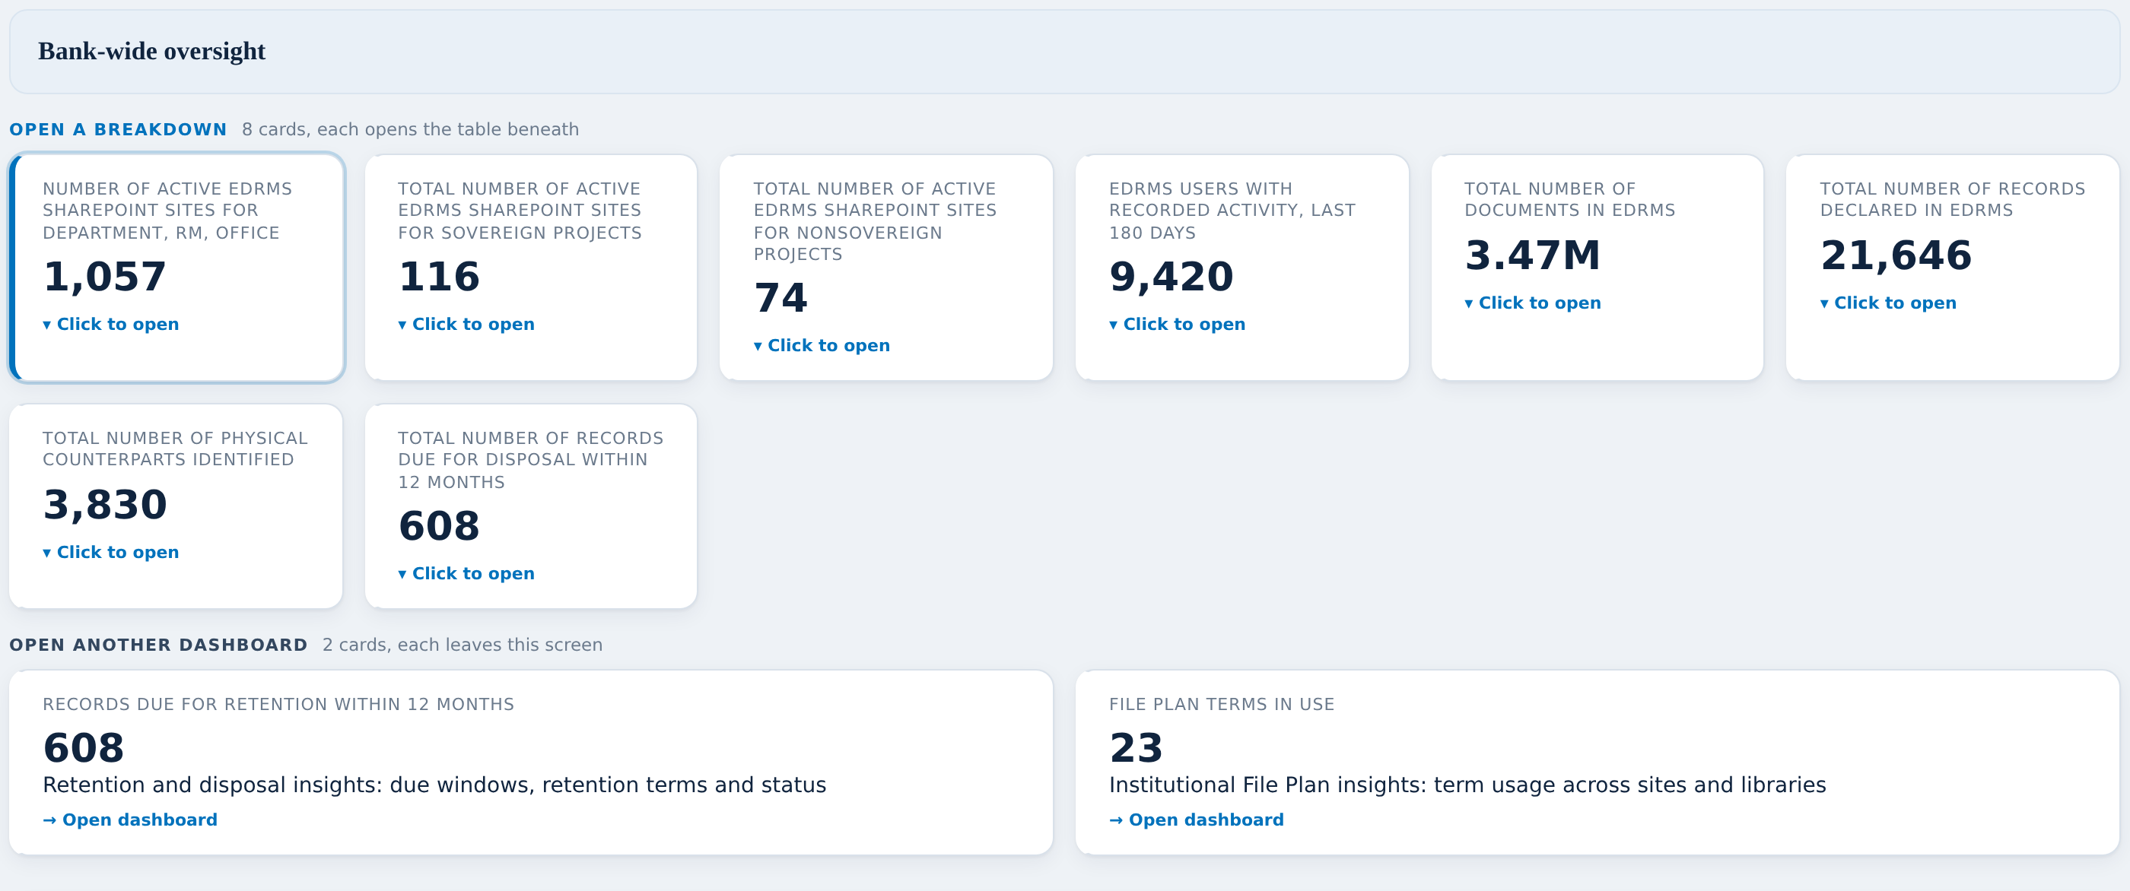
THE MOCKUPS COLUMN
Every screen is pictured beside the requirement it came from.
What you get on each row
Your requirement, in your own words
Whether it is built, in one word
A picture of the built screen, in the row
If it is not built, the reason and the ask
So nobody has to remember what a screen looked like. It is on the row, next to the words you wrote about it.
OPEN THE FILE Any tab, column I. Click a picture to enlarge it.
EDRMS_Util_Dashboard_Gap_Checker_2026-08-21.xlsx
5

Slide 6
THE SCOREBOARD
Six tabs, and where the open questions actually are.
1 Bank-wide Oversight
44 in
21 out
2 Department Insights
59 in
25 out
3 Project Insights
20 in
none out
4 Institutional File Plan
24 in
none out
5 Retention and Disposal
18 in
9 out
6 Records and Archive Holdings
28 in
none out
Tabs 3, 4 and 6 have nothing marked out, and that is not good news. It means every row is drawn but almost none of it has a real source yet. Tabs 1 and 2 carry all 55 of the open rows.
OPEN THE FILE Tab 1 to start. We work left to right.
EDRMS_Util_Dashboard_Gap_Checker_2026-08-21.xlsx
6

Slide 7
THE FIVE ANSWERS
Almost every open row waits on one of these five.
The user register
Who is staff, contractor or consultant, and who was trained
9 rows
Q3
The project register
Which SharePoint sites belong to which project
20 rows
Q2
Division
What a division is and what records it
8 rows
Q5
Go-live date
When each site became EDRMS compliant
2 rows
Q4
The physical sources
eServe for requests, RAC for the holdings register
tab 6 entire
Q6, Q15
If we leave today with an owner and a date against each of these five, the workshop has done its job. Everything else is detail.
EDRMS_Util_Dashboard_Gap_Checker_2026-08-21.xlsx
7

Slide 8
TAB 1 OF 6
Bank-wide Oversight
44 in • 21 not built • rows 6 to 78
The ten tiles the client drew on slide 34, the overview of all 1,032 sites, the two project lists, and the drills behind users, documents, records, counterparts and disposal.
WHAT WE NEED TO SETTLE HERE
The user register, which is five columns on this tab alone
Division, which is four more
The disposal fields: approver, status, disposed month on month
Questions on this tab: Q1, Q3, Q5, Q6, Q7, Q8
Start at row 6, the ten tiles. Then scroll to row 36, where the red starts.
OPEN THE FILE Tab 1, "Bank-wide Oversight". Rows 6 to 78.
EDRMS_Util_Dashboard_Gap_Checker_2026-08-21.xlsx
8

Slide 9
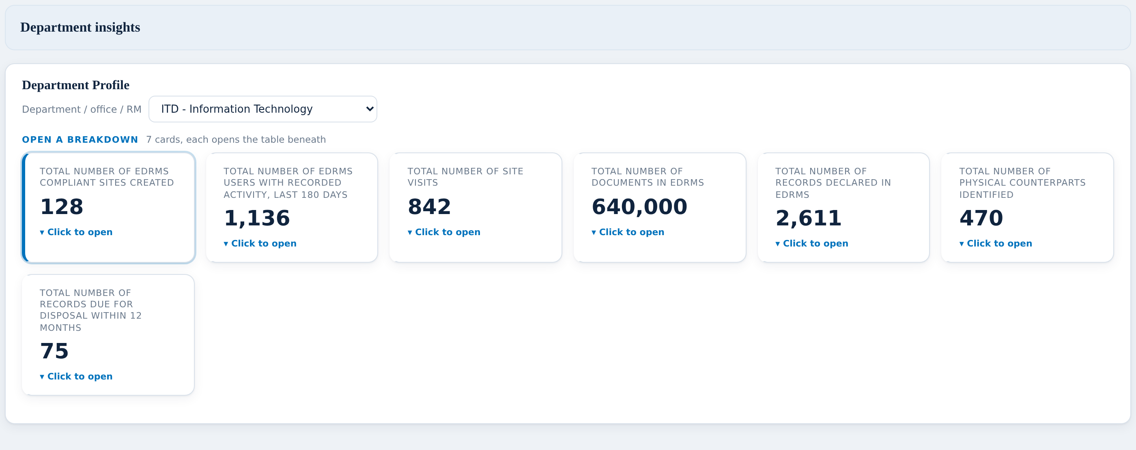
TAB 2 OF 6
Department Insights
59 in • 25 not built • rows 6 to 100
One department at a time: its profile, its users, its sites, its visits, its documents, records, counterparts, disposal, and its libraries by file plan category.
WHAT WE NEED TO SETTLE HERE
Go-live date per site, or agreement that the creation date stands in
Visitors split internal and external, and access requests
Whether the six library categories need their own picker
Questions on this tab: Q4, Q9, Q10
Start at row 6, the department picker. The red runs from row 22.
OPEN THE FILE Tab 2, "Department Insights". Rows 6 to 100.
EDRMS_Util_Dashboard_Gap_Checker_2026-08-21.xlsx
9

Slide 10
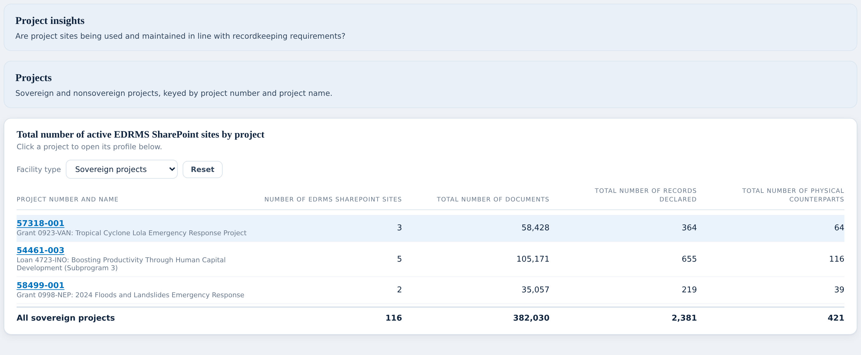
TAB 3 OF 6
Project Insights
20 in • none marked out • rows 6 to 28
One project's profile: eight fields, seven clickable tiles and three charts. Every row on this tab says Yes, and every row waits on the same one thing.
WHAT WE NEED TO SETTLE HERE
Which SharePoint sites belong to which project
Which system holds the project attributes, and who owns it
Questions on this tab: Q2
This tab is short. Read the What it needs column down the whole tab: it says ASK on every row.
OPEN THE FILE Tab 3, "Project Insights". Rows 6 to 28.
EDRMS_Util_Dashboard_Gap_Checker_2026-08-21.xlsx
10

Slide 11
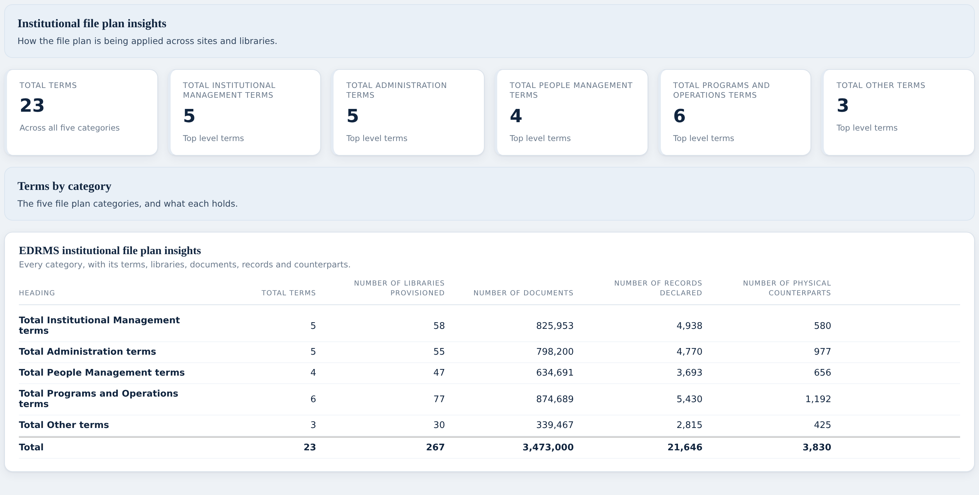
TAB 4 OF 6
Institutional File Plan
24 in • none marked out • rows 6 to 30
The rollup across the five categories, then one screen per category with its terms, libraries, documents, records and counterparts.
WHAT WE NEED TO SETTLE HERE
Where the file plan actually lives, and who maintains it
How we know which library or document uses which term
Whether new library and new term requests are tracked anywhere
Questions on this tab: Q12, Q13, Q14
Every row on this tab says Yes. The question here is not what to build, it is what feeds it.
OPEN THE FILE Tab 4, "Institutional File Plan". Rows 6 to 30.
EDRMS_Util_Dashboard_Gap_Checker_2026-08-21.xlsx
11

Slide 12
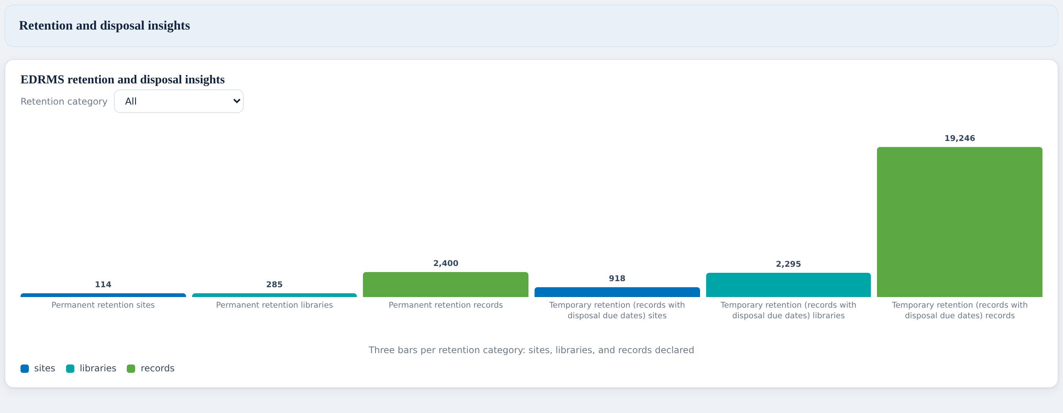
TAB 5 OF 6
Retention and Disposal
18 in • 9 not built • rows 6 to 35
The permanent and temporary split, the two retention tables, the retention filter, and declared records by retention label.
WHAT WE NEED TO SETTLE HERE
Which retention labels are permanent and which are temporary
The six removed columns on the slide 44 rollup
Whether records disposed can be counted at all today
Questions on this tab: Q11
Start at row 6. The red block is rows 12 to 17, and row 33.
OPEN THE FILE Tab 5, "Retention and Disposal". Rows 6 to 35.
EDRMS_Util_Dashboard_Gap_Checker_2026-08-21.xlsx
12

Slide 13
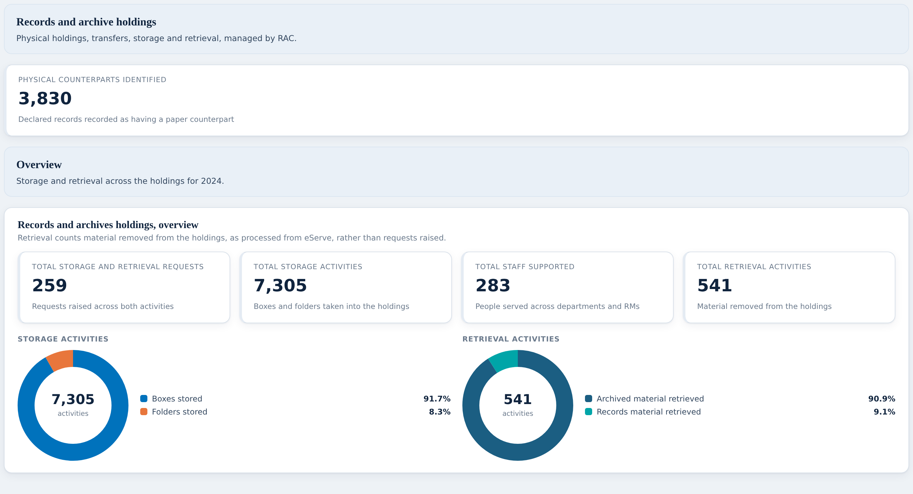
TAB 6 OF 6
Records and Archive Holdings
28 in • none marked out • rows 6 to 36
The physical estate: the overview you screenshotted, the storage table, the retrieval table, and disposal. Built from the totals on your own slide 67, because nothing else exists to build it from.
WHAT WE NEED TO SETTLE HERE
Is eServe the retrieval system of record, and who owns it
Can room capacity be included, which your slide 68 asks us
Does retrieval free up capacity, which your slide 69 asks us
Questions on this tab: Q15, Q16, Q17
Every row says Yes, and every figure on the screen is illustrative. That distinction is the whole conversation on this tab.
OPEN THE FILE Tab 6, "Records and Archive Holdings". Rows 6 to 36.
EDRMS_Util_Dashboard_Gap_Checker_2026-08-21.xlsx
13

Slide 14
WHAT WE NEED FROM YOU
A name and a date against each. We will fill this in now.
The source
Does it exist?
Who owns it
By when
The user register Who is staff, contractor or consultant, and who was trained
The project register Which SharePoint sites belong to which project
Division What a division is and what records it
Go-live date When each site became EDRMS compliant
The physical sources eServe for requests, RAC for the holdings register
If the answer to "does it exist" is no, that is a good answer. It lets us take the rows off the report today instead of showing you a blank column for another month.
EDRMS_Util_Dashboard_Gap_Checker_2026-08-21.xlsx
14

Slide 15
WHAT HAPPENS NEXT
What each answer turns into.
You confirm the department rule
→
Every per department figure reconciles to the bank total
Same week
You send the project register
→
Project Insights becomes real, all 20 rows
Same week
You send the user register
→
Nine columns across two dashboards come back
Same week
You settle division
→
Eight rows either return or come off for good
Immediate
You name the physical sources
→
Tab 6 stops being an illustration
Depends on eServe
Anything you say no to
→
We remove the row rather than leave it pending
Immediate
The prototype is at perezfiles01-droid.github.io/Jim. It is a specification for the Power BI report, not the report itself.
EDRMS_Util_Dashboard_Gap_Checker_2026-08-21.xlsx
15

Slide 16
The file is the record.
It goes back to you today with your answers typed into it, in the same rows we read them from.
193 built • 55 waiting on you • 17 questions
EDRMS_Util_Dashboard_Gap_Checker_2026-08-21.xlsx

