Slide 1
EDRMS Utilization Report
Clickable prototype (R2026.4)
November 2026
Open the report ▶

Slide 2
How to use this prototype
1. Start the Slide Show, then click Open the report.
2. Click anything you would click in the real report: the menu, the cards, Filter, the page numbers, a department code, Export, Import data.
3. Each click opens the slide that shows what that click does.
4. Long pages have an orange Scroll down button at the bottom, and Scroll up at the top.
5. Clicking anywhere that is not a button does nothing, as in the report. Use the mouse rather than the arrow keys.
6. Figures are sample data. Layout and wording may still change slightly in the final system.
Open the report ▶

Slide 3
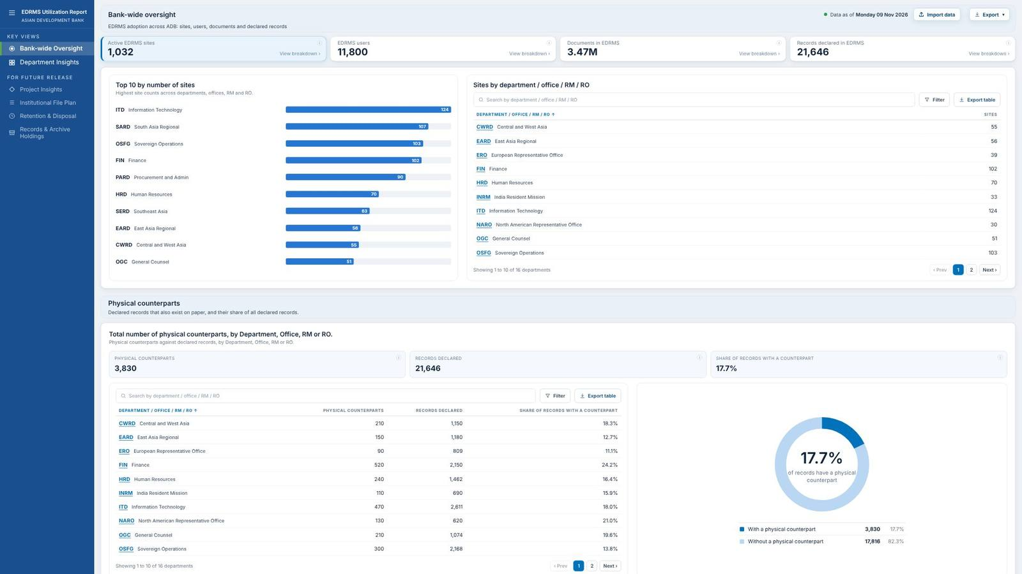
Scroll down ▼

Slide 4
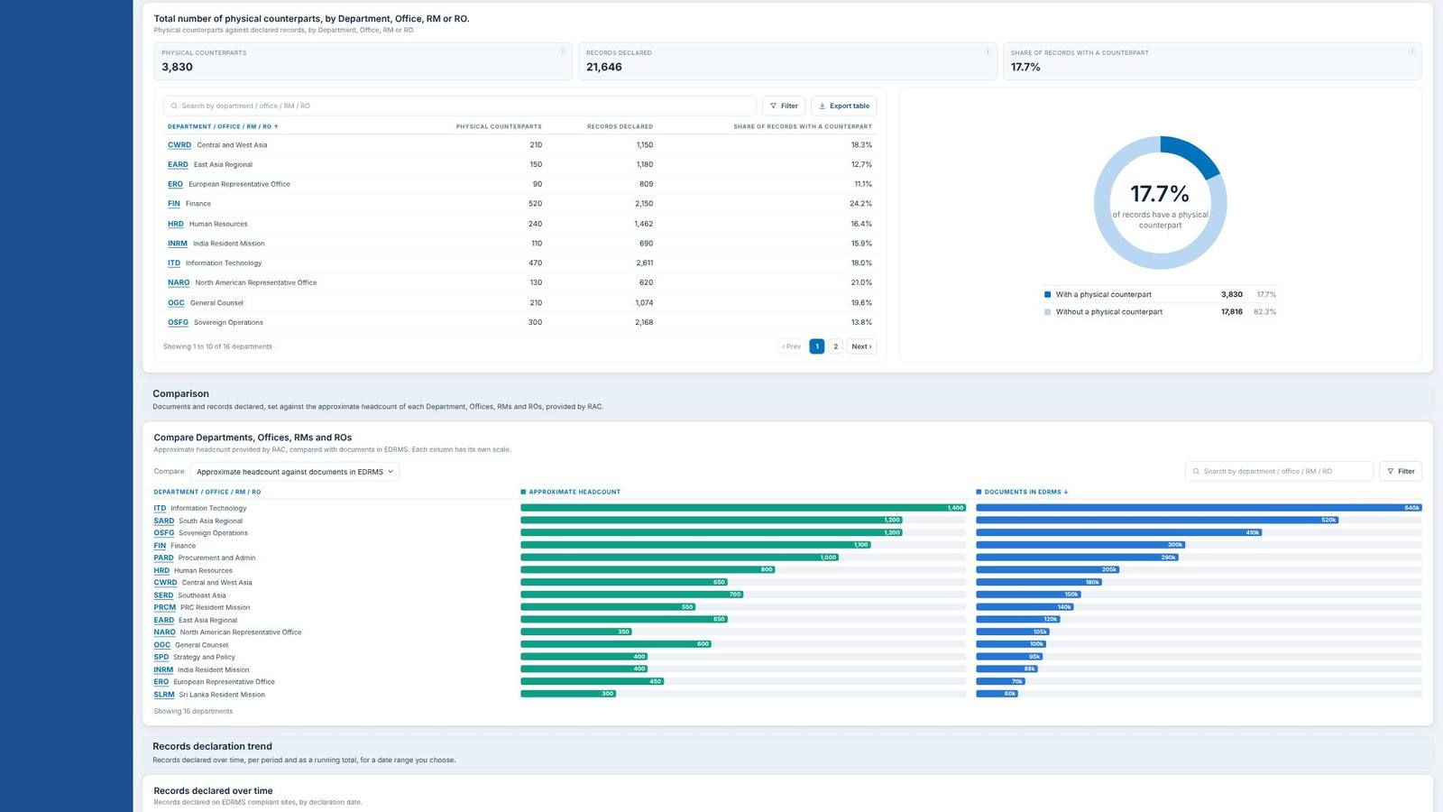
▲ Scroll up
Scroll down ▼

Slide 5
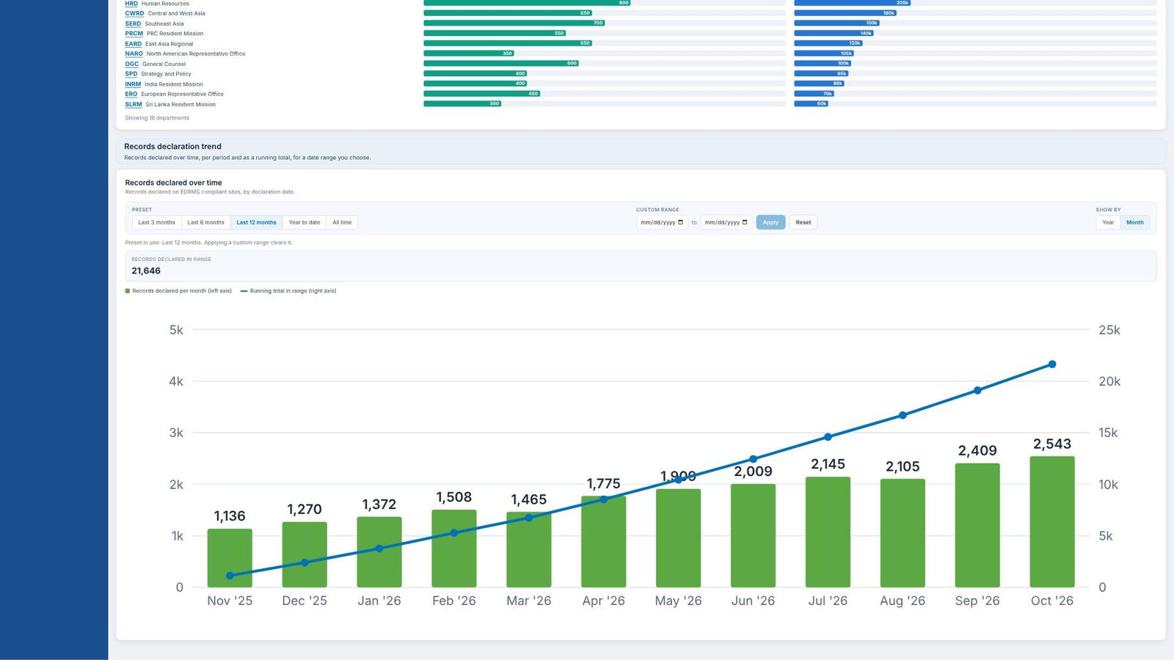
▲ Scroll up

Slide 6
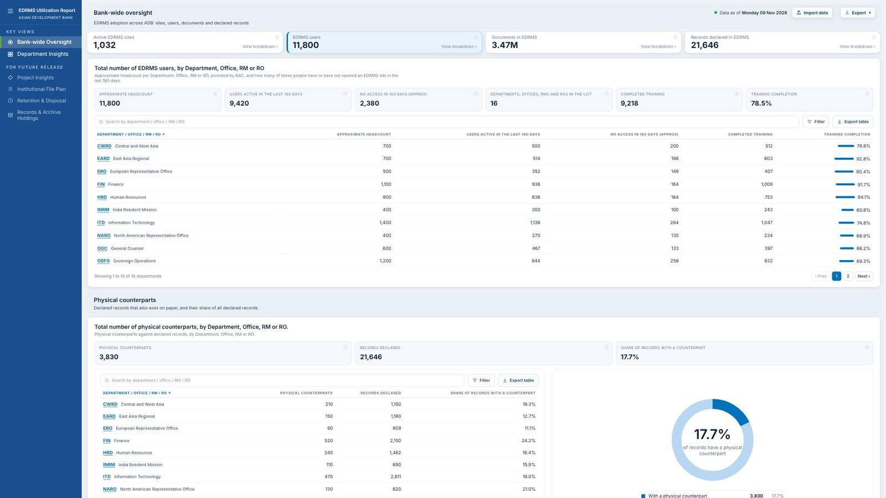
Scroll down ▼

Slide 7
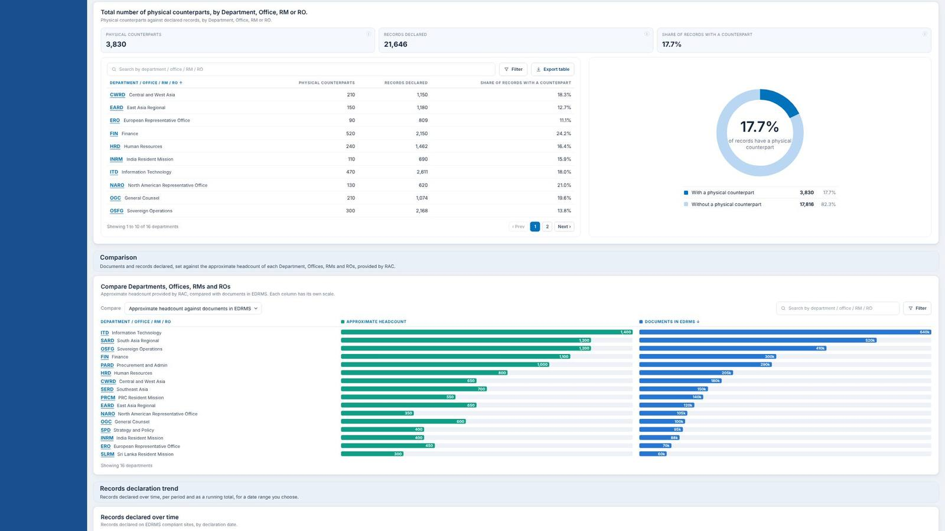
▲ Scroll up
Scroll down ▼

Slide 8

▲ Scroll up

Slide 9
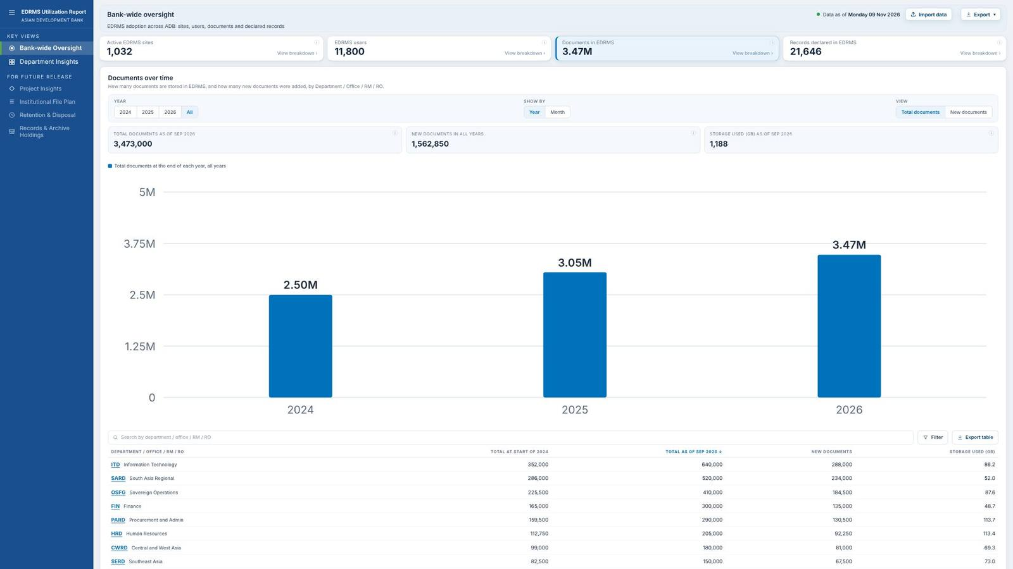
Scroll down ▼

Slide 10
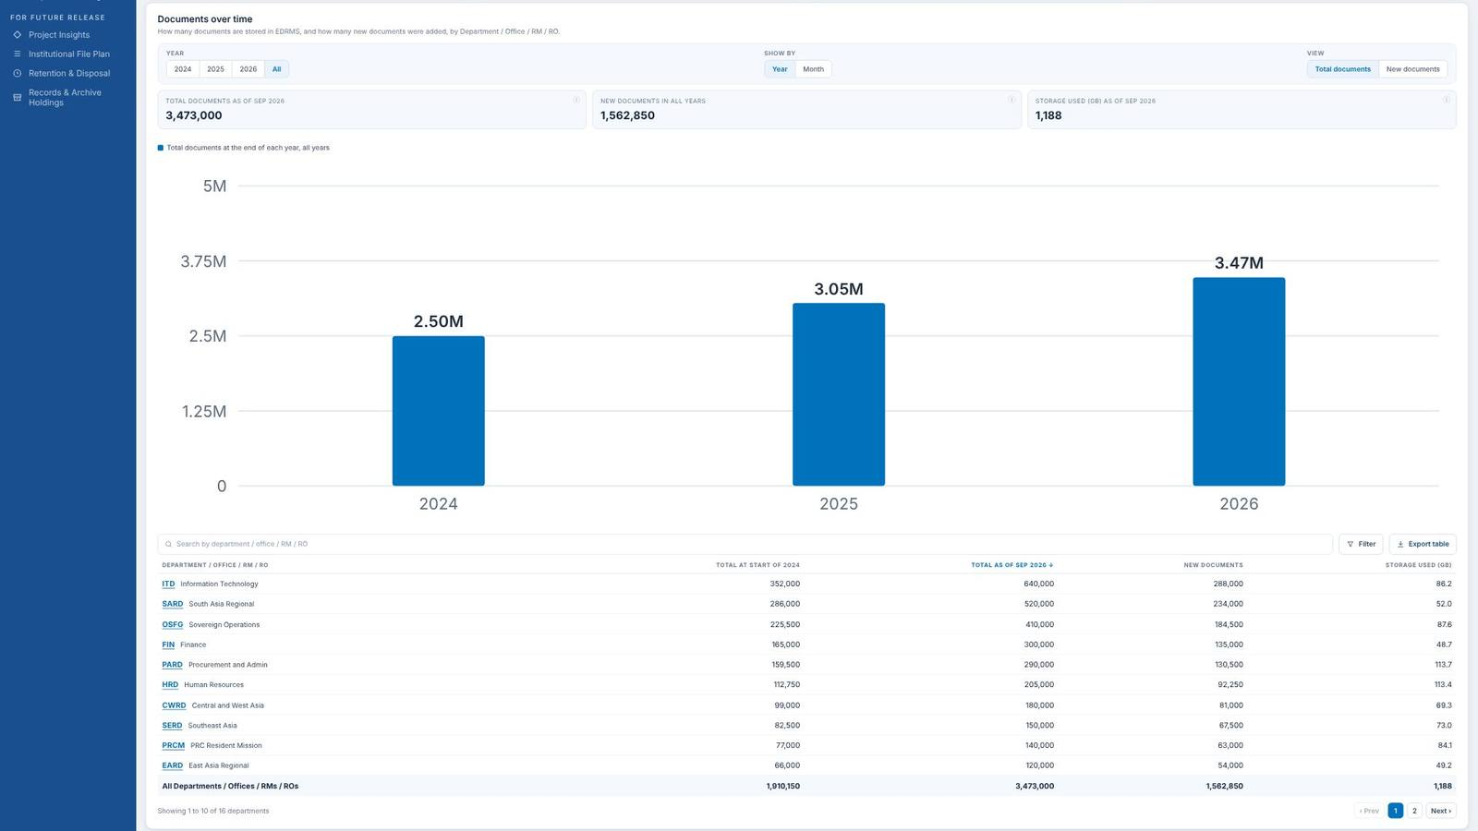
▲ Scroll up
Scroll down ▼

Slide 11
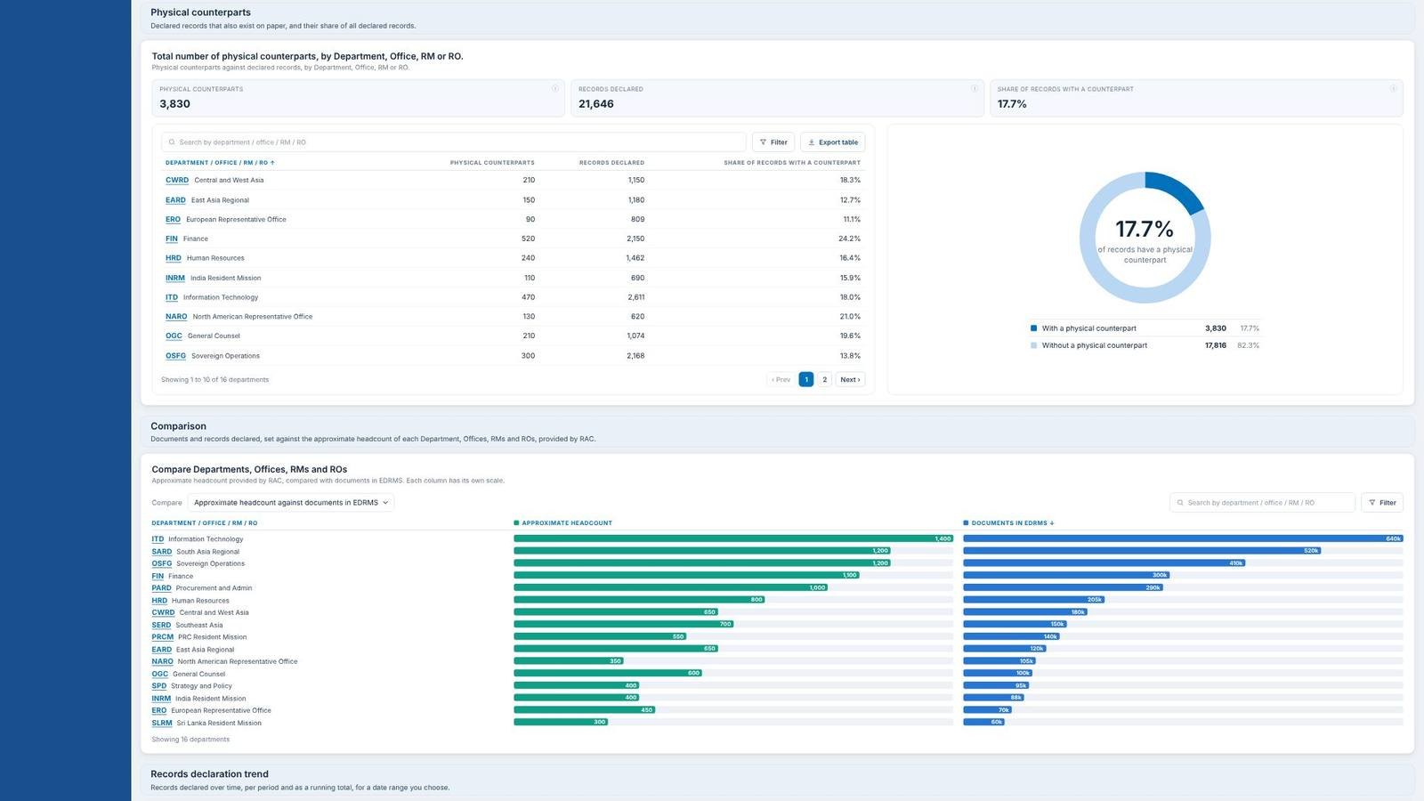
▲ Scroll up
Scroll down ▼

Slide 12

▲ Scroll up

Slide 13
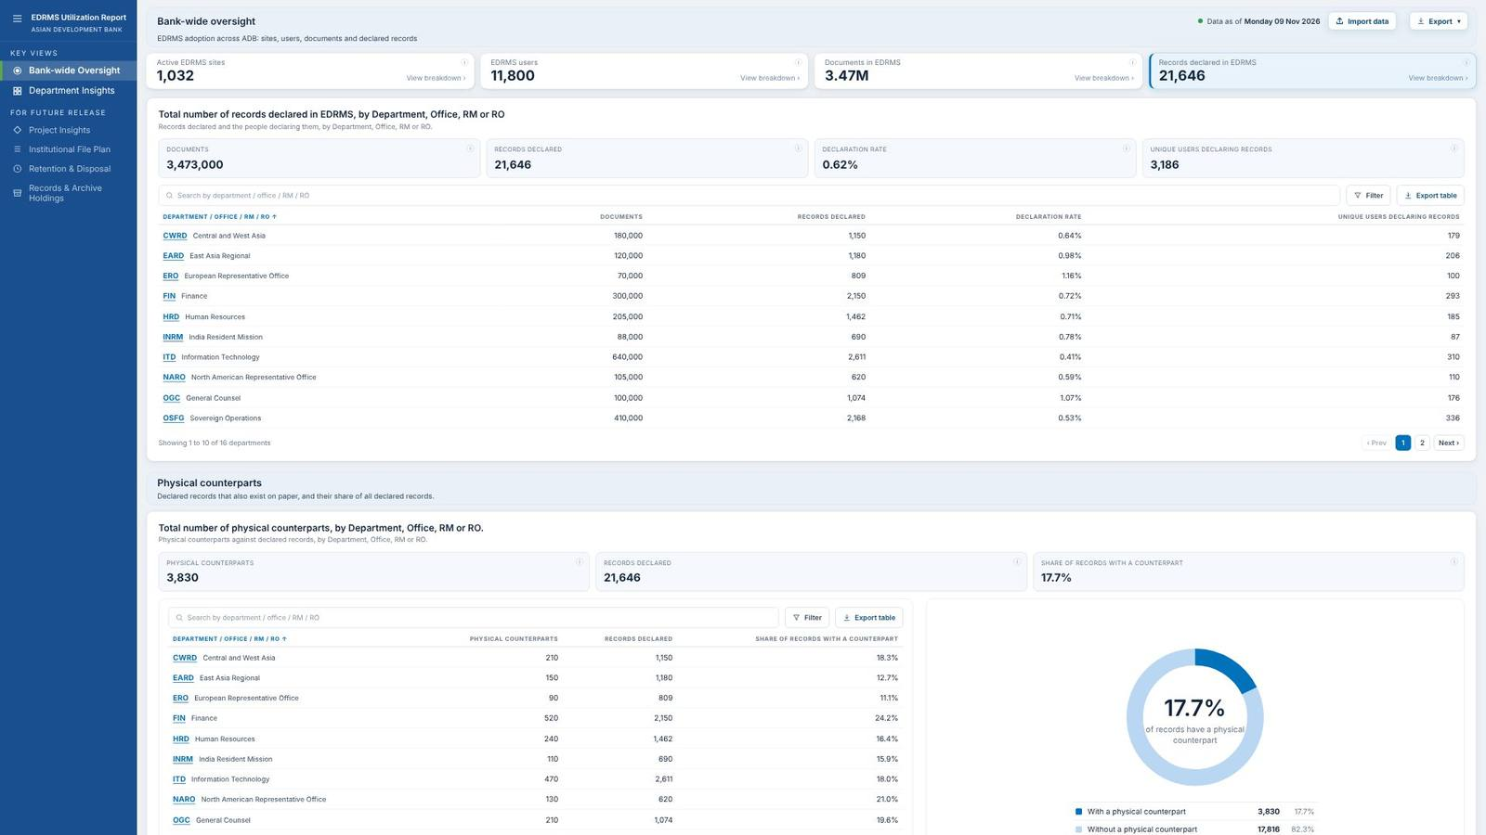
Scroll down ▼

Slide 14

▲ Scroll up
Scroll down ▼

Slide 15

▲ Scroll up

Slide 16
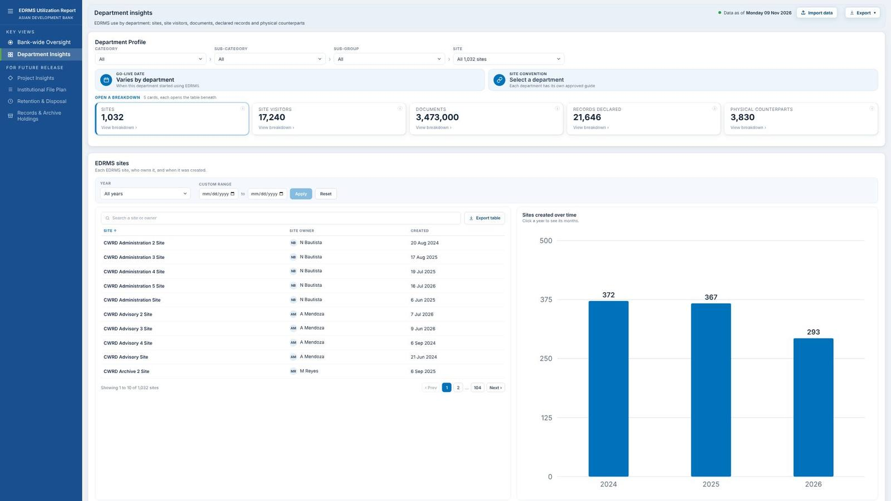
Scroll down ▼

Slide 17
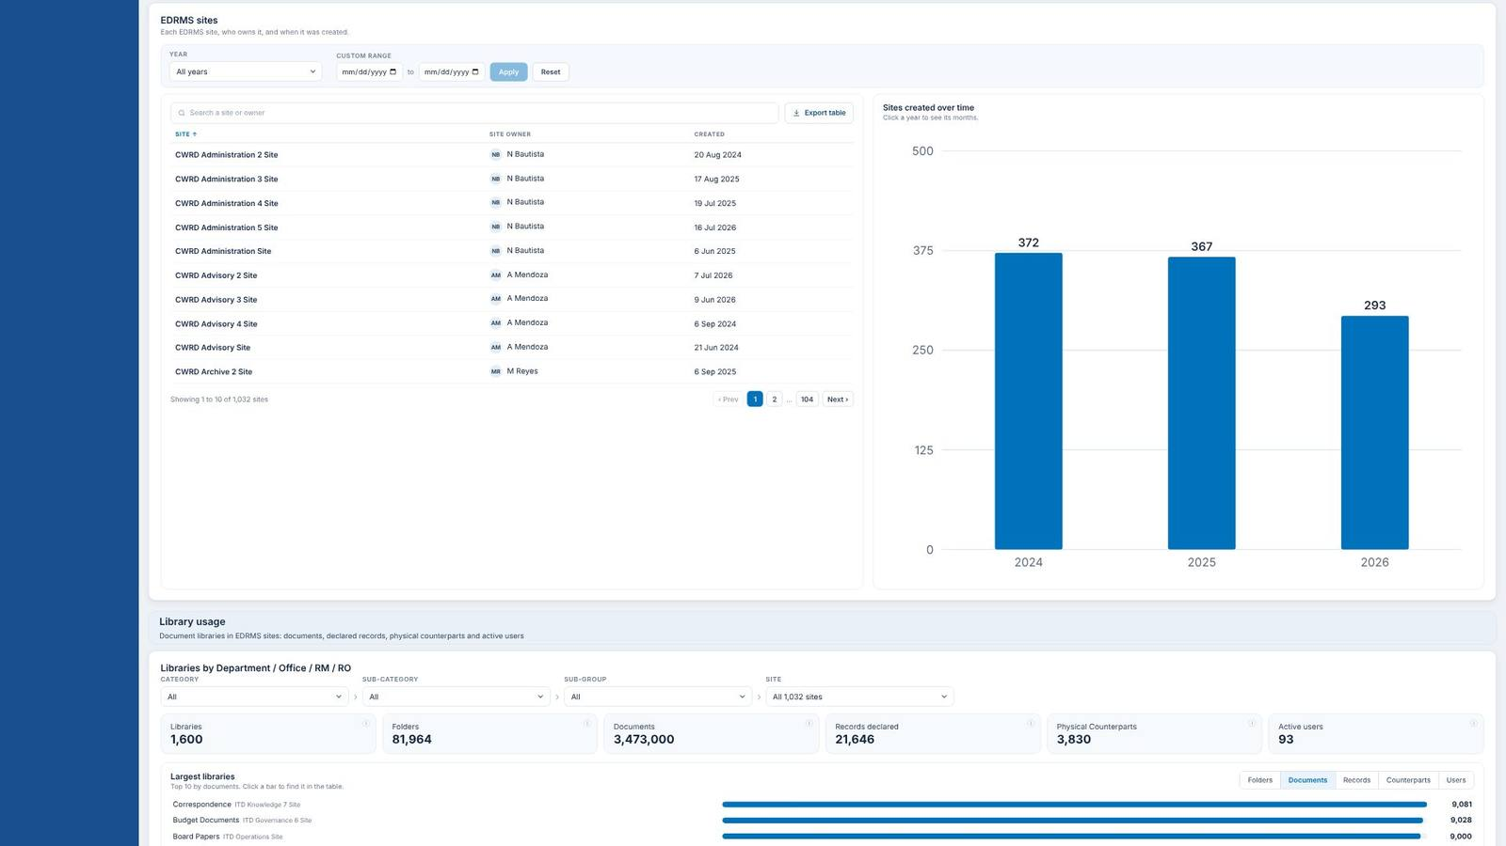
▲ Scroll up
Scroll down ▼

Slide 18
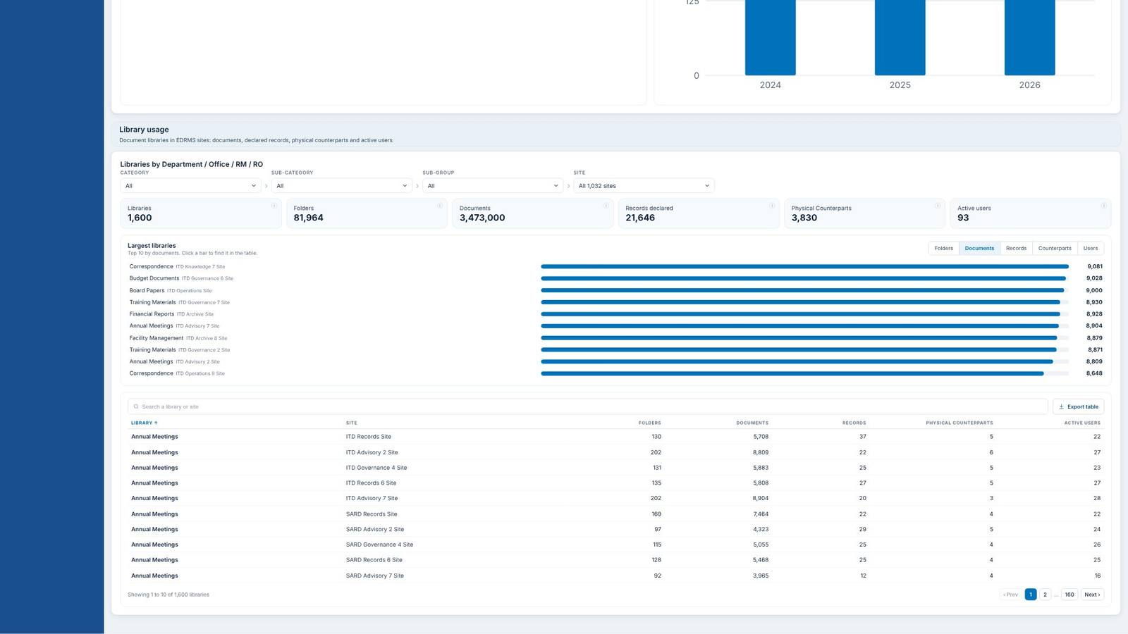
▲ Scroll up

Slide 19
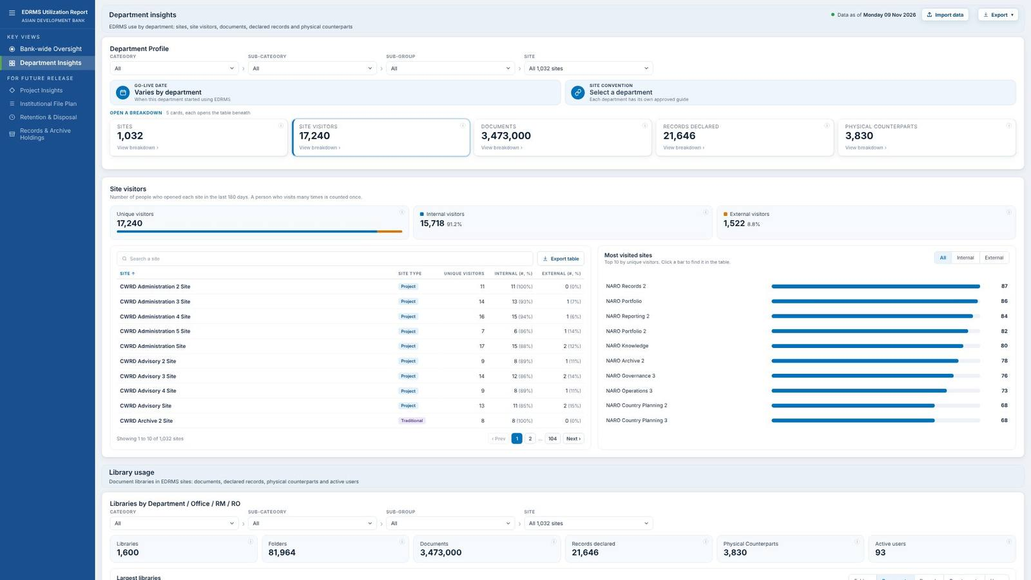
Scroll down ▼

Slide 20
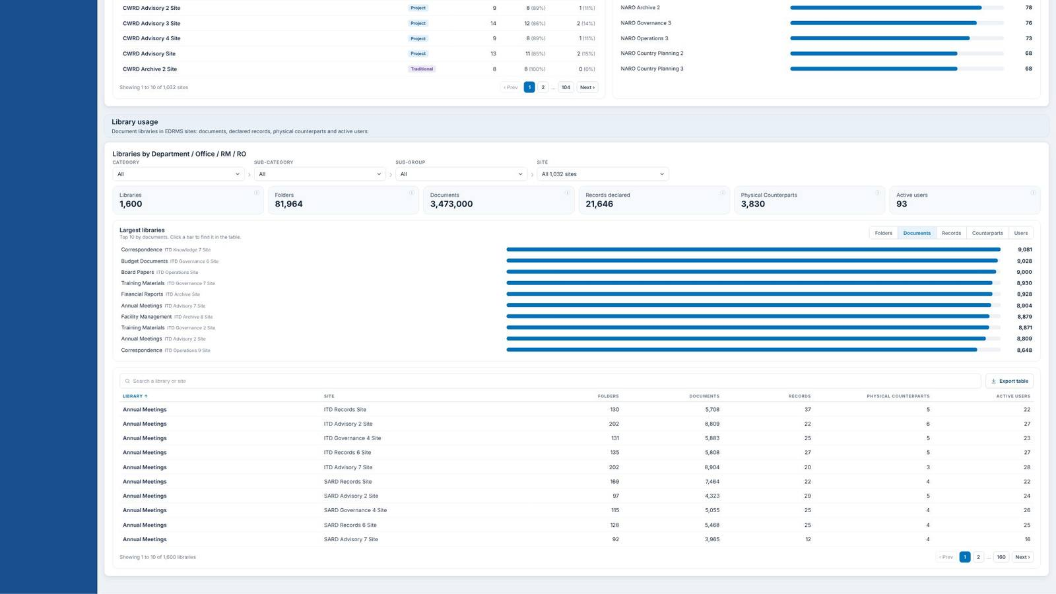
▲ Scroll up

Slide 21
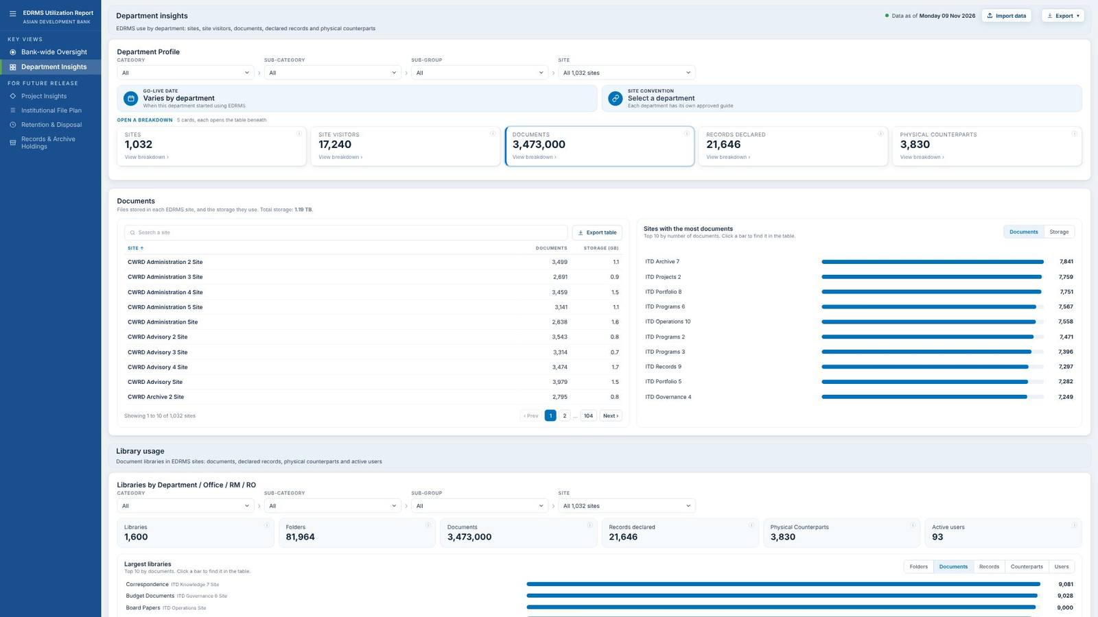
Scroll down ▼

Slide 22
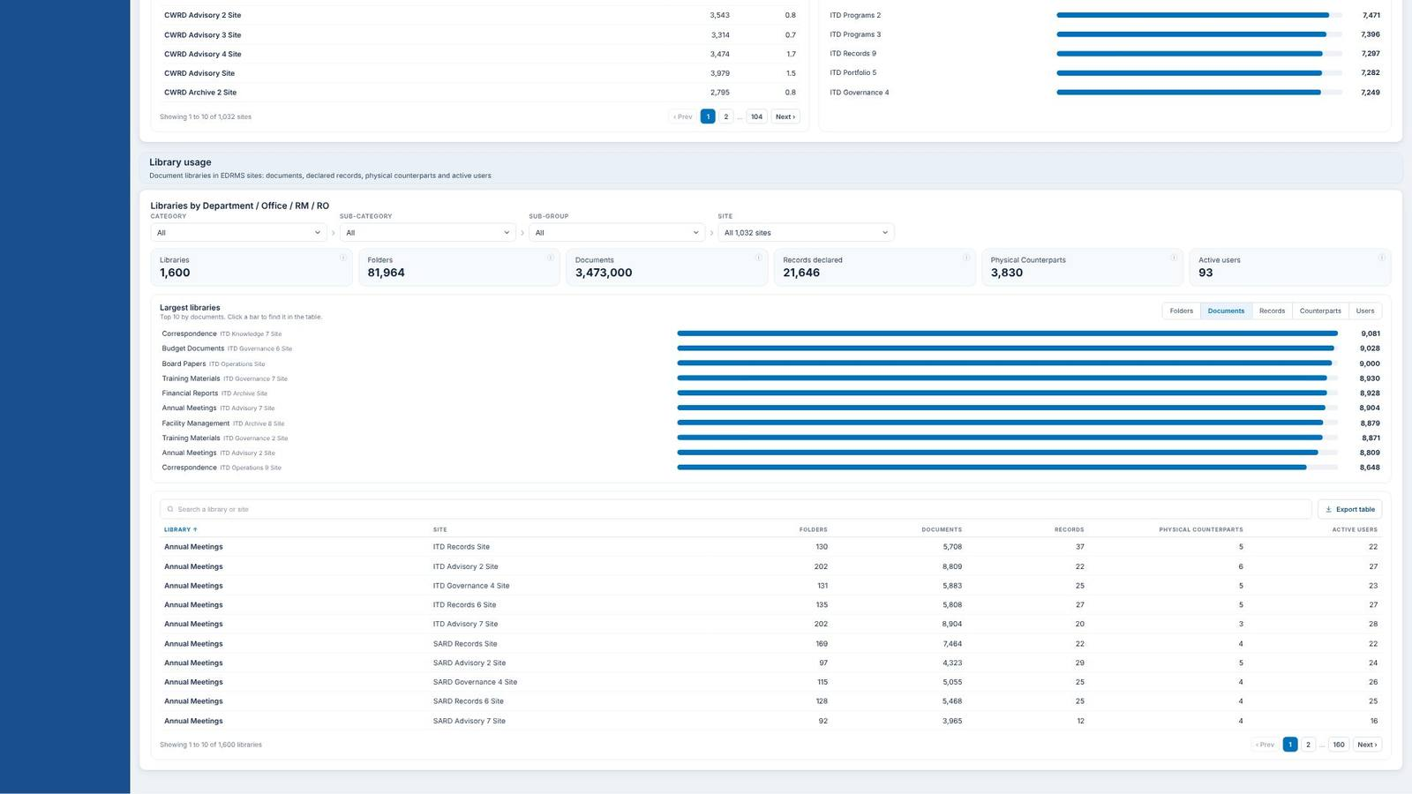
▲ Scroll up

Slide 23
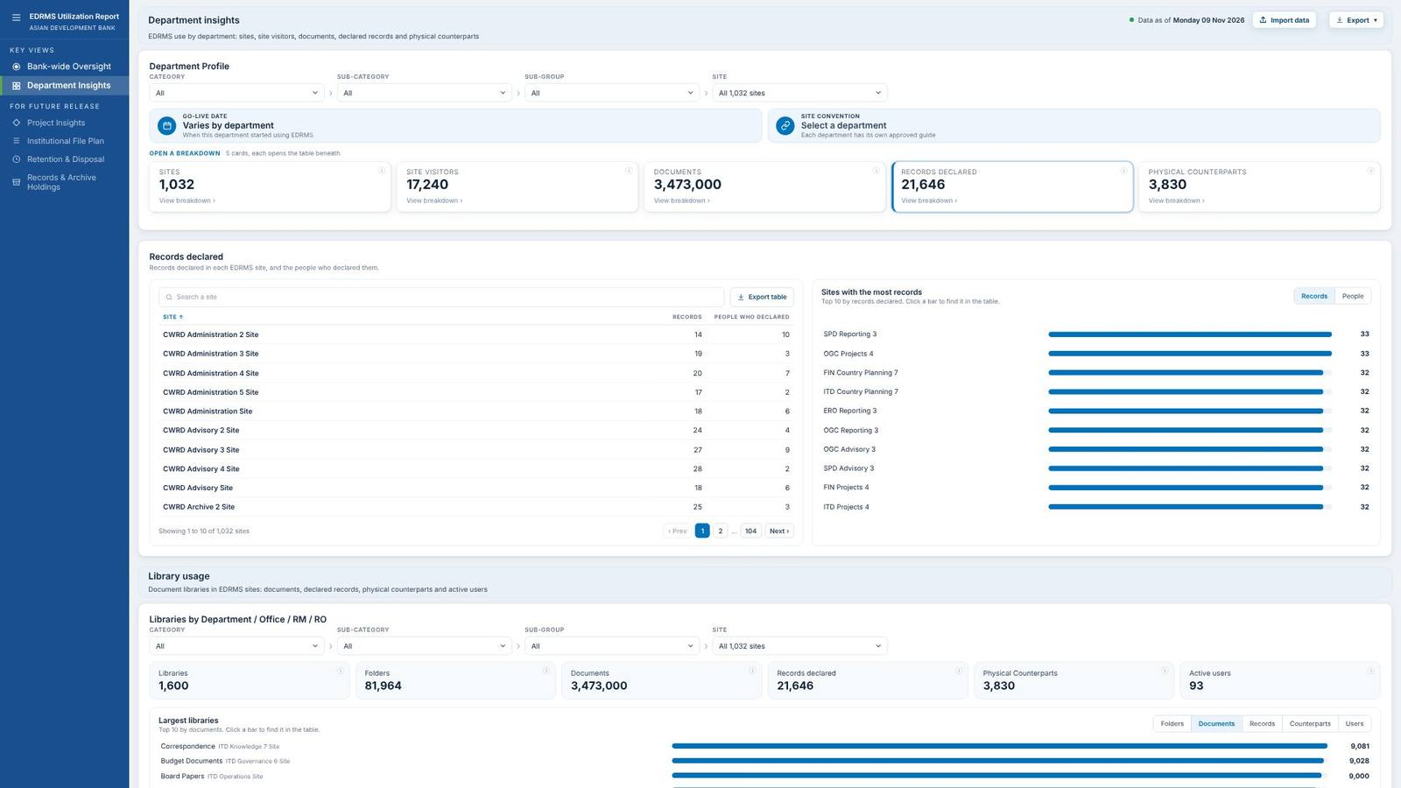
Scroll down ▼

Slide 24

▲ Scroll up

Slide 25
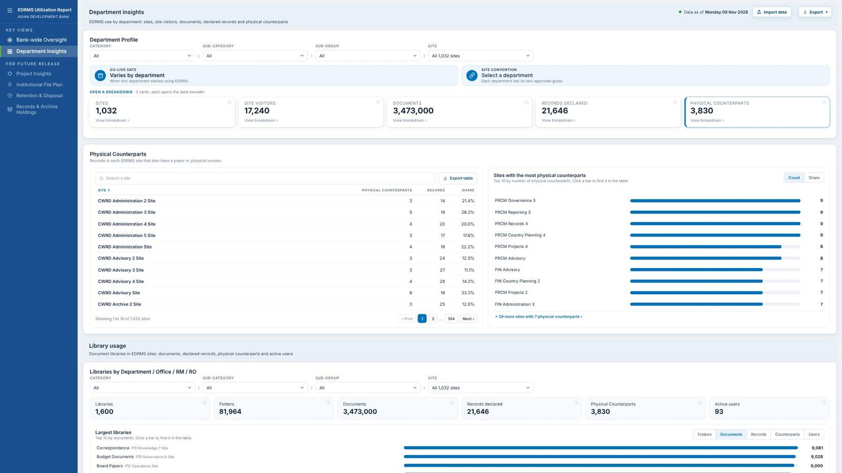
Scroll down ▼

Slide 26
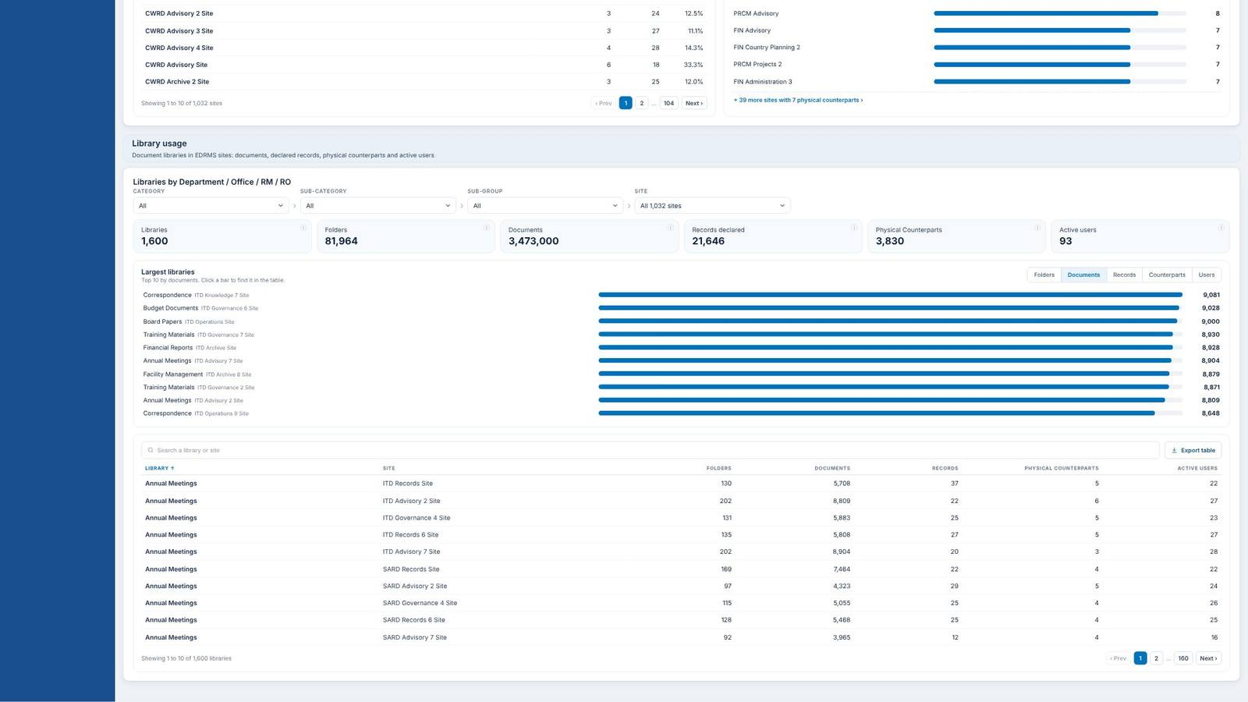
▲ Scroll up

Slide 27
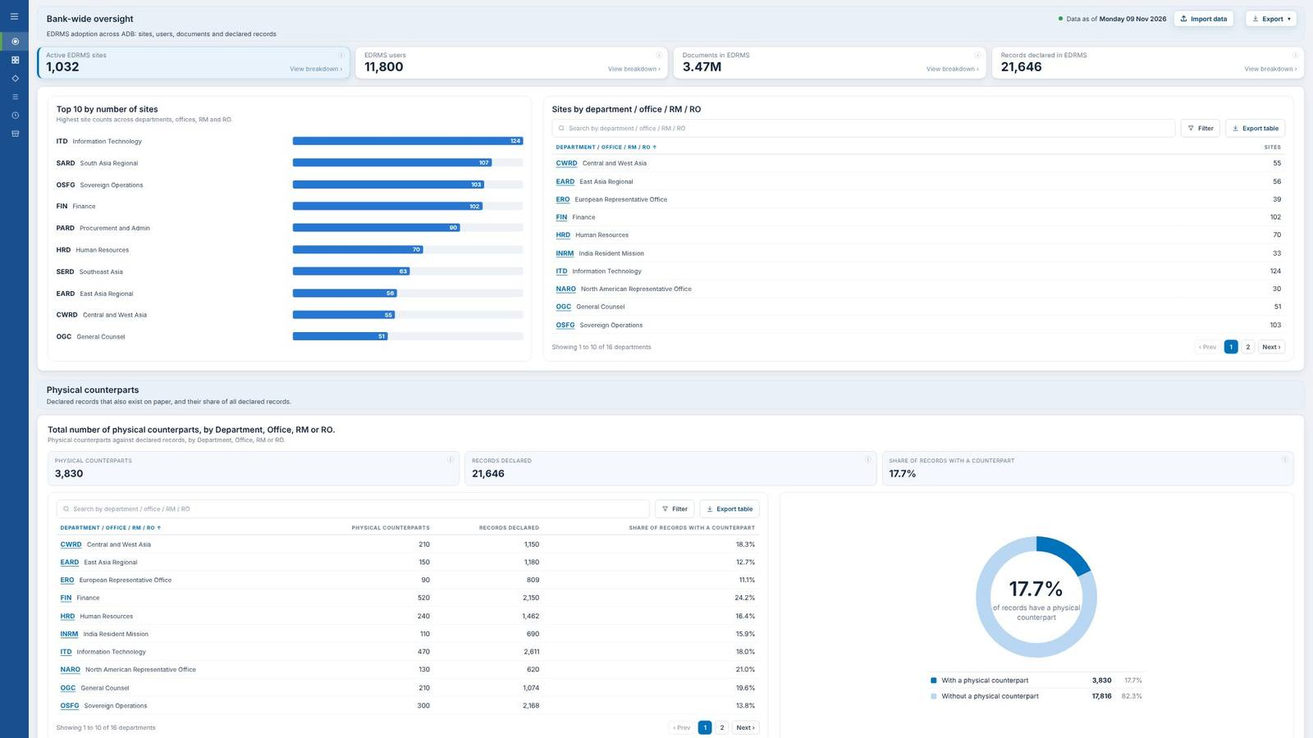
Scroll down ▼

Slide 28
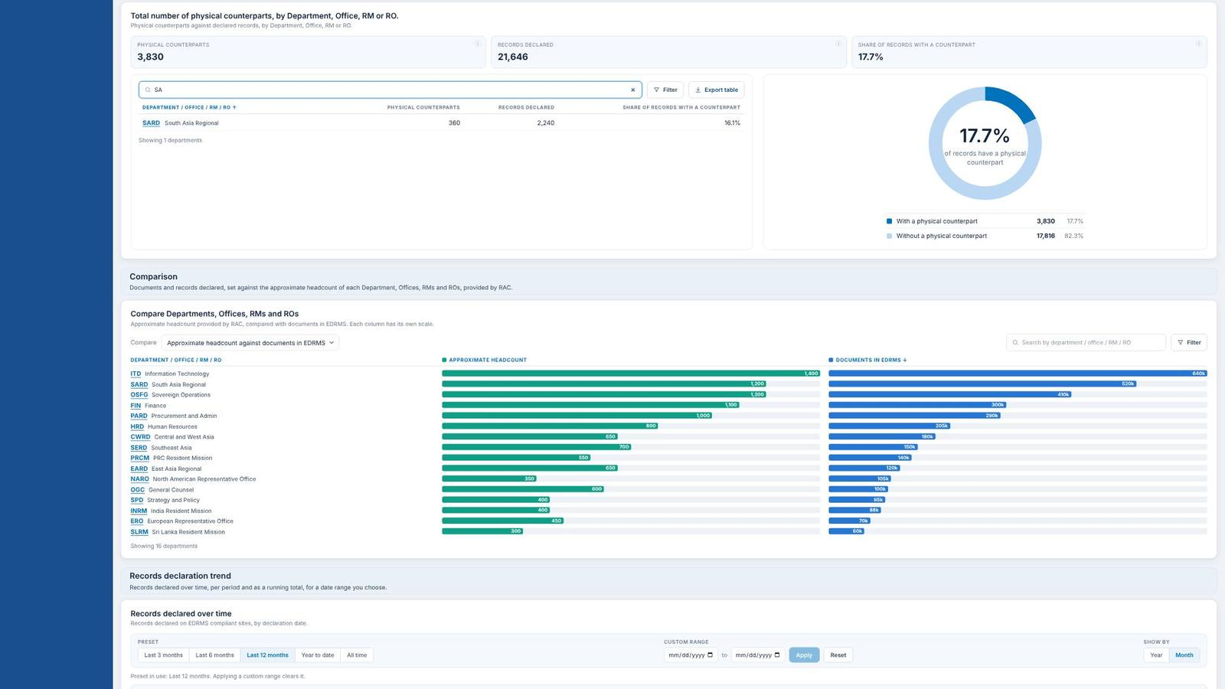
▲ Scroll up
Scroll down ▼

Slide 29
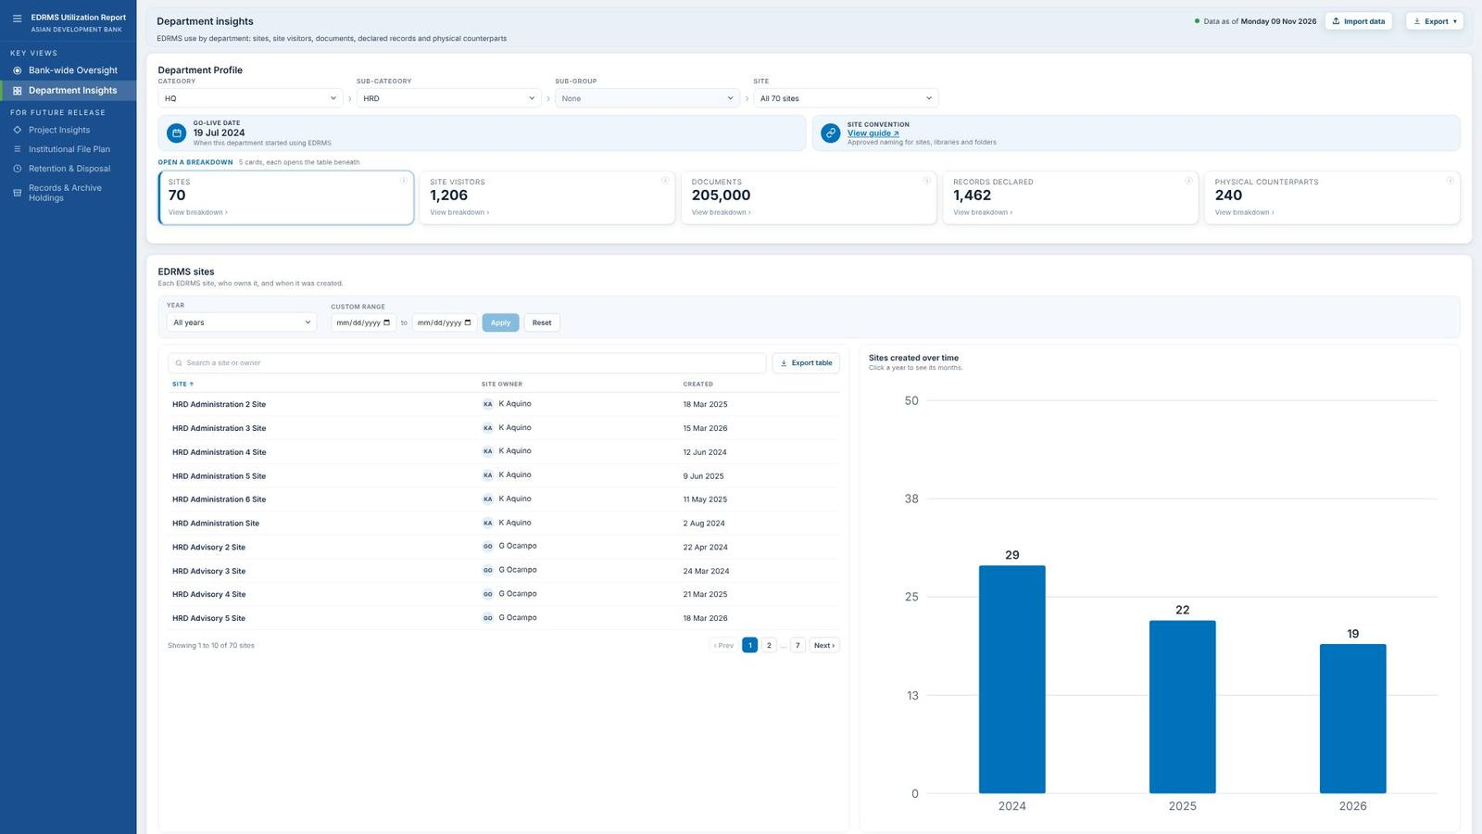
▲ Scroll up

Slide 30
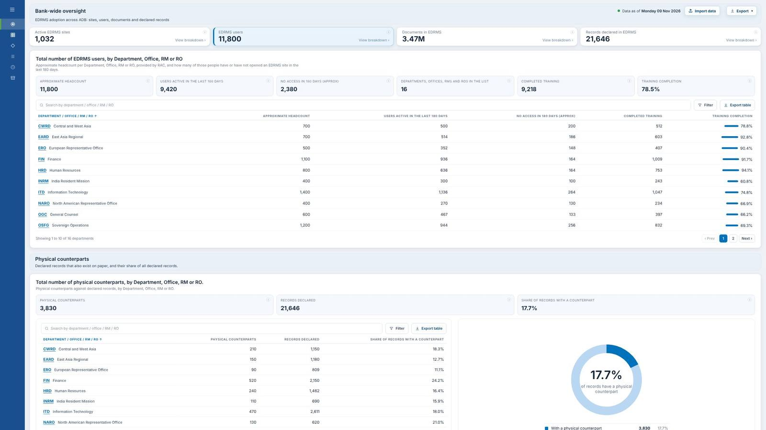
Scroll down ▼

Slide 31

▲ Scroll up
Scroll down ▼

Slide 32
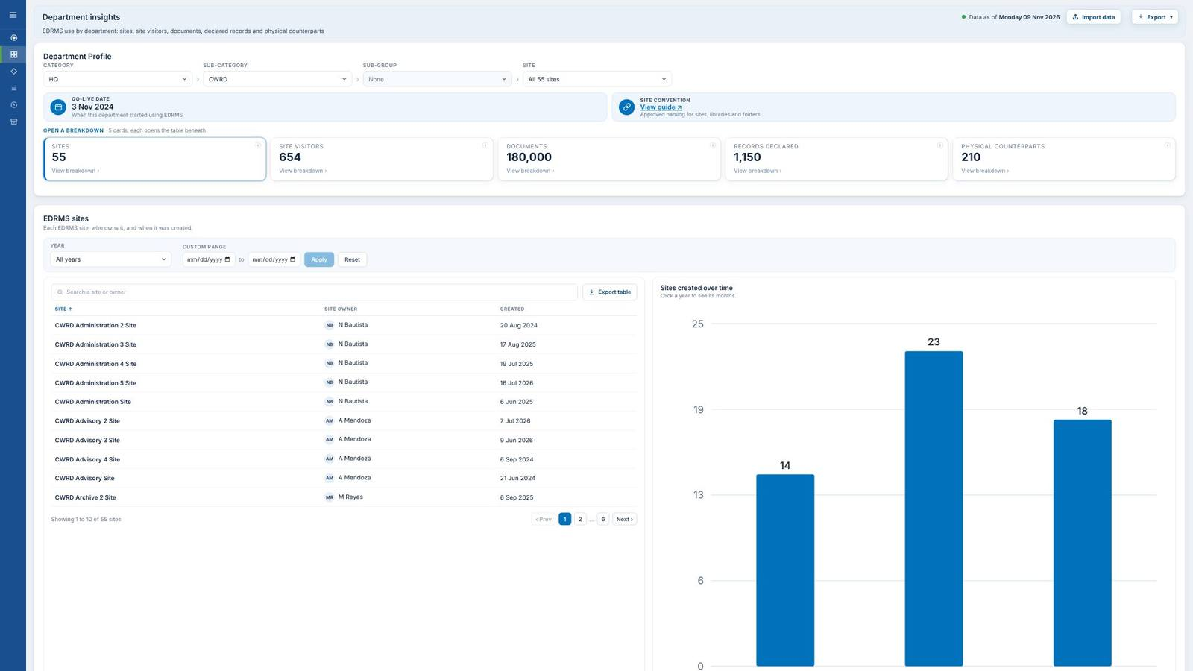
▲ Scroll up

Slide 33
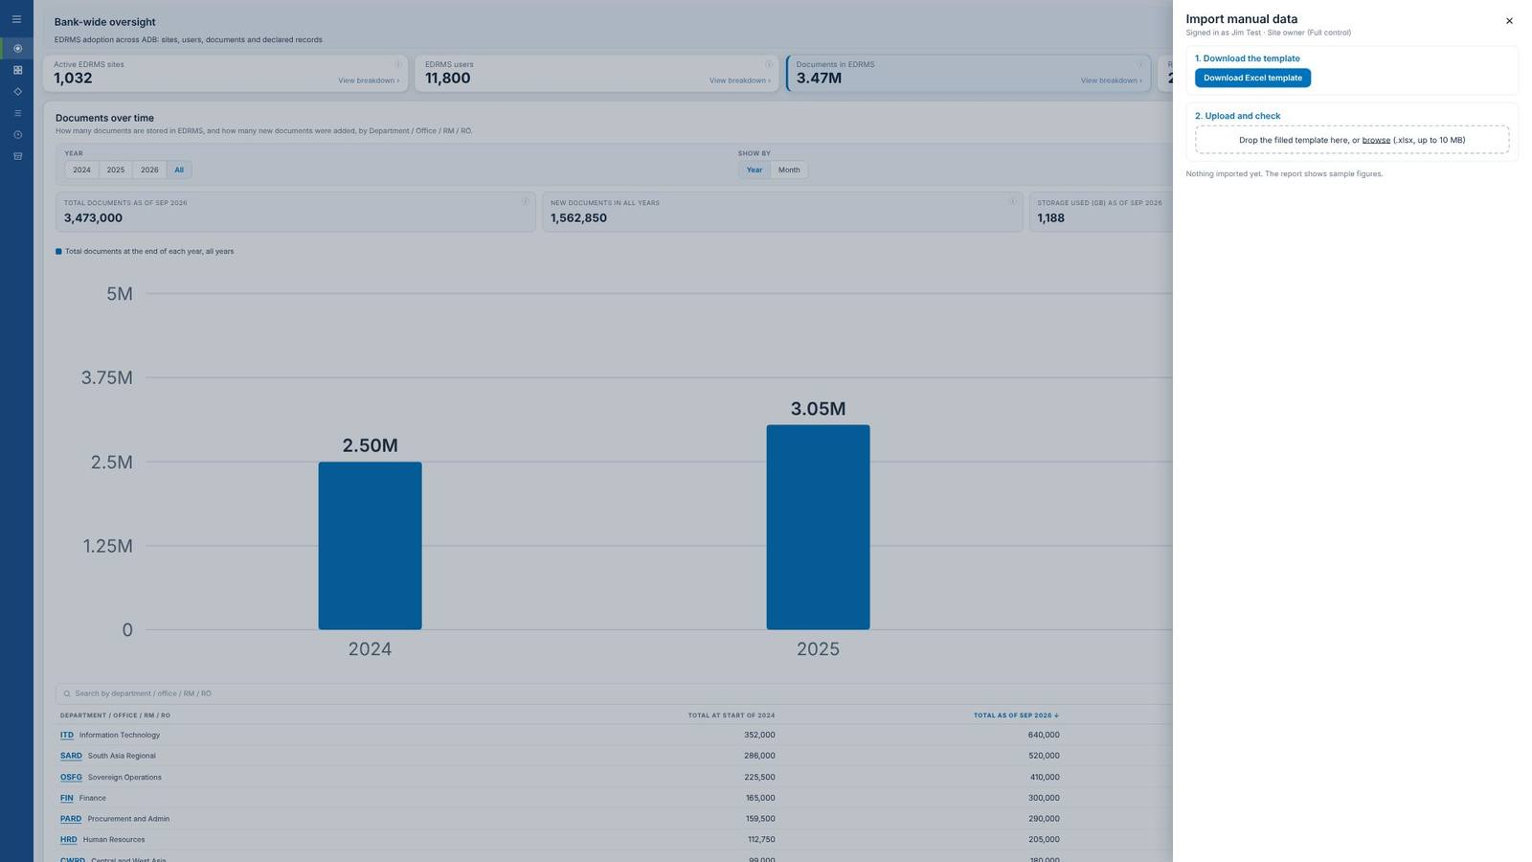

Slide 34
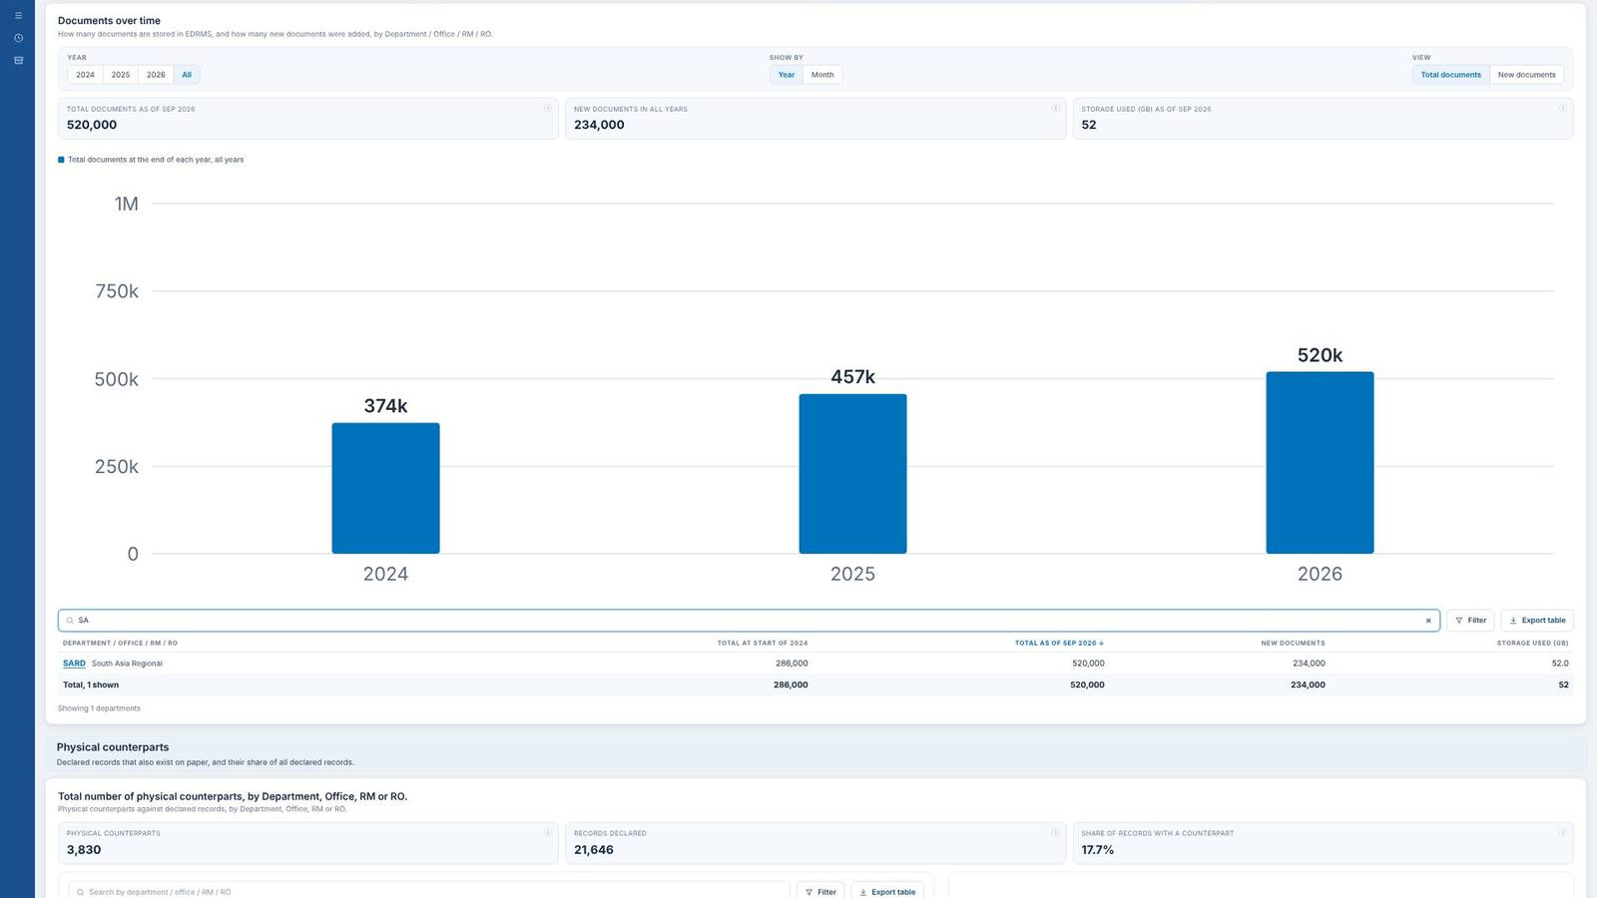
▲ Scroll up
Scroll down ▼

Slide 35
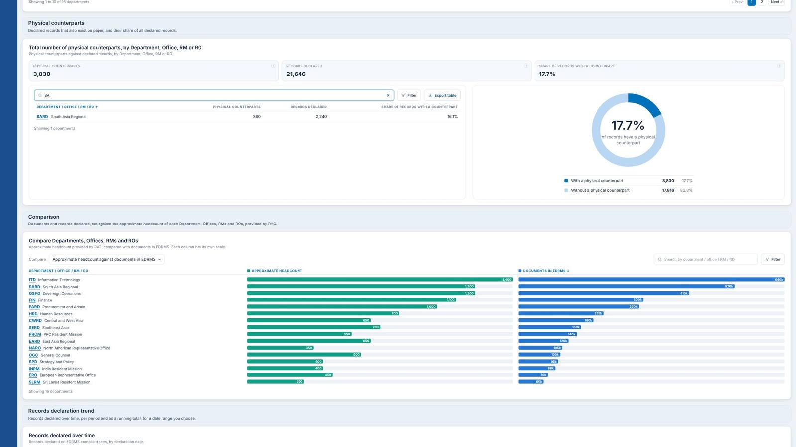
▲ Scroll up
Scroll down ▼

Slide 36
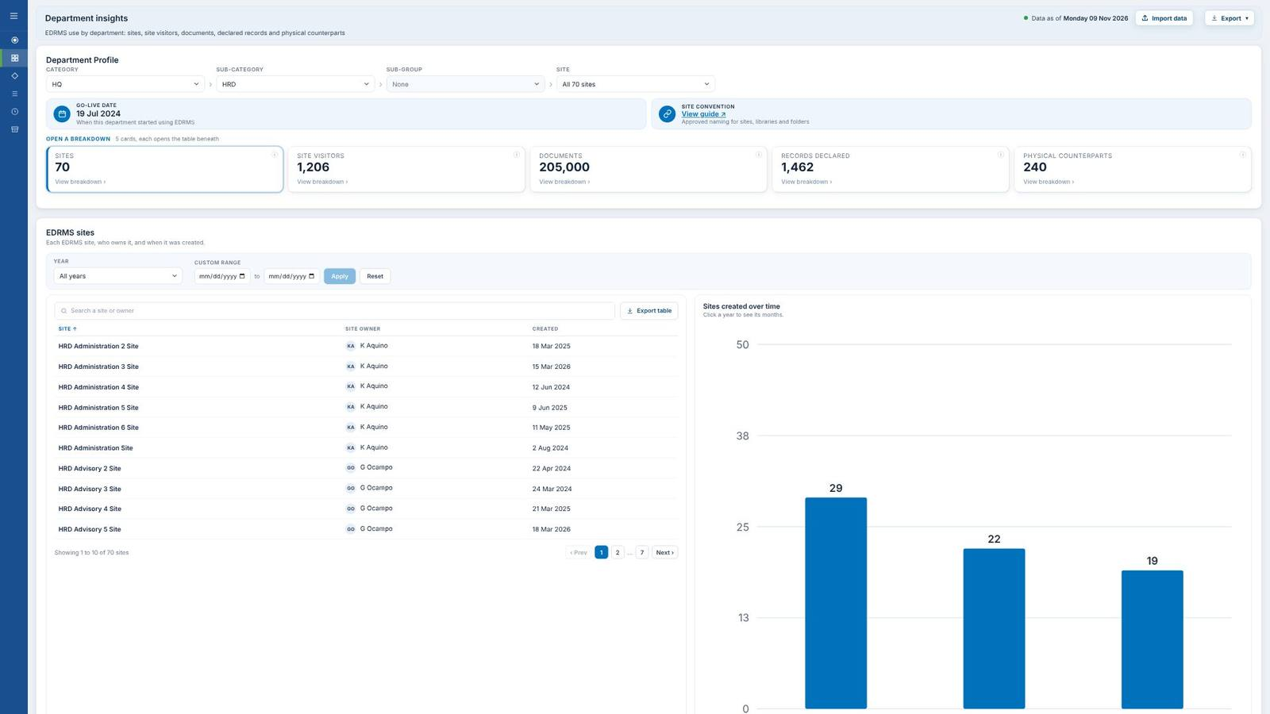
▲ Scroll up
Scroll down ▼

Slide 37
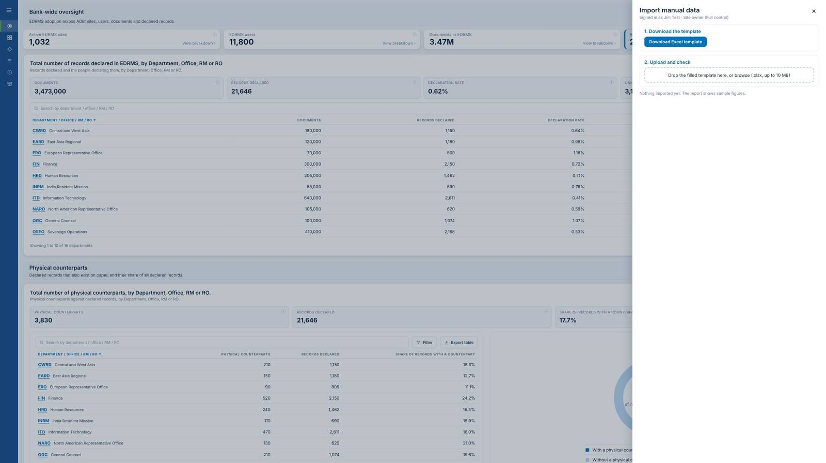

Slide 38
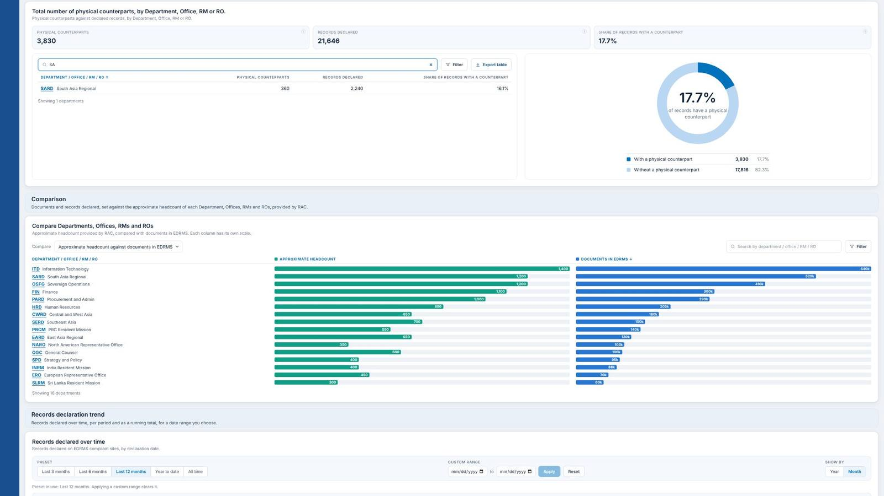
▲ Scroll up
Scroll down ▼

Slide 39
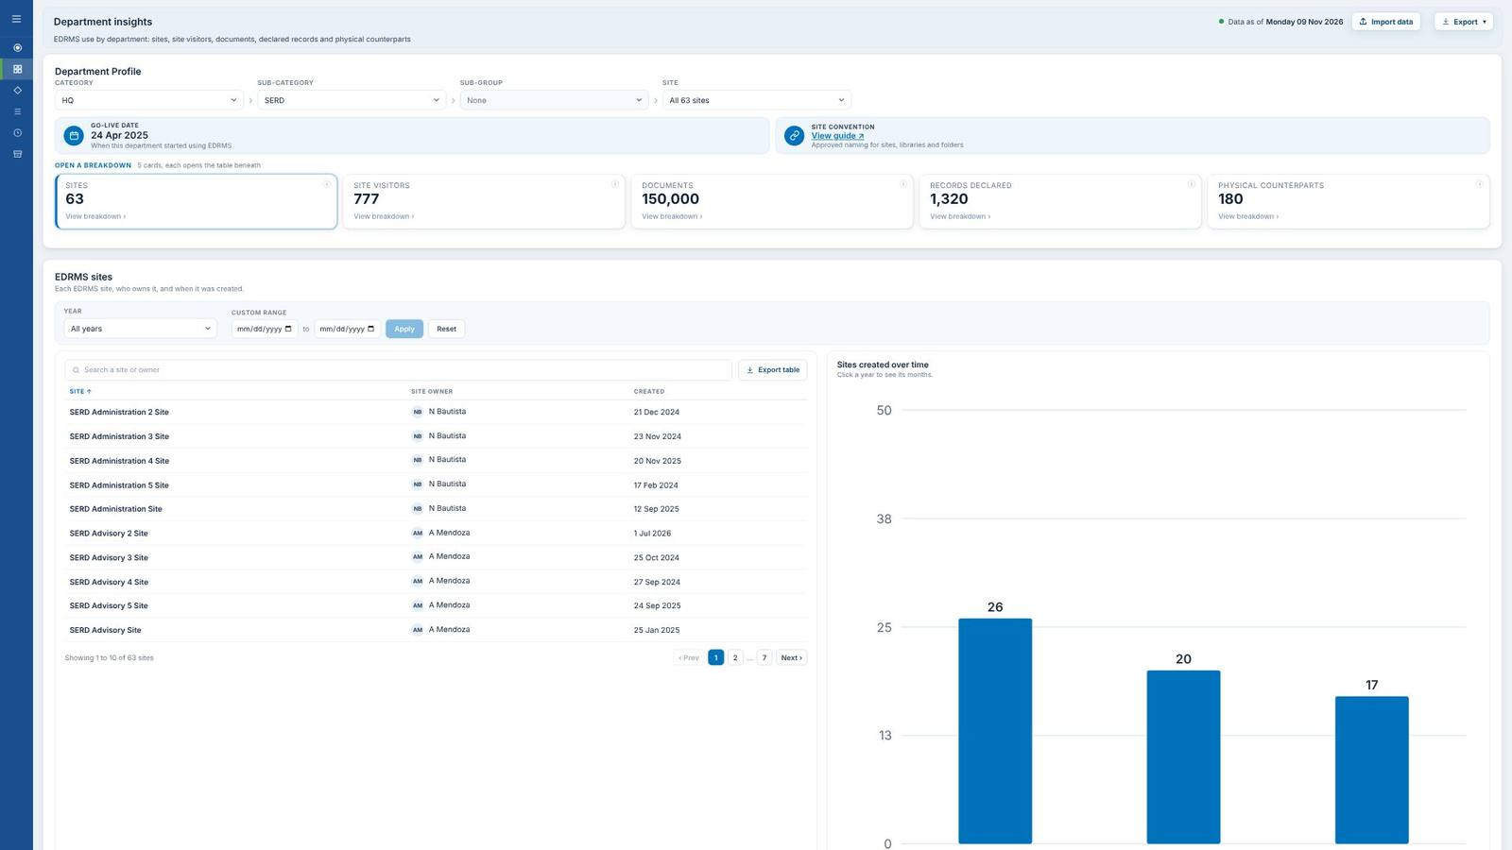
▲ Scroll up

Slide 40
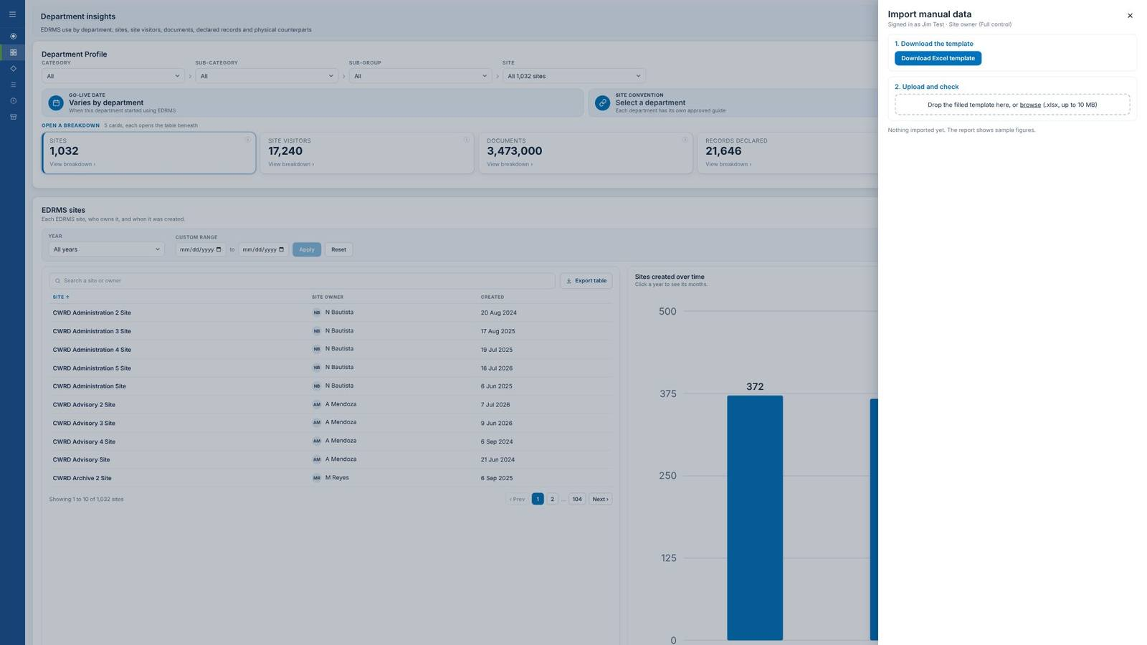

Slide 41
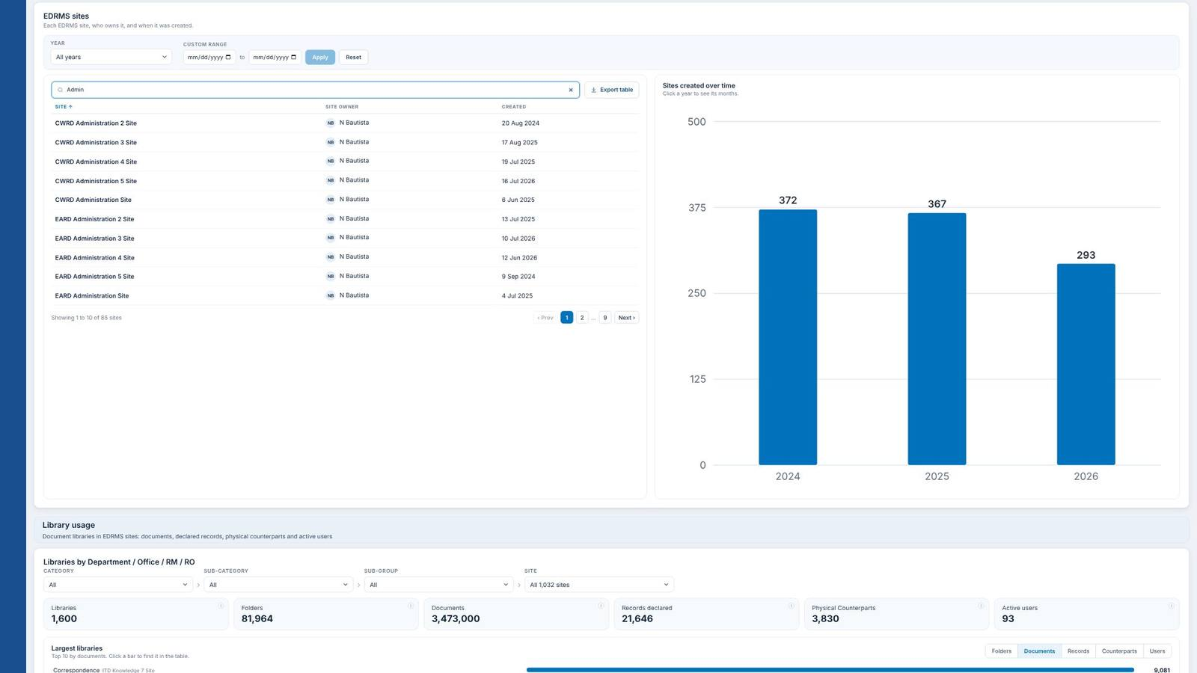
▲ Scroll up
Scroll down ▼

Slide 42
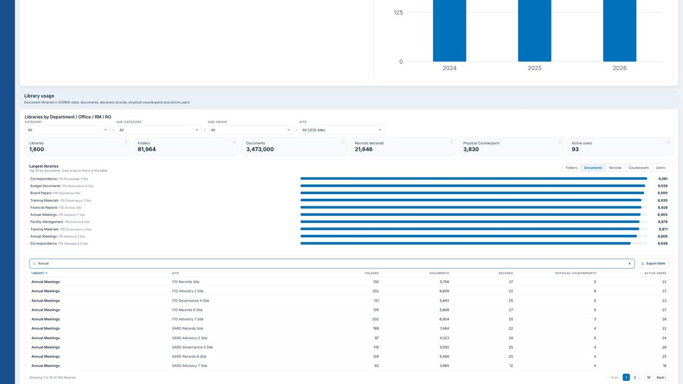
▲ Scroll up

Slide 43
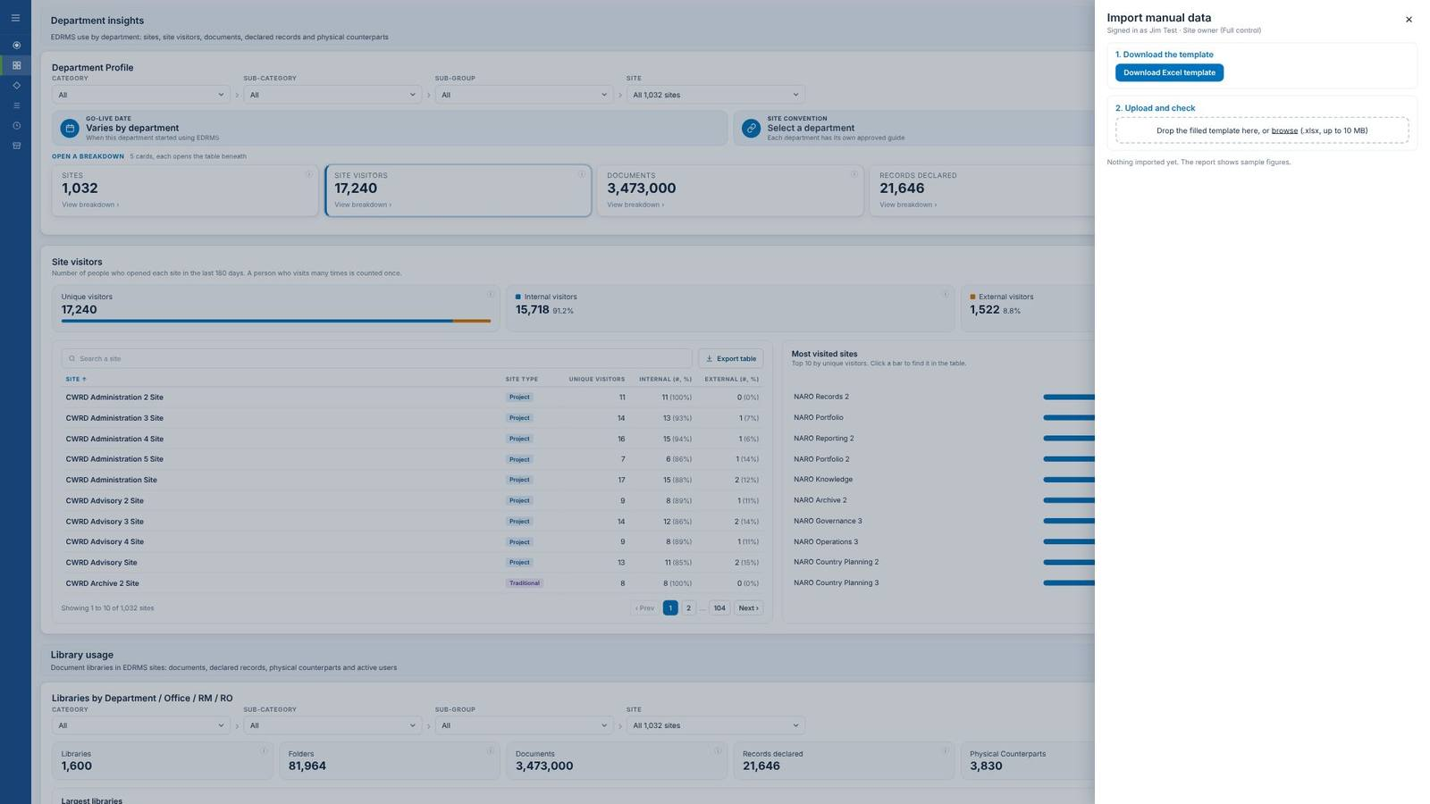

Slide 44
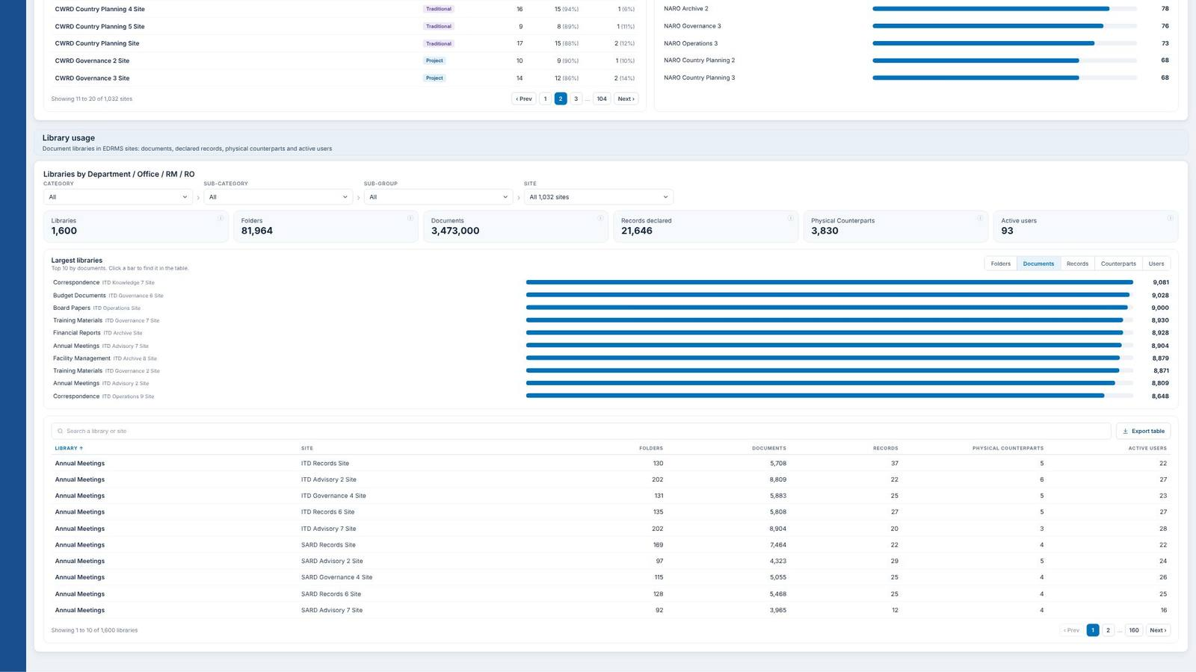
▲ Scroll up

Slide 45
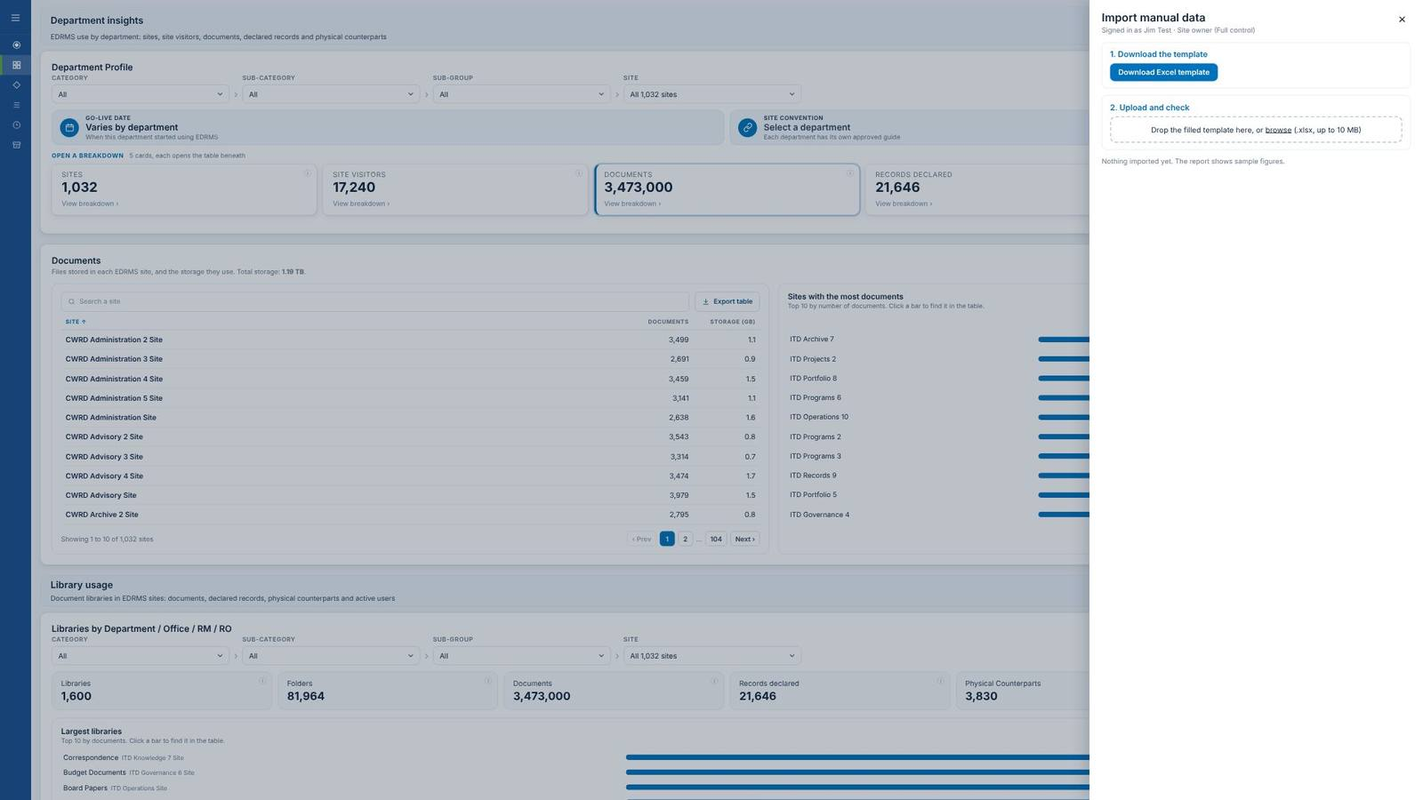

Slide 46
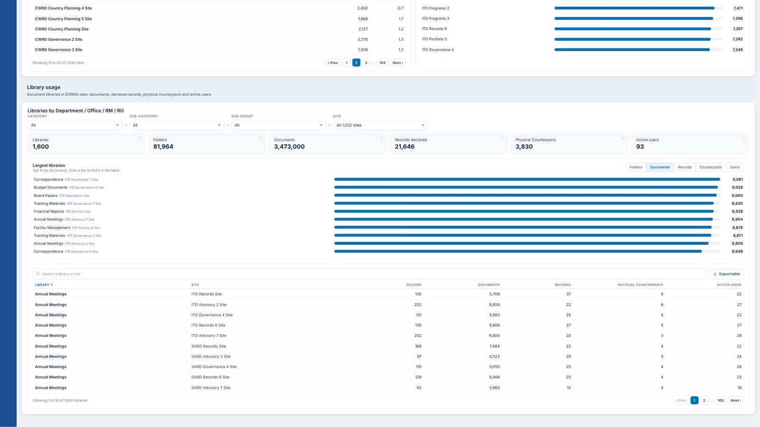
▲ Scroll up

Slide 47


Slide 48

▲ Scroll up

Slide 49
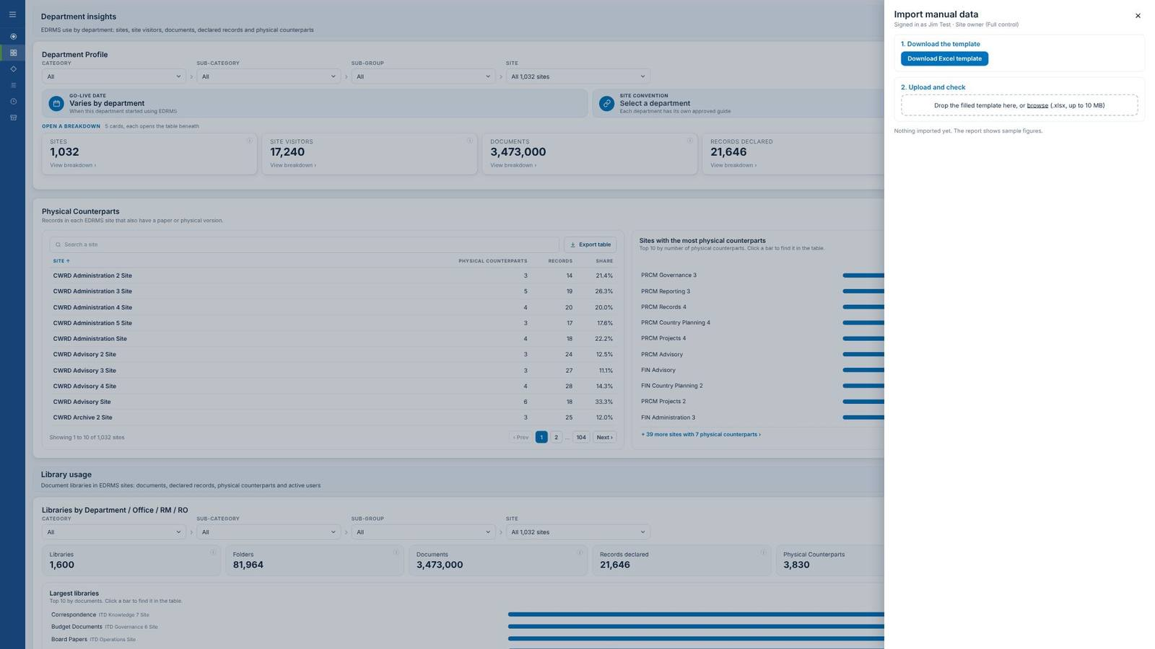

Slide 50
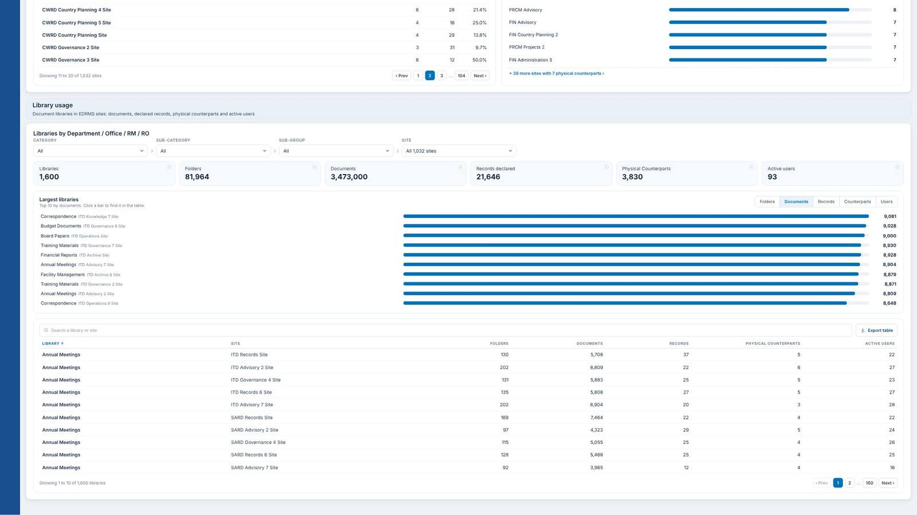
▲ Scroll up

Slide 51
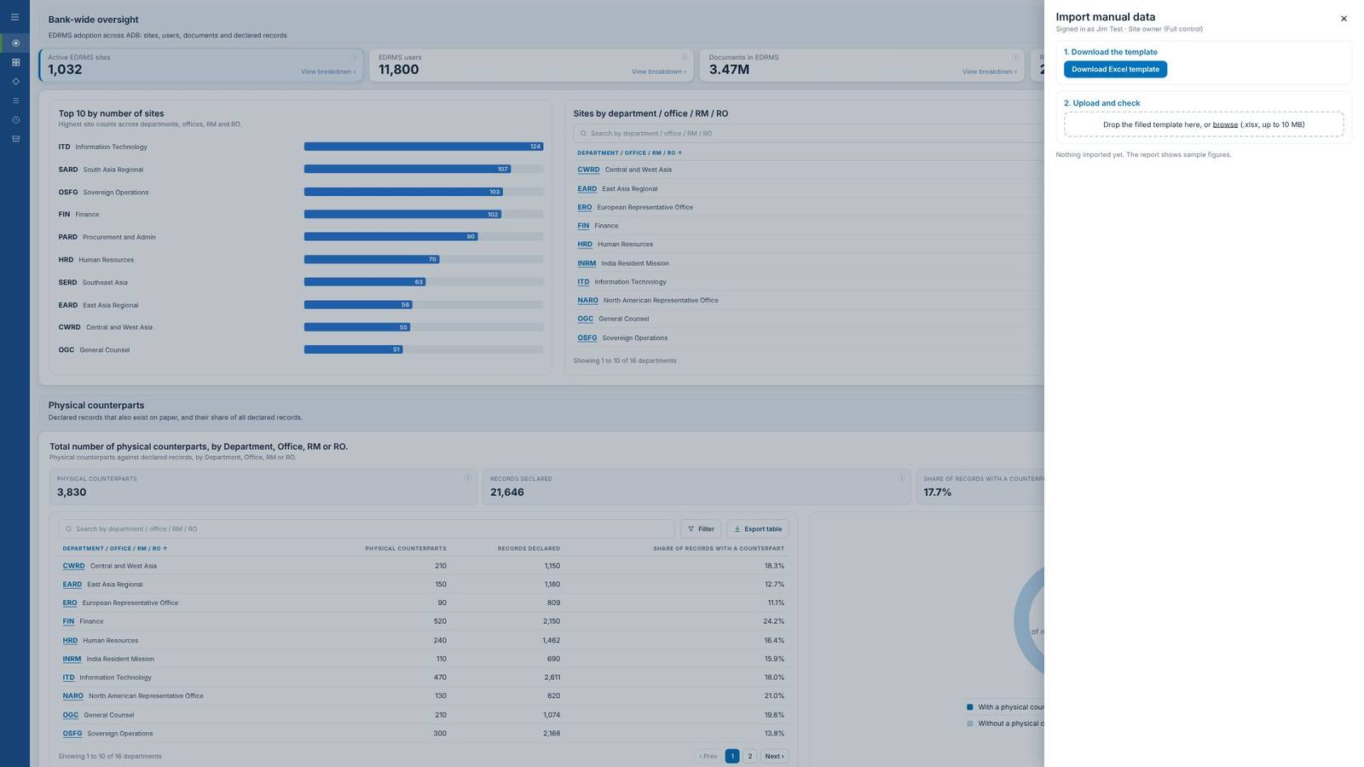

Slide 52
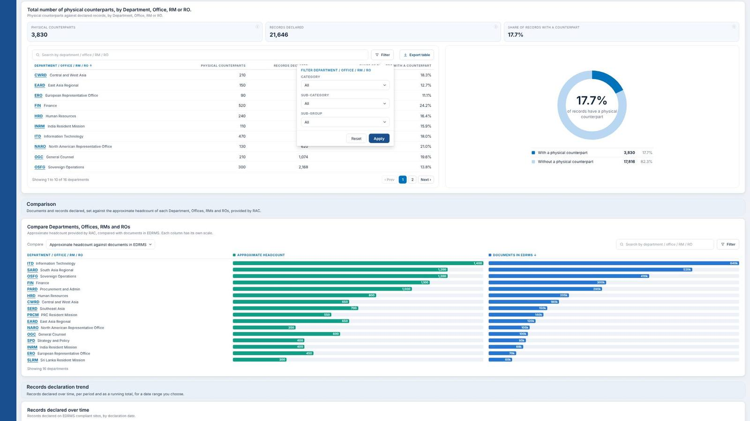

Slide 53

▲ Scroll up

Slide 54
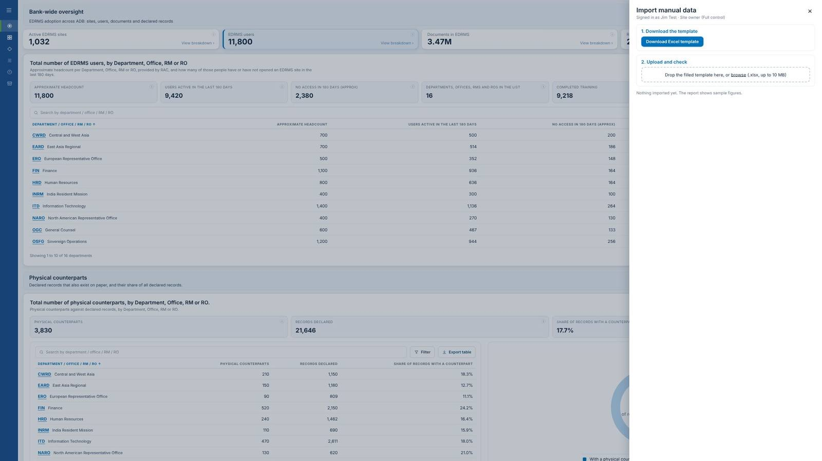

Slide 55


Slide 56
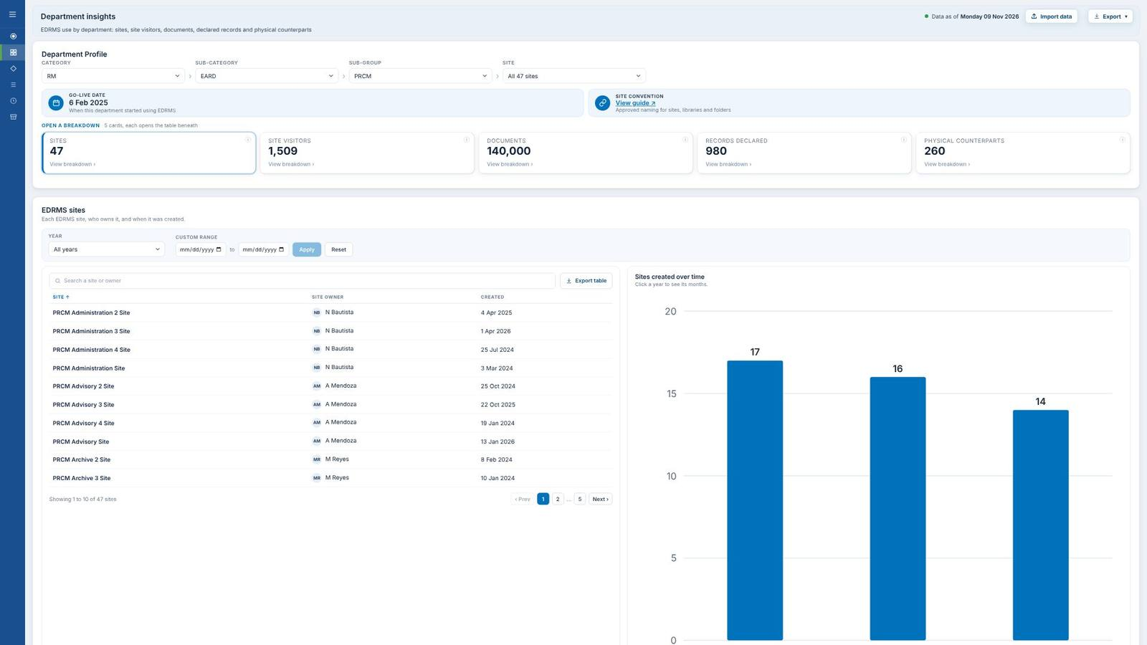
▲ Scroll up

Slide 57
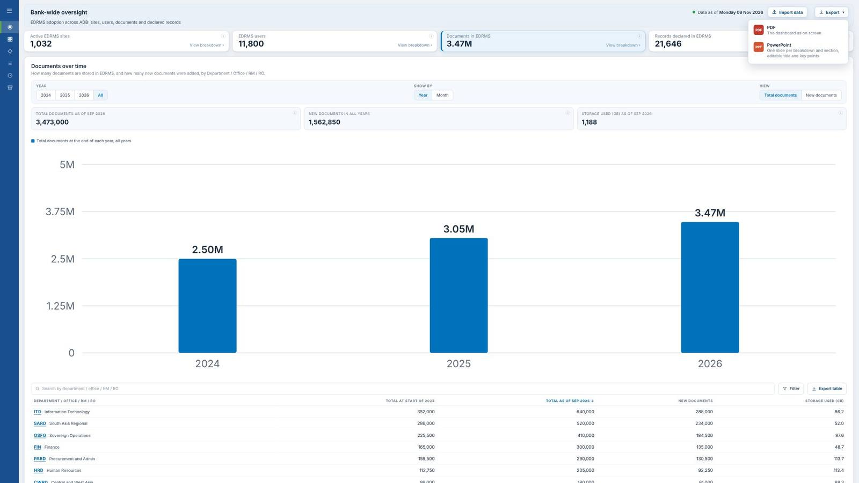

Slide 58
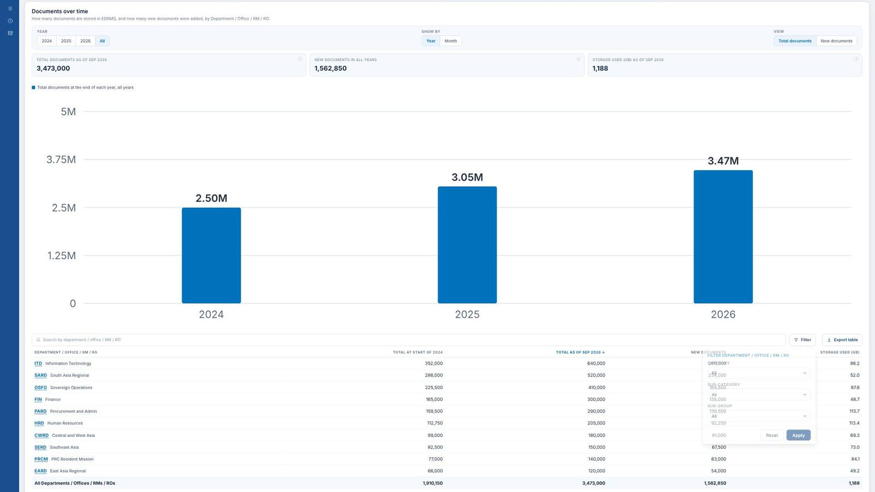

Slide 59
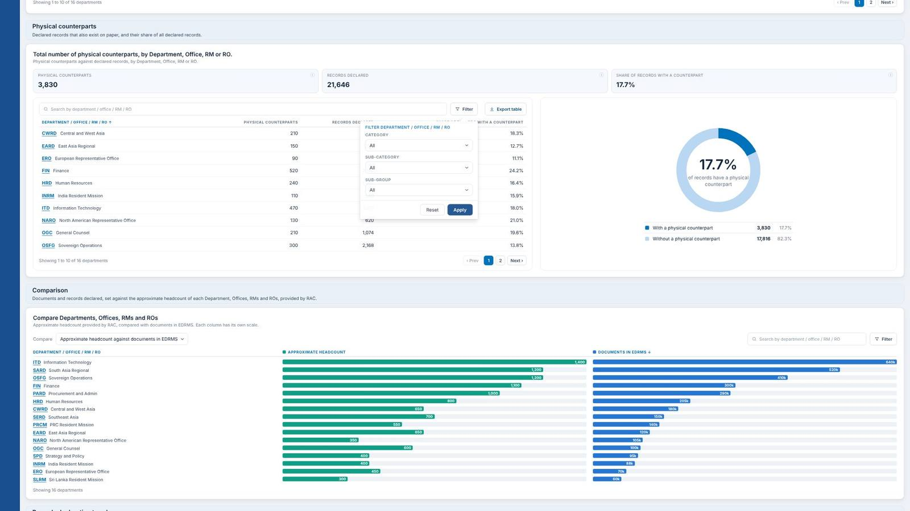

Slide 60
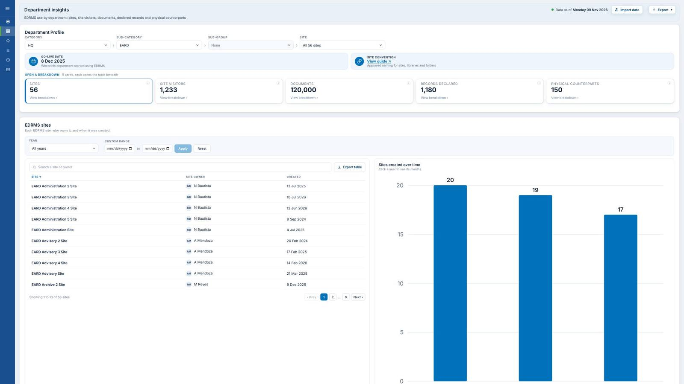
▲ Scroll up

Slide 61
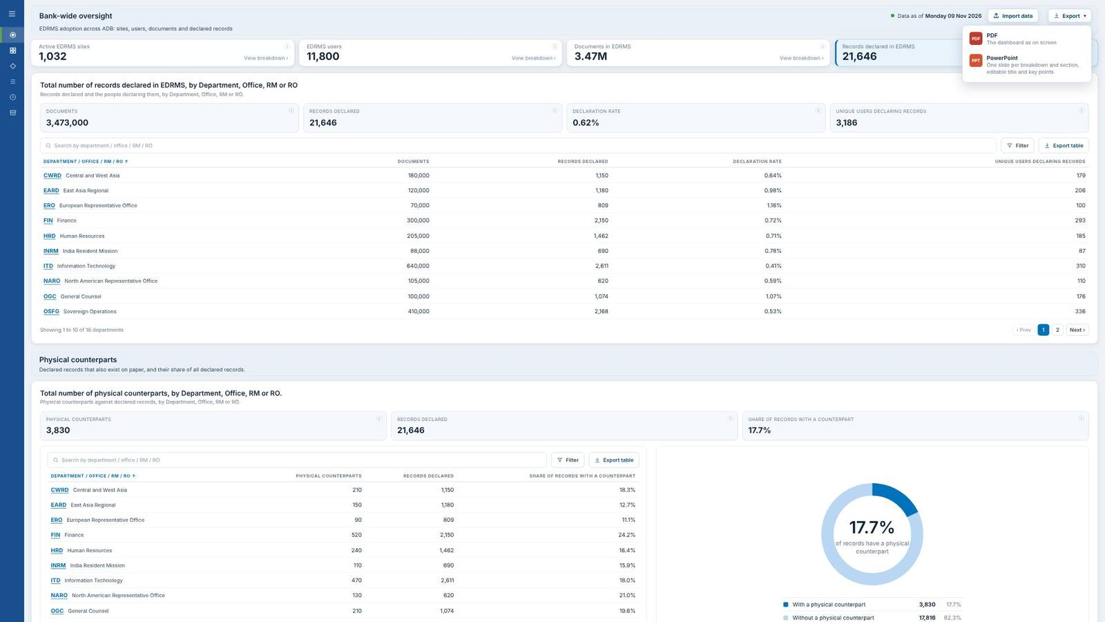

Slide 62


Slide 63

▲ Scroll up
Scroll down ▼

Slide 64
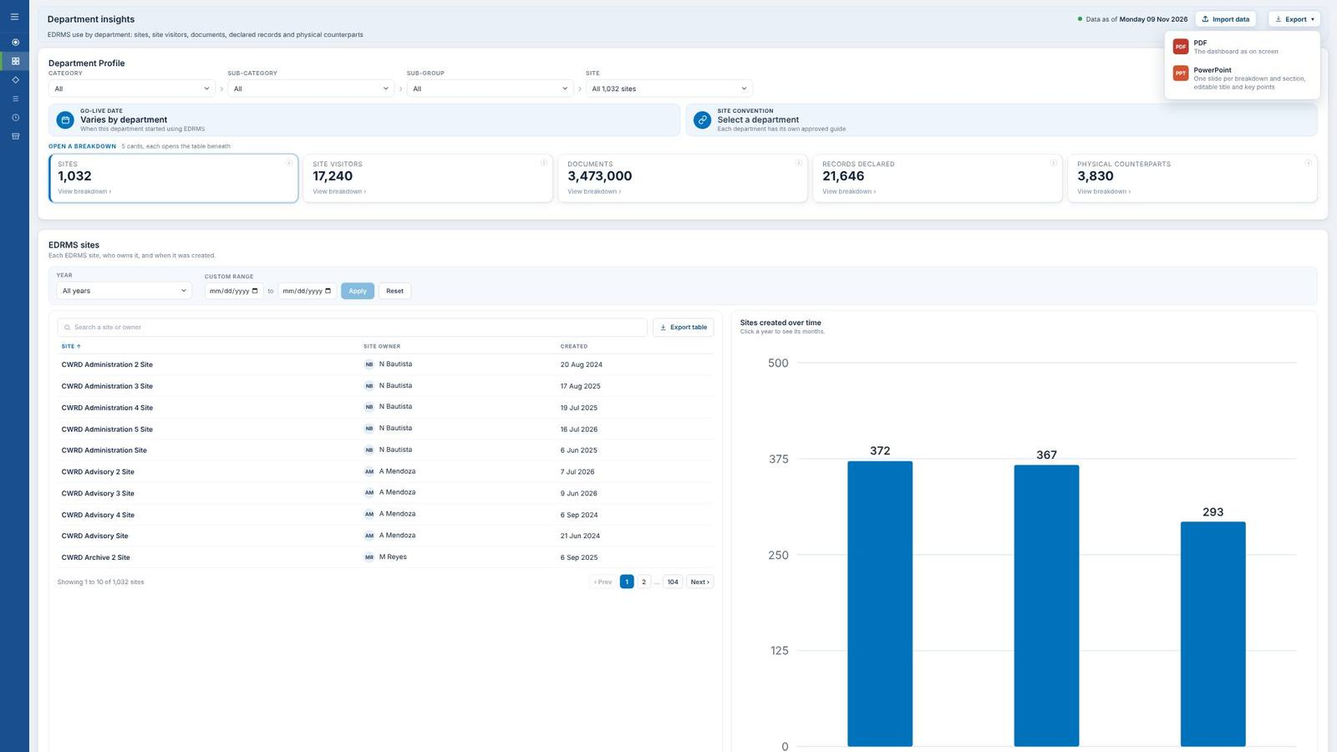

Slide 65

▲ Scroll up
Scroll down ▼

Slide 66

▲ Scroll up

Slide 67


Slide 68

▲ Scroll up

Slide 69


Slide 70

▲ Scroll up

Slide 71


Slide 72

▲ Scroll up

Slide 73


Slide 74

▲ Scroll up

Slide 75


Slide 76

▲ Scroll up
Scroll down ▼

Slide 77

▲ Scroll up

Slide 78


Slide 79

▲ Scroll up
Scroll down ▼

Slide 80

▲ Scroll up

Slide 81

Scroll down ▼

Slide 82

▲ Scroll up
Scroll down ▼

Slide 83

▲ Scroll up
Scroll down ▼

Slide 84

▲ Scroll up
Scroll down ▼

Slide 85

Scroll down ▼

Slide 86

▲ Scroll up
Scroll down ▼

Slide 87

▲ Scroll up

Slide 88

Scroll down ▼

Slide 89


Slide 90


Slide 91

Scroll down ▼

Slide 92

▲ Scroll up

Slide 93

Scroll down ▼

Slide 94

▲ Scroll up

Slide 95

Scroll down ▼

Slide 96

▲ Scroll up

Slide 97

Scroll down ▼

Slide 98

▲ Scroll up

Slide 99

Scroll down ▼

Slide 100

▲ Scroll up
Scroll down ▼

