Slide 1
EDRMS Utilization Report
Functional walkthrough of the SharePoint web part, for RAC to confirm each function
Release 2026.4 | Web part version 1.0.57 | November 2026
Notes:
Purpose: walk RAC through every screen and every click of the Utilization Report, and collect a decision on each function: keep it, change it, or remove it.

Slide 2
How to read and comment on this deck
1
One function per slide
Each slide shows one part of the report as it looks in SharePoint, what it shows, and exactly what happens when you click.
RAC decision for F-00
2
Every function has an ID
☑ Keep with changes
F-01, F-02 and so on. Use the ID when you comment, so there is no doubt which part you mean.
Comments: show the top 15 instead of the top 10.
3
Tick one box per function
Keep as shown, Keep with changes (write the change), or Remove. The last slides collect all decisions in one table.
Example of a filled-in decision box
4
Figures are sample data
Numbers on screen are sample figures for review. Real figures replace them when the reporting database is connected.

Slide 3
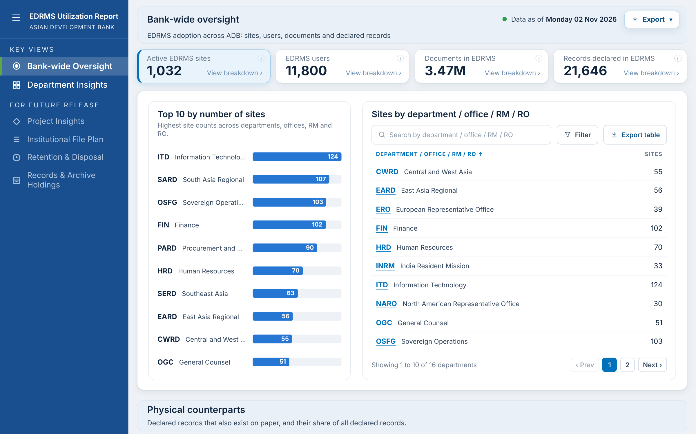
The report at a glance
Two live dashboards
Bank-wide Oversight (all of ADB) and Department Insights (one or more units).
Four future dashboards
Project Insights, Institutional File Plan, Retention and Disposal, Records and Archive Holdings: shown in the menu, not yet available.
Same pattern everywhere
A title band, summary cards, and a breakdown that opens under the card you click.
Every figure is clickable to the detail
Cards open breakdowns; department codes open Department Insights; bars find their row.
Weekly data
"Data as of" shows the Monday of the latest weekly refresh.

Slide 4
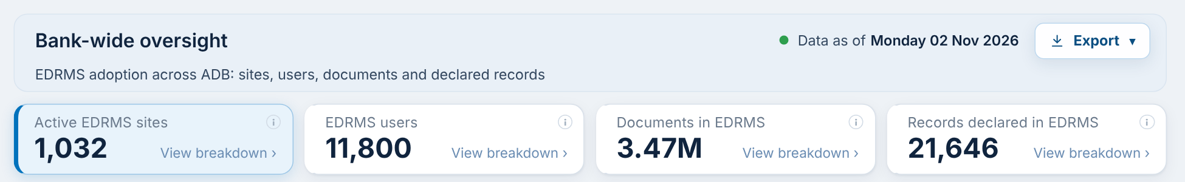
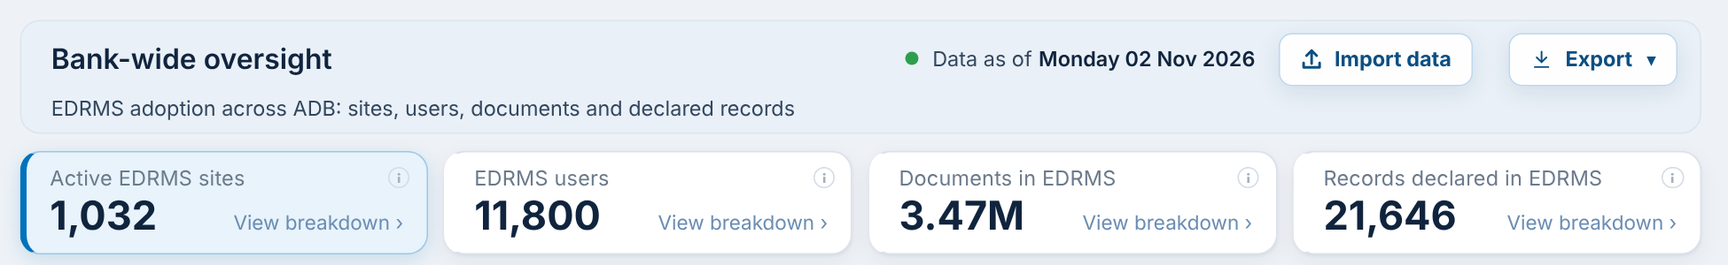
Who sees what
Visitors and Members
Site Owners and admins
Read or Edit access to the site
Full Control, or site collection admin
See both dashboards and every breakdown
Use search, filters, sorting and paging
Export to PDF, PowerPoint and Excel
Do NOT see Import data
Everything Members can do
PLUS the Import data button beside Export
Load the manual data template (headcount, training, Go-Live, site convention, site list)
Only they can change the stored manual data

Slide 5
A. Navigation and common tools
Controls that work the same way on every dashboard: the menu, the information icons, export, search, filter, sorting, paging and table export.

Slide 6
F-01 Dashboard menu
What it shows
The left menu lists the two live dashboards under Key Views and the four planned ones under For Future Release.
When you click
Bank-wide Oversight or Department Insights: the page switches to that dashboard and scrolls to the top.
A For Future Release item: nothing opens. It is greyed out until that dashboard is built (RAC Item 6).
Data: None. Menu labels can be renamed.
RAC decision for F-01
☐ Keep ☐ Change ☐ Remove
Comments:
Notes:
The left menu lists the two live dashboards under Key Views and the four planned ones under For Future Release. Click steps: Bank-wide Oversight or Department Insights: the page switches to that dashboard and scrolls to the top. A For Future Release item: nothing opens. It is greyed out until that dashboard is built (RAC Item 6).

Slide 7
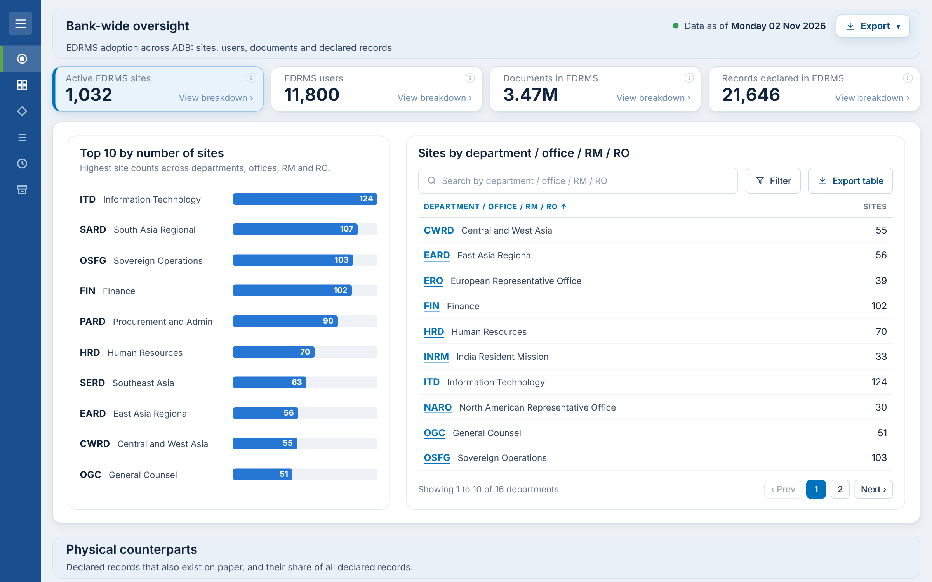
F-02 Collapse and expand the menu
What it shows
The menu button (three lines) at the top of the menu hides the menu so the dashboard uses the full width.
When you click
Menu button: the menu shrinks to icons only; the dashboard widens.
Menu button again: the full menu returns.
The choice is remembered on that browser the next time the report opens.
RAC decision for F-02
☐ Keep ☐ Change ☐ Remove
Comments:
Notes:
The menu button (three lines) at the top of the menu hides the menu so the dashboard uses the full width. Click steps: Menu button: the menu shrinks to icons only; the dashboard widens. Menu button again: the full menu returns. The choice is remembered on that browser the next time the report opens.

Slide 8
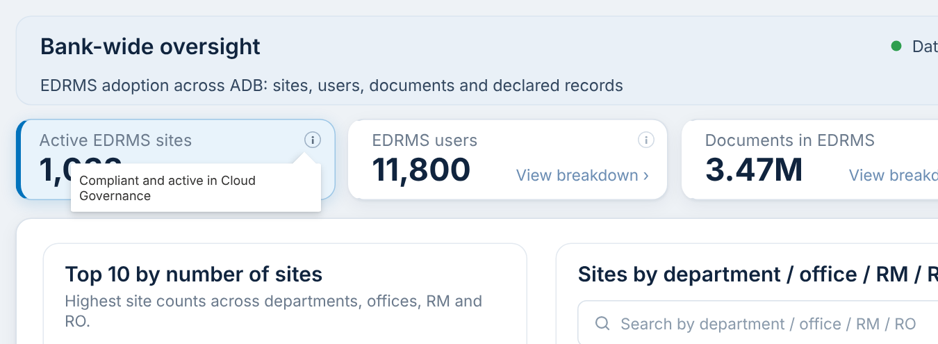
F-03 Information icons (i)
What it shows
Every card has a small (i) icon. It explains in one sentence what the figure counts and over which period.
When you click
Point at or tap the (i): a tooltip shows the definition.
Move away: it closes. Nothing else changes.
RAC decision for F-03
☐ Keep ☐ Change ☐ Remove
Comments:
Notes:
Every card has a small (i) icon. It explains in one sentence what the figure counts and over which period. Click steps: Point at or tap the (i): a tooltip shows the definition. Move away: it closes. Nothing else changes.

Slide 9
F-04 Data as of
What it shows
The green dot and date beside the dashboard title show when the data was last refreshed: the Monday of the latest weekly refresh (RAC Item 11).
When you click
Not clickable. It updates on its own every week.
Date pickers in the report cannot go past this date.
RAC decision for F-04
☐ Keep ☐ Change ☐ Remove
Comments:
Notes:
The green dot and date beside the dashboard title show when the data was last refreshed: the Monday of the latest weekly refresh (RAC Item 11). Click steps: Not clickable. It updates on its own every week. Date pickers in the report cannot go past this date.

Slide 10
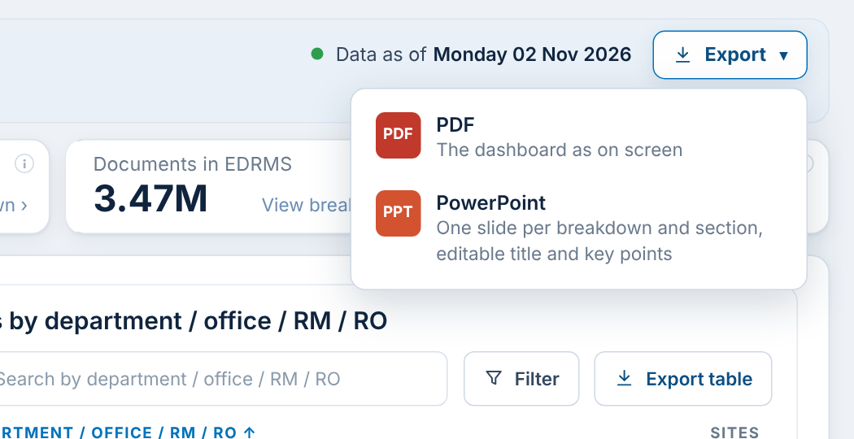
F-05 Export the dashboard (PDF or PowerPoint)
What it shows
The Export button beside the title exports the whole dashboard as it is on screen, including open breakdowns and the filters in use (RAC Item 8).
When you click
Export: a menu opens with PDF and PowerPoint.
PDF: downloads the dashboard as a PDF. Page breaks never cut through a chart.
PowerPoint: downloads one slide per breakdown and section, with an editable title, a Key points box, the filter line and the Data as of date. Tall sections continue on a "(continued)" slide.
Data: Excel is per table (F-10). Word is not offered (not a standard Power BI export).
RAC decision for F-05
☐ Keep ☐ Change ☐ Remove
Comments:
Notes:
The Export button beside the title exports the whole dashboard as it is on screen, including open breakdowns and the filters in use (RAC Item 8). Click steps: Export: a menu opens with PDF and PowerPoint. PDF: downloads the dashboard as a PDF. Page breaks never cut through a chart. PowerPoint: downloads one slide per breakdown and section, with an editable title, a Key points box, the filter line and the Data as of date. Tall sections continue on a "(continued)" slide.

Slide 11
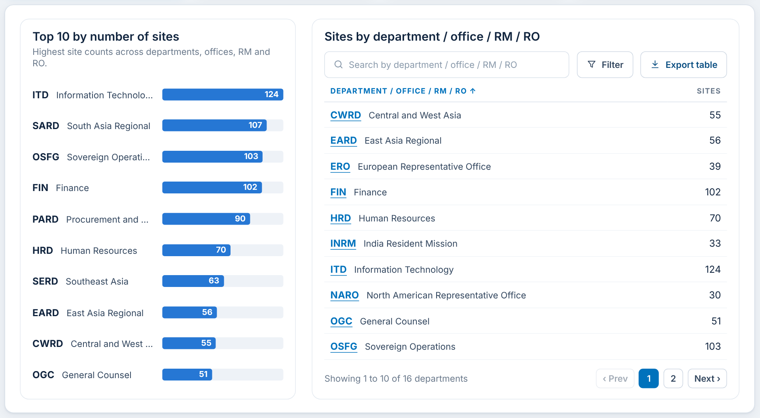
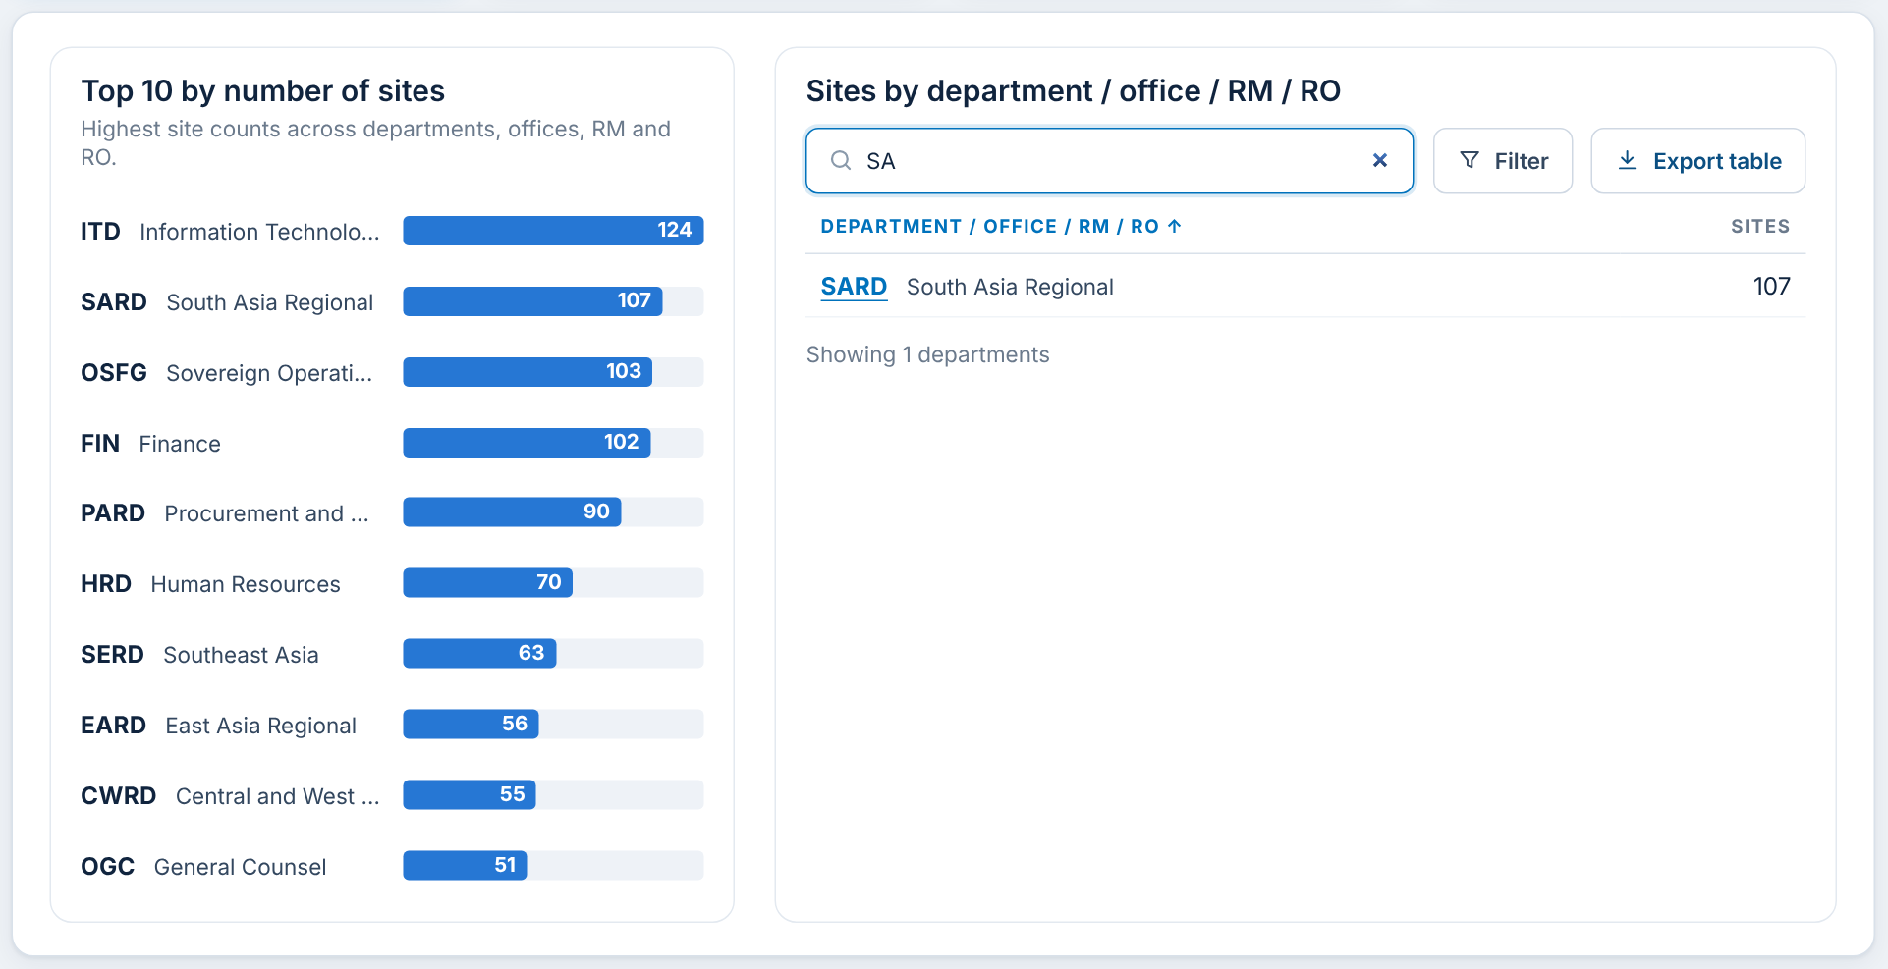
F-06 Search in a table
What it shows
Department tables have a search box. It matches the code or the name of the Department / Office / RM / RO.
When you click
Type in the box: the table narrows as you type (here "SA" finds SARD, ERO, NARO and others).
Clear the box: all rows return.
Counts under the table ("Showing 1 to 10 of N") follow the search.
RAC decision for F-06
☐ Keep ☐ Change ☐ Remove
Comments:
Notes:
Department tables have a search box. It matches the code or the name of the Department / Office / RM / RO. Click steps: Type in the box: the table narrows as you type (here "SA" finds SARD, ERO, NARO and others). Clear the box: all rows return. Counts under the table ("Showing 1 to 10 of N") follow the search.

Slide 12
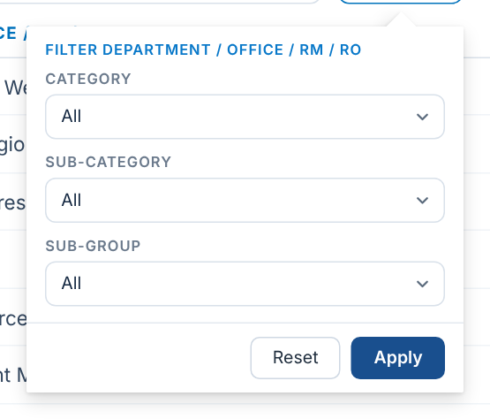
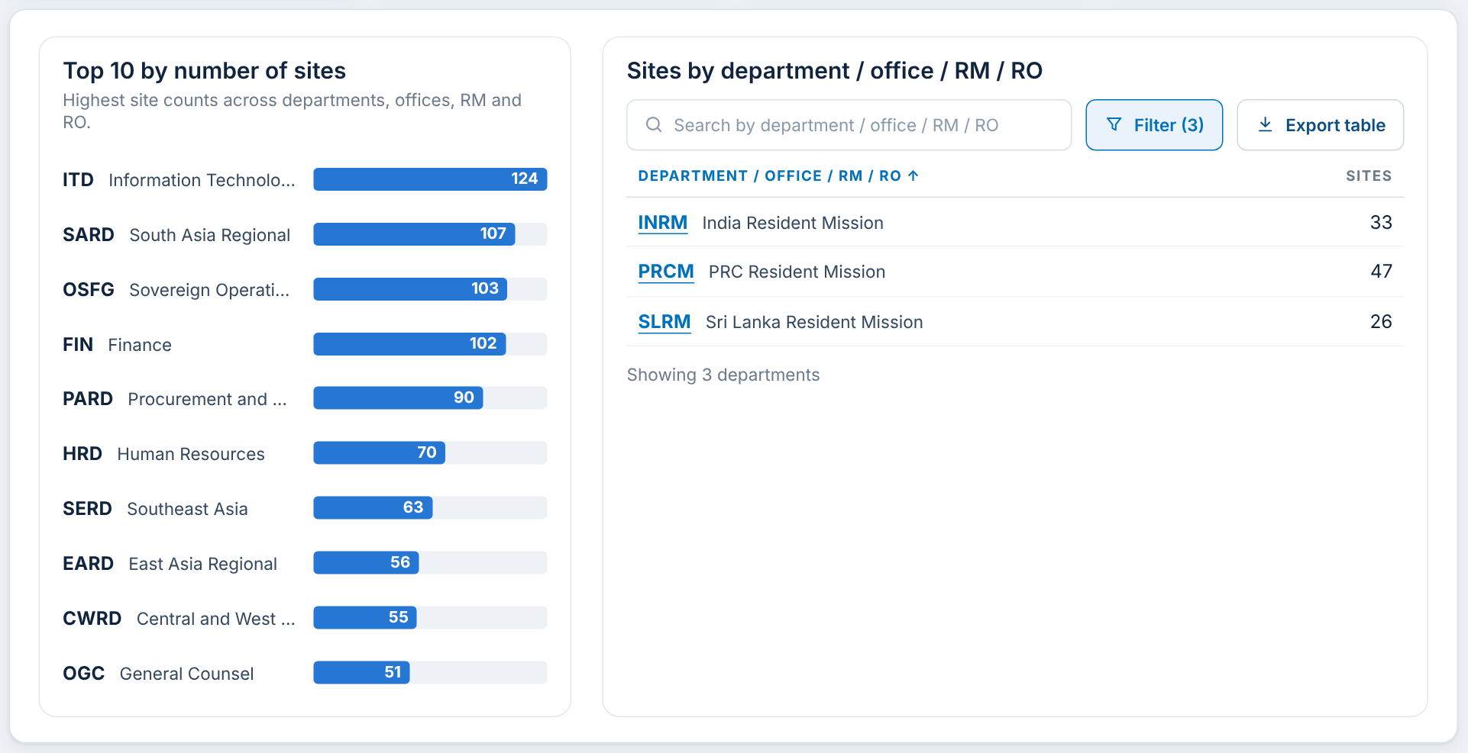
F-07 Filter Department / Office / RM / RO
What it shows
The Filter button opens three linked boxes: Category (HQ, RM, RO), Sub-category (the department) and Sub-group (e.g. a Resident Mission). Each box narrows the next (RAC Item 5).
When you click
Filter: the pop-up opens.
Pick one or more values in each box (each box has its own search). The pop-up stays open while you choose.
Apply: the table shows only the matching units. Reset: clears all three boxes.
Data: Category values come from the Sites tab of the manual data template (F-50).
RAC decision for F-07
☐ Keep ☐ Change ☐ Remove
Comments:
Notes:
The Filter button opens three linked boxes: Category (HQ, RM, RO), Sub-category (the department) and Sub-group (e.g. a Resident Mission). Each box narrows the next (RAC Item 5). Click steps: Filter: the pop-up opens. Pick one or more values in each box (each box has its own search). The pop-up stays open while you choose. Apply: the table shows only the matching units. Reset: clears all three boxes.

Slide 13
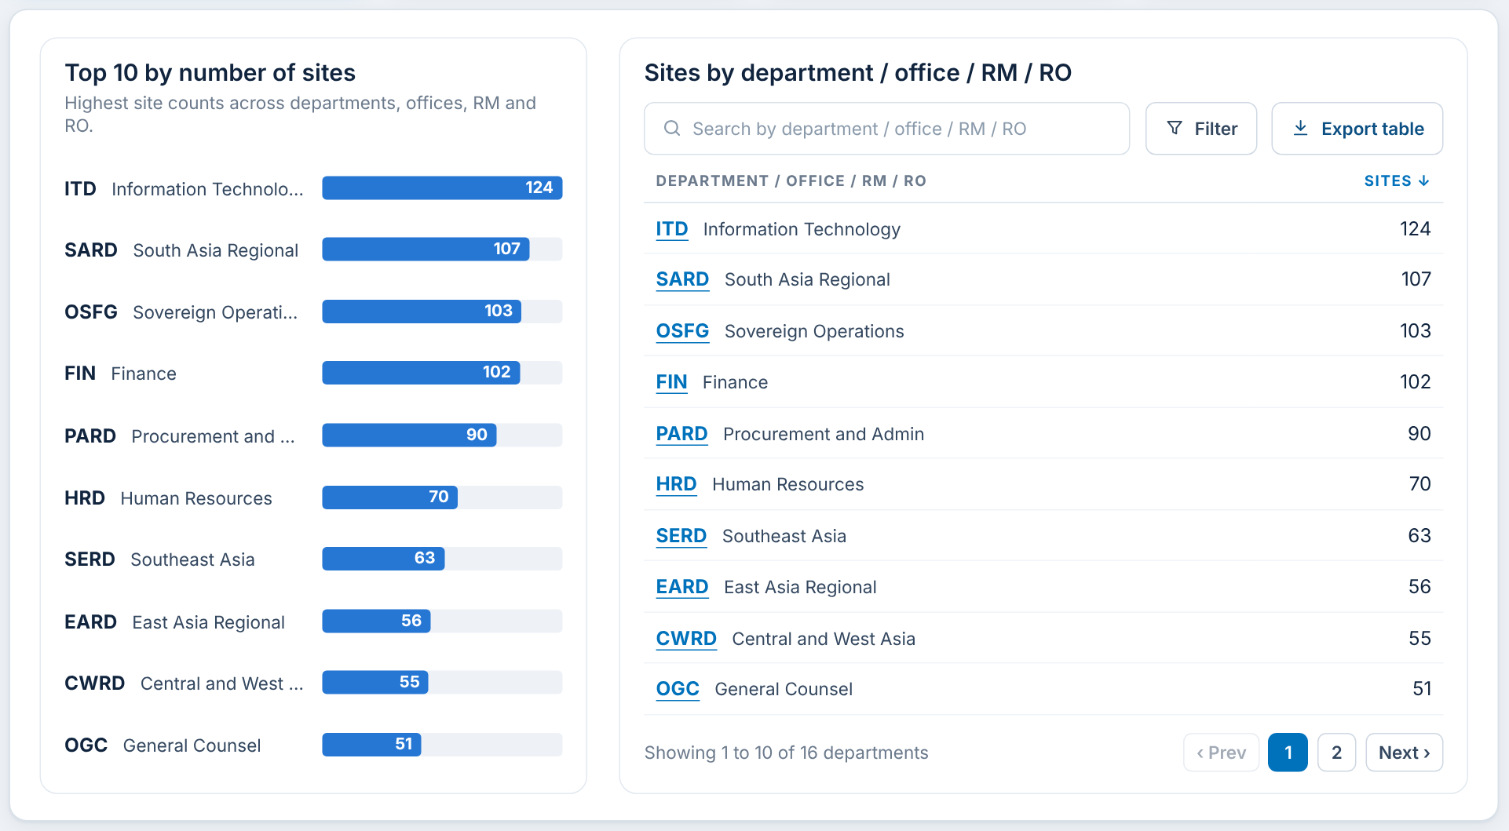
F-08 Sort a table
What it shows
Every column heading in every table can be sorted. The arrow beside the heading shows the current order.
When you click
Click a heading: the table sorts by it (numbers largest first, names A to Z).
Click the same heading again: the order reverses.
Sorting returns the table to page 1.
RAC decision for F-08
☐ Keep ☐ Change ☐ Remove
Comments:
Notes:
Every column heading in every table can be sorted. The arrow beside the heading shows the current order. Click steps: Click a heading: the table sorts by it (numbers largest first, names A to Z). Click the same heading again: the order reverses. Sorting returns the table to page 1.

Slide 14
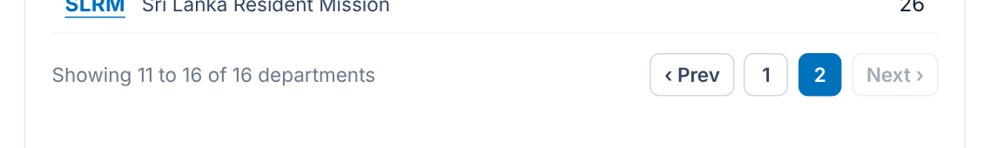
F-09 Page through a table
What it shows
Tables show 10 rows at a time with a pager under them, and say which rows are shown out of how many.
When you click
Next / Prev: moves one page.
A page number: jumps to that page.
Search, filter and sort all go back to page 1.
RAC decision for F-09
☐ Keep ☐ Change ☐ Remove
Comments:
Notes:
Tables show 10 rows at a time with a pager under them, and say which rows are shown out of how many. Click steps: Next / Prev: moves one page. A page number: jumps to that page. Search, filter and sort all go back to page 1.

Slide 15
F-10 Export a table to Excel
What it shows
Export table, beside each table, downloads that table to Excel with the rows currently shown by the search and filter.
When you click
Export table: an .xlsx file downloads at once (e.g. "Sites by department.xlsx").
The file has the same columns as the screen, formatted headings and a filter on each column.
RAC decision for F-10
☐ Keep ☐ Change ☐ Remove
Comments:
Notes:
Export table, beside each table, downloads that table to Excel with the rows currently shown by the search and filter. Click steps: Export table: an .xlsx file downloads at once (e.g. "Sites by department.xlsx"). The file has the same columns as the screen, formatted headings and a filter on each column.

Slide 16
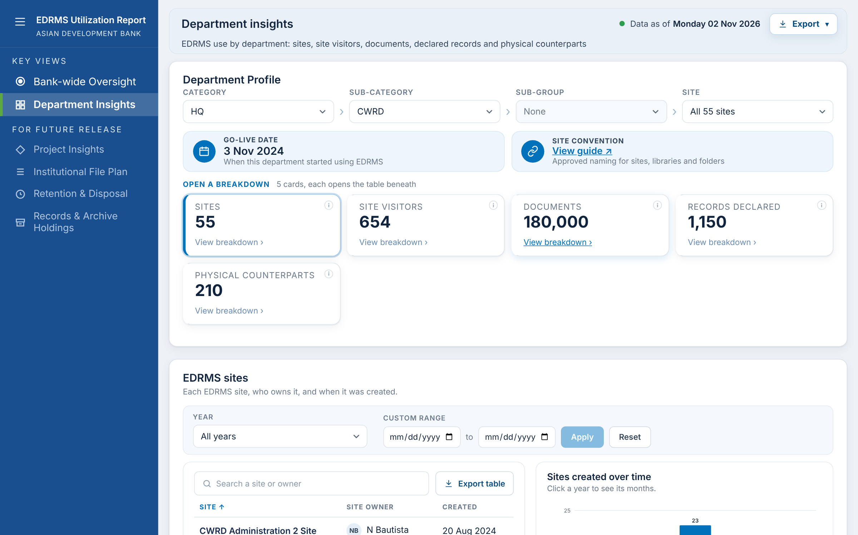
F-11 Click a department code to open Department Insights
What it shows
Department codes in the tables are underlined links. They take you straight to that unit's details (RAC Item 9).
When you click
Click a code (e.g. CWRD) or its row: Department Insights opens, already filtered to that unit.
The Category, Sub-category and Site boxes are set for that unit, so every panel and export on the page shows only that unit.
RAC decision for F-11
☐ Keep ☐ Change ☐ Remove
Comments:
Notes:
Department codes in the tables are underlined links. They take you straight to that unit's details (RAC Item 9). Click steps: Click a code (e.g. CWRD) or its row: Department Insights opens, already filtered to that unit. The Category, Sub-category and Site boxes are set for that unit, so every panel and export on the page shows only that unit.

Slide 17
F-24 Web part settings (page editors)
When the SharePoint page is in Edit mode, the web part's settings pane (pencil icon on the web part) offers three choices. Readers never see these.
Dashboard on this page
Show the report's own sidebar
Text size
Bank-wide Oversight or Department Insights
Shown or Hidden
Standard, Large (default) or Extra large
Which dashboard the page opens on. Readers can still switch with the menu.
Hide it when the site's own navigation already links to each dashboard page.
Large is 25% bigger, Extra large 50% bigger, for readers who need larger text. Exports are always drawn at standard size.
RAC decision for F-24
☐ Keep ☐ Change ☐ Remove
Comments:
Notes:
Page settings are for whoever edits the SharePoint page, not for readers.

Slide 18
B. Bank-wide Oversight
EDRMS adoption across ADB: four summary cards, each opening a breakdown, then physical counterparts, the comparison and the records declaration trend.

Slide 19
F-12 The four summary cards
What it shows
Active EDRMS sites, EDRMS users (approximate headcount), Documents in EDRMS and Records declared in EDRMS, for all of ADB.
When you click
Click a card (or View breakdown): its breakdown opens under the cards; the card is highlighted.
Only one breakdown is open at a time. Active EDRMS sites is open when the page loads.
Data: Sites: Cloud Governance. Headcount: AP All Users export (manual). Documents: M365 usage. Records: EDRMS records table.
RAC decision for F-12
☐ Keep ☐ Change ☐ Remove
Comments:
Notes:
Active EDRMS sites, EDRMS users (approximate headcount), Documents in EDRMS and Records declared in EDRMS, for all of ADB. Click steps: Click a card (or View breakdown): its breakdown opens under the cards; the card is highlighted. Only one breakdown is open at a time. Active EDRMS sites is open when the page loads.

Slide 20
F-13 Active EDRMS sites breakdown
What it shows
Left: the Top 10 units by number of sites as bars. Right: every unit with its number of sites.
When you click
Hover a bar: shows the unit's full name and site count.
Table: search (F-06), filter (F-07), sort (F-08), page (F-09), Export table (F-10).
A code or row opens Department Insights for that unit (F-11).
RAC decision for F-13
☐ Keep ☐ Change ☐ Remove
Comments:
Notes:
Left: the Top 10 units by number of sites as bars. Right: every unit with its number of sites. Click steps: Hover a bar: shows the unit's full name and site count. Table: search (F-06), filter (F-07), sort (F-08), page (F-09), Export table (F-10). A code or row opens Department Insights for that unit (F-11).

Slide 21
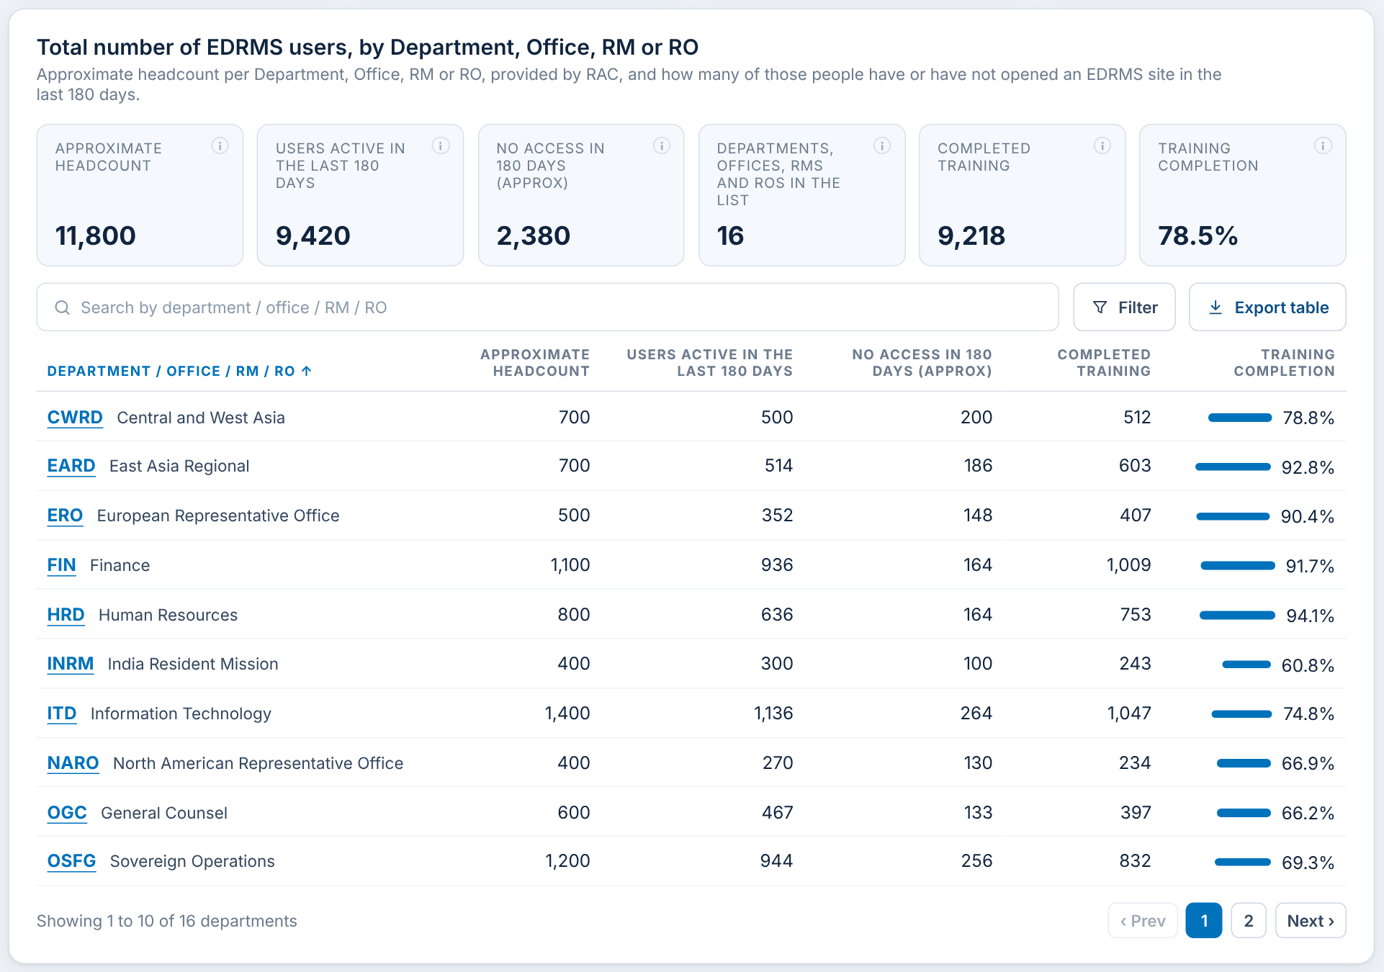
F-14 EDRMS users breakdown
What it shows
Six figures: Approximate Headcount, Users active in the last 180 days, No access in 180 days (Approx), units in the list, Completed training and Training completion %. The table gives the same per unit.
When you click
Search or Filter (F-06, F-07): the table and all six figures follow the units chosen.
Sort any column; Export table downloads all six columns.
A row opens Department Insights for that unit.
Data: Headcount and training are imported (F-50). No access = headcount minus active users.
RAC decision for F-14
☐ Keep ☐ Change ☐ Remove
Comments:
Notes:
Six figures: Approximate Headcount, Users active in the last 180 days, No access in 180 days (Approx), units in the list, Completed training and Training completion %. The table gives the same per unit. Click steps: Search or Filter (F-06, F-07): the table and all six figures follow the units chosen. Sort any column; Export table downloads all six columns. A row opens Department Insights for that unit.

Slide 22
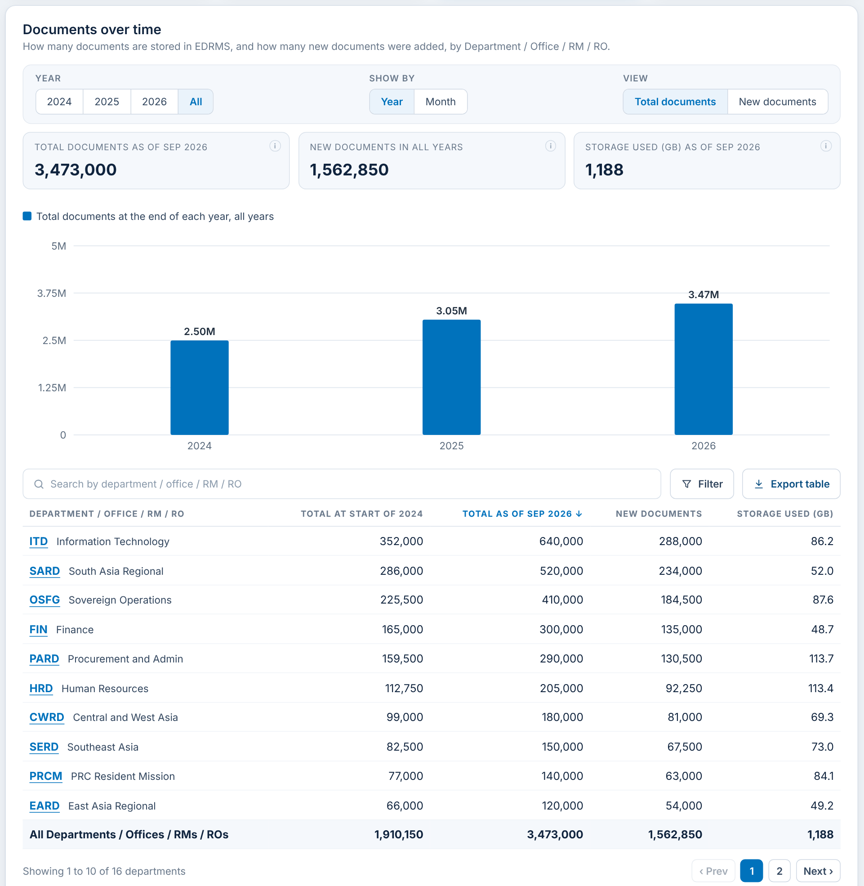
F-15 Documents in EDRMS breakdown
What it shows
Documents held over time with three choices: Year (2024, 2025, 2026, All), Show by (Year or Month) and View (Total documents or New documents), plus Search and Filter for the units.
When you click
Change Year / Show by / View: the chart, the three figures and the table update.
Search or Filter (Category > Sub-category > Sub-group): the chart, figures and table add up only the units chosen.
Table: total at start, total now, new documents and storage (GB) per unit, with a total row.
RAC decision for F-15
☐ Keep ☐ Change ☐ Remove
Comments:
Notes:
Documents held over time with three choices: Year (2024, 2025, 2026, All), Show by (Year or Month) and View (Total documents or New documents), plus Search and Filter for the units. Click steps: Change Year / Show by / View: the chart, the three figures and the table update. Search or Filter (Category > Sub-category > Sub-group): the chart, figures and table add up only the units chosen. Table: total at start, total now, new documents and storage (GB) per unit, with a total row.

Slide 23
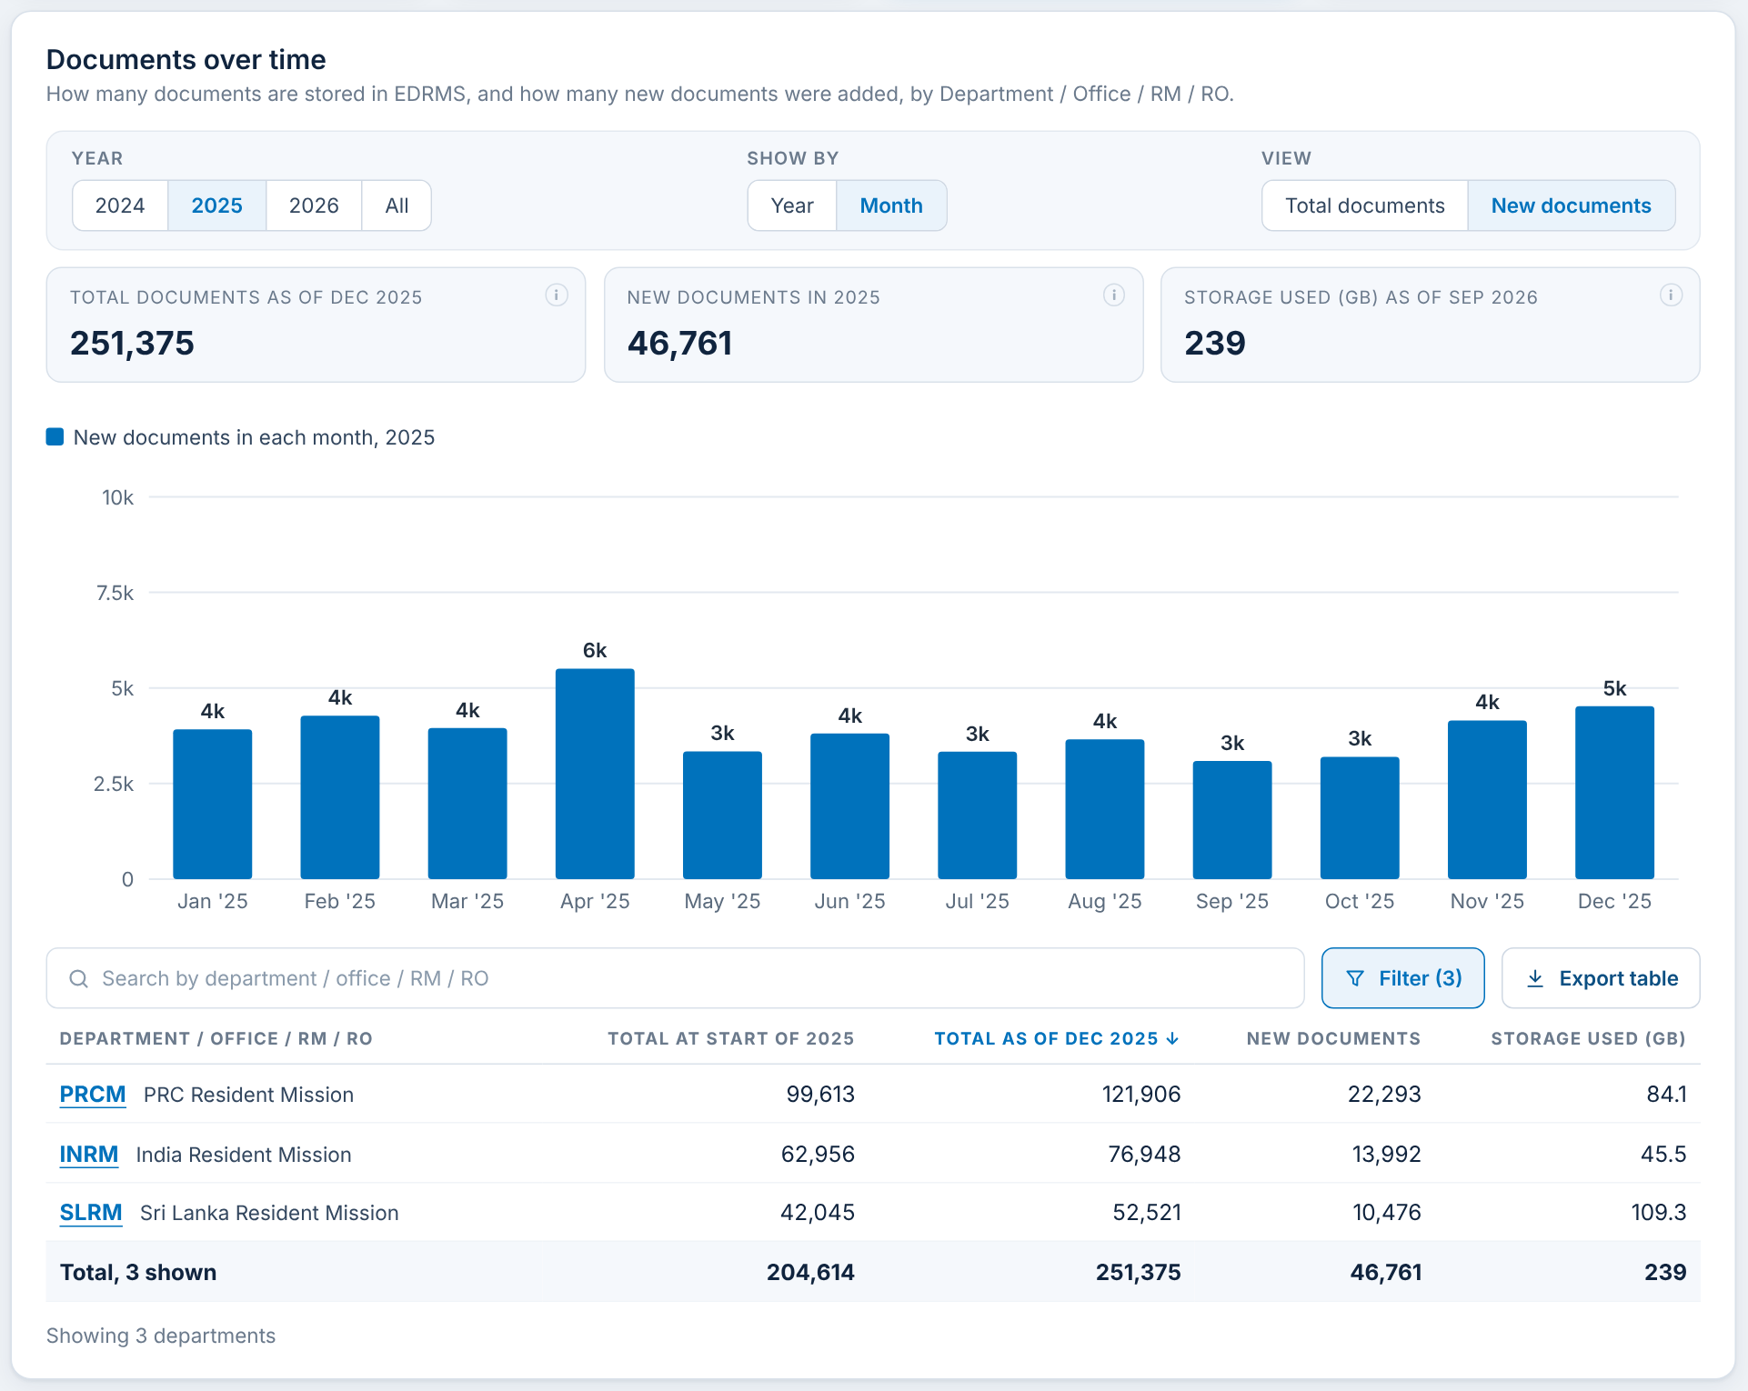
F-16 Documents: by month, new documents, filtered
What it shows
The same panel set to 2025, by Month, New documents, and filtered to Category RM: how many documents the Resident Missions added each month.
When you click
Year 2025 + Month + New documents: one column per month of 2025.
Filter, Category RM, Apply: only PRCM, INRM and SLRM are counted; the button shows Filter (3).
Switch back to Total documents: the columns show documents held at each month end.
RAC decision for F-16
☐ Keep ☐ Change ☐ Remove
Comments:
Notes:
The same panel set to 2025, by Month, New documents, and filtered to Category RM: how many documents the Resident Missions added each month. Click steps: Year 2025 + Month + New documents: one column per month of 2025. Filter, Category RM, Apply: only PRCM, INRM and SLRM are counted; the button shows Filter (3). Switch back to Total documents: the columns show documents held at each month end.

Slide 24
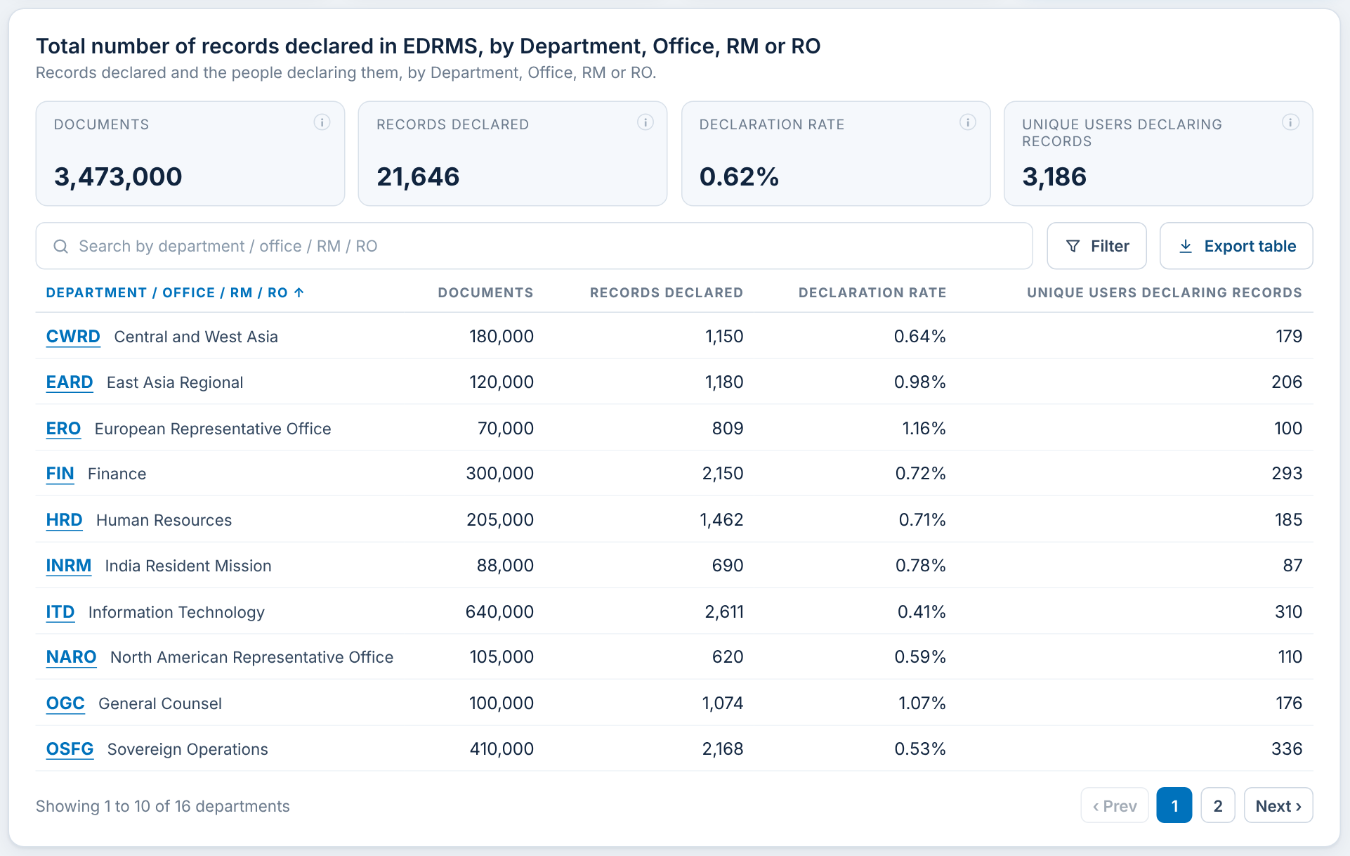
F-17 Records declared breakdown
What it shows
Documents, Records declared, Declaration rate (records as a share of documents) and Unique users declaring records, overall and per unit.
When you click
Search or Filter: the table and the four figures follow the units chosen.
Sort, page and Export table as in F-08 to F-10.
A row opens Department Insights for that unit.
RAC decision for F-17
☐ Keep ☐ Change ☐ Remove
Comments:
Notes:
Documents, Records declared, Declaration rate (records as a share of documents) and Unique users declaring records, overall and per unit. Click steps: Search or Filter: the table and the four figures follow the units chosen. Sort, page and Export table as in F-08 to F-10. A row opens Department Insights for that unit.

Slide 25
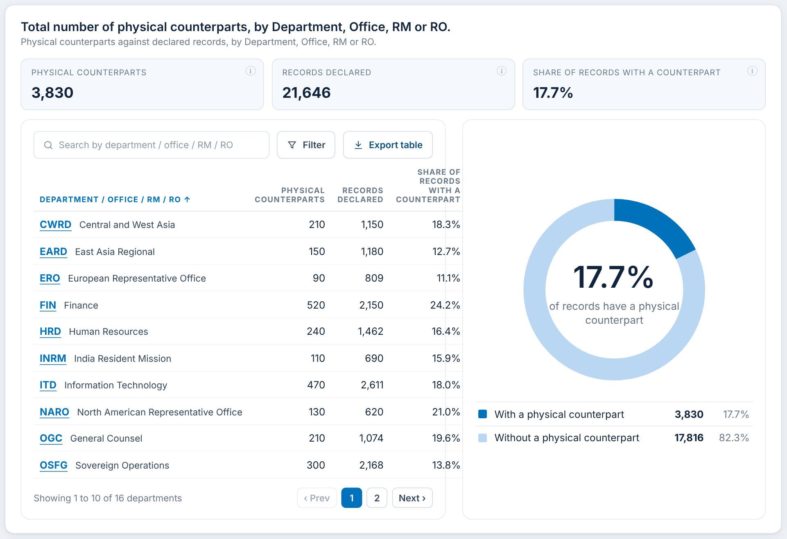
F-18 Physical counterparts
What it shows
Declared records that also exist on paper: total, records declared, and the share of records with a counterpart, with a table and a donut per unit.
When you click
Search, Filter, sort, page and Export table as in F-06 to F-10.
Filter also updates the three figures and the donut.
A row opens Department Insights for that unit.
RAC decision for F-18
☐ Keep ☐ Change ☐ Remove
Comments:
Notes:
Declared records that also exist on paper: total, records declared, and the share of records with a counterpart, with a table and a donut per unit. Click steps: Search, Filter, sort, page and Export table as in F-06 to F-10. Filter also updates the three figures and the donut. A row opens Department Insights for that unit.

Slide 26
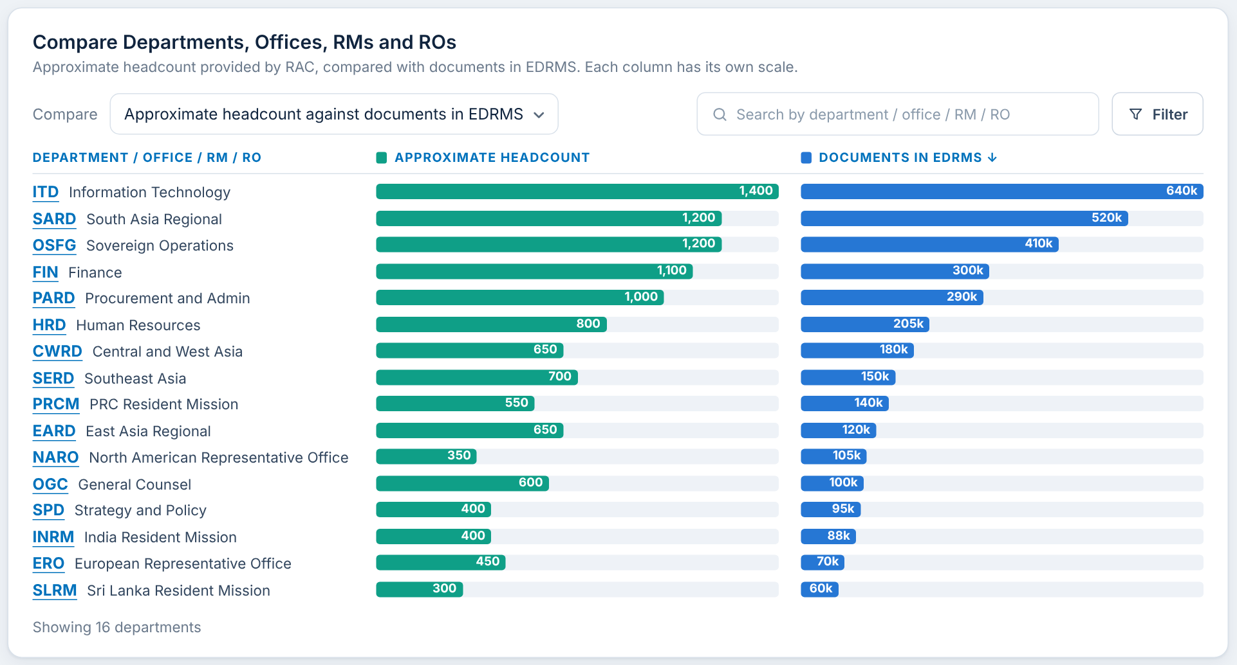
F-19 Comparison: headcount against documents
What it shows
Each unit's approximate headcount (green) beside its documents (blue). Each column has its own scale, so bars compare within a column.
When you click
Compare: choose Documents in EDRMS or Records declared in EDRMS.
Click a column heading: sort by it; again to reverse.
Search and Filter narrow the units; bar scales stay fixed so they do not jump.
Click a unit: opens Department Insights.
RAC decision for F-19
☐ Keep ☐ Change ☐ Remove
Comments:
Notes:
Each unit's approximate headcount (green) beside its documents (blue). Each column has its own scale, so bars compare within a column. Click steps: Compare: choose Documents in EDRMS or Records declared in EDRMS. Click a column heading: sort by it; again to reverse. Search and Filter narrow the units; bar scales stay fixed so they do not jump. Click a unit: opens Department Insights.

Slide 27
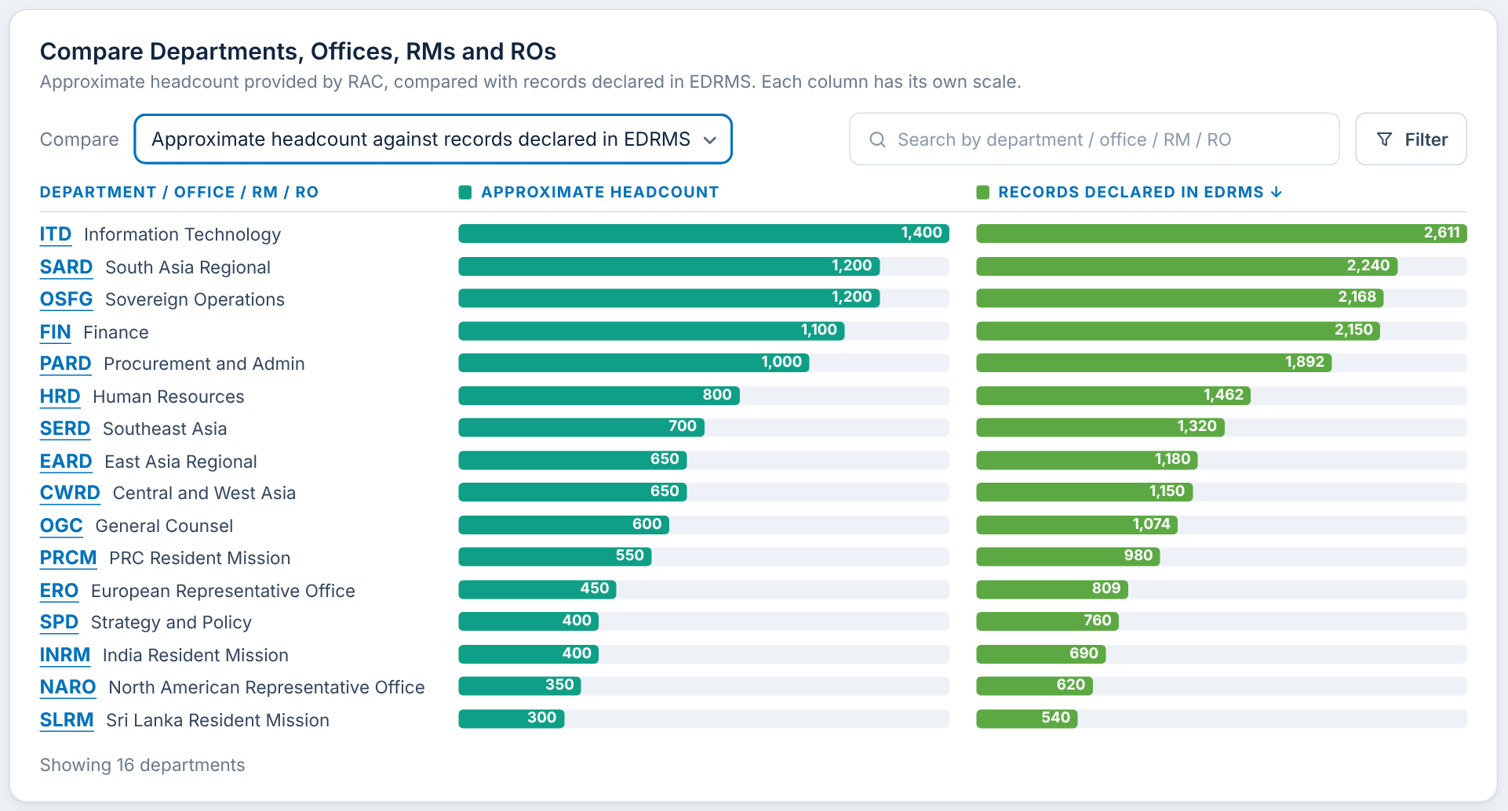
F-20 Comparison: headcount against records declared
What it shows
The same panel with Compare set to Records declared in EDRMS (green bars change to records).
When you click
Compare drop-down: switch between documents and records.
Hover a bar: exact figure.
RAC decision for F-20
☐ Keep ☐ Change ☐ Remove
Comments:
Notes:
The same panel with Compare set to Records declared in EDRMS (green bars change to records). Click steps: Compare drop-down: switch between documents and records. Hover a bar: exact figure.

Slide 28
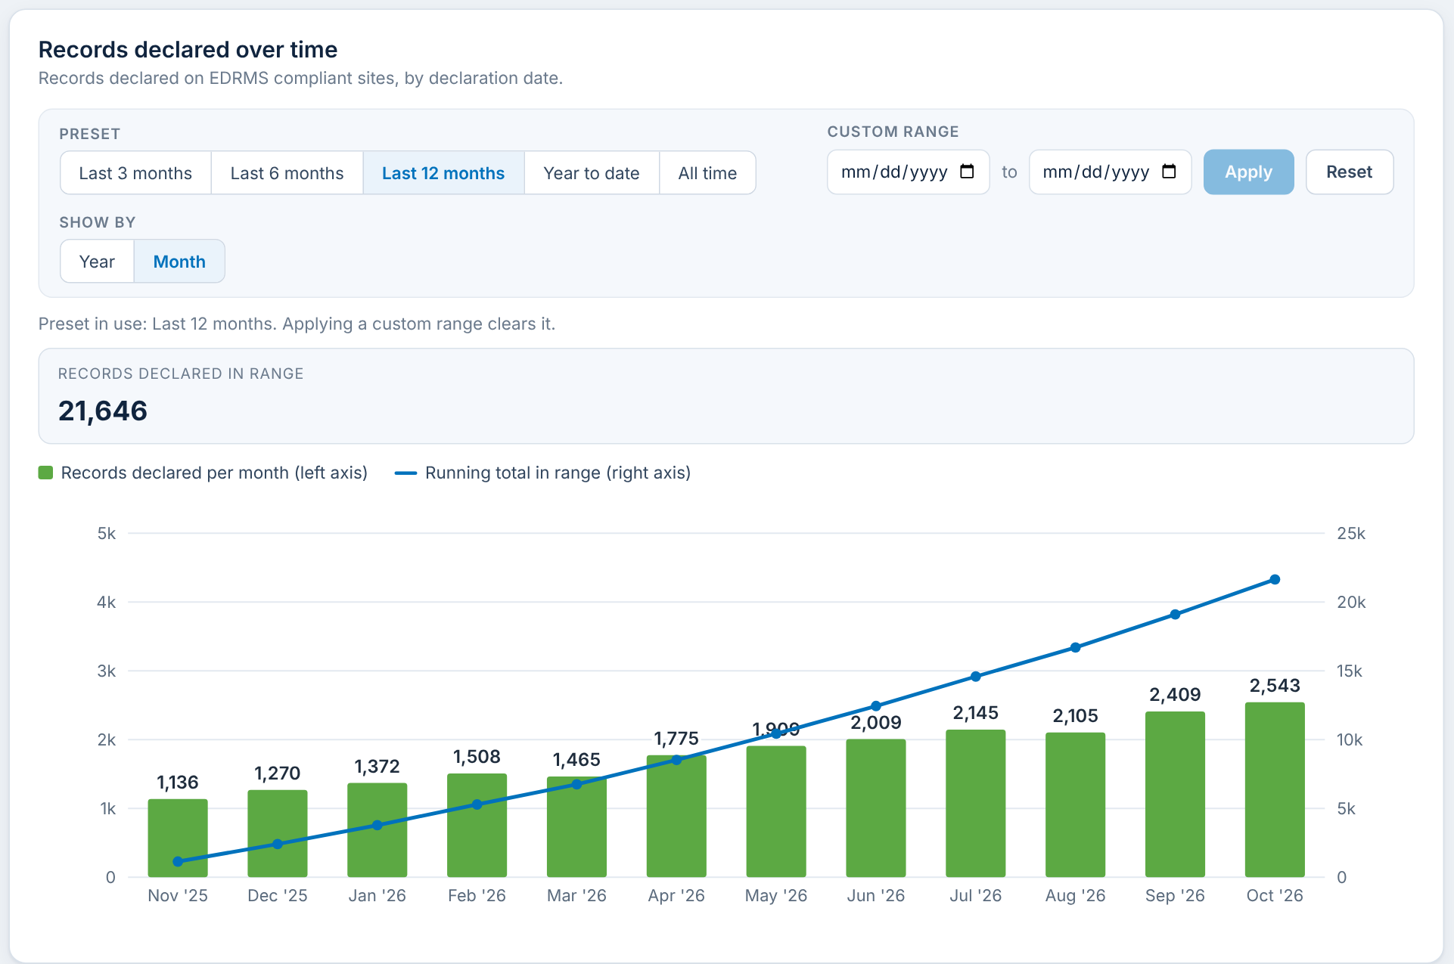
F-21 Records declaration trend
What it shows
Records declared per month (bars, left axis) and the running total (line, right axis) for a chosen period.
When you click
Preset: Last 3 / 6 / 12 months, Year to date, All time. Last 12 months on opening.
Custom range: pick From and To, then Apply. Reset goes back to Last 12 months.
Show by: Year or Month.
RAC decision for F-21
☐ Keep ☐ Change ☐ Remove
Comments:
Notes:
Records declared per month (bars, left axis) and the running total (line, right axis) for a chosen period. Click steps: Preset: Last 3 / 6 / 12 months, Year to date, All time. Last 12 months on opening. Custom range: pick From and To, then Apply. Reset goes back to Last 12 months. Show by: Year or Month.

Slide 29
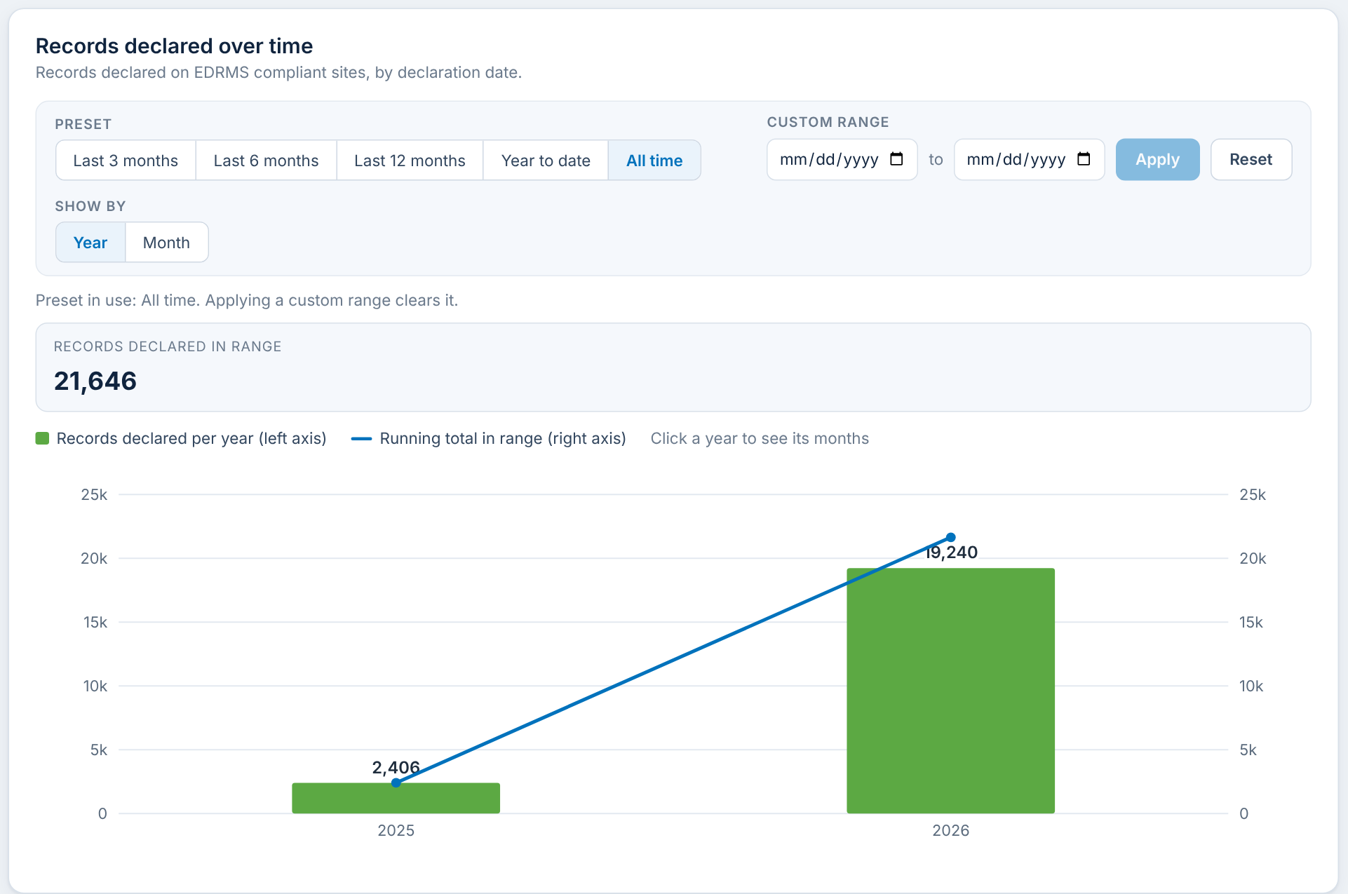
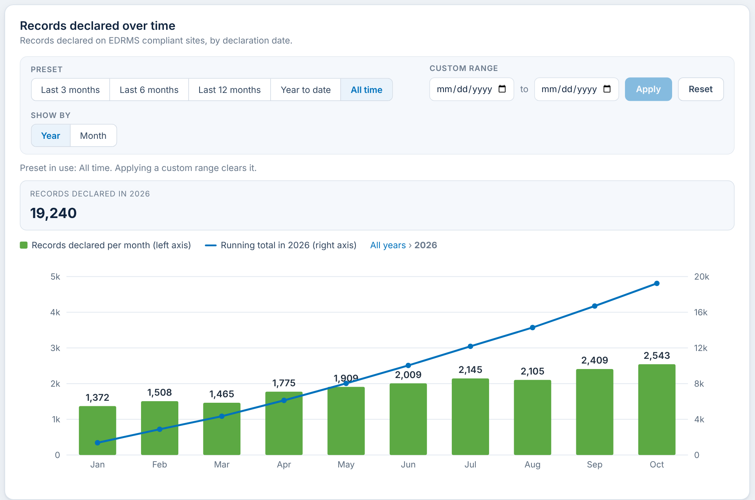
F-22 Trend: drill from years into months
What it shows
Shown by Year, each year's bar can be opened to see its months.
When you click
Click a year's bar: the chart shows that year by month; the figure becomes "Records declared in <year>".
Click "All years" in the path above the chart: back to years.
RAC decision for F-22
☐ Keep ☐ Change ☐ Remove
Comments:
Notes:
Shown by Year, each year's bar can be opened to see its months. Click steps: Click a year's bar: the chart shows that year by month; the figure becomes "Records declared in <year>". Click "All years" in the path above the chart: back to years.

Slide 30
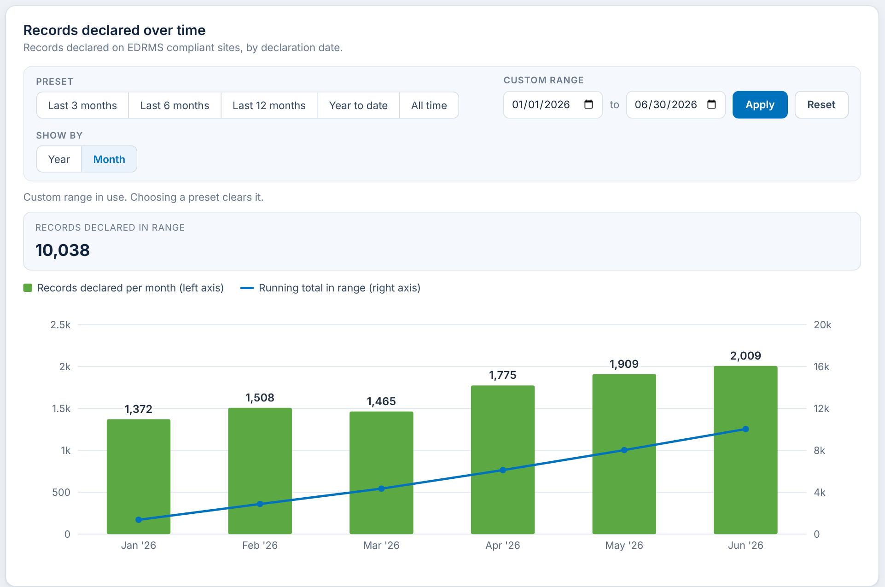
F-23 Trend: custom date range
What it shows
Any From and To date up to the Data as of date. Here January to June 2026.
When you click
Pick From and To, then Apply: the chart and the total use that range; the preset is cleared.
Reset: returns to Last 12 months.
RAC decision for F-23
☐ Keep ☐ Change ☐ Remove
Comments:
Notes:
Any From and To date up to the Data as of date. Here January to June 2026. Click steps: Pick From and To, then Apply: the chart and the total use that range; the preset is cleared. Reset: returns to Last 12 months.

Slide 31
C. Department Insights
One or more Departments, Offices, RMs or ROs in detail: the profile, five cards with their breakdowns, and library usage.

Slide 32
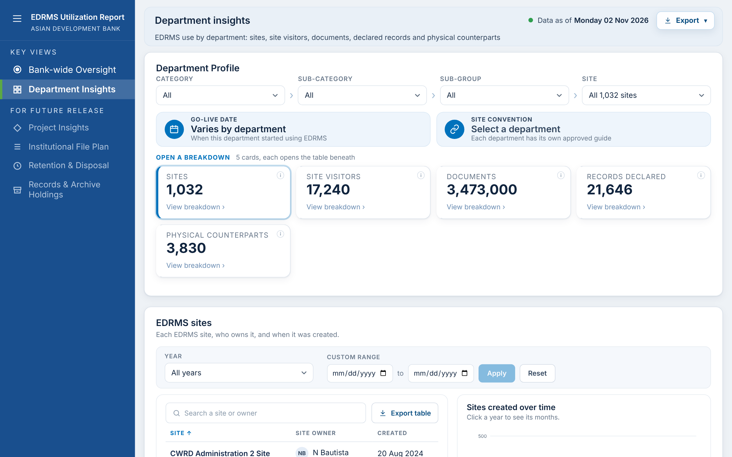
F-30 Department Profile and the four filter boxes
What it shows
Category, Sub-category, Sub-group and Site at the top decide which units and sites every panel on the page shows. Opens on All.
When you click
Pick values in any box: every card, breakdown and export below follows.
Each box narrows the next (Category > Sub-category > Sub-group > Site).
Several values can be ticked in each box.
RAC decision for F-30
☐ Keep ☐ Change ☐ Remove
Comments:
Notes:
Category, Sub-category, Sub-group and Site at the top decide which units and sites every panel on the page shows. Opens on All. Click steps: Pick values in any box: every card, breakdown and export below follows. Each box narrows the next (Category > Sub-category > Sub-group > Site). Several values can be ticked in each box.

Slide 33
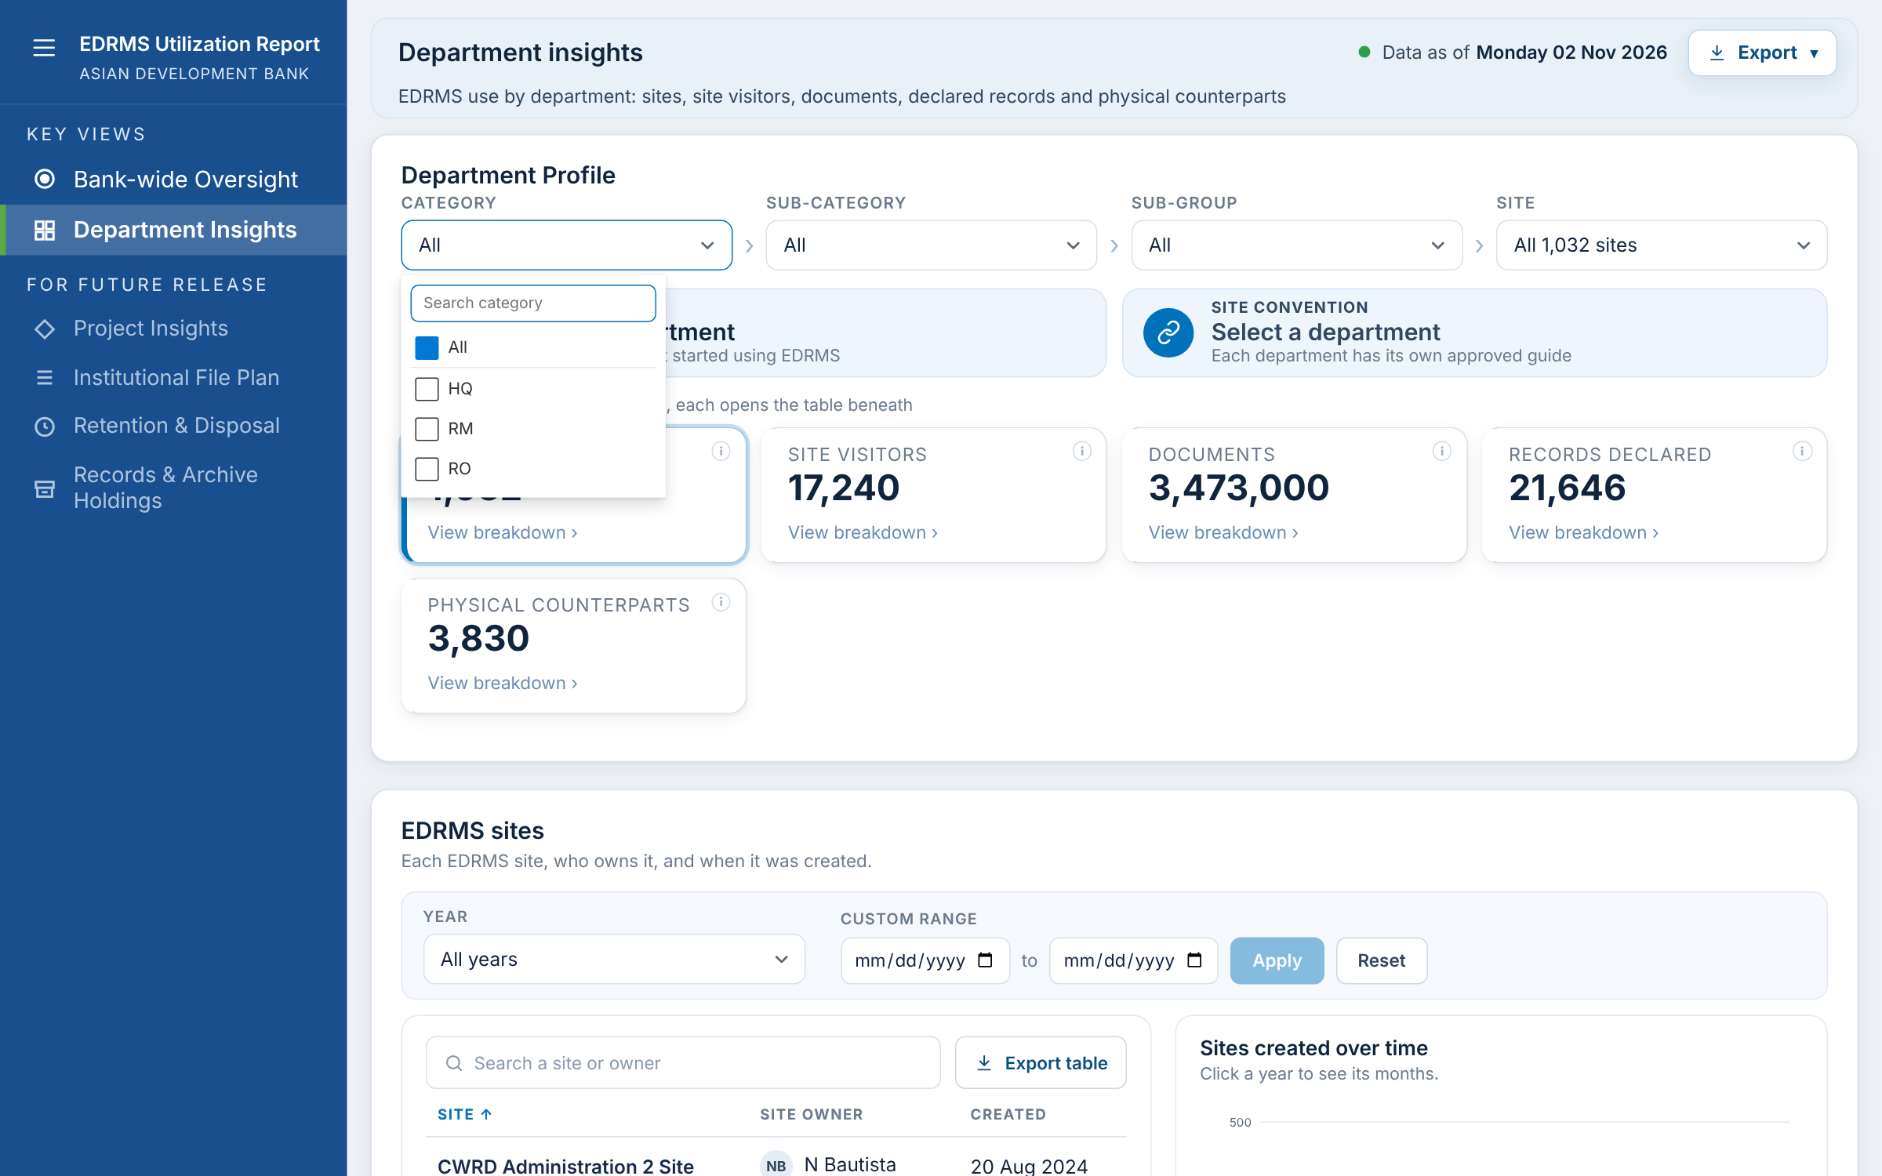
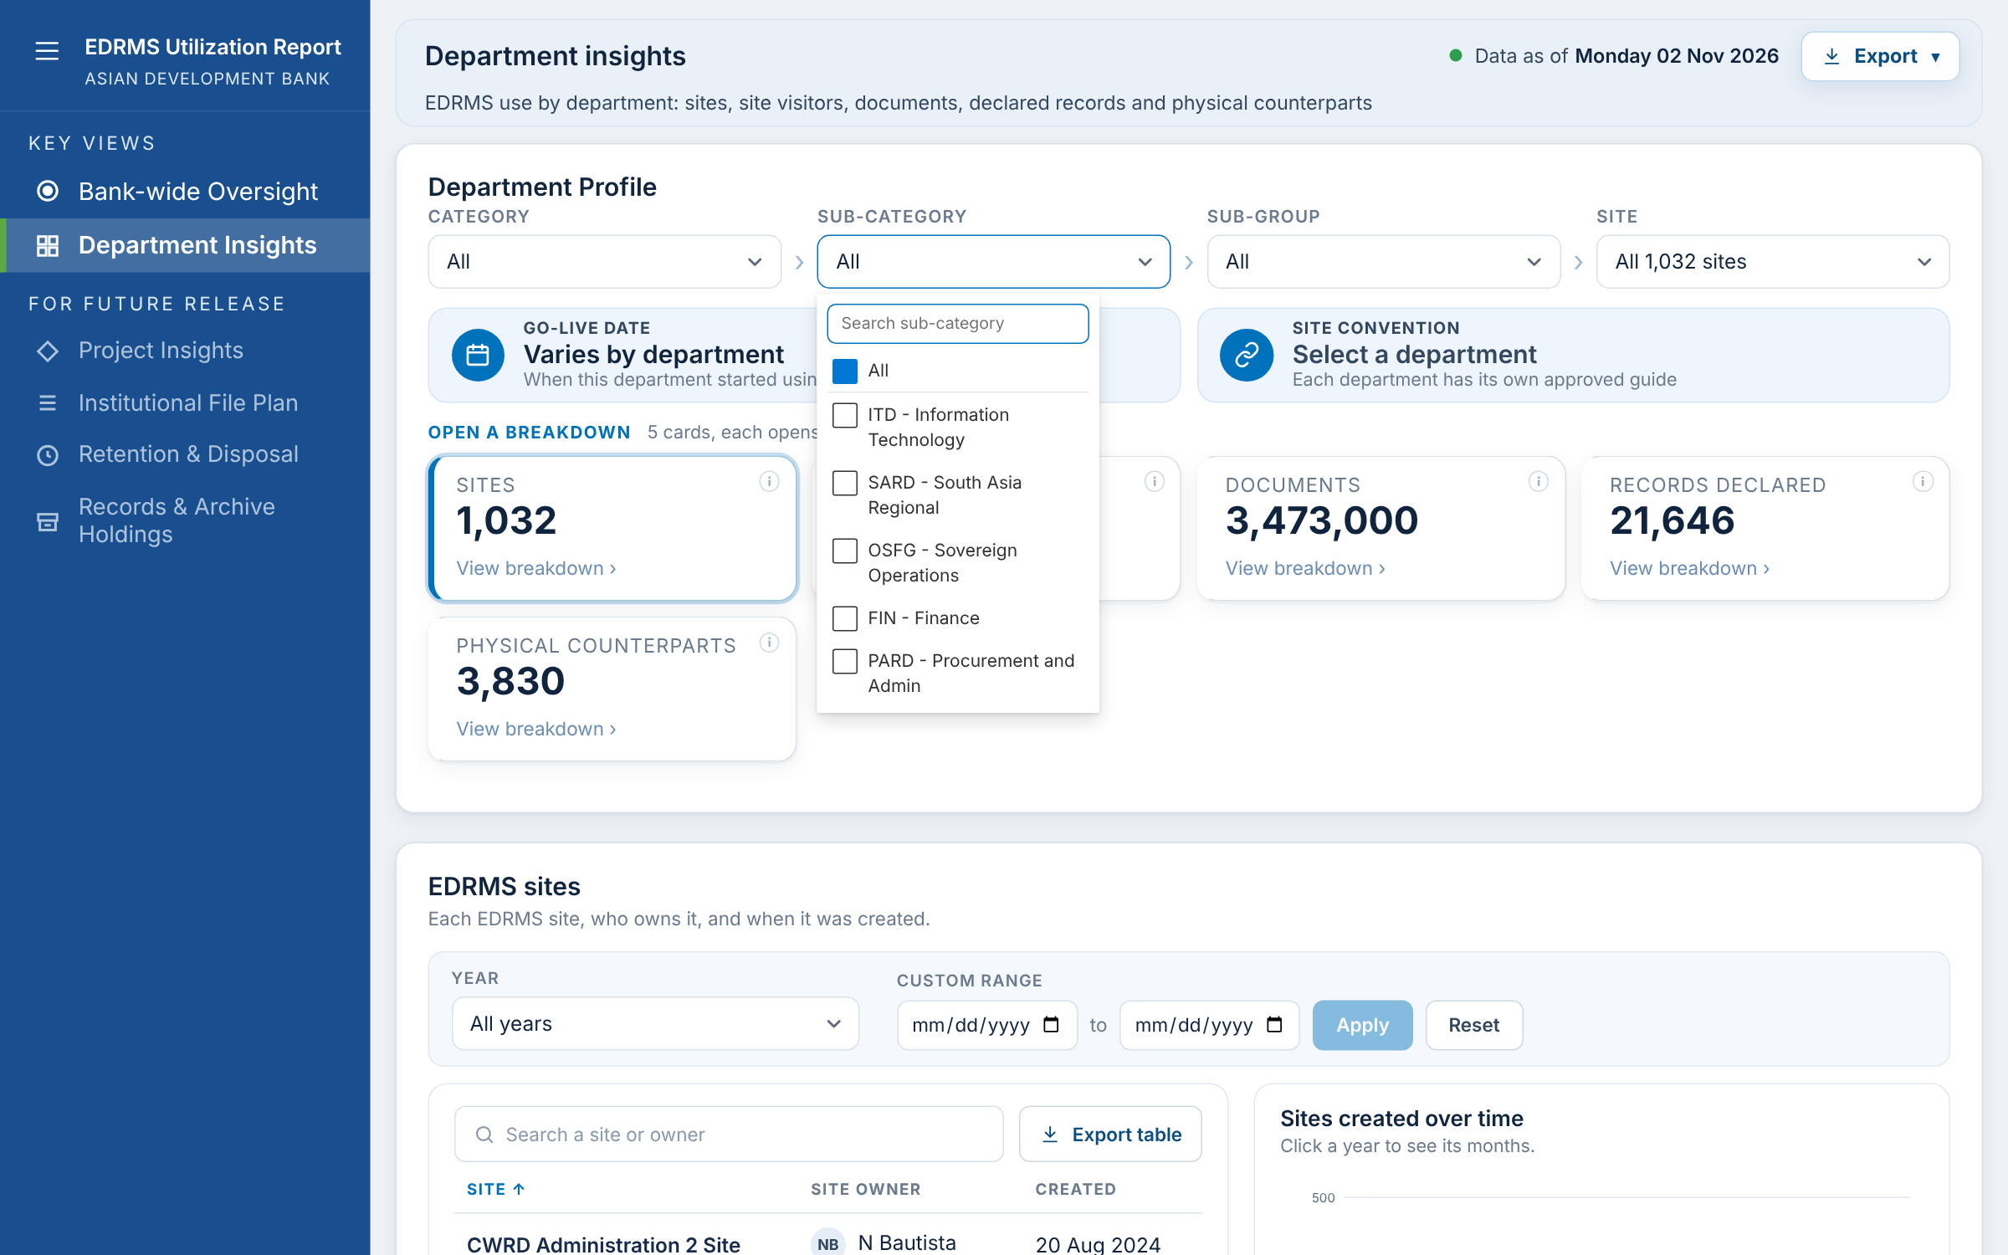
F-31 Category and Sub-category boxes
What it shows
Category lists HQ, RM and RO. Sub-category lists the departments in the chosen category; Sub-group the missions or groups under them.
When you click
Open a box: tick one or more values; "All" clears the box.
Type in the box's search to find a value.
Values and labels come from the site list and can be renamed (RAC Item 5).
RAC decision for F-31
☐ Keep ☐ Change ☐ Remove
Comments:
Notes:
Category lists HQ, RM and RO. Sub-category lists the departments in the chosen category; Sub-group the missions or groups under them. Click steps: Open a box: tick one or more values; "All" clears the box. Type in the box's search to find a value. Values and labels come from the site list and can be renamed (RAC Item 5).

Slide 34
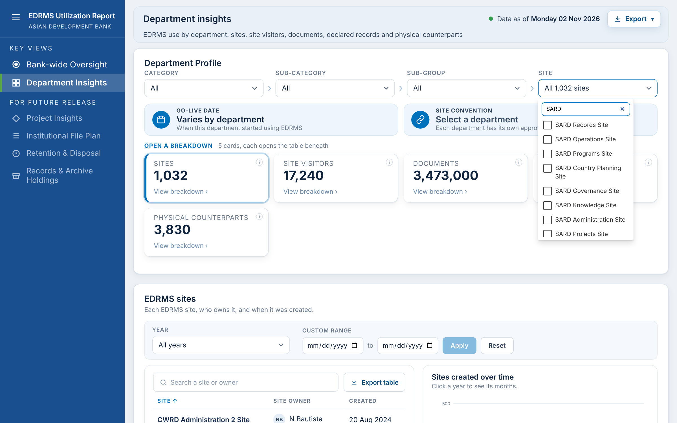
F-32 Site box with search
What it shows
Lists the sites under the chosen units ("All 1,032 sites" when nothing is chosen).
When you click
Type part of a name: the list narrows.
Tick one or more sites: the cards and breakdowns show only those sites.
Changing the unit boxes resets the site choice.
RAC decision for F-32
☐ Keep ☐ Change ☐ Remove
Comments:
Notes:
Lists the sites under the chosen units ("All 1,032 sites" when nothing is chosen). Click steps: Type part of a name: the list narrows. Tick one or more sites: the cards and breakdowns show only those sites. Changing the unit boxes resets the site choice.

Slide 35
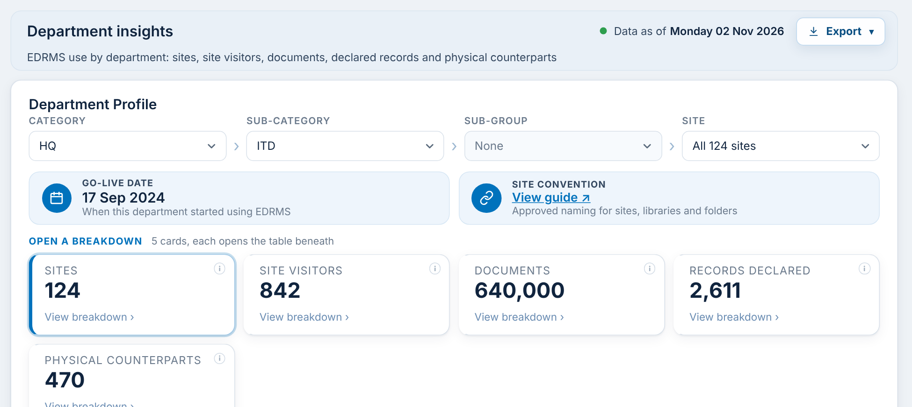
F-33 Go-Live date and site convention
What it shows
Two chips under the filters: the date the unit started using EDRMS, and a link to its approved site naming guide (RAC Items 3 and 4).
When you click
With one unit chosen: shows its Go-Live date ("Not yet provided" if blank).
View guide: opens the unit's guide in a new tab. With several units: "Varies by department" / "Select a department".
Data: Imported from the Departments tab of the manual data template (F-50).
RAC decision for F-33
☐ Keep ☐ Change ☐ Remove
Comments:
Notes:
Two chips under the filters: the date the unit started using EDRMS, and a link to its approved site naming guide (RAC Items 3 and 4). Click steps: With one unit chosen: shows its Go-Live date ("Not yet provided" if blank). View guide: opens the unit's guide in a new tab. With several units: "Varies by department" / "Select a department".

Slide 36
F-34 The five cards
What it shows
Sites, Site visitors, Documents, Records declared and Physical Counterparts for the chosen units and sites.
When you click
Click a card: its breakdown opens beneath the cards. Sites is open on loading.
The cards follow the four filter boxes.
RAC decision for F-34
☐ Keep ☐ Change ☐ Remove
Comments:
Notes:
Sites, Site visitors, Documents, Records declared and Physical Counterparts for the chosen units and sites. Click steps: Click a card: its breakdown opens beneath the cards. Sites is open on loading. The cards follow the four filter boxes.

Slide 37
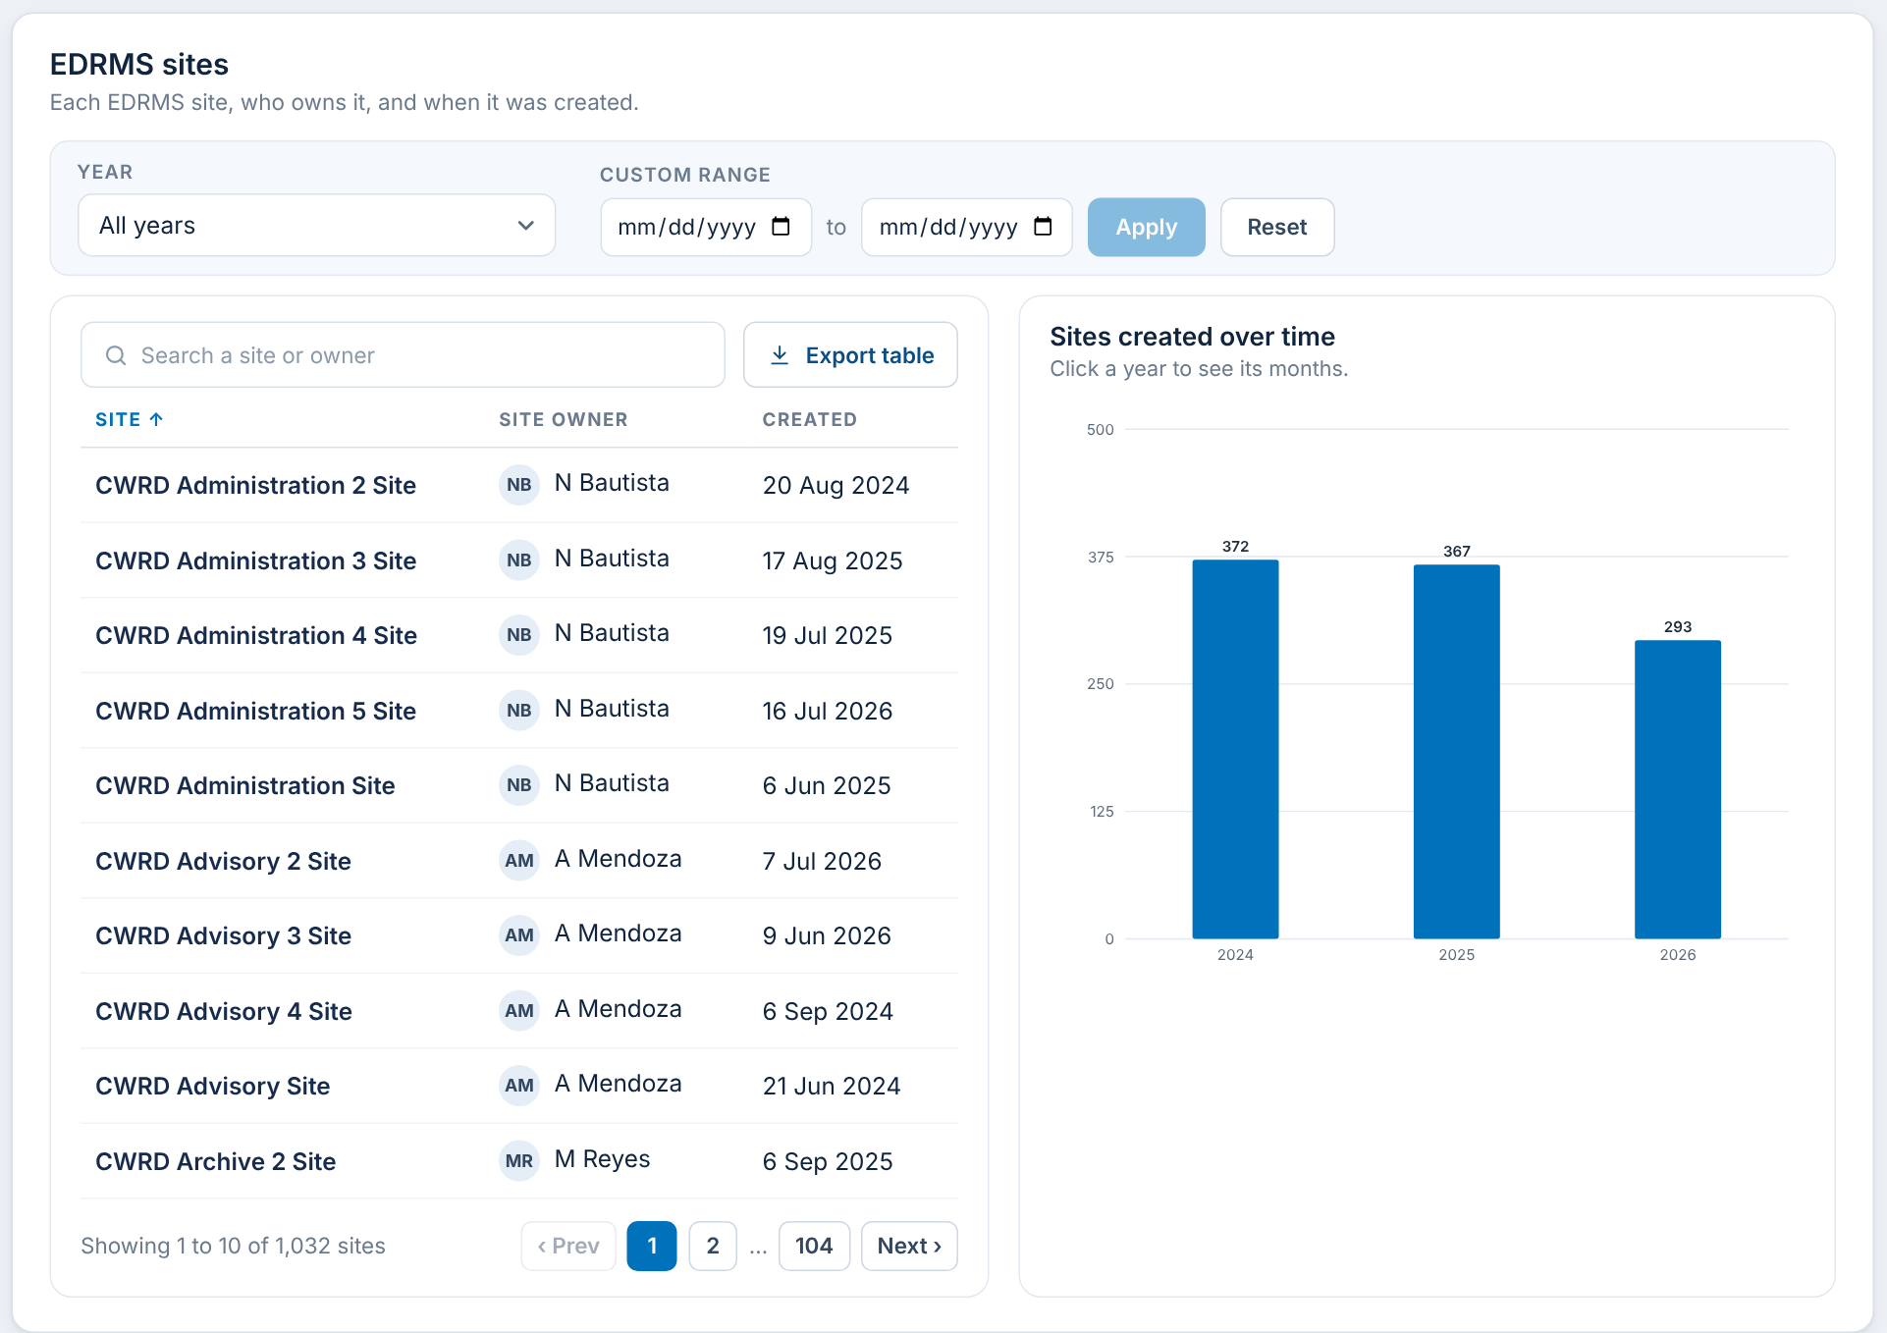
F-35 EDRMS sites breakdown
What it shows
Each site, its owner and when it was created (RAC Item 10: site names, not URLs; owners by name, not email).
When you click
Year: all years or one year. Or choose a custom From / To, then Apply.
Search a site or owner; sort; page; Export table.
Hover an owner: shows the owner's email.
RAC decision for F-35
☐ Keep ☐ Change ☐ Remove
Comments:
Notes:
Each site, its owner and when it was created (RAC Item 10: site names, not URLs; owners by name, not email). Click steps: Year: all years or one year. Or choose a custom From / To, then Apply. Search a site or owner; sort; page; Export table. Hover an owner: shows the owner's email.

Slide 38
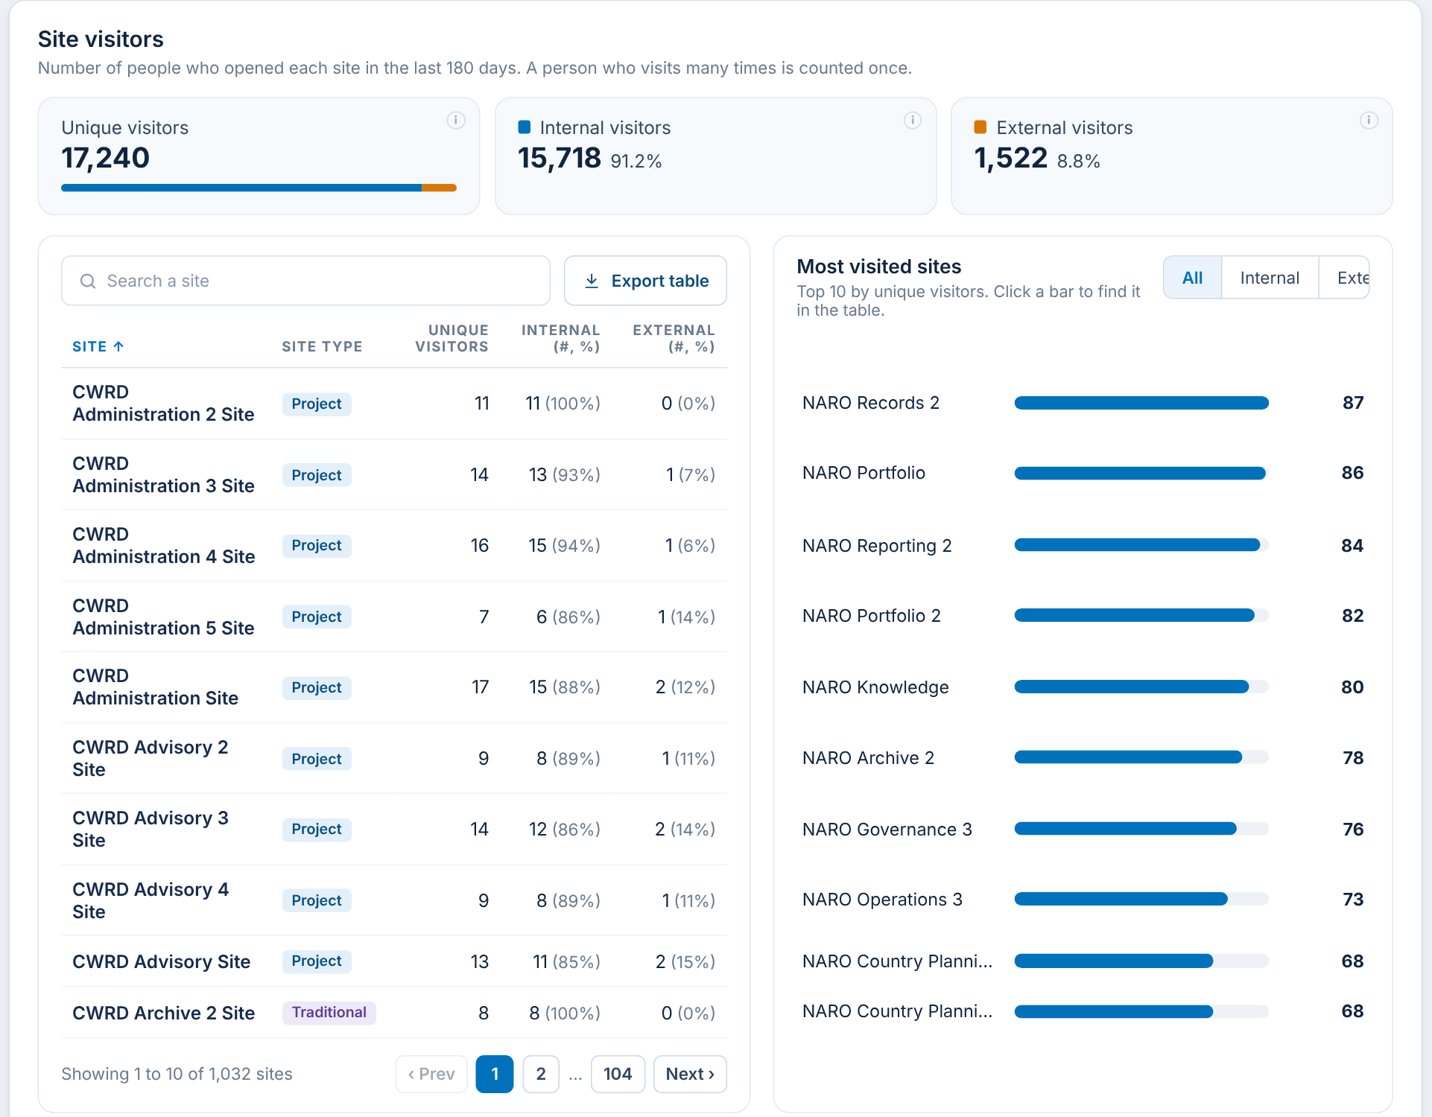
F-36 Site visitors breakdown
What it shows
Unique visitors in the last 180 days, split into internal (ADB accounts) and external (guests), per site, plus the 10 most visited sites.
When you click
All / Internal / External: changes the top 10 chart.
Click a bar: finds that site in the table and highlights it.
Search a site; sort; page; Export table.
Data: A visitor opened anything on the site; counted once per site (Purview audit log).
RAC decision for F-36
☐ Keep ☐ Change ☐ Remove
Comments:
Notes:
Unique visitors in the last 180 days, split into internal (ADB accounts) and external (guests), per site, plus the 10 most visited sites. Click steps: All / Internal / External: changes the top 10 chart. Click a bar: finds that site in the table and highlights it. Search a site; sort; page; Export table.

Slide 39
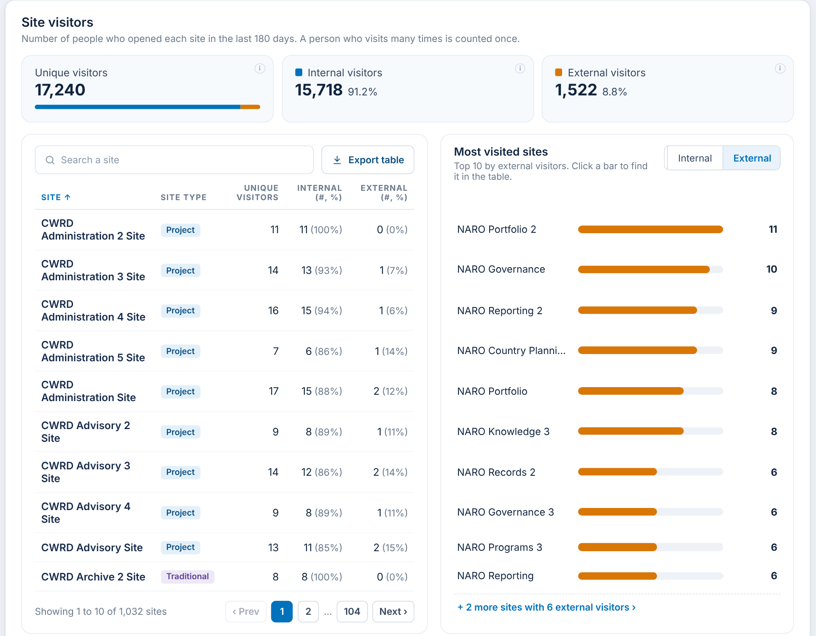
F-37 Site visitors: external only
What it shows
The same panel with External chosen: the sites most visited by guests.
When you click
External: the chart ranks sites by external visitors.
All: back to all visitors.
RAC decision for F-37
☐ Keep ☐ Change ☐ Remove
Comments:
Notes:
The same panel with External chosen: the sites most visited by guests. Click steps: External: the chart ranks sites by external visitors. All: back to all visitors.

Slide 40
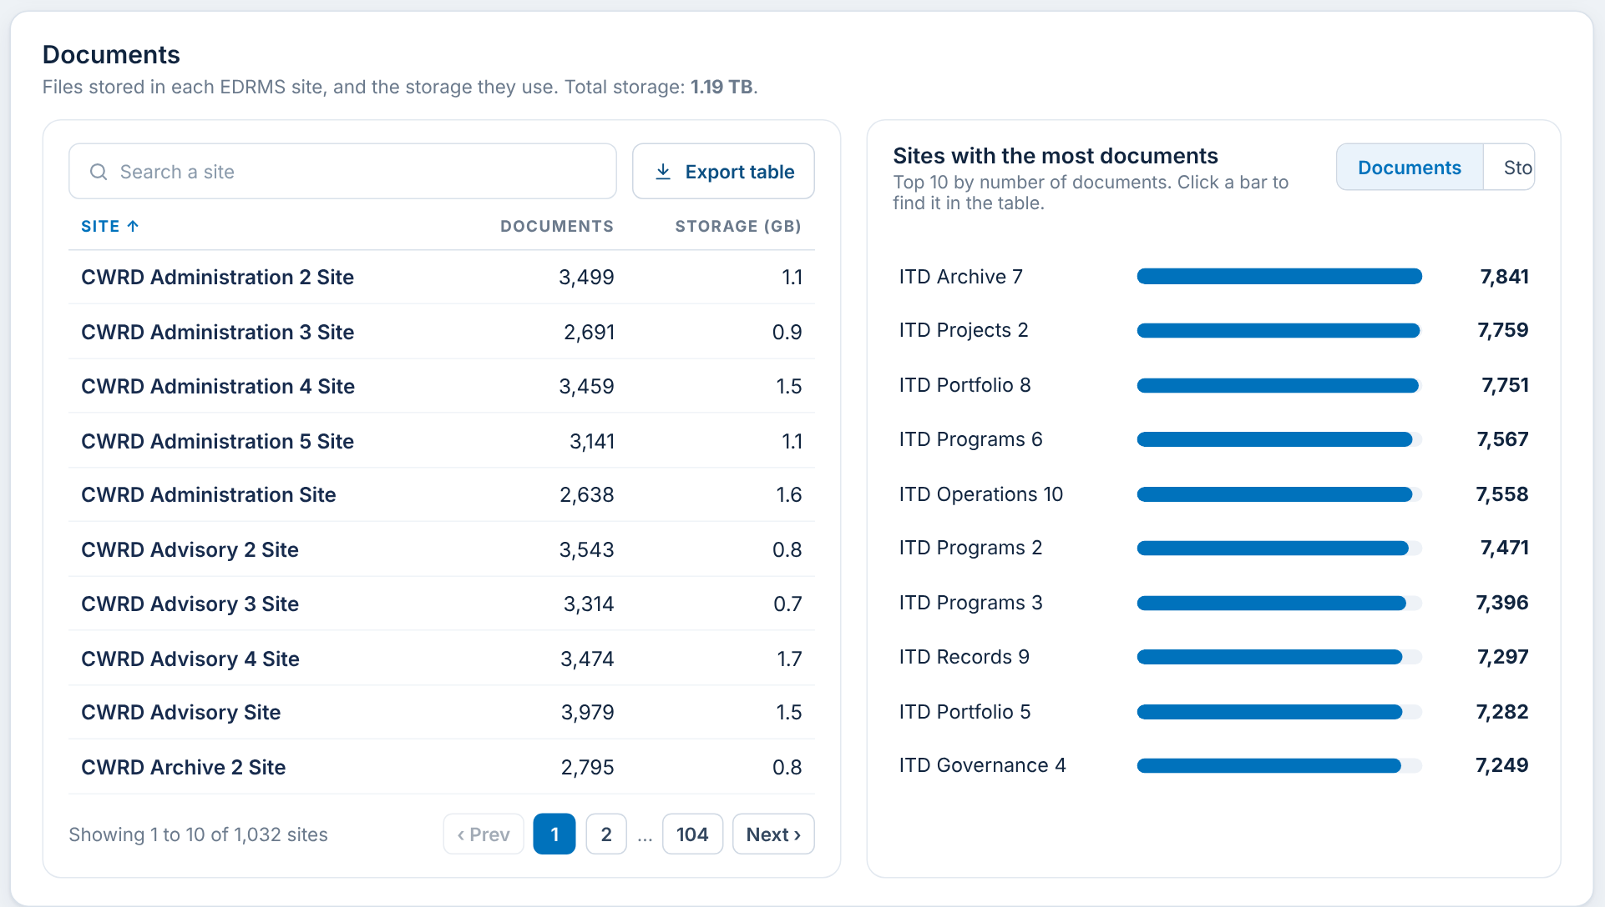

F-38 Documents breakdown
What it shows
Files and storage per site, with the total storage in the panel title.
When you click
Measure Documents / Storage: the top 10 chart ranks by that measure.
Click a bar: finds the site in the table.
Search; sort; page; Export table.
RAC decision for F-38
☐ Keep ☐ Change ☐ Remove
Comments:
Notes:
Files and storage per site, with the total storage in the panel title. Click steps: Measure Documents / Storage: the top 10 chart ranks by that measure. Click a bar: finds the site in the table. Search; sort; page; Export table.

Slide 41
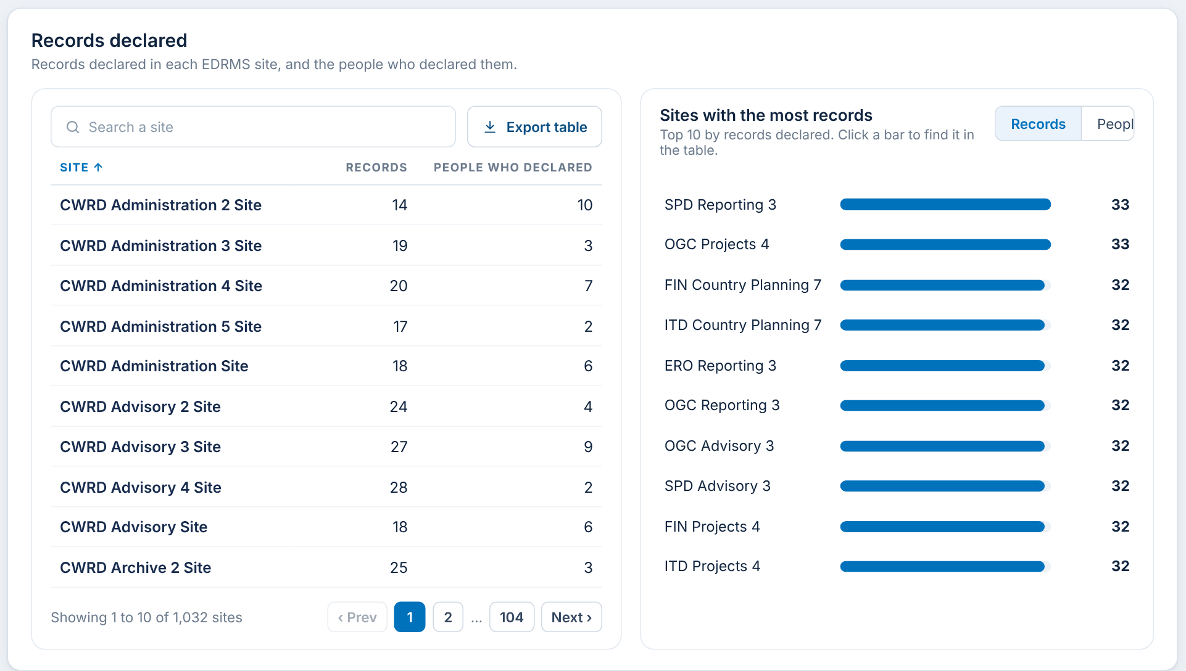
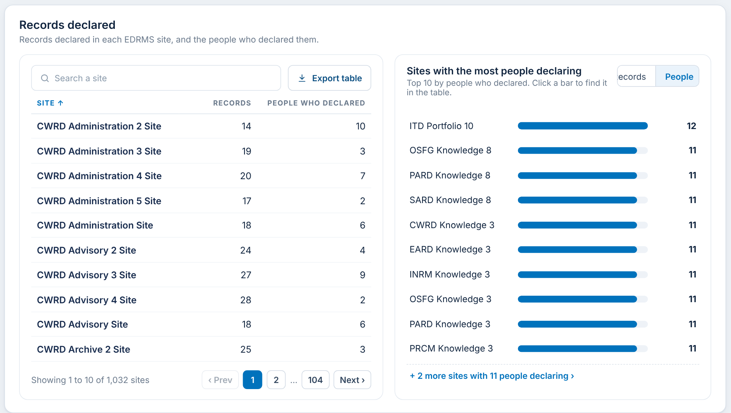
F-39 Records declared breakdown
What it shows
Records declared per site and the number of people who declared them.
When you click
Measure Records / People: the chart ranks by records or by people declaring.
Click a bar: finds the site in the table.
Search; sort; page; Export table.
RAC decision for F-39
☐ Keep ☐ Change ☐ Remove
Comments:
Notes:
Records declared per site and the number of people who declared them. Click steps: Measure Records / People: the chart ranks by records or by people declaring. Click a bar: finds the site in the table. Search; sort; page; Export table.

Slide 42
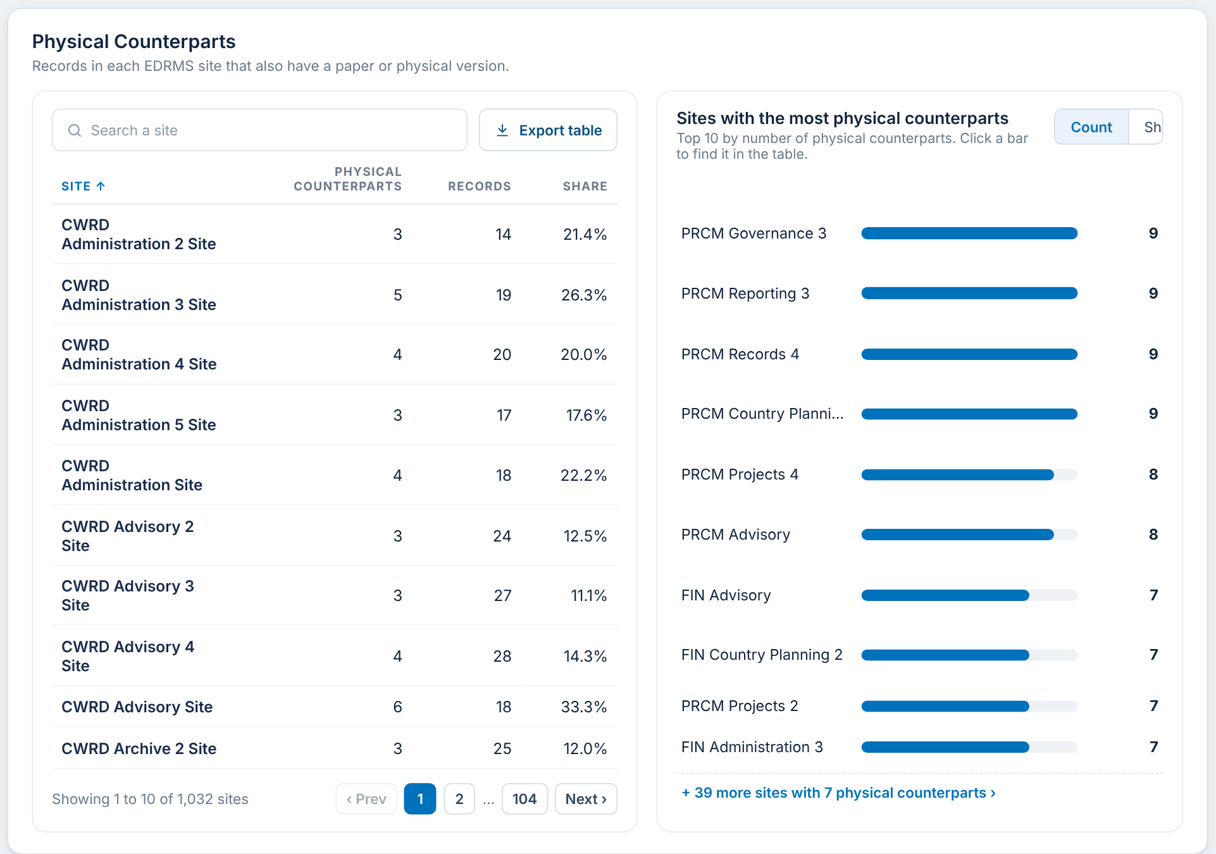
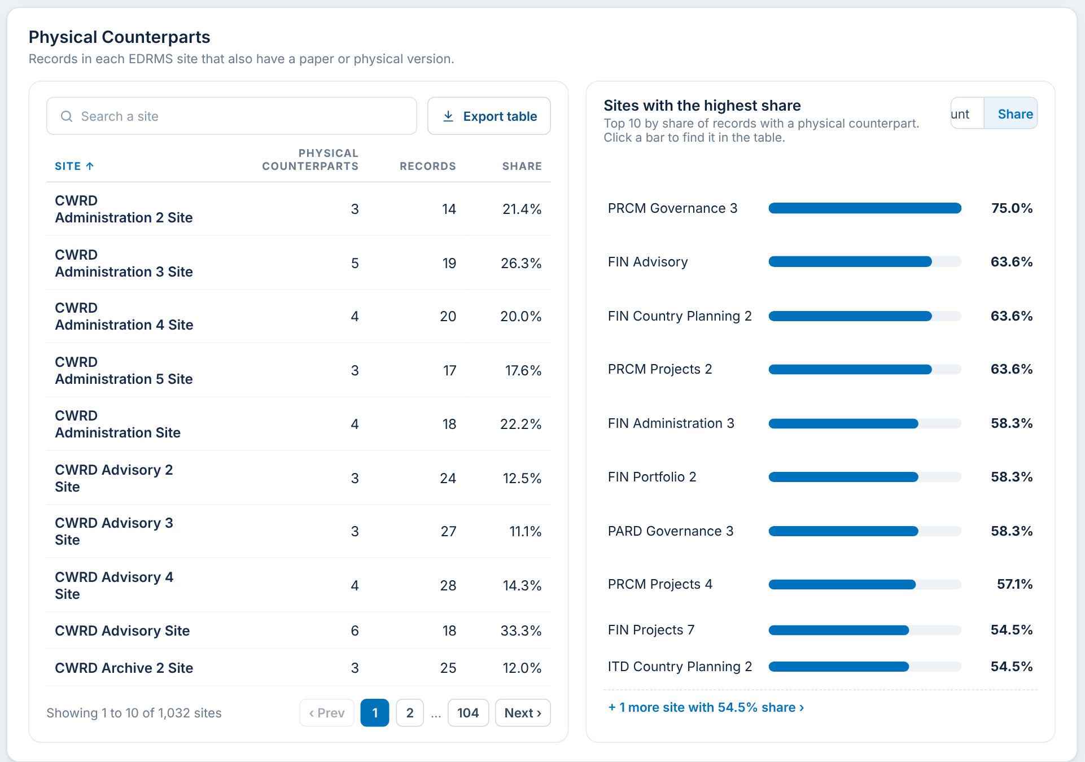
F-40 Physical counterparts breakdown
What it shows
Records with a paper version per site, and their share of the site's records.
When you click
Measure Count / Share: the chart ranks by number or by share.
Click a bar: finds the site in the table.
Search; sort; page; Export table.
RAC decision for F-40
☐ Keep ☐ Change ☐ Remove
Comments:
Notes:
Records with a paper version per site, and their share of the site's records. Click steps: Measure Count / Share: the chart ranks by number or by share. Click a bar: finds the site in the table. Search; sort; page; Export table.

Slide 43
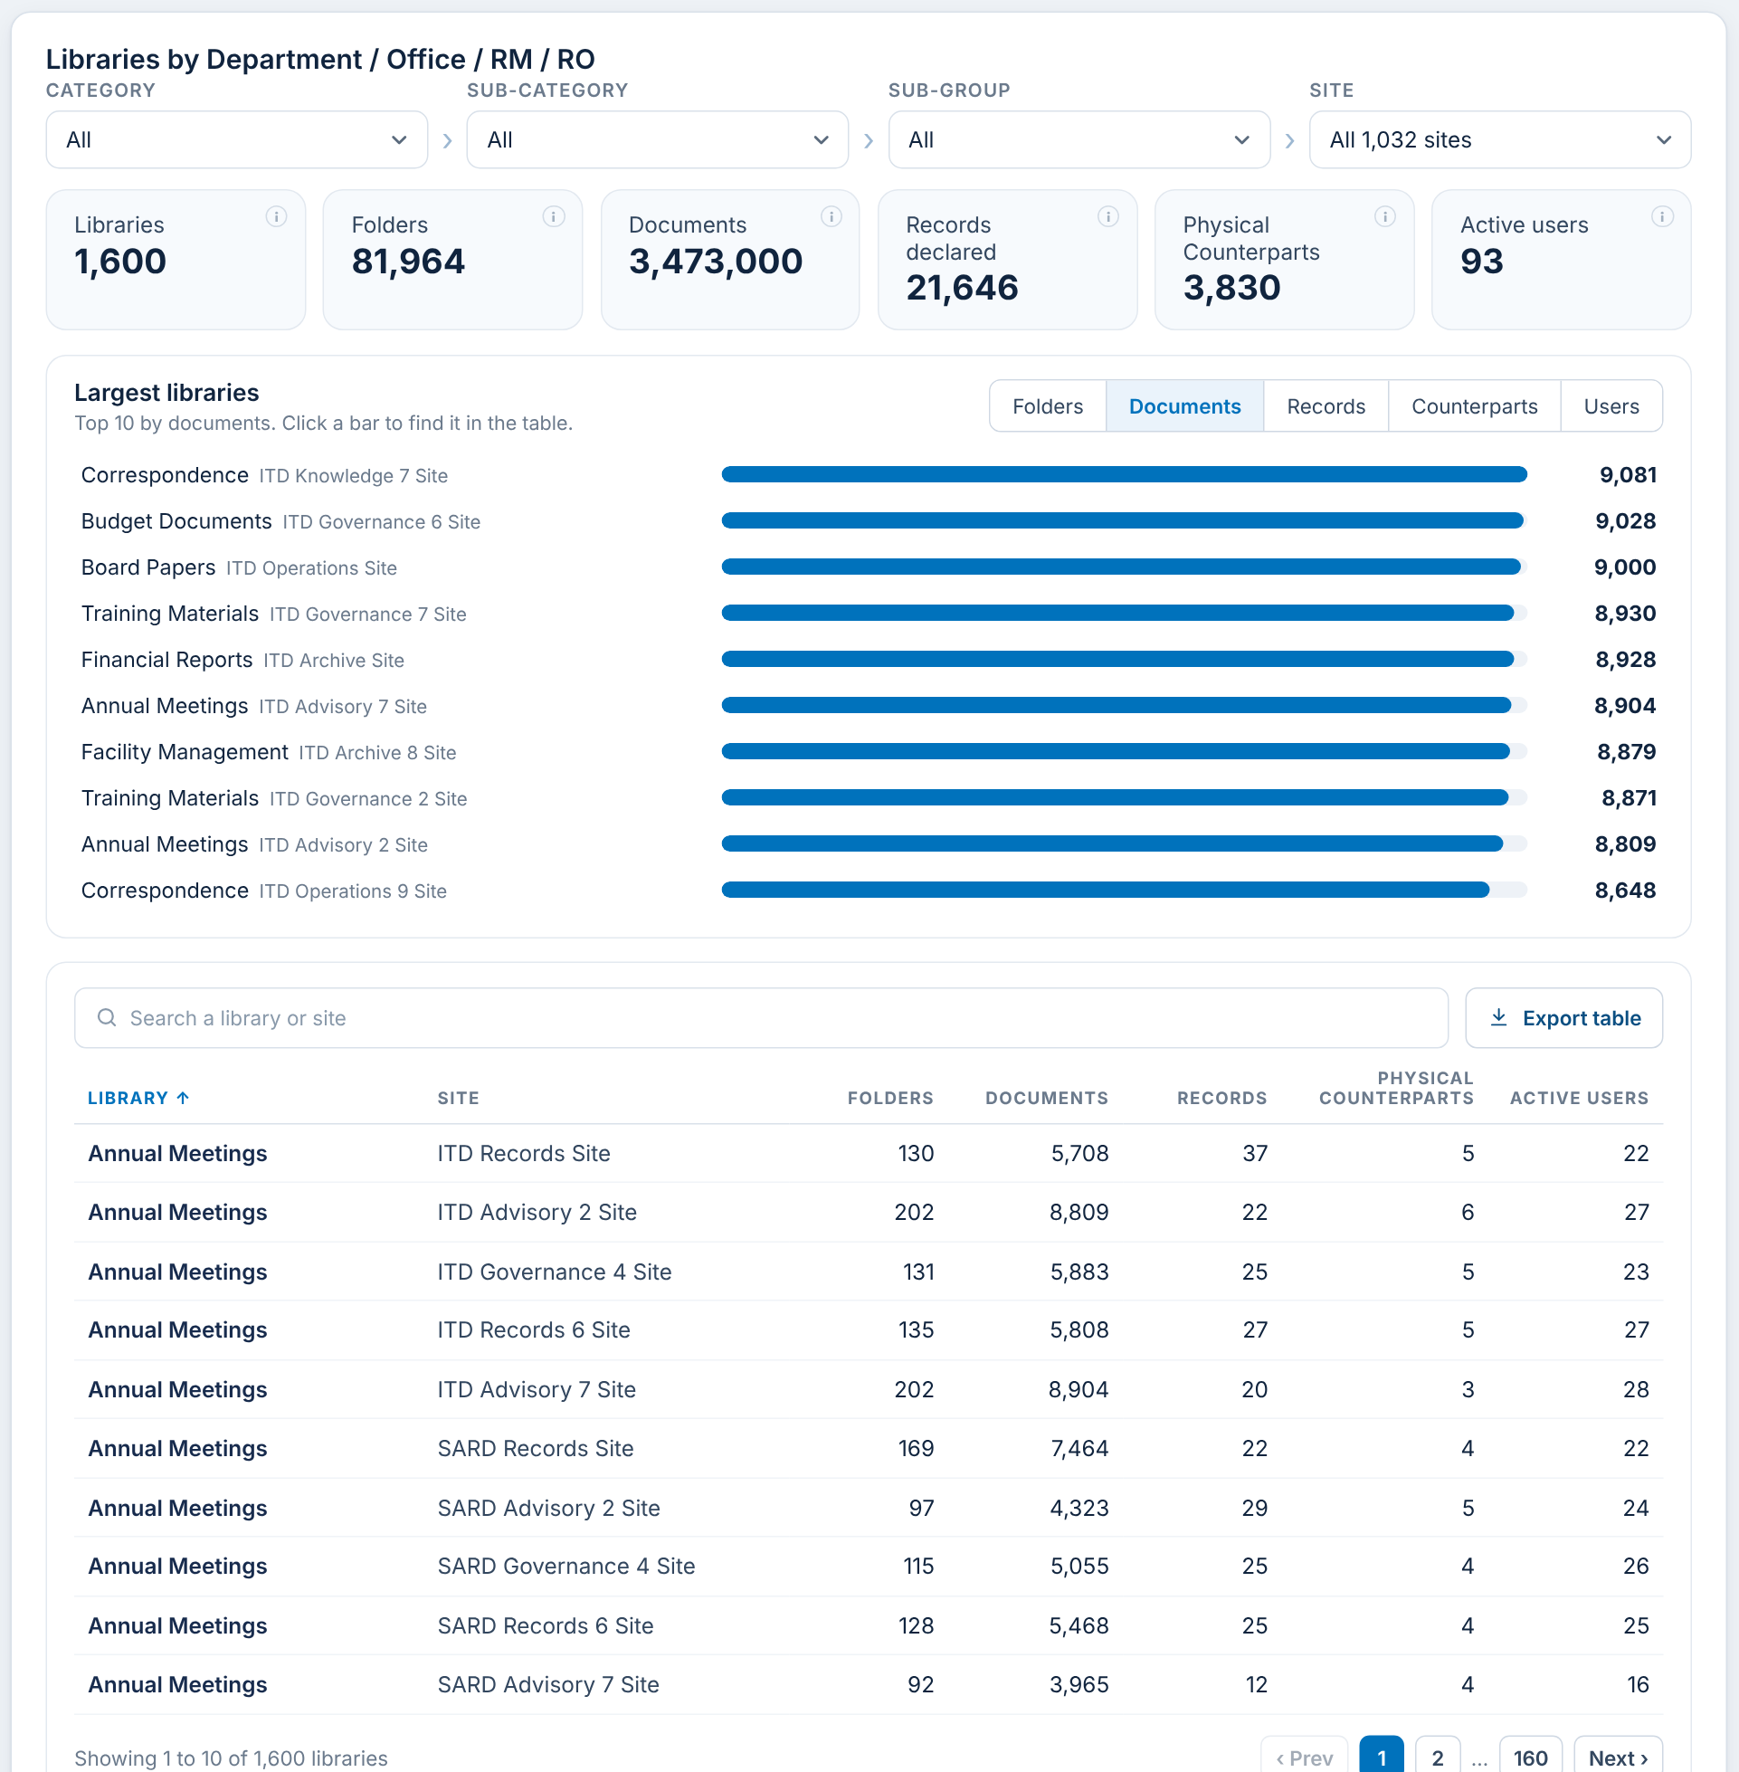
F-41 Library usage
What it shows
Every document library in the chosen sites: folders, documents, records, physical counterparts and active users, with its own four filter boxes.
When you click
Category / Sub-category / Sub-group / Site boxes: narrow the libraries.
Six summary figures update with the boxes.
Search a library or site; sort; page; Export table.
Data: Folder count: Microsoft Graph weekly scan, pending AvePoint confirmation (Item 12).
RAC decision for F-41
☐ Keep ☐ Change ☐ Remove
Comments:
Notes:
Every document library in the chosen sites: folders, documents, records, physical counterparts and active users, with its own four filter boxes. Click steps: Category / Sub-category / Sub-group / Site boxes: narrow the libraries. Six summary figures update with the boxes. Search a library or site; sort; page; Export table.

Slide 44
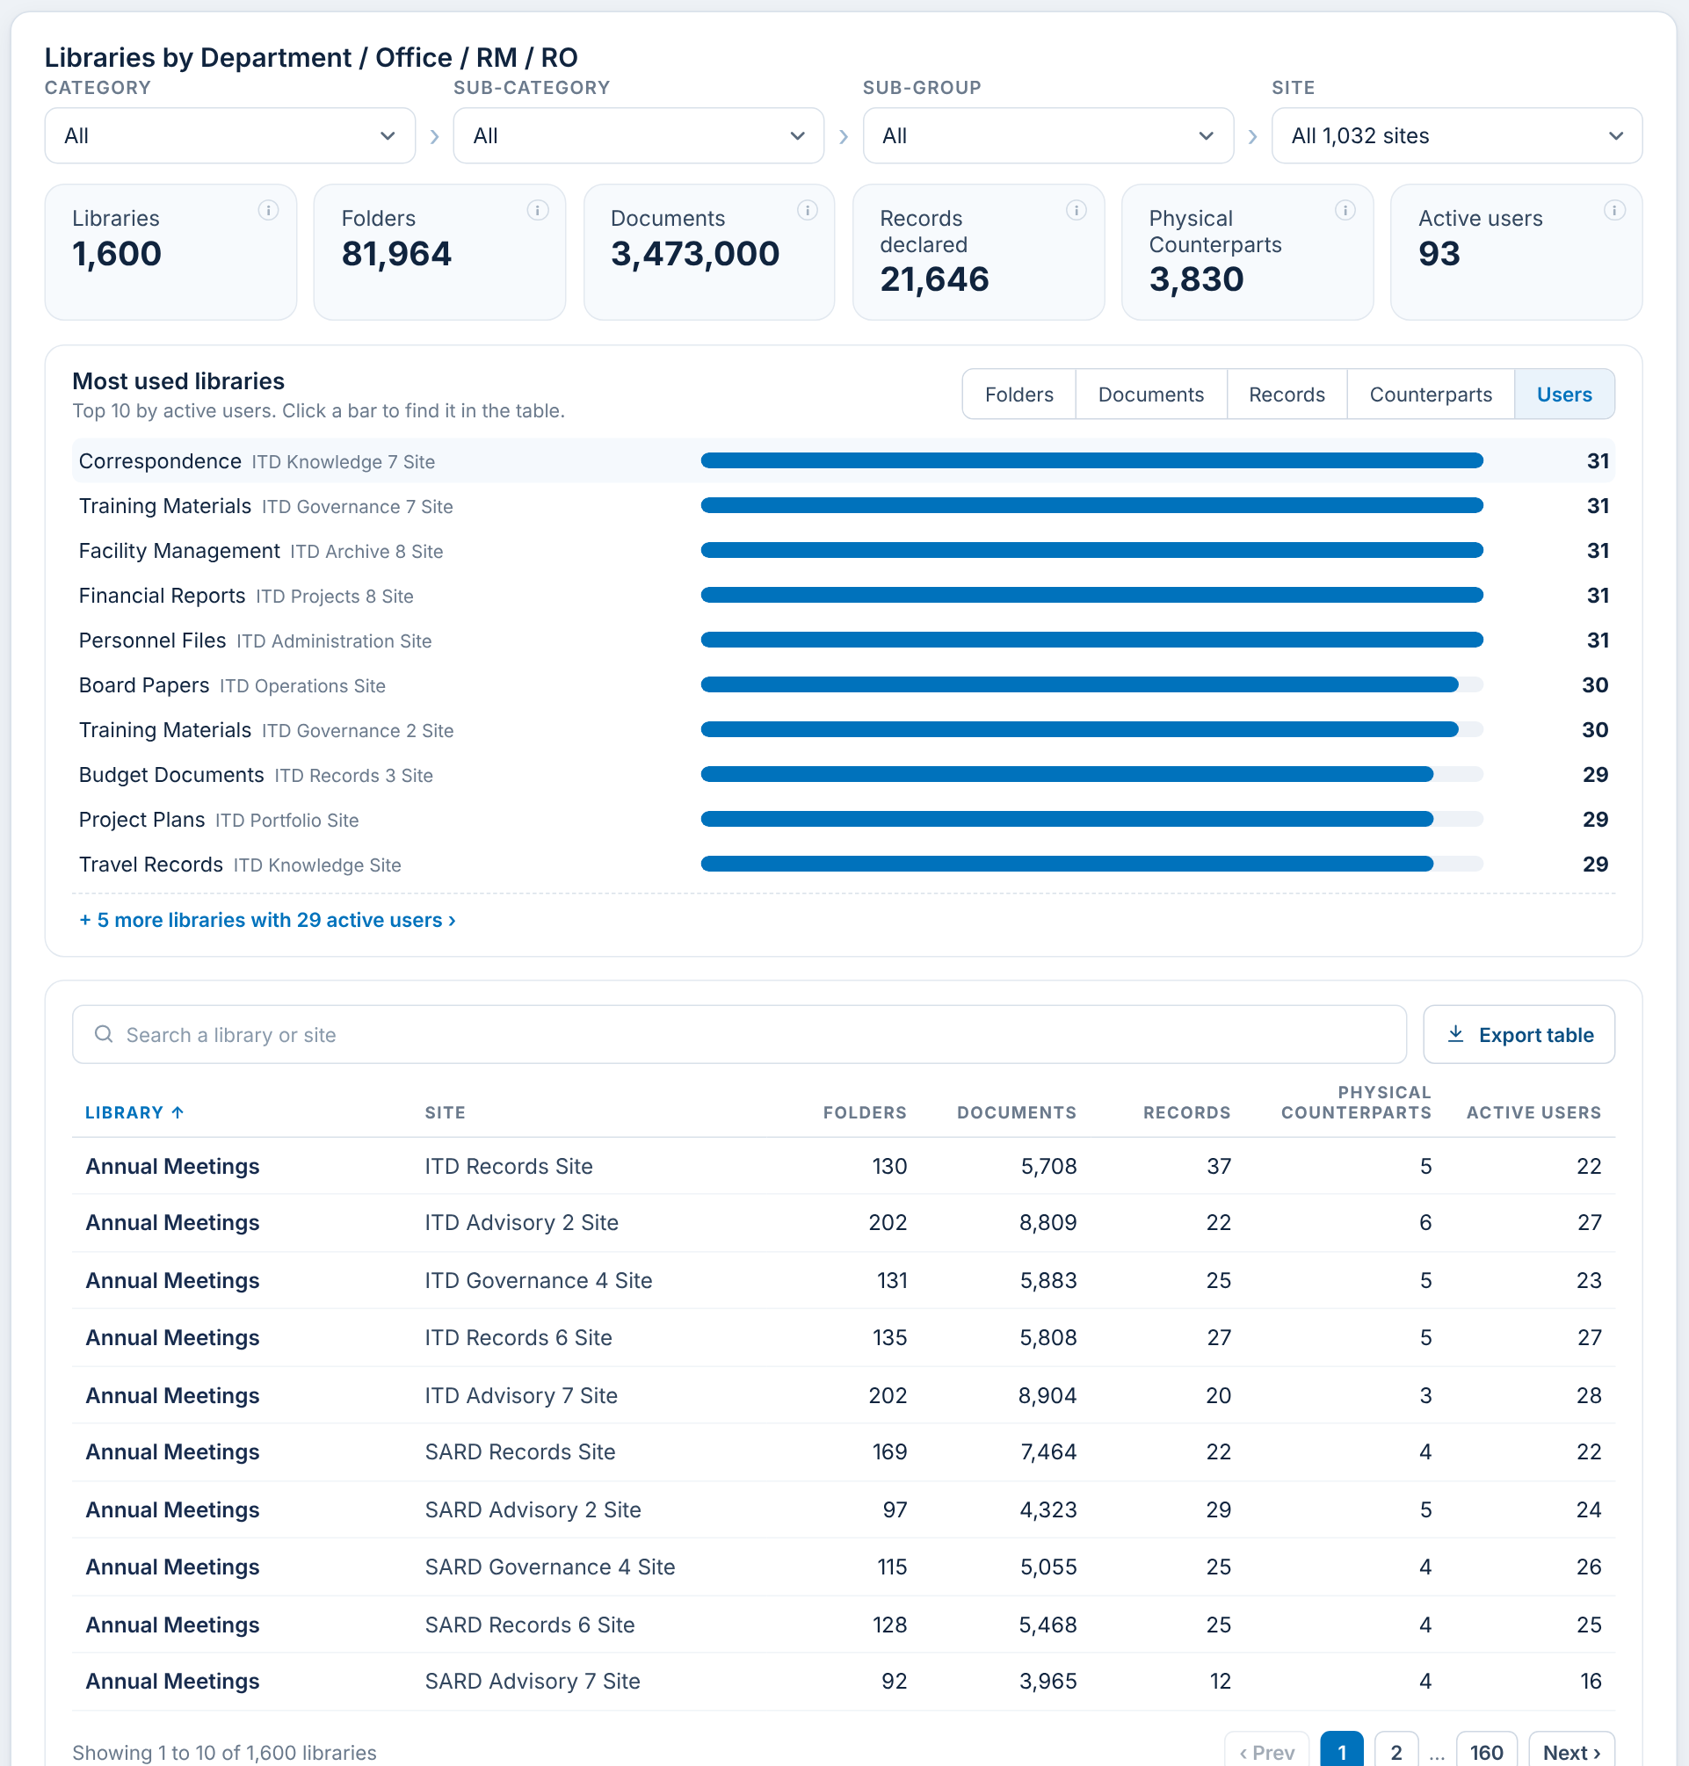
F-42 Library usage: most used libraries
What it shows
The top 10 libraries by the chosen measure. Here Users: people who opened or edited files in the library in the last 180 days.
When you click
Measure Folders / Documents / Records / Counterparts / Users: re-ranks the chart.
Click a bar: finds the library in the table.
"+ N more libraries with ..." lists ties beyond the top 10.
Data: Active users are counted per library (Purview audit log, file actions only).
RAC decision for F-42
☐ Keep ☐ Change ☐ Remove
Comments:
Notes:
The top 10 libraries by the chosen measure. Here Users: people who opened or edited files in the library in the last 180 days. Click steps: Measure Folders / Documents / Records / Counterparts / Users: re-ranks the chart. Click a bar: finds the library in the table. "+ N more libraries with ..." lists ties beyond the top 10.

Slide 45
D. Import data (Owners and admins only)
How the manual data RAC provides gets into the report: one template, checked in full before anything is saved.

Slide 46
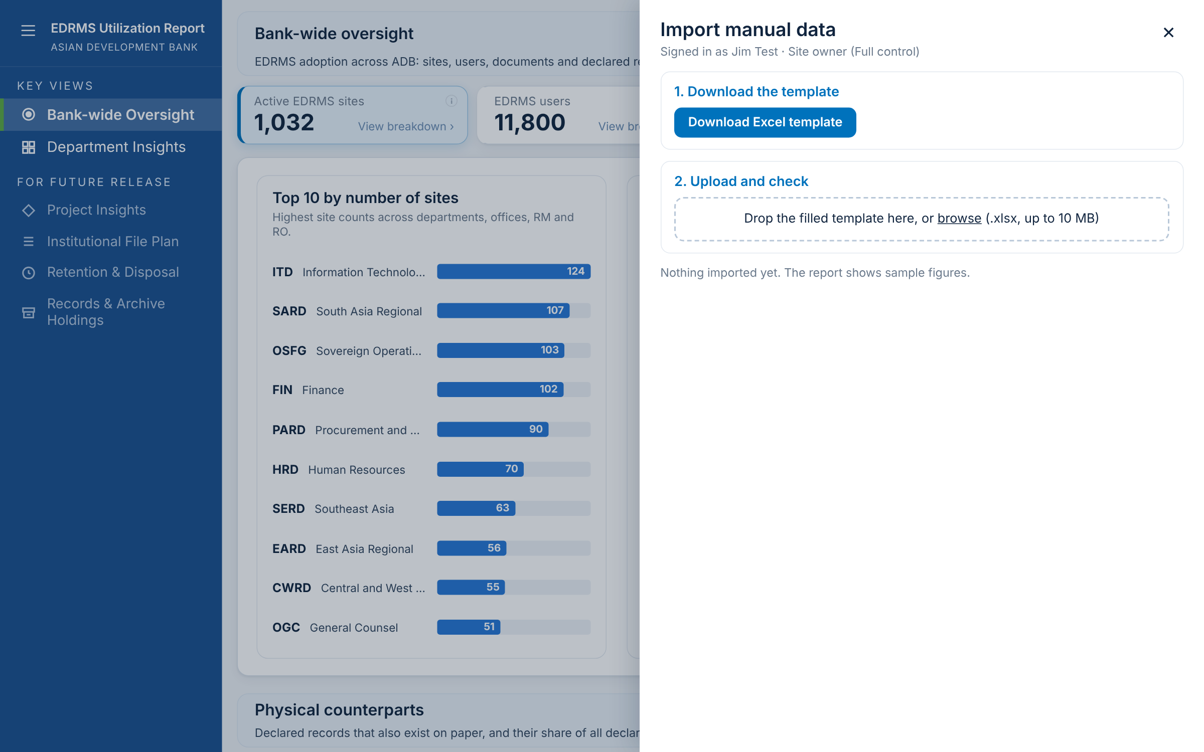
F-50 Import data button and panel
What it shows
Site Owners and admins see Import data beside Export. Members and Visitors do not see it at all; SharePoint decides from the person's site permission.
When you click
Import data: a side panel opens over the report.
Download Excel template: one file with the tabs Sites, People, Departments, Code mapping and Valid values, pre-filled with what is loaded now.
Close (X) or Esc: closes the panel.
Data: Saved in a library on the site that only Owners can change. No names or emails are stored.
RAC decision for F-50
☐ Keep ☐ Change ☐ Remove
Comments:
Notes:
Site Owners and admins see Import data beside Export. Members and Visitors do not see it at all; SharePoint decides from the person's site permission. Click steps: Import data: a side panel opens over the report. Download Excel template: one file with the tabs Sites, People, Departments, Code mapping and Valid values, pre-filled with what is loaded now. Close (X) or Esc: closes the panel.

Slide 47
F-51 The manual data template
Tab | What it is | Columns | Feeds
Sites | Sir Rotsen's site list (VLOOKUP SITE), pasted as it is | Site, URL, Site Name, Department, Division, Production, Full Name, Category, Sub-category, Sub-group | The four filter boxes (F-07, F-30)
People | The AP All Users export, plus one column RAC fills | Email, Display Name, Department, Division, Unit, Office Location, Staff type, Completed EDRMS training (Yes/No) | Headcount and Completed training (F-14, F-19)
Departments | One row per unit | Unit code, Go-Live date, Site convention link, Completed training (count) | Go-Live date and View guide (F-33); training as a number
Code mapping | Optional | Code in People, Report unit (e.g. SD1 > report unit) | Places people under the right unit
Rules every file must pass
Tab names and headings as in the template
Valid codes, Yes/No, dates up to today, sharepoint.com links
Training no more than the headcount; per person or as a count, not both
Service accounts and repeated rows skipped and reported
If any rule is broken, nothing is loaded
RAC decision for F-51
☐ Keep ☐ Change ☐ Remove
Comments:

Slide 48
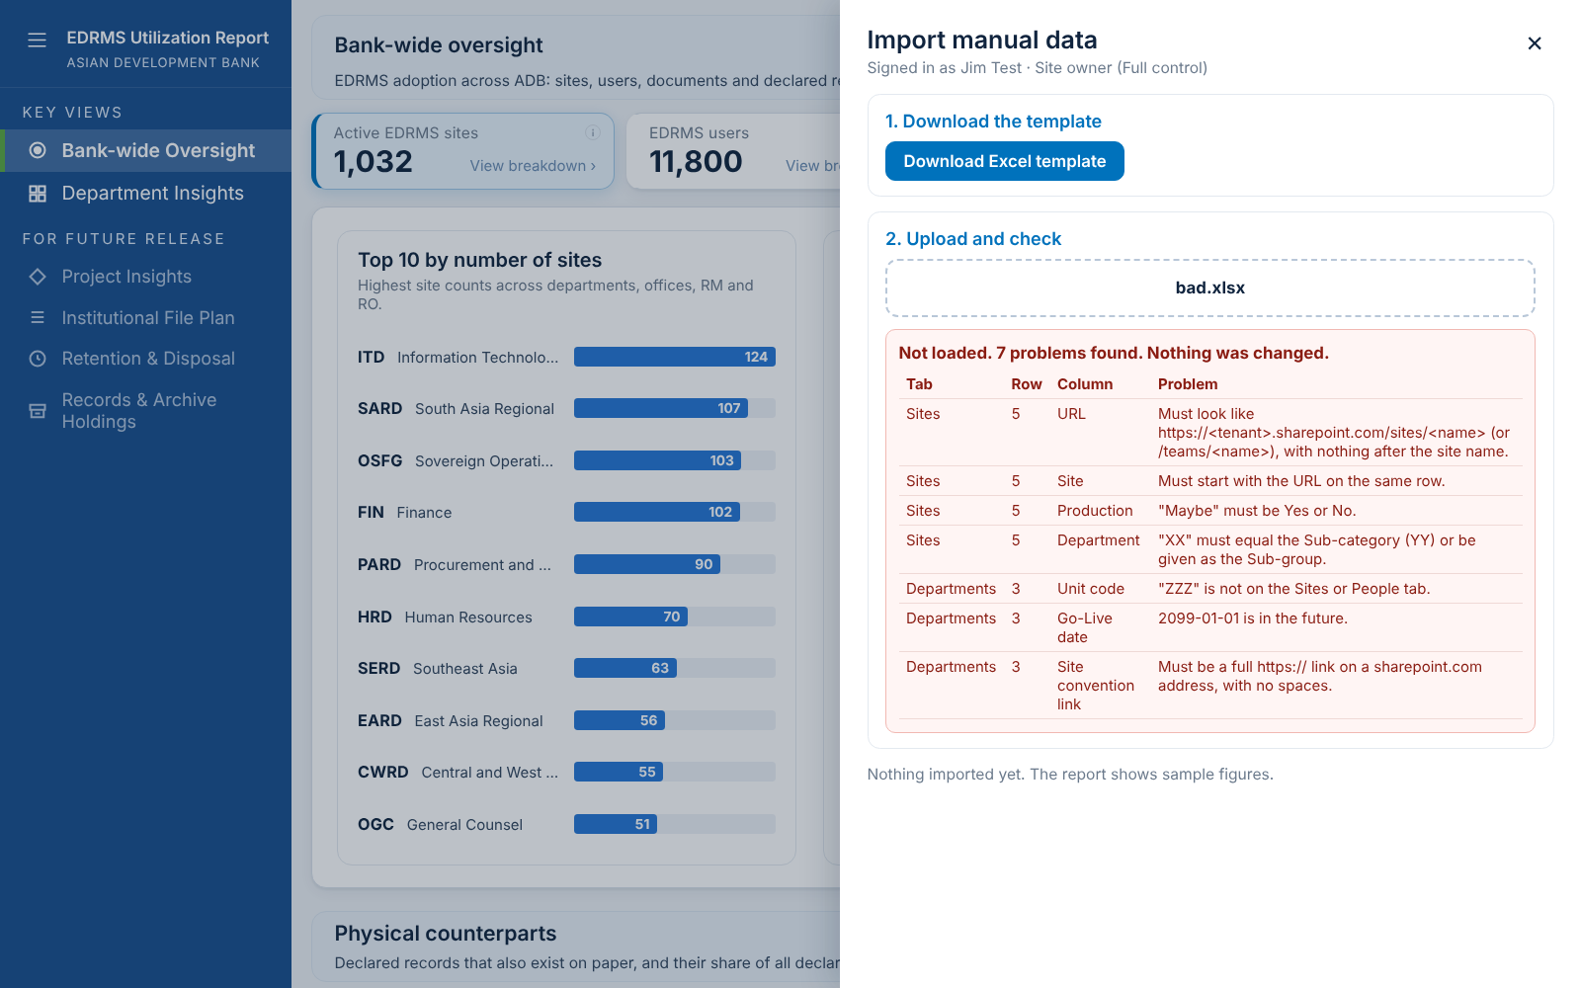
F-52 A file with problems is refused
What it shows
Uploading a file checks every row first. Any problem means nothing is loaded, and every problem is listed.
When you click
Drop the file in the panel or browse to it.
The list shows each problem by tab, row and column, in plain words.
Fix the file and upload again. The refusal is recorded in the import history.
RAC decision for F-52
☐ Keep ☐ Change ☐ Remove
Comments:
Notes:
Uploading a file checks every row first. Any problem means nothing is loaded, and every problem is listed. Click steps: Drop the file in the panel or browse to it. The list shows each problem by tab, row and column, in plain words. Fix the file and upload again. The refusal is recorded in the import history.

Slide 49
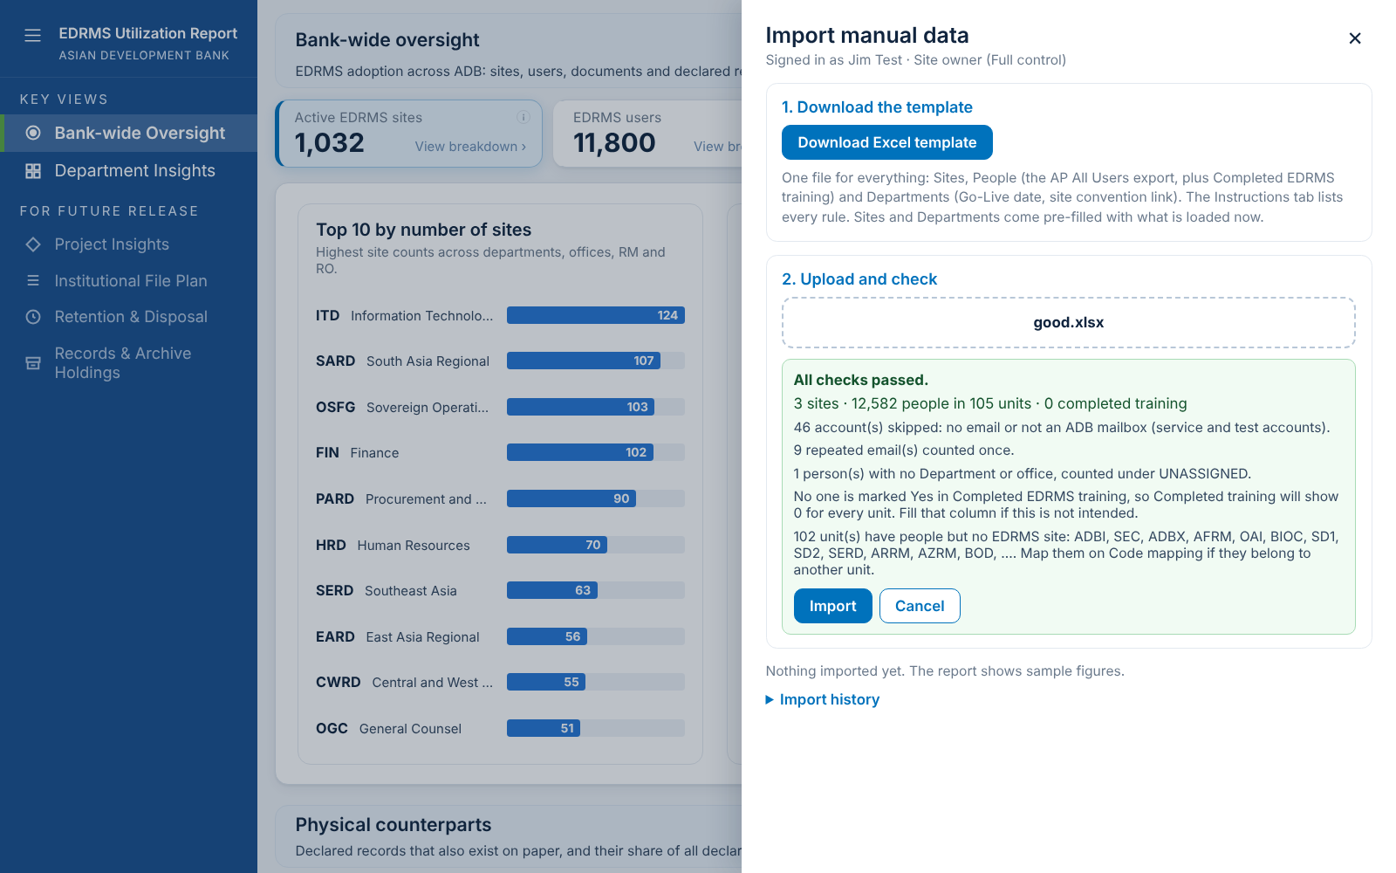
F-53 A file that passes is loaded in one click
What it shows
When every row passes, the panel shows what will be loaded and any notes (e.g. service accounts skipped).
When you click
Import: the data is saved; every reader sees the new figures on their next refresh.
Cancel: nothing changes.
Import history: who loaded which file, and when.
RAC decision for F-53
☐ Keep ☐ Change ☐ Remove
Comments:
Notes:
When every row passes, the panel shows what will be loaded and any notes (e.g. service accounts skipped). Click steps: Import: the data is saved; every reader sees the new figures on their next refresh. Cancel: nothing changes. Import history: who loaded which file, and when.

Slide 50
E. Data behind the figures, and your decisions
Where each figure comes from, what RAC still needs to provide, and the decision register.

Slide 51
Where each figure comes from
Figure | Source | How it arrives
Sites, site owners, created date | AvePoint Cloud Governance | Automatic, weekly
Documents, storage | Microsoft 365 / Graph scan | Automatic, weekly
Records declared, physical counterparts | EDRMS records table (drm-npr) | Automatic, weekly
Site visitors, active users | Purview audit log | Automatic, weekly
Folders per library | Microsoft Graph scan | Pending AvePoint confirmation
Headcount, staff type | AP All Users export (People tab) | Manual import (F-50)
Completed training | RAC list (People or Departments tab) | Manual import
Go-Live date, site convention link | RAC (Departments tab) | Manual import
Category, Sub-category, Sub-group | Sir Rotsen's site list (Sites tab) | Manual import

Slide 52
What we still need from RAC
1
Completed EDRMS training
Per person (Yes/No on People) or a count per unit (Departments). Please say which.
2
Go-Live date and site convention link
One row per Department / Office / RM / RO on the Departments tab.
3
Category, Sub-category, Sub-group
The three columns in sir Rotsen's site file, to confirm the drill-down (HQ, RM, RO and below).
4
Code mapping
Which report unit each HR code belongs to (SD1, SD2, SD3, CCSD, CSD and others).
5
Decisions on F-01 to F-53
Keep, change or remove, using the register on the next slides.

Slide 53
Decision register
ID | Function | Area | Keep | Change | Remove | Comments
F-01 | Dashboard menu | Navigation and common tools | ☐ | ☐ | ☐
F-02 | Collapse and expand the menu | Navigation and common tools | ☐ | ☐ | ☐
F-03 | Information icons (i) | Navigation and common tools | ☐ | ☐ | ☐
F-04 | Data as of | Navigation and common tools | ☐ | ☐ | ☐
F-05 | Export the dashboard (PDF or PowerPoint) | Navigation and common tools | ☐ | ☐ | ☐
F-06 | Search in a table | Navigation and common tools | ☐ | ☐ | ☐
F-07 | Filter Department / Office / RM / RO | Navigation and common tools | ☐ | ☐ | ☐
F-08 | Sort a table | Navigation and common tools | ☐ | ☐ | ☐
F-09 | Page through a table | Navigation and common tools | ☐ | ☐ | ☐
F-10 | Export a table to Excel | Navigation and common tools | ☐ | ☐ | ☐
F-11 | Click a department code to open Department Insights | Navigation and common tools | ☐ | ☐ | ☐
F-12 | The four summary cards | Bank-wide Oversight | ☐ | ☐ | ☐
F-13 | Active EDRMS sites breakdown | Bank-wide Oversight | ☐ | ☐ | ☐
F-14 | EDRMS users breakdown | Bank-wide Oversight | ☐ | ☐ | ☐
F-15 | Documents in EDRMS breakdown | Bank-wide Oversight | ☐ | ☐ | ☐
F-16 | Documents: by month, new documents, filtered | Bank-wide Oversight | ☐ | ☐ | ☐
F-17 | Records declared breakdown | Bank-wide Oversight | ☐ | ☐ | ☐

Slide 54
Decision register (continued)
ID | Function | Area | Keep | Change | Remove | Comments
F-18 | Physical counterparts | Bank-wide Oversight | ☐ | ☐ | ☐
F-19 | Comparison: headcount against documents | Bank-wide Oversight | ☐ | ☐ | ☐
F-20 | Comparison: headcount against records declared | Bank-wide Oversight | ☐ | ☐ | ☐
F-21 | Records declaration trend | Bank-wide Oversight | ☐ | ☐ | ☐
F-22 | Trend: drill from years into months | Bank-wide Oversight | ☐ | ☐ | ☐
F-23 | Trend: custom date range | Bank-wide Oversight | ☐ | ☐ | ☐
F-24 | Web part settings (page editors) | Navigation and common tools | ☐ | ☐ | ☐
F-30 | Department Profile and the four filter boxes | Department Insights | ☐ | ☐ | ☐
F-31 | Category and Sub-category boxes | Department Insights | ☐ | ☐ | ☐
F-32 | Site box with search | Department Insights | ☐ | ☐ | ☐
F-33 | Go-Live date and site convention | Department Insights | ☐ | ☐ | ☐
F-34 | The five cards | Department Insights | ☐ | ☐ | ☐
F-35 | EDRMS sites breakdown | Department Insights | ☐ | ☐ | ☐
F-36 | Site visitors breakdown | Department Insights | ☐ | ☐ | ☐
F-37 | Site visitors: external only | Department Insights | ☐ | ☐ | ☐
F-38 | Documents breakdown | Department Insights | ☐ | ☐ | ☐
F-39 | Records declared breakdown | Department Insights | ☐ | ☐ | ☐
F-40 | Physical counterparts breakdown | Department Insights | ☐ | ☐ | ☐

Slide 55
Decision register (continued)
ID | Function | Area | Keep | Change | Remove | Comments
F-41 | Library usage | Department Insights | ☐ | ☐ | ☐
F-42 | Library usage: most used libraries | Department Insights | ☐ | ☐ | ☐
F-50 | Import data button and panel | Import data (Owners and admins only) | ☐ | ☐ | ☐
F-51 | The manual data template | Import data (Owners and admins only) | ☐ | ☐ | ☐
F-52 | A file with problems is refused | Import data (Owners and admins only) | ☐ | ☐ | ☐
F-53 | A file that passes is loaded in one click | Import data (Owners and admins only) | ☐ | ☐ | ☐

Slide 56
Next steps
1. RAC reviews each function and fills in the decision register.
2. RAC provides the training list, Go-Live dates, convention links, categories and code mapping.
3. The EDRMS team updates the report and walks RAC through the changes.

