Slide 1
EDRMS Utilization Report
Release 2026.4
Reconfirmation of Requirements | October 2026

Slide 2
AGENDA
1. Session Objective
2. Full Mockup Walkthrough (PDF)
3. Release 2026.4 Scope
4. Bank-wide Oversight: Items to Confirm
5. Department Insights: Items to Confirm
6. Summary of Inputs Needed
7. Q&A

Slide 3
SESSION OBJECTIVE
Reconfirm the requirements for Release 2026.4 before build is finalised
REVIEW
CONFIRM
PROVIDE
1
Walk through the full mockup of Bank-wide Oversight and Department Insights.
2
Go item by item: confirm what is agreed and settle the open questions.
3
Agree who provides the remaining lists and links, and by when.
How each item is marked in this deck
Agreed
Settled earlier. Confirm it still stands.
To confirm
A decision is needed in this session.
Input needed
A list, link or figure is needed from RAC.

Slide 4
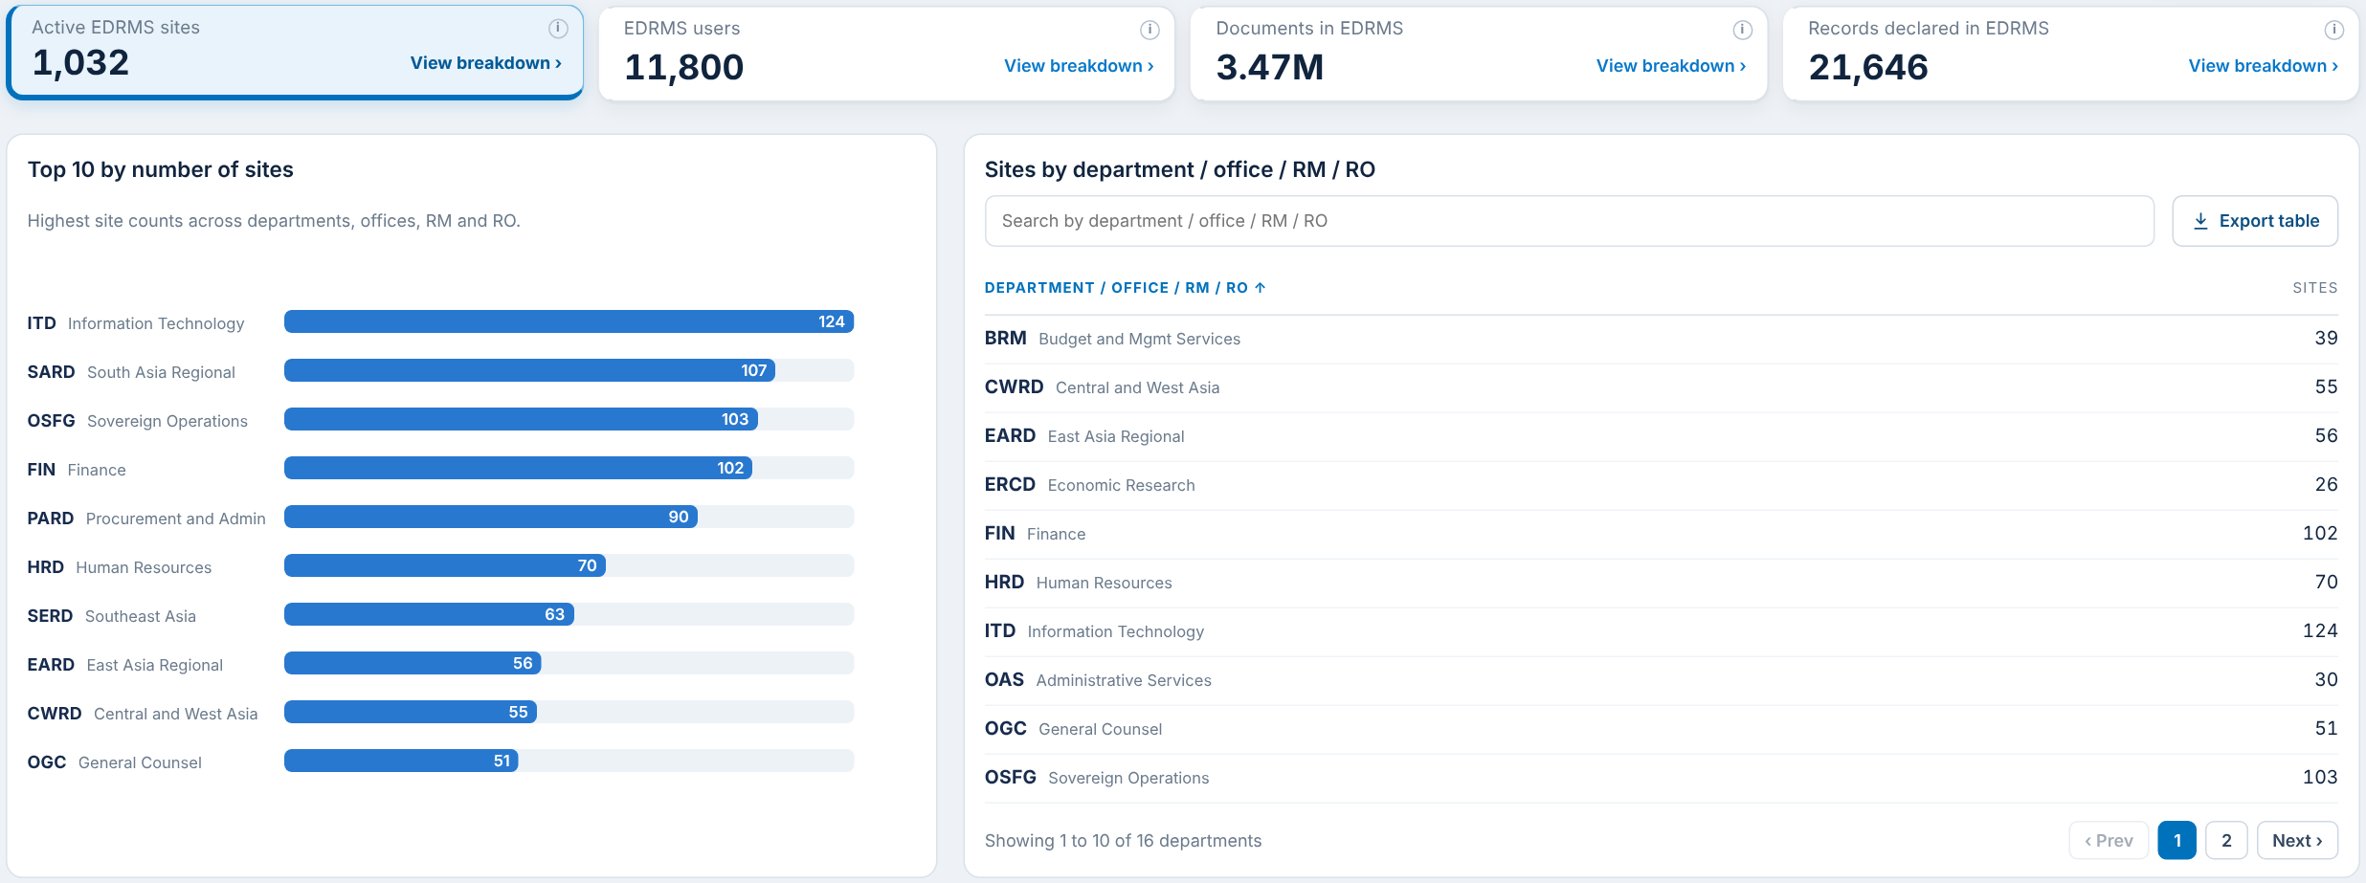
FULL MOCKUP WALKTHROUGH
Bank-wide Oversight and Department Insights, as currently designed
LINK
Open the full mockup
Release 2026.4 mockup (PDF)
Interactive prototype (web)
Every page of both dashboards. The slides that follow focus only on the items that need your confirmation or input.
Figures in the mockup are sample data. They show layout and behaviour, not actual EDRMS usage.

Slide 5
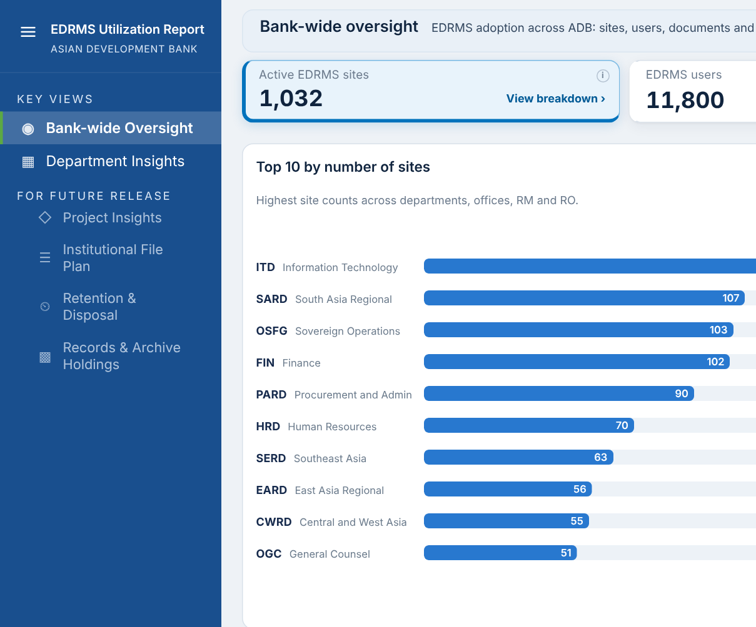
RELEASE 2026.4 SCOPE
Two dashboards are the MVP for this release
In this release
Bank-wide Oversight
Department Insights
Future release
Project Insights, Institutional File Plan, Retention & Disposal, Records & Archive Holdings
TO CONFIRM
For the four future dashboards: keep them visible but disabled (as in the mockup), or hide them completely from the Utilization Report site?

Slide 6
BANK-WIDE OVERSIGHT
Four headline cards and three panels

Slide 7
ACTIVE EDRMS SITES
Card 1 of 4: compliant, active sites with the Top 10 chart and the sites table
Item | What it shows | Status
Active EDRMS sites card | Sites marked EDRMS in Cloud Governance | Agreed
Top 10 by number of sites | Ranked bars, units with the most EDRMS sites | Agreed
Sites by Department / Office / RM / RO | Searchable, paged table from the Cloud Governance Department field | To confirm
TO CONFIRM
Is the Department / Office / RM / RO list the one Sir Rotsen provided earlier?
Or are Offices, RMs and ROs on a separate list? We currently have the department list only.

Slide 8
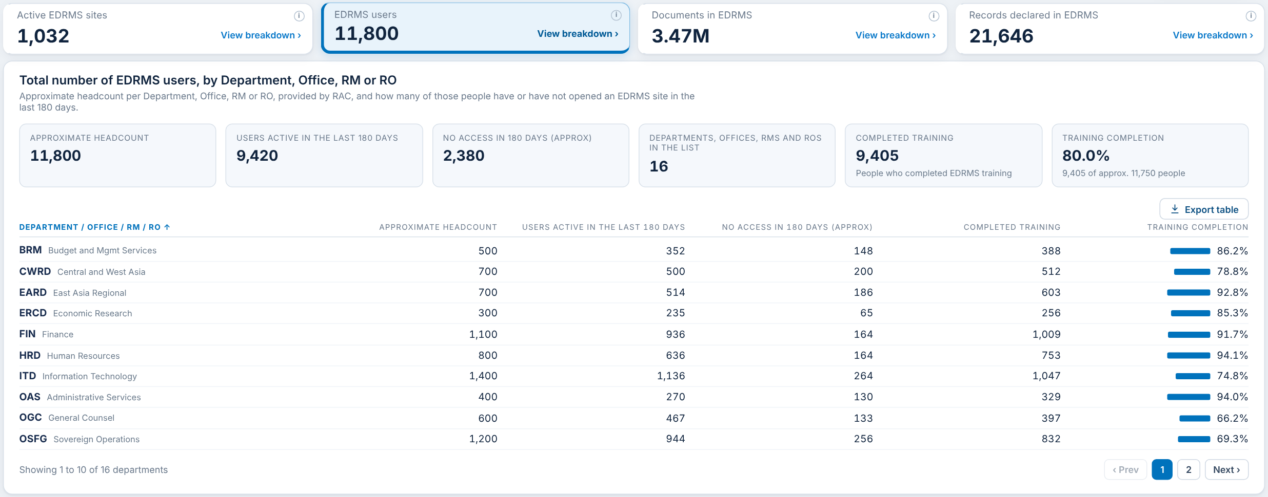
EDRMS USERS
Card 2 of 4: approximate workforce headcount, users active, no access and training
Item | What it shows | Status
EDRMS users | Approximate (rounded) headcount | Input needed
Active in last 180 days | People who opened an EDRMS site (SharePoint activity report; 180 days is the longest window) | Agreed
No access in 180 days | Headcount minus active users | Agreed
Completed training and Training % | Training completion from RAC | Input needed
PLEASE PROVIDE
Approximate workforce headcount per Department / Office / RM / RO
Completed training list per department (manual, as agreed, until a source is identified)

Slide 9
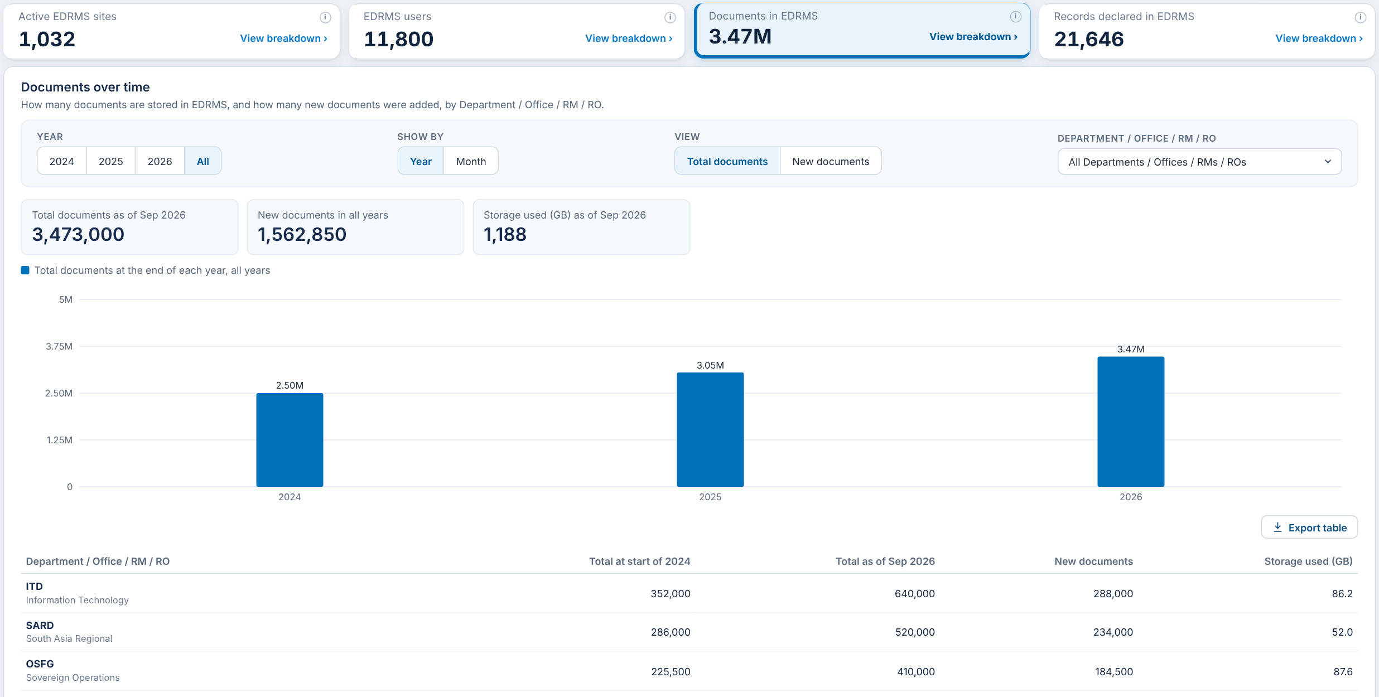
DOCUMENTS IN EDRMS
Card 3 of 4: documents and storage, with the history over time
Item | What it shows | Status
Documents card | Files on EDRMS sites (File Count, SharePoint site usage report) | Agreed
Documents and storage by unit | Documents and storage used (GB) per Department / Office / RM / RO | Agreed
Storage used | Storage Used, also in Cloud Governance per site | Agreed
TO CONFIRM
No open questions. Please confirm the card is complete as shown.

Slide 10
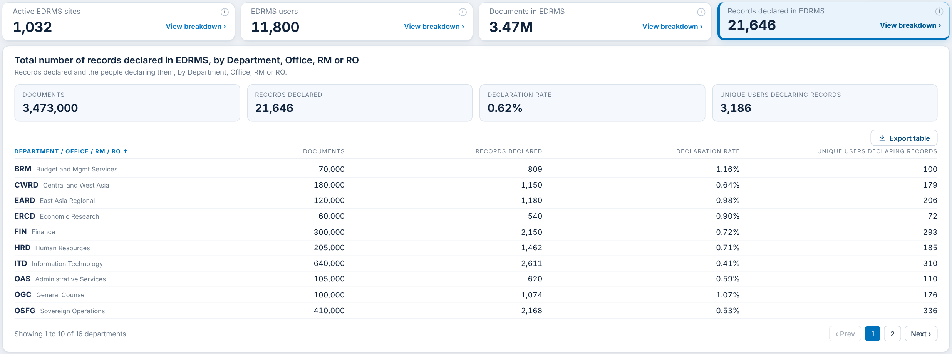
RECORDS DECLARED IN EDRMS
Card 4 of 4: records declared, declaration rate and the people declaring
Item | What it shows | Status
Records declared card | Rows in the EDRMS Records table (drm-npr). Declared records only | Agreed
Declaration rate | Records declared divided by documents | Agreed
Unique users declaring | Distinct people who declared a record | Agreed
Records per department | Records follow their site to a department via the site URL | Agreed
TO CONFIRM
No open questions. Please confirm the card is complete as shown.

Slide 11
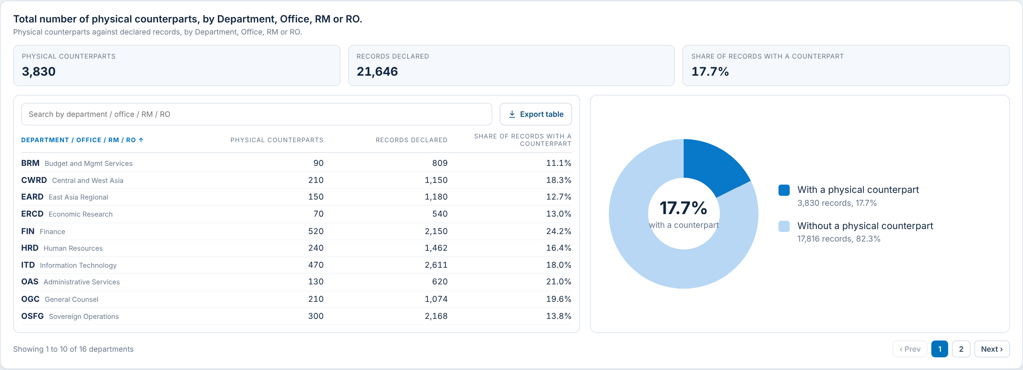
PHYSICAL COUNTERPARTS
Panel: declared records that also exist on paper
Item | What it shows | Status
Physical counterparts | Declared records flagged as also existing on paper | Agreed
Share with a counterpart | Counterparts divided by records declared, with donut chart | Agreed
Counterparts by unit table | Counterparts, records and share per Department / Office / RM / RO | Agreed
TO CONFIRM
No open questions. Please confirm the panel is complete as shown.

Slide 12
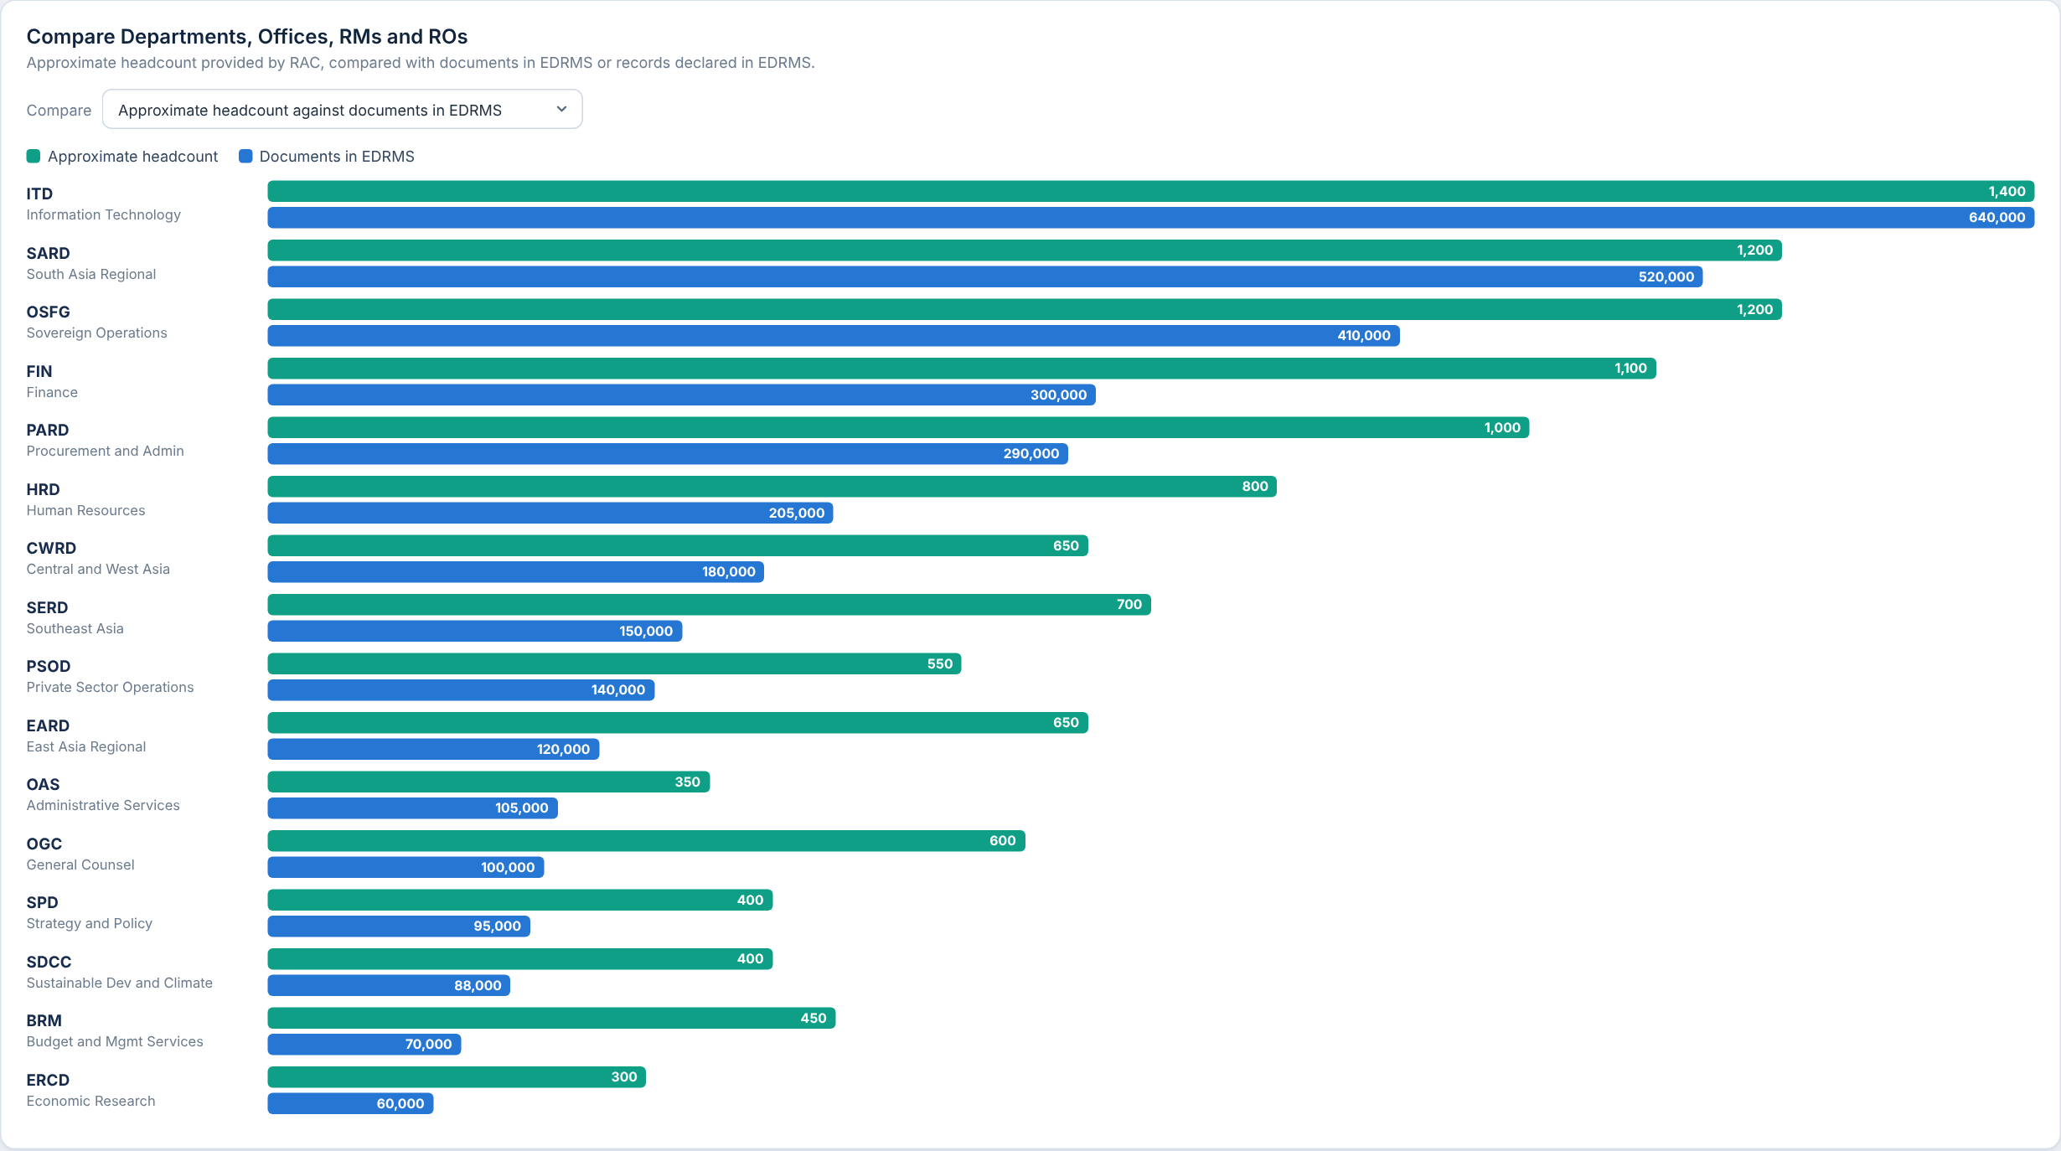
COMPARISON
Panel: approximate headcount against documents or records
Item | What it shows | Status
Headcount against documents | Paired bars per unit, each measure on its own scale | Input needed
Headcount against records | Same view, with records declared | Input needed
Headcount values | The green bars | Input needed
PLEASE PROVIDE
Approximate workforce headcount per Department / Office / RM / RO (the same list as EDRMS Users)

Slide 13
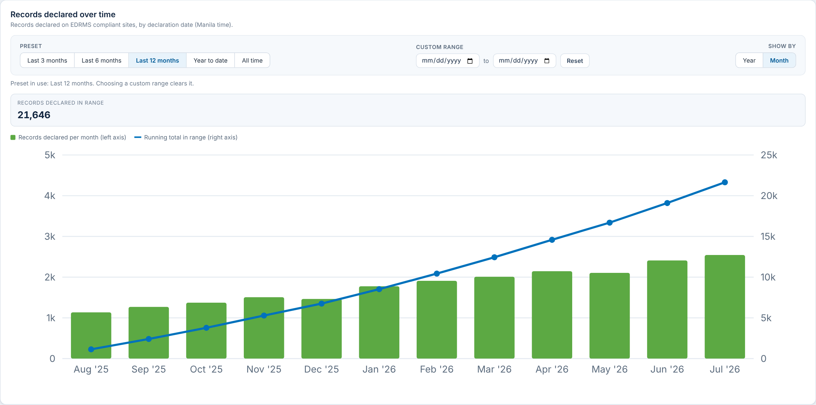
RECORDS DECLARATION TREND
Panel: records declared per month and the running total
Item | What it shows | Status
Presets and custom range | Last 3, 6, 12 months, year to date, all time, or a date range | Agreed
Per month bars and running total | By declaration date, Manila time, from the Records table | Agreed
Records declared in range | Total for the chosen range | Agreed
TO CONFIRM
No open questions. Please confirm the panel is complete as shown.

Slide 14
DEPARTMENT INSIGHTS
Department profile, five cards and library usage

Slide 15
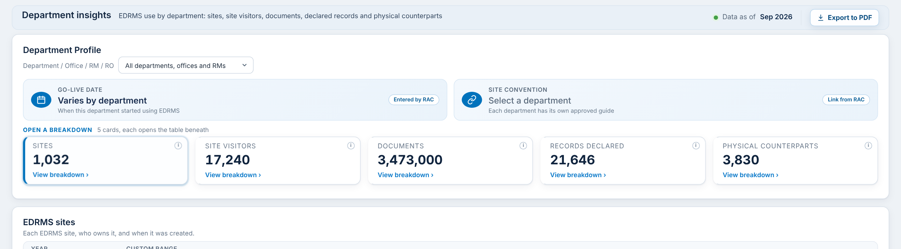
DEPARTMENT PROFILE
Department picker, Go-Live date and site convention
Item | What it shows | Status
Department picker | Filters the whole dashboard by Department / Office / RM / RO | Agreed
Go-Live date | When the department started using EDRMS. Entered by RAC | Input needed
Site convention | Link to each department’s approved site guide | Input needed
PLEASE PROVIDE
Go-Live date for each department
Site convention link for each department

Slide 16
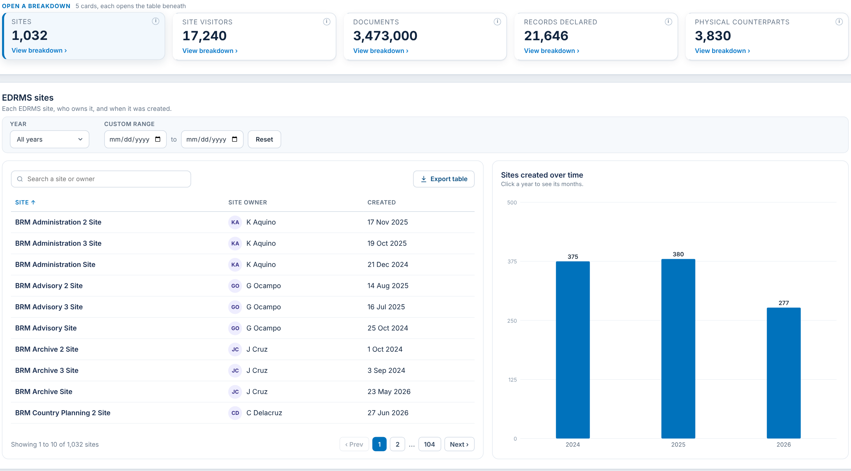
SITES
Card 1 of 5: EDRMS sites, owners and creation dates
Item | What it shows | Status
Sites card | EDRMS sites for the chosen department | Agreed
Site, owner, created | Cloud Governance: Primary Business Owner and Created Time | Agreed
Sites created over time | Sites per year; click a year for its months | Agreed
Year and custom range filter | Narrows the table and chart by creation date | Agreed
TO CONFIRM
No open questions. Please confirm the card is complete as shown.

Slide 17
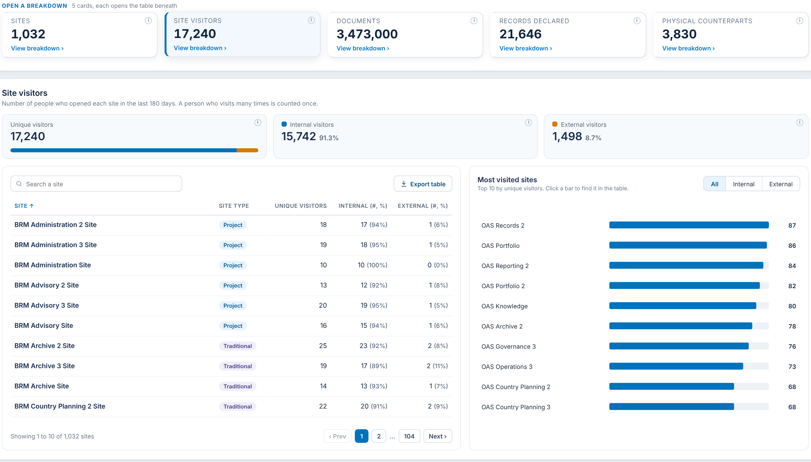
SITE VISITORS
Card 2 of 5: unique people who opened each site in the last 180 days
Item | What it shows | Status
Site visitors card | Unique people | Agreed
Internal and external split | ADB accounts against guests. Shown with sample figures; no source proven yet | To confirm
Site type column | Project or Traditional site | To confirm
Most visited sites | Top 10 by unique visitors: all, internal or external | Agreed
TO CONFIRM
Internal / external split: may the Microsoft 365 audit logs be used as the source?
Site type: confirm it is taken from Cloud Governance

Slide 18
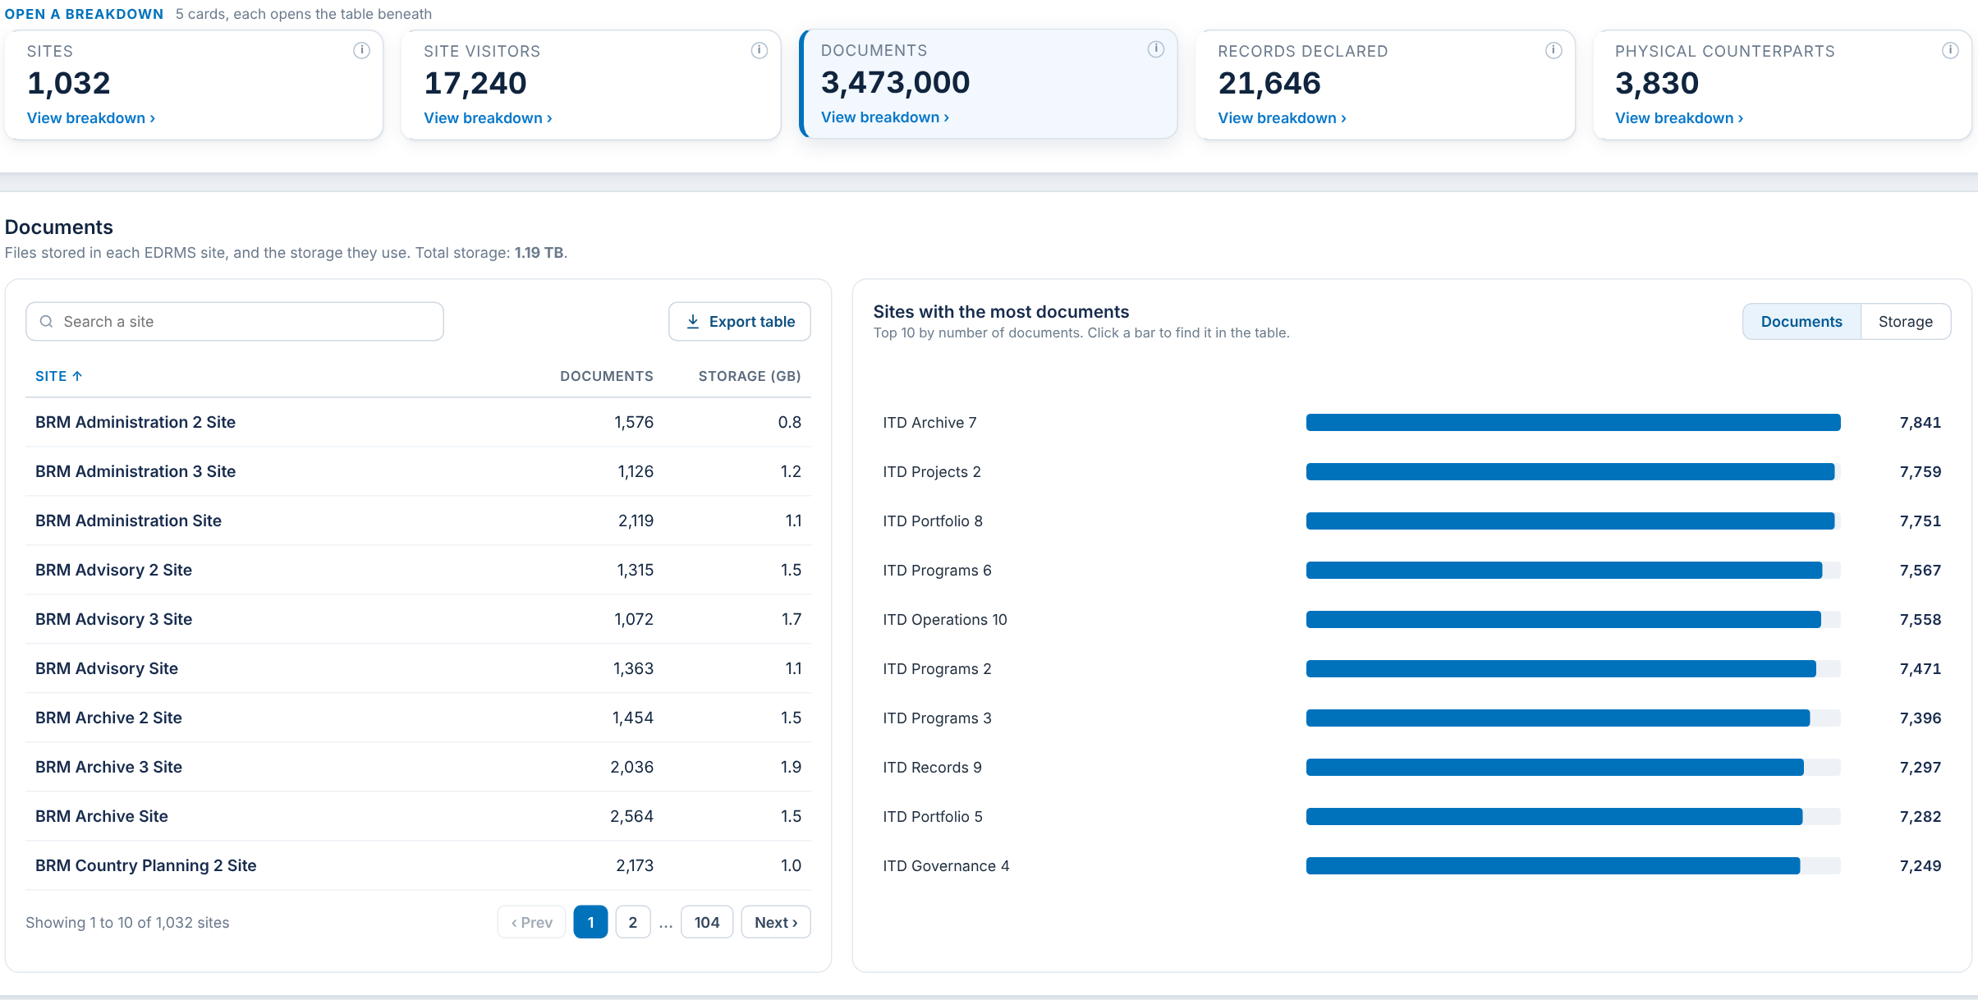
DOCUMENTS
Card 3 of 5: files and storage per site
Item | What it shows | Status
Documents card | Files stored in EDRMS for the department | Agreed
Documents and storage per site | File Count and storage for each EDRMS site | Agreed
TO CONFIRM
No open questions. Please confirm the card is complete as shown.

Slide 19
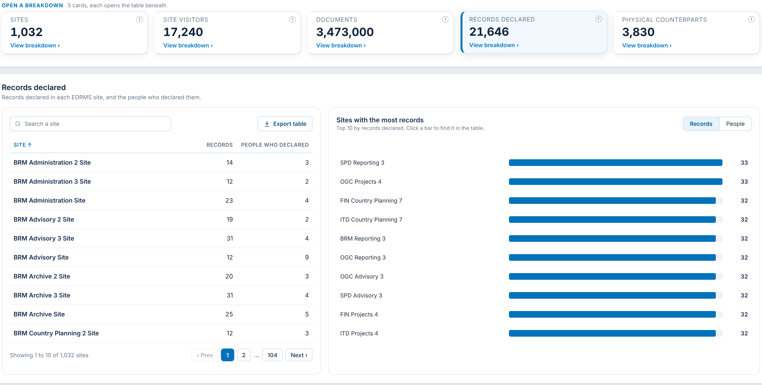
RECORDS DECLARED
Card 4 of 5: records and the people who declared them, per site
Item | What it shows | Status
Records declared card | Records table, for the department | Agreed
Records and people per site | Records declared and distinct people declaring, per site | Agreed
TO CONFIRM
No open questions. Please confirm the card is complete as shown.

Slide 20
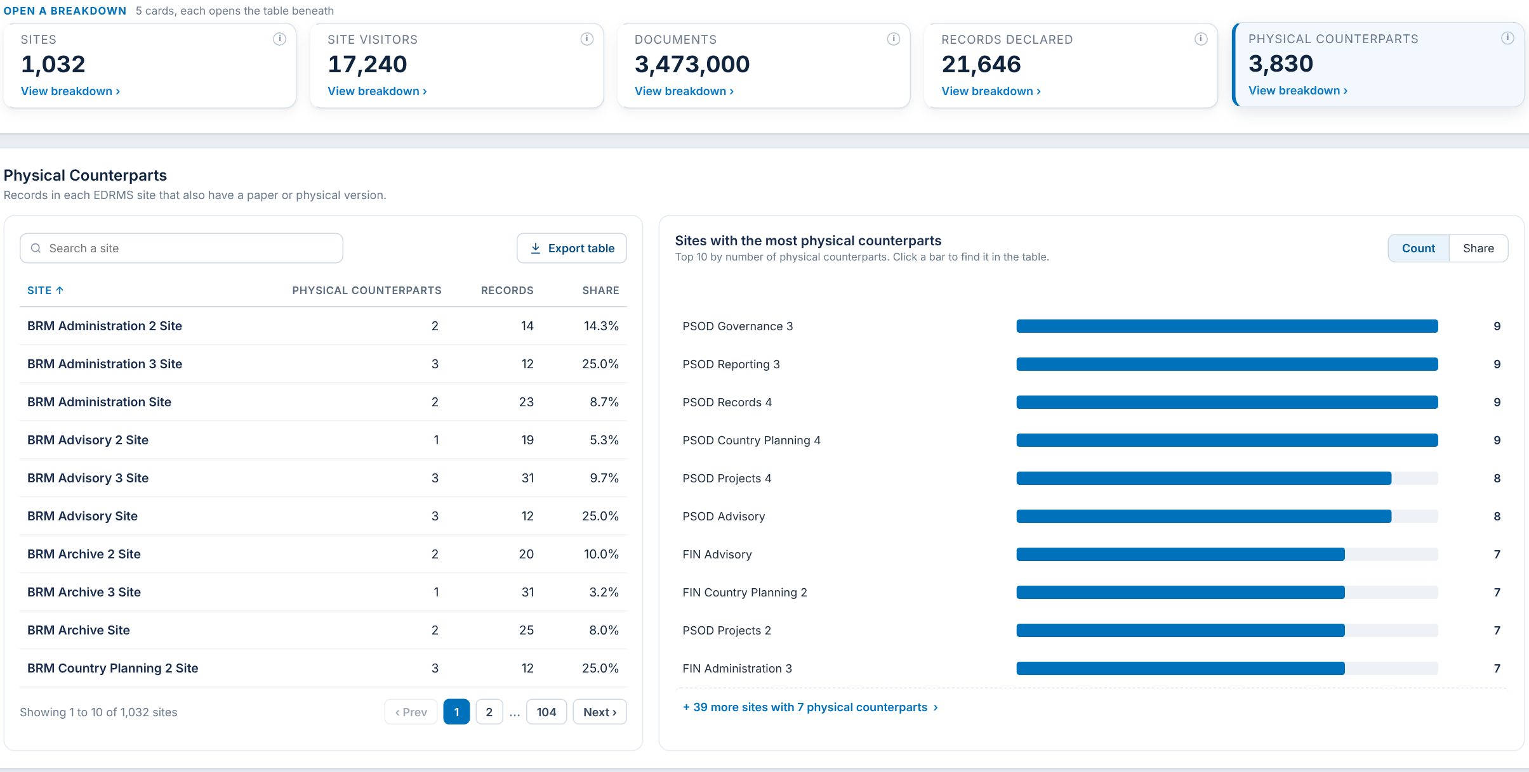
PHYSICAL COUNTERPARTS
Card 5 of 5: records that also have a paper version, per site
Item | What it shows | Status
Physical counterparts card | Records with a paper or physical version | Agreed
Counterparts, records and share per site | Per-site table with share | Agreed
TO CONFIRM
No open questions. Please confirm the card is complete as shown.

Slide 21
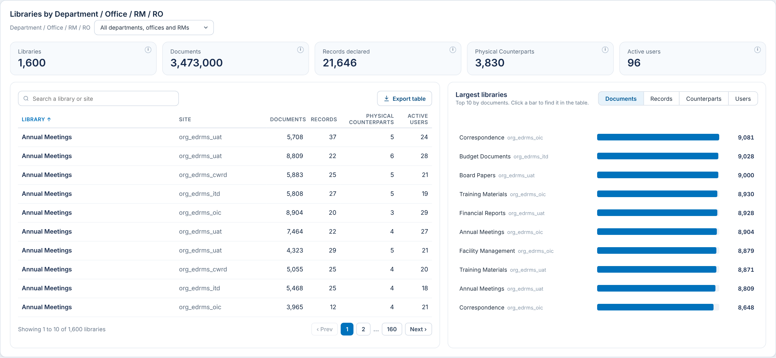
LIBRARY USAGE
Panel: document libraries by Department / Office / RM / RO
Item | What it shows | Status
Libraries | Document libraries in EDRMS sites | Agreed
Documents, records, counterparts per library | Per-library table and Largest libraries chart | Agreed
Active users per library | People who opened or edited files in the library | To confirm
TO CONFIRM
Microsoft 365 reports activity per site, never per library. Drop Active users per library, or show it as "Not captured"?

Slide 22
SUMMARY OF INPUTS NEEDED
What we are asking RAC to provide or decide
# | Item | Used in | Type | Owner / target date
1 | Approximate workforce headcount per Department / Office / RM / RO | EDRMS Users, Comparison | Provide | RAC / ____
2 | Completed training list per department (manual for now) | EDRMS Users | Provide | RAC / ____
3 | Go-Live date per department | Department Profile | Provide | RAC / ____
4 | Site convention link per department | Department Profile | Provide | RAC / ____
5 | Department / Office / RM / RO list: Sir Rotsen’s list or separate lists? | Active EDRMS Sites | Decide | RAC / ____
6 | Future dashboards: disabled or hidden? | Release scope | Decide | RAC / ____
7 | Internal / external visitors: may audit logs be used? | Site Visitors | Decide | RAC / ____
8 | Site type: confirm Cloud Governance as the source | Site Visitors | Decide | RAC / ____
9 | Active users per library: drop or mark "Not captured"? | Library Usage | Decide | RAC / ____

Slide 23
Q & A

Slide 24
REFERENCE LINKS
1. Release 2026.4 mockup (PDF)
2. Interactive prototype (web)

