Slide 1
EDRMS Utilization Report
Release 2026.4
Reconfirmation of Requirements | October 2026

Slide 2
AGENDA
1. Session Objective
2. Full Mockup (for reference)
3. Release 2026.4 Scope
4. Bank-wide Oversight: Items to Confirm
5. Department Insights: Items to Confirm
6. Export Options
7. Summary of Inputs Needed

Slide 3
SESSION OBJECTIVE
Reconfirm the requirements for Release 2026.4 – Utilization Report
REVIEW
CONFIRM
PROVIDE
1
See the full mockup of Bank-wide Oversight and Department Insights, and say if anything should change.
2
Go item by item: confirm what is agreed and settle the open questions.
3
Agree who provides the remaining lists and links, and by when.
How each item is marked in this deck
Agreed
Settled earlier. Confirm it still stands.
To confirm
A decision is needed in this session.
Input needed
A list, link or figure is needed from RAC.

Slide 4
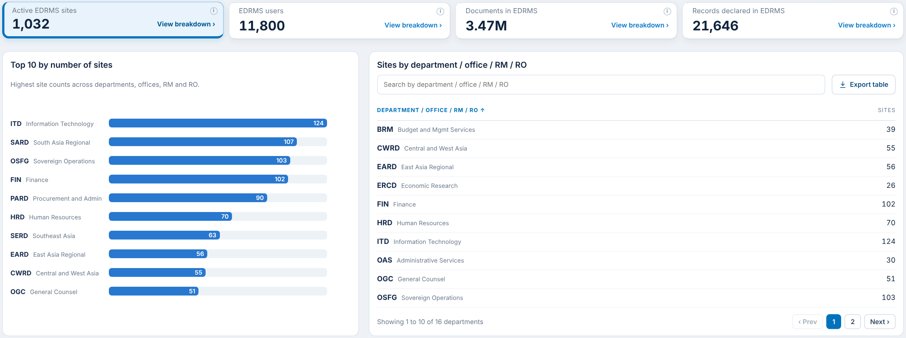
FULL MOCKUP
Shared for reference: the complete picture of what will be built
OPEN THE FILE
Release 2026.4 mockup (PDF)
Every page of Bank-wide Oversight and Department Insights, so you can see the full report.
Names and labels have been revised and shortened, as agreed in our last discussion.
All figures are sample data. They show layout, not actual EDRMS usage.
TO CONFIRM
Are you okay with the mockup design?
Is there anything you wish to change, or remove as not needed?

Slide 5
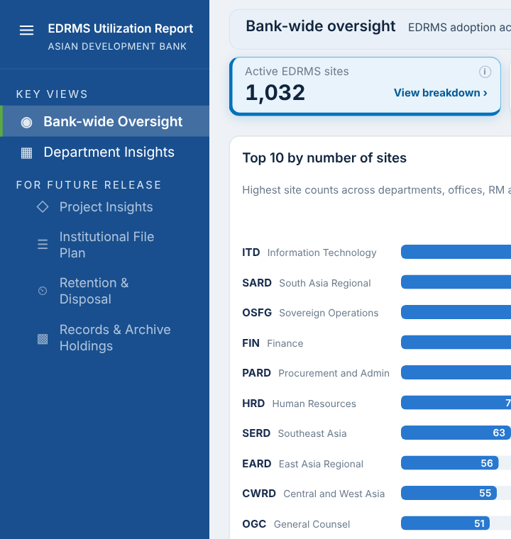
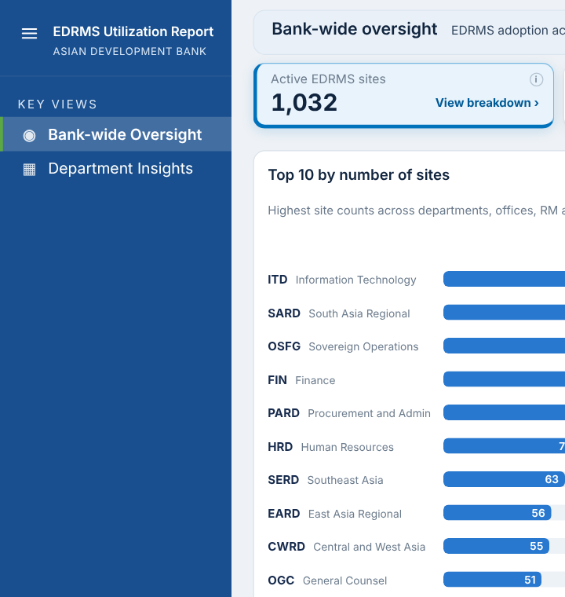
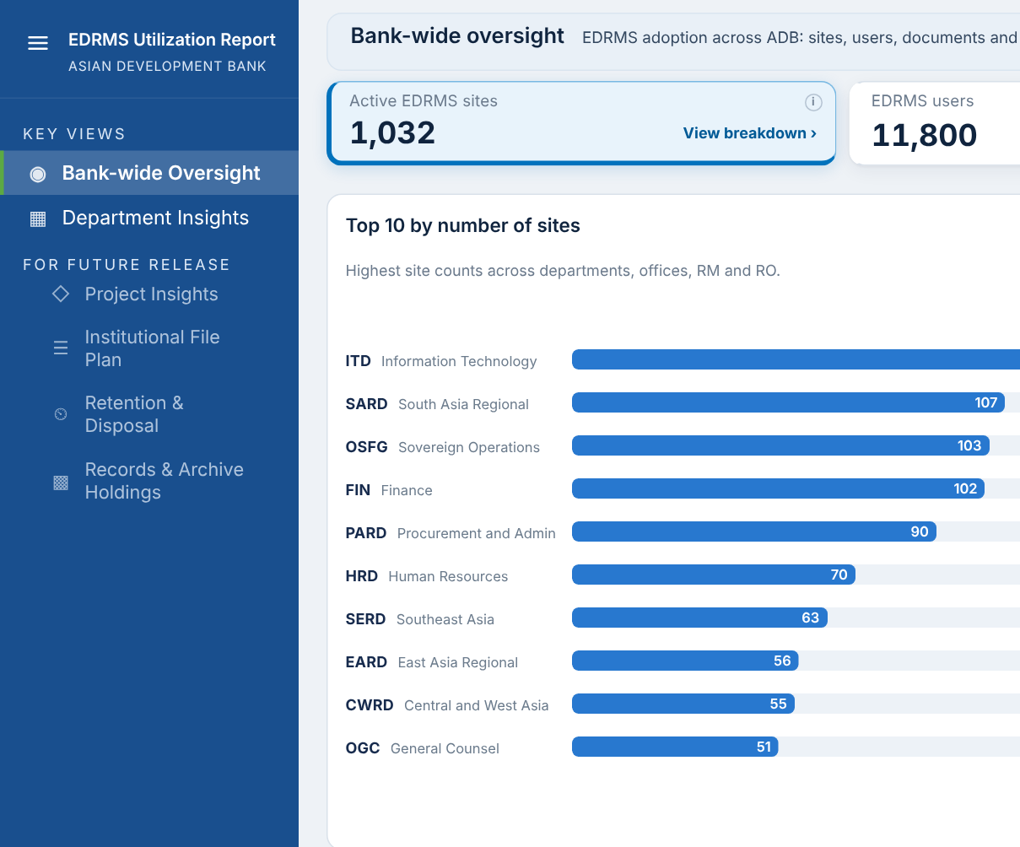
RELEASE 2026.4 SCOPE
Two dashboards are the MVP for this release
Option A: Disabled
As in the mockup. Future dashboards are listed, greyed out, and cannot be opened.
Option B: Hidden
Only the two live dashboards are shown. Future ones appear when released.
In this release
Bank-wide Oversight
Department Insights
Future release
Project Insights, Institutional File Plan, Retention & Disposal, Records & Archive Holdings
TO CONFIRM
For the four future dashboards: Option A, keep them visible but disabled (as in the mockup), or Option B, hide them completely from the Utilization Report site?

Slide 6
BANK-WIDE OVERSIGHT
Four headline cards and three panels

Slide 7
ACTIVE EDRMS SITES
Card 1 of 4: compliant, active sites with the Top 10 chart and the sites table
Item | What it shows | Status
Active EDRMS sites card | Sites marked EDRMS in Cloud Governance | Agreed
Top 10 by number of sites | Ranked bars, units with the most EDRMS sites | Agreed
Sites by Department / Office / RM / RO | Searchable, paged table from the Cloud Governance Department field | To confirm
TO CONFIRM
RAC requested the label “Department / Office / RM / RO.” We received a file already from sir Rotsen for all the list of the departments.
Can you confirm that “Department / Office / RM / RO” is only a label, and there is no separate list for Offices, RMs and ROs?

Slide 8
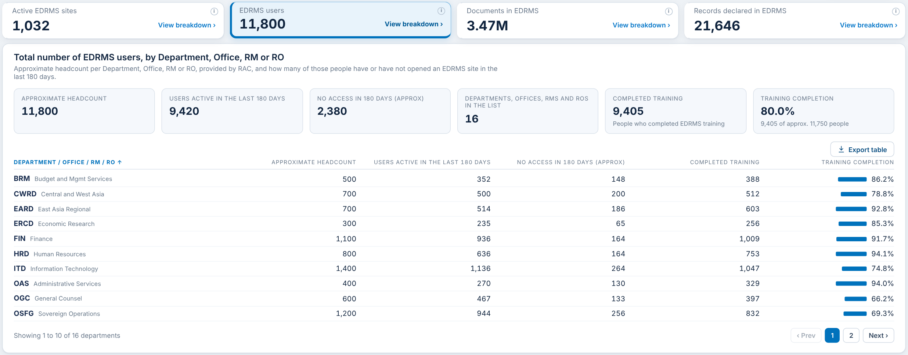
EDRMS USERS
Card 2 of 4: approximate workforce headcount, users active, no access and training
Item | What it shows | Status
EDRMS users | Approximate (rounded) headcount | Input needed
Active in last 180 days | EDRMS Users Active in last 180 days sourced from Purview Audit log | Agreed
No access in 180 days (Approx) | Headcount minus active users | Agreed
Completed training and Training % | Training completion from RAC | Input needed
PLEASE PROVIDE
Approximate workforce headcount per Department / Office / RM / RO
Completed training list per department (manual, as agreed, until a source is identified)

Slide 9
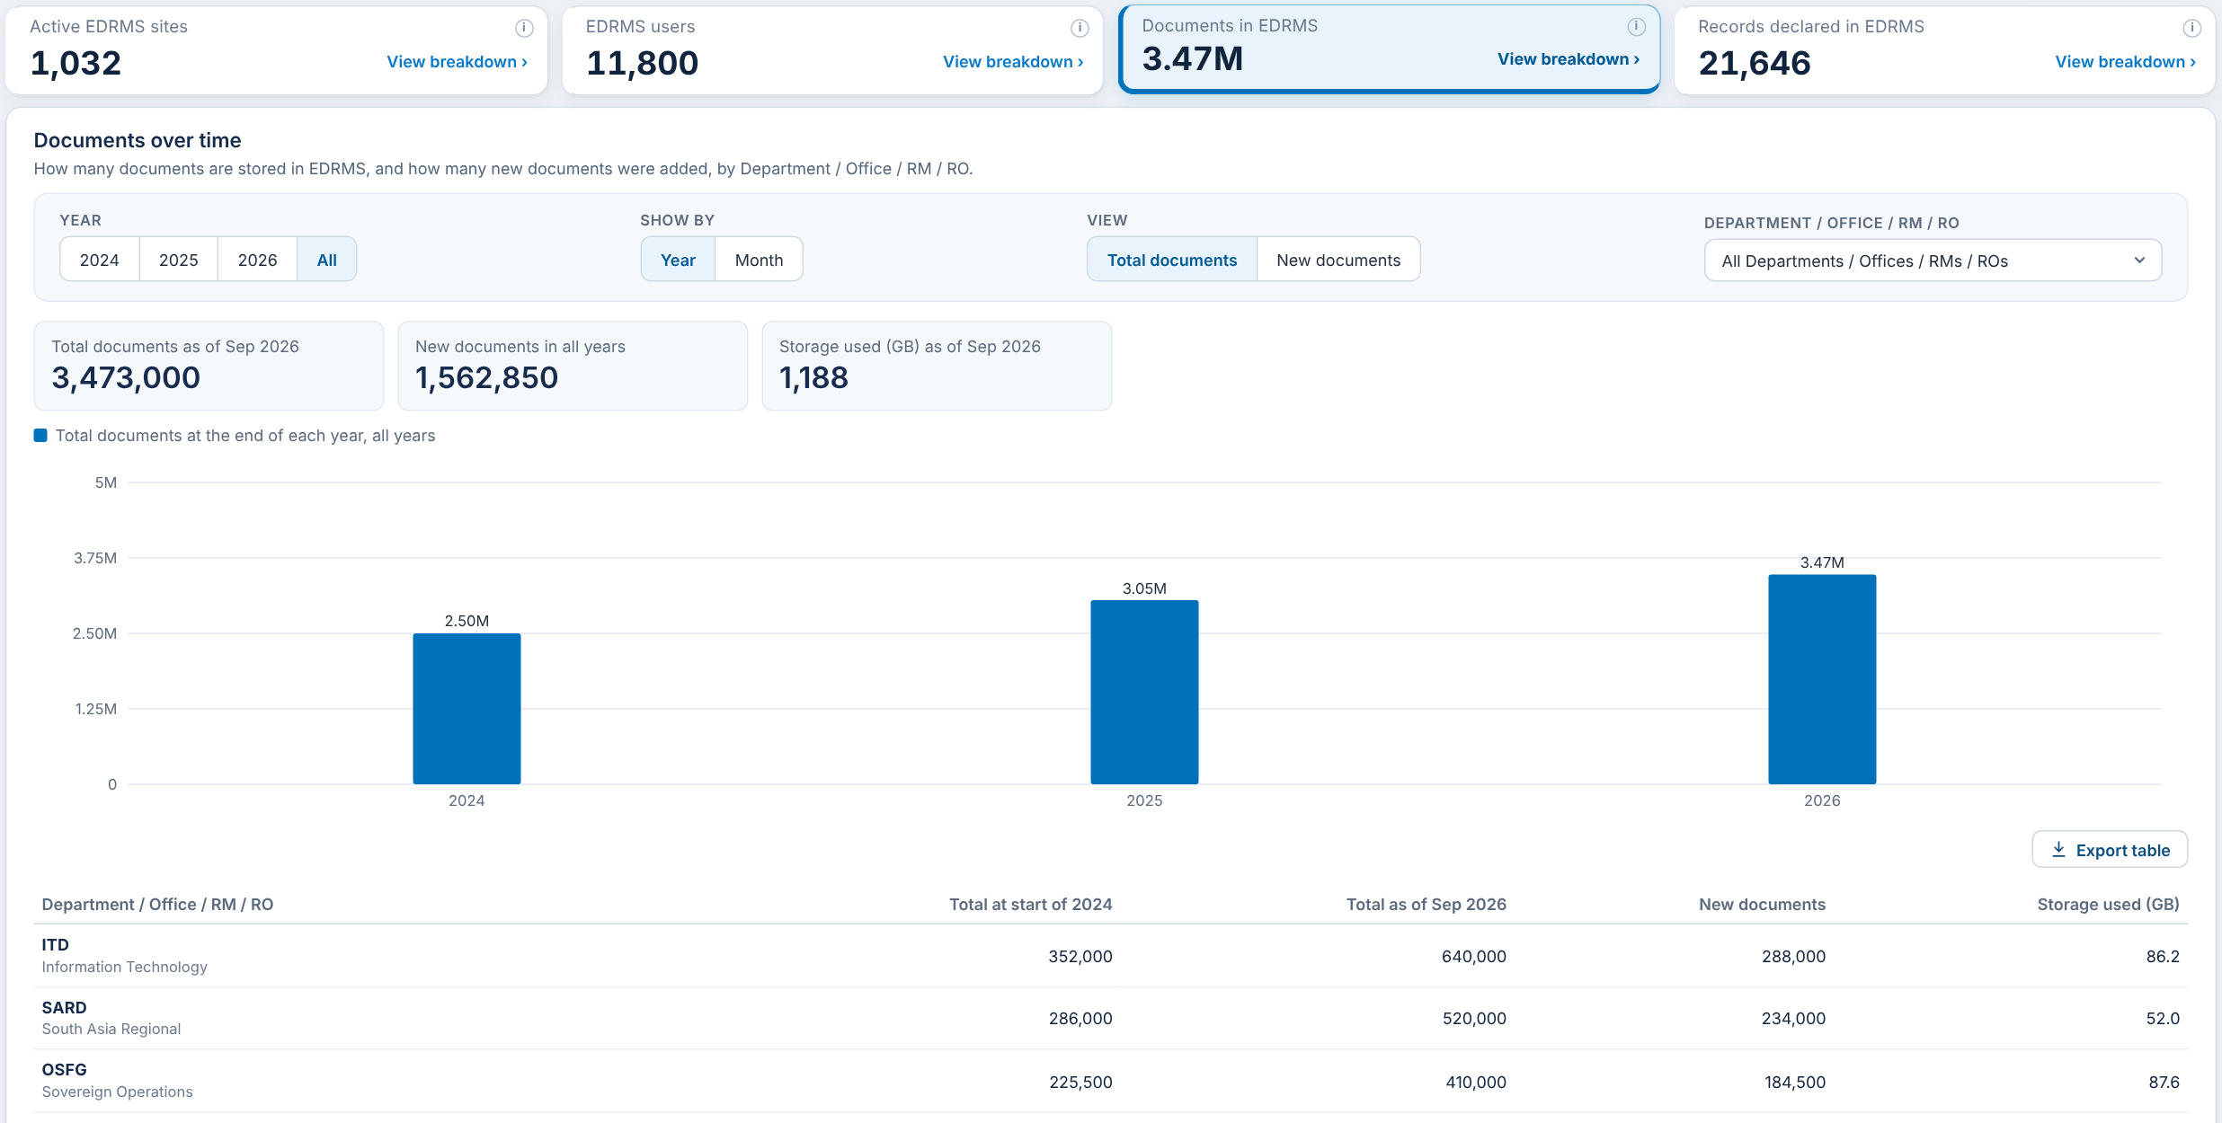
DOCUMENTS IN EDRMS
Card 3 of 4: documents and storage, with the history over time
Item | What it shows | Status
Documents card | Files on EDRMS sites (File Count, SharePoint site usage report) | Agreed
Documents and storage by unit | Documents and storage used (GB) per Department / Office / RM / RO | Agreed
Storage used | Storage Used, also in Cloud Governance per site | Agreed

Slide 10
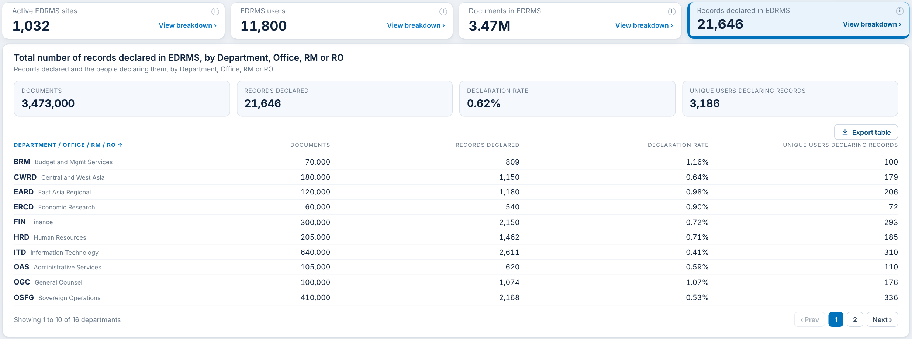
RECORDS DECLARED IN EDRMS
Card 4 of 4: records declared, declaration rate and the people declaring
Item | What it shows | Status
Records declared card | Rows in the EDRMS Records table (drm-npr). Declared records only | Agreed
Declaration rate | Records declared divided by documents | Agreed
Unique users declaring | Distinct people who declared a record | Agreed
Records per department | Records follow their site to a department via the site URL | Agreed

Slide 11
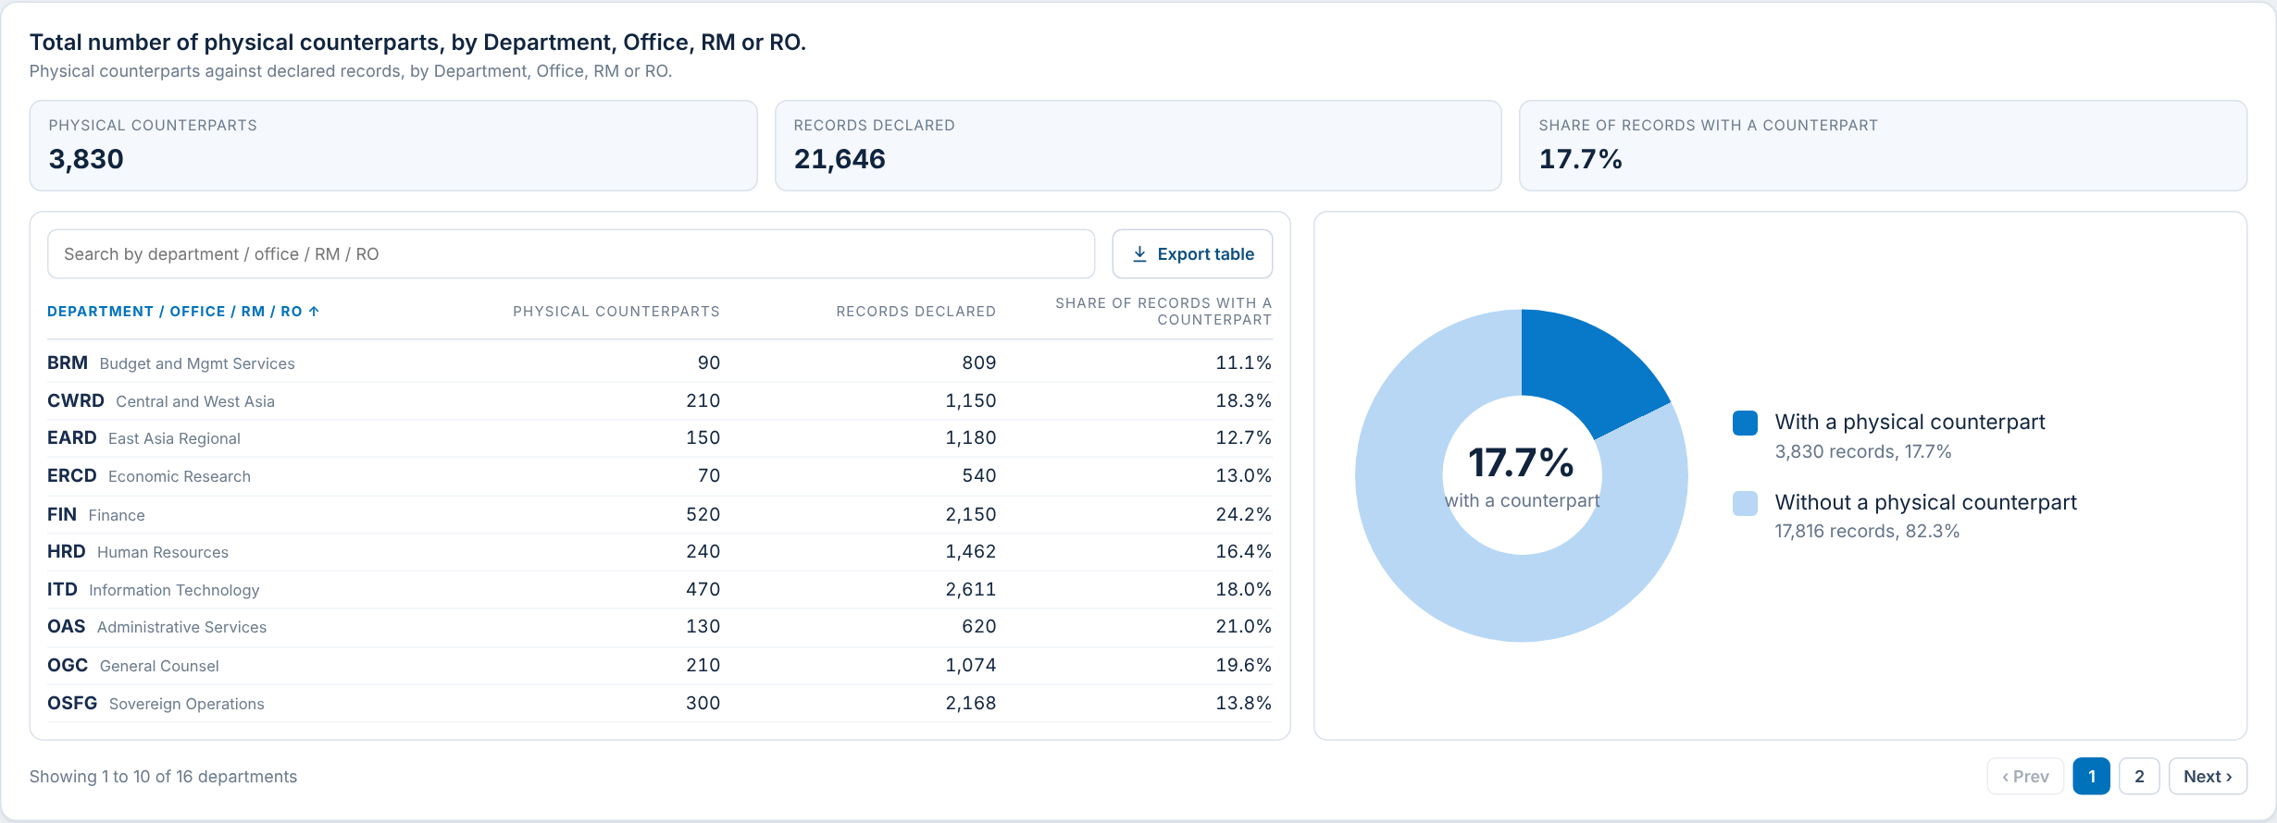
PHYSICAL COUNTERPARTS
Panel: declared records that also exist on paper
Item | What it shows | Status
Physical counterparts | Declared records flagged as also existing on paper | Agreed
Share with a counterpart | Counterparts divided by records declared, with donut chart | Agreed
Counterparts by department table | Counterparts, records and share per Department / Office / RM / RO | Agreed

Slide 12
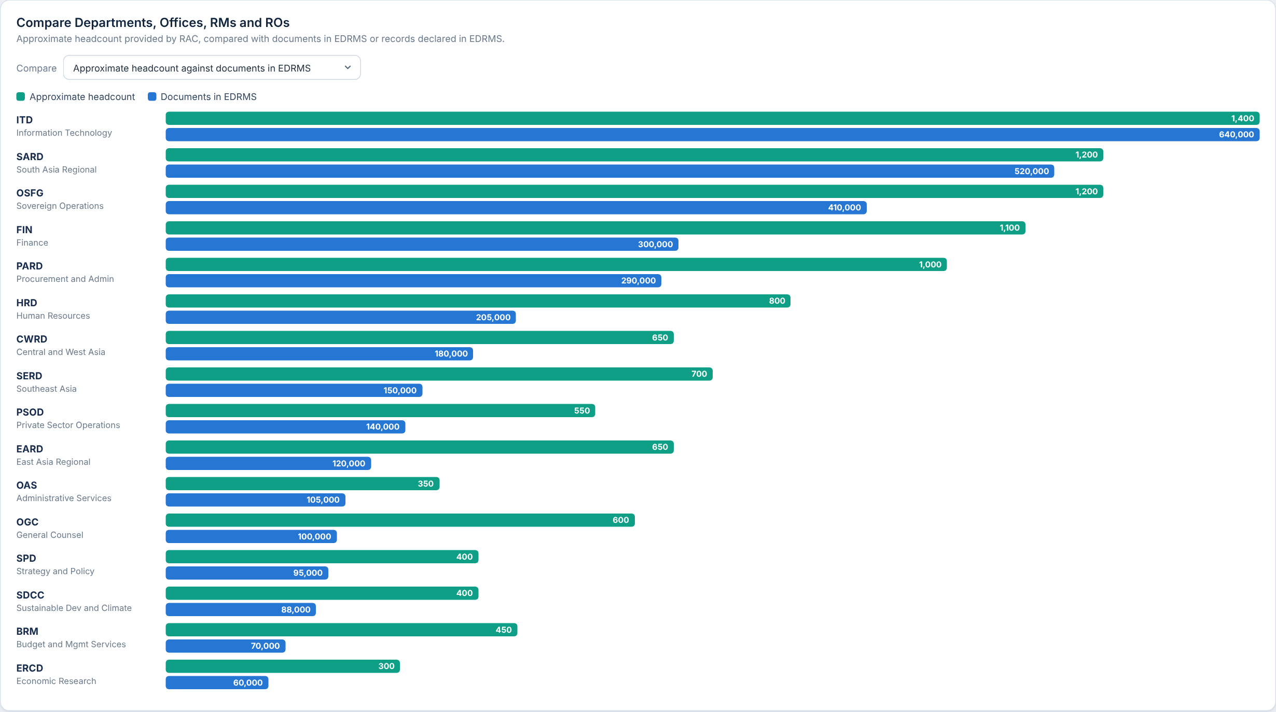
COMPARISON
Panel: approximate headcount against documents or records
Item | What it shows | Status
Headcount against documents | Paired bars per unit, each measure on its own scale | Input needed
Headcount against records | Same view, with records declared | Input needed
Headcount values | The green bars | Input needed
PLEASE PROVIDE
Approximate workforce headcount per Department / Office / RM / RO (the same list as EDRMS Users)

Slide 13
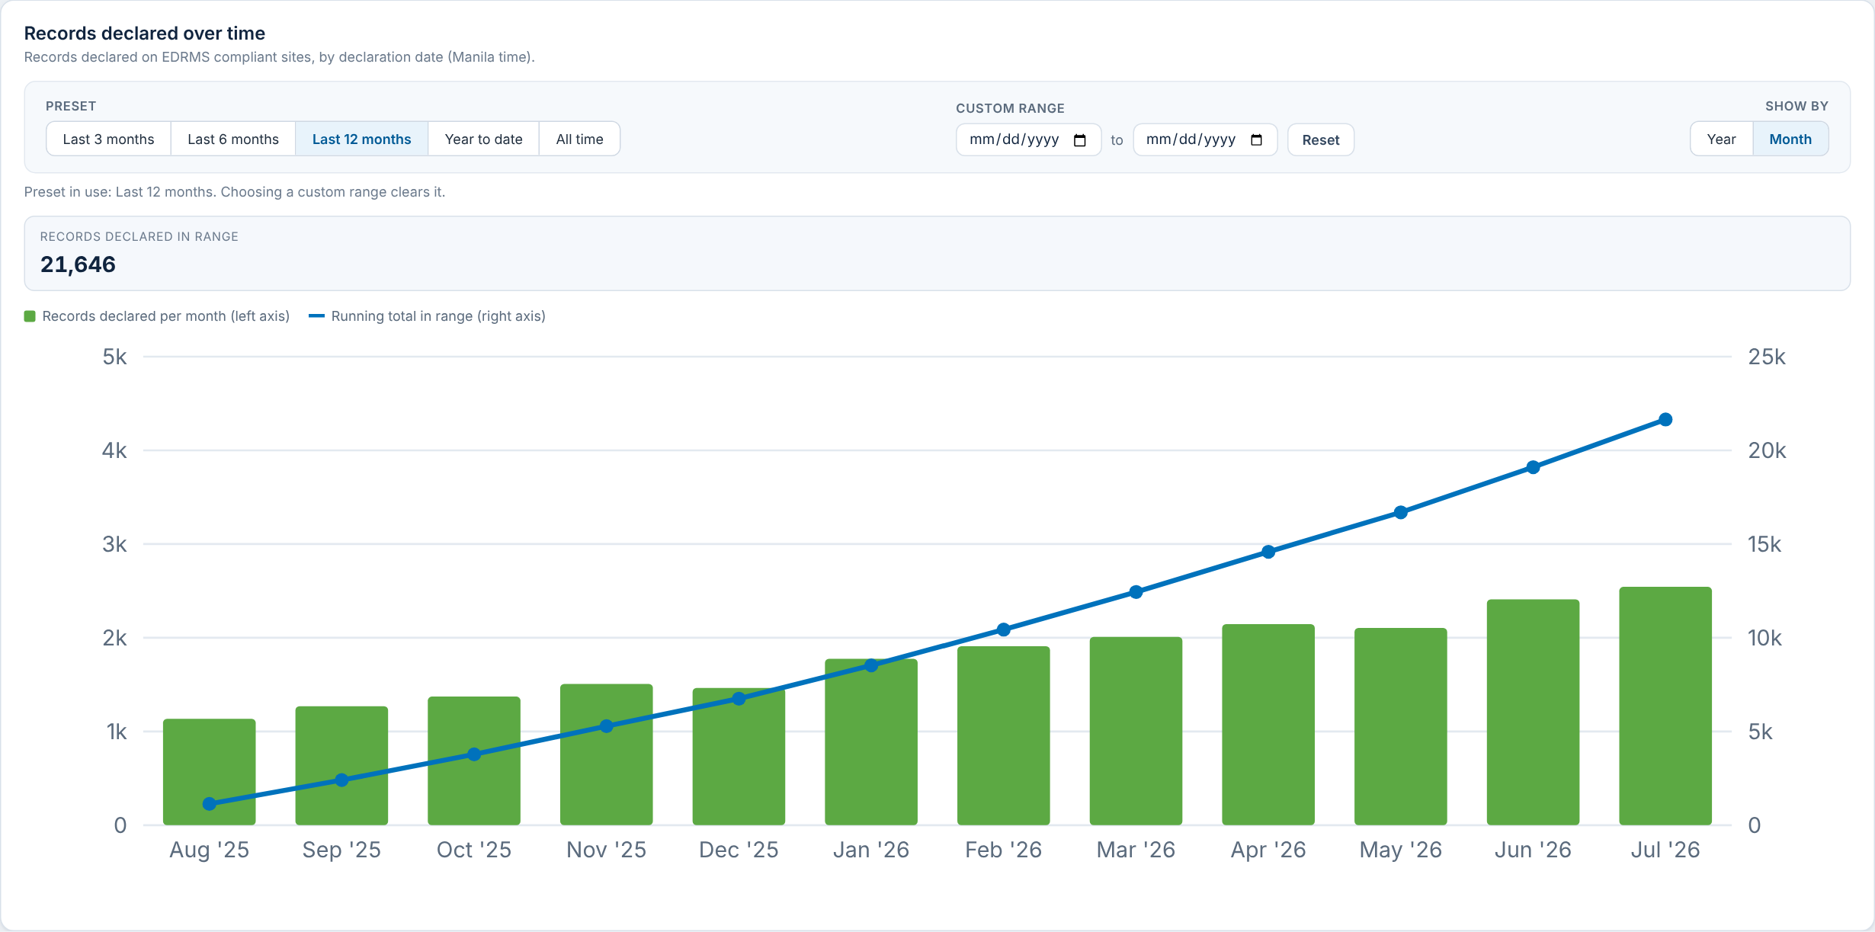
RECORDS DECLARATION TREND
Panel: records declared per month and the running total
Item | What it shows | Status
Presets and custom range | Last 3, 6, 12 months, year to date, all time, or a date range | Agreed
Per month bars and running total | By declaration date, Manila time, from the Records table | Agreed
Records declared in range | Total for the chosen range | Agreed

Slide 14
DEPARTMENT INSIGHTS
Department profile, five cards and library usage

Slide 15
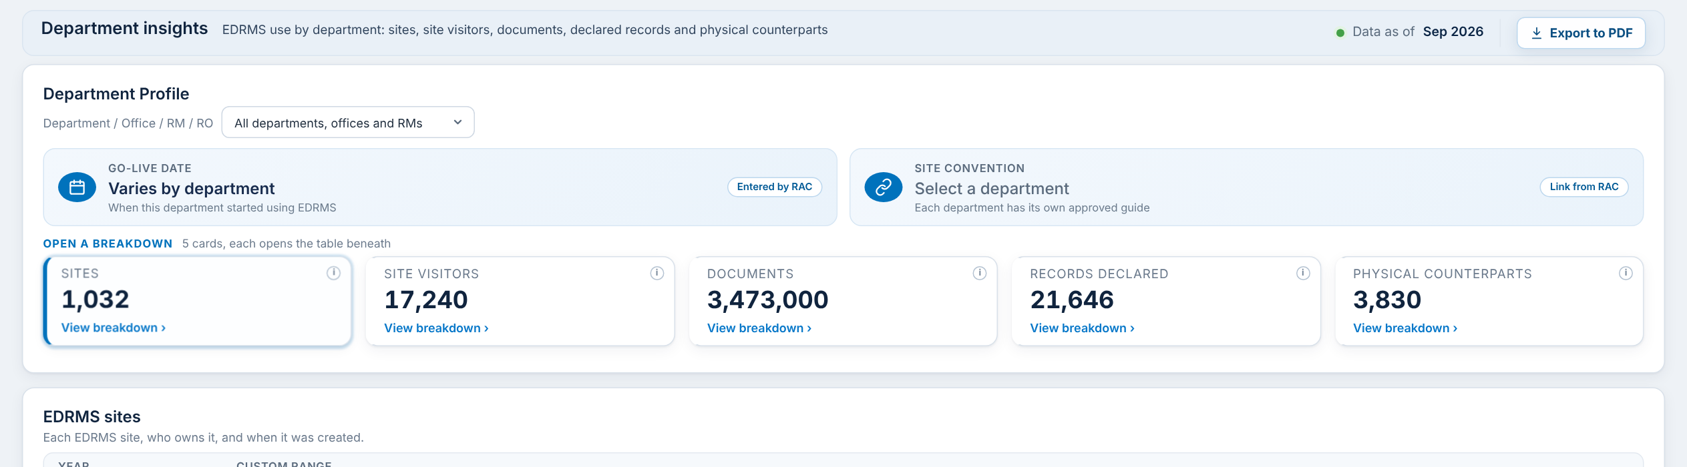
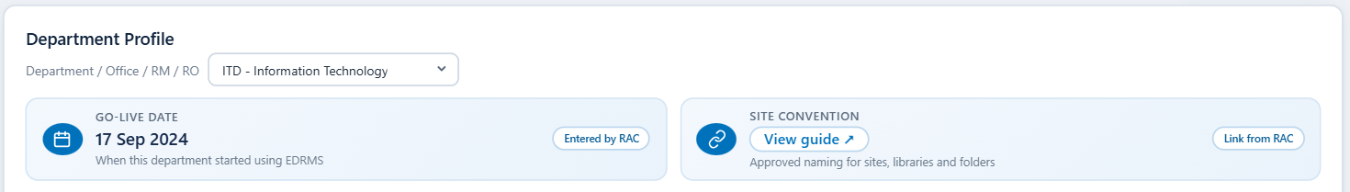
DEPARTMENT PROFILE
Department picker, Go-Live date and site convention
Item | What it shows | Status
Department picker | Filters the whole dashboard by Department / Office / RM / RO | Agreed
Go-Live date | When the department started using EDRMS. Entered by RAC | Input needed
Site convention | Link to each department’s approved site guide | Input needed
Site filter | Under the department picker; lists only sites in the chosen departments | To confirm
PLEASE PROVIDE
Go-Live date for each department
Site convention link for each department

Slide 16
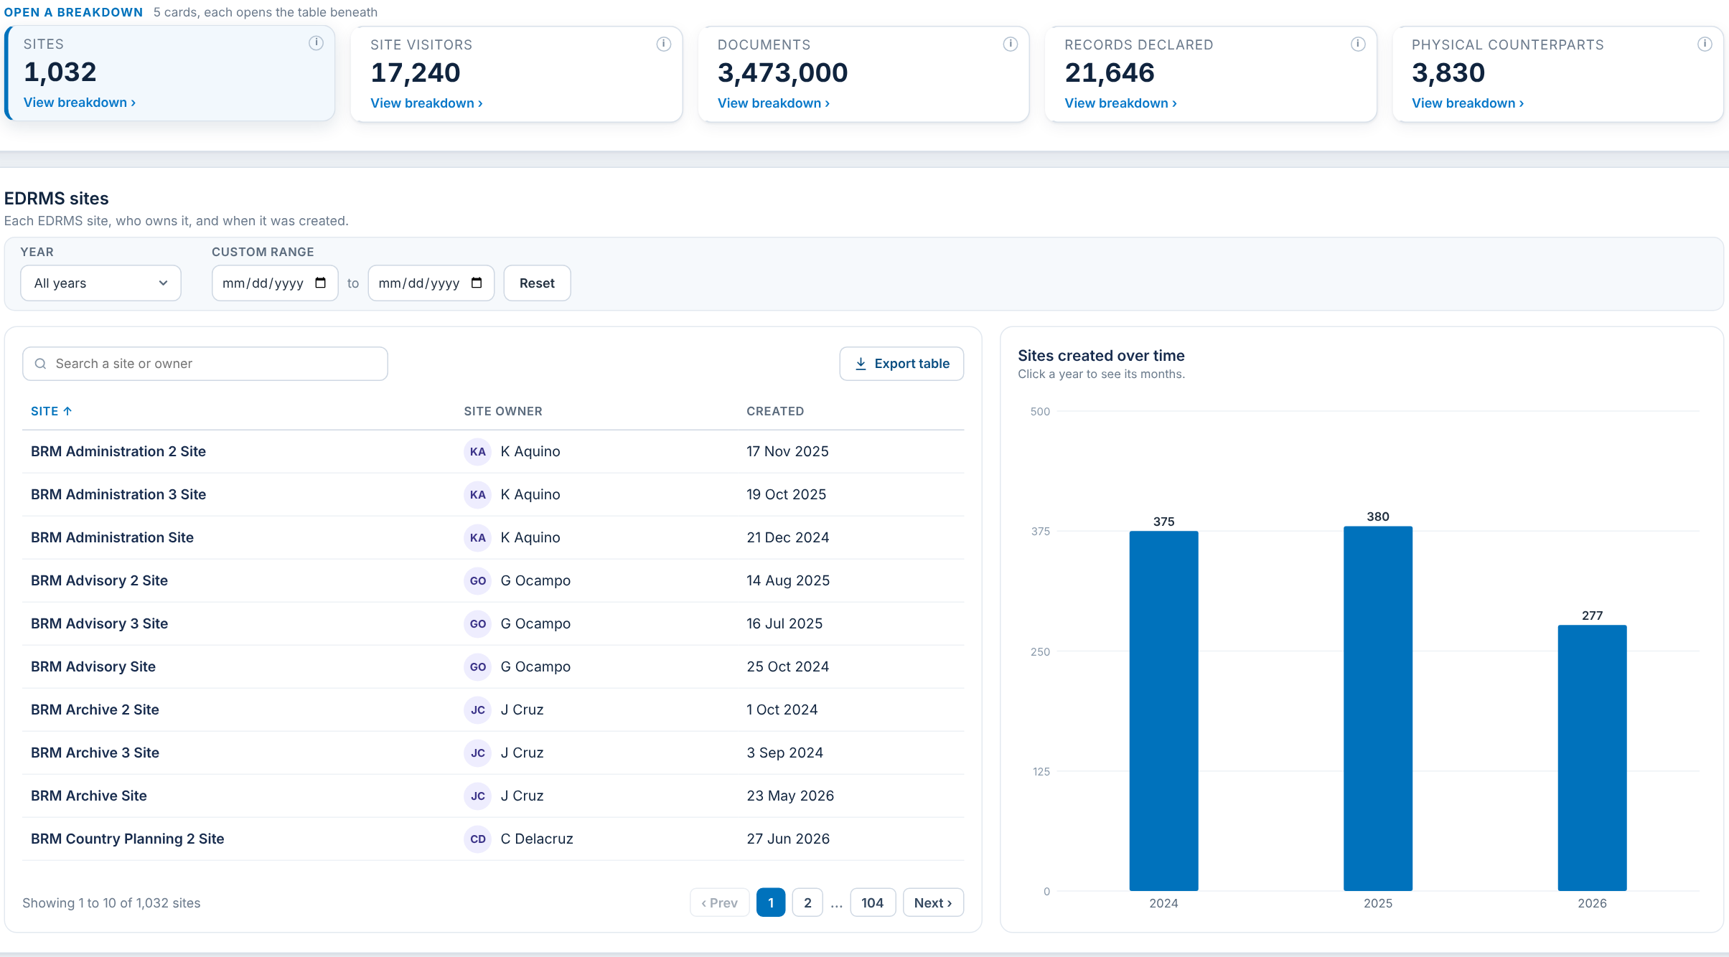
SITES
Card 1 of 5: EDRMS sites, owners and creation dates
Item | What it shows | Status
Sites card | EDRMS sites for the chosen department | Agreed
Site, owner, created | Cloud Governance: Primary Business Owner and Created Time | Agreed
Sites created over time | Sites per year; click a year for its months | Agreed
Year and custom range filter | Narrows the table and chart by creation date | Agreed

Slide 17
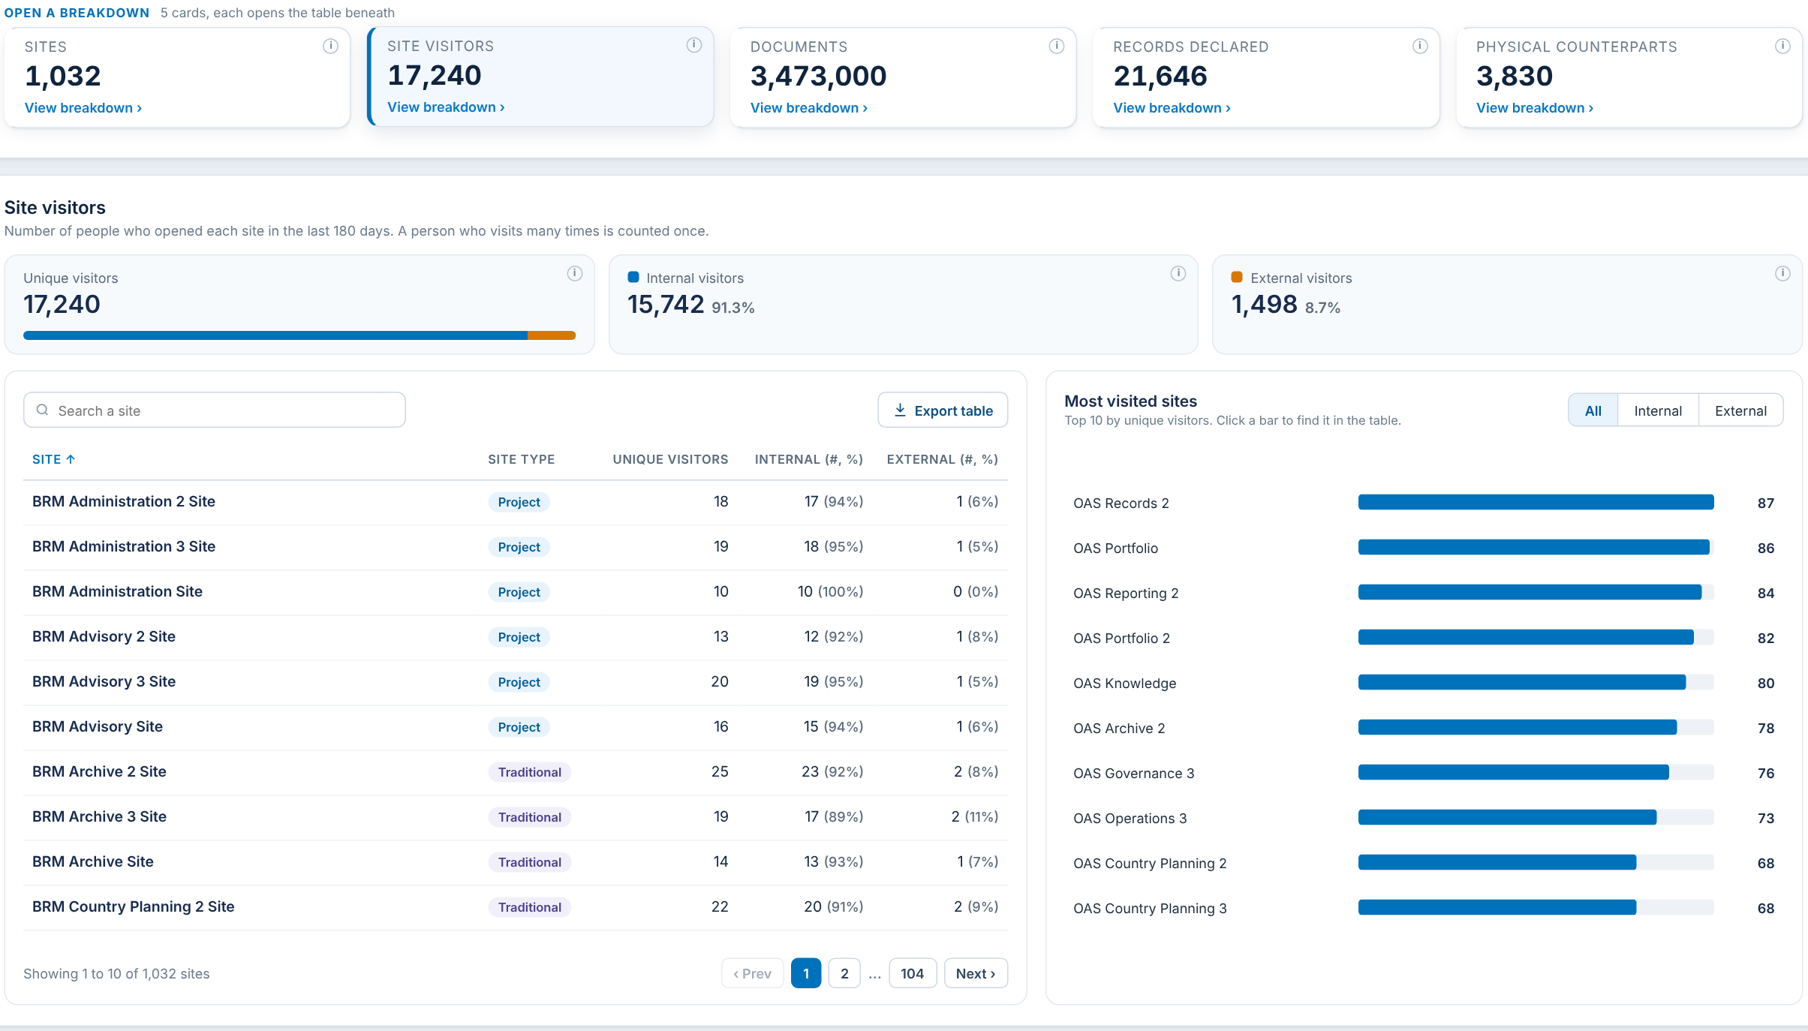
SITE VISITORS
Card 2 of 5: unique people who opened each site in the last 180 days
Item | What it shows | Status
Site visitors card | Unique people | Agreed
Internal and external split | ADB accounts against guests. | Agreed
Site type column | Taken from Cloud Governance | Agreed
Most visited sites | Top 10 by unique visitors: all, internal or external | Agreed

Slide 18
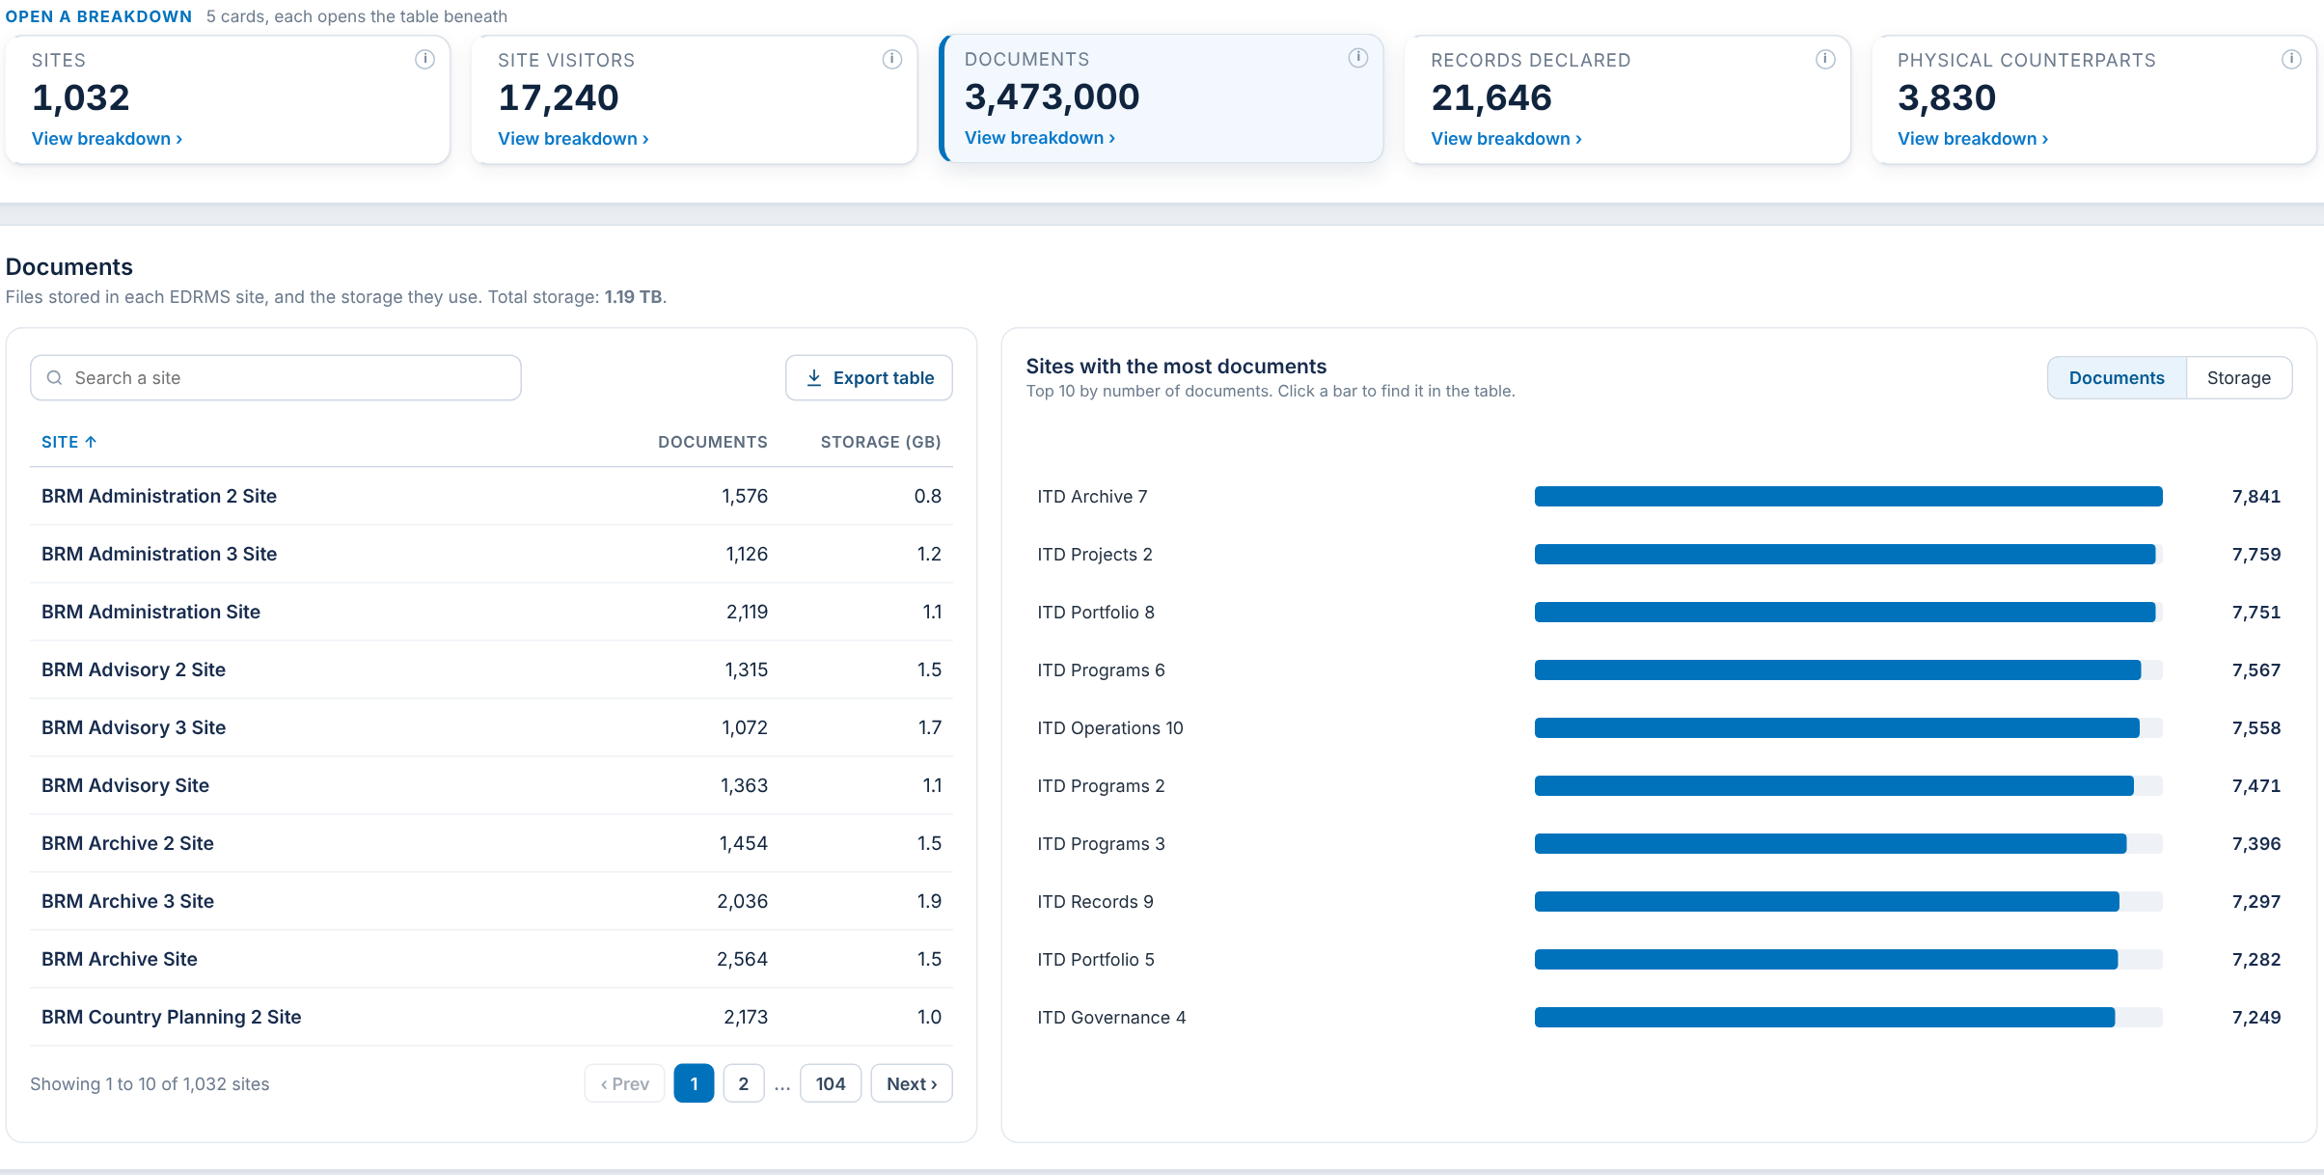
DOCUMENTS
Card 3 of 5: files and storage per site
Item | What it shows | Status
Documents card | Files stored in EDRMS for the department | Agreed
Documents and storage per site | File Count and storage for each EDRMS site | Agreed

Slide 19
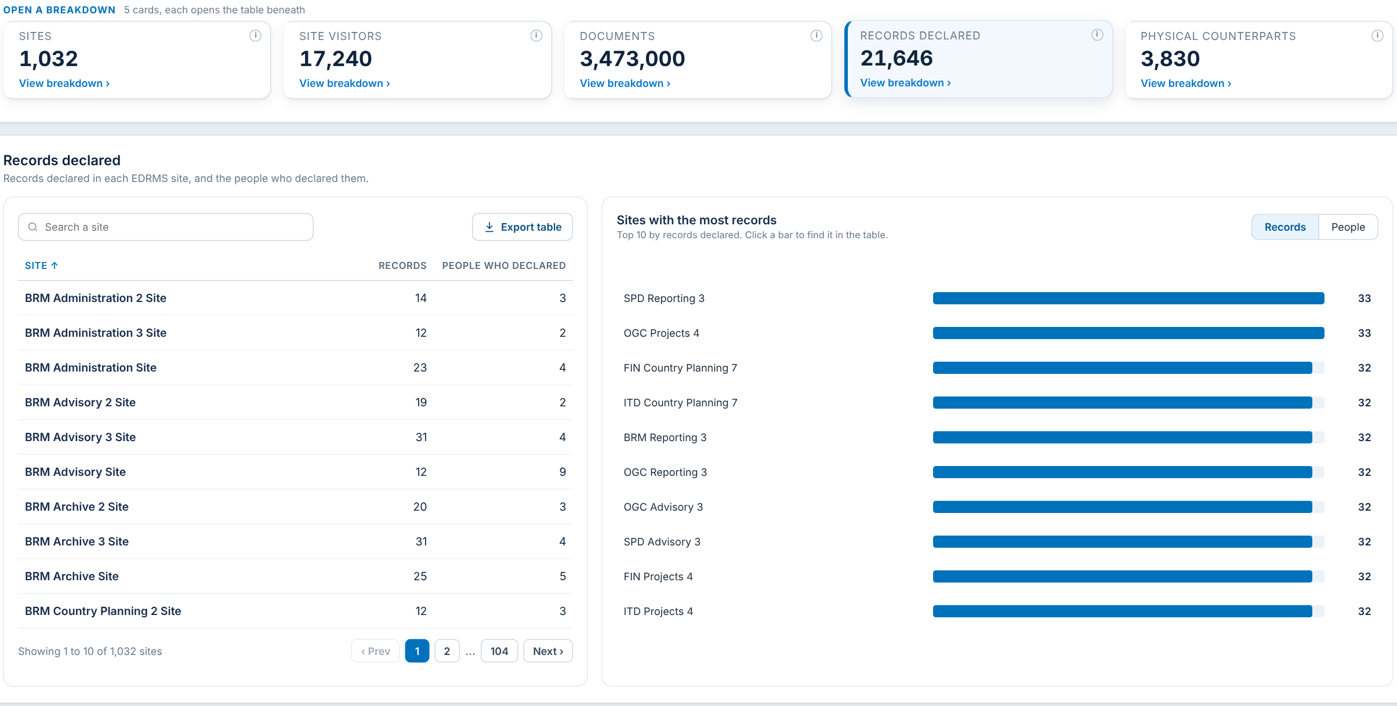
RECORDS DECLARED
Card 4 of 5: records and the people who declared them, per site
Item | What it shows | Status
Records declared card | Records table, for the department | Agreed
Records and people per site | Records declared and distinct people declaring, per site | Agreed

Slide 20
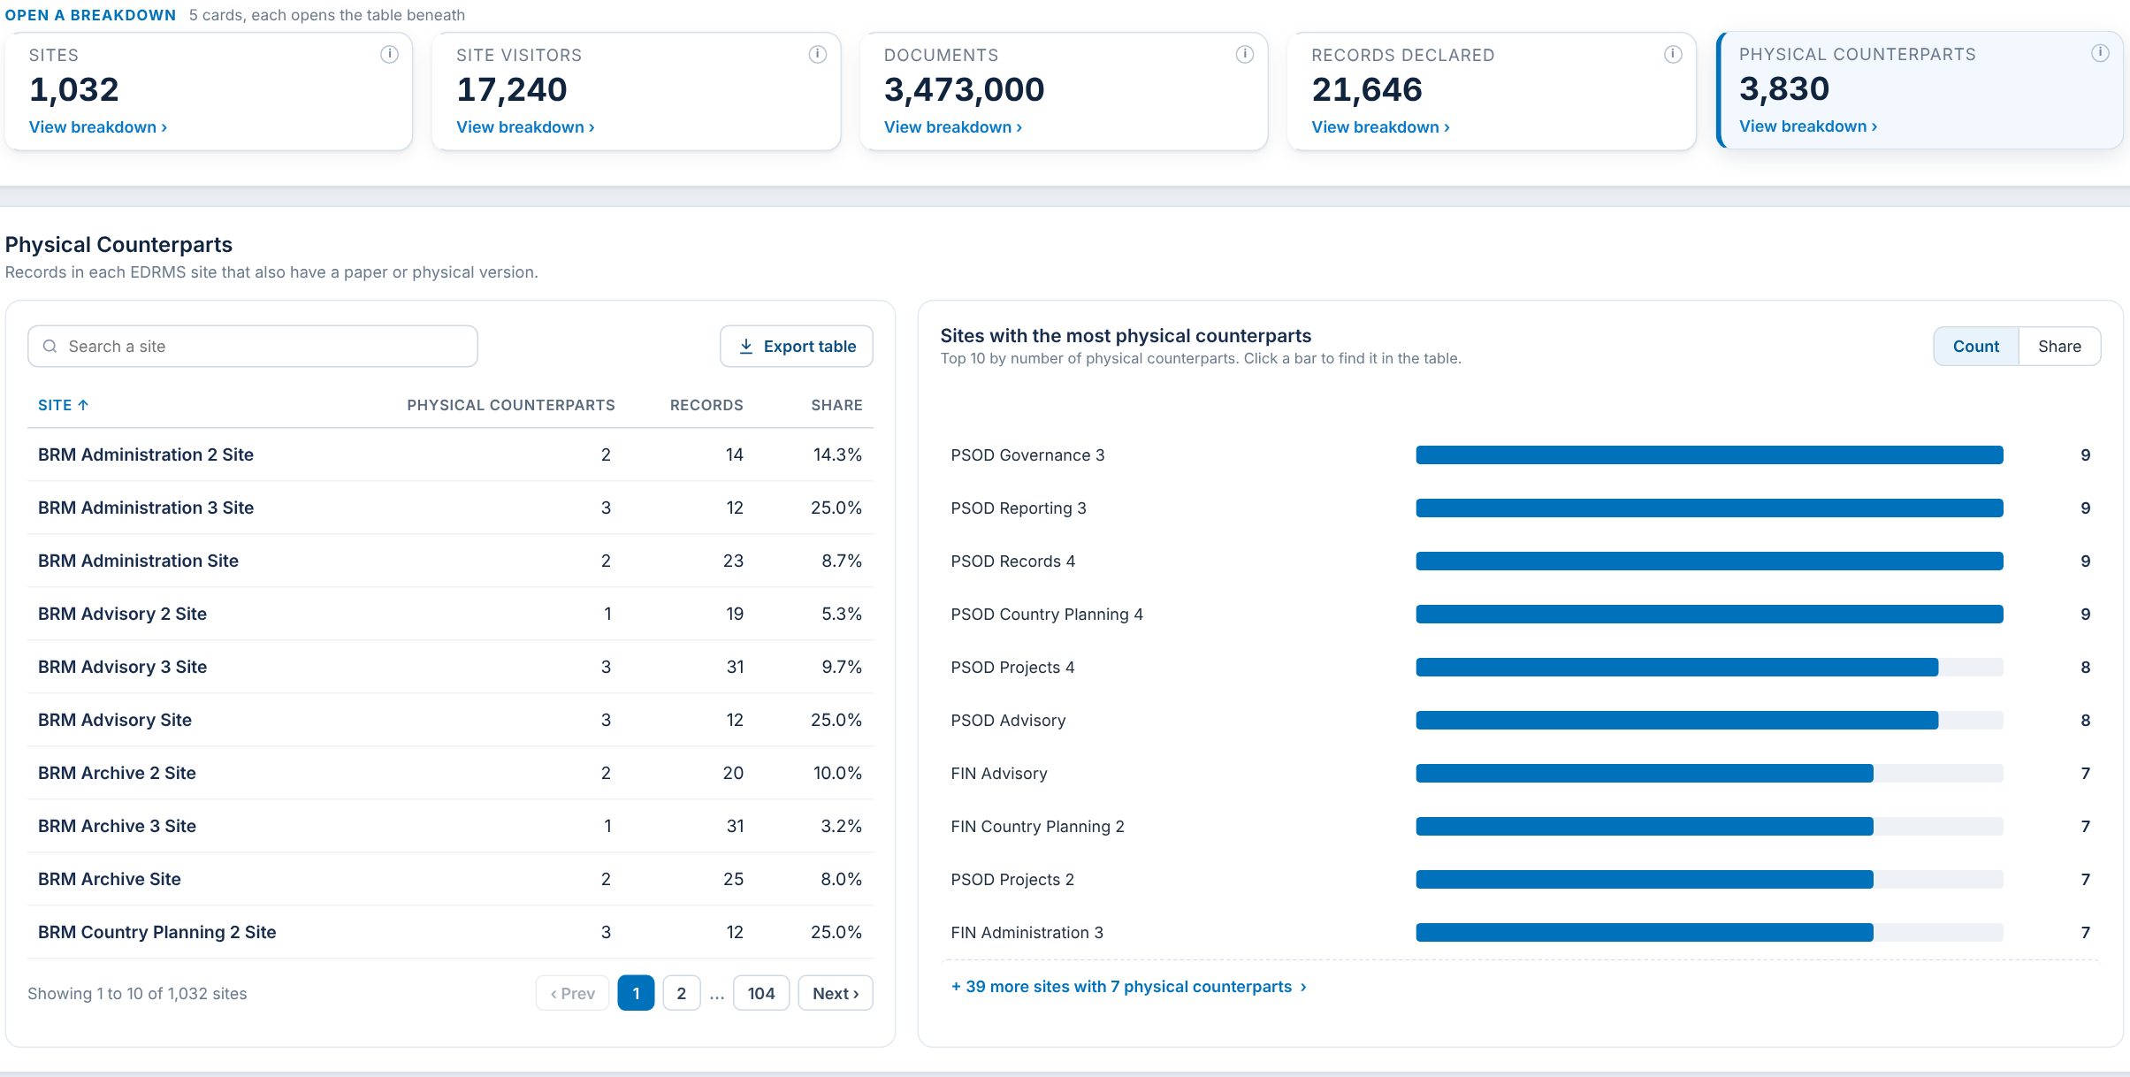
PHYSICAL COUNTERPARTS
Card 5 of 5: records that also have a paper version, per site
Item | What it shows | Status
Physical counterparts card | Records with a paper or physical version | Agreed
Counterparts, records and share per site | Per-site table with share | Agreed

Slide 21
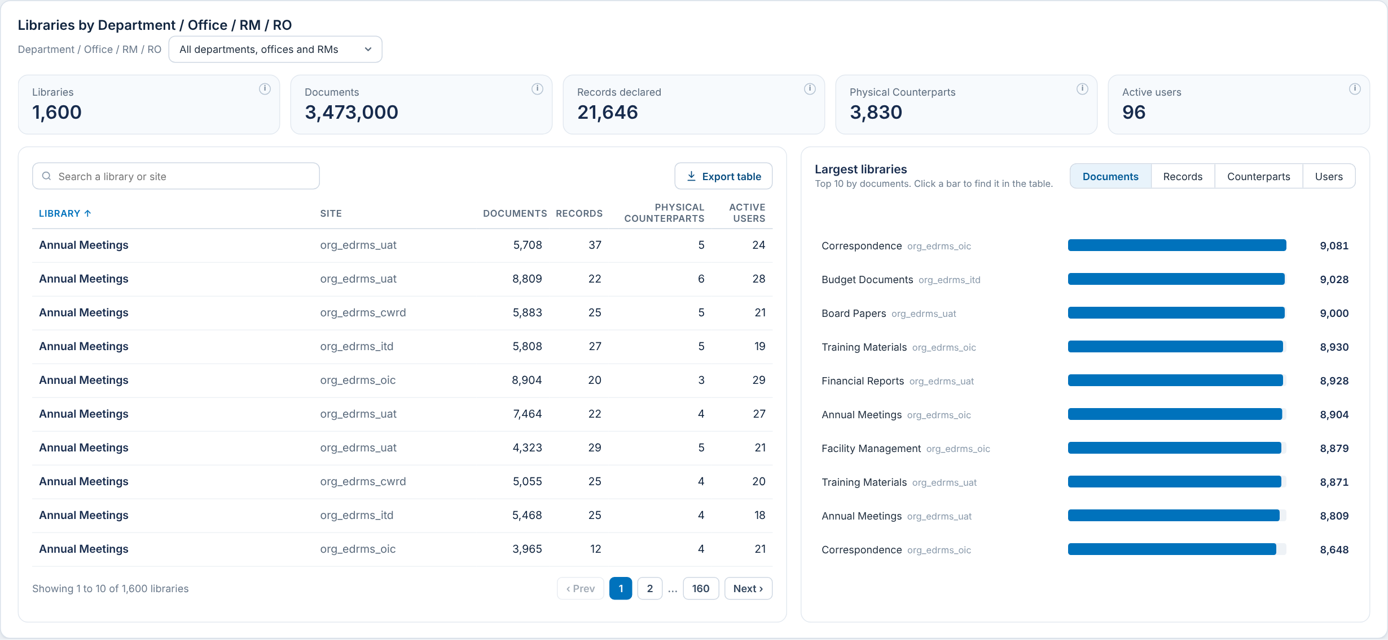
LIBRARY USAGE
Panel: document libraries by Department / Office / RM / RO
Item | What it shows | Status
Libraries | Document libraries in EDRMS sites | Agreed
Documents, records, counterparts per library | Per-library table and Largest libraries chart | Agreed
Active users per library | People who opened or edited files in the library | Agreed
Folder count per library | Number of folders in each document library | To confirm
Site name column | Shows the site name in place of the site URL | To confirm

Slide 22

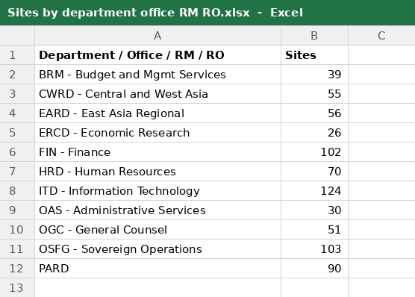

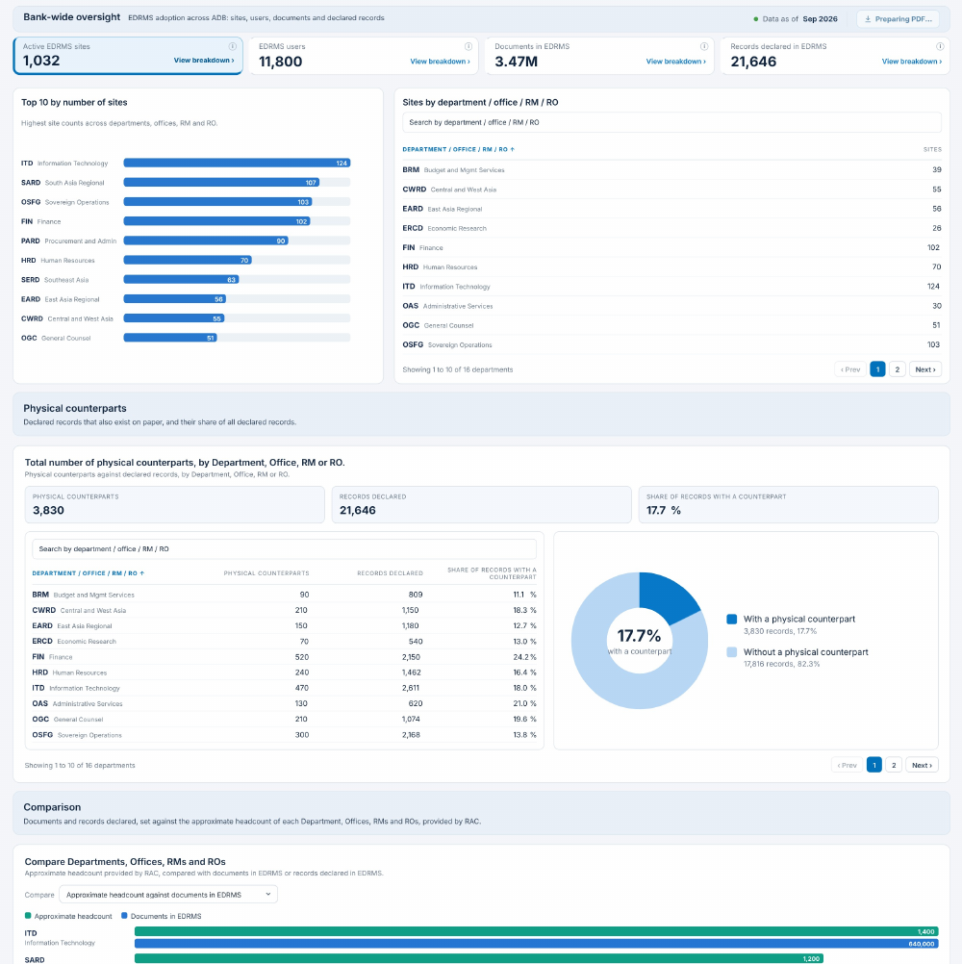
EXPORT OPTIONS
Take a table or a whole dashboard out of the report
Export table → Excel
On every table, beside its search box
Exports all rows, not just the page on screen, with the current sort and filter
File is named after the table
Export to PDF → PDF file
At the top right of each dashboard
Saves the dashboard exactly as on screen, including any open breakdown
File is named after the dashboard and date
Button on the report
Button on the report
Sample: Sites by department office RM RO.xlsx
Sample: EDRMS Bank-wide Oversight 2026-10-12.pdf
TO CONFIRM
Would you agree to include export functionality to support reporting needs?

Slide 23
SUMMARY OF INPUTS NEEDED (1 of 2)
What we are asking RAC to provide or decide
# | Item | Description | Refer to slide | Type
1 | Approximate workforce headcount per Department / Office / RM / RO | Rounded staff count per unit. It is the EDRMS users figure, the base for No access in 180 days, and the green bars in Comparison. | 8, 12 | Provide
2 | Completed training list per department (manual for now) | Number of people per unit who completed EDRMS training. Drives Completed training and Training %, kept manual until a source is identified. | 8 | Provide
3 | Go-Live date per department | The date each department started using EDRMS, shown in the Department Profile. | 15 | Provide
4 | Site convention link per department | Link to each department's approved site guide, opened from the Department Profile. | 15 | Provide
5 | Department / Office / RM / RO list: Sir Rotsen's list or separate lists? | Confirm the label covers one list (Sir Rotsen's file, matching the Cloud Governance Department field) and that there are no separate lists for Offices, RMs and ROs. | 7 | Decide
6 | Release scope, and future dashboards: disabled or hidden? | This release covers: • Bank-wide Oversight: Active EDRMS sites, EDRMS users, Documents and Records declared cards; Physical counterparts, Comparison and Records declaration trend panels • Department Insights: department profile with Site filter; Sites, Site visitors, Documents, Records declared and Physical counterparts cards; Library usage with folder count and site name • Export to Excel (every table) and PDF (every dashboard) Decide whether Project Insights, Institutional File Plan, Retention & Disposal and Records & Archive Holdings show as disabled or are hidden. | 5 | Decide

Slide 24
SUMMARY OF INPUTS NEEDED (2 of 2)
What we are asking RAC to provide or decide (continued)
# | Item | Description | Refer to slide | Type
7 | Mockup design: okay as is, or anything to change or remove? | Review of the full Release 2026.4 mockup PDF covering every page of both dashboards. Sample data only. | 4 | Decide
8 | Export options: Excel and PDF enough? | Excel export on every table (all rows, current sort and filter) and PDF export of each dashboard as on screen. | 22 | Decide
9 | Site filter in Department Insights | A Site picker under the department picker that narrows the dashboard to chosen sites. Lists only the sites in the selected departments. | 15 | Decide
10 | Folder count per library | A Folders column in Library usage giving the number of folders in each document library. | 21 | Decide
11 | Site name instead of site URL in Library usage | The site column in the Library usage table shows the site name, replacing the full site URL. | 21 | Decide

Slide 25
THANK YOU

